Slide 1
Task Team on Tsunami Evacuation Maps

Slide 2
Appendix 1 to Recommendation ICG/CARIBE EWS-XII.2
Terms of Reference - Working Group 2 Task Team on Tsunami Evacuation Maps
1. Identify standardized tools and methodologies, consider best practices worldwide, and link existing training workshops, such that modules cover:
  a. Evacuation Planning
  b. Evacuation Map Development (including inundation modeling and map creation)
2. Take advantage of the Mapping Modulus of the TEMPP Process and perform the necessary adjustments for Caribbean communities.
3. Identify funding sources and collaborations to organize workshops, perform bathymetric surveys, etc.
Membership: interested Member States, including Member States interested in TEMPP and Tsunami Ready

Slide 3
Task Team Tsunami Evacuation Mapping
Membership
1. Jose Jorge Escobar (Honduras) – Chair (2017-
2. Roy Ruiz, PRSN
3. Norwin Acosta, INETER, Nicaragua
4. Barbados (TBD, CZMU)
5. All representatives of Nicaragua to WG2 y WG4
6. All representatives of Venezuela to WG4
7. Muriel Gomez, SINAPRED, Nicaragua
8. Teniente Coronel Luis Guillermo Acosta, Defensa Civil, Nicaragua
9. Bricelda Mora, FUNVISIS, Venezuela

Slide 4
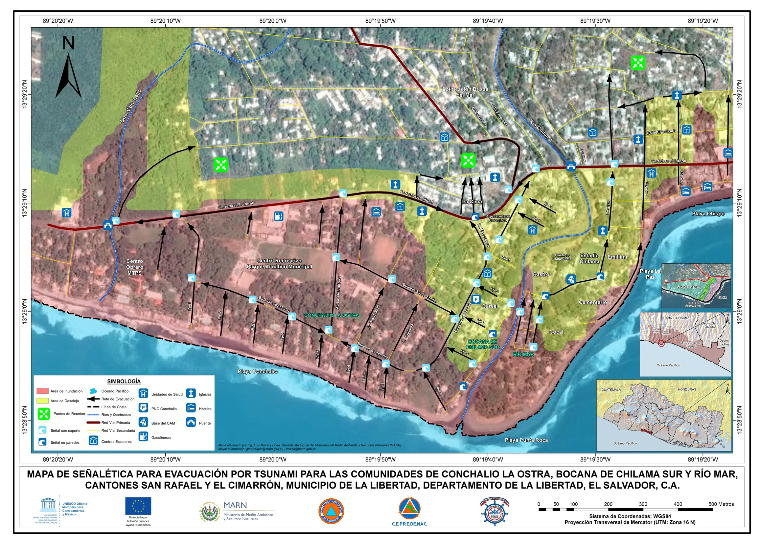

Slide 5
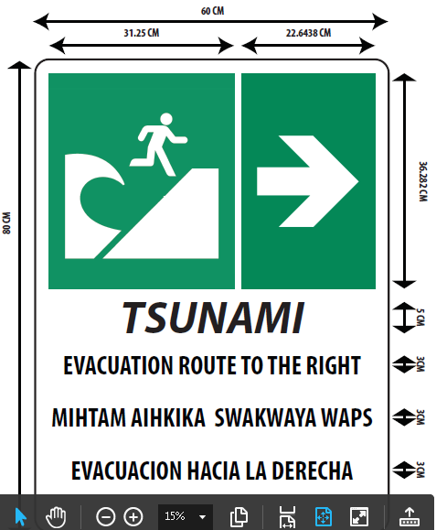

Slide 6
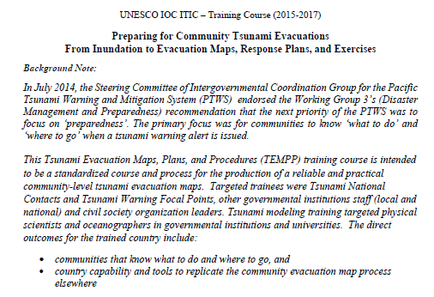
NEW Manual:
Preparing for Community Tsunami Evacuations
From Inundation to Evacuation Maps, Response Plans, and Exercises

Slide 7
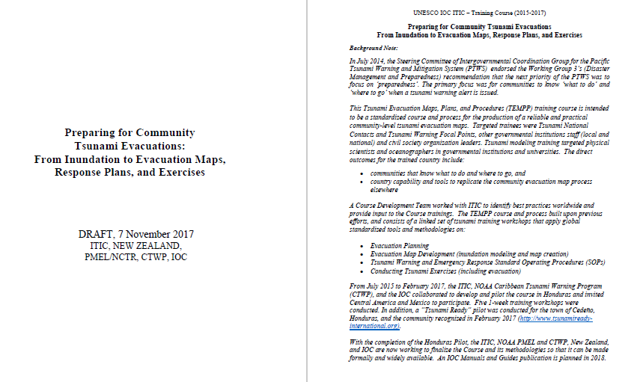

Slide 8
