Slide 1
Global Ocean Acidification Observing Network: Ocean Acidification Climate Indicators
Richard Feely¹, Bronte Tilbrook², Libby Jewett¹ ¹NOAA, ²CSIRO

Slide 2
THE GLOBAL CLIMATE INDICATORS
GCOS Secretariat, WMO
Carolin Richter

Slide 3
Criteria for physical indicators
Relevance:
Each should be a clear, understandable indicator of global climate
change, which has broad impact for a range of audiences. Some indicators will also have national and regional values.
Representativeness: Indicators as a package should provide a
representative picture of changes to the earth system related to climate change.
Traceability:
agreed (and published) method.
The Indicators should be calculated using an internationally
Timeliness:
Should be calculated regularly (at least annually) with a short
lag between the end of the period and publishing the data.
Limited number:
To allow clear, concise, communication the
number of indicators should be limited to less than 10.

Slide 4
Global Climate Indicators
Temperature and Energy
Atmospheric Composition
Cryosphere
Ocean and Water
Surface Temperature
Ocean Acidification
Glacier Mass Balance
Atmospheric CO
2
Arctic and Antarctic Sea Ice Extent
Ocean Heat
Sea Level
The Indicators are meant be used to tell stories about climate change in a way that can be understood by non-experts
The Indicators are not limited to specific datasets or certain storylines

Slide 5
Next Steps for the GOA-ON Executive Council
Identify where the OA indicators are already used
To which narrative are the indicators connected?
Are they used for a climate statement, for a research project…?
Is there already peer reviewed material available for an individual indicators / for a set of indicators?
Discuss:
Which baselines are used. Indicators do not have common baseline periods, but the baselines are relevant.
Which methods are used. The measurements do not have common methods or time periods for the above reason.
What does the communication expert require on information.
What kind of information is already available?
What needs to be done to motivate better communication?
Agree on a work plan

Slide 6
Dear Richard,
As a priority, we need an agreed data source, which is regularly updated. For most indicators, we aim for annual updates but for some, we recognize that there can be a delay (particularly for chemistry). An example plot, and other relevant figures are also useful. We can then advise other groups (e.g. WMO, Copernicus, etc) on how Ocean Acidification should be represented. There is no hard deadline, but your input will be very useful as soon as you have an agreed view.
For the WMO state of the climate report, work on framing this will begin in July, so advice on this timeframe would be particularly useful. Usually the report comprises an annual update on the specific climate statistics, plus some contextual information in text boxes. Previous reports can be found here: https://public.wmo.int/en/wmo-statement-state-of-global-climate. In the 2017 report, Ocean Acidification information was included (see page 13), and this information was provided through Salvatore's team at IOC. For this, it would be great to have an agreed and most current dataset/figure for Ocean Acidification, as well as any new developments in the current year (both in terms of Ocean Acidification events/impacts and also developments in the observing system itself and our capability to measure OA.
Katy Hill

Slide 7
GOA-ON OA Indicators What do we need to decide on today 1. What data and datasets we want to report on? What: surface pH, surface pCO₂, etc. Where: HOTS, BATS, ESTOC, etc. How: Agreed Upon constants, standards, depth ranges, metadata. etc
www.goa-on.org

Slide 8
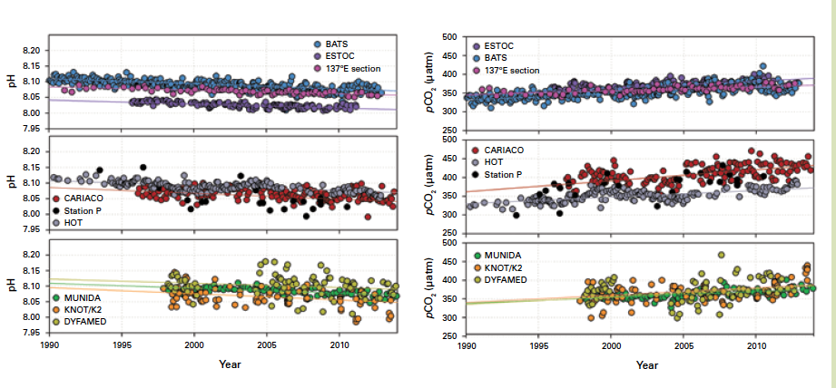
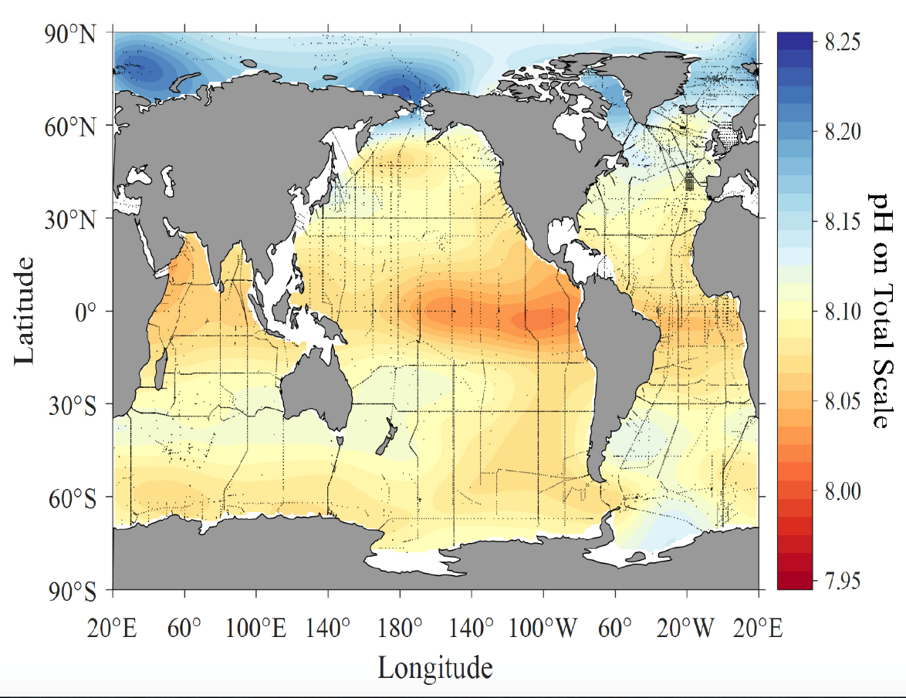
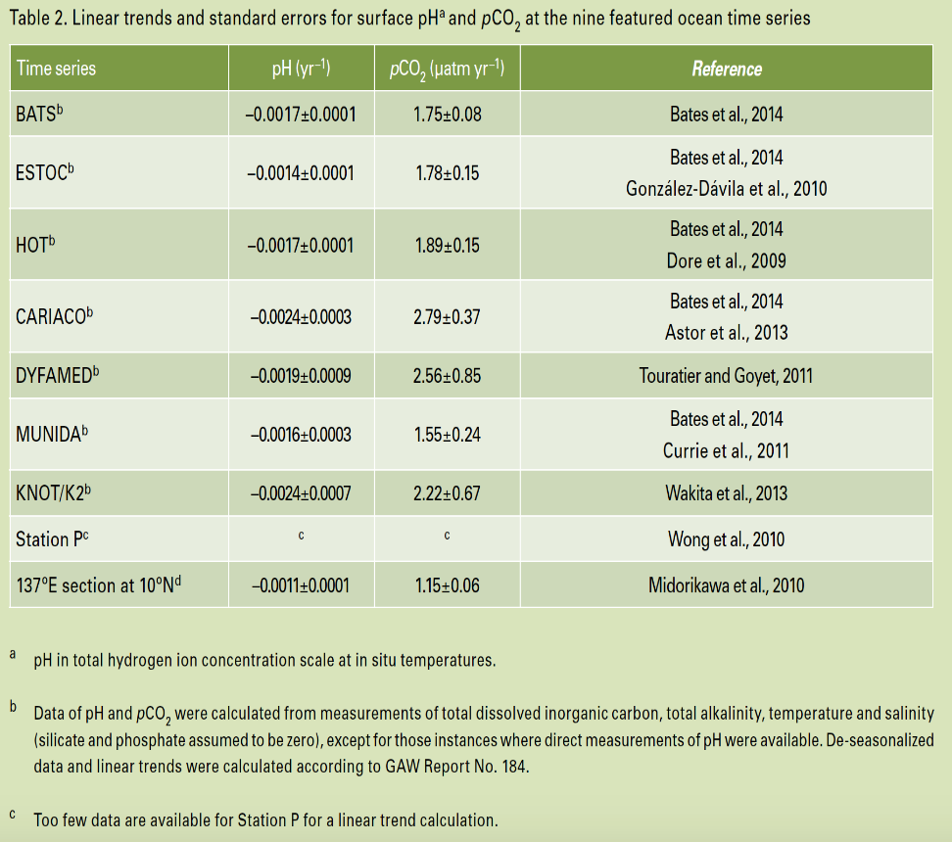
GOA-ON OA Indicators What do we need to decide on today 1. What data and datasets we want to report on? pH, pCO₂, etc. 2. How do we want the data to be presented? What units? Plots, Maps, Tables? Associated text and metadata?
www.goa-on.org

Slide 9
GOA-ON OA Indicators What do we need to decide on today 1. What data and datasets we want to report on? pH, pCO₂, etc. 2. How do we want the data to be presented? Plots, Maps, Tables? Associated text and metadata?
Differences in calculated pH and pCO₂ between two different measurement teams using the same data.
www.goa-on.org

Slide 10
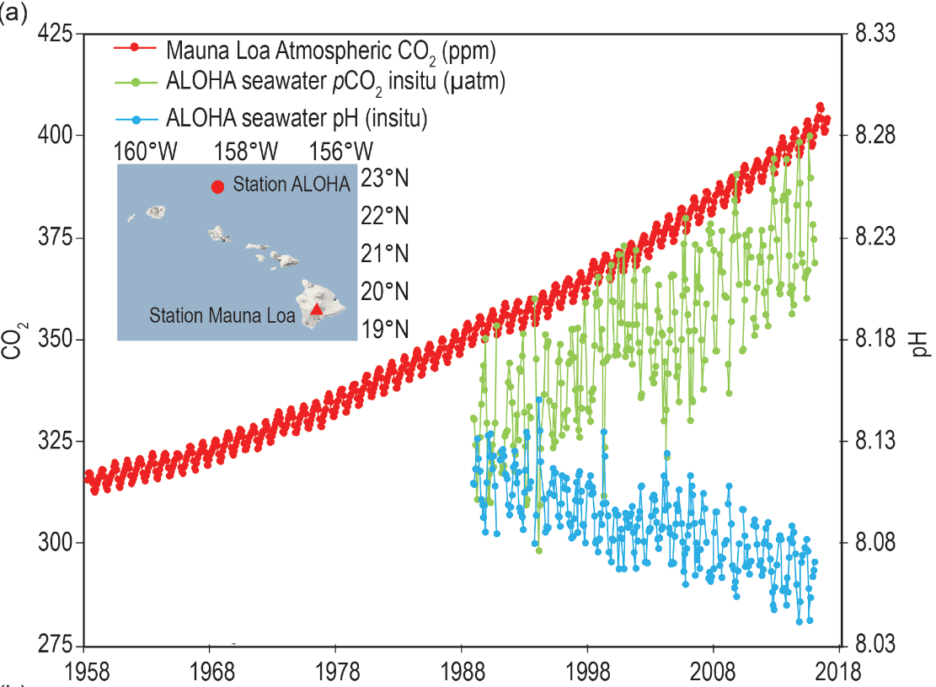
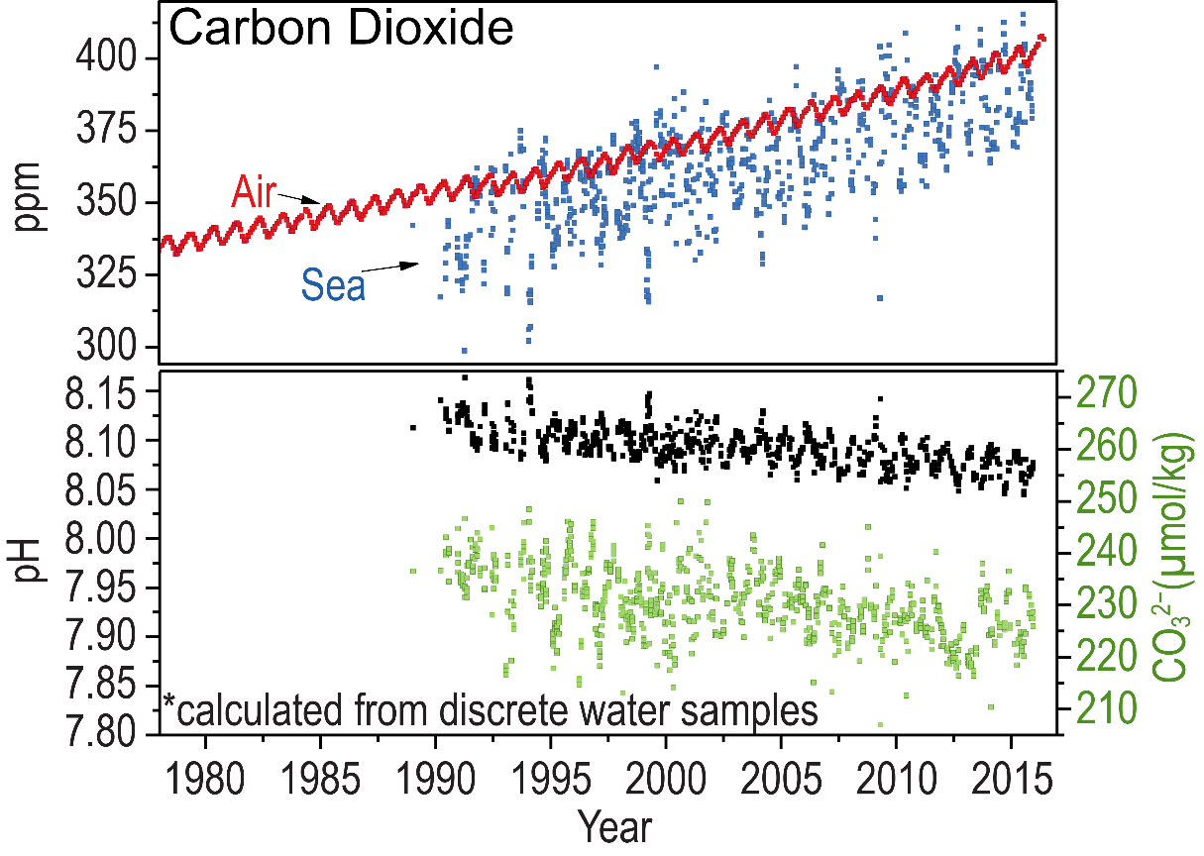
GOA-ON OA Indicators What do we need to decide on today 1. What data and datasets we want to report on? pH, pCO₂, etc. 2. How do we want the data to be presented? Plots, Maps, Tables? Associated text and metadata?
Differences in calculated pH and seawater CO₂ between two different measurement teams using the same data.
Year

Slide 11
GOA-ON OA Indicators What do we need to decide on today 1. What data and datasets we want to report on? pH, pCO₂, etc. 2. How do we want the data to be presented? Plots, Maps, Tables? Associated text and metadata? 3. Where is the data going to be located? GOA-ON Website, GOA-ON data portal?
www.goa-on.org

Slide 12
GOA-ON OA Indicators What do we need to decide on today 1. What data and datasets we want to report on? pH, pCO₂, etc. 2. How do we want the data to be presented? Plots, Maps, Tables? Associated text and metadata? 3. Where is the data going to be located? GOA-ON Website, GOA-ON data portal? 4. How often will the information be updated?
www.goa-on.org

Slide 13
GOA-ON OA Indicators What do we need to decide on today 1. What data and datasets we want to report on? pH, pCO₂, etc. 2. How do we want the data to be presented? Plots, Maps, Tables? Associated text and metadata? 3. Where is the data going to be located? GOA-ON Website, GOA-ON data portal? 4. How often will the information be updated? 5. Who will do the work and how will it be funded?
www.goa-on.org

Slide 14
GOA-ON OA Indicators What do we need to decide on today 1. What data and datasets we want to report on? pH, pCO₂, etc. 2. How do we want the data to be presented? Plots, Maps, Tables? Associated text and metadata? 3. Where is the data going to be located? GOA-ON Website, GOA-ON data portal? 4. How often will the information be updated? 5. Who will do the work and how will it be funded? 6. How do we want this product to grow over time?
www.goa-on.org

