Slide 1
September 16-20, 2019
Hawai’i Convention Center

Slide 2
History of OceanObs Series
Each conference of the OceanObs series focuses on a new area in need of enhanced guidance:
OceanObs’99 – St. Raphael, France (300 participants)
Resulted in an internationally coordinated system for physical climate and ocean carbon observations (drifter, floats, xbt, tide gauge…)
OceanObs’09 – Venice, Italy (640 participants)
Expanded the range of communities working together to undertake more comprehensive and sustainad ocean observations and led to the Framework for Ocean Observing.
OceanObs’19 – Honolulu, USA (1200 participants)
Connecting with a wide range of user communities and improve data flows and governance arrangements.

Slide 3

Conference Overview
Hawai’i Convention Center
16-20 September 2019 (571 Days!)
Anchor Sponsor: NASA
Co-Sponsors: WMO, IOC, ICSU, GEO, GCOS, NSF, NOAA, ESA, MERCATOR, SOA, IMOS and growing!
Main goal/s: Further develop effective strategies for a sustained, multidisciplinary, and integrated ocean observing system, and to better connect user communities and observers.
User communities: Engage operational users, national and local authorities as well as researchers in both the public and private sectors in all aspects of ocean observing.
International engagement: Closer interaction to improve governance arrangements, support observing networks, data flows and derived products and their use in ocean affairs.

Slide 4
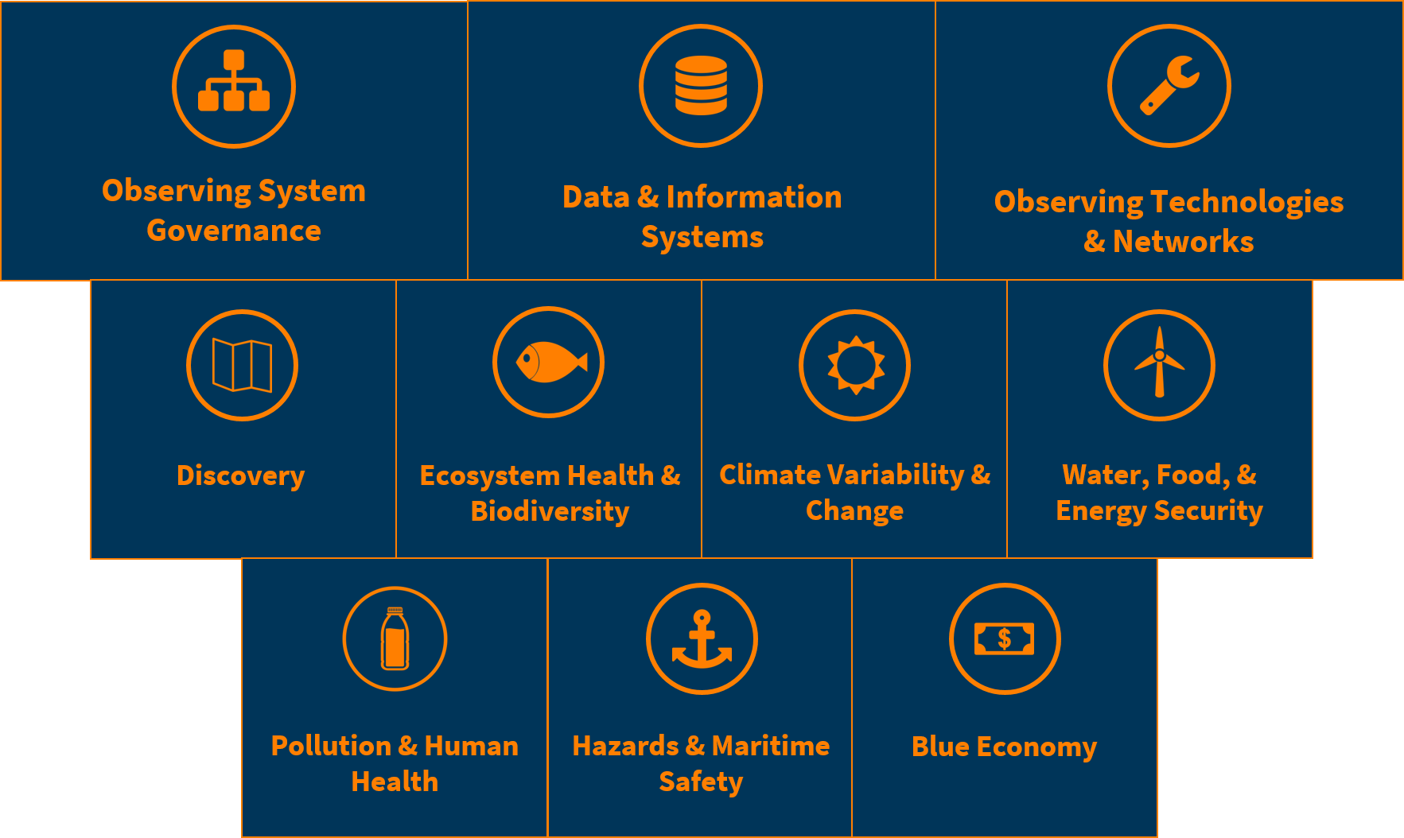
Conference Themes
The societal benefit themes will be examined by their relationship to Ocean Observing and how information products can be best supported through the observing system themes.
Overarching Themes
Societal Themes

Slide 5
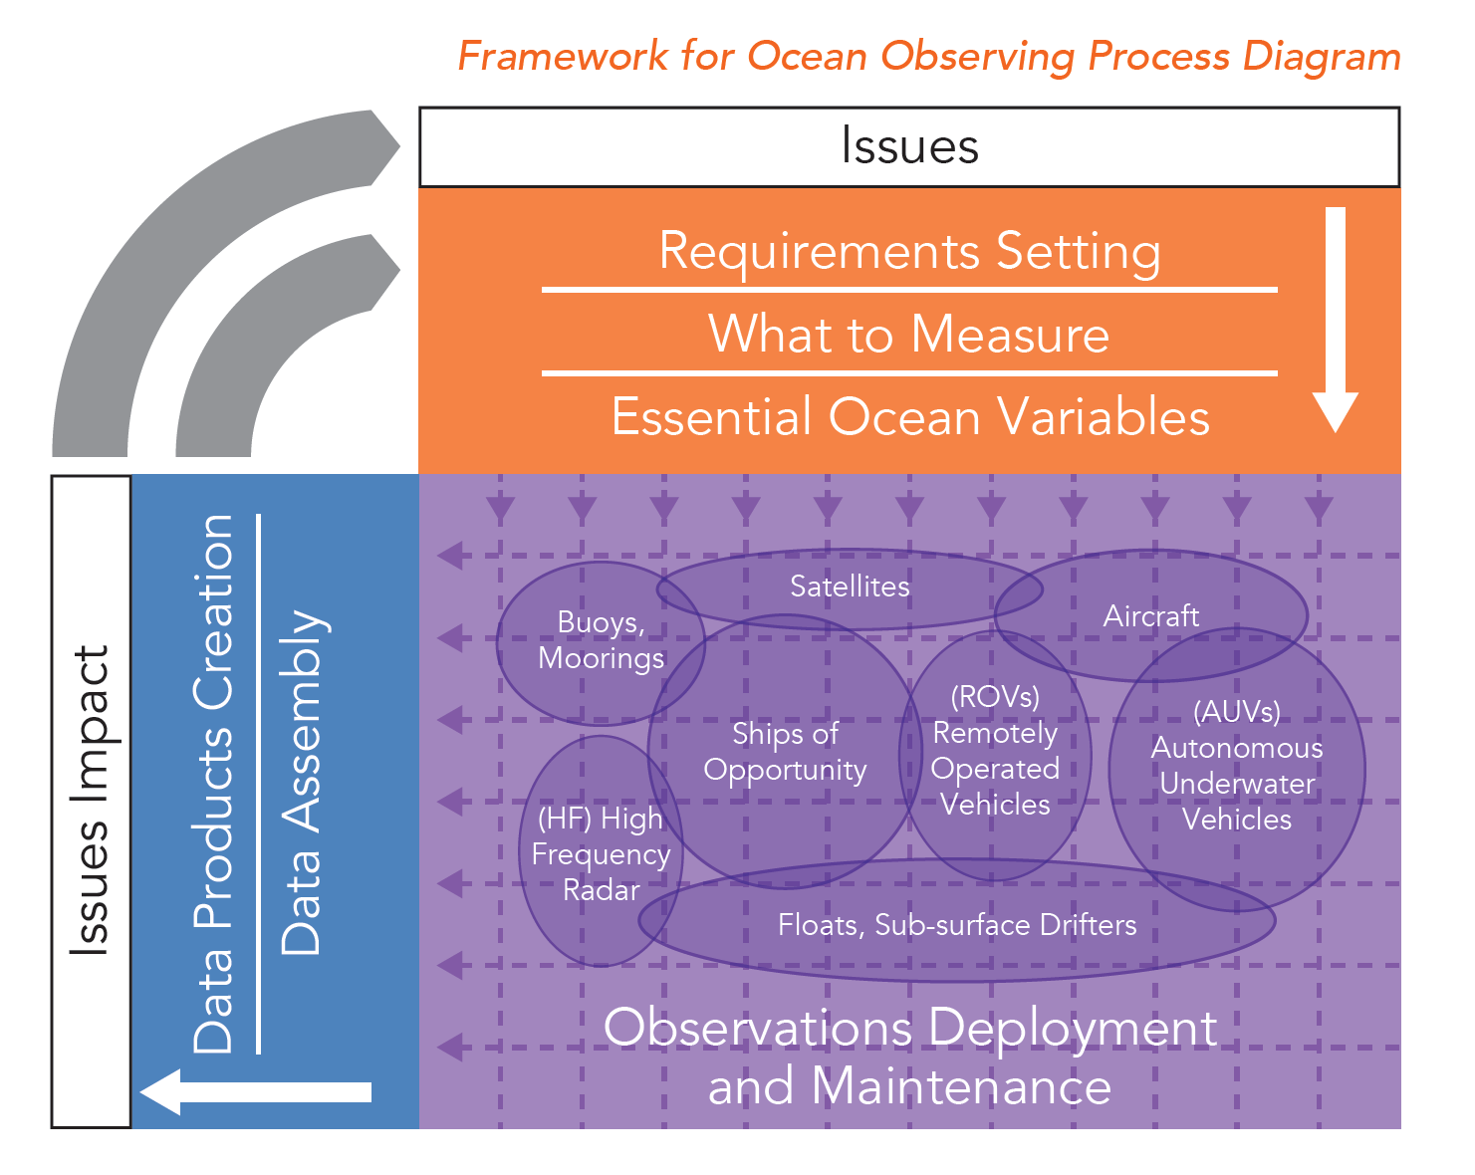
Framework for Ocean Observing (FOO)
OceanObs’19 will build on the success generated by the Framework developed at OceanObs’09.
Experts will work during the lead up to the conference to identify opportunities and drawbacks, which will be articulated prior to, and during OceanObs’19.
We expect to develop a number of follow-up activities including update of existing processes.

Slide 6
Conference Coordination
Program Committee - “The input to the conference”
  Co-chairs: Sabrina Speich (France), Tony Lee (USA), Minhan Dai (China), Sanae Chiba (Japan)
  Members Selected: 17 Global experts
  Staff support from Nicholas Rome and Kruti Desai (US IOOC)
Local Organizing Committee - “Executing the event.”
  Co-chairs: Bruce Howe (U.Hawaii) and Jim Potemra (U.Hawaii)
  Staff support from Andrea McCurdy, Michelle McCambridge, Melanie Russ (UCAR/CPAESS)
Sponsor Committee - “Guiding the output from the event”
  Co-chairs selected: Eric Lindstrom (USA), Martin Visbeck (Germany), Weidong Yu (China)
  Representation from main intellectual and financial sponsors
  Staff support from Katy Hill (WMO)
Executive Committee - “Coordination”
  Constituted from the ALL Co-Chairs

Slide 7
Sponsorship Opportunities
Sponsors can provide support within a financial or intellectual capacity
Financial
Intellectual
Monetary and in kind support:
To support the execution of the conference: student and developing country fellowships, coffee breaks, speakers, townhalls, etc.
Community engagement:
Promote the conference
Engage the community
Shape outcomes
Promote results broadly
Financial sponsors levels
Bronze | Silver | Gold | Platinum
>$9,000 | >$19,000 | >$99,000 | >$190,000

Slide 8
Financial Sponsors (a work in progress!)
Thank you to our sponsors!
Bronze | Silver | Gold | Platinum
Monmouth/Rockefeller (MURU) Marine Science and Policy Initiative | European Space Agency* | National Science Foundation | National Aeronautics and Space Administration
Scientific Committee on Oceanic Research (SCOR) | Mercator* |  | National Oceanic and Atmospheric Administration
IMOS (Australia)* | Group on Earth Observations*
NOC (UK) | EU Commission*
 | EUMETSAT*
 | Mercator/ Copernicus*
 | Saildrone*
*To Be Confirmed (also including WMO, IOC, ICSU, GCOS, SOA)

Slide 9
OceanObs’19 Outcomes
Information
Interoperability
Innovation
Integration
Four “I”s
Product delivery
Bringing the observing system closer to end users and making it more responsive
Governance
Including responsibility for delivery, advocacy, funding, and alignment
Value proposition
New capabilities and intelligent/responsive design of systems
Capacity development
Use and transformation of available information

Slide 10
Call for Abstracts: Status Update
Strong response from obs community…
430
*Published White Papers

Slide 11
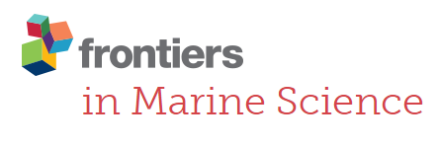
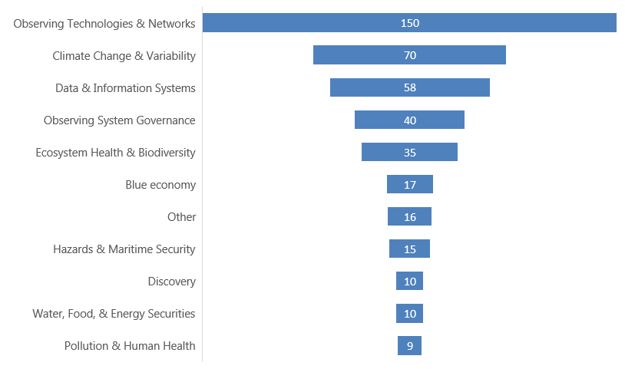
Breakdown of Submissions
Abstracts by primary topic

Slide 12
Conference Structure (Preliminary)
Date |  |  | Theme
 | Registration
 | Report-outs (Tus-Fri)
 | Keynote / Daily Plenary
 | Break
 | Topical Plenaries
 | Lunch
 | Thematic Breakout | Thematic Breakout | Thematic Breakout | Thematic Breakout
 | Break
 | Thematic Breakout | Thematic Breakout | Thematic Breakout | Thematic Breakout
 | Posters
 | Evening Reception / Function

Slide 13
What is needed near-term?
RESOURCES AND INFORMATION
Further mobilizing sponsors (led by Sponsors Committee)
Determining priority outcomes of the conference
Guidance for the all conference participants (FAQ)
ENGAGEMENT
Engaging observing system groups
Engaging user communities
Send ideas to any member of the Executive Committee

Slide 14
Whitepapers
430 Abstracts reviewed
Combined into 198 invited Community whitepapers, to be published in Frontiers in Marine Science before Oceanobs19
Community whitepapers have a Sep 30, 2018 deadline
Whitepapers must address the following:
  Be forward-looking to the next decade
  Address end-user engagement
  Address opportunities for integration
  Connect to conference themes
COMBINED NEW PAPER: The Role and Vision of JCOMM with emphasis on observing and data services
  85: Marine monitoring to information services: JCOMM experience and outlook on end-to-end delivery (LEAD) – Nadia Pinardi
  97: The JCOMM Marine Climate Data System: providing structure for the international flow of climate data
  132: JCOMM OCG: coordinating implementation of an effective, responsive and sustained ocean observing system to support services, knowledge, health and sustainable oceans
  158: A long-term Vision for Ocean Data Acquisition and Distribution
  239: The JCOMM Voluntary Observing Ship (VOS) Scheme

Slide 15
Opportunities for OCG and JCOMM?
In addition to Community Whitepapers, Oceanobs19 provides opportunities to advance many other things:
  Side meetings
  Advancing the FOO
  Town Hall meetings
  Demonstrations of JCOMMOPS
  Etc…
  How will OCG take advantage of Oceanobs19?

Slide 16
See you in Honolulu!!!

