Slide 1
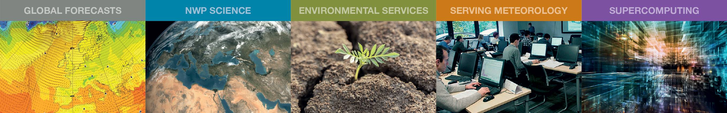
WMO rolling review of requirements for ocean observations
Erik Andersson
Deputy Director, Forecast Department, ECMWF
erik.andersson@ecmwf.int

Slide 2
The WIGOS RRR process:
Rolling Review of Requirements
Observing capabilities
User requirements for observations
User requirements for observations
User requirements for observations
User requirements for observations
Gap Analyses
(Statements of Guidance)
Implementation Plan
Long-term Vision for global observing systems
Programmes of Members and Agencies

Slide 3
Global NWP
High-resolution NWP
Nowcasting
Sub-seasonal to Longer-range Forecasting
Aeronautical Meteorology
Forecasting Atmospheric Composition
Monitoring Atmospheric Composition
Atmospheric Composition info → services in urban and populated areas
Ocean Applications (JCOMM)
Agricultural Meteorology
Hydrology
Climate Monitoring (GCOS)
Climate Science
Space Weather
RRR process: Application Areas

Slide 4
Status – RRR Ocean Applications
Point of Contact for Ocean Applications, Guimei Liu (China), stepped down - JCOMM to nominate new PoC
OOPC provided its feedback by mean of a letter from the OOPC co-chairs to the PoC
JCOMM-5 Decision 14 (e.g. with regard to consideration of sea-ice and snow requirements),
GCOS implementation plan – has 57 actions relating to the ocean
Notes:
And this is what we deliver to our community at a glance...

Slide 5
OSCAR (Observing Systems Capability Analysis and Review Tool)
User requirements: http://www.wmo-sat.info/oscar/requirements
Space-based capabilities: http://www.wmo-sat.info/oscar/spacecapabilities
Surface-based observing (under development): https://oscar.wmo.int/OSCAR/index.html#/
Gap Analyses (Statements of Guidance, SoGs) http://www.wmo.int/pages/prog/www/OSY/GOS-RRR.html#SOG
Vision: http://www.wmo.int/pages/prog/www/OSY/gos-vision.html
Implementation Plan, EGOS-IP: http://www.wmo.int/pages/prog/www/OSY/gos-vision.html#egos-ip
RRR process: documentation

Slide 6
OSCAR/Requirements : http://www.wmo-sat.info/oscar/requirements
Organised by:
Application Area geophysical variable horizontal, vertical and temporal resolution; timeliness; uncertainty; stability
“maximum”=“goal”
“breakthrough”
“minimum”=“threshold”
RRR process: user requirements

Slide 7
Vision for WIGOS in 2040 – ocean underwater observations
Profiling floats | Temperature, salinity, current, dissolved oxygen, CO₂ concentration, and various bio-geochemical variables
Autonomous Underwater Vehicles (e.g. gliders) | Temperature, salinity, current, dissolved oxygen, CO₂ concentration, and various bio-geochemical variables
Sub-surface observations from drifting and moored buoys | Temperature, salinity, currents, CO₂ concentration, pH
Ships of opportunity | Temperature, salinity, ocean colour, currents
Observations from platforms hosted at submarine telecommunication cables | Bottom and sub-surface multi-disciplinary measurements, Tsunami monitoring (earthquakes, Tsunami wave)
Ice tethered platform observations | Temperature, salinity, current
Instrumented marine animals | Temperature, salinity

Slide 8
EGOS-IP: Ocean Observation sustainability
JCOMM-5 recognized the need for closer coordination and regular interaction between GOOS and JCOMM in the development of sustained observations, particularly in engaging new communities, networks, and technologies, and decided to recognize that OCG is jointly sponsored by GOOS.
JCOMM will monitor and coordinate testing and assessments of ocean observing technologies as they mature and approach readiness for sustained operation. JCOMM-5 also advocated that emerging observing networks improve their readiness for sustained observing development (drawing on the framework for ocean observing) and identified key actions in this regard.
JCOMM-5 also decided that TPOS 2020 implementation and transition into the global sustained observing system will be coordinated by the TPOS 2020/JCOMM cross-cutting Transition and Implementation Task Team.
WMO SP / ET-SAT to provide guidance on satellite capabilities through OSCAR.
The “Capability review” functionality of OSCAR is available (http://www.wmo-sat.info/oscar/observingmissions) to highlight the missions related to, e.g.: Radar altimetry, sea surface wind, ocean colour. Furthermore, the “Gap analysis by variable” function is available to highlight the missions supporting a particular parameter, e.g. SST.

Slide 9
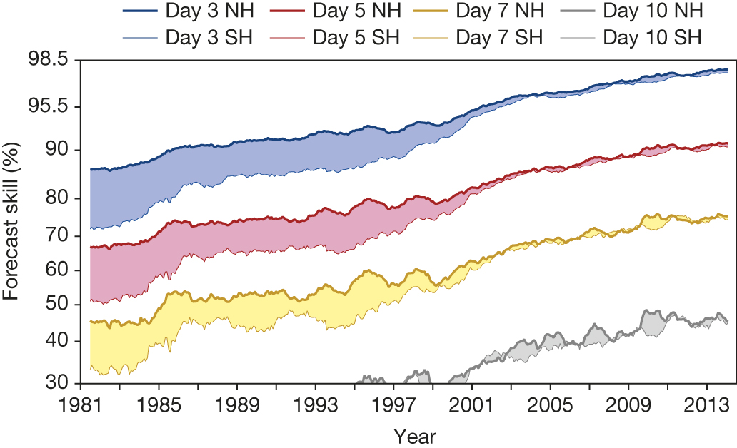
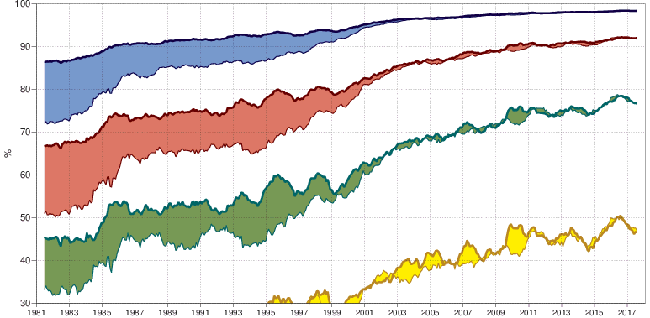
A measure of forecast skill at three-, five-, seven- and ten-day ranges,
computed over the extra-tropical northern and southern hemispheres.
P Bauer et al. Nature 525, 47-55 (2015) doi:10.1038/nature14956

Slide 10

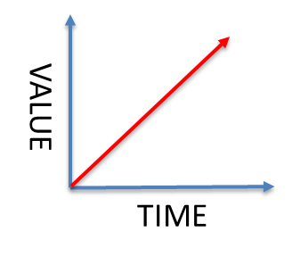
Global NWP
Observations
NMHS +
Private Sector
Forecast products
Observations
Forecast Systems
Meteorologists
Services
Impact and Value

Slide 11
Three ingredients of Global NWP
NWP science
Supercomputing
Observations
“The success of WMO has been based on the free exchange of high-quality standardized observations and of scientific know-how worldwide”
Notes:
And this is what we deliver to our community at a glance...

Slide 12
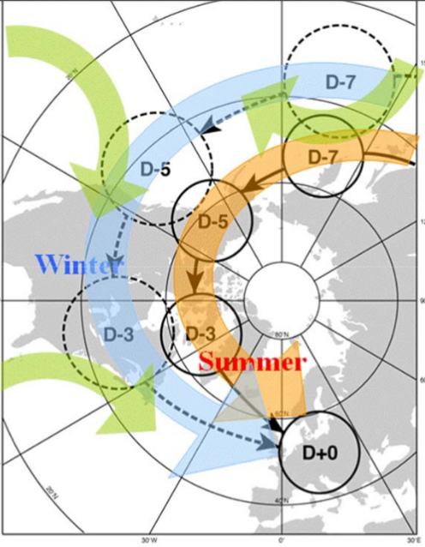
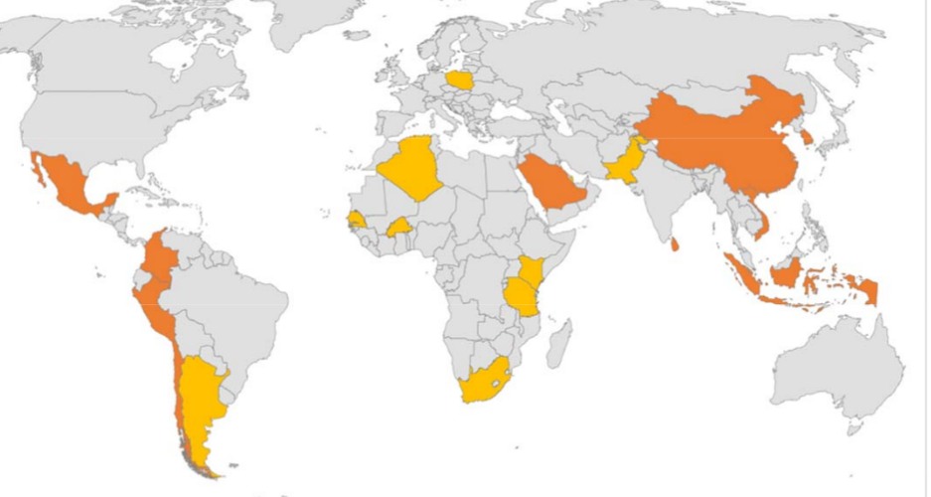
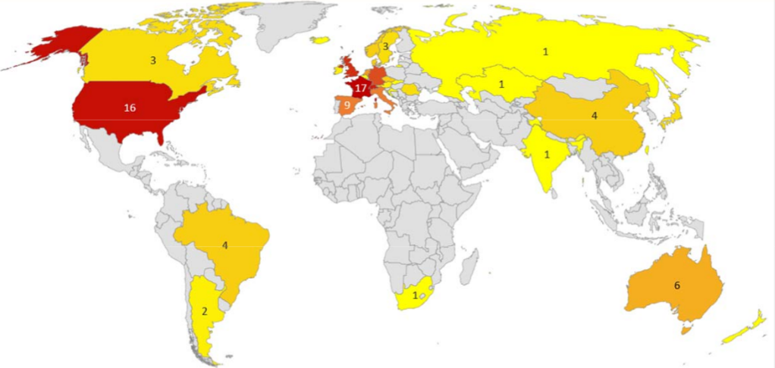
ECMWF’s role is to address the critical and most difficult research problems in medium-range NWP that no one country could tackle on its own
Notes:
With a very clear task, to address what nations could and should not do at their individual level. The point was of course not to duplicate national capabilities, but to extend and complement them.

Slide 13
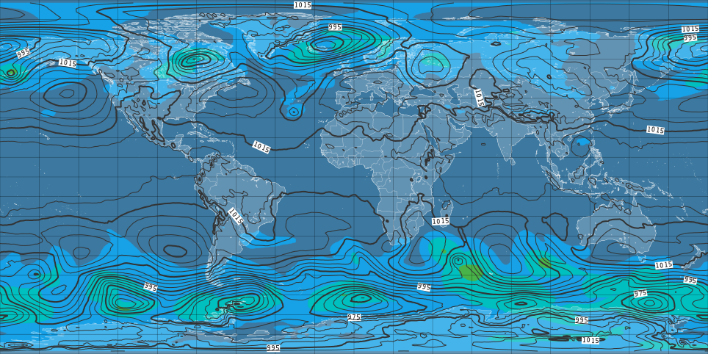
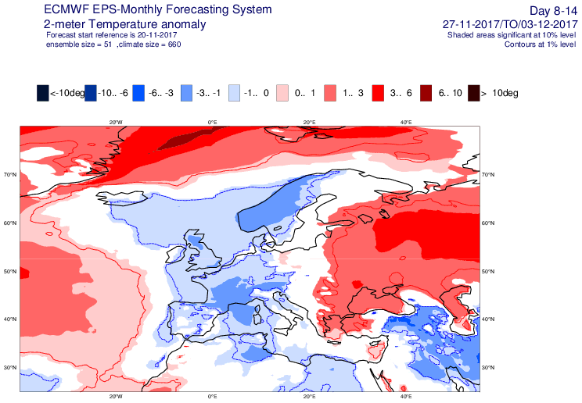
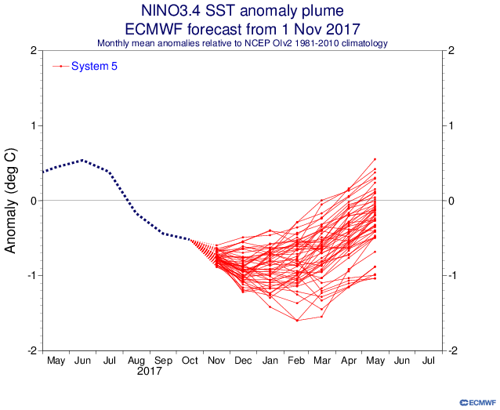
NWP Deliverables: Global NWP at all ranges
Medium range prediction
Monthly forecasts
Long range prediction
High resolution mean sea level pressure and ensemble spread
Weekly anomaly – 2m temperature over Europe
(3-10 Dec)
El Nino 3.4 SST anomaly plume – 1 November 2017
Notes:
And a few examples…

Slide 14
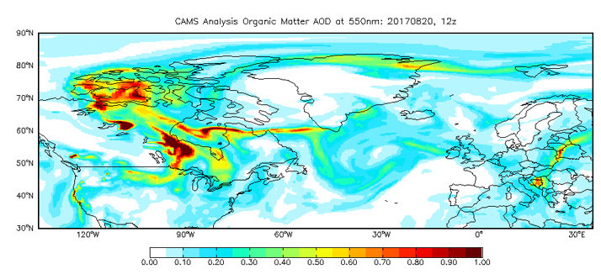
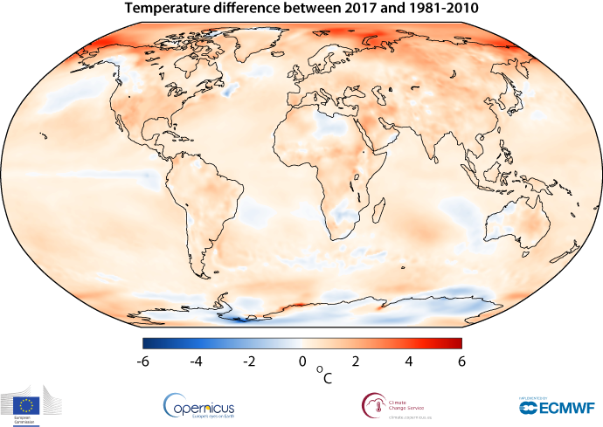
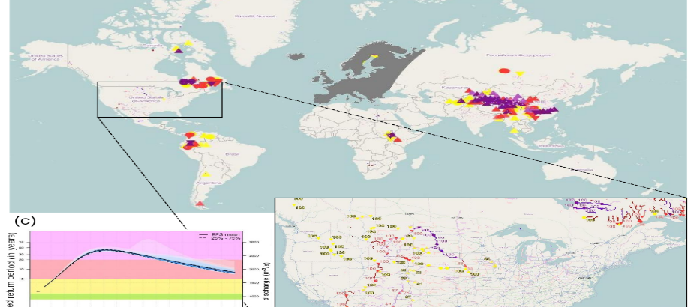
NWP Deliverables: Environmental information
Emergency management Service Flood and Fire forecasting
Atmosphere Monitoring Service
Climate Change Service
CAMS analysis organic matter AOD (fire emissions)
Reanalysis monitoring changes in global surface air temperature
Main GloFAS interface
Notes:
ECMWF became an entrusted entity for the EU in November 2014, and has since then been operating on its behalf 2 services of the Copernicus Programme, CAMS and C3S and contributing to a third one, CEMS. (I am missing FIRE but will try to add something)

Slide 15
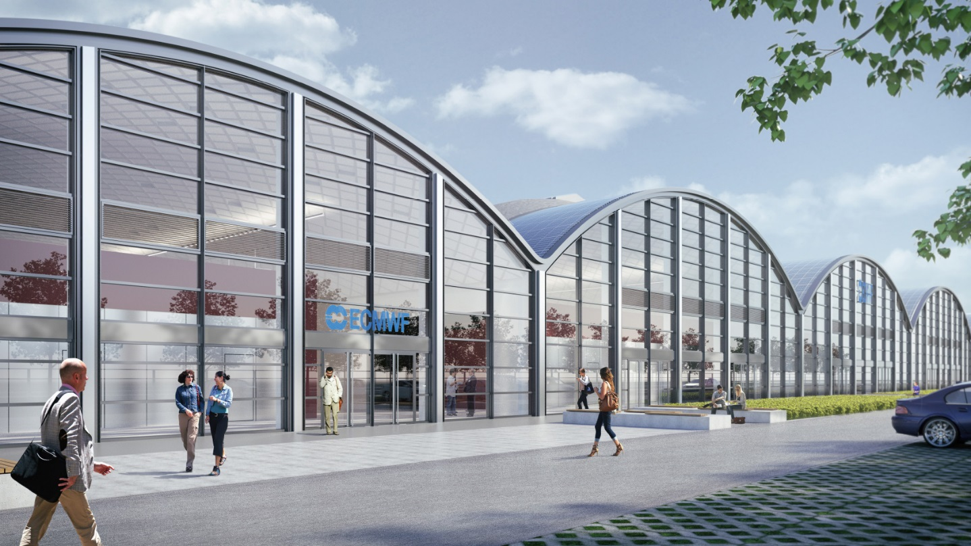
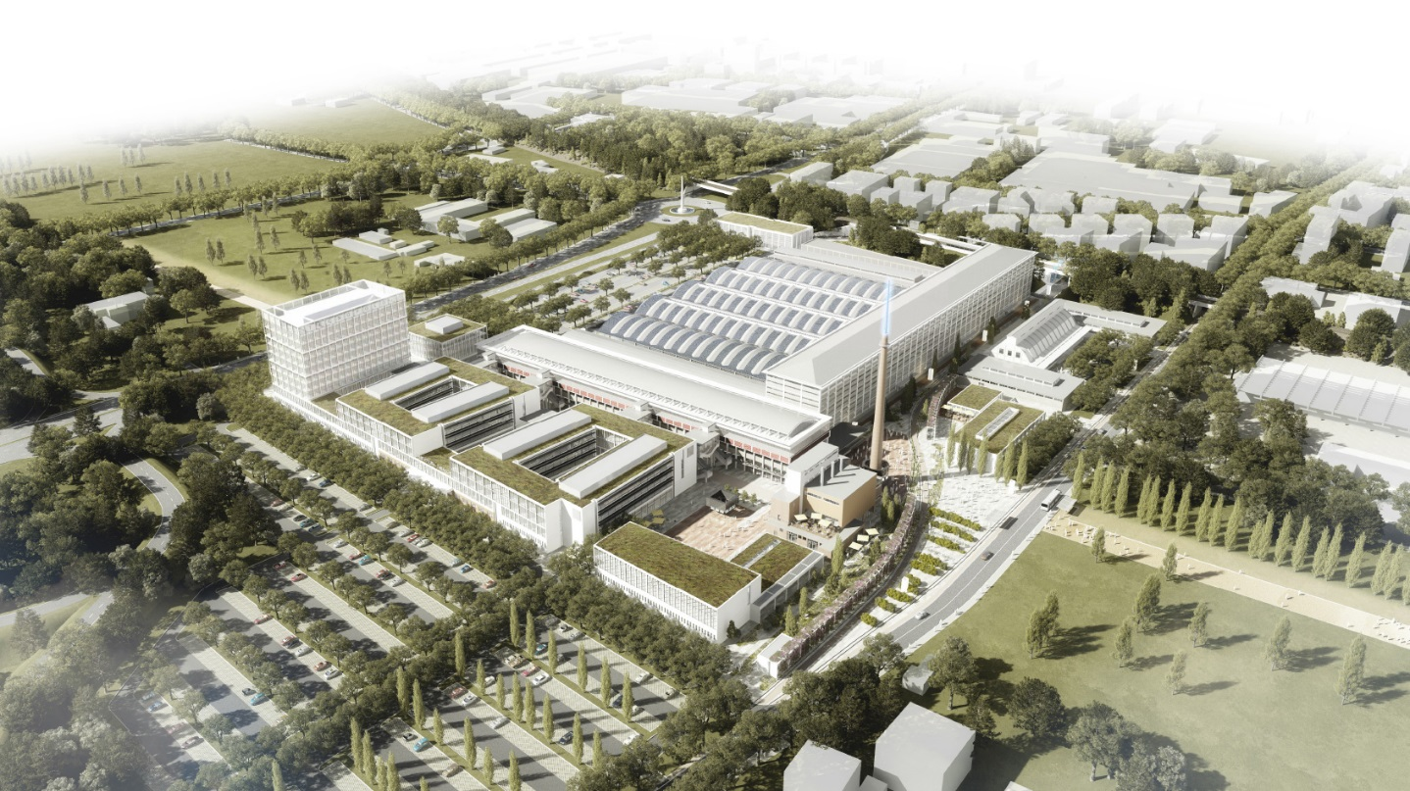
Italy to become host of ECMWF new Data Centre
HPC upgrade in 2020 to enable an increase in the resolution of the forecast ensemble from 18km to around 12km.
Extend predictability of high-impact weather events
Notes:
IN order to meet the requirements of our next HPC, we’ve had to accept the fact that we cannot continue to host our supercomputers here in Reading with our offices, and the data centre will now move to Italy and ready for operations in 2020.

Slide 16
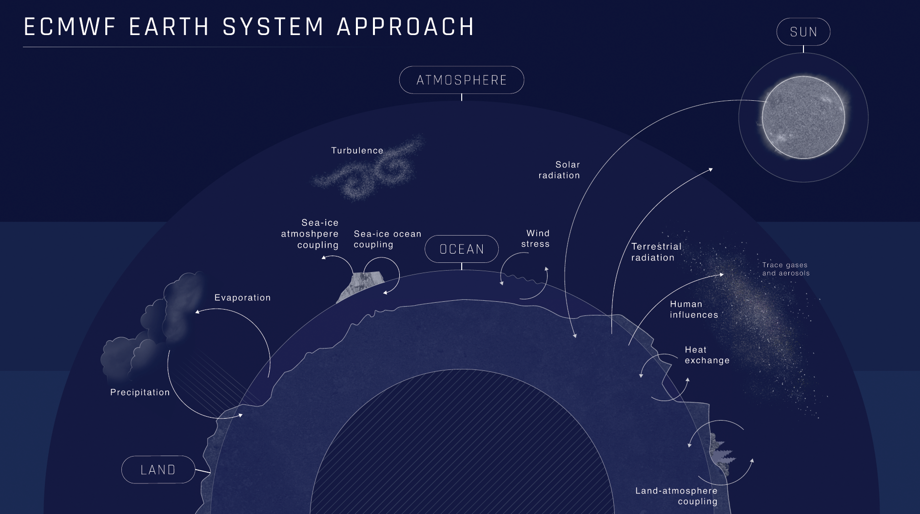
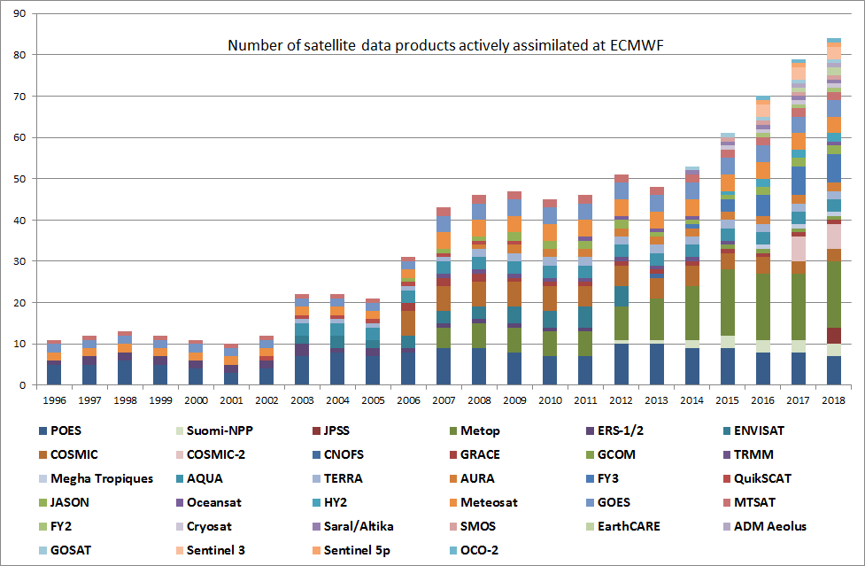
ECMWF & satellite observations: 1996-2015 projected to 2018
Notes:
I’ll just give you the headlines, which are that we our science is based on an Earth system approach, which is one of the three pillars of our ten year strategy.

Slide 17
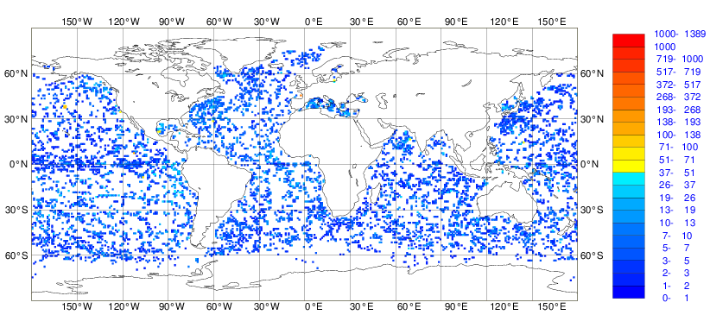
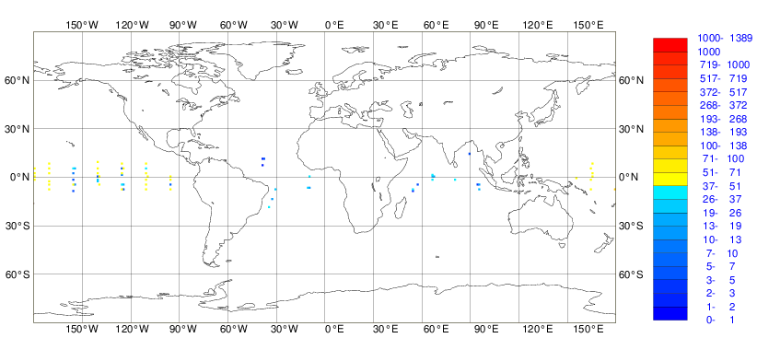
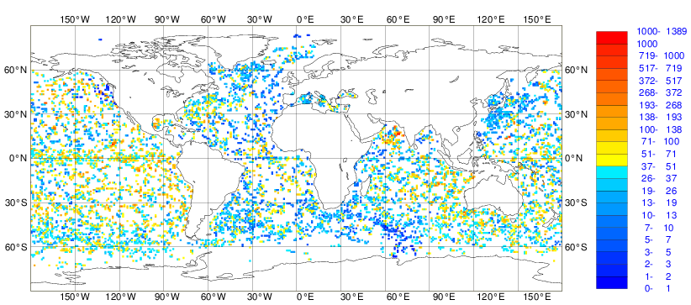

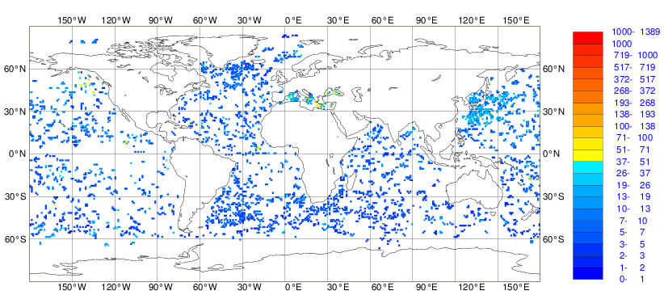

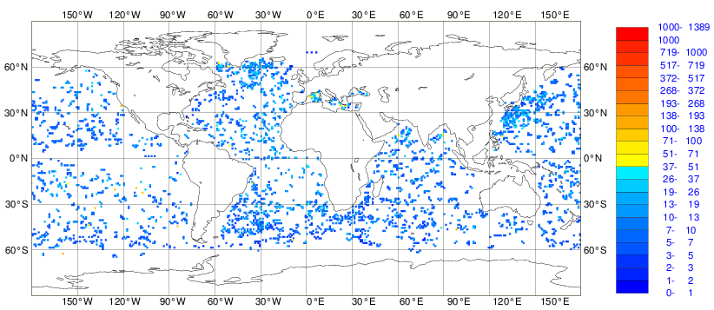
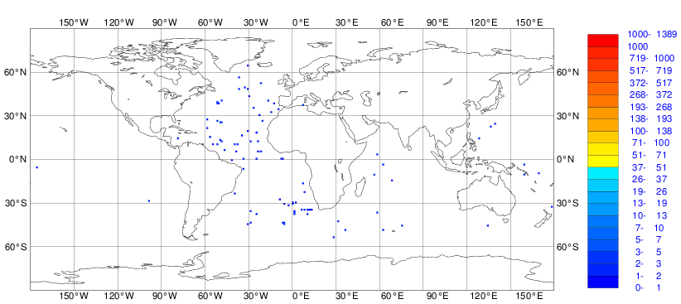
Argo
Operational Observation Monitoring
Moorings
5m
200m
600m
1000m
Number of Temperature Observations
2000m

Slide 18
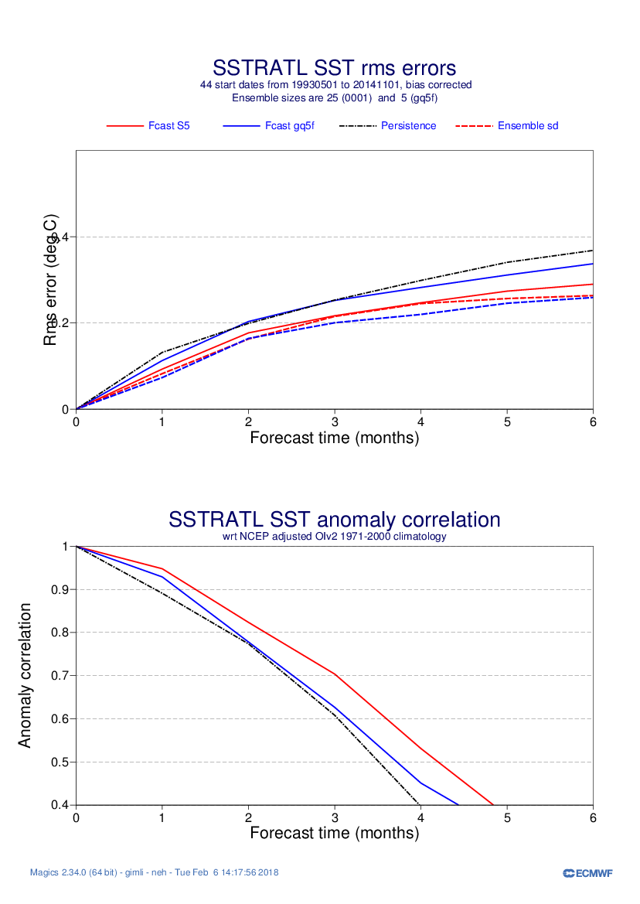
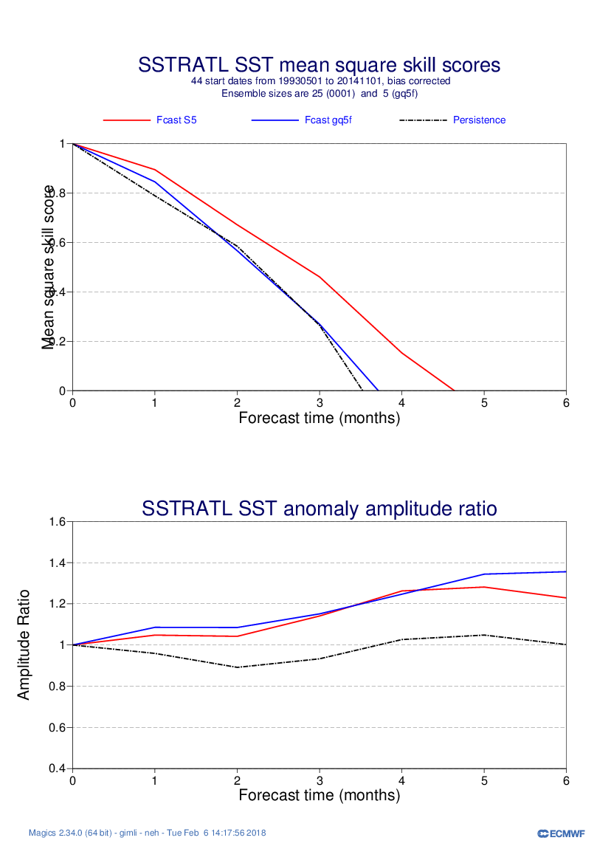
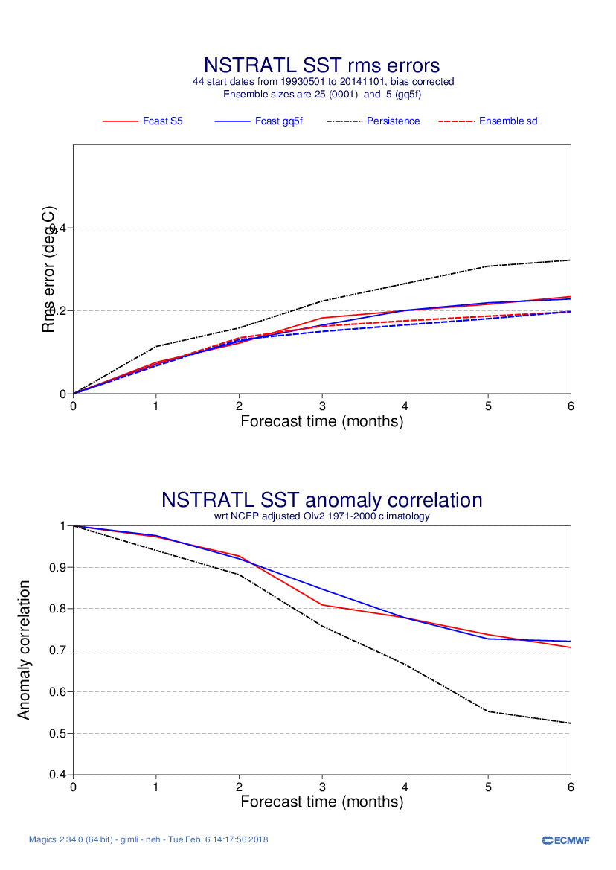
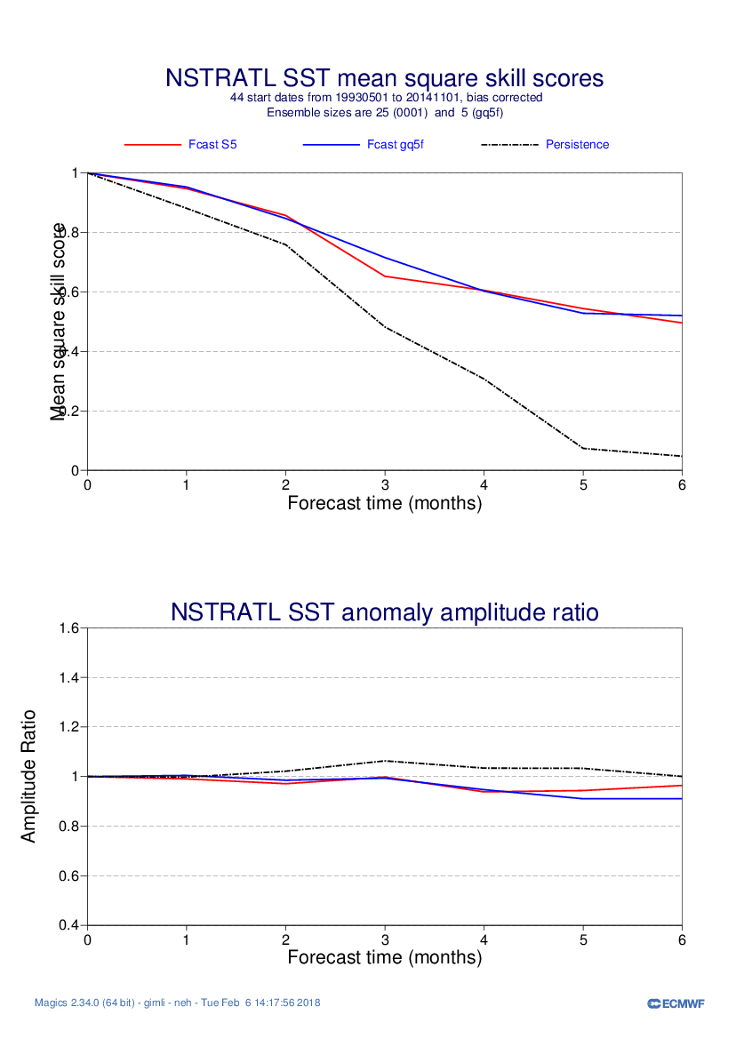
SEASONAL FORECASTS 1: Impact of assimilating Ocean Observations on skill
Assim NoAssim Persistence
Eq and South ATL
Model overestimates variability
Assim improves RMS and anomaly correlation.
North Atllantic
Assimilation does not improve skill.
Predictability limit reached?

Slide 19
Standard deviation of the surface wind speed difference between Sentinel-3A and ECMWF model (13 Dec. 2016 – 12 Dec. 2017)
NWP : In situ data valuable for verification on wind speed and waves, complementing altimeter
Mean Sentinel-3A surface wind speed (13 Dec. 2016 – 12 Dec. 2017)
Courtesy of Saleh Abdalla
Notes:
Geographical distribution of the standard deviation of the difference (SDD) between Sentinel-3A and ECMWF model surface wind speed in the Tropical Atlantic. The period covered is one year from 13 Dec. 2016 to 12 Dec. 2017. The majority of the region has SDD values lower than ~0.8 m/s. Higher values however, are bounded between the equator and latitude 10°N.

Slide 20
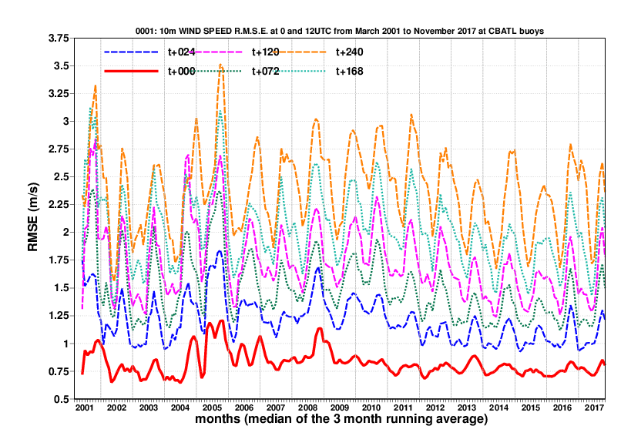
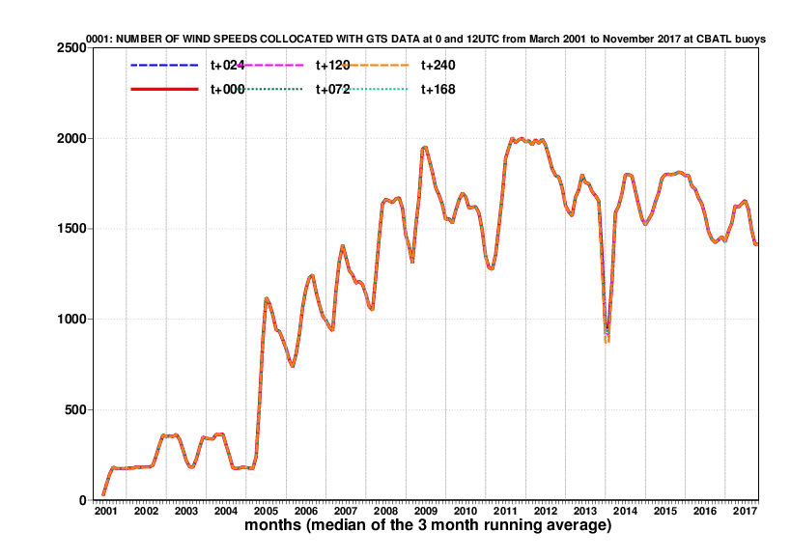
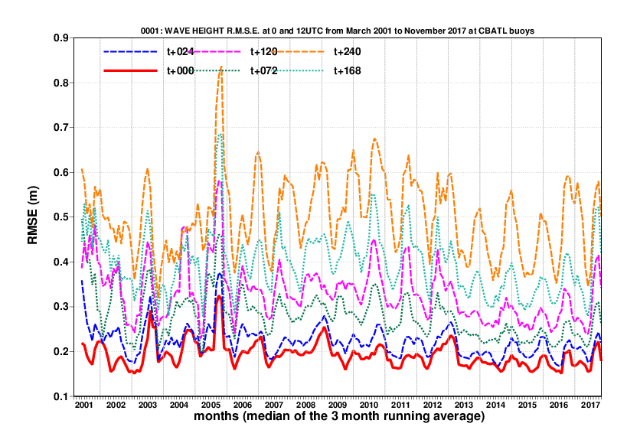
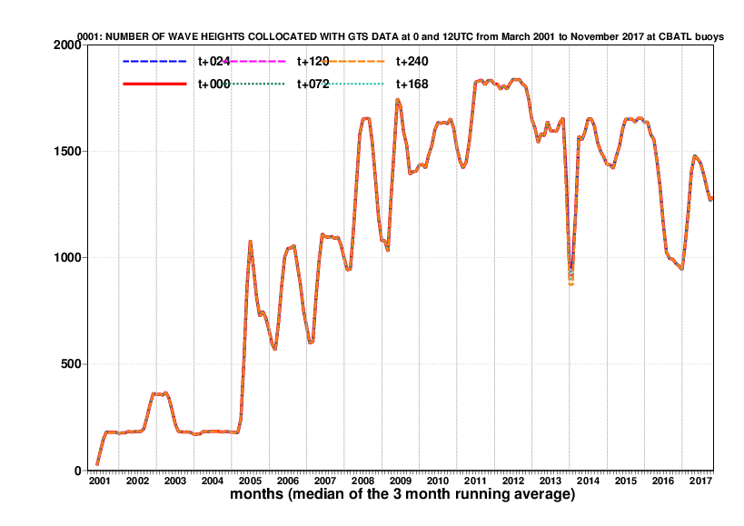
NWP: Comparison with GTS buoy data in the Tropical Atlantic Ocean, north of 15˚ N
Wind speed
Wave height
But sufficient number of buoys lacking in the South Atlantic
Courtesy of Jean Bidlot

Slide 21
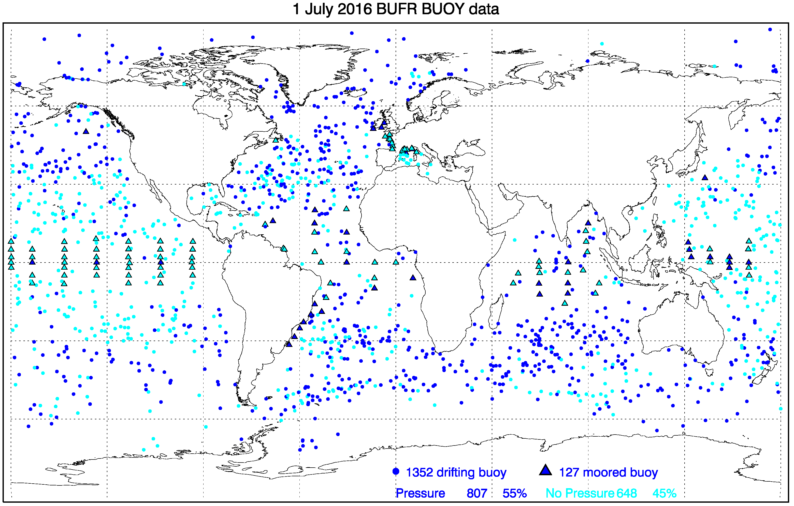
The value of MSLP in Buoys for NWP
Ingleby and Isaksen 2017 conclude of SLP from Buoys significantly improves NWP.
Pressure measurements from buoys better than pressure measurements from ship
Yet, about 40% of buoys no not report Pressure.
Recommendation: equipe buoys and moorings with barometers. Report to GTS.

Slide 22
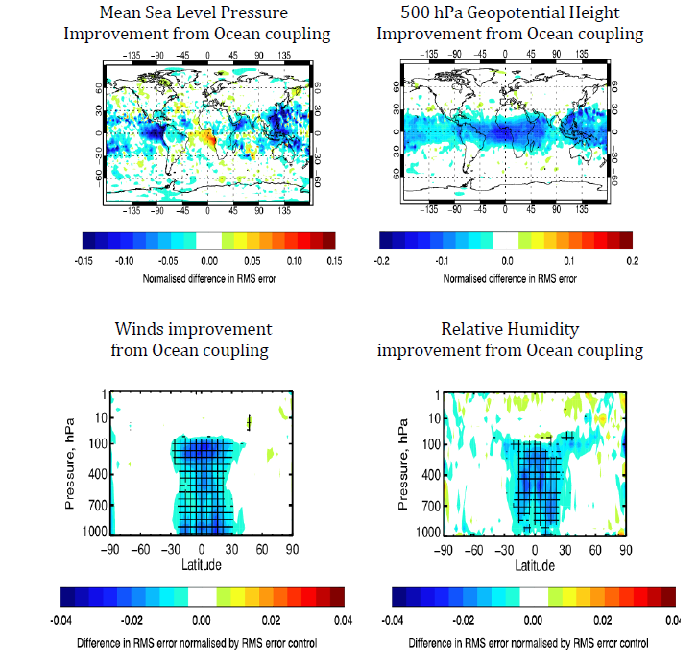
Coupling with the ocean improves the weather forecast scores.
RMSE reduction (blue) in Day+5 weather forecast by coupling to the ocean in the tropics
Large benefit across the tropics. Some degradation in Gulf of Guinea. Need observational sudies to understand why
Courtesy of Kristian Mogensen

Slide 23


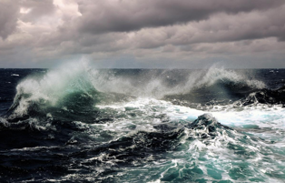

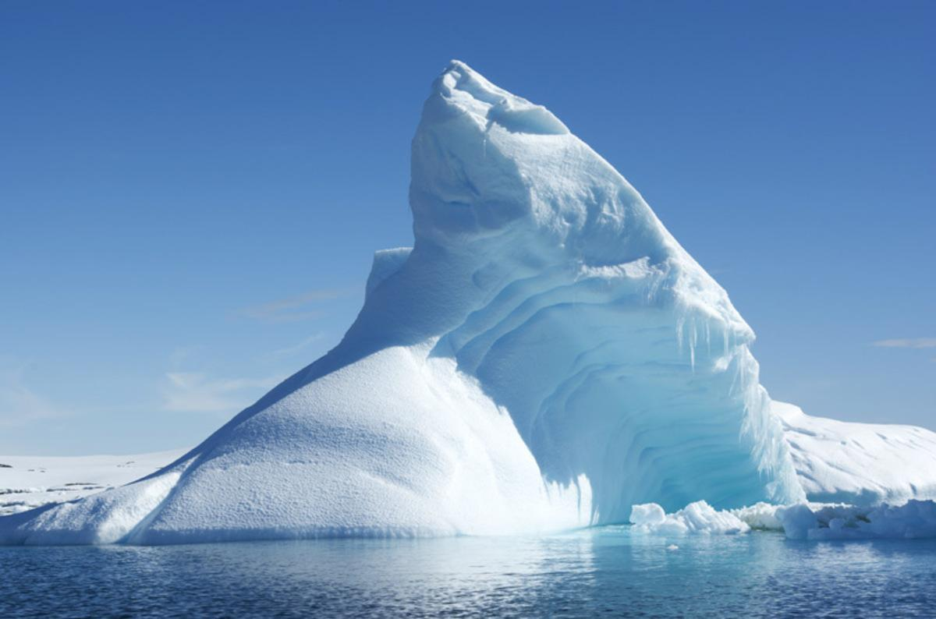

ERA-CLIM2 - Selected description of work
Produce global reanalyses to reconstruct the past climate/weather of the earth system
CERA-20C: A coupled reanalysis of the 20th century
based on conventional surface and subsurface observations
deliver long time series of Essential Climate Variables (ECVs)
CERA-SAT: A coupled reanalysis at higher resolution
based on conventional and satellite observations
evaluate the impact of a higher resolution on the coupled processes

Slide 24
Three ingredients of NWP
NWP science
Supercomputing
Observations
  Access (free or affordable)
  Discovery
  Quality
  Accuracy of metadata
  Standardisation (of data formats and instrumentation)
  Longevity – for climate reanalyses
Notes:
And this is what we deliver to our community at a glance...

Slide 25
WMO is the global standard-setting body
XXX
Notes:
And this is what we deliver to our community at a glance...

