Slide 1
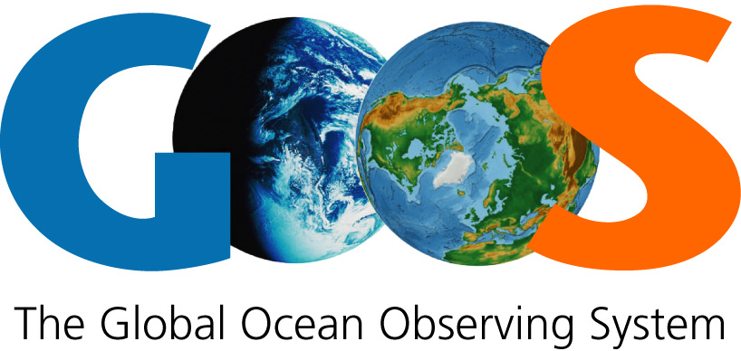
Vision
A truly global ocean observing system that delivers the essential information needed for
our sustainable development, safety, wellbeing and prosperity
Mission
To lead the ocean observing community in growing an integrated and sustained global observing system
For
Climate • Operational services • Marine ecosystem health
Strategic Objectives
Engagement & Impact | 1. Strengthen partnerships, to improve delivery to end users from observations through forecasts, services, and scientific assessments | 2. Building advocacy and visibility for the sustained observing system with stakeholders, including key users and national funders | 3. Regularly evaluate the system to assess fitness-for-purpose | 4. Strengthen knowledge and exchange around value creation from ocean observation, empowering the spread of end user applications at a local level
Integration & Delivery | 5. Provide authoritative guidance on implementation for integrated observing; synthesizing across evolving requirements | 6. Sustain, strengthen and expand observations coordination through GOOS and partner communities, promoting standards and best practice, and developing metrics to measure success | 7. Ensure GOOS ocean observing data and information are findable, accessible, interoperable, and reusable; with appropriate quality and latency
Building for the future | 8. Support innovation in observing technologies and networks | 9. Develop capacity to ensure broader participation in and benefit from GOOS | 10. Extend systematic observations to measure human impacts on the ocean | 11. Play a leading role in establishing effective governance for global in situ and satellite observing, together with partners and stakeholders

