Slide 1
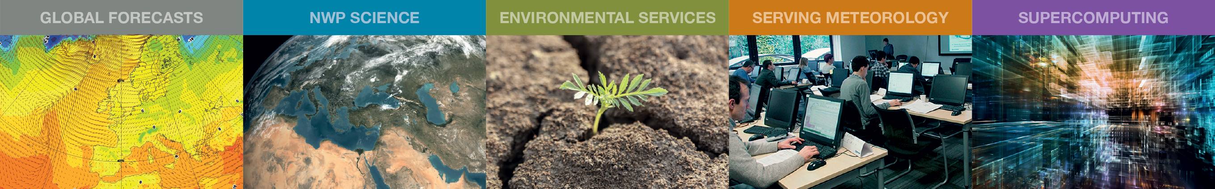
WMO rolling review of requirements
Erik Andersson
Deputy Director, Forecast Department, ECMWF
erik.andersson@ecmwf.int

Slide 2
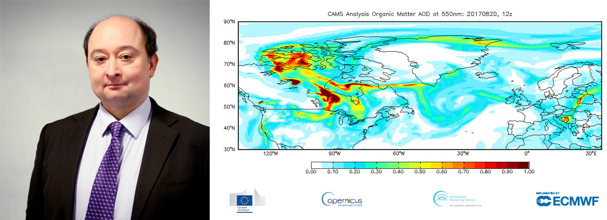
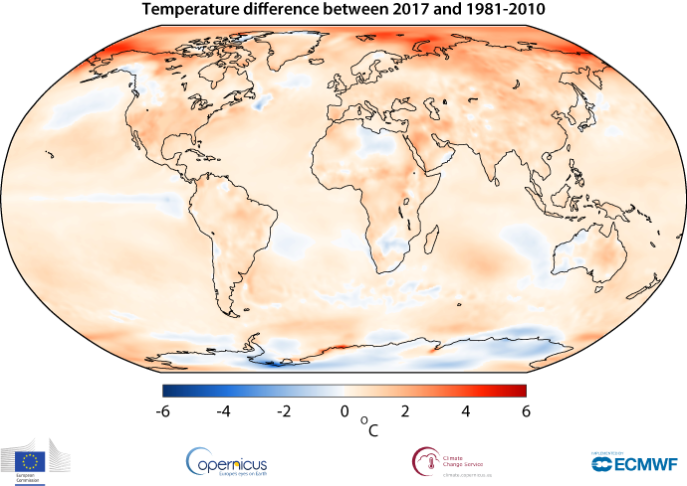
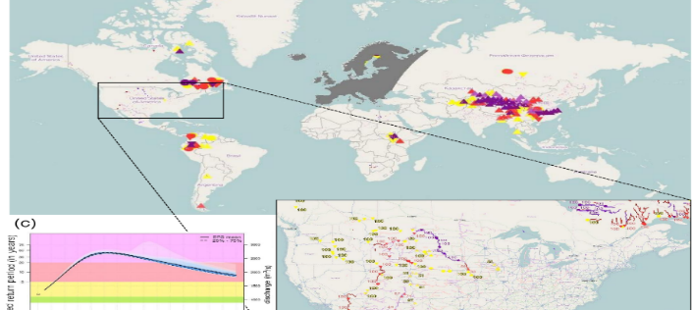
Three ingredients of monitoring and forecasting
Earth Science
Supercomputing
Observations
“The success of WMO has been based on the free exchange of high-quality standardized observations and of scientific know-how worldwide”
Notes:
The role of observations, alongside science and computers in forecasting.

Slide 3
Observation requirements in support of WMO Programmes
The forecasting and monitoring activities of the WMO Programmes need comprehensive earth-system observations – hence the WIGOS.
The observation requirements are determined for a number of application areas (AAs)
Compare stated requirements to the actual, current observation capabilities
Perform a gap analysis
Write a plan how to mitigate those gaps
Set the long-term vision
Notes:
The RRR process in words

Slide 4
Global NWP
High-resolution NWP
Nowcasting
Sub-seasonal to Longer-range Fc
Aeronautical Meteorology
Forecasting Atm Composition
Monitoring Atm Composition
Atmospheric Composition Urban
Ocean Applications (JCOMM)
Agricultural Meteorology
Hydrology
Climate Monitoring
Climate Science
Space Weather
The WMO Rolling Review of Requirements (RRR) process
Observing capabilities
User requirements for observations
User requirements for observations
User requirements for observations
User requirements for observations
Gap Analyses
(Statements of Guidance)
Implementation Plan
Long-term Vision for global observing systems
Programmes of Members and Agencies
Notes:
And this is what we deliver to our community at a glance...

Slide 5
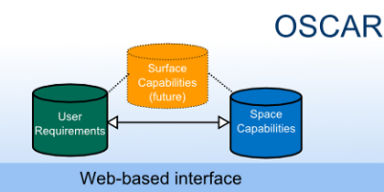
OSCAR (Observing Systems Capability Analysis and Review Tool)
User requirements: http://www.wmo-sat.info/oscar/requirements
Space-based capabilities: http://www.wmo-sat.info/oscar/spacecapabilities
Surface-based observing: https://oscar.wmo.int/OSCAR/index.html#/
Gap Analyses (Statements of Guidance, SoGs) http://www.wmo.int/pages/prog/www/OSY/GOS-RRR.html#SOG
Vision for the global observing system: http://www.wmo.int/pages/prog/www/OSY/gos-vision.html
Implementation Plan, EGOS-IP: http://www.wmo.int/pages/prog/www/OSY/gos-vision.html#egos-ip
The RRR process and OSCAR
Notes:
Each box in the schematic diagram of the previous slide corresponds to thorough documentation, either captured in the OSCAR data base, or in specific WMO documents as listed here: the Statement of Guidance, the Vision for the GOS and the EGOS Implementation Plan.

Slide 6
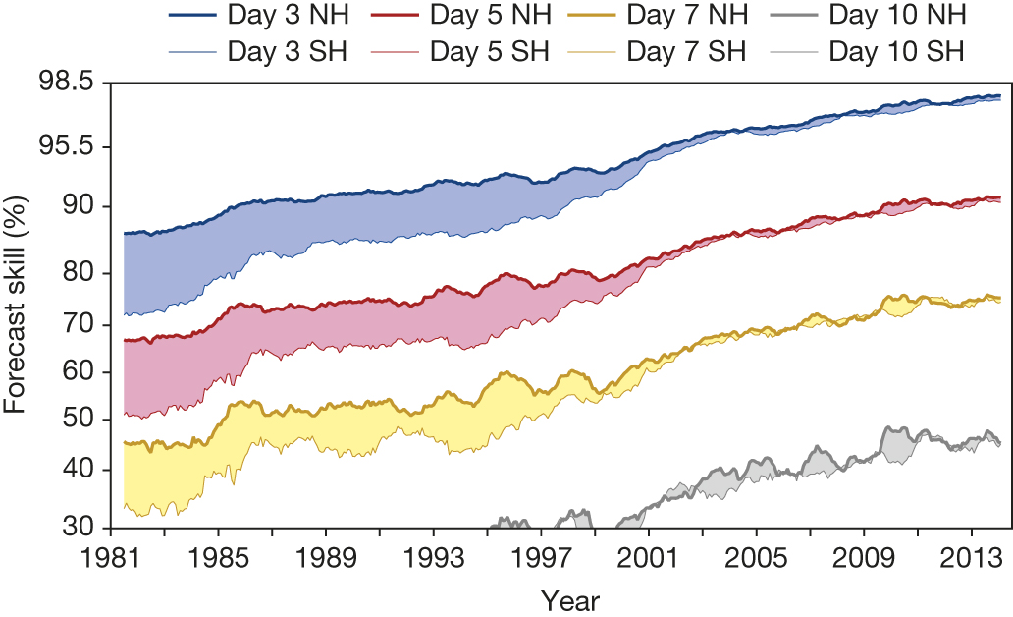
Vision and trends
Climate focus -> long time series, high accuracy, consistency
Earth system approach -> requirements for ocean, atmosphere, land, lake, sea ice, snow, … observations
Higher resolution -> higher density observations
Impact focus -> higher frequency observations
Demands for accuracy -> higher quality, and timely delivery of observations
Notes:
The RRR process in words

Slide 7
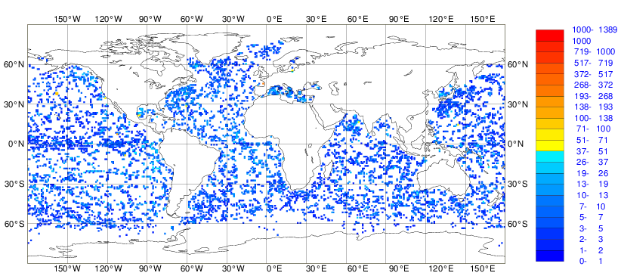
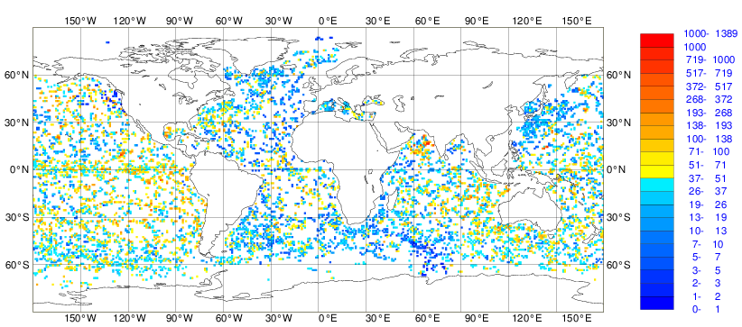
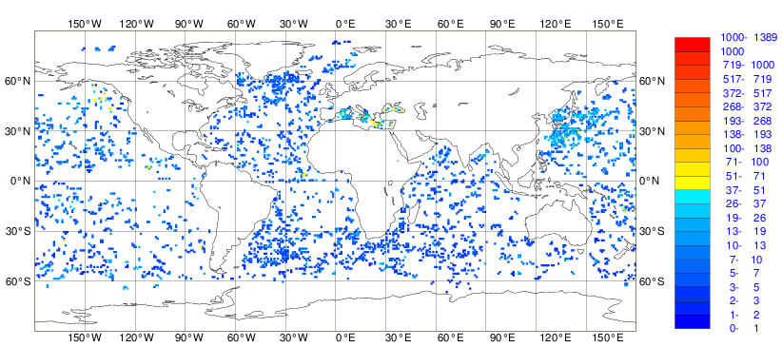
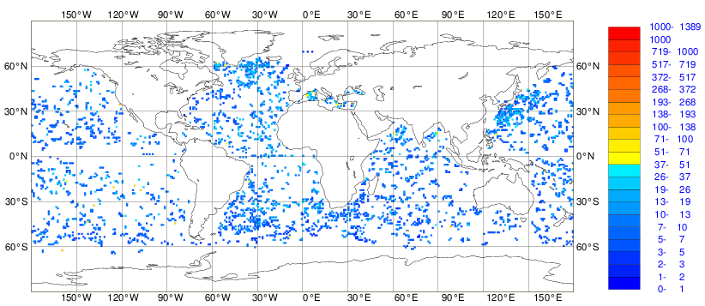
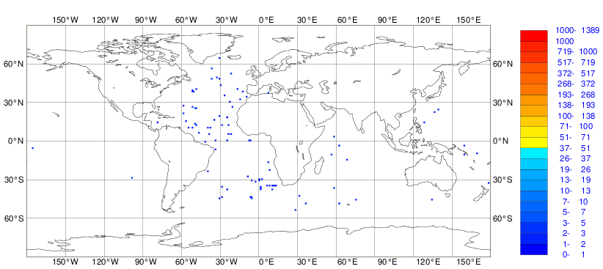
Observation challenges for the years ahead
Enhanced data sharing
Expand global exchange of observations
Improved coverage of all the Earth-system components (atm., ocean, land, sea ice, snow, …
Accuracy and completeness of metadata
Quality and quality-monitoring
Timeliness of collection and distribution
Notes:
The RRR process in words

