Slide 1
Goal (of the discussion) will be to develop implementation actions that can reinforce regional and national development of GOOS

Slide 2
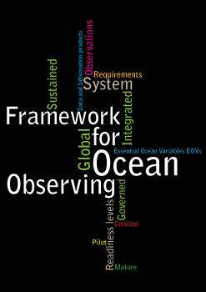
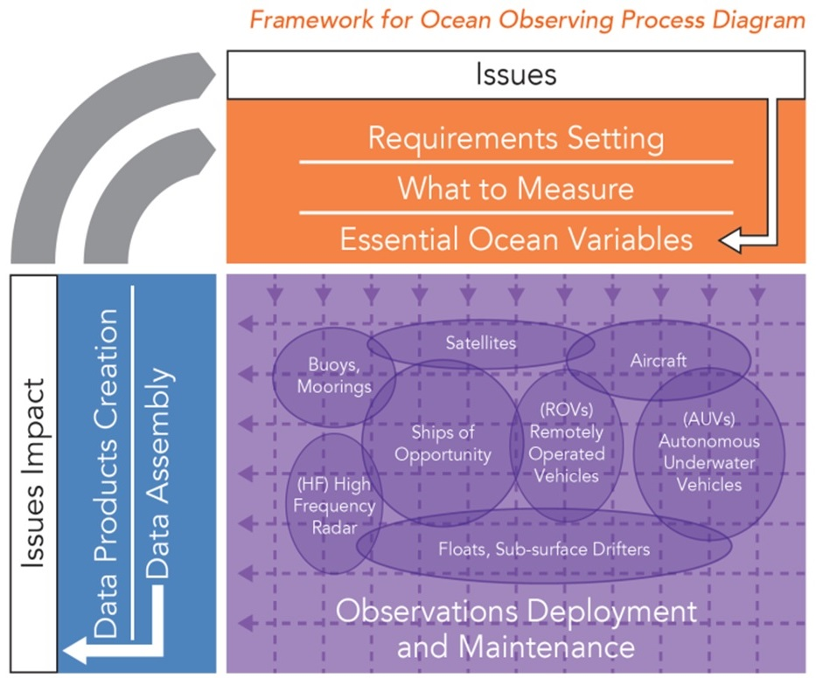
Framework for Ocean Observing
A systems approach
What should/will we measure?
New technologies
Societal questions
Policy context
Requirements
Ocean Health
Climate
RT Services
Panels
Who will measure and what technologies?
Who will benefit?
GRAs
IOC
Nations
Users
Integration with models and satellites
EEZ/local
Reg. Coord
Networks
POGO
+ Partners
Notes:
GOOS at the global level as a program delivers strategic oversight, coordination, and evaluation of the sustained ocean observing system. The program is helping to coordinate a wide range of efforts by national and regional research and operational agencies, entraining a wide range of voluntary effort.
Since the publication by IOC in 2012 of the Framework for Ocean Observing, a growing community has been working using the same interoperable language of developing observing requirements for societal benefit, identifying Essential Ocean Variables or EOVs based on feasibility and impact, coordinating ocean observing networks through standards and the sharing and promotion of best practices, developing readiness to observe new EOVs in a globally sustained way, and developing coordinated and interoperable data management streams that feed different information generation mechanisms.

Slide 3
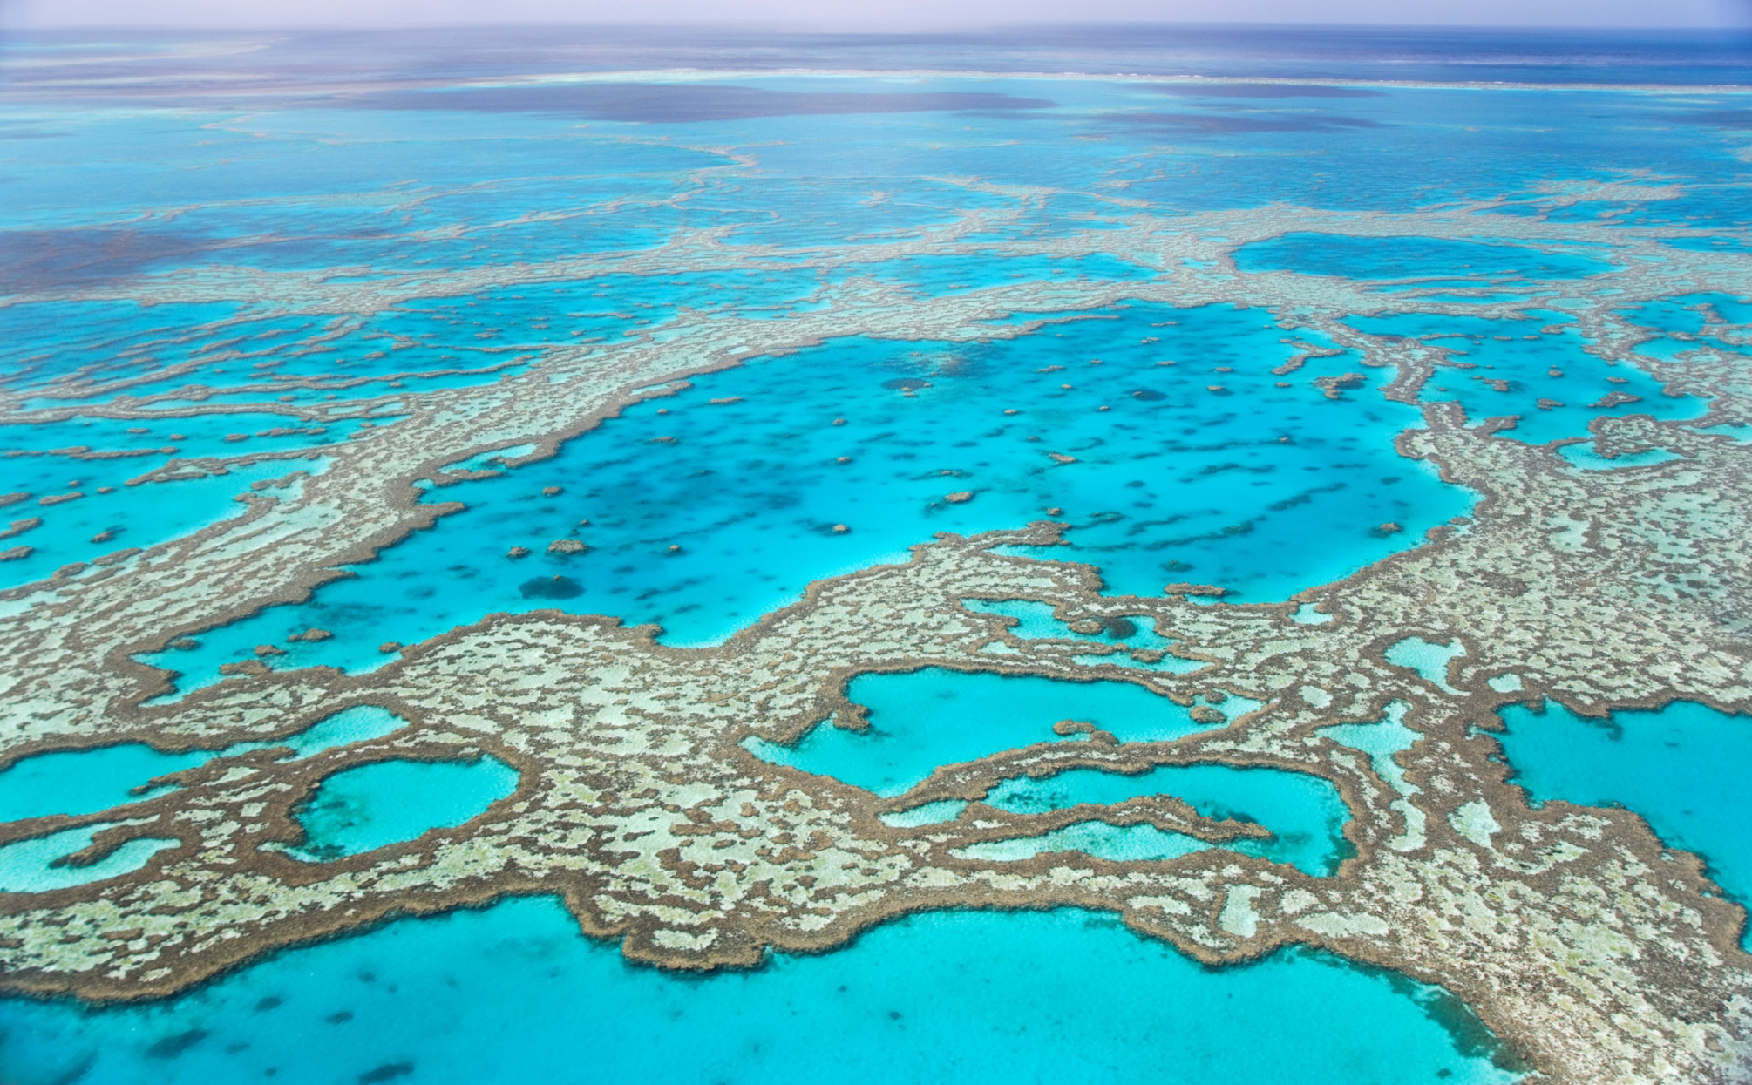
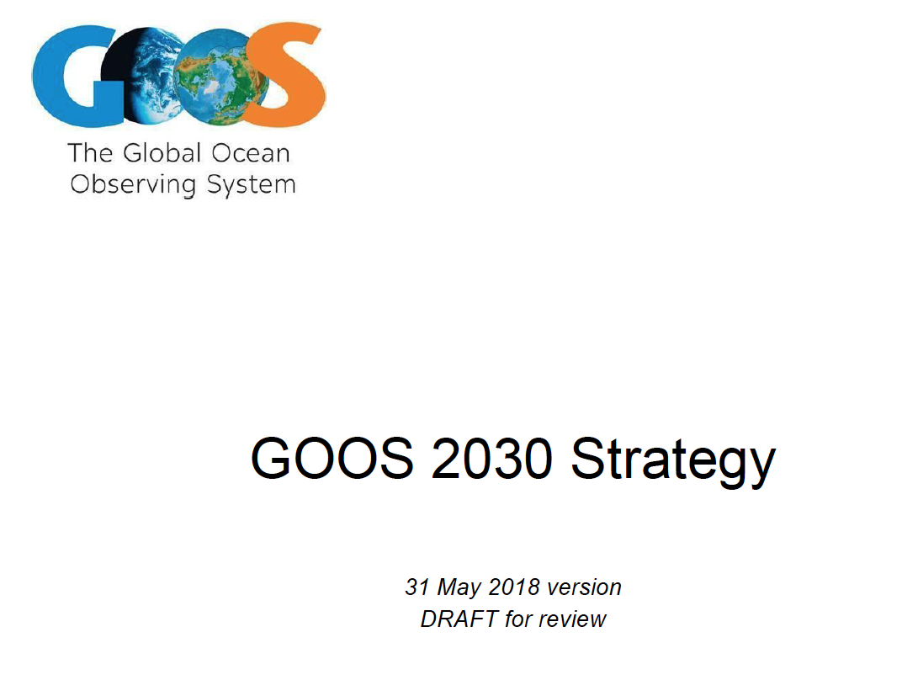
New GOOS Strategy:
targets, 6 month window
Vision
A sustained global ocean observing system, spanning from coasts to open ocean, serving governments, communities and industry by delivering the essential information to improve our safety, sustainability, wellbeing and prosperity
Notes:
Developing and public review between now and May.

Slide 4
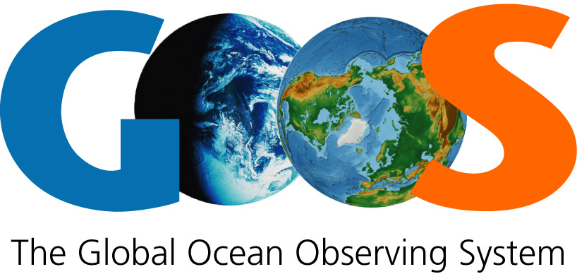
A truly global ocean observing system that delivers the essential information needed for
our sustainable development, safety, wellbeing and prosperity
Vision
To lead the ocean observing community in growing an integrated and sustained global observing system
Mission
For
Strategic Objectives
Climate • Operational services • Marine ecosystem health
Engagement & Impact | 1. Strengthen partnerships, to improve delivery to end users from observations through forecasts, services, and scientific assessments | 2. Building advocacy and visibility for the sustained observing system with stakeholders, including key users and national funders | 3. Regularly evaluate the system to assess fitness-for-purpose | 4. Strengthen knowledge and exchange around value creation from ocean observations, empowering local spread of end user applications
How will nations/GRAs contribute to this?
Mechanism for reporting/feedback?
Integration & Delivery | 5. Provide authoritative guidance on implementation for integrated observing; synthesizing across evolving requirements | 6. Sustain, strengthen and expand observations coordination through GOOS and partner communities, promoting standards and best practice, and developing metrics to measure success | 7. Ensure GOOS ocean observing data and information are findable, accessible, interoperable, and reusable; with appropriate quality and latency
Building for the future | 8. Support innovation in observing technologies and networks | 9. Develop capacity to ensure broader participation in and benefit from GOOS | 10. Extend systematic observations to measure human pressures on the ocean | 11. Play a leading role in establishing effective governance for global in situ and satellite observing, together with partners and stakeholders

Slide 5

Examples of initiatives in Latin and South America.
IGMETS
LAOCA
SimCosta
SiAM
SAMOC
PIRATA
CECOLDO
And many others
Each GRA region has a similar array of relevant activity
Subset of the extensive activity underway, all contributing to GOOS implementation
How can GOOS engage such initiatives in the medium term?
www.eoos-ocean.eu #EOOS

Slide 6
Governance
GOOS specifies terms of reference (linked to strategy) and asks GRAs to fulfil
Autonomous GRAs with limited reporting requirements to GOOS (NOW)
Strengthen GOOS national contacts
Some thoughts on governance and
Funding and links to GOOS
GRA as Legal entity:
Project participation
Tenders
Authority to represent
Funding models:
Centralised; (IMOS, IOOS,
single country)
Decentralised; subscription based for “glue money” but bulk of resources rest with individual countries/institutes e.g. EuroGOOS, GRASP, Oceatlan
www.eoos-ocean.eu #EOOS

Slide 7
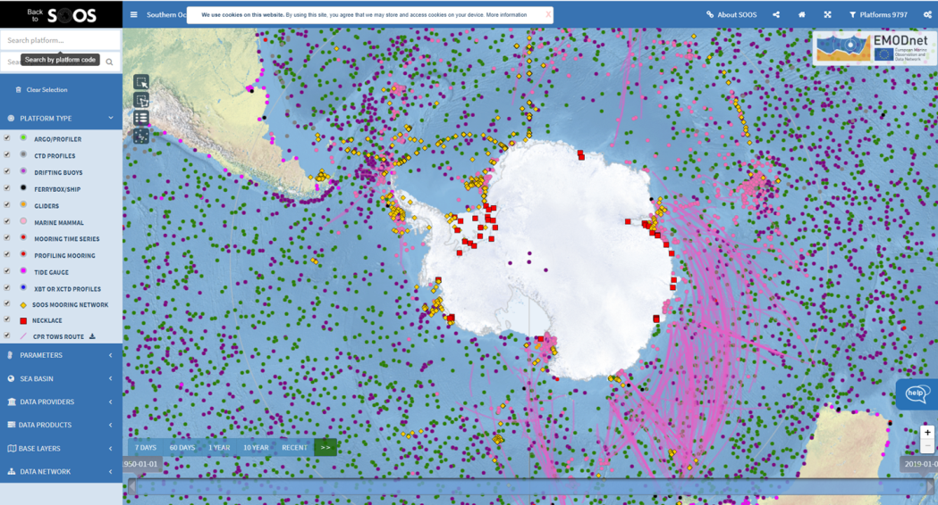
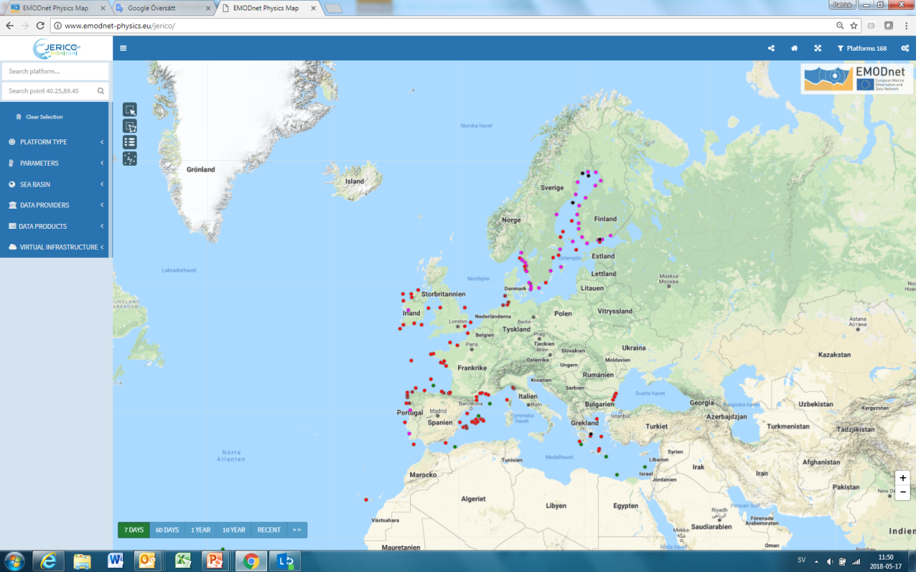

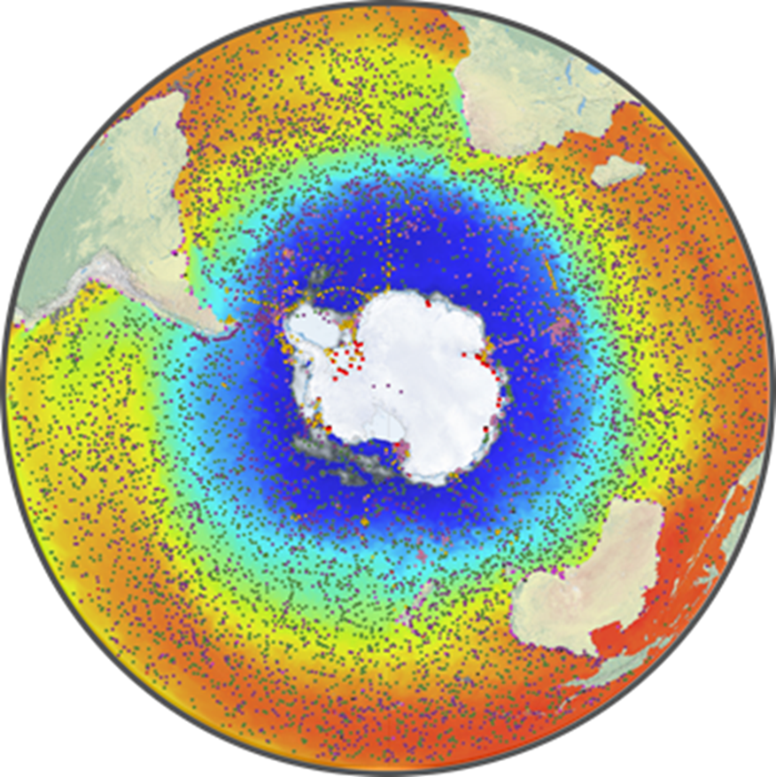
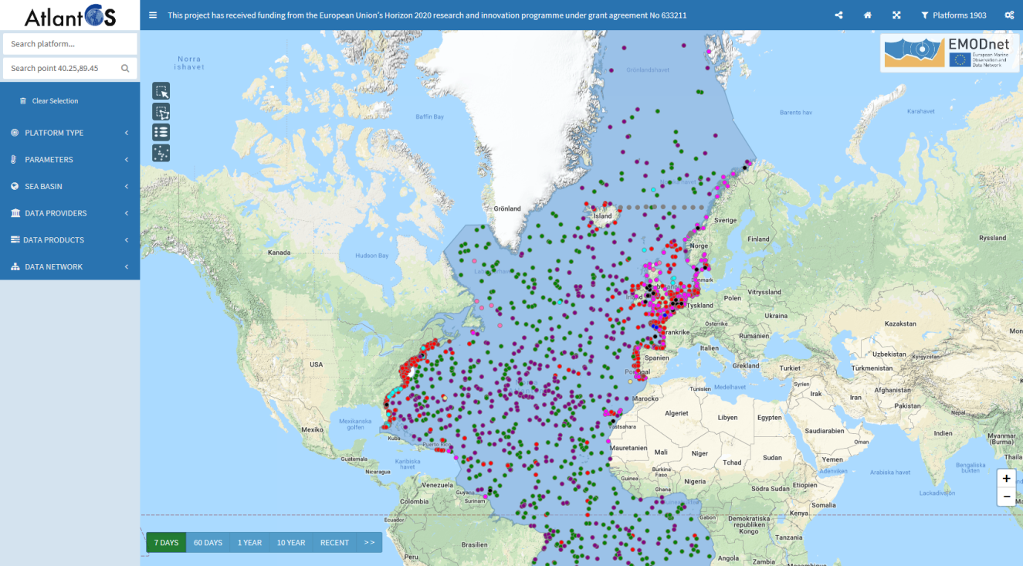
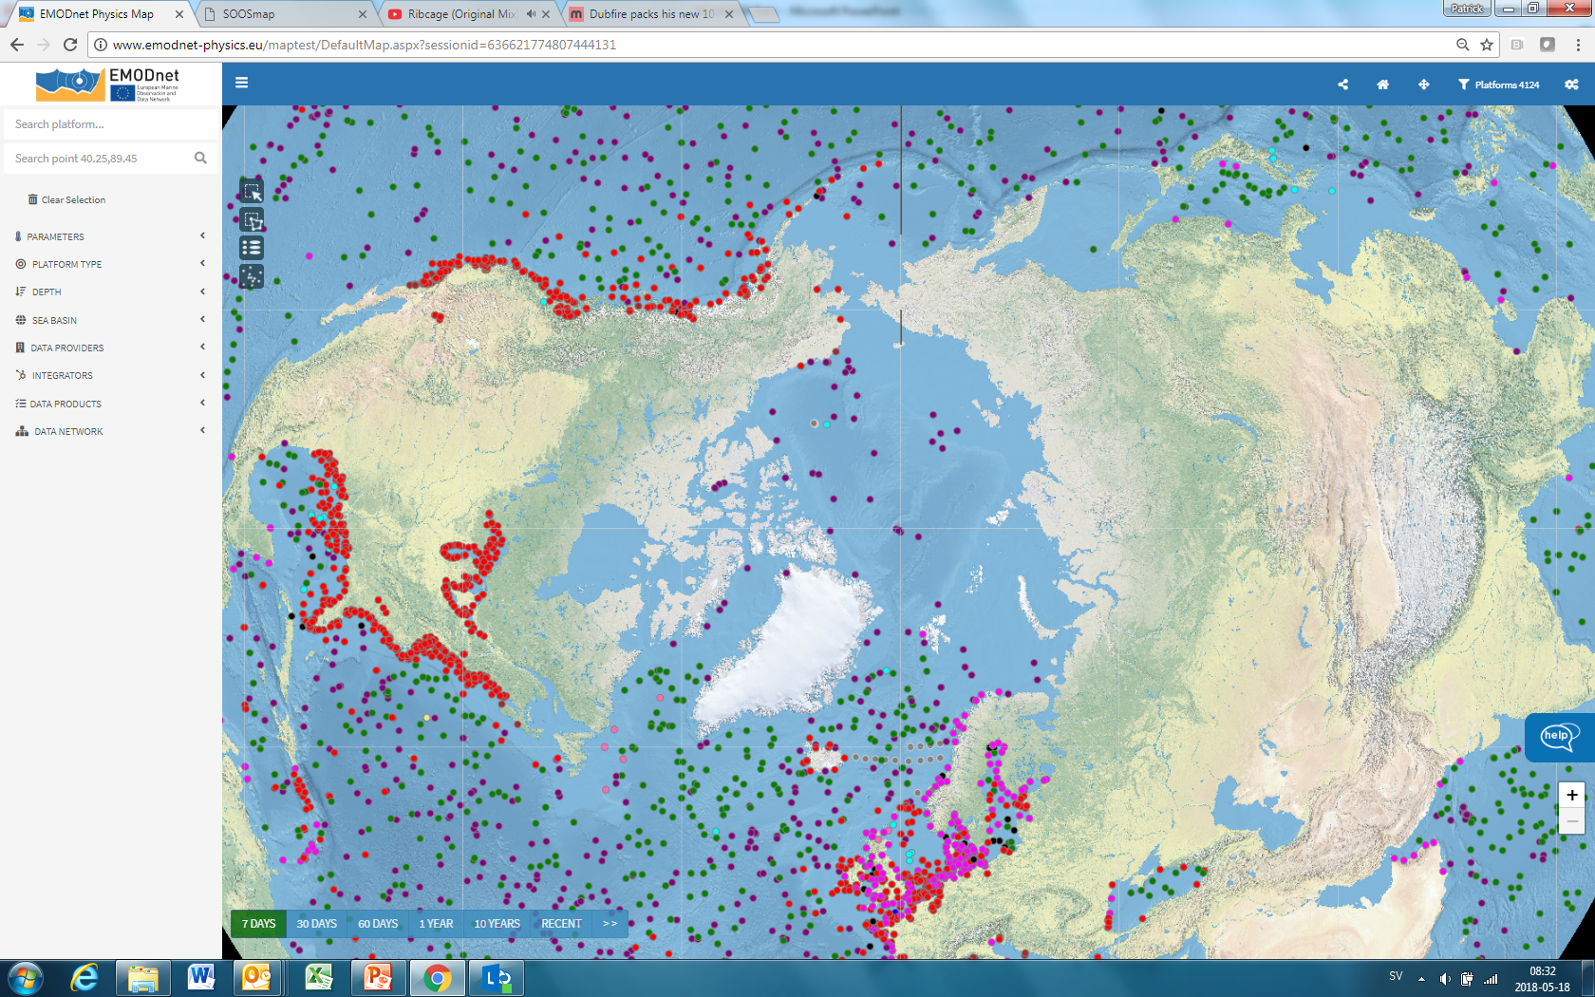
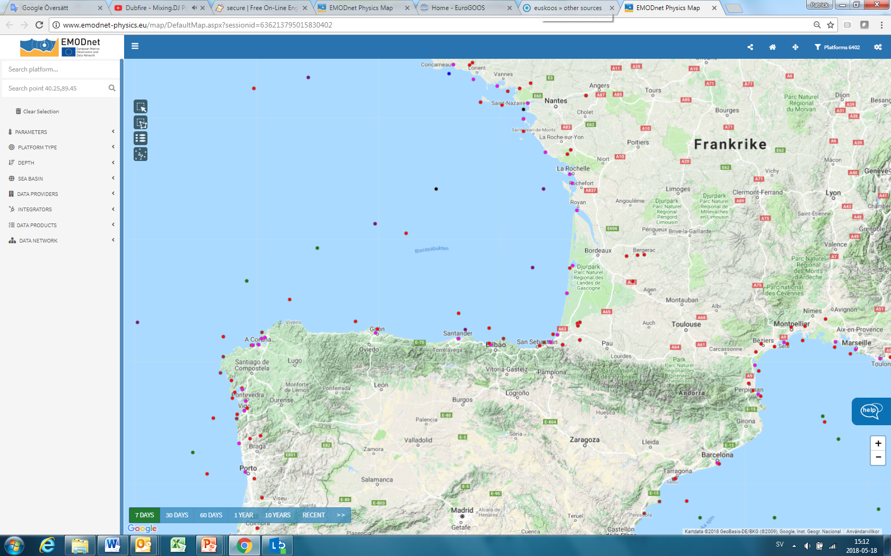
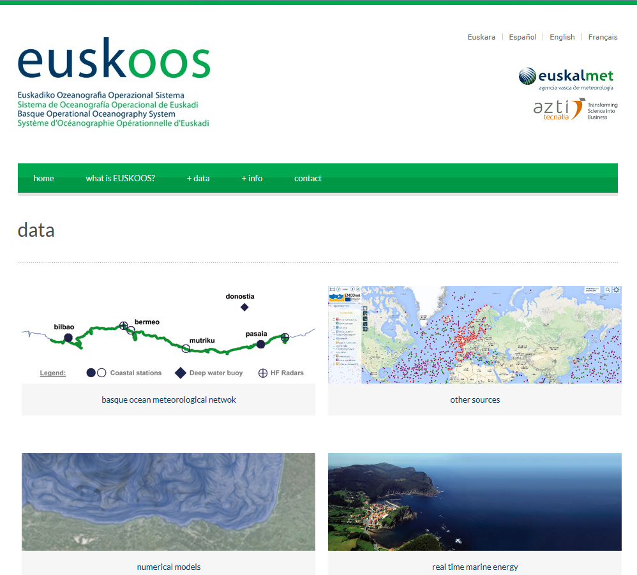

Slide 8
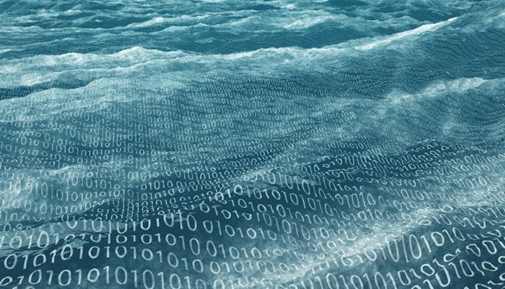
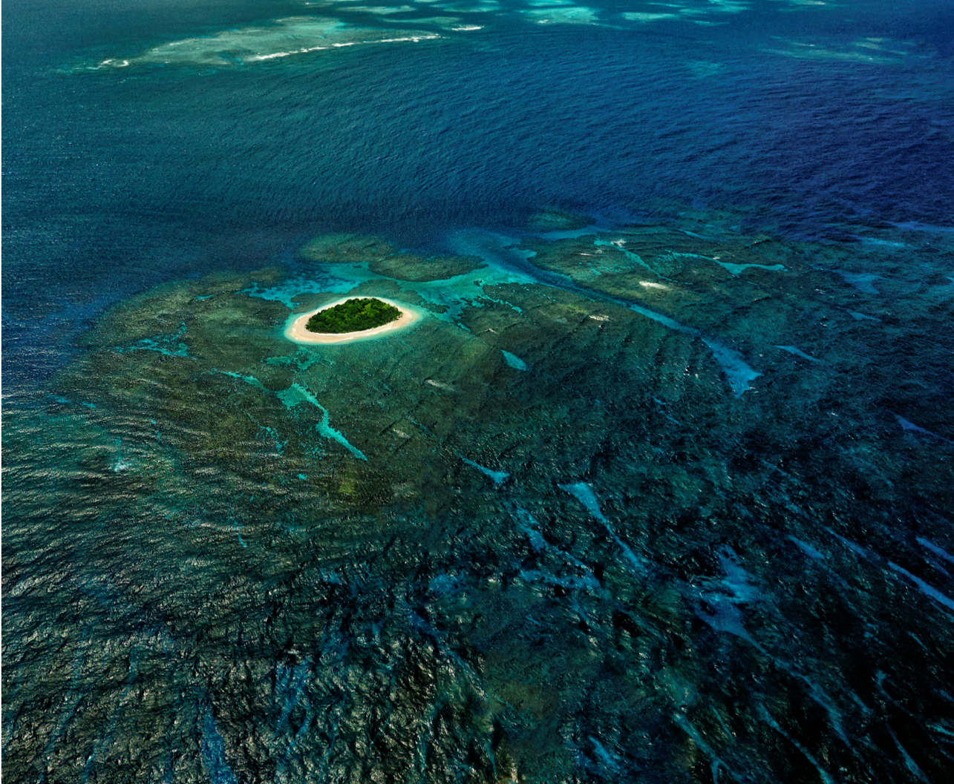
UN Decade of Ocean Science for Sustainable Development
Priority Research and Development Areas
R&D Priority Area 4:
Data & information portal
Data
Ocean
Big
Vavau © Stuart Chape

Slide 10

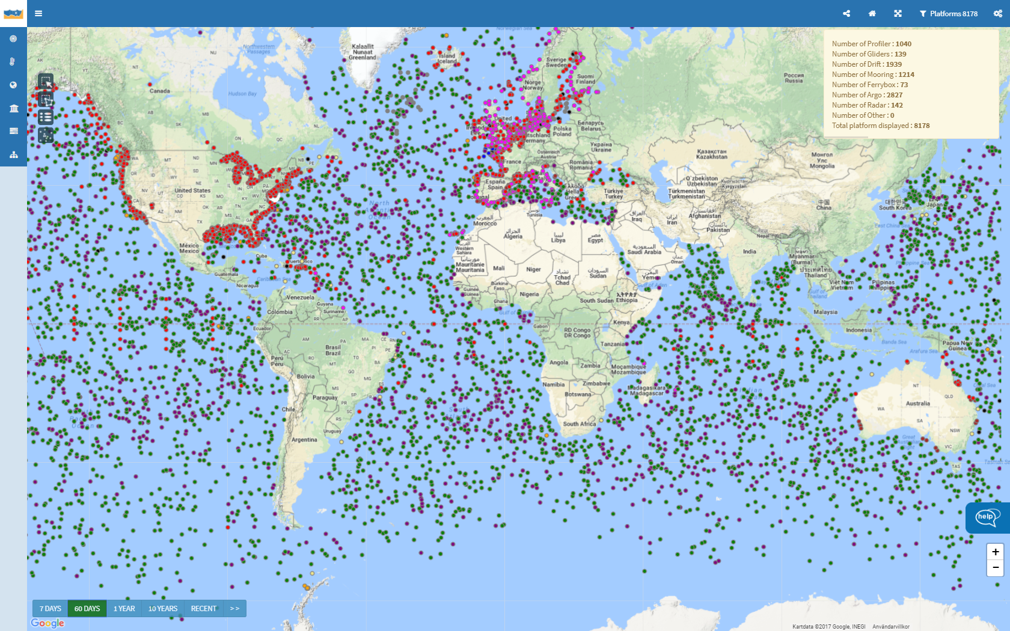
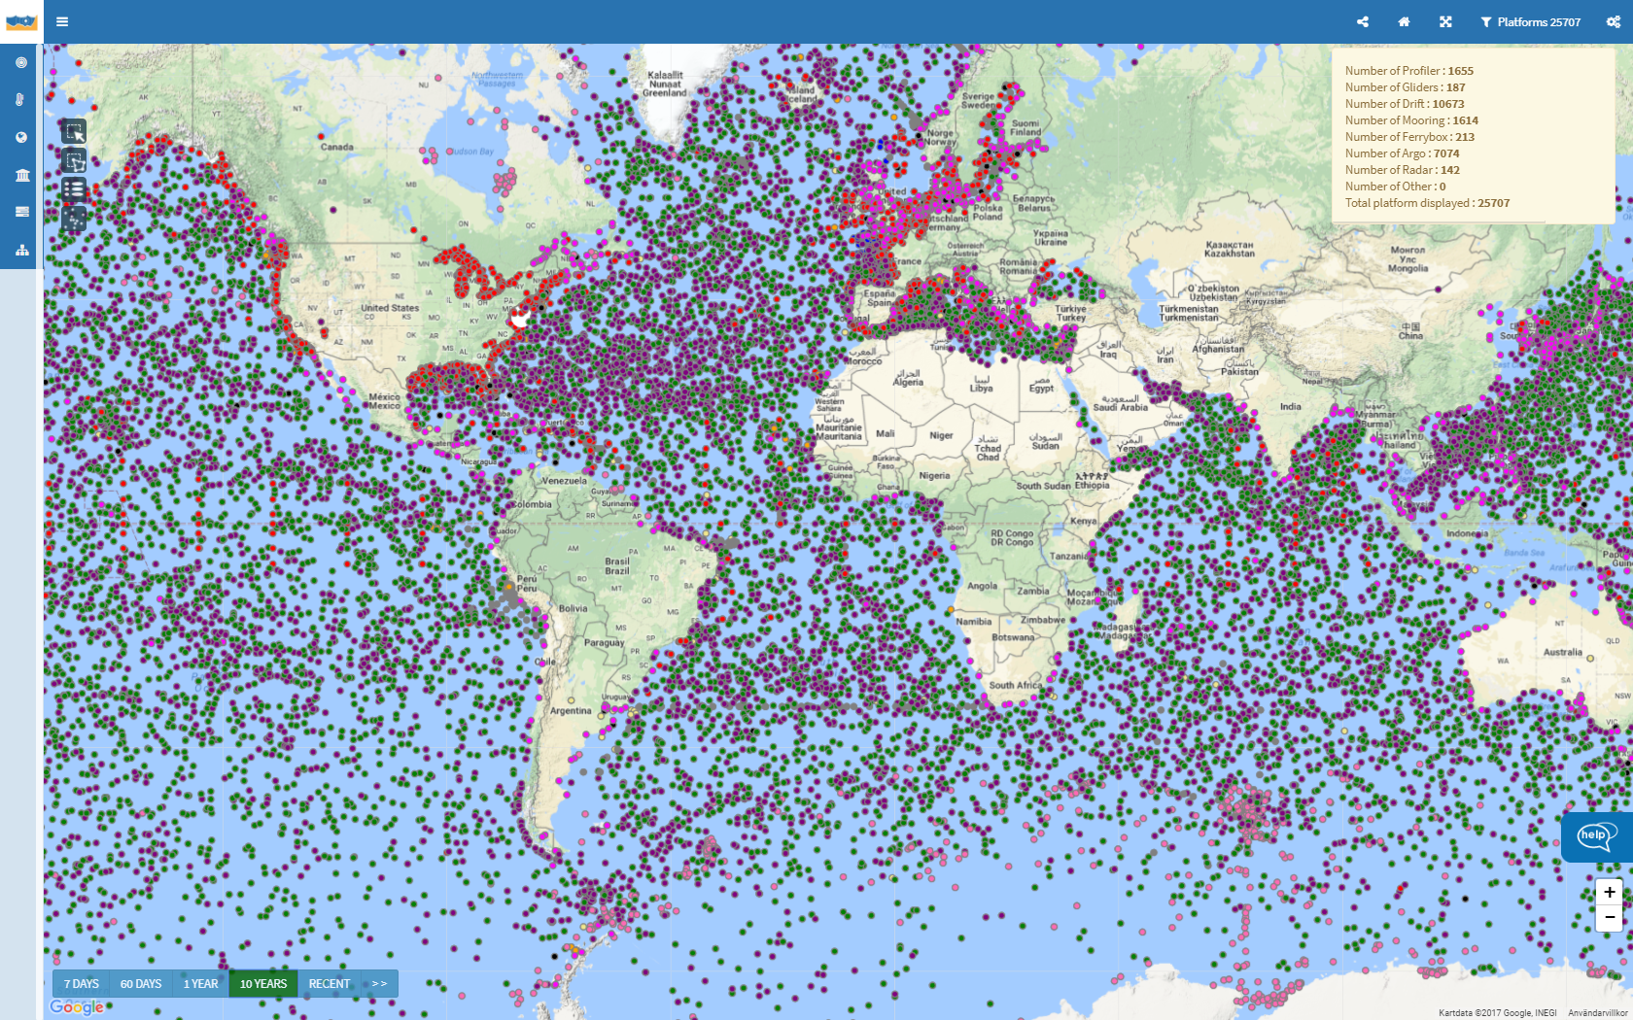
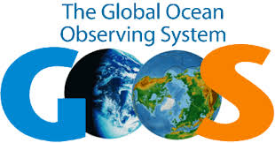
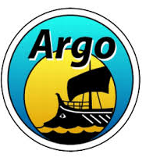


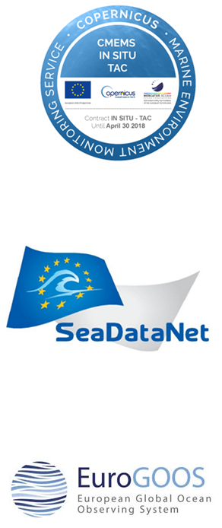
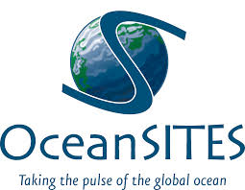
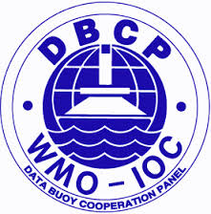

Global Portal
eurogoos.eu | twitter.com/EuroGOOS

Slide 11
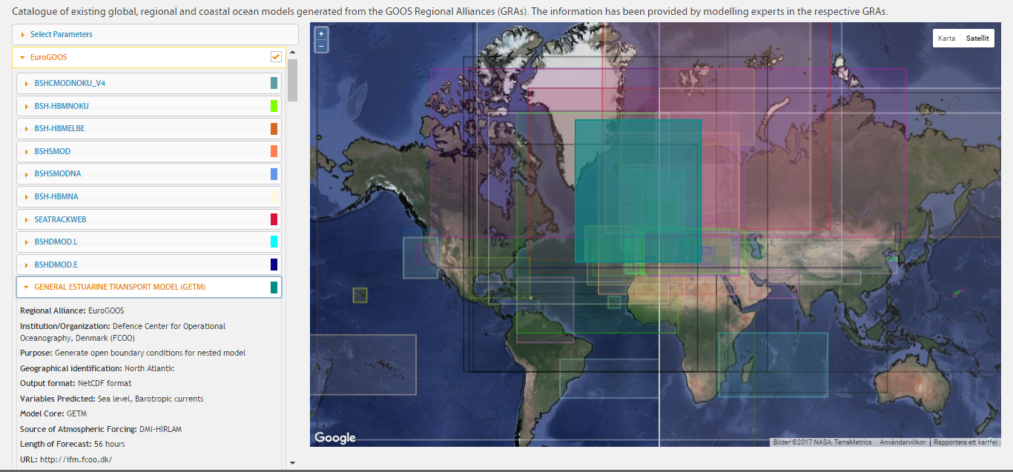
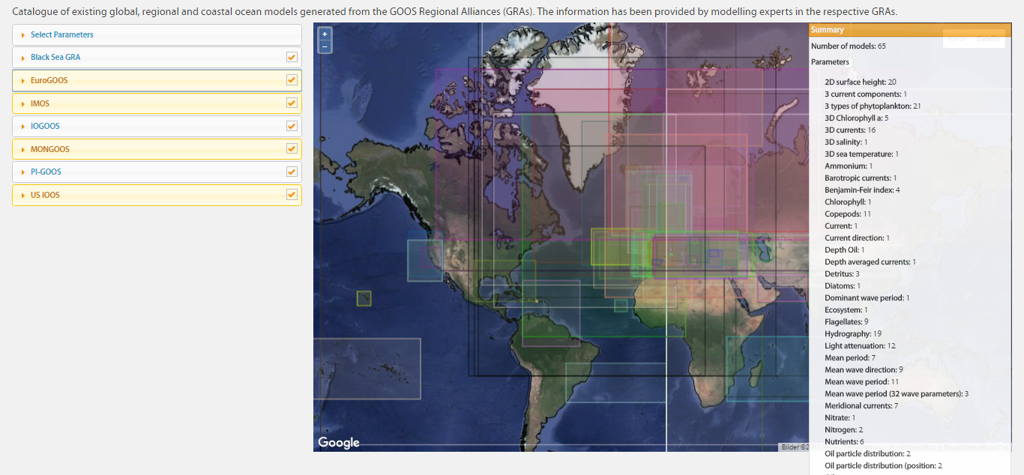
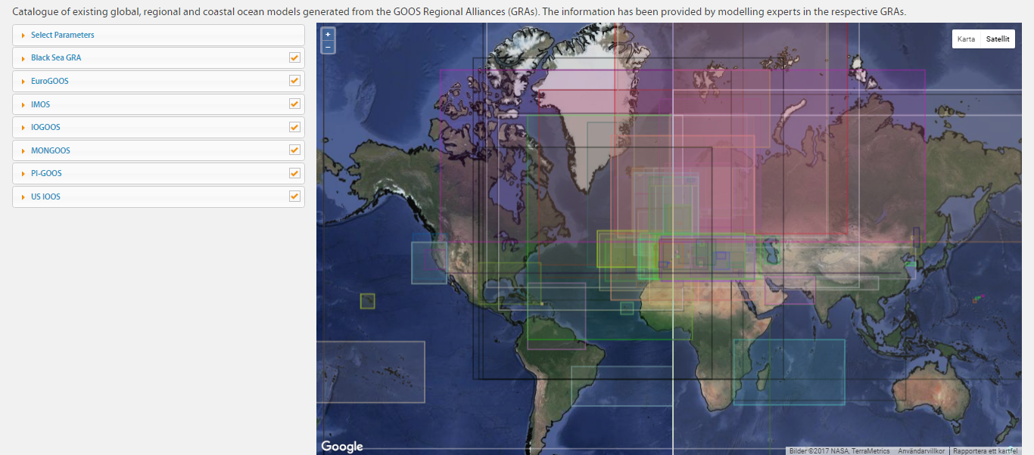
Global modelling inventory
eurogoos.eu | twitter.com/EuroGOOS

Slide 12
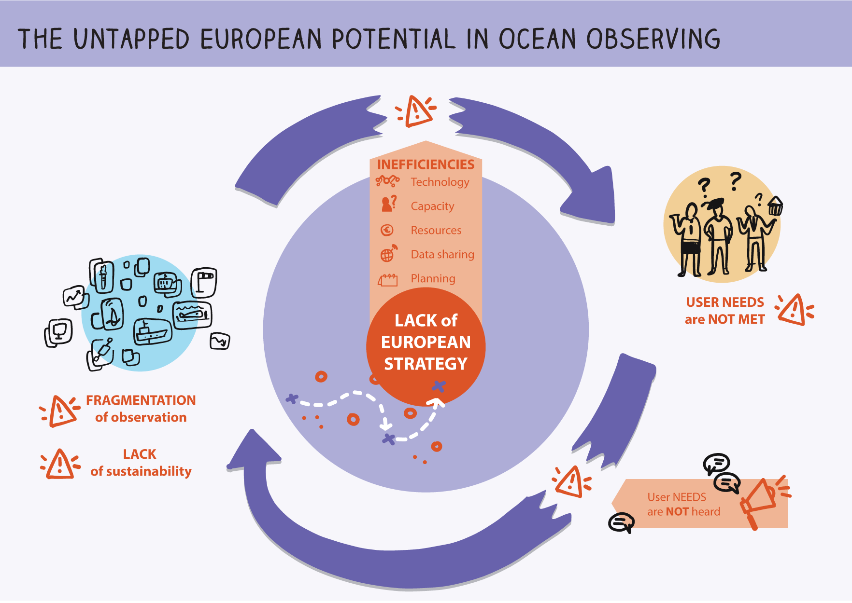
50% of national budgets for marine science in the EU are spent on operating and replacing marine infrastructure assets (GOSR, 2017)

Slide 13
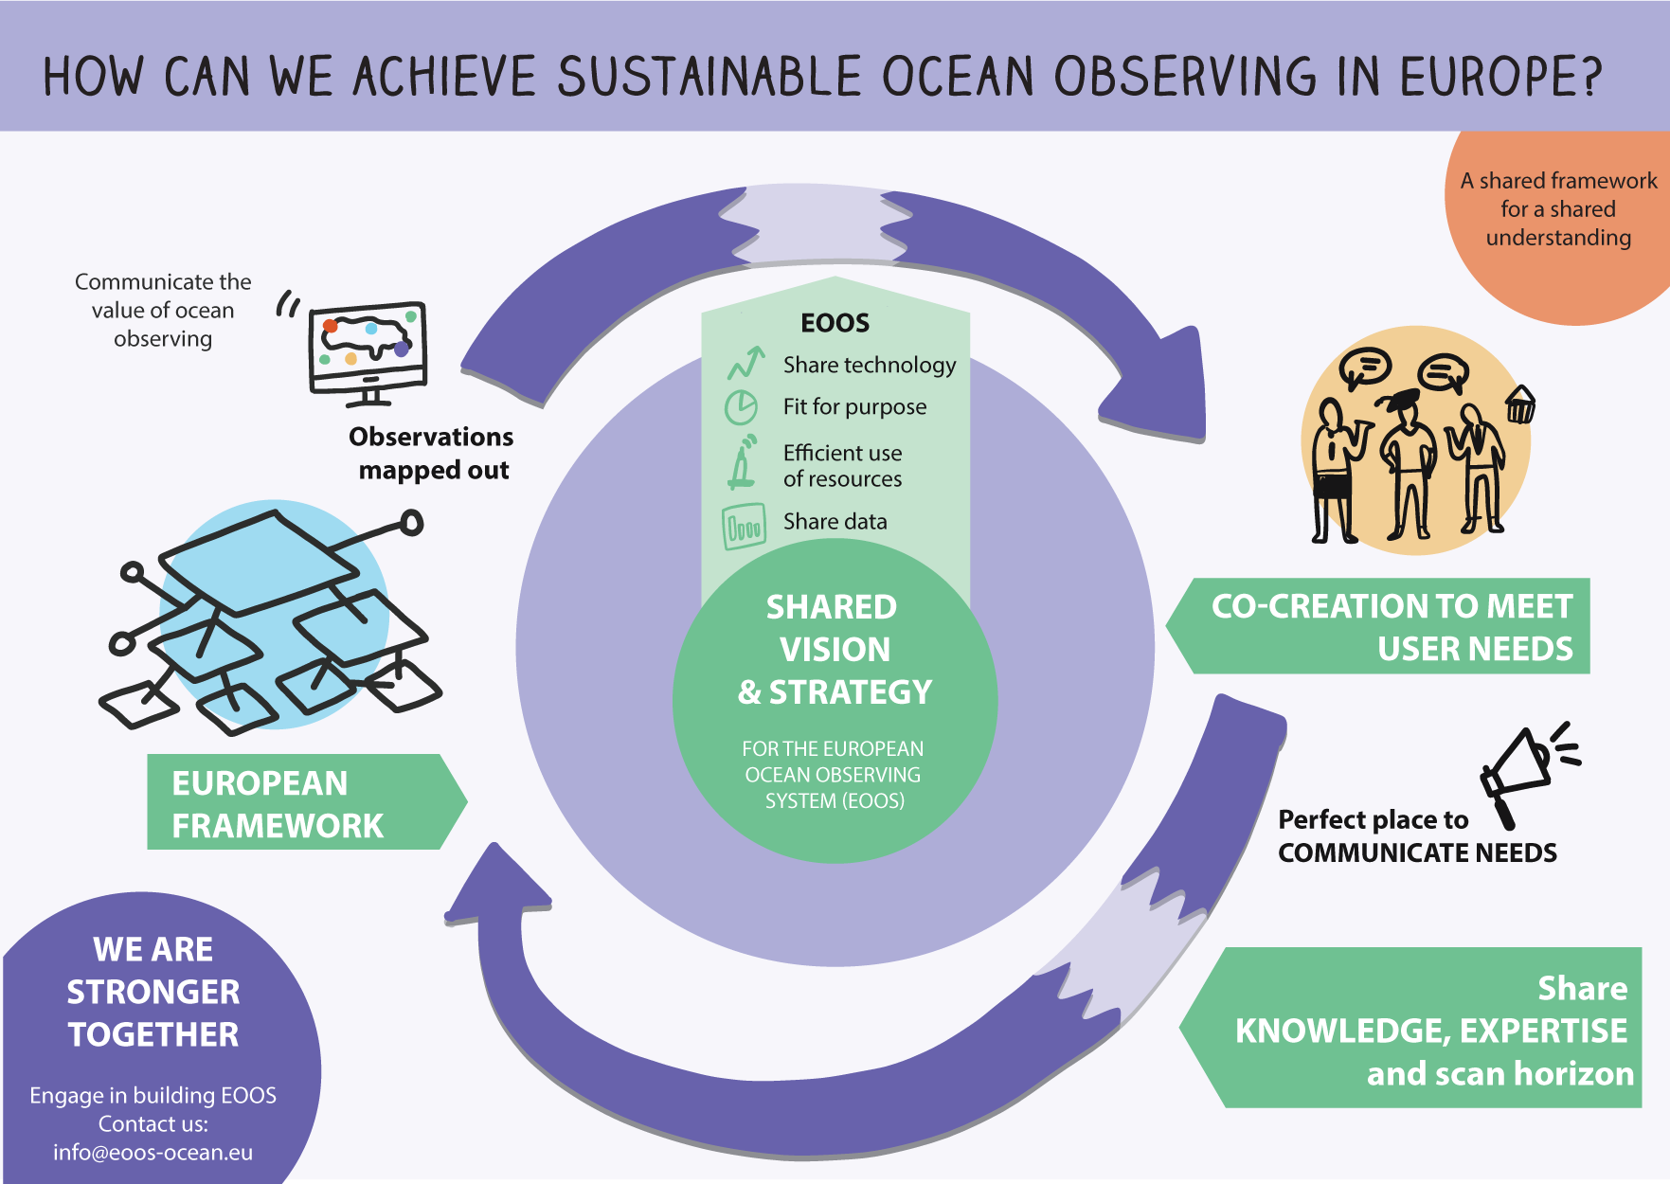

Slide 14
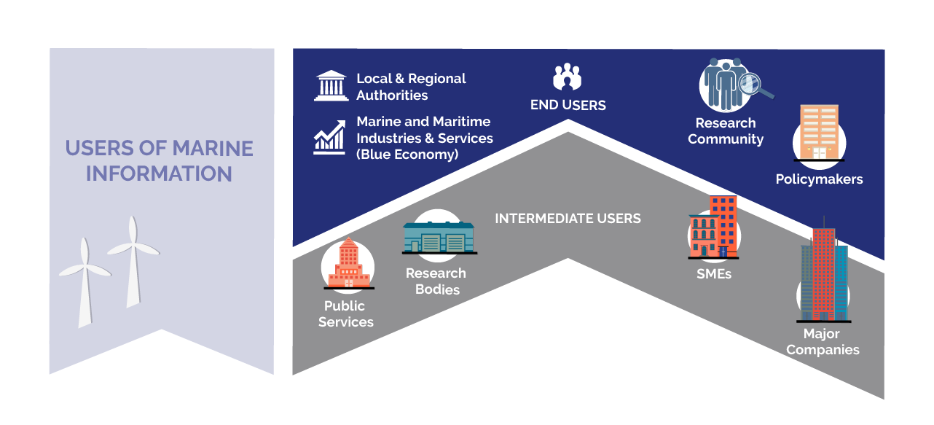
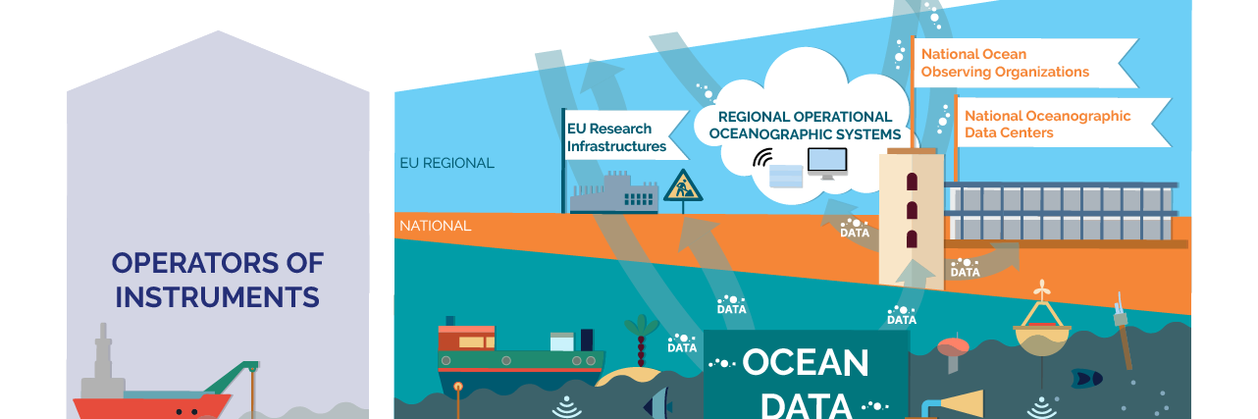
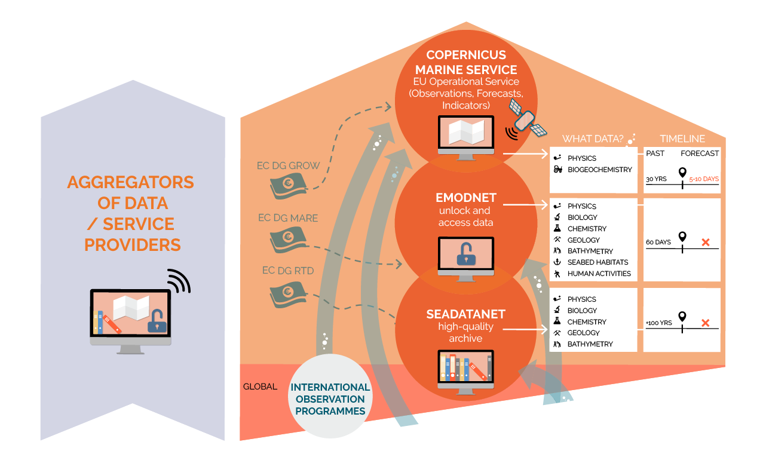
Global needs
European needs
… a large part the global ocean observing system is supported by … small number of dedicated scientists, working together internationally and supporting long-term activities with an accumulation of short-term science and R&D projects, meaning that the system does not have much funding resilience—and no basis on which to continue to build and enhance it.
Newsweek, opinion piece by Ed Hill, NOC, 6 April 2018
Dina Eparkhina, Patrick Gorringe, 9 April, EGU18, OS 2.4 www.eoos-ocean.eu #EOOS

