Slide 1
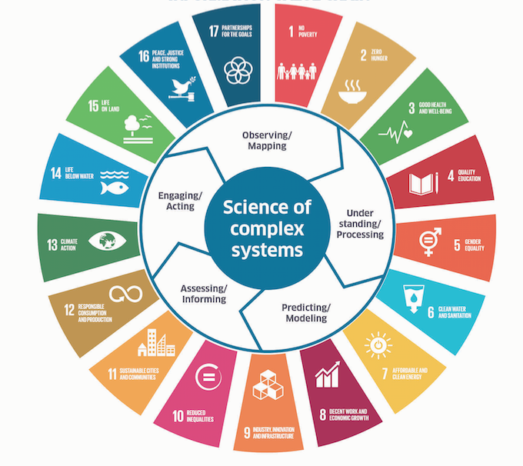

United Nations Decade of Ocean Science for Sustainable Development
(2021-2030)
SDG 14
Paris
Sendai
SAMOA
Biodiversity

Slide 2
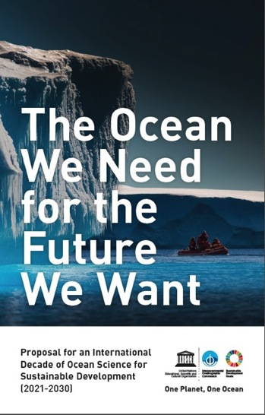
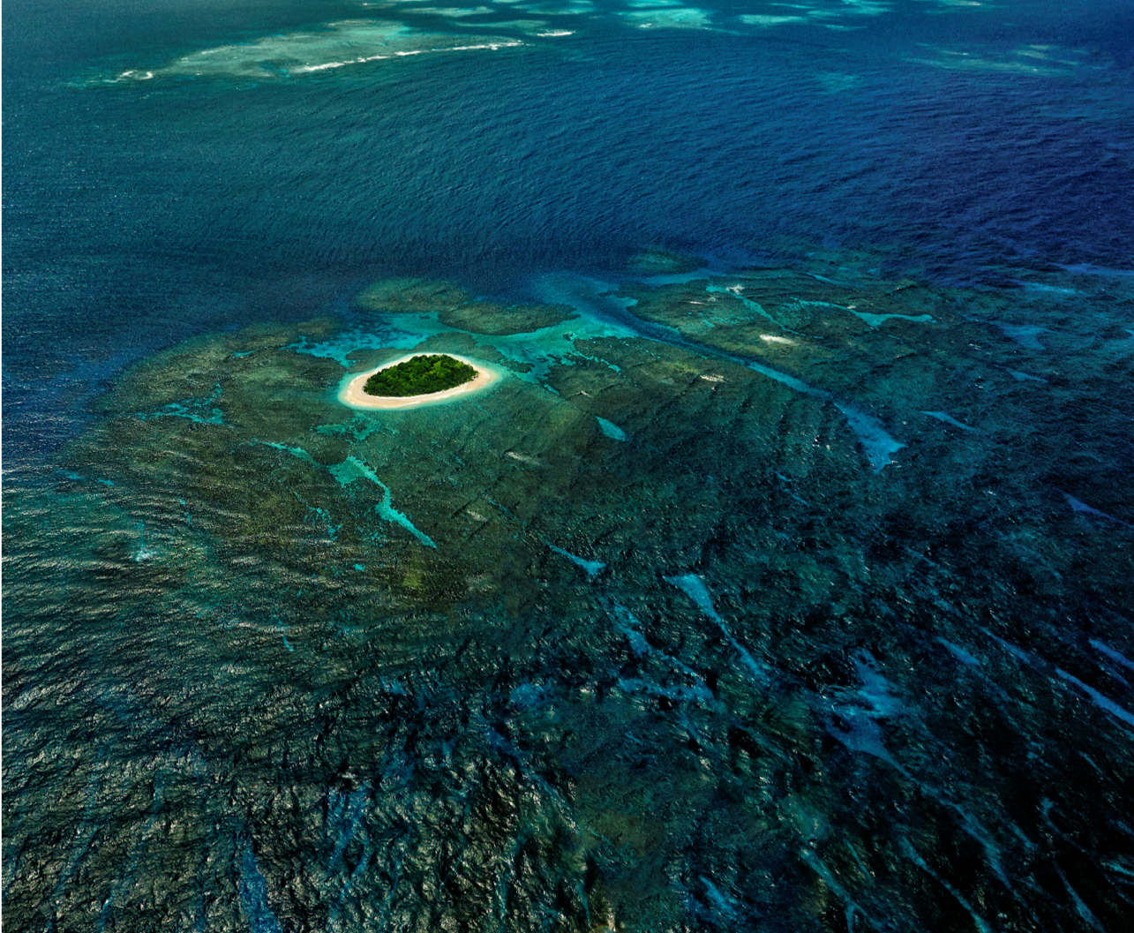
2016: Thinktank of IOC, the idea!
2017: discussions, massive support
from UN, IGOs, NGOs, … (including ICES,
PICES and FAO), proposal to UN
6 December 2017
72nd UN General Assembly Resolution
UN Decade of Ocean Science for
Sustainable Development (2021-2030)
Vavau © Stuart Chape

Slide 3
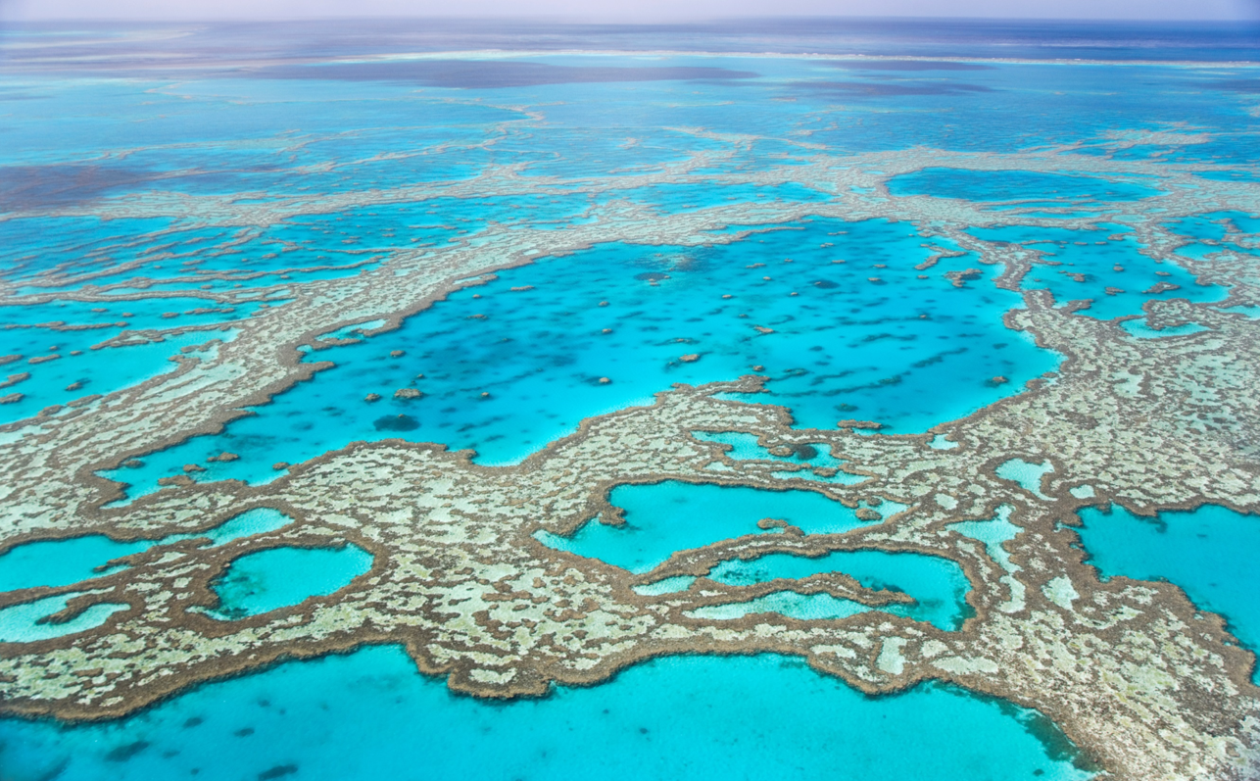
A Vision for the Decade
Develop scientific knowledge, build infrastructure, and foster partnerships
(to trigger effective action) towards
a sustainable and healthy ocean

Slide 4
Decade: Mutual Acceleration
of Science and Practice
Planned R&D –> +/- top-down design
Science
Pickup by practice –> stimulated bottom-up
Science
Practice
Science
Practice
Practice

Slide 5
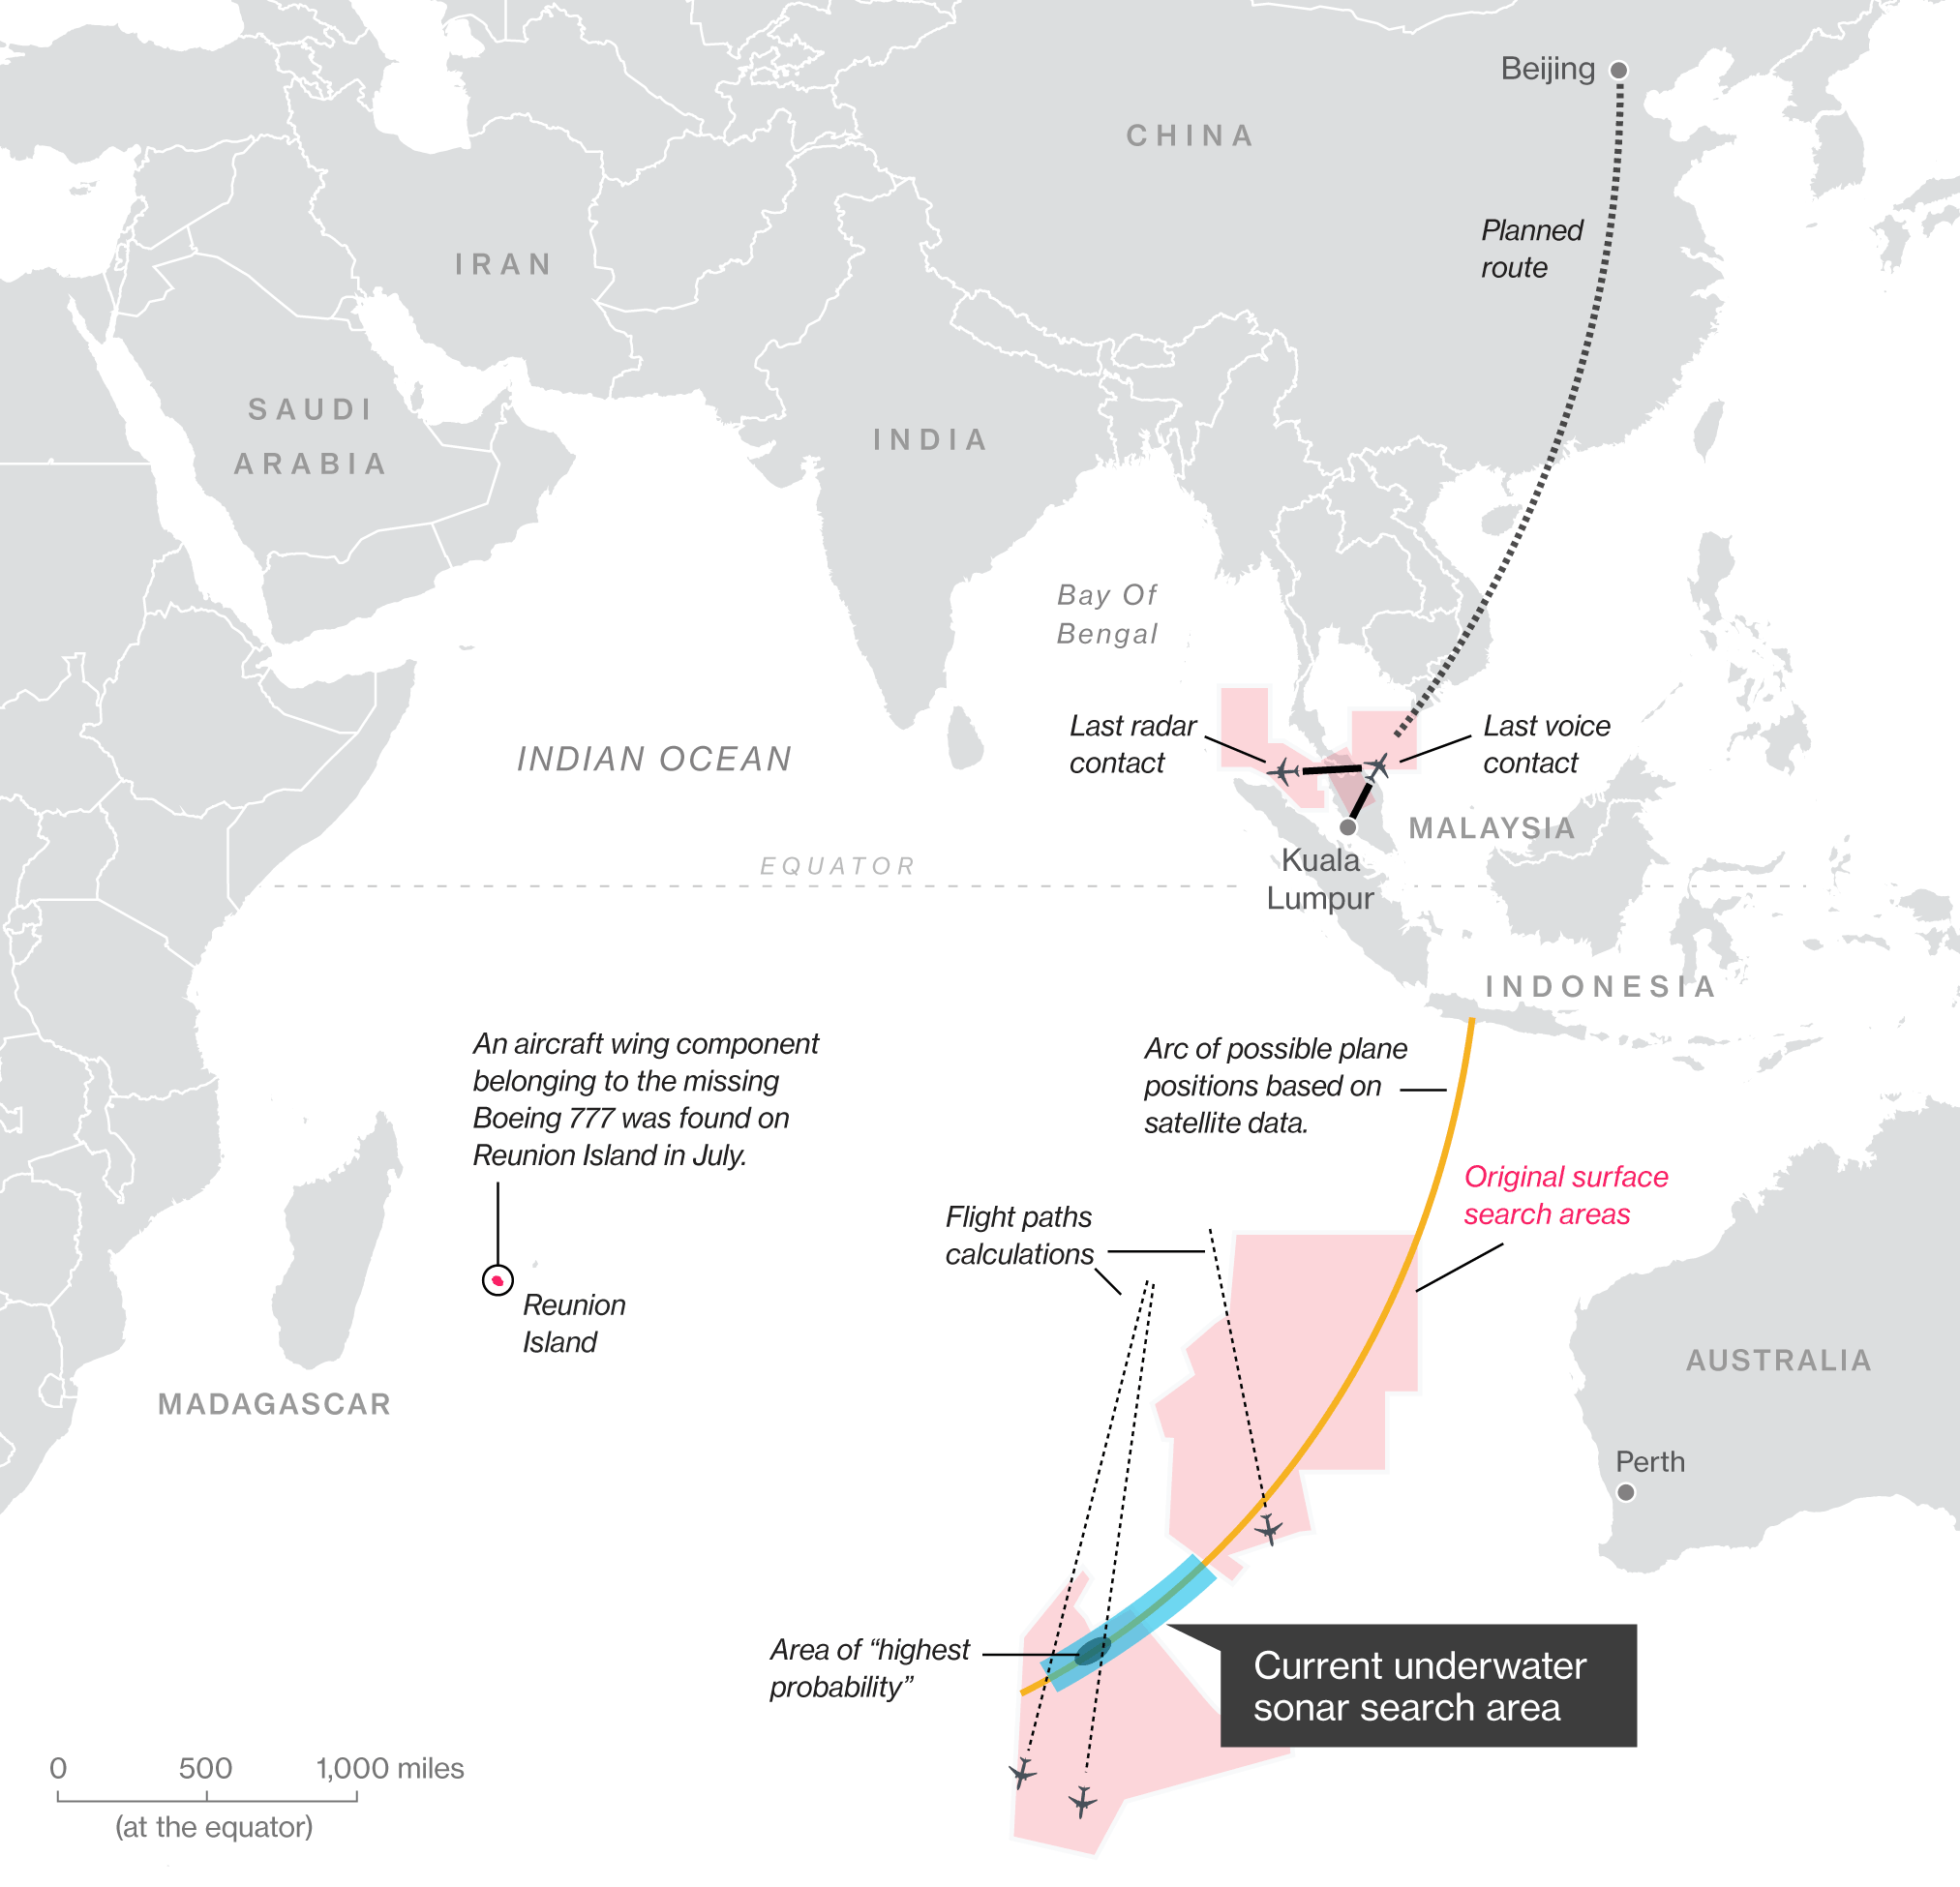
UN Decade of Ocean Science for Sustainable Development
Priority Research and Development Areas
R&D Priority Area 1: Comprehensive map
(digital atlas) of the ocean
(well beyond topography)
Vavau © Stuart Chape

Slide 6
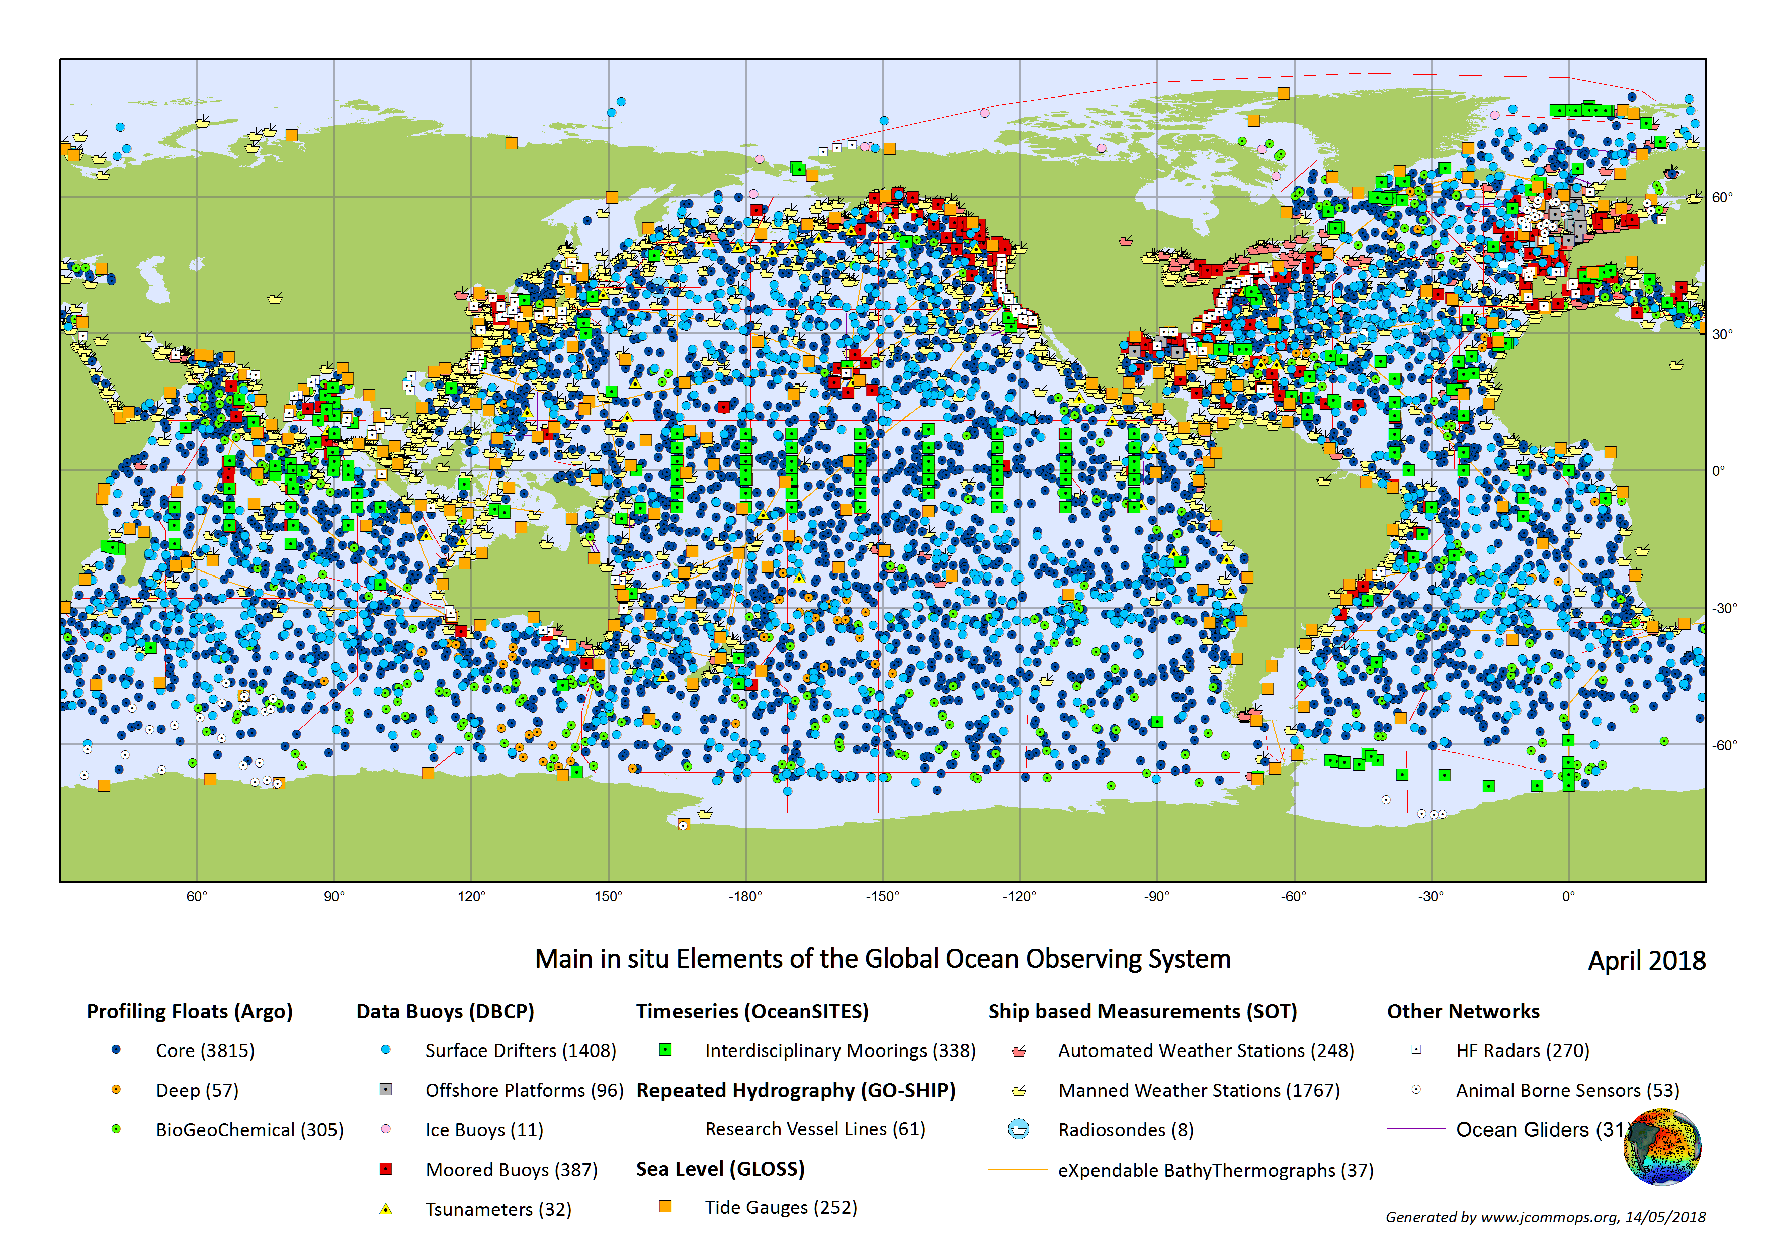
UN Decade of Ocean Science for Sustainable Development
Priority Research and Development Areas
R&D Priority Area 2:
A comprehensive ocean observing system
(polar, bio, eco, BGC,
eDNA, deep ocean)
Vavau © Stuart Chape

Slide 7
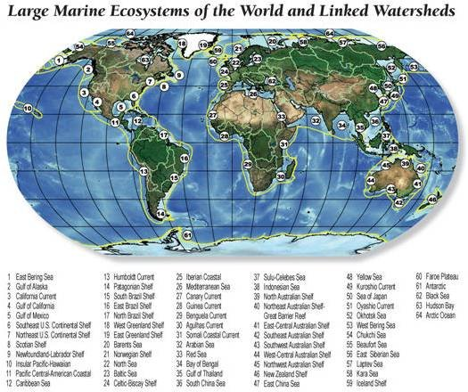
UN Decade of Ocean Science for Sustainable Development
Priority Research and Development Areas
R&D Priority Area 3:
A quantitative understanding
of ocean ecosystems as the
basis for their management
and adaptation
(multiple stressors, deep ocean, bottom, predictive, assisted adaptation, e.g. of coral reef ecosystem)
Vavau © Stuart Chape

Slide 8

UN Decade of Ocean Science for Sustainable Development
Priority Research and Development Areas
R&D Priority Area 4:
Data & information portal
Data
Ocean
Big
Vavau © Stuart Chape

Slide 9
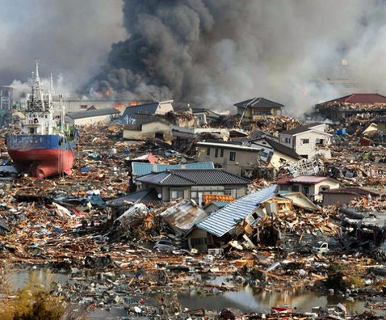
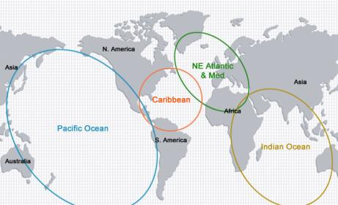
UN Decade of Ocean Science for Sustainable Development
Priority Research and Development Areas
R&D Priority Area 5: Ocean dimension in an integrated multi-hazard warning system
Vavau © Stuart Chape

Slide 10
UN Decade of Ocean Science for Sustainable Development
Priority Research and Development Areas
R&D Priority Area 6:
Ocean part of Earth System Science and Observations
Vavau © Stuart Chape

Slide 11
Decade: Mutual Acceleration
of Science and Practice
Planned R&D –> +/- top-down design
Science
Pickup by practice –> stimulated bottom-up
Science
Practice
Science
Practice
Practice

Slide 12



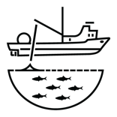





Key Societal Benefit Areas
Marine
Spatial
Planning/
Blue economy
Coastal zone
management
and adaptation
Establishment of
Marine Protected
Areas
Nationally
Determined
Contributions
to UNFCCC
Governance:
Implemented
national ocean
policies
Fishery
management
Regional and
national capacity
development
planning
Development
of national
R&D strategies
Early warning
systems

Slide 13
oceandecade@unesco.org
Your UN Decade of Ocean Science
for Sustainable Development!
Your once-in-a professional-life time opportunity to make the difference!

