Slide 1

7th meeting of the GOOS Steering committee
(Santa Marta, 13-15 June 2018)
WMO Engagement with GOOS
Etienne Charpentier, Chief, WMO Observing Systems Division

Slide 2
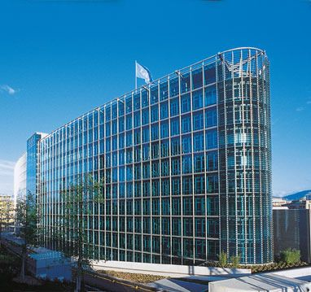
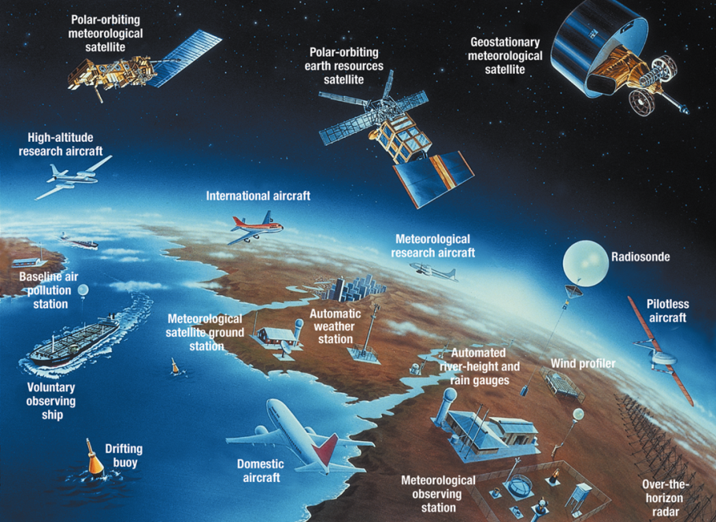
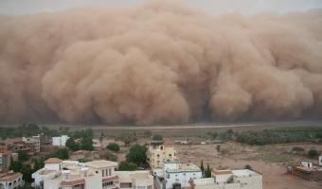
World Meteorological Organization
UN Specialized Agency
Authoritative voice on weather, climate and water, enabling world-wide observations, research and services needed to meet the enormous challenge of climate change…
Facilitate networks of monitoring stations and service centres
Promote systems for real time global exchange of data
Promote standardization of observations
Further the application of meteorology to socioeconomic sectors;
Promote activities in operational hydrology and cooperation among meteorological and hydrological services;
Encourage research and training
WMO HQ in Geneva
Tanggula, 5100 m, China
Snow, Permafrost

Slide 3
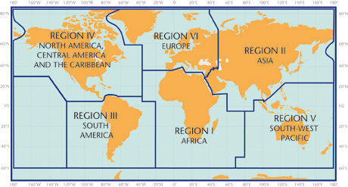
WMO Membership and Regional Associations
WMO has 185 Member States and 6 Member Territories from:
Region I: Africa
Region II: Asia
Region III: South America
Region IV: North America, Central America and the Caribbean
Region V: South-West Pacific
Region VI: Europe

Slide 4
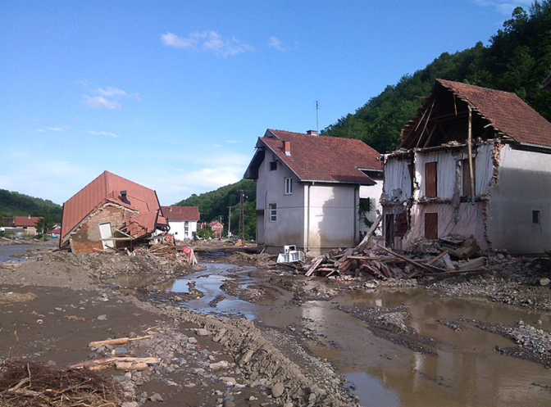
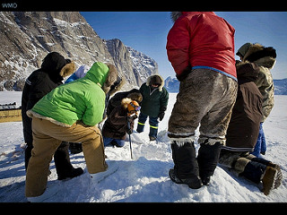
WMO Priorities 2016-2019
Foundation for WMO’s substantial contribution to
“the protection of life and property against natural disasters,
safeguarding the environment enhancing the economic and social well-being of all sectors of society
in areas such as food security, water resources and transport”
Disaster Risk Reduction
Global Framework for Climate Services
WMO Integrated Global Observing System
Aviation Meteorological Services
Polar and High-mountain Regions
Capacity Development
WMO Governance
Notes:
Align the WMO priority activities with emerging global needs,
The historical weather, climate and water patterns are no longer reliable guide to the future;
new science and scientific tools are needed to understand the significant changes in the global earth eco-system, e.g.

Slide 5
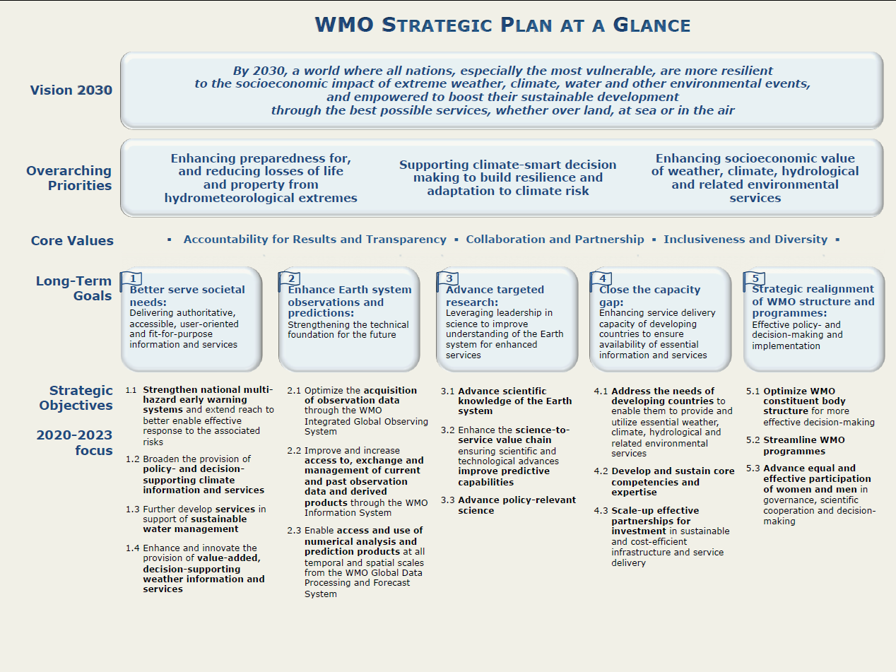
(2020-2023), Draft
WIGOS, WIS, GDPFS
Main link to GOOS Strategy

Slide 6
Goal 2 - Enhance Earth system observations and predictions: Strengthening the technical foundation for the future
Strategic objective | Indicators
2.1 Optimize the acquisition of observation data through the WMO Integrated Global Observing System (WIGOS) | 2.1.1 Percentage of the Earth system covered by observations (esp. hydrosphere, cryosphere, developing and LDCs, SIDs) 2.1.2 Number of Members complying with WMO observation standards 2.1.3 Number of Members implementing national observing system WIGOS
2.2 Improve and increase access to, exchange and management of current and past observation data and derived products through the WMO Information System (WIS) | 2.2.1 Number of Members with national network monitoring and data management systems established 2.2.2 Number of Members implementing data exchange policies, as per Resolutions 40, 25 and 60
2.3 Enable access and use of numerical products at all temporal and spatial scales from the WMO Global Data Processing and Forecast System (GDPFS) | 2.3.1 Number of Members (a) accessing and (b) using quantitative numerical model fields in support of national product generation and service delivery 2.3.2 Number of Members providing verification data to the producing centres

Slide 7
WMO Reform: Driving WMO in the 21st Century
Some drivers
Climate change, disasters and (lack of) water resources very high on the global agenda
Holistic climate approach: climatology, climate services, science
Strengthening of global hydrological co-operation
Need for wide range of data & infrastructure: weather, oceans, hydrosphere, cryosphere, sea ice, terrestrial, chemical composition
Enhanced science-services interaction, contribution of academia
Multi-hazard and impact based services expected
Coordinated engagement of private sector: Data policy, National legislation, Code of ethics, Public private partnerships, Global Weather Enterprise
…

Slide 8
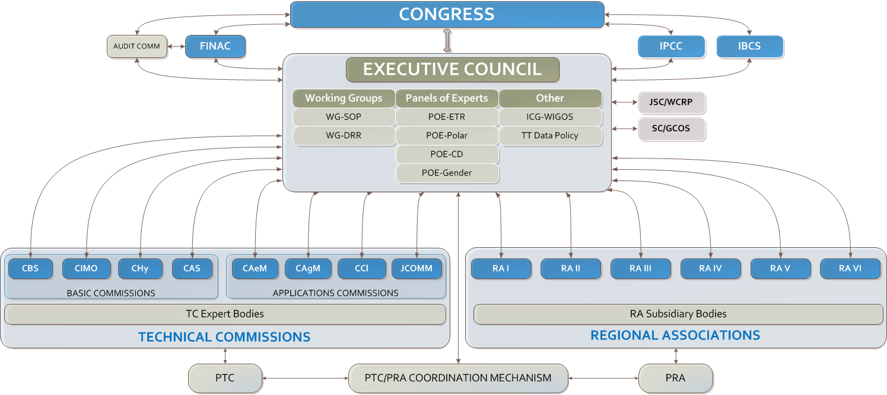
Current structure

Slide 9
Audit Committee
Executive Council
Other EC bodies
Fin. & Adm. Comm.
Technical Coordination Committee
Policy Advisory Committee
Scientific Advisory Panel
Enhance the collaboration between regional associations, technical commissions and the Research Board
Strategic, operational and budget planning
Role of NMHSs
Streamline programmes
Optimize structures
Promote science
Guide development of seamless systems
Advice on investments in science and technology
Promote scientific collaboration
Guidance, not parent body
Presidents of Technical Commissions
Presidents of Regional Associations
Coordination of WMO research programmes and partnerships
Research
Board

Slide 10
Observing systems
and measurement
Data exchange
and management
Weather and DRR
Climate
Hydrology
Marine
Technical commissions
Commission for Weather, Climate and Water
Services and Applications
Commission for Observation, Infrastructure and Information System
Joint WMO/IOC Committee on Oceanography and Meteorology
Sub-committees
Standing Comm.
Mostly normative work
Mostly normative work
Methods of
observation and
instrumentation
Data processing
and modelling
Aviation
Agriculture
Urban, health and energy
Research Board
Research to operations
Science to services
Coordinated systems of observation and data management
Standards for observation and measurements
Mechanisms to engage international partners beyond the WMO community
Harmonized services for decision-making and socioeconomic benefits

Slide 11
Better engagement of RAs & Regional experts
Congress / EC
Political and economic regional groups
Scientific and technical communities
Regional reqs, needs and priorities
TECHNICAL
COMMISSIONS
REGIONAL
ASSOCIATIONS
Tech solutions
Standards, guidance
National/regional experts
Expertise, assistance, efficiency, innovation
Implementation Process

Slide 12
Value Chain & WMO Basic Infrastructure
Observations
  WMO Integrated Global Observing System (WIGOS)
Information exchange and data dissemination,
  WMO Information System (WIS)
Data processing
  Global Data Processing and forecasting System (GDPFS)
Service delivery
  Weather Services, Marine Services, Climate Services, Aviation Services, Global Multi-Hazard Alarm System (GMAS) …

Slide 13

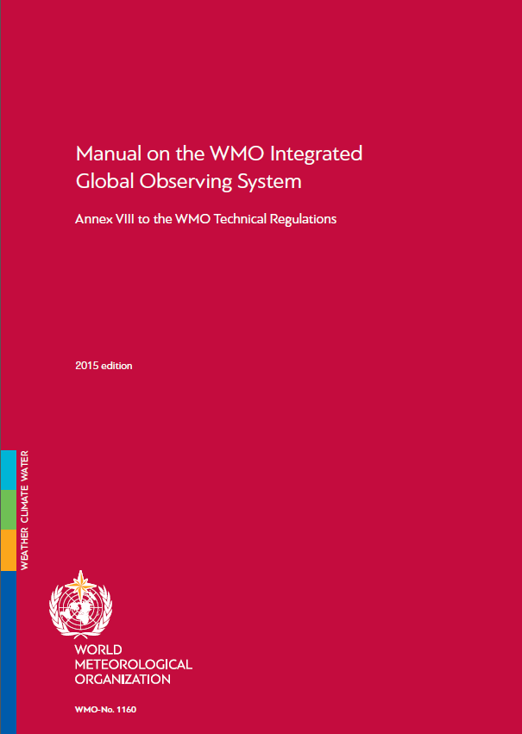

WIGOS
WMO Component Observing Systems
  GOS (weather and climate)
  GAW (atmospheric composition)
  GCW (cryosphere)
  WHOS (hydrology)
WMO Contribution to co-sponsored observing systems
  GOOS, GCOS
Technical Regulations and Guidance material (WMO No. 1160, 1165)
Establishing a network of Regional WIGOS Centres
WIGOS Tools
  OSCAR (requirements and observing capabilities)
  WIGOS Data Quality Monitoring System
Rolling Review of Requirements (RRR)

Slide 14
Regional WIGOS Centres (RWCs)
Main functions:
Coordination between Members and WMO bodies
Improved communication through provision of contact points
Education and training concerning WIGOS implementation
Technical support
Network design / management
Data quality monitoring
Meta data management
Providing links to external entities and establishing of partnerships with different regional groupings
(oceanography, climate, hydrology, instrument calibration)
Note: Individual tasks or functionalities could be given to separate RWCs
WMO

Slide 15
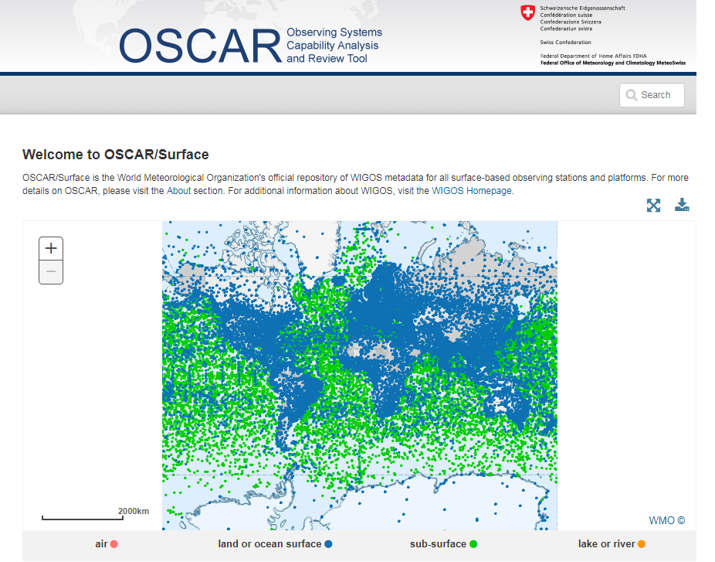
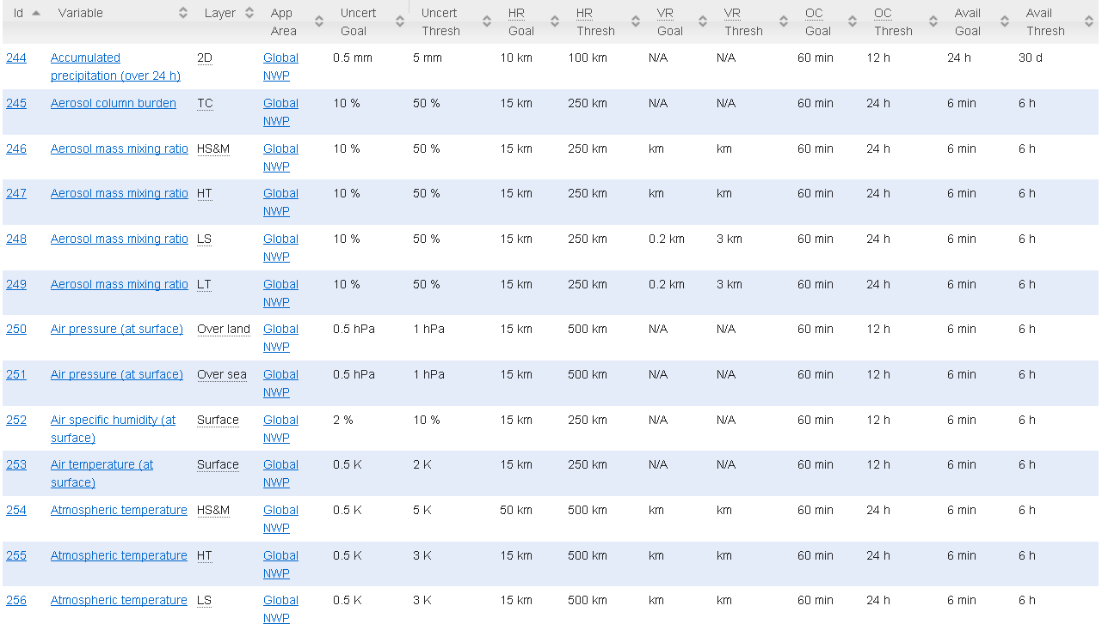
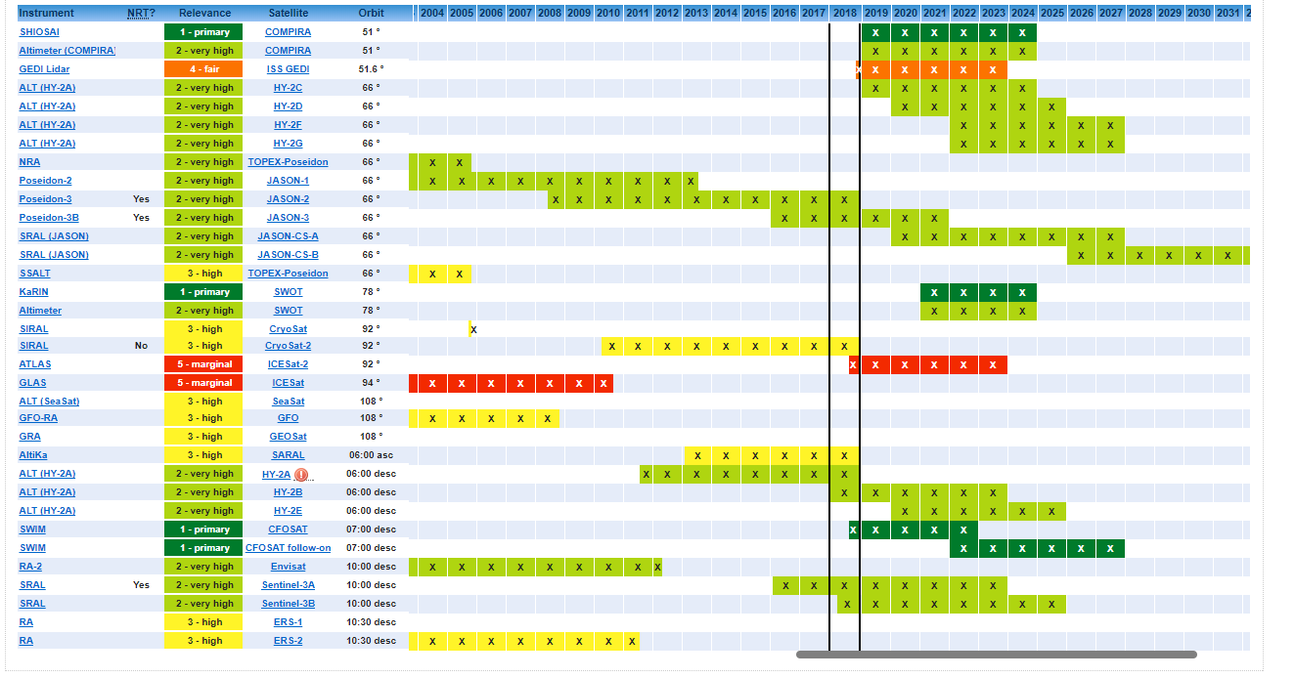
WIGOS Information Resource (OSCAR)
The RRR is supported by three key databases of OSCAR, the Observation Systems Capabilities and Review tool :
  OSCAR/Requirements, in which “technology free” requirements are provided for each application area, expressed in units of geophysical variables (260 in total currently);
  OSCAR/Space, listing the capabilities of all satellite sensors, whether historical, operational or planned
  OSCAR/Surface, list surface-based capabilities; developed by MeteoSwiss for WMO, operational since May 2016
Requirements: Pressure at surface
Space: Ocean Dynamic Topography gap analysis
Surface capabilities

Slide 16
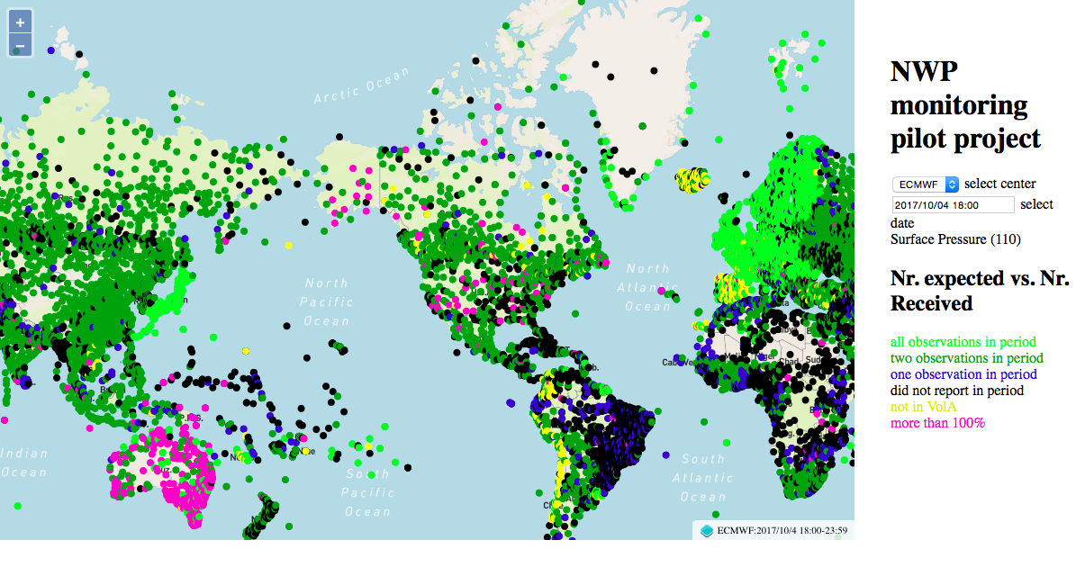
WIGOS Data Quality Monitoring System (WDQMS)
Real-time monitoring of performance (data availability and data quality) of all WIGOS components, searchable by region, country, station type, period, etc.
Delayed mode monitoring of data quality as measured against reference sources of information will be included for non-real time observations
Incident management component for mitigation of performance issues
The WDQMS will provide a complete description of how well WIGOS is functioning
Current activities
  Pilot project on NWP-based monitoring; ECMWF, NCEP, DWD, JMA
  RA-I Demonstration Project of monitoring and incident management involving Kenya and Tanzania running through 2017

Slide 17
WMO Application Areas
Definition: an activity involving primary use of observations, in a chain of activities which allow NMHSs or other organizations to render services contributing to public safety, socio-economic well-being and development in their respective countries, in a specific domain related to weather, climate and water. The concept of a WMO Application Area is used in the framework of the WMO Rolling Review of Requirements (RRR) and describes a homogeneous activity for which it is possible to compile a consistent set of observational user requirements agreed by community experts working operationally in this area.
Global Numerical Weather Prediction
High Resolution Numerical Weather Prediction
Nowcasting and Very Short Range Forecasting
Sub-seasonal to longer predictions
Aeronautical Meteorology
Forecasting Atmospheric Composition
Monitoring Atmospheric Composition
Providing Atmospheric Composition information to support services in urban and populated areas
Ocean Applications
Agricultural Meteorology
Hydrology
Climate Monitoring (GCOS)
Space Weather
Climate Science
Cross cutting:
Global Cryosphere Watch (GCW)
Global Framework for Climate Services (GFCS)

Slide 18
Rolling Review of Requirements (RRR)
Global Observing Systems Vision 2025
(coming: WIGOS Vision 2040)
(multidisciplinary)
Other considerations:
WMO Priorities
Cost effectiveness
New Technologies
Current national investments and plans
…
WIGOS Metadata
(capabilities – space & surface)
Implementation Plan
EGOS-IP
(115 actions)
OSCAR
Statements of Guidance
(gap analysis)
Critical review:
Gap analysis
Impact studies
Expert knowledge
Monitoring of actions
Implementation
Requirements
Action
“owners”
NFPs
WMO Application Areas
(direct use of observations)
WMO Members
USERS

Slide 19
Oceans & RRR
Observational Requirements of Ocean Applications
  Consideration of sub-applications: Marine Services, Wave models, Operational Ocean Forecasting, Tsunami monitoring
  New Point of Contact needed (JCOMM to nominate)
  OSCAR/Requirements (Ocean req.)
  SoG for Ocean Applications (June 2016)
  Critical Variables (JCOMM-5 Decision 14) : Sea Level & SSHA, Waves, SLP, Visibility
  Consideration of Coastal Requirements
Ocean observations required for other WMO Application Areas
  GNWP, HRNWP, SSLP, GCOS …
OOPC comments (Annex 16 of IPET-OSDE-3 report)
  Reflecting coupled models (e.g. consideration of air-sea coupling processes, e.g. strong SST gradients), new observing technologies, changes proposed to SSLP SoG (e.g. Argo cannot do near-boundary or shelf-break regions & other technologies needed; deep Argo in selected deep ocean basins …)

Slide 20
Draft WIGOS Vision 2040
(for 18th Congress adoption in 2019)
CHAPTER I: Introduction, Purpose and Scope
  Key drivers for meteorological services
  Trends in capabilities and requirements for meteorological service delivery
  WIGOS principles and design drivers
  Integration in WIGOS
CHAPTER II: The Space-Based Observing System Components of WIGOS in 2040
  General trends and issues (requirements and capabilities)
  Approach to developing the space-based component of the Vision
CHAPTER III: The Surface-Based Observing System Components of WIGOS in 2040
  General trends and issues
  The Surface-based component: evolution and trends
ANNEX A OBSERVING NETWORK DESIGN PRINCIPLES

Slide 21
Observing Network Design Principles
Serving many application areas
Responding to user requirements
Meeting national, regional and global requirements
Designing appropriately spaced networks
Designing cost-effective networks
Achieving homogeneity in observational data
Designing through a tiered approach
Designing reliable and stable networks
Making observational data available

Slide 22
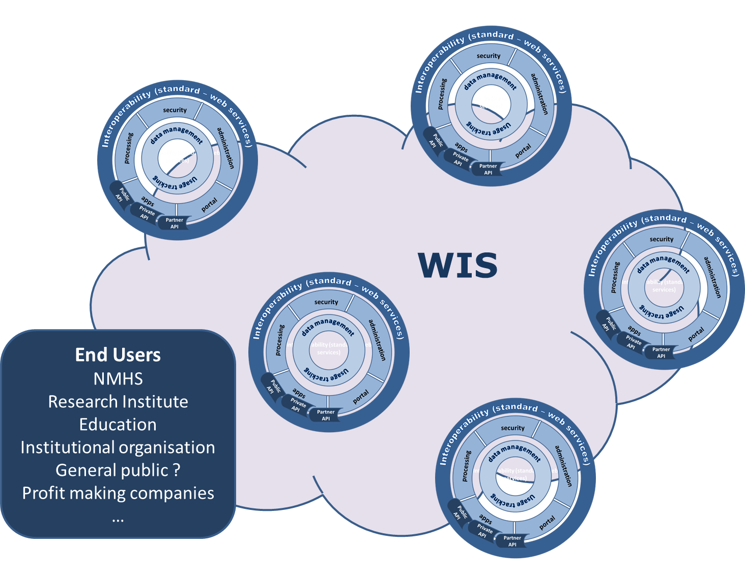
WMO Information System - WIS 2.0 : Implementation approach
We are not starting from scratch
  WIS 2.0 will be built on activities already engaged :
    NMHS initiative
    EUMETSAT DIAS, ECMWF CDS
    European H2020 projects
    GEOSS Common Infrastructure
We are working on the implementation plan for WIS 2.0
  Final version available late November
  Endorsment by Congress-18
  Implementation 2020-2025

Slide 23

Global Data Processing and Forecasting System (GDPFS)
Worldwide network of operational centres operated by WMO Members
Purpose: Make operationally available among WMO Members and relevant operational organizations defined products and services for applications related to weather, climate, water and environment
EC-68 endorsed a Vision for a future Seamless GDPFS to make information of relevance to the mandate of WMO available across all timescales and domains of the Earth system, and provide impact-based forecasts & risk-based warnings …
Regulated in WMO No. 485, GDPFS Manual

Slide 24
GDPFS activities
General-purpose activities:
  Global deterministic NWP, Limited-area deterministic NWP, Global ensemble NWP, Limited-area ensemble NWP, Global numerical long-range prediction, Numerical ocean wave prediction, Global numerical ocean prediction, Nowcasting
Specialized activities:
  Regional climate prediction and monitoring, Coordination of multi-model ensemble prediction for long-range forecasts (LRFs), Annual to decadal climate prediction, Coordination of annual to decadal climate prediction, Regional severe weather forecasting, Tropical cyclone forecasting, including marine-related hazards, Nuclear environmental emergency response, Non-nuclear environmental emergency response, Atmospheric sandstorm and duststorm forecasts, Volcano watch services for international air navigation, Marine meteorological services, Marine environmental emergency response
Non-real-time coordination activities:
  Coordination of deterministic NWP verification (DNV), Coordination of Ensemble Prediction System (EPS) verification, Coordination of LRF verification, Coordination of wave forecast verification (WFV), Coordination of tropical cyclone forecast verification (TCFV), Coordination of observation monitoring

Slide 25
GDPFS Centres
World Meteorological Centres (WMCs)
  Global deterministic NWP, Global ensemble NWP, Global numerical long-range prediction
  Beijing, ECMWF, Exeter, Melbourne (southern hemisphere only), Montreal, Moscow, Tokyo, Washington
Regional Specialized Meteorological Centres (RSMCs)
  …
  RSMCs for Tropical Cyclone Forecasting, including marine-related hazards: Honolulu, La Réunion, Nadi, New Delhi, Miami, Tokyo
  ECMWF is recommended for RSMC for verification of wave data
  Canada, France, Japan are recommended for numerical ocean wave prediction
National Meteorological Centres (NMCs)

Slide 26
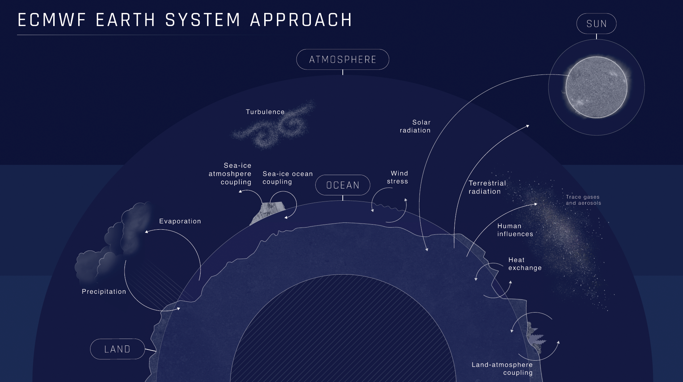
Notes:
Our science is based on an Earth system approach, which is one of the three pillars of our ten year strategy. The ECMWF IFS forecast model will incorporate more and more realism in the ocean, land, ice and snow components of the Earth system, to better capture the interactions between the atmosphere and the underlying surfaces.

Slide 27
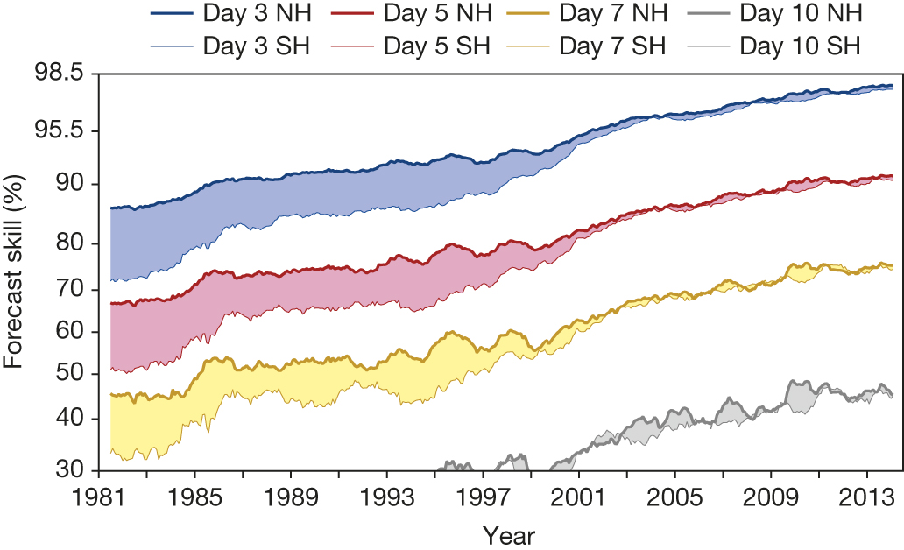
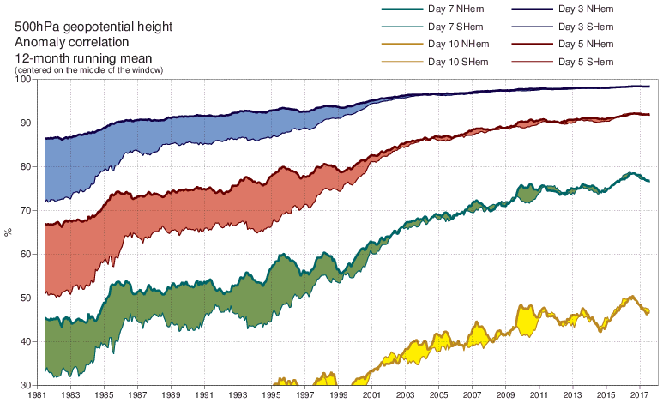
A measure of forecast skill at three-, five-, seven- and ten-day ranges,
computed over the extra-tropical northern and southern hemispheres (ECMWF)
P Bauer et al. Nature 525, 47-55 (2015) doi:10.1038/nature14956

Slide 28
ECMWF atmosphere-ocean coupling, since 5 June 2018
The newly introduced version of the ECMWF forecasting system includes coupling with the ocean, also for the high-resolution (HRES, 9km) forecast.
  Previously, the medium range ensemble (ENS, 18km) was coupled, as well as the seasonal forecasts
The HRES forecasting is now coupled to the NEMO ocean model at ¼ degree resolution
ECMWF receives, monitors & assimilates real-time ocean observations for the HRES, ENS and climate-reanalyses - for Global NWP, the requirements for timely, good quality data of the ocean (and other Earth system components) are increasing
Significant forecast skill improvement has been demonstrated in terms of tropical cyclone intensity, and more generally in the tropics

Slide 29
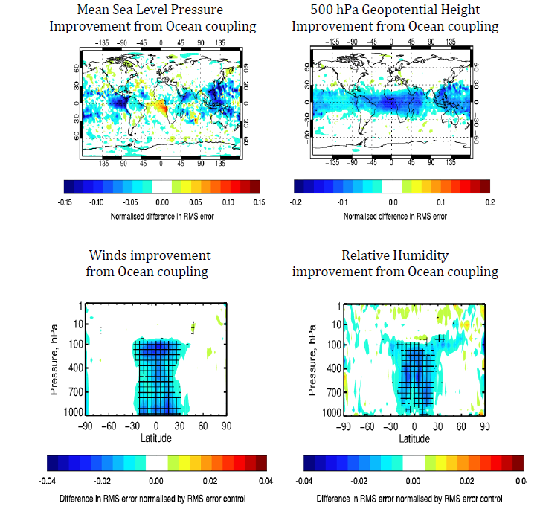
HRES coupling with the ocean improves the weather forecast scores.
Plots show RMSE reduction (blue) in Day+5 weather forecast by coupling to the ocean in the tropics
Large benefit across the tropics.
Tropical cyclone intensity forecasts also show significant improvement.

Slide 30
Standard deviation of the surface wind speed difference between Sentinel-3A and ECMWF model (13 Dec. 2016 – 12 Dec. 2017)
NWP : In situ data valuable for verification on wind speed and waves, complementing altimeter
Mean Sentinel-3A surface wind speed (13 Dec. 2016 – 12 Dec. 2017)
Courtesy of Saleh Abdalla
Notes:
Geographical distribution of the standard deviation of the difference (SDD) between Sentinel-3A and ECMWF model surface wind speed in the Tropical Atlantic. The period covered is one year from 13 Dec. 2016 to 12 Dec. 2017. The majority of the region has SDD values lower than ~0.8 m/s. Higher values however, are bounded between the equator and latitude 10°N.

Slide 31
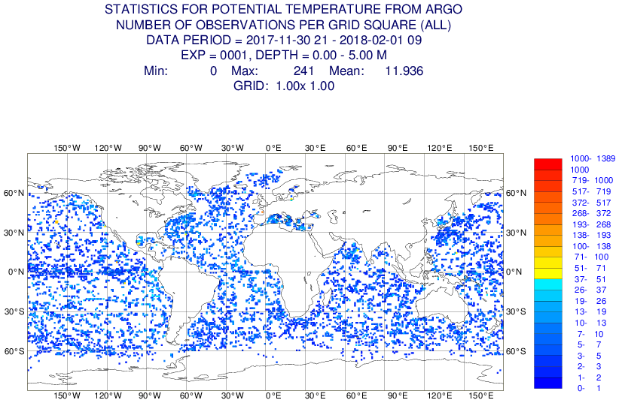
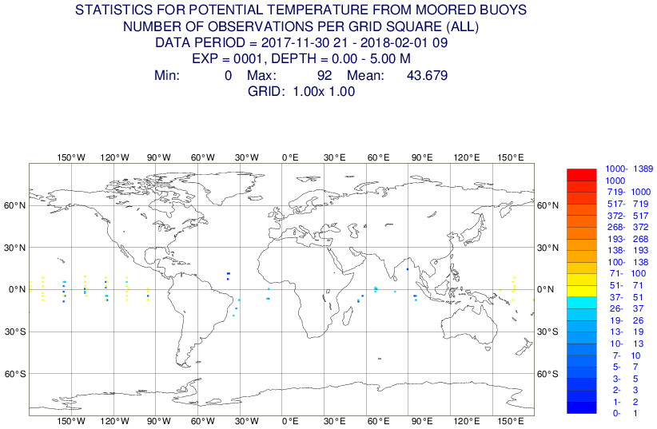
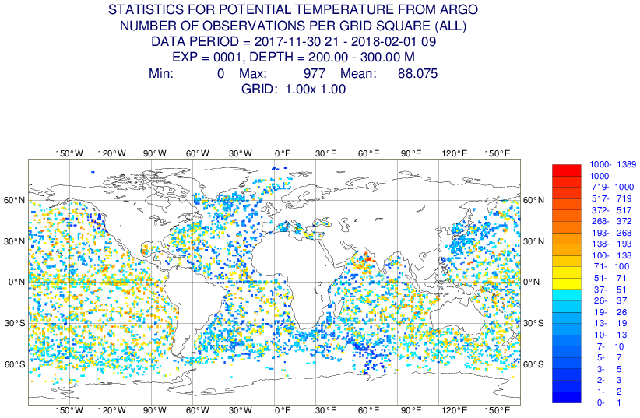

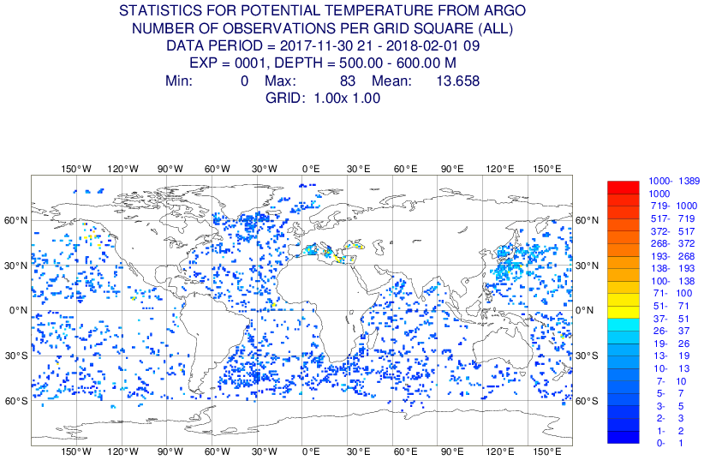

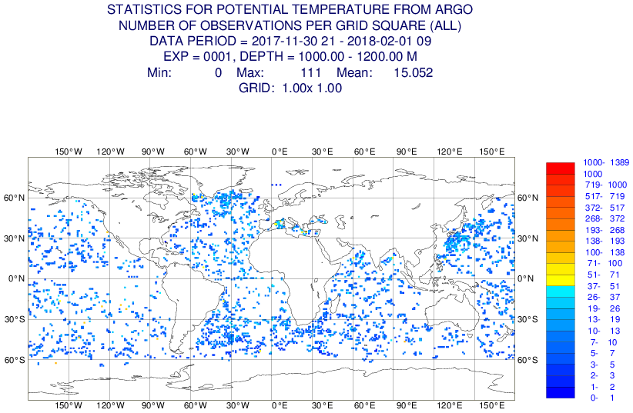
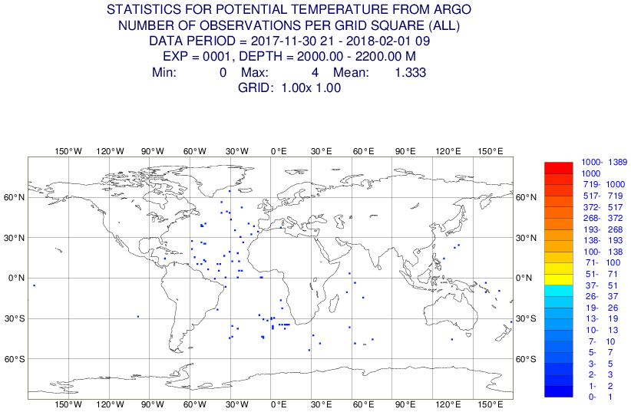
Ocean observation monitoring – floats and moored buoys
Argo
Moorings
5m
200m
600m
1000m
Number of Temperature Observations
2000m
Notes:
Following the approach that has been successful for the atmosphere, ECMWF now monitors the operational observing systems for the ocean. The monitoring includes data availability, differences between observed and model values, trends and jumps, in order to detect potential data quality issues.

Slide 32
JCOMM (SFSPA) drivers with regard to Marine Services
Experienced forecasters issue warnings and forecasts, and relates their impacts. Forecast models produce guidance.
Observations are critical inputs to the weather forecast process.
Fully coupled models should lead to improved maritime forecasts. Closer interaction among the ocean/weather and research/operational communities are keys to success.
Product and service delivery to ships at sea must be modernized!

Slide 33
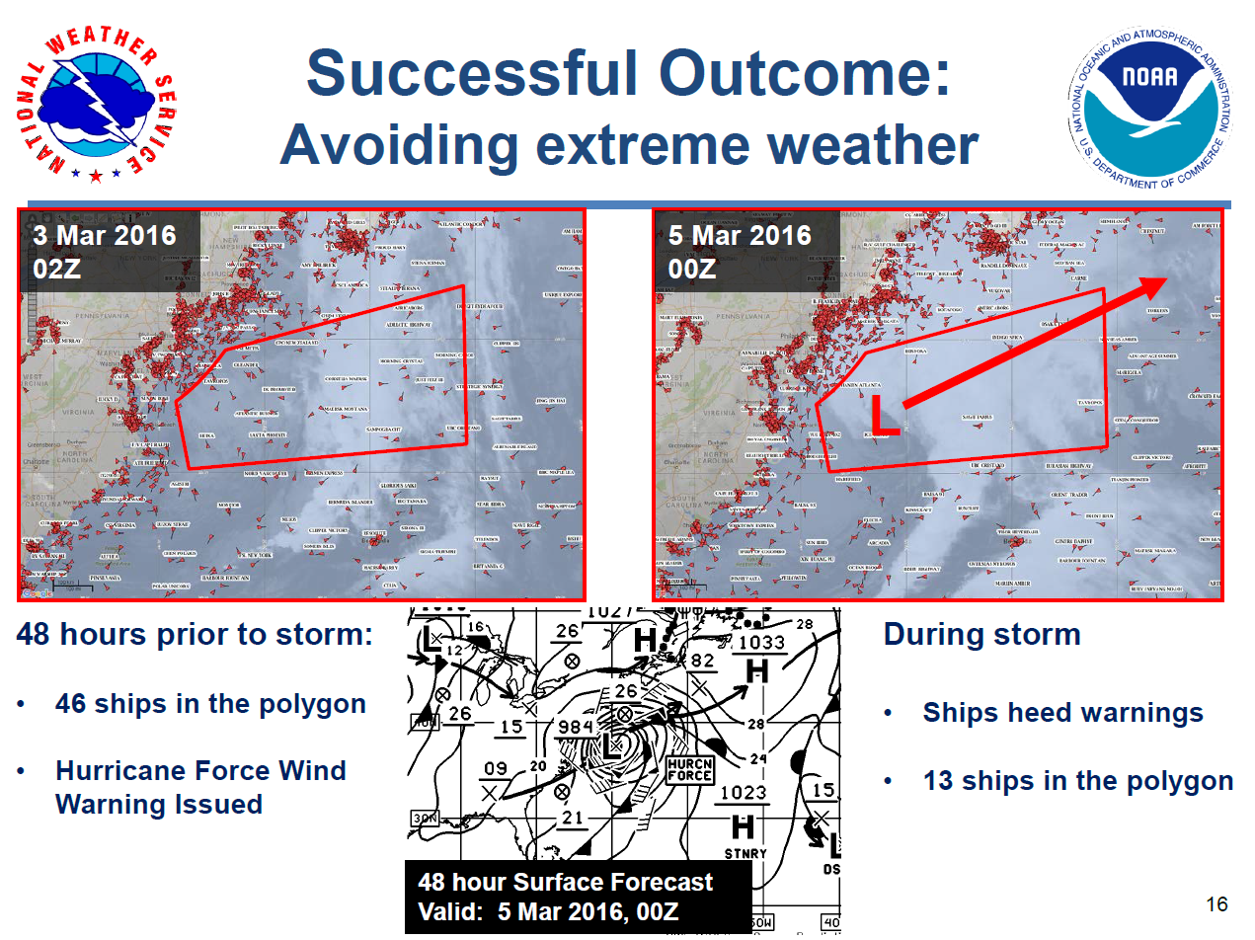

Slide 34
JCOMM (SFSPA) Vision for Services and Forecast Systems
New structure, to reflect evolving requirements of the marine meteorological and oceanographic community
Enhance the positioning of NMHS as the authoritative voice on national marine services
Continued focus on safety of life and property in the coastal zones, on the high seas, and in polar regions
  Improve alignment to support marine meteorological and oceanographic forecasts & maritime safety information
Build resiliency in maritime service delivery with the identification of marine Global Data Processing and Forecasting System centers and arrangements for their backup
Provide support and response for marine environmental emergencies
Increase focus on disaster risk reduction in the coastal and marine environments

Slide 35
WMO Contribution to GOOS
Ocean observing networks partly funded and maintained by NMHSs (e.g. some drifters, coastal moorings & Argo floats)
Infrastructure for data distribution and exchange (WIS, GTS)
  Open approach of WMO in WIGOS context, e.g. Open GTS Project of JCOMM
Ocean data assimilated in NWP and coupled ocean-atmosphere models
  Some NMHSs operating Ocean models
Marine Services (maritime safety, sea-ice services, coastal inundation forecasting, marine pollution prevention & mitigation, sea state, …)
Rolling Review of Requirements (RRR)
Joint Centres with IOC: Marine Instrument Centres (RMICs), Marine Climate Centres (CMOCs)
Monitoring of quality of observations (WDQMS)
Management of JCOMMOPS (closely with IOC)
Standards and Best Practices (incl. WIGOS, JCOMM TRs & DBCP TDs, Technical Regulations and Guidance material)

Slide 36
GOOS Strategy 2040 | Draft WMO Strategic Plan 2020-2023 | Draft WIGOS Vision 2040
Goal 1: Deepening Engagement & Impact | Long Term Goals 1, 2, 3, 4
1. Strengthen partnerships, to improve delivery to end users from observations through forecasts, services, and scientific assessments | SO 4.3 (partnership) | 1.4 Integration in WIGOS (… integrate NMHS and partner observations into one overall system to the extent possible …)
2. Build advocacy and visibility for the sustained observing system with stakeholders, including key users and national funders | SO 1.2 (policy decisions on climate information & services), SO 3.3 (advance policy relevant science), SO 4.1 (capacity development)
3. Regularly evaluate the system to assess fitness-for-purpose | SO 2.1 (WIGOS/RRR) | 1.1 Key drivers for meteorological services 1.2 Trends in capabilities and requirements for meteorological service delivery 1.3 WIGOS Principles and design drivers Observing Network Design Principles
4. Strengthen knowledge and exchange around value creation … | SO 3.1 (advance scientific research) SO 3.2 (enhance science to service value chain) | 1.1 Key drivers for meteorological services

Slide 37
GOOS Strategy 2040 | Draft WMO Strategic Plan 2020-2023 | Draft WIGOS Vision 2040
Goal 2: Supporting Integration & Delivery | Long Term Goals 2, 4
5. Provide authoritative guidance on implementation for integrated observing, synthesizing across evolving requirements | SO 2.1 (WIGOS) | 1.4 Integration in WIGOS (… WIGOS Manual and Guide, …) Observing Network Design Principles
6. Sustain, strengthen and expand observations coordination through GOOS and partners … | SO 2.1 (WIGOS) SO 4.3 (partnership) | 1.4 Integration in WIGOS (… WIGOS Manual and Guide, Observing Network Design Principles …) Chapter II (Space, General trends and issues, expansion) Chapter III (Surface, Evolution and trends)
7. Ensure GOOS ocean observing data and information are findable, accessible, interoperable & reusable … | SO 2.2 (WIS) | Observing Network Design Principle 9 (making data available)

Slide 38
GOOS Strategy 2040 | Draft WMO Strategic Plan 2020-2023 | Draft WIGOS Vision 2040
Goal 3: Building for the future | Long Term Goals 2, 3, 4, 5
8. Support innovation in observing technologies and networks | SO 2.1 (WIGOS) | Chapter II (Space, Trends in system capabilities) Chapter III (Surface, Evolution and trends, automation and technology trends)
9. Develop capacity to ensure a broader range of stakeholders participate in, and benefit from, GOOS | SO 4.1 (capacity development) SO 4.2 (develop competencies)
10. Extend systematic observations to understand human impacts on the ocean | SO 2.1 (WIGOS), SO 3.1 (advance scientific research), SO 3.2 (enhance science to service value chain) | 1.1 Key drivers for meteorological services Chapter II (Space, General trends and issues, expansion) Chapter III (Surface, Evolution and trends)
11. Play a leading role in establishing effective governance … together with partners & stakeholders | SO 5.1 (Optimize WMO Constituent Body Structure) SO 5.2 (Streamline WMO Programmes) SO 5.3 (Gender balance)

Slide 39
Updating GOOS Strategy 2030
WMO inviting GSC to consider better reflecting the following elements in GOOS Strategy:
  Link with WMO Strategic Plan, and particularly Long Term Goal 2 and its Strategic Objectives
  Earth System Prediction, role of the ocean and polar regions (incl. cryosphere & sea-ice)
  Climate Services (GFCS)
  Operational Marine Services
  Tropical Cyclone prediction
  Role of co-sponsors, incl. role of NMHSs and operational agencies
  TPOS 2020

Slide 40
Other issues 1/2
EC-70 (June 2018)
  WMO contributing to GOOS Strategy (requesting CBS & JCOMM to engage with the GSC according to ICG-WIGOS guidance)
  Recommend draft Cg-18 Resolution on oper. meteorological measurements (for deployment of instruments in EEZs)
  Recommendations of JCOMM-5
    TPOS 2020 , Masking scheme, strategy for data buoy vandalism, JCOMMOPS, Long Term Ship Observing Stations, VOS Classes, VOS Metadata
    Recommendation to Cg-18 on Joint WMO-IOC Strategy for Data Management

Slide 41
Other issues 2/2
WMO Observer of the Arctic Council,
  WMO can be proxy for IOC & GOOS requirements (e.g. Cryosphere/Sea-Ice in Arctic)
  IOC to participate in EC-PHORS
Addressing the gaps in the Value Chain
  Particularly within JCOMM: SFSPA – DMPA – OPA
Satellite observations
  Coordinator on Satellite Data Requirements (D. Halpern): feedback needed on GOOS Operational Services requiring satellite data and information to advance their missions
  WMO Commission for Basic Systems (CBS) Expert Teams on Satellite Systems (ET-SAT and Satellite Utilization and Products (IPET-SUP)
Guide on Operational Ocean Forecasting in preparation (ET-OOFS)

Slide 42

Thank you
Merci

