Slide 1
The UN Decade of Ocean Science for Sustainable Development (2021-2030)

Slide 2
Ocean in the UN Frameworks
PSMA
CCRP
Notes:
Ocean high on the policy agenda

Slide 3
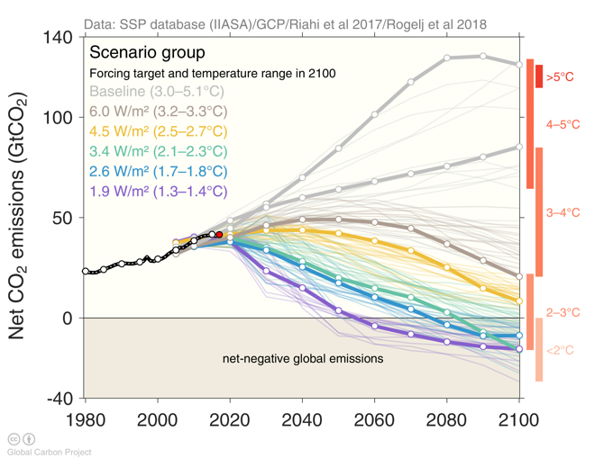
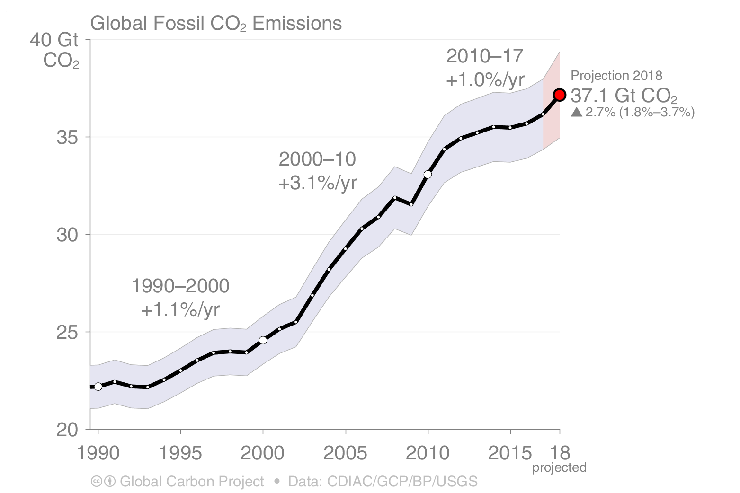
Reality Check: Where Are We?
Carbon Emissions and the Shared Socioeconomic Pathways
Source: CDIAC; Le Quéré et al 2018; Global Carbon Budget 2018
Source: Riahi et al. 2016; Rogelj et al. 2018; IIASA SSP Database; IAMC; Global Carbon Budget 2018
Notes:
But conditions are not improving –just an example here on CO2 emission forecasts

Slide 4
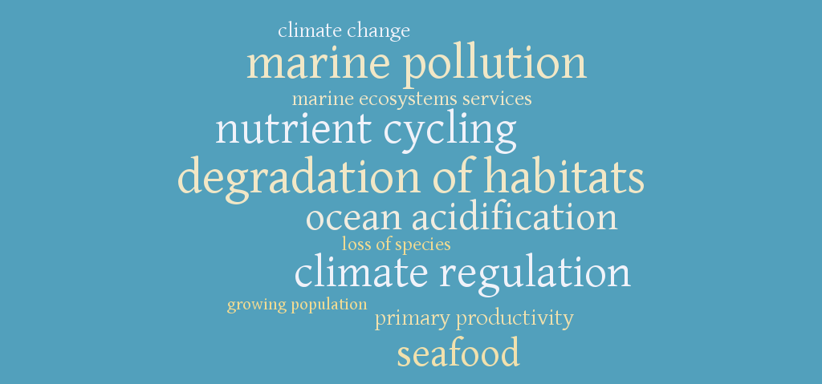
Blue Economy
Notes:
Message: Value of the ocean economy –
If the ocean were ranked among nations’ GDPs, the ocean economy would be the 7th largest economy in the world. (World Wildlife Fund Ocean Economy report, 2015).
AND even as we use the ocean as a source of resources, we must also acknowledge that over 40% of the World’s oceans are heavily affected by human activities.
The ocean’s role in earth systems and as a provider of ecosystem services must be safeguarded if we are to maximize our scientific understanding to be applied to societal benefit, protecting and feeding human communities, and supporting their sustainable development.
IF NEEDED
There are large extents of heavily impacted ocean in the North Sea, the South and East China Seas, and the Bering Sea. Much of the coastal area of Europe, North America, the Caribbean, China and Southeast Asia are also heavily impacted.
The least impacted areas are largely near the poles, but also appear along the north coast of Australia, and small, scattered locations along the coasts of South America, Africa etc
#OceansAt40 90% of people who derive livelihoods from fishing live in developing countries.
#OceansAt40 About 46,000 pieces of plastic are est to be afloat on every square mile of ocean.
#OceansAt40 1bn people in developing countries depend on fish for their primary source of protein.
#OceansAt40 85 nations & an est US$102bn per year are involved in the international trade in fish and fish products.
#OceansAt40 The annual value of the fish trade for dev countries is about US$25bn -2x the value of the coffee trade.
#OceansAt40 In 2008, nearly 80 million tonnes of fish were captured - that's an est US$80bn & 35m jobs.
#OceansAt40 Today > 30% of the world's fish stocks are overexploited, depleted or recovering from depletion.
#OceansAt40 #didyouknow Over 400 dead zones-where nothing can live-exist in today's oceans, covering 95,000 sq miles.

Slide 5
Omnibus Resolution for Oceans and the law of the sea (A/RES/72/73) -December 2017
The UNGA decided (Para. 292) to proclaim the United Nations Decade of Ocean Science for Sustainable Development for the 10-year period beginning on 1 January 2021, within existing structures and available resources, and called upon the Intergovernmental Oceanographic Commission to prepare an implementation plan for the Decade in consultation with Member States, specialized agencies, funds, programmes and bodies of the United Nations, as well as other intergovernmental organizations, non- governmental organizations and relevant stakeholders.
Notes:
Ocean science and observations need mainstreaming!
2016: Thinktank of IOC -> the IDEA! 2017: discussions, massive support from UN, IGOs, NGOs, … Proposal to UN
5 December 2017
72nd UN General Assembly Resolution
UN Decade of Ocean Science for Sustainable Development (2021-2030)

Slide 6
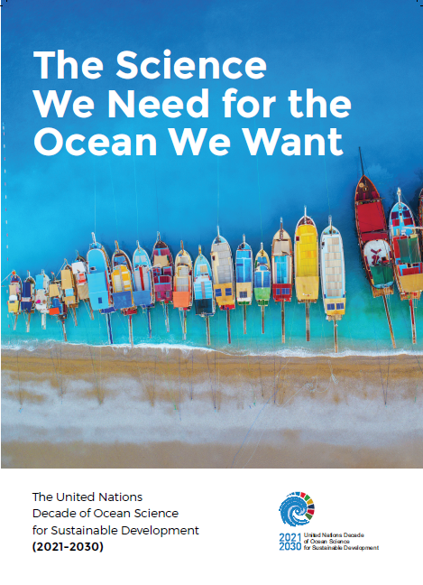
ROADMAP
Notes:
Development of a vision for the Decade through the preparation of a Roadmap, detailing the governance arrangements of the preparation phase, as well as the preliminary objectives and expected outcomes of the Decade. The Roadmap was tabled at the IOC Executive Council that endorsed it, whilst also recognizing that it is an evolving document, which will be enriched through consultation and expert inputs.

Slide 7
Towards a transformative approach
Radically change our understanding of the ocean's contribution to sustainable development
Translate research results into problem-based solutions
Add value by integrating social and natural sciences, but also traditional knowledge
Strengthen access and use of science by policy makers and citizens
Promote partnership with the private sector
Build and lead to new technologies
Allow access to open data and information
Target specific audiences (young scientists, gender, SIDS / LDCs, etc.)
Gather the UN under a common initiative
Notes:
What do we mean by transformative approach? – this requires the development develop a number of principles that should be core attributes of initiatives under the Decade

Slide 8
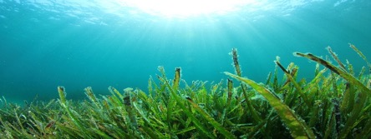
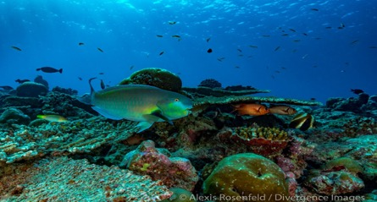
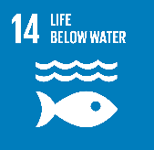
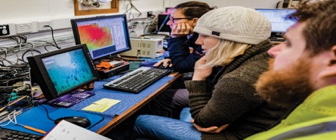
Societal outcomes of the Decade (1 of 2)
A clean Ocean
Sources of pollution are identified, quantified and reduced, and pollutants removed from the Ocean.
A healthy and resilient Ocean
Marine ecosystems are mapped and protected, multiple impacts, including climate change, are measured and reduced, and the provision of Ocean ecosystem services is maintained.
A predicted Ocean
Society has the capacity to understand current and future Ocean conditions, forecast their change and impact on human wellbeing and livelihoods.
Notes:
Responsive to societal needs:
If the societal benefits of the sustainable use of the ocean are to be accrued through achievement of the SDG targets as well as other frameworks, it is important to define a number of outcomes that the Decade will address over the course of its implementation.
These outcomes are considered to be highly transformative because they are expected to trigger environmental, societal and policy changes.
The Decade will address both deep disciplinary understanding of ocean processes and solution-oriented research to generate knowledge.
This knowledge will support societal actors in reducing pressures of the ocean, preserving and restoring ocean ecosystems and safeguarding ocean-related prosperity for generations to come.
The Decade should turn the scientific knowledge and understanding into effective actions supporting improved ocean management, stewardship and sustainable development.
Here are 6 societal outcomes.

Slide 9
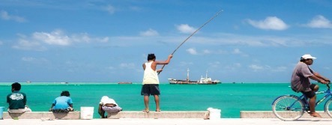
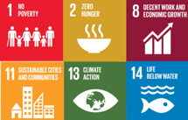
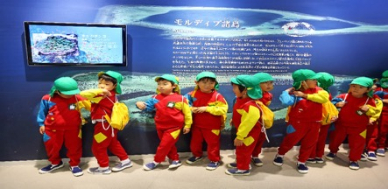
Societal outcomes of the Decade (2 of 2)
A safe Ocean
Human communities are protected from ocean hazards and the safety of operations at sea and on the coast is guaranteed.
A sustainable
productive Ocean
The provision of food supply and alternative livelihoods are secured.
A transparent and accessible Ocean
All nations, stakeholders and citizens have access to ocean data and information, technologies, and are capable of making informed decisions.
Notes:
This Decade will empower decision-makers with Science solutions.

Slide 10
UN Decade of Ocean Science for Sustainable Development
Priority Research and Development Areas with particular relevance to the BBNJ process
Notes:
The high seas and seabed remain a frontier of largely unexplored and under-studied biodiversity. It is critical that a new governance framework enhances marine scientific exploration and knowledge, and ensures that best available scientific evidence is incorporated into ABNJ decision making processes.
The UN Decade can aim to align and increase global investment in marine research which will benefit BBNJ issues by providing information on vulnerable species, populations, habitats and ecosystems that need to be protected. It will also about standaridising scientific data in order to make these openly accessible.

Slide 11
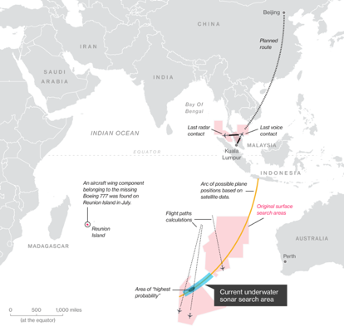
UN Decade of Ocean Science for Sustainable Development
Priority Research and Development Areas
R&D Priority Area 1: Comprehensive map (digital atlas) of the ocean
(Scope: well beyond topography)
Notes:
The high seas and seabed remain a frontier of largely unexplored and under-studied biodiversity. It is critical that a new governance framework enhances marine scientific exploration and knowledge, and ensures that best available scientific evidence is incorporated into ABNJ decision making processes. In this respect the developement of a comprehensive map of the ocean and its sea floor is key.
Mapping the ocean should include much more than depth measurements. It includes parameters of the physical, biological, chemical, and geological environments, ecosystems, cultural objects, boundaries, resources, etc. The Decade will have a strong focus on these aspect and build on the Seabed 2030 initiative to reach this objective. [A global ocean mapping campaign to provide a high resolution map of the seabed (currently only 6% of the seabed is mapped in high resolution];

Slide 12
UN Decade of Ocean Science for Sustainable Development
Priority Research and Development Areas
R&D Priority Area 2: A comprehensive ocean observing system (polar, bio, eco, BGC, eDNA, deep ocean )
Vavau © Stuart Chape
Notes:
A reinforced coordination of ocean observation efforts across disciplines, and expansion of existing observation programmes, including through the development & deployment of new technologies will be promoted. This will lead to the collection of new seabed ecosystem variables that can contribute to ecosystem management.

Slide 13
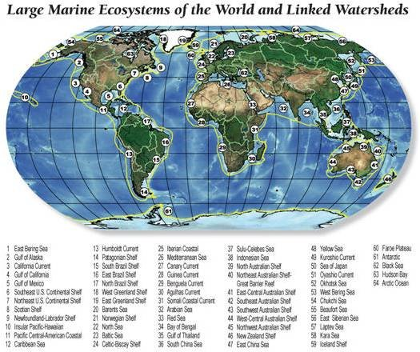
UN Decade of Ocean Science for Sustainable Development
Priority Research and Development Areas
R&D Priority Area 3: A quantitative understanding of ocean ecosystems as the basis for their integrated ocean management
(multiple stressors, deep ocean, bottom, predictive, assisted adaptation, e.g. of coral reef ecosystem)
Vavau © Stuart Chape
Notes:
Another key focus of the Decade is to develop a far more detaild knowdege of ocean ecosystems and their functionning
For eg IOC Ocean Biogeographic Information System, which is the largest global database on marine biodiversity provides an initial picture of where marine species do leave, but this requires more investment in order to have higher resolution.
Key questions to answer are:
How are populations & habitats connected? (scales of dispersal, food flow)
How can we predict where they are given that ABNJ are too large to fully sample?
How do they impact how Earth works? What is the role of these living organisms in ecosystem function & service?
How do these unique deep sea ecosystems respond to perturbation? (vulnerability to human impacts)

Slide 14
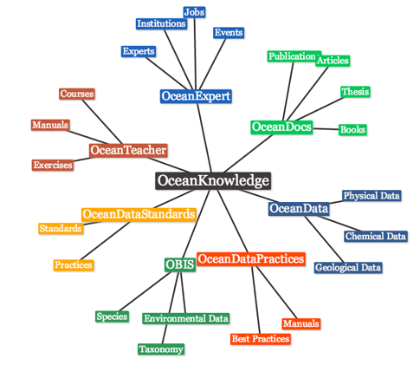
UN Decade of Ocean Science for Sustainable Development
Priority Research and Development Areas
Data
Ocean
Big
R&D Priority Area 4: Data & information System
Standards need to be global
Notes:
The development of ocean data sharing mechanism, ensuring equitable, fast and free access to research data through global online open-access data sharing platform and data clearing house mechanism will be another pillar of the Decade
This wil require the promotion of mechanism for coordinating targeted and cooperative marine scientific research resulting in the collection of new baseline data to characterize existing environments and biodiversity, and better understanding of cumulative stressors impacts.

Slide 15
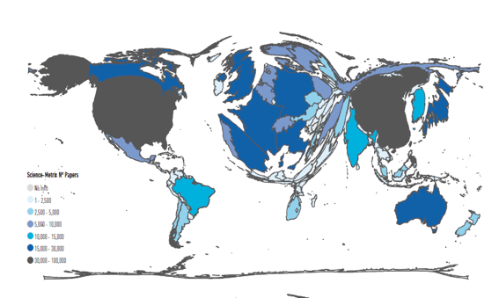
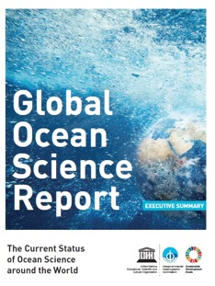
UN Decade of Ocean Science for Sustainable Development
Priority Research and Development Areas
R&D Priority Area 7: Capacity Development
Education and Training
Ocean Literacy
Vavau © Stuart Chape
Notes:
Capacity development and transfer of marine technology are considered absolutely necessary to make the BBNJ instrument universal, serving all its future Parties and particularly developing countries. Improving the scientific knowledge base and transfer of marine technology to regions and groups that are presently limited in capacity and capability, especially SIDS and LDCs, through dedicated training programmes and initiatives will also be at the core of the Decade. A specific CD plan will be developed based on priorities identified by each ocean region.

Slide 16
UN Decade of Ocean Science for Sustainable Development
Science breakthroughs
Mapping, digital atlas
Observing system
Ecosystem knowledge
Data and Information
Multi-Hazard Warning Systems
Ocean in Earth System Science
CD, Education, Ocean Literacy
Mega Projects
Solutions
Resources
Requirements
Societal Applications
Aquaculture /
Climate services
Notes:
The Decade could provide the opportunity to mobilize the research community around BBNJ issues and create new connections between ocean observations and science on one hand, and global and regional institutions with a focus on economic development, conservation, and sustainability of ABNJs, on the other hand.

Slide 17
Notes:
IOC-UNESCO, the coordinating agency for the Decade, will convene a Global Planning Meeting on 13-15 May 2019 at the National Museum of Denmark, Copenhagen, Denmark.
This key multi-stakeholder event of the Preparatory Phase of the Decade will offer a unique forum to co- design research strategies, develop plans, stimulate new partnerships, identify the key priorities to be addressed for the Decade to be a truly global initiative, and identify concrete deliverables to achieve a:
Clean
Healthy and resilient
Predicted
Safe
Sustainably harvested and productive
Transparent and accessible
Ocean

Slide 18
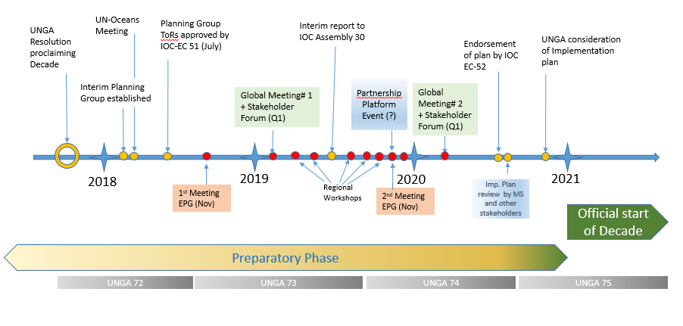
Timeline
Notes:
This is the time line for the preparation phase of the Decade, leading to the finalisation of the implementation plan by the end of 2020, and the engagement of key stakeholders (governements, NGOs, scientists, private sector)

Slide 19
dank u!
ありがとう
THANK YOU
MERCI
GRACIAS
Спасибо
شكران
谢谢

Slide 20
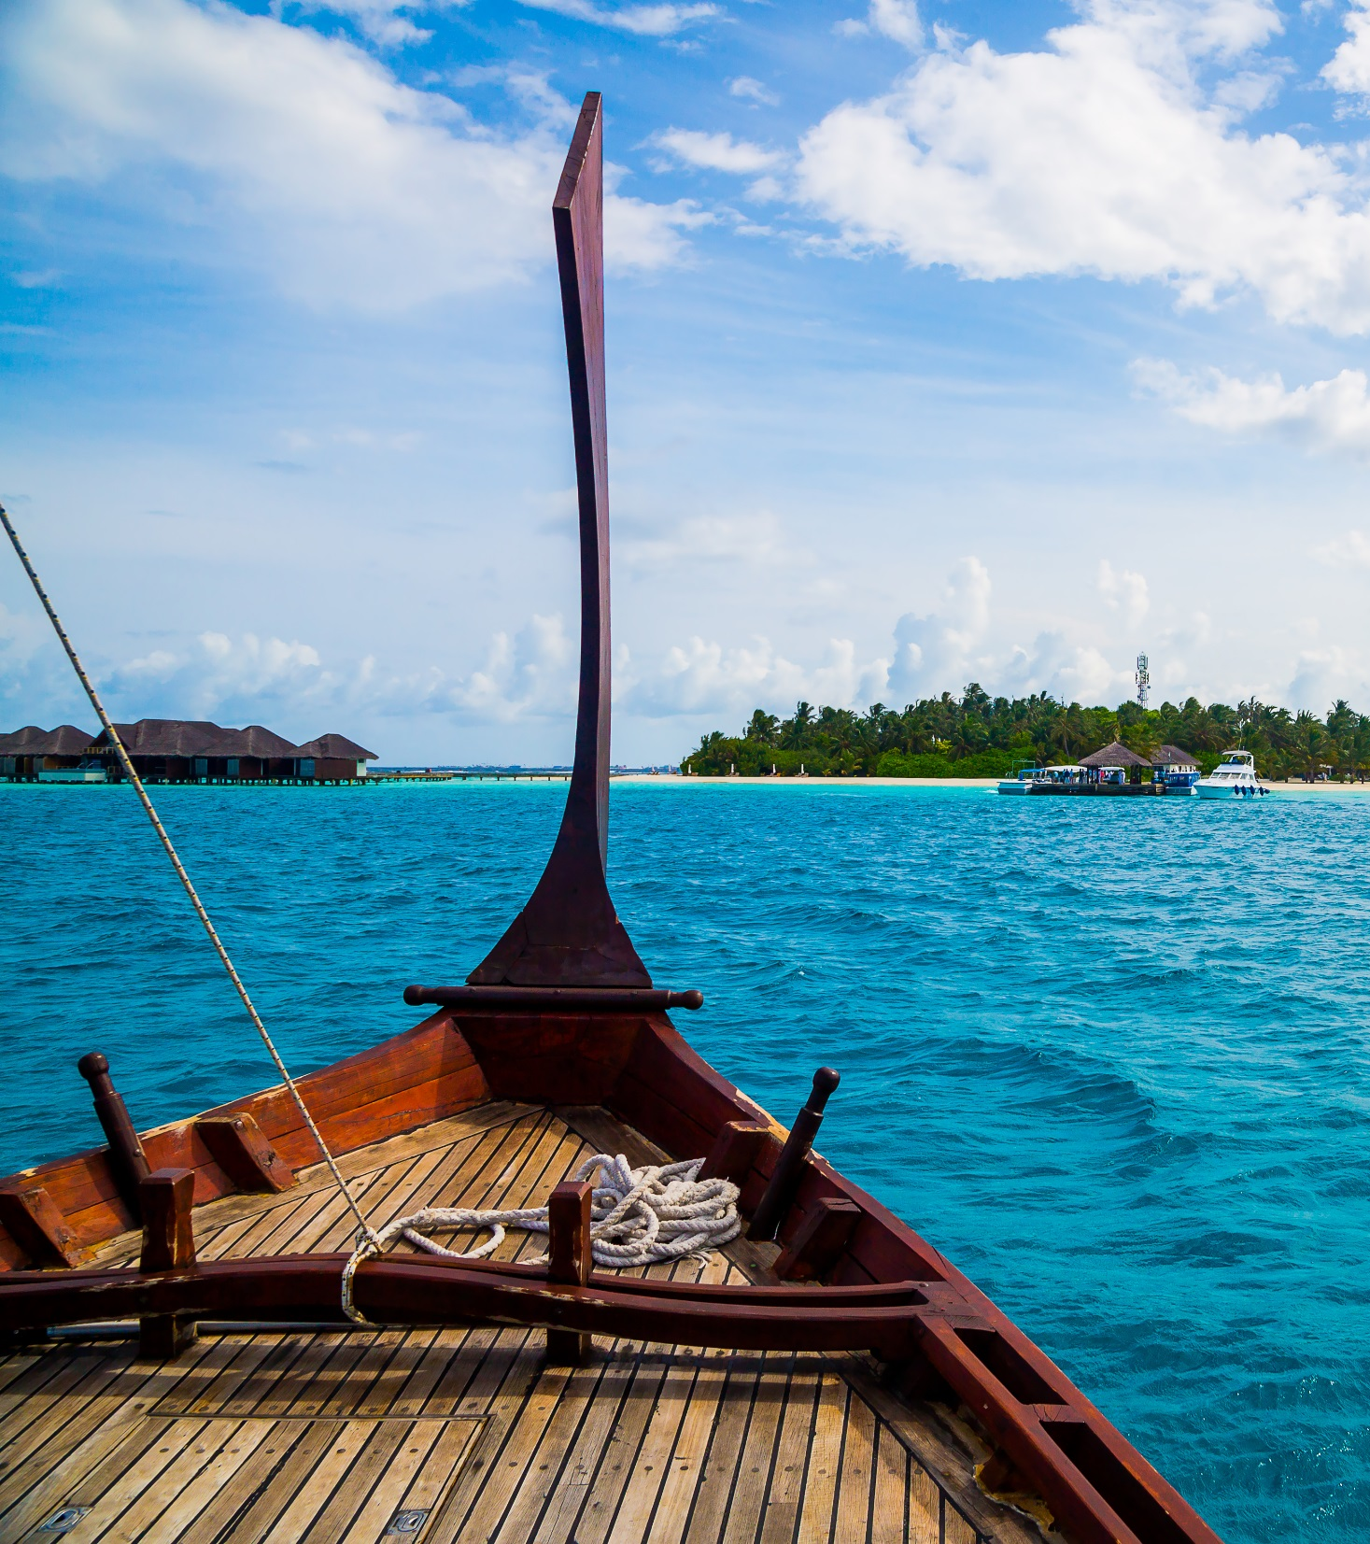
Get in touch Write to us: oceandecade@unesco.org Follow all Decade news: http://en.unesco.org/ocean-decade Social media:
IocUnesco
IocUnesco
ioc_unesco
Notes:
Are you interested in working toward the ocean we need for the future we want? Let us know and we will keep you informed of all future developments.

Slide 21
Arctic Council
RFMOs, UNEP Regional Seas Conventions, UN Regional Commissions, etc….
EC
JPI Oceans
ICES
EMB
ICES
WESTPAC
PICES
Black Sea Com
WESTPAC
PICES
MAP
CIESM
IOCARIBE
IOCAFRICA
PERSGA
OECS
UNESCAP
Preparatory Phase: Building partnerships with regional stakeholders
AORA
IIOE-2, IOCINDIO,
Indian Ocean Commission
IORA
WIOMSA +???
Pacific Community SPREP
CPPS
CCAMLR / SCAR
Notes:
The preparation of the Decade is coordinated by IOC but requires the full engagement of all regional stakeholders at that have an
interest in the development of ocean science in support of SD. These partners are key because they contribute to the development and conduct of research at the regional level but also because they are end –users and can define specififc information and data needs.
Through the Decade, we can deliver in a coordinated manner, by scaling up and complementing existing investment in science.

