Slide 1
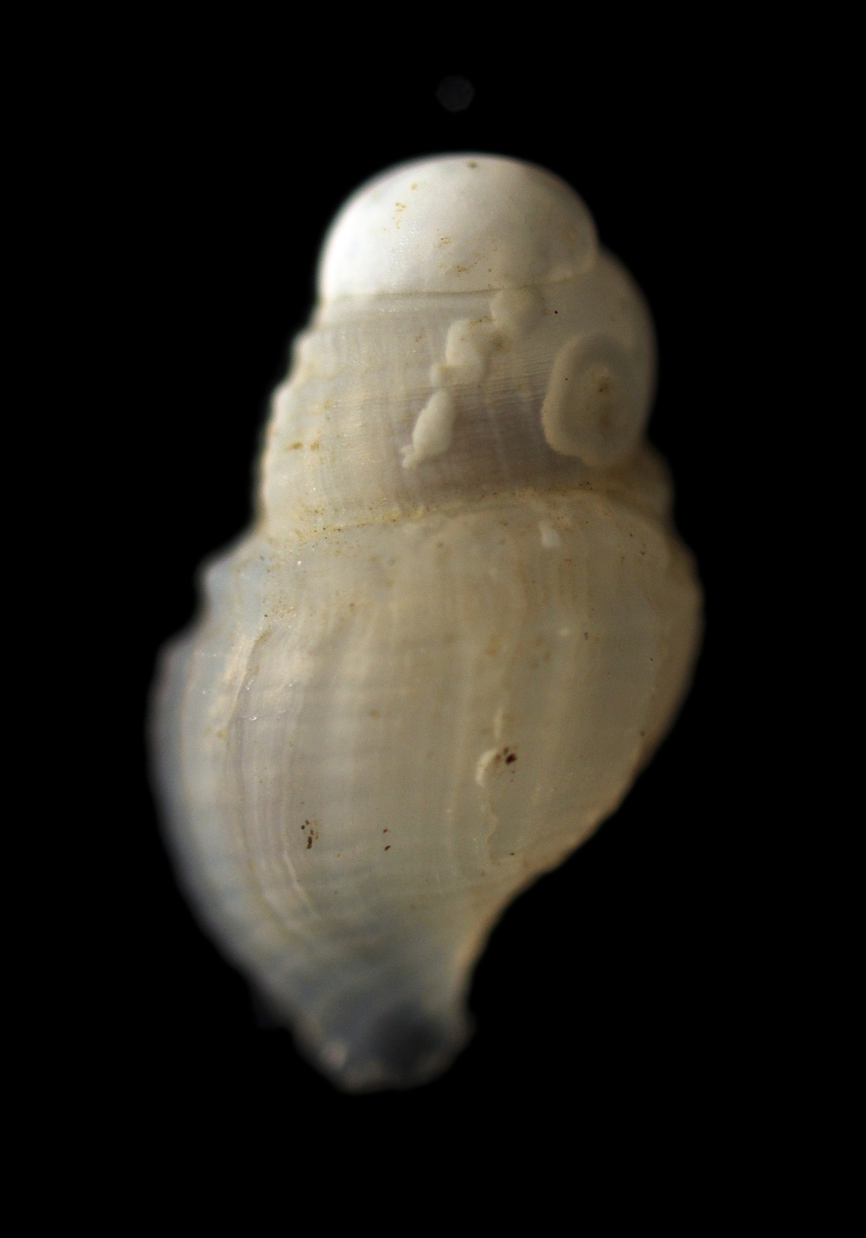
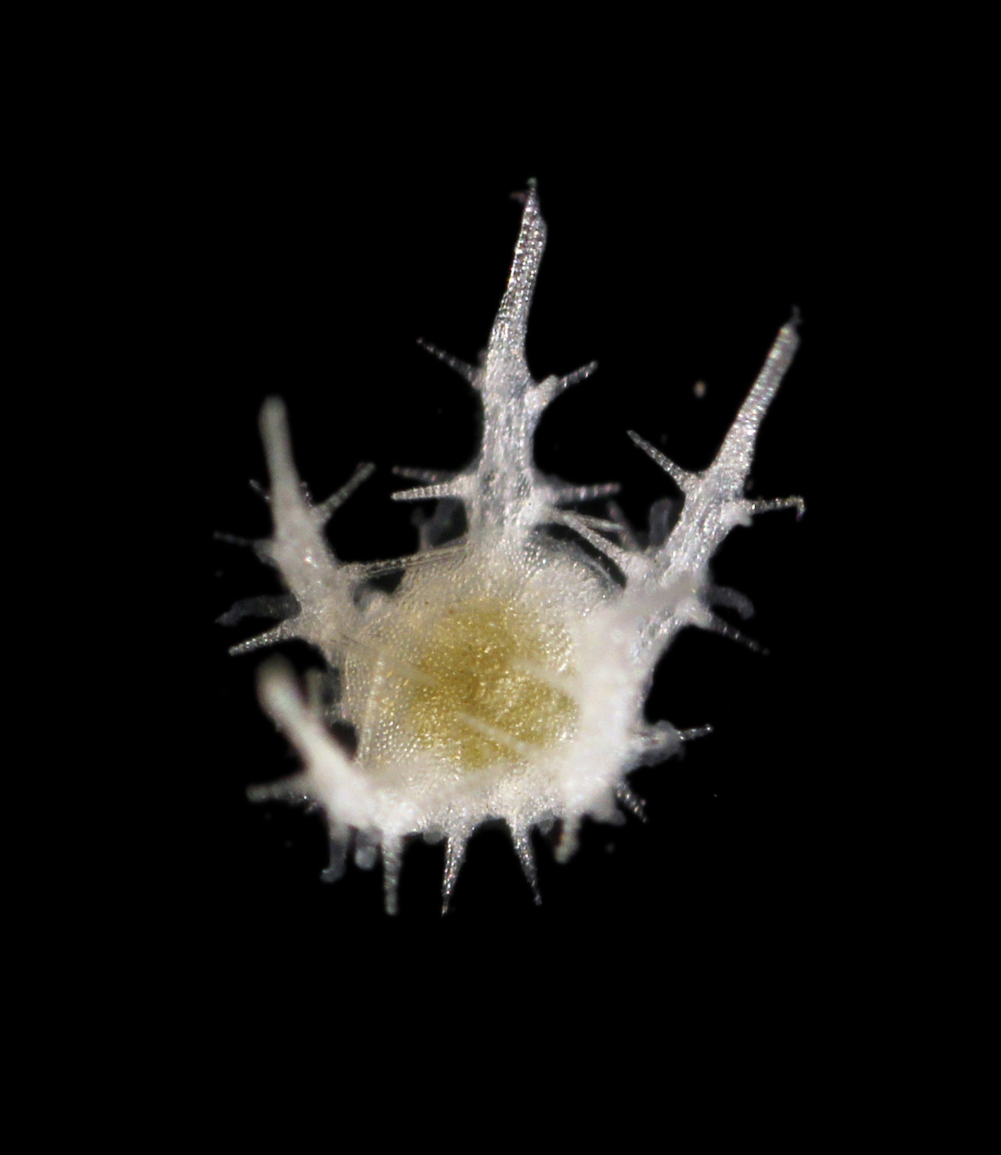
CRUISES COLLECTIONS
& DATA:
enabling ocean science and sharing benefits from Marine Genetic Resources
Muriel Rabone, Tammy Horton, Harriet Harden-Davies, Sabine Zadjerman, Ward Appeltans, Gabi Droege, Angelika Brandt, Liliana Pardo-Lopez, Thomas Dahlgren, Paul Snelgrove, Adrian Glover, Jane Collins

Slide 2
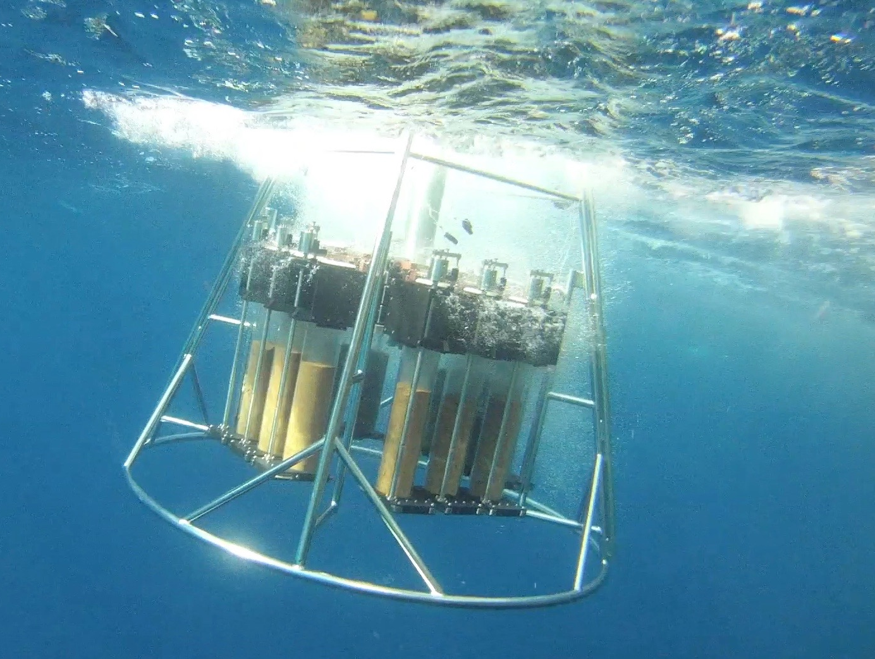
Sampling in ABNJ
Notes:
2 (megacore) Sampling the deep sea, particularly in areas beyond national jurisdiction (ABNJ) presents substantial collection challenges, particularly for developing countries. Access to deep sea samples and data or MGR is therefore critical to both research, and benefit sharing, and more widely, to ensure conservation and sustainable use of marine biodiversity. Numerous initiatives already enable access through best practices, and these practices could be streamlined and strengthened by a BBNJ agreement.

Slide 3
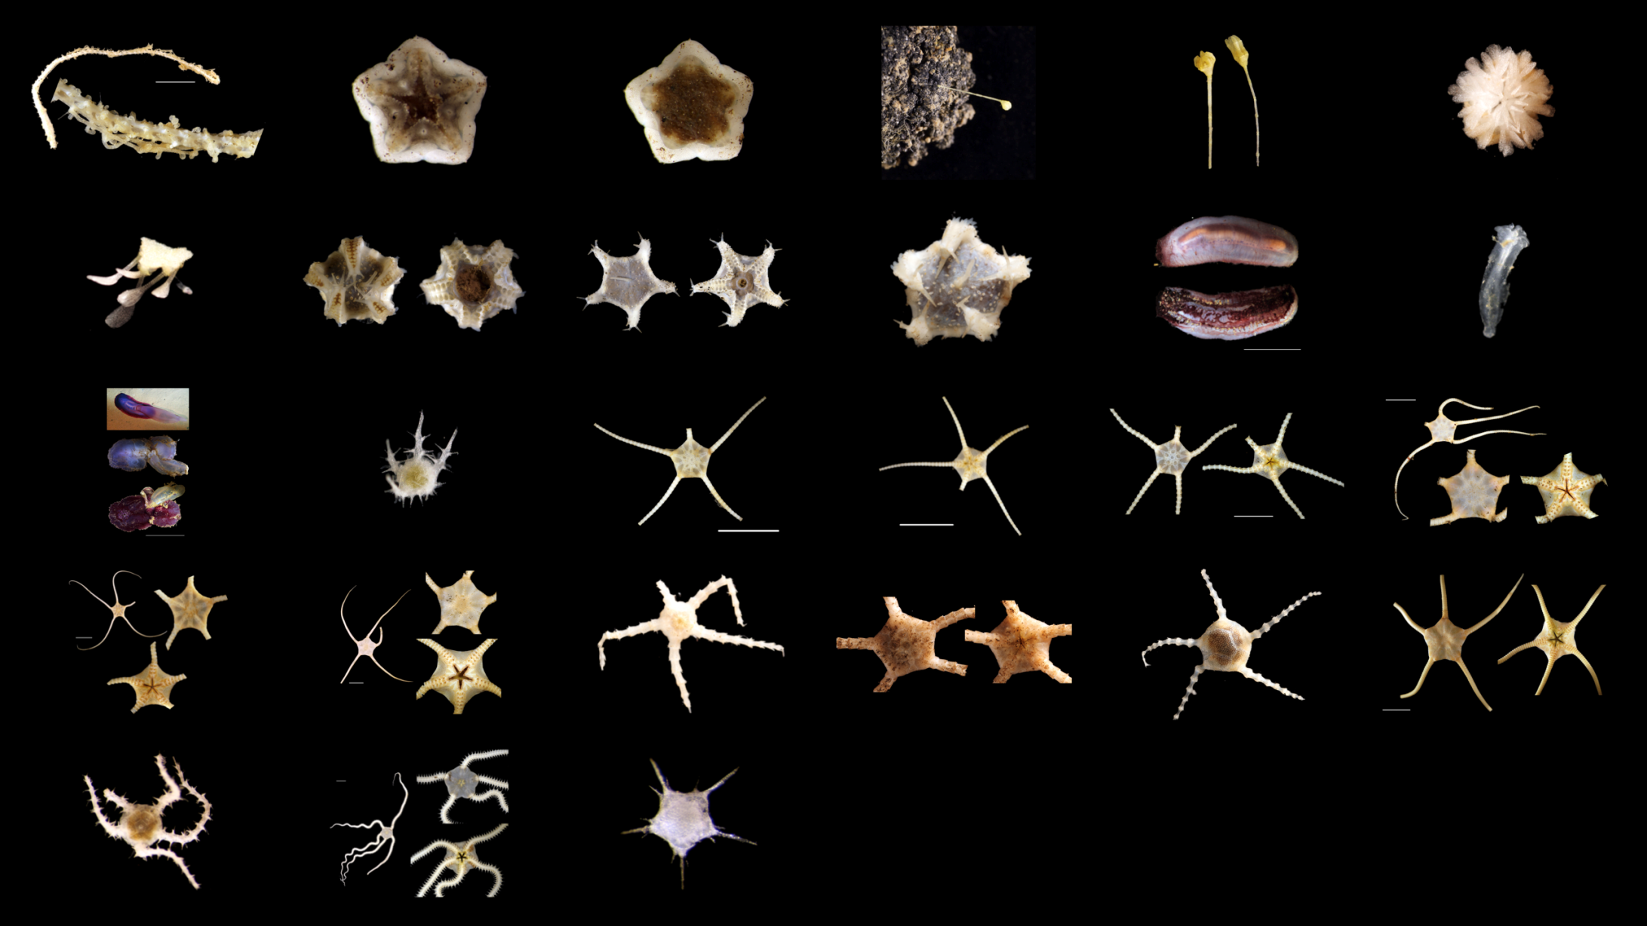
What are Marine Genetic Resources
Notes:
3 (echinoderm) to discuss access and benefit sharing for MGR, first we need to describe what they are. There is a well discussed lack of clarity and agreement on existing relevant definitions for MGR, namely those in the Nagoya Protocol, so here I describe an MGR sample as covering a wide range of sample types, from whole or partial organisms, to environmental samples of water or sediments, that may contain organisms, preserved so as to allow ‘utilisation’ of an MGR.

Slide 4
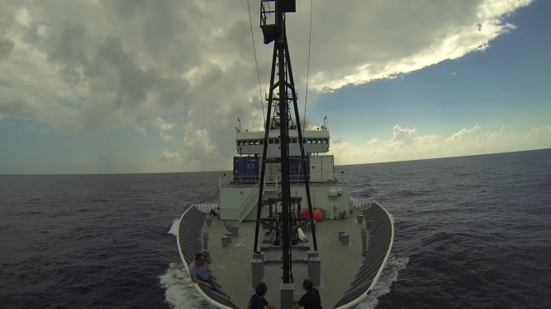
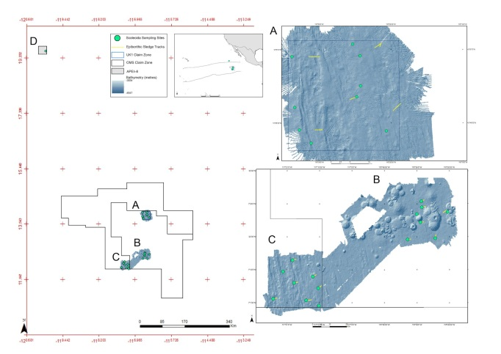
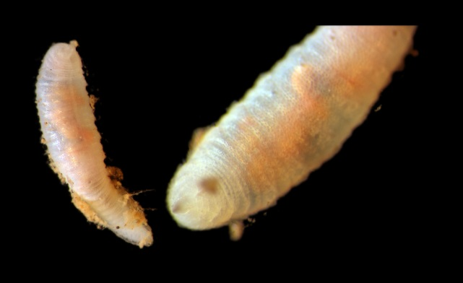
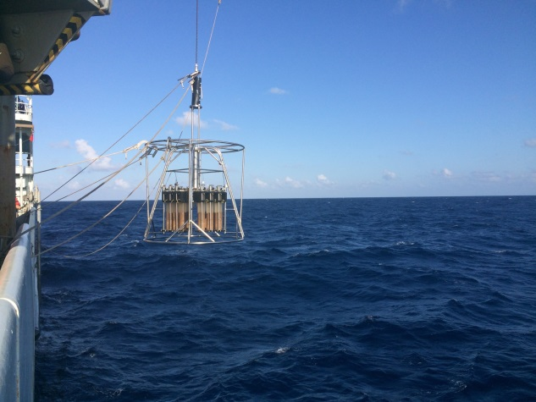
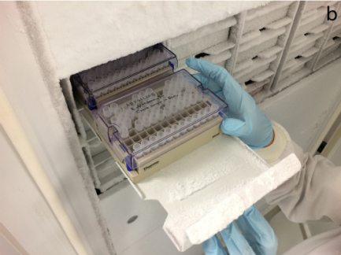
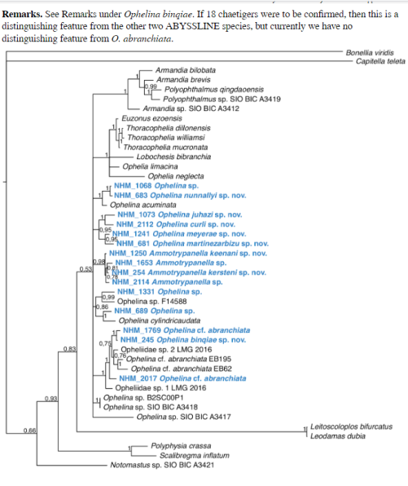
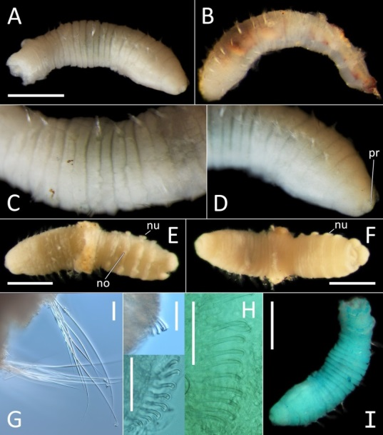
MGR data: integration
Notes:
4 (composite) further, MGR data could encompass all information associated with or extracted from a physical MGR sample, specifically any associated genetic sequence data, from raw sequences, to downstream analysis. MGR data also includes: current identification or taxonomy of the sample; location and storage method; sampling event info or where, when and how the sample was collected, associated environmental data; and information on any derived samples for eaxmple DNA extractions isolated from the MGR. To safeguard the scientific value of the sample, it is important that all these data types are integrated and linked to the MGR in question.

Slide 5
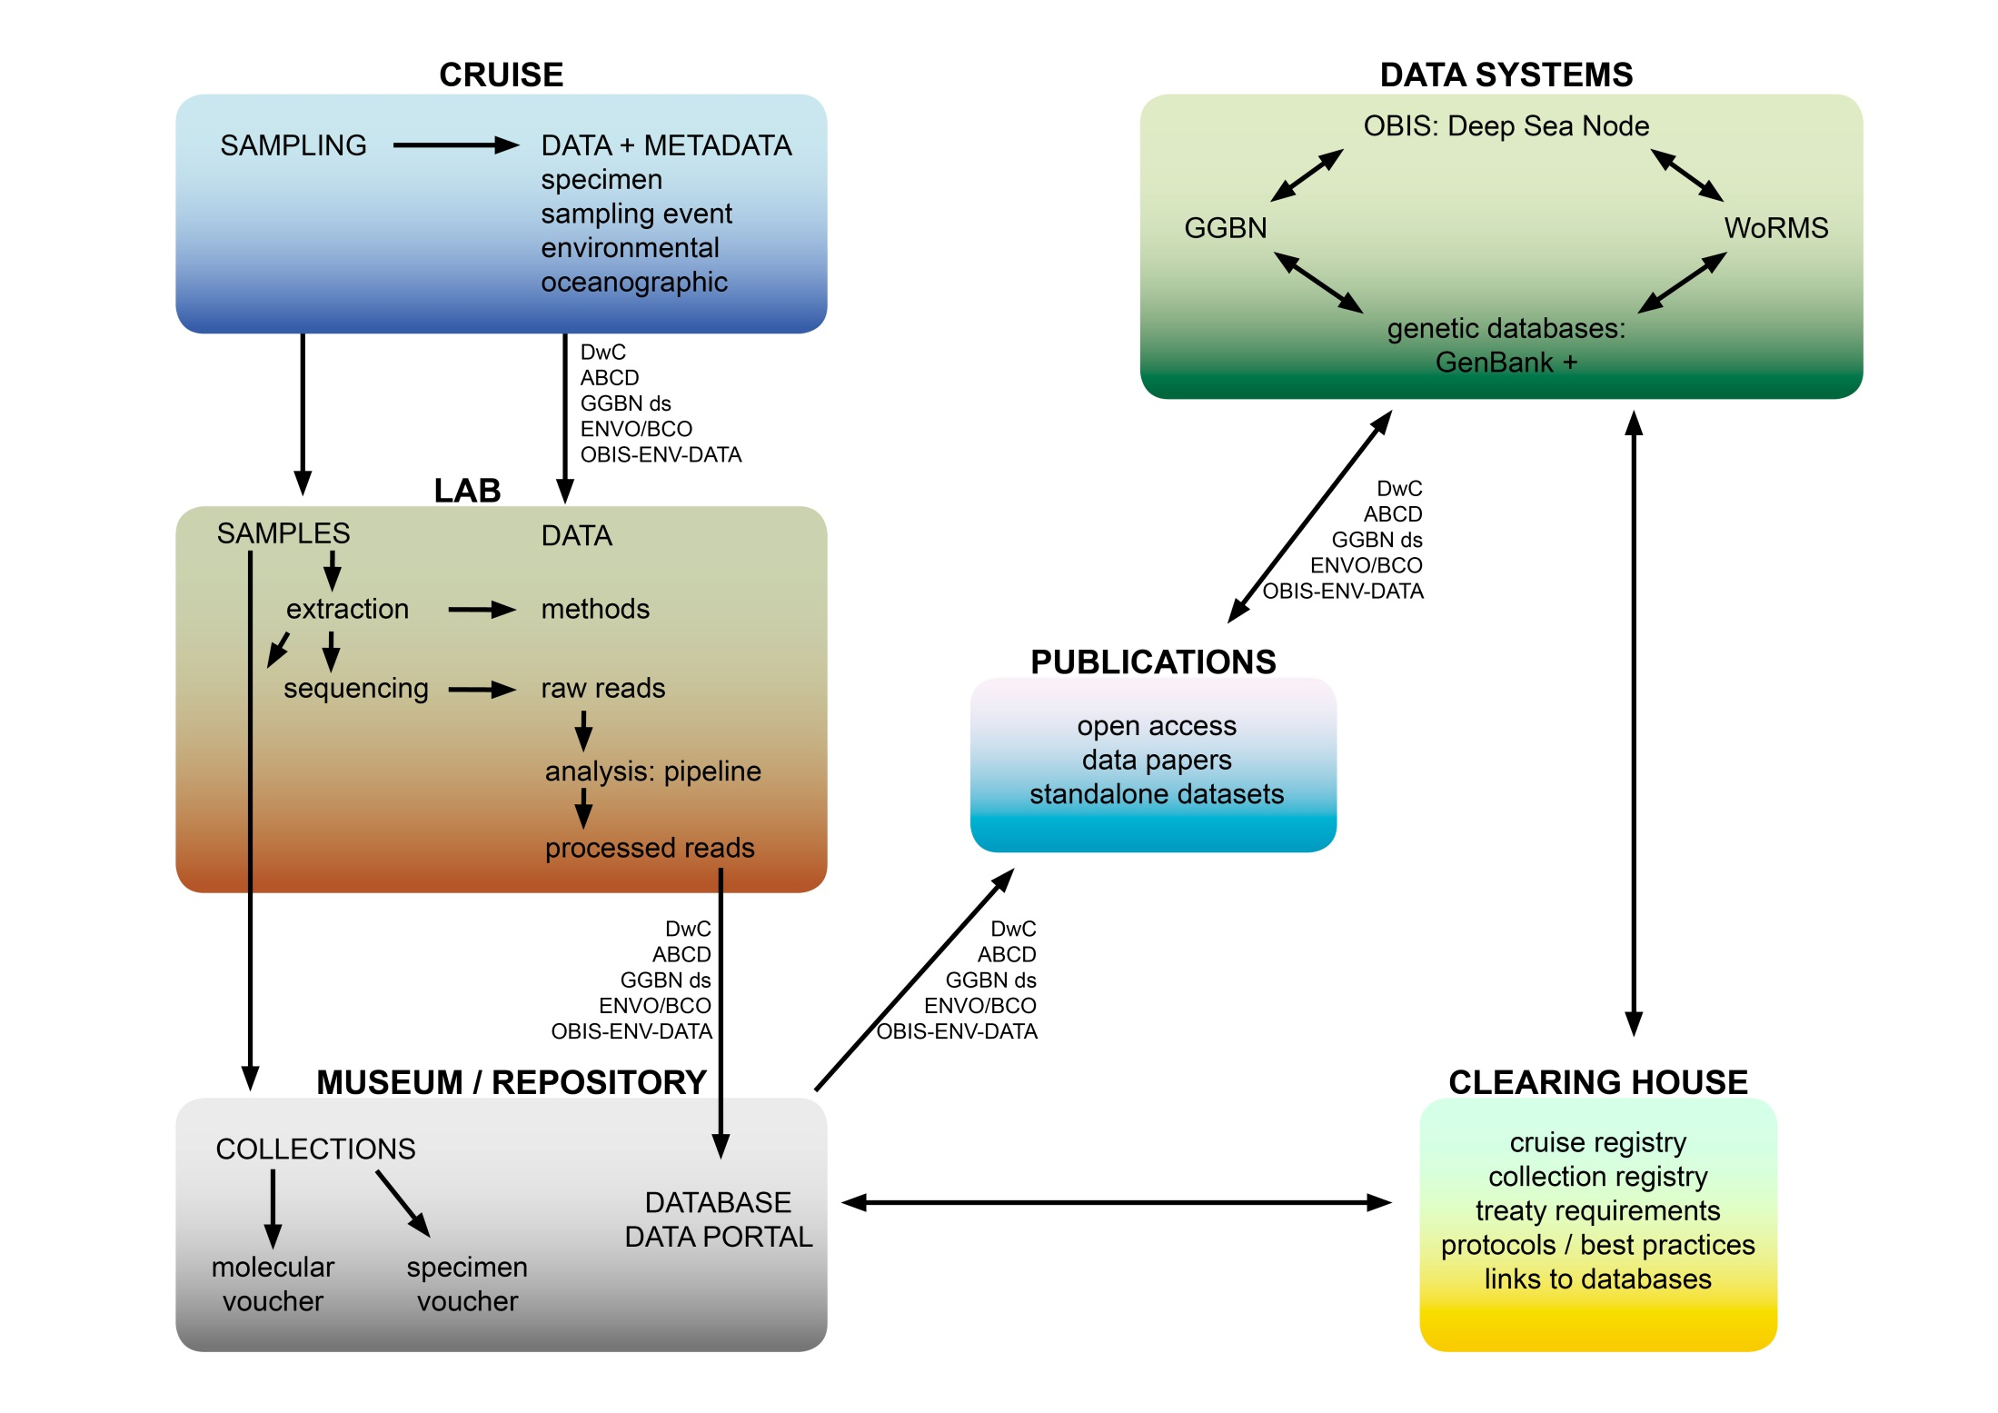
Notes:
5 (workflow) Here I’ll discuss BOTH the current process of the sample and data lifecycle – from sample collection to data repository, and scope for improvements in current practice

Slide 6
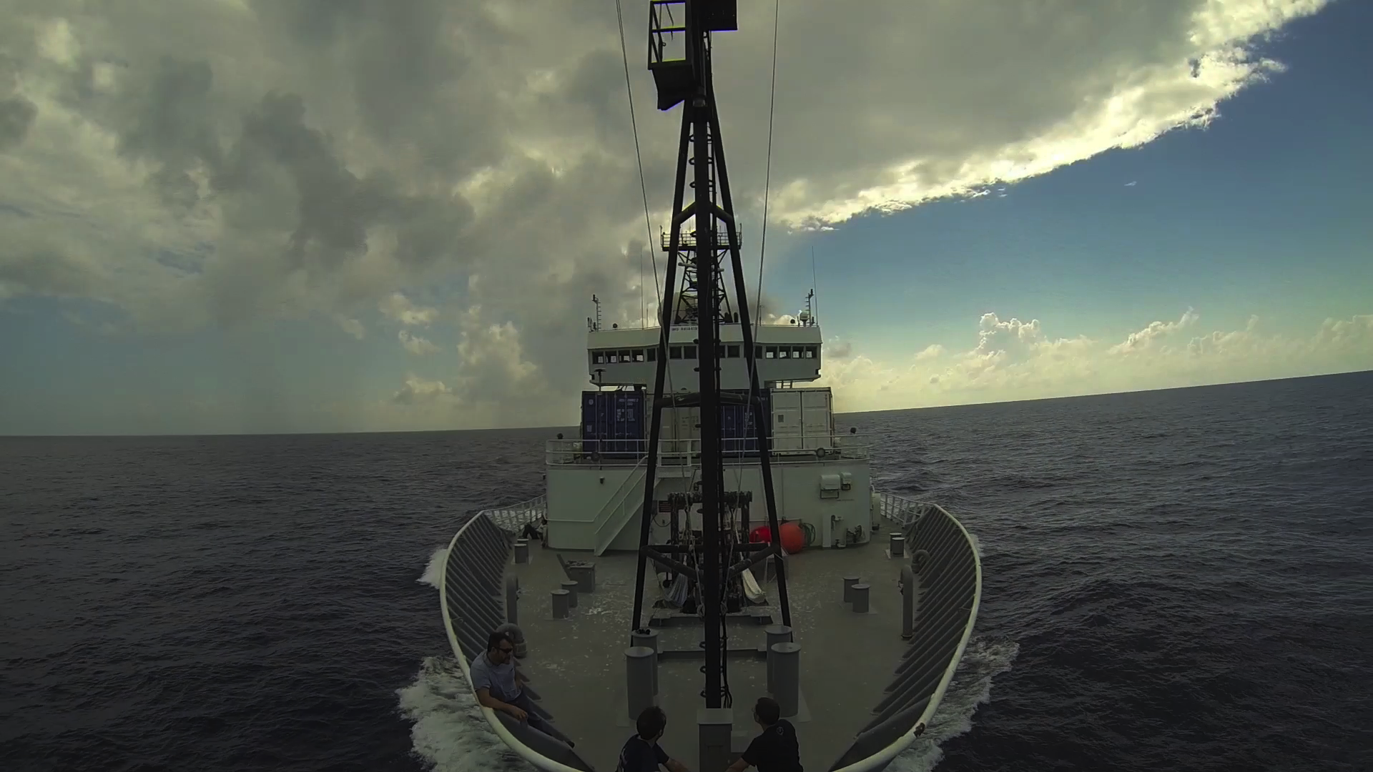
Notes:
6 (ship) the origin story of an MGR starts with the cruise. Such cruises are planned months, even years in advance, and are often a result of international collaborations. The ships that conduct them are managed by institutes and governments and cruise data are typically logged in national repositories, but there are no current legal requirements for this and there is currently no central global cruise registry.

Slide 7
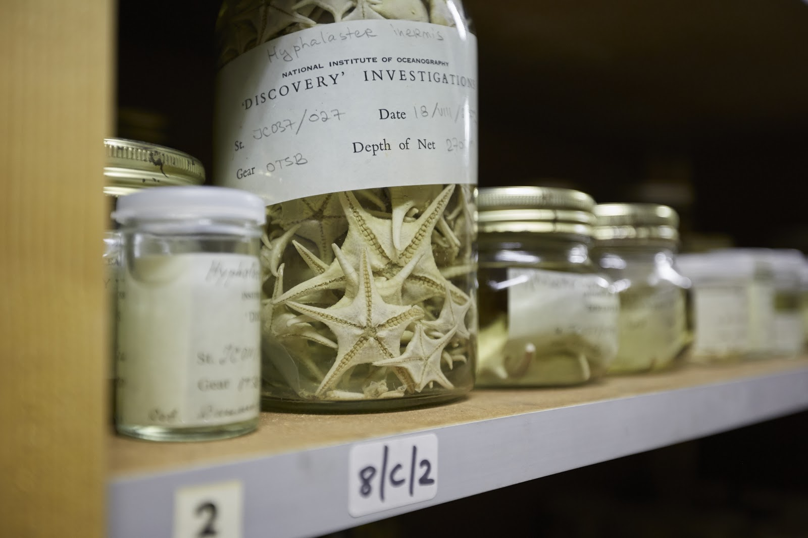
Sample archiving in biorepositories / museums
Discovery Collections. Courtesy of Tammy Horton, National Oceanography Centre
Notes:
7 (Tammy) MGR samples will then be are archived in biorepositories such as museums. Such archives are critical to taxonomy and to reproducible science. There are again currently no legal requirements to archive samples, however, there have been improvements in sample management in recent years in recognition of their importance. Museums currently support non-monetary benefit sharing through commitment to long-term curation and data management for collections. However, there are significant technical and financial implications for this storage.

Slide 8
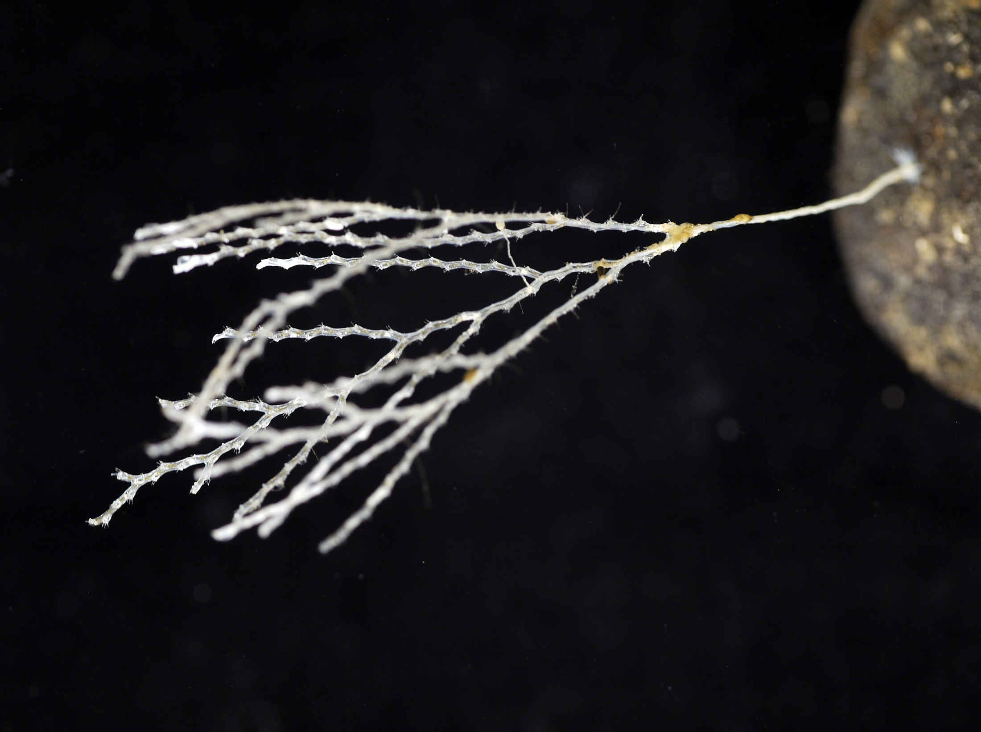
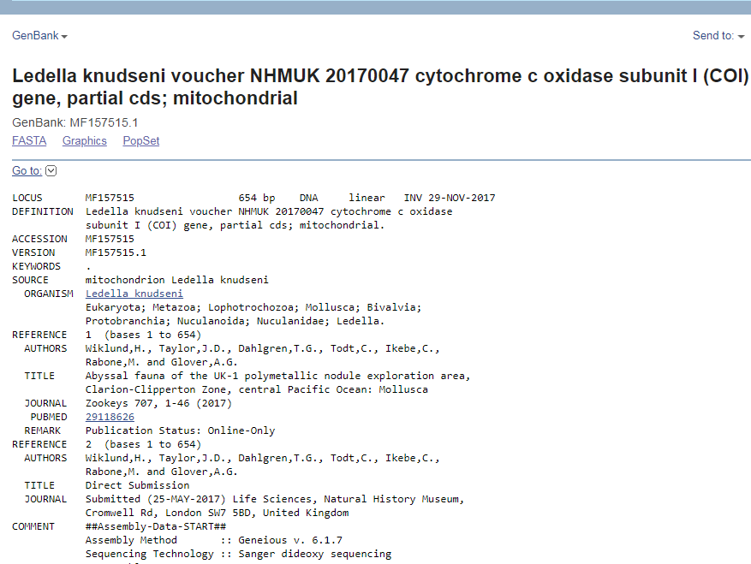
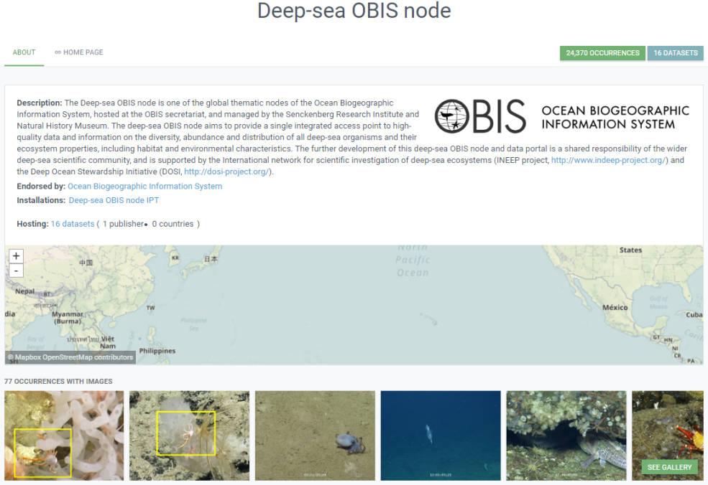
WoRMS
GenBank
OBIS
Notes:
8 (OBIS) Management of MGR data is currently conducted in an open access arena. For example, it is an established practice that data are published in open access databases, for example Genbank for genetic data, World Register of Marine Species for taxonomic data, and OBIS the Ocean Biogeographic Information System for occurrence data or where species occur in time and space. Access to MGR samples and data therefore are already possible through biorepositories, open access databases and papers. However, if datasets are in a format that may limit accessibility, or only published in non-open access papers, this will present a barrier to their use.

Slide 9
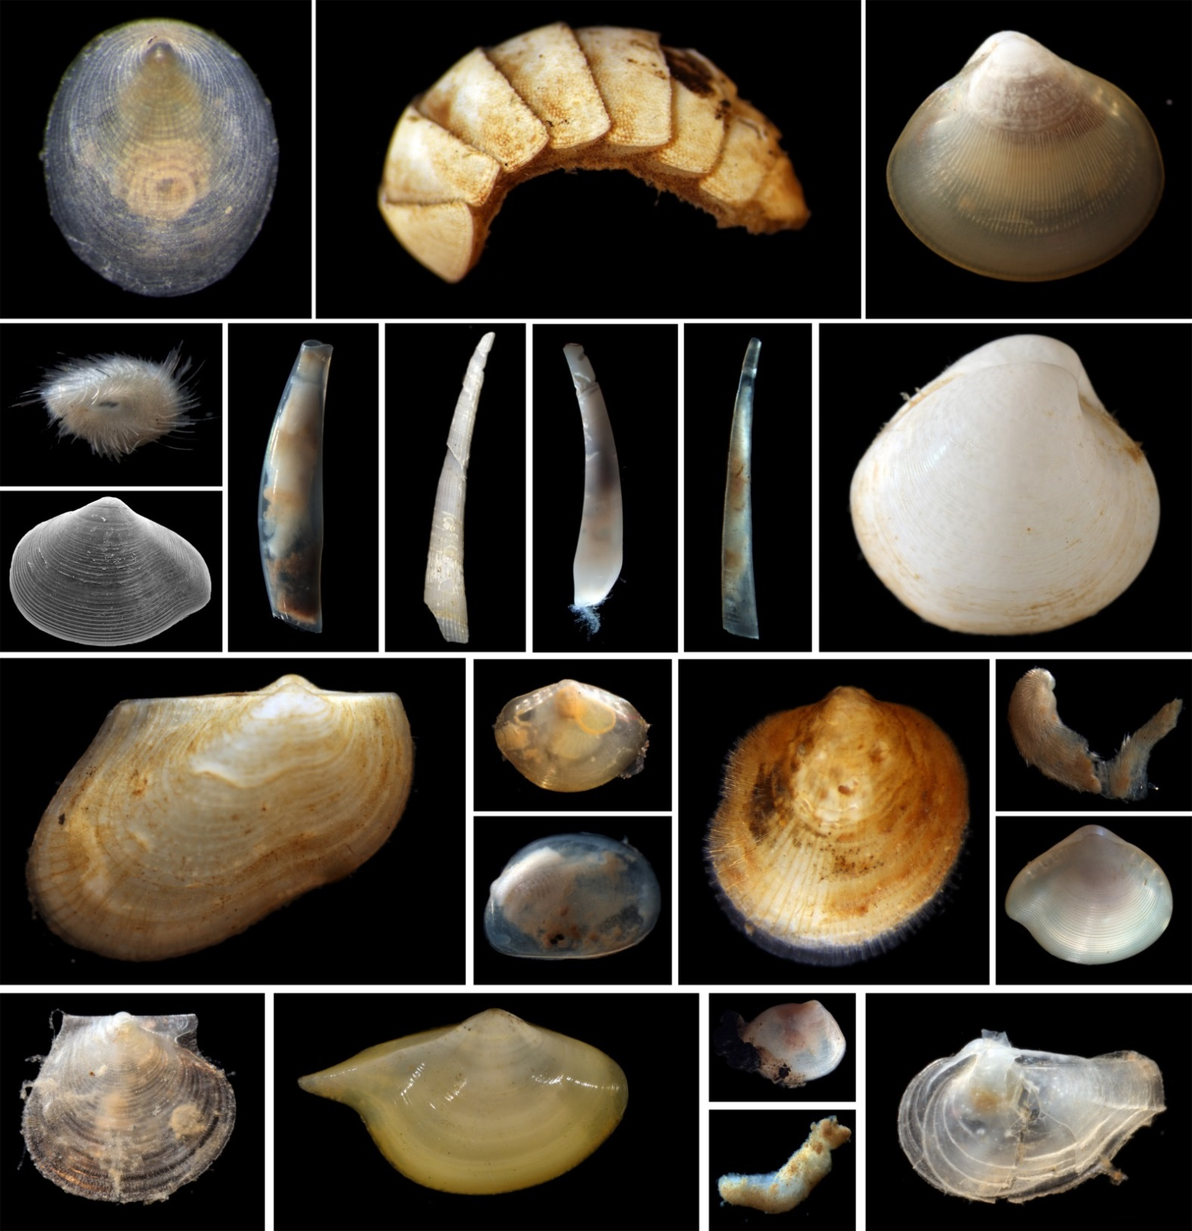
IMPROVED ACCESS, SHARING AND TRANSPARENCY FOR
MGR
Notes:
9 (mollusca) while best practices already exist, these can be streamlined, strengthened and their visibility improved by the BBNJ agreement

Slide 10
Global online registry of cruises and associated collections
Build on existing systems
ODIS (Ocean Data Information System)
Notes:
10 (cruise) Registration of all research cruises, and of the resulting collections would be of great benefit to the deep-sea research community and the BBNJ process alike. This should be built into existing systems, and emerging ones such as the Ocean Data Information system or ODIS. Such a global dataset could also provide discoverability to unused/ un-worked on samples- currently effectively invisible

Slide 11
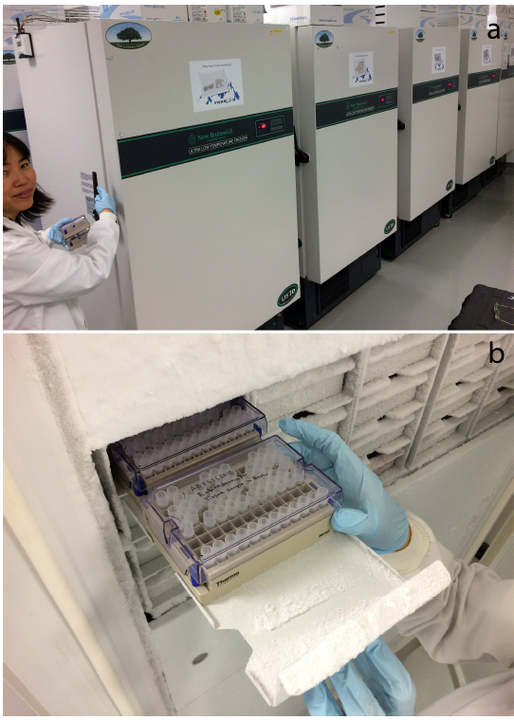
Support for biorepositories/museums:
Recognising the role and needs of collections for current and future use
Notes:
11 (museum). Archiving and maintaining collections for as wide as possible future use is crucial for the research community, and reduces potential repeat collection. Biorepositories are the main suppliers of MGR, and will lead in standardising procedures for curation and tracking of collections to improve access. A formalised role for collections could be considered for BBNJ, however, resource implications need to be taken into account.

Slide 12
DATA STANDARDS: increase awareness
Data must be FAIR: Findable Accessible Interoperable Reusable
FAIR via usage of data standards: established data storage & exchange formats
Data standards are common vocabularies:
analogous to common understanding of legal terms, “MGR” and “utilisation”
Key for monitoring: delineate Essential Ocean/Biodiversity Variables: EBVs/EOVS
Notes:
12 (Data stds): data need to be open and FAIR- Findable, Accessible, Interoperable and Reusable. Realising all of these characteristics requires standardisation of data through usage of data and metadata standards, an analogy here are the importance of finding common understanding for legal terms in the BBNJ agreement such as “MGR” and “utilisation”.
Data standards are key also for monitoring applications, which rely on high quality and timely data. For example they delineate standardisation frameworks of Essential Ocean/Biodiversity Variables (EBVs and EOVs), or data frameworks which aim to standardise monitoring of biodiversity at global scales.

Slide 13
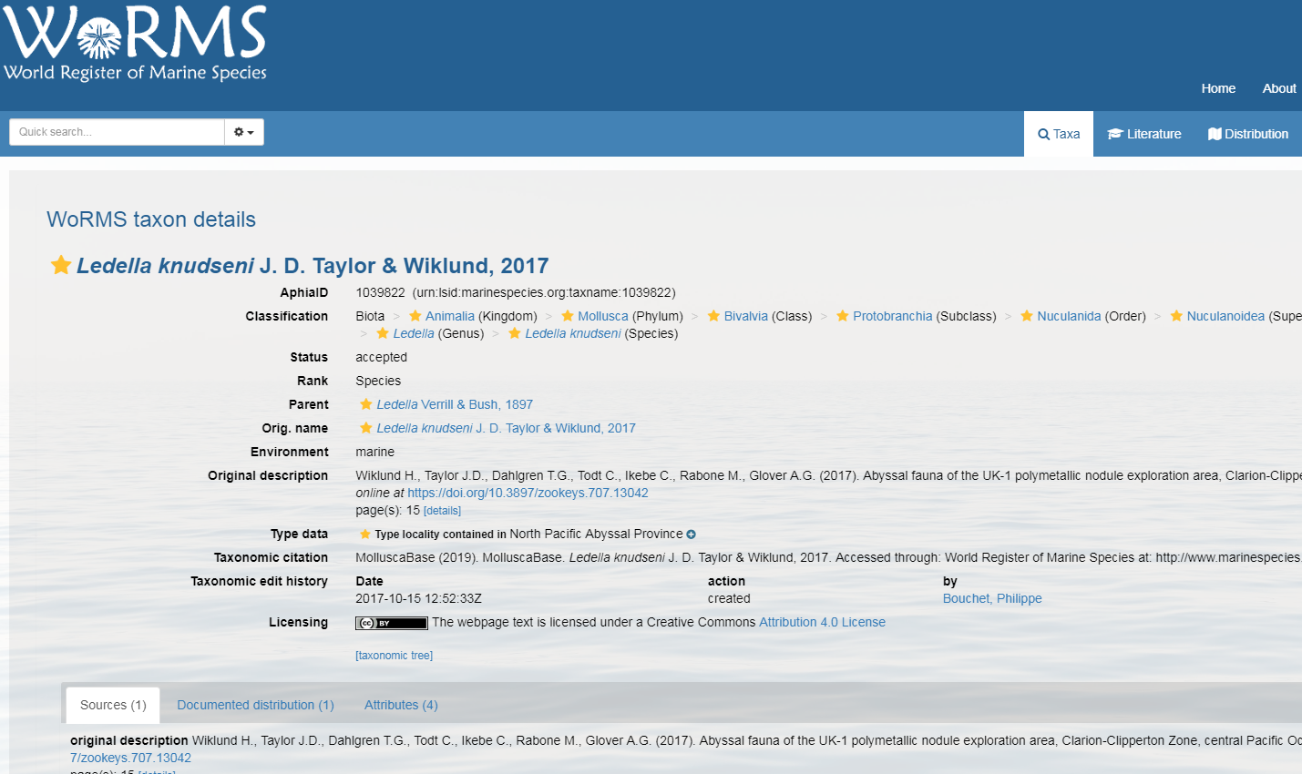
Support for data systems
Potential for greater integration of genetic and occurrence data
Notes:
13 (OBIS-deep-sea) Improvements to existing data systems can support best practice. OBIS is a key platform in the context of MGR in ABNJ, and the deep-sea OBIS node provides a clear focus for the publishing of deep-sea biodiversity data by the research community. Increased integration of genetic and occurrence datasets could be achieved by improvements to existing data systems, potentially a major contribution to streamlining access to MGR.

Slide 14
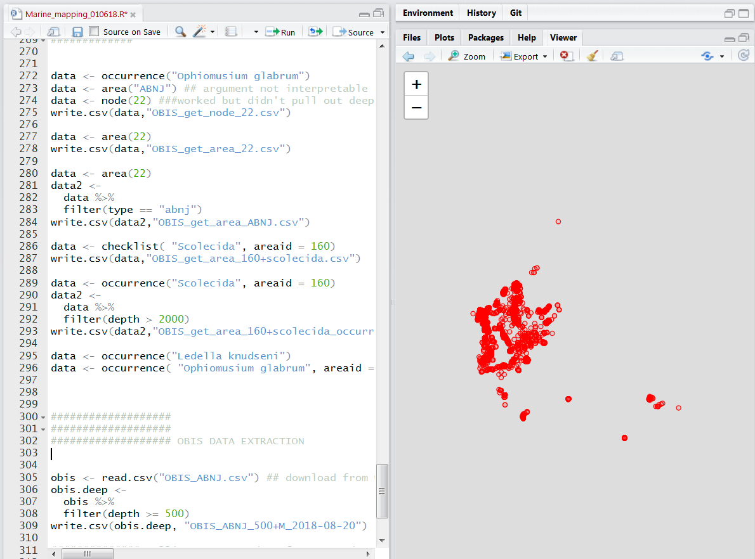
Encourage open source and publishing of datasets
Notes:
14 (r screenshot) Technical innovations, like development of data standards are needed but require an active community and efforts on open source. OBIS for example allows for third party development via existing tools. Open source accompanies open data, and code should be archived, a growing trend which together with publishing standalone datasets and committing to open access publications, should be strongly encouraged by funding bodies. These processes align with ABS enhance collaboration, transparency and technology transfer via sharing knowledge.

Slide 15
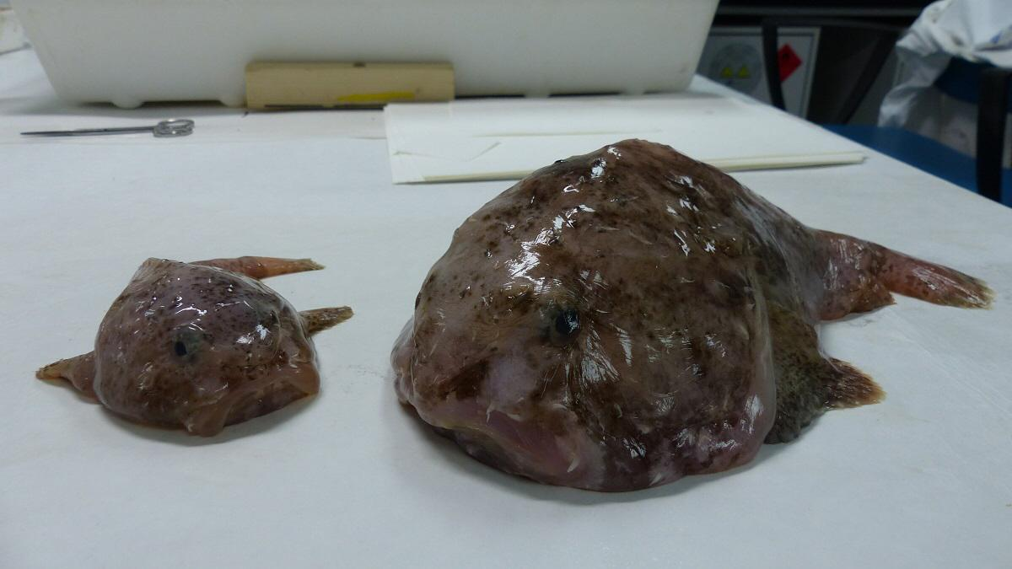
Supported role for networks
Global Genome Biodiversity Initiative
Notes:
15 (networks) Improvements to best practice will require collaboration at multiple levels, from individuals to global networks. Global and regional networks are essential to progress development of data standards, guide best practices, and facilitate access to MGR, for example GGBN provides guidance on best-practice for managing molecular biodiversity collections and data and enables access to over 2 million molecular samples through the network

Slide 16
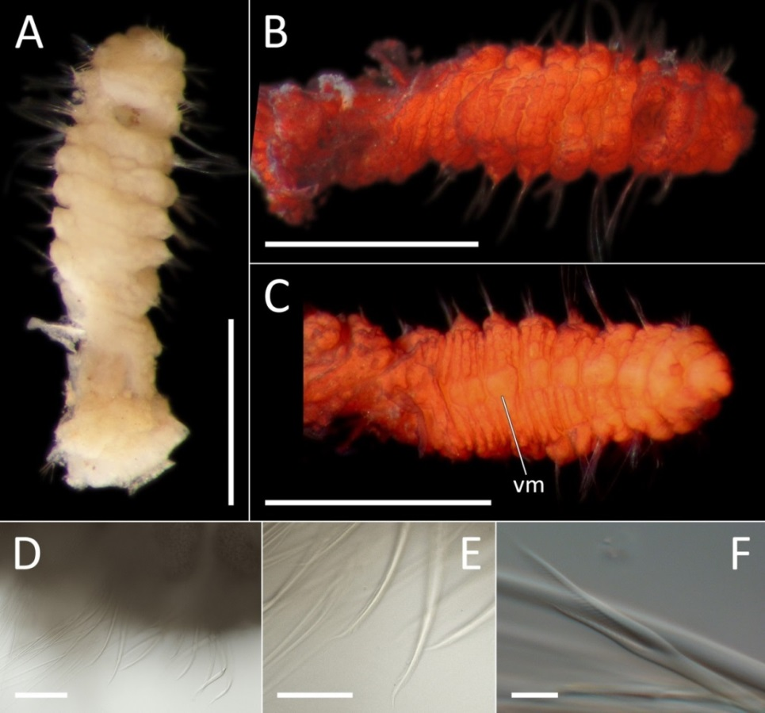
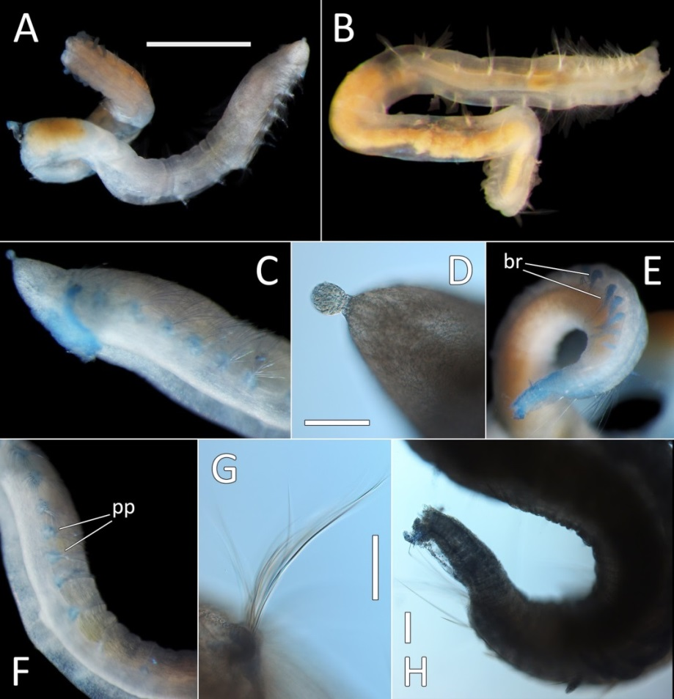
Ensure common understanding of terms:
“ MGR”, “derivatives” …………………………
learn from Nagoya!
Notes:
16 (Nagoya) lessons must be learnt from the Nagoya Protocal, for example to ensure the common understanding of terms associated with ‘Marine Genetic Resources’, including those relating to data and utilisation.

Slide 17
Notes:
(Workflow diagram) back to our overview. Many of the improvements to current practices discussed here could be supported by a clearinghouse mechanism, as shown in diagram. This will be discussed by Ward- coming up next

Slide 18
BBNJ agreement must maintain and support open access
Notes:
18 (Summary) Management of MGR samples and data is currently conducted in an open access arena, so it is critical that the ILBI maintains open sharing of MGR from ABNJ, while building solutions to ensure access for developing countries. It is crucial to ensure best practices for sample and data management are adopted by the scientific community and embedded into protocols and workflows. Maintenance of sample and data repositories also are key to advance knowledge and enable reproducible science. Overall, the elements are in place to build an agreement for access to MGR from ABNJ that can support science and society.

Slide 19
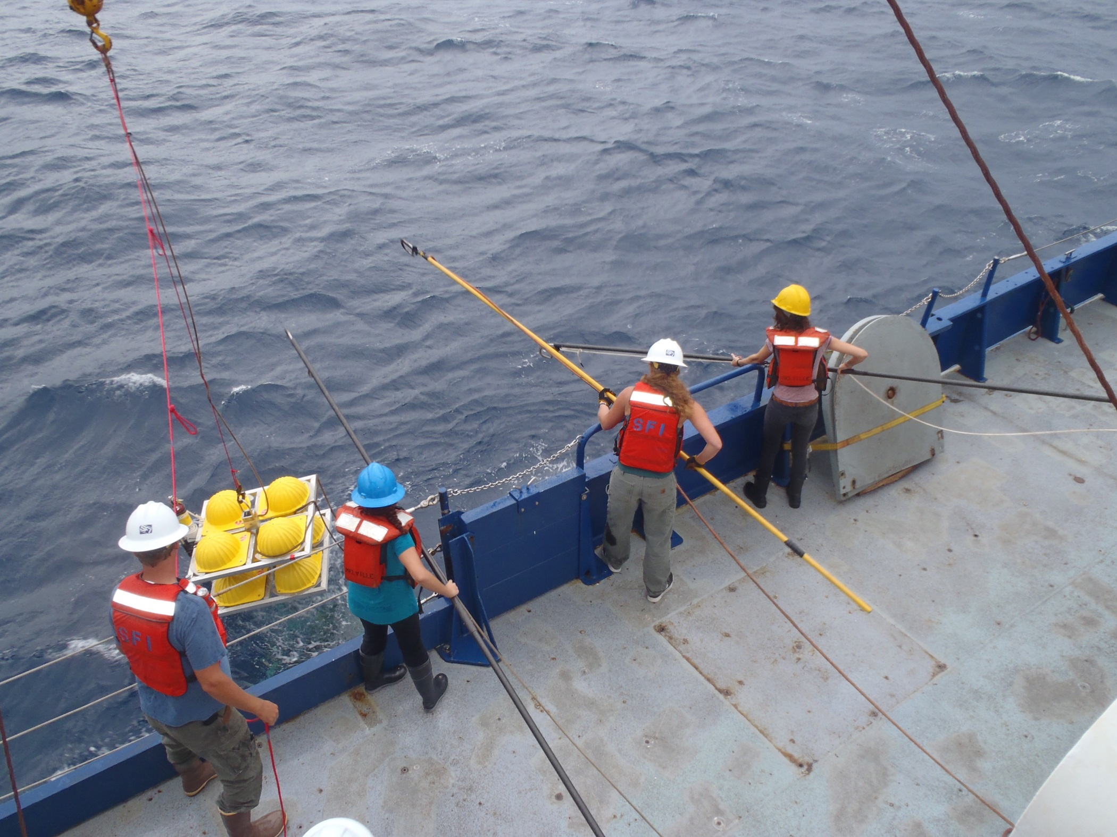
ACKNOWLEDGEMENTS:
Sarah Long (NHM),Maria Baker (NOC), Marcel Jaspars (University of Aberdeen), Kristina Gjerde (IUCN), Jackie Mackenzie-Dodds (NHM), Chiho Ikebe (NHM),
Matt Woodburn (NHM), Diva Amon (NHM), Gordon Patterson (NHM),
DOSI DSGR working group

