Slide 1
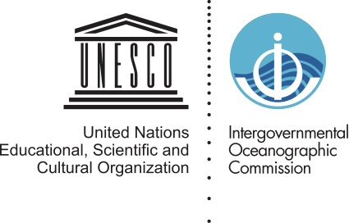
A data and information Clearing-House Mechanism, examples from IOC
Ward Appeltans
UNESCO-IOC

Slide 2
Existing references of IOC in UNCLOS
ANNEX II. COMMISSION ON THE LIMITS OF THE CONTINENTAL SHELF
2. The Commission may cooperate, to the extent considered necessary and useful, with the Intergovernmental Oceanographic Commission of UNESCO, the International Hydrographic Organization and other competent international organizations with a view to exchanging scientific and technical information which might be of assistance in discharging the Commission's responsibilities.
ANNEX VIII. SPECIAL ARBITRATION
Article 2 Lists of experts
2. The lists of experts shall be drawn up and maintained, in the field of fisheries by the Food and Agriculture Organization of the United Nations, in the field of protection and preservation of the marine environment by the United Nations Environment Programme, in the field of marine scientific research by the Intergovernmental Oceanographic Commission, in the field of navigation, including pollution from vessels and by dumping, by the International Maritime Organization, or in each case by the appropriate subsidiary body concerned to which such organization, programme or commission has delegated this function.
Notes:
IOC is mentioned twice in UNCLOS and has a role to exchange scientific and technical information to the Commission on the limits of the continental shelf.
It is also responsible for maintaining a list of experts in MSR.

Slide 3
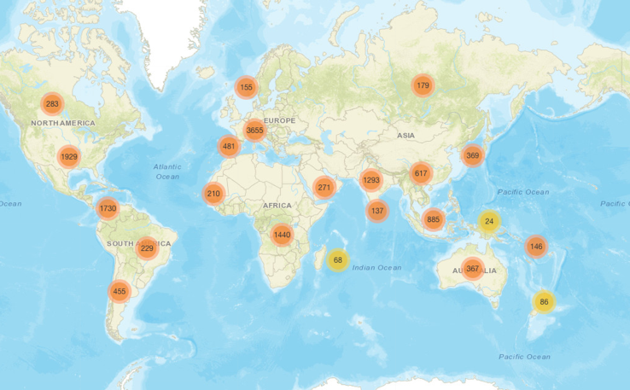
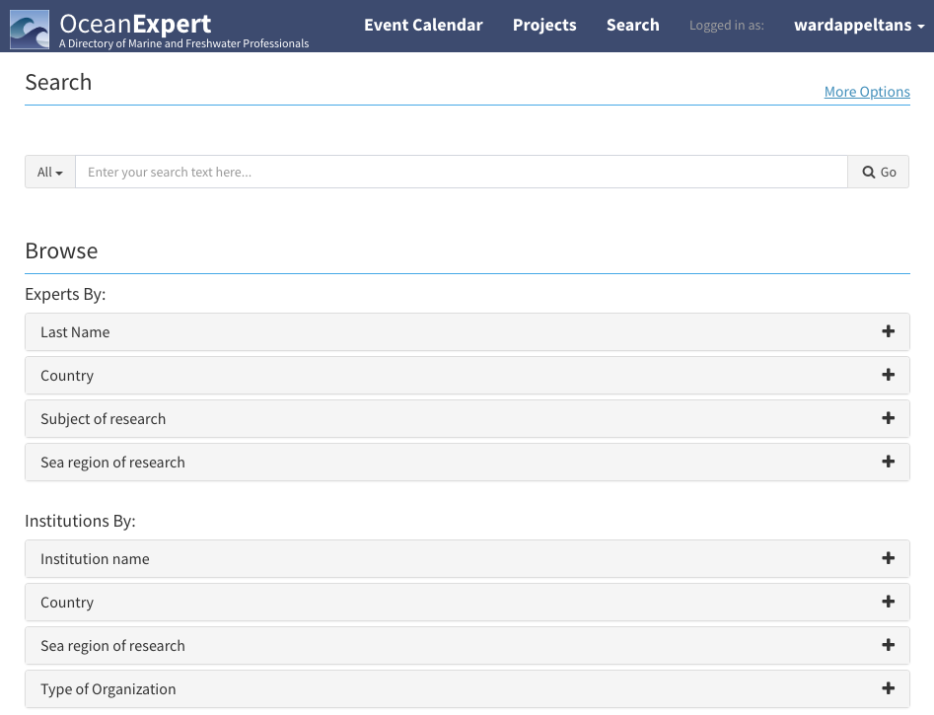
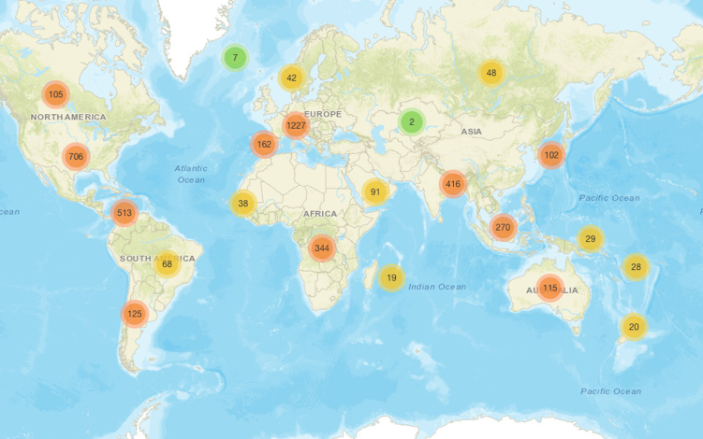
OceanExpert
https://oceanexpert.net/
Experts (15120)
Expert and institute profiles
Events calendar (=> alumni system)
Projects
Country profiles
Institutions (5108)
Notes:
The IOC list of experts is called “OceanExpert” and currently has over 15,000 persons and 5,100 institutions.
OceanExpert is also used to manage events, projects and country profiles.

Slide 4
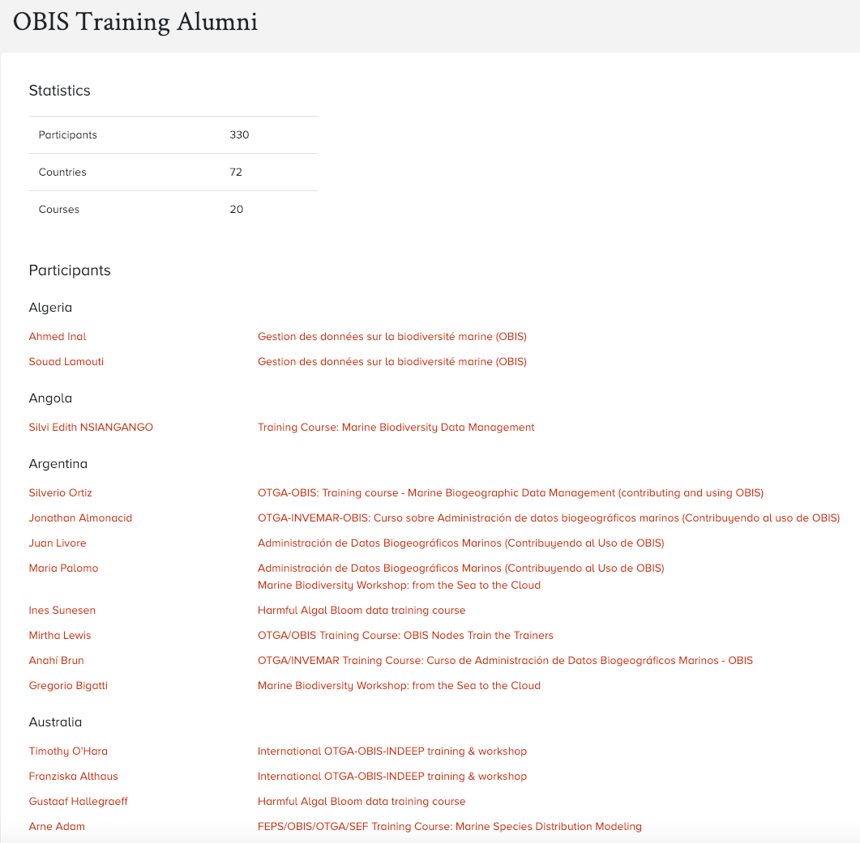
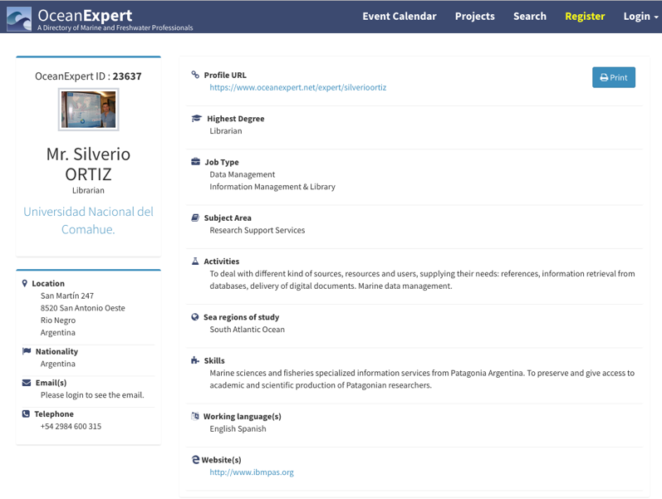
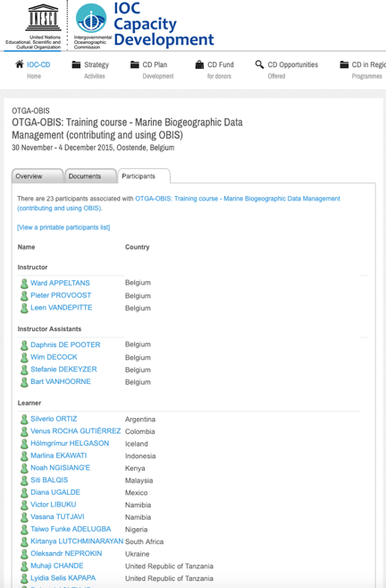
OceanExpert
Expert and institute profiles
Events calendar (=> alumni system)
Projects
Country profiles
OBIS has trained 330 experts from 72 countries in 20 training courses.
2219 events
Notes:
OceanExpert is API driven, which means that third-party applications can easily access the information via webservices and build tools using the information in OceanExpert.
OBIS for example is making use of the OceanExpert API to maintain its alumni list of trainees per country, making use of the events calendar.
The participants need to create an account in OceanExpert and provide information on their expertise. Their account is linked to the training events.
So far, OBIS has trained 330 experts from 7 countries in 20 training courses.

Slide 5
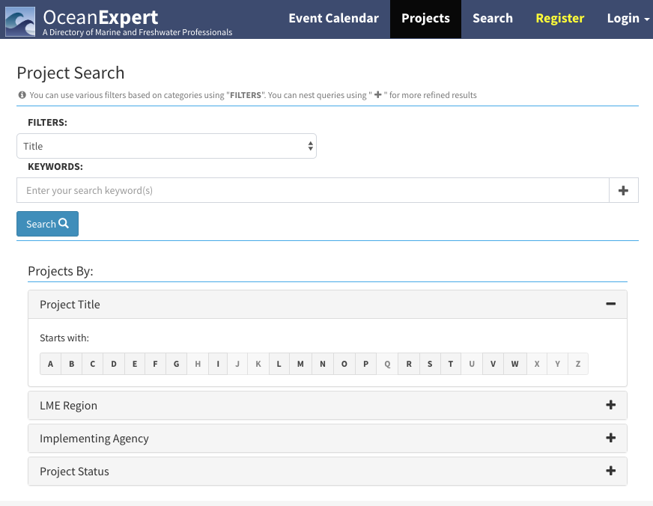
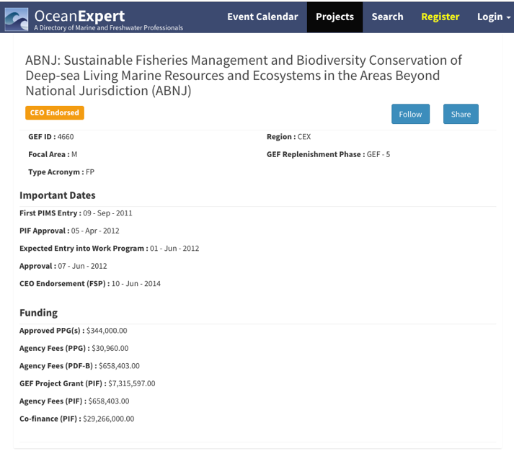
OceanExpert
Expert and institute profiles
Events calendar (=> alumni system)
Projects
Country profiles
Notes:
OceanExpert can also hold information on projects, such as this ABNJ project.

Slide 6
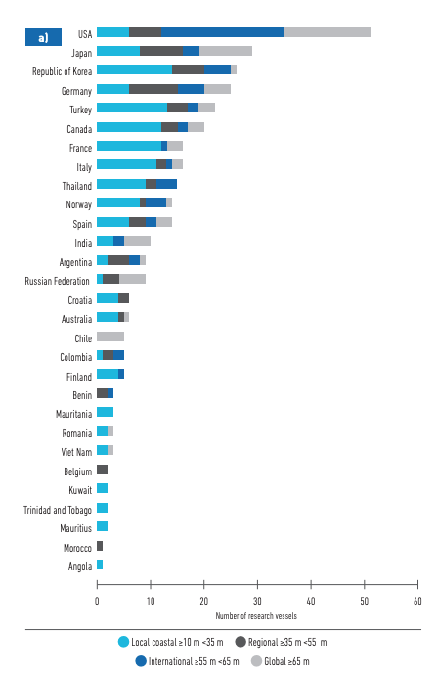
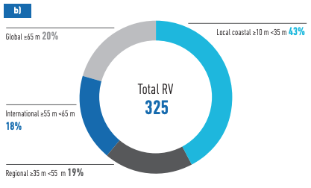
OceanExpert
Expert and institute profiles
Events calendar (=> alumni system)
Projects
Country profiles
Notes:
OceanExpert is also the platform to manage country profiles for the IOC Global Ocean Science Report.
GOSR could be further tailored to support BBNJ in assessing the capacity of Member States in ABNJ.
Some information is already useful, such as the number of Research Vessels (and their size indicates whether they can operate in international waters)

Slide 7
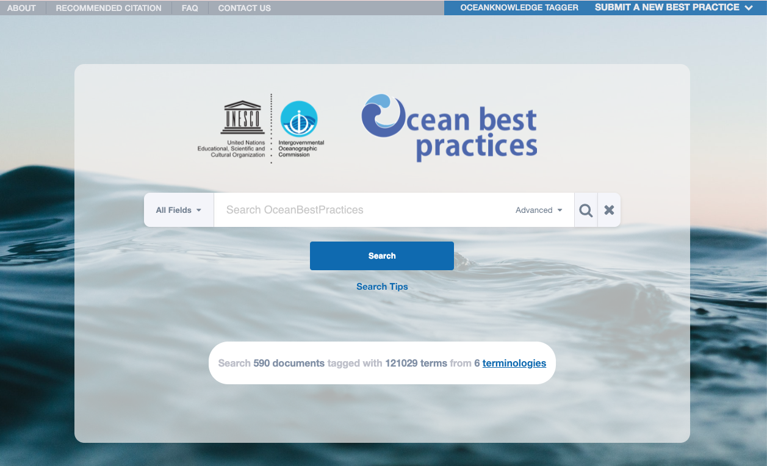
oceanbestpractices.org
Notes:
This project only recently started and so far has documented 590 best practices. These manuals and guides are linked to 6 terminologies. This semantically enhances the records and makes it easier to classify and as such retrieve the right information.

Slide 8
IOC Ocean Data and Information System
https://catalogue.odis.org/
The ODIS "Catalogue of Sources" aims to be an online browsable and searchable catalogue of existing ocean related web-based sources/systems of data and information as well as products and services. It will also provide information on products and visualize the landscape (entities and their connections) of ocean data and information sources.
Notes:
Last week, IODE launched the prototype of the Ocean Data and Information System (ODIS) which is a catalogue of web-based sources of data and information systems.
A lot of the data is still scattered in many national or regional data systems. ODIS aims to make it easier to discover them.
The ODIS Concept Statement
The IOC Ocean Data and Information System (ODIS) will be an e-environment where users can discover data, information and associated products or services provided by Member States, projects and other partners associated with IOC.
IODE will work with existing stakeholders, linked and not linked to the IOC, to improve the accessibility and interoperability of existing data and information, and to contribute to the development of a global ocean data and information system, to be referred to as the IOC Ocean Data and Information System, leveraging established solutions where possible.

Slide 9
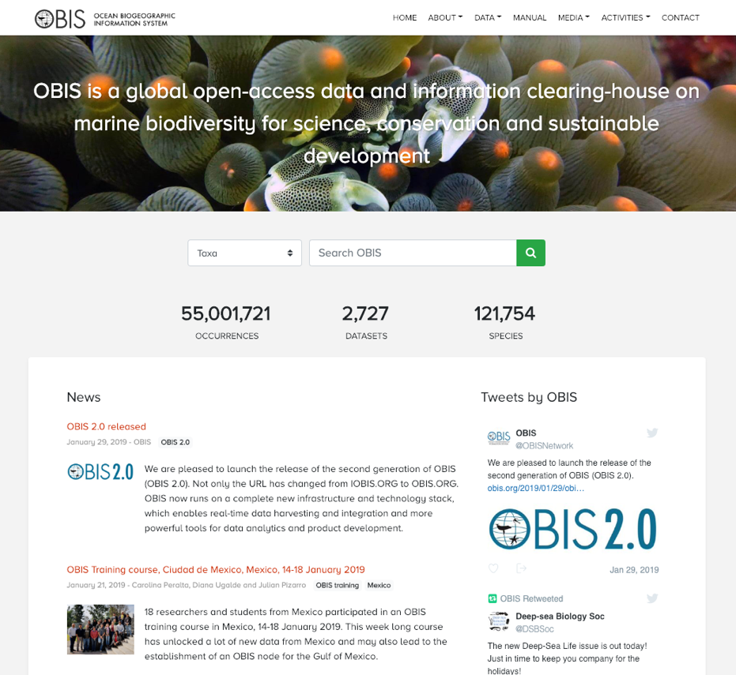
Ocean
Biogeographic
Information
System
https://obis.org/
Provide the world's largest scientific knowledge base on the diversity, distribution and abundance of all marine organisms in an integrated and standardized format
Notes:
In contrast to ODIS, OBIS does harvest and integrate the actual data from over 2,700 databases from all over the world, into a central database. It currently has 55 million observations of 121,000 marine species. Two weeks ago OBIS launched its completely new infrastructure, OBIS2.0
OBIS is a project of IODE under IOC and the secretariat is based in Belgium. There are currently 2 people working at the secretariat (a manager and a technical data manager/IT developer).

Slide 10
A journey of 50,000,000 records in time and space
Notes:
This is what 50 million occurrences look like. We cover the entire global ocean.

Slide 11
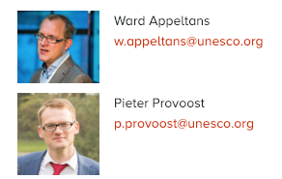
OBIS NODES NETWORK
Notes:
However, a lot of the work is done by the 60 people working at the national, regional or thematic OBIS nodes.
The OBIS nodes are responsible for the local networking, formating and quality control of the data, so that OBIS can seamlessly harvest the data from those nodes.
8 new OBIS nodes were established in the last 2 years, so the network is growing. However, only 1/3 of them have their resources secured for 2019-2020.
For the sustainability of OBIS, it is very important that countries not only provide core funding for the OBIS secretariat, but also to its national OBIS nodes.

Slide 12
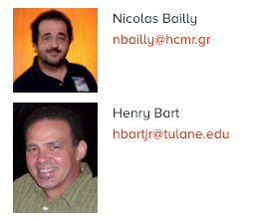
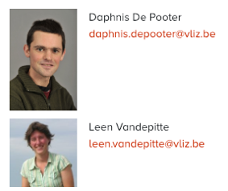
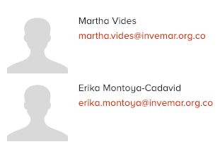
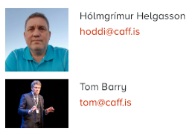
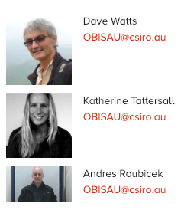
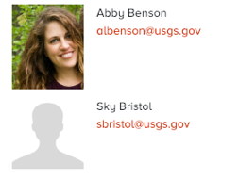
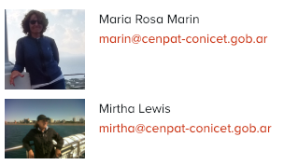
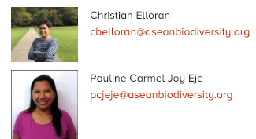
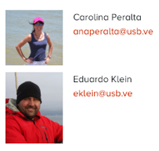
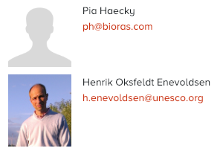
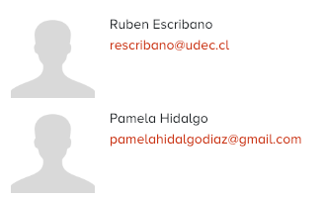
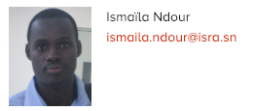
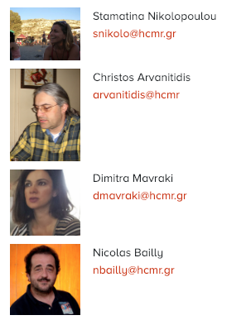
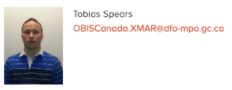
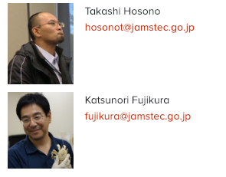
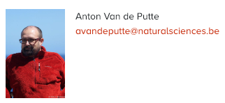
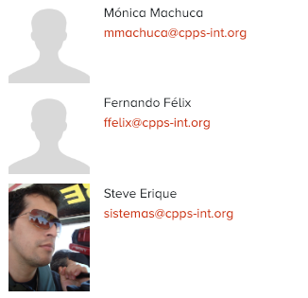
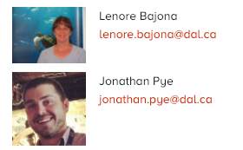
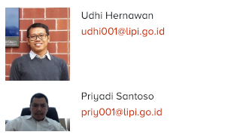
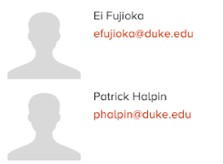
OBIS NODES NETWORK
Notes:
However, a lot of the work is done by the 60 people working at the national, regional or thematic OBIS nodes.
The OBIS nodes are responsible for the local networking, formating and quality control of the data, so that OBIS can seamlessly harvest the data from those nodes.
8 new OBIS nodes were established in the last 2 years, so the network is growing. However, only 1/3 of them have their resources secured for 2019-2020.
For the sustainability of OBIS, it is very important that countries not only provide core funding for the OBIS secretariat, but also to its national OBIS nodes.

Slide 13
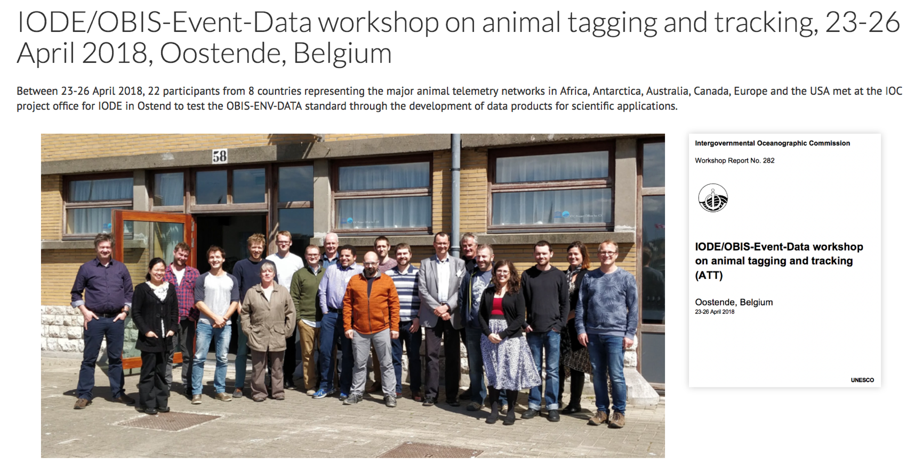
Developing international standards and data exchange protocols
Notes:
OBIS is also active in developing international standards and data exchange protocols, such as this meeting we organized in April last year, where the major animal tracking networks agreed to share the detection locations of tagged animals (e.g. fish, crustacea, mammals etc) with OBIS.

Slide 14
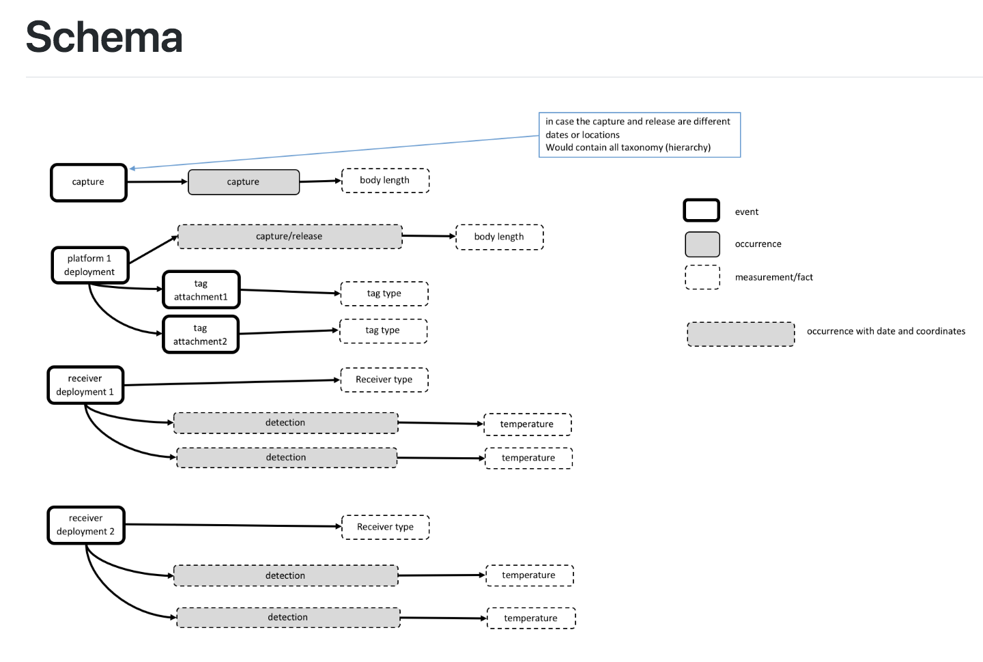
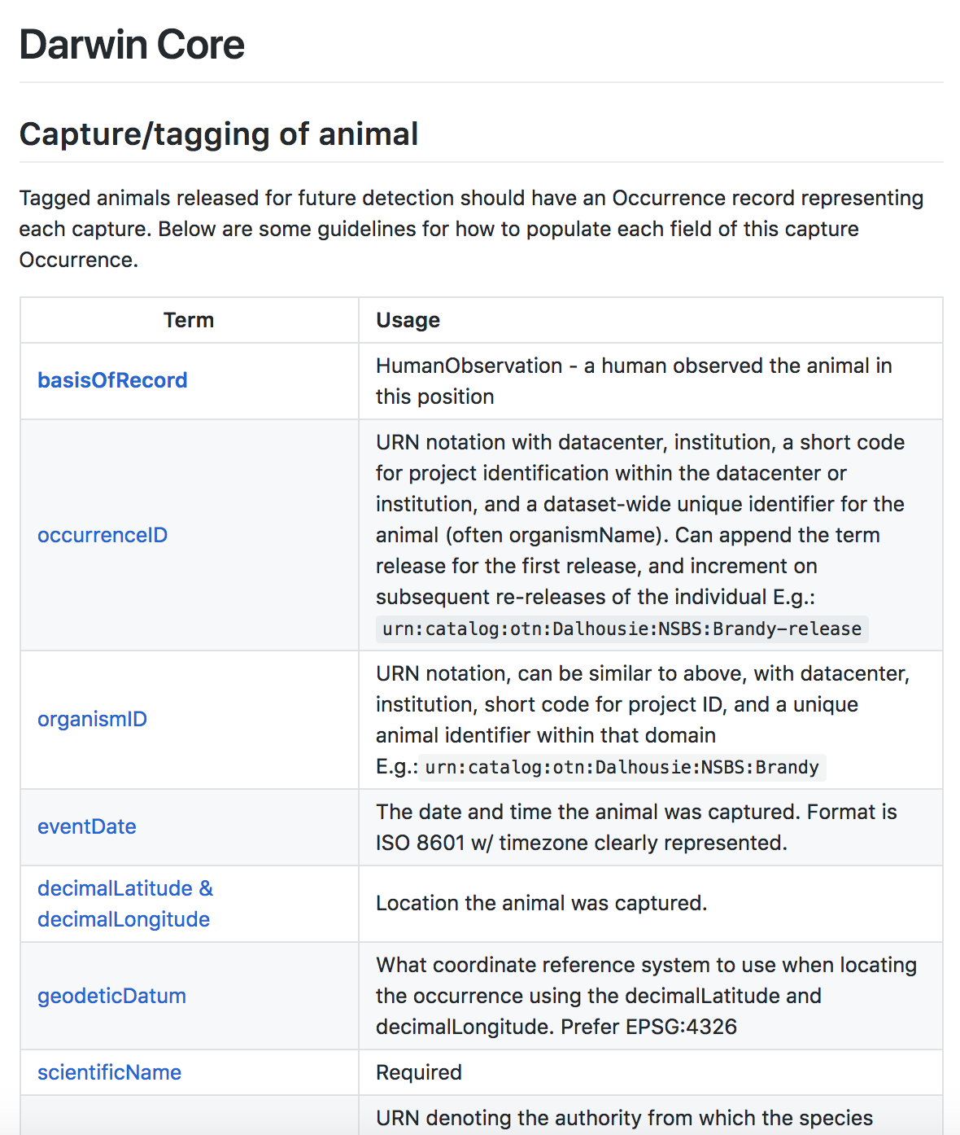
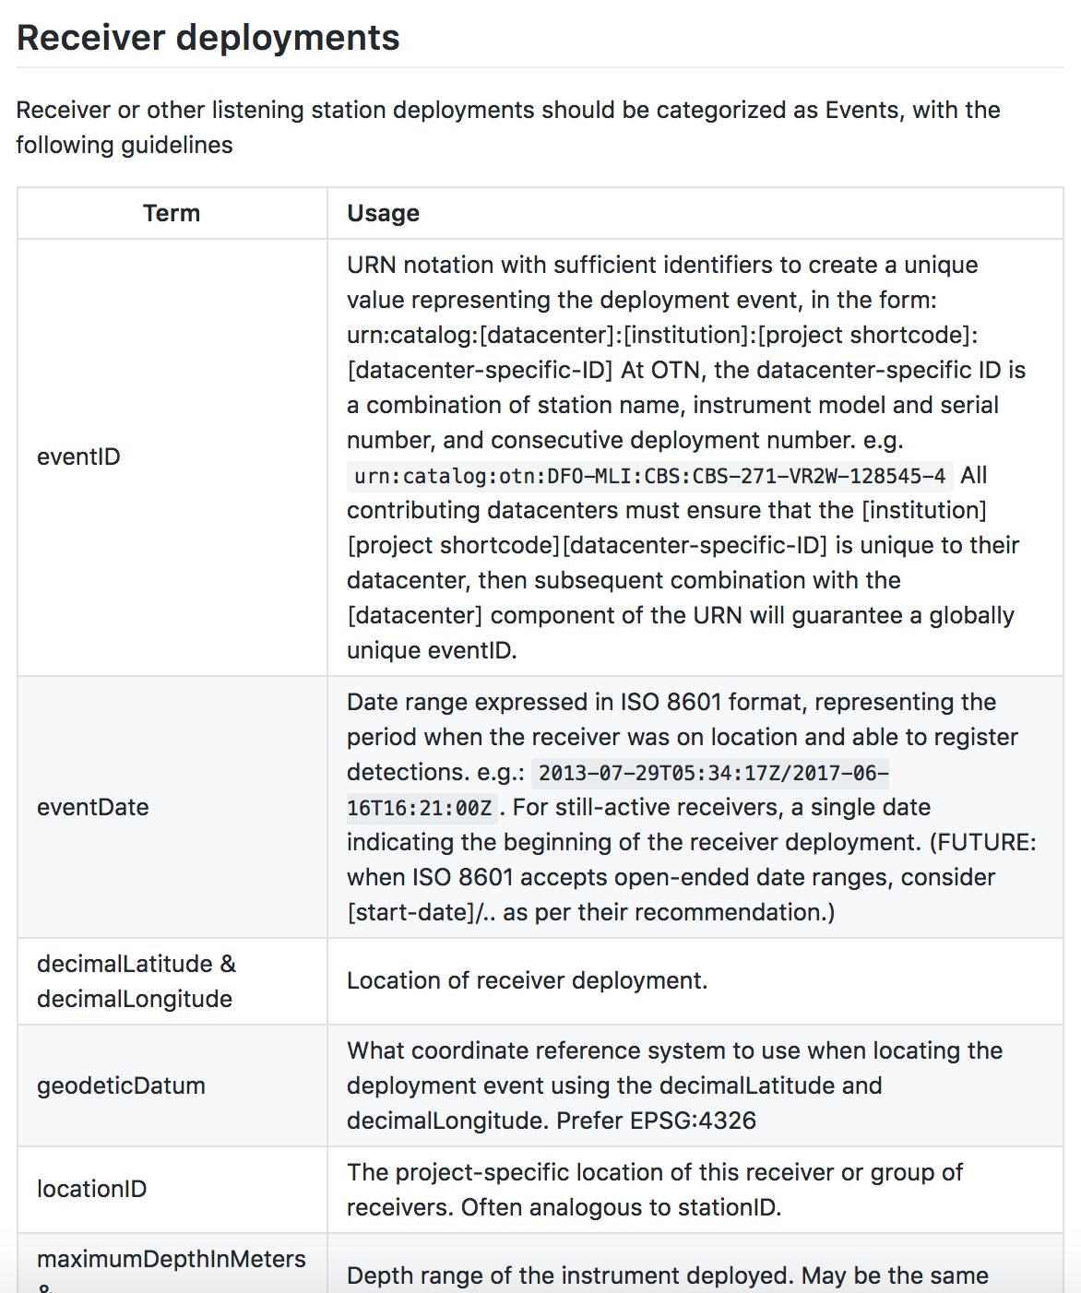
Developing international standards and data exchange protocols
Notes:
Here is an example of the definitions of the data terms.

Slide 15
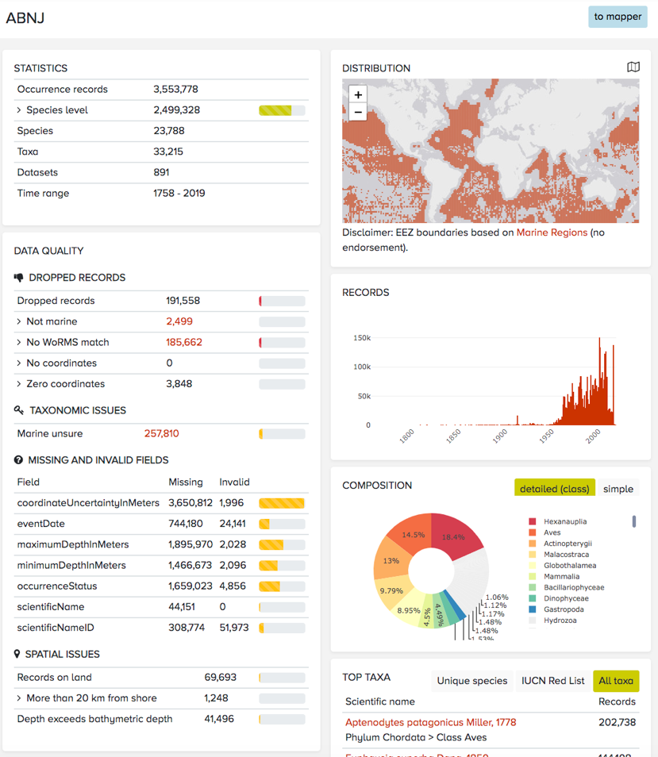
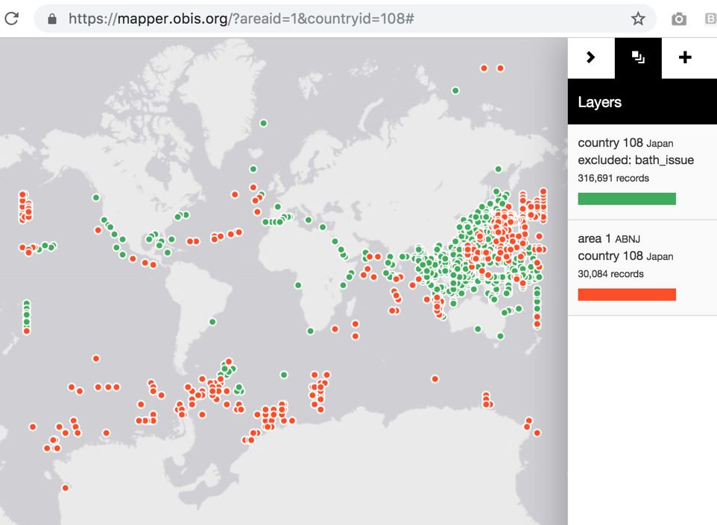
Data portal
Notes:
As I said, OBIS launched its new portal recently. You can find statistics for areas, such as EEZs, IHO sea areas, Large Marine Ecosystems, EBSAs, but also ABNJ.
3% of the datasets only holds data from ABNJ and interestingly 26% of the datasets hold data both in EEZ and ABNJ, so cross the EEZ boundary. 71% of the datasets do not hold data from ABNJ.
4% or more than 5000 species occur exclusively in ABNJ, and 16% occur in both EEZs and ABNJ, and 80% occur only in EEZ.

Slide 16
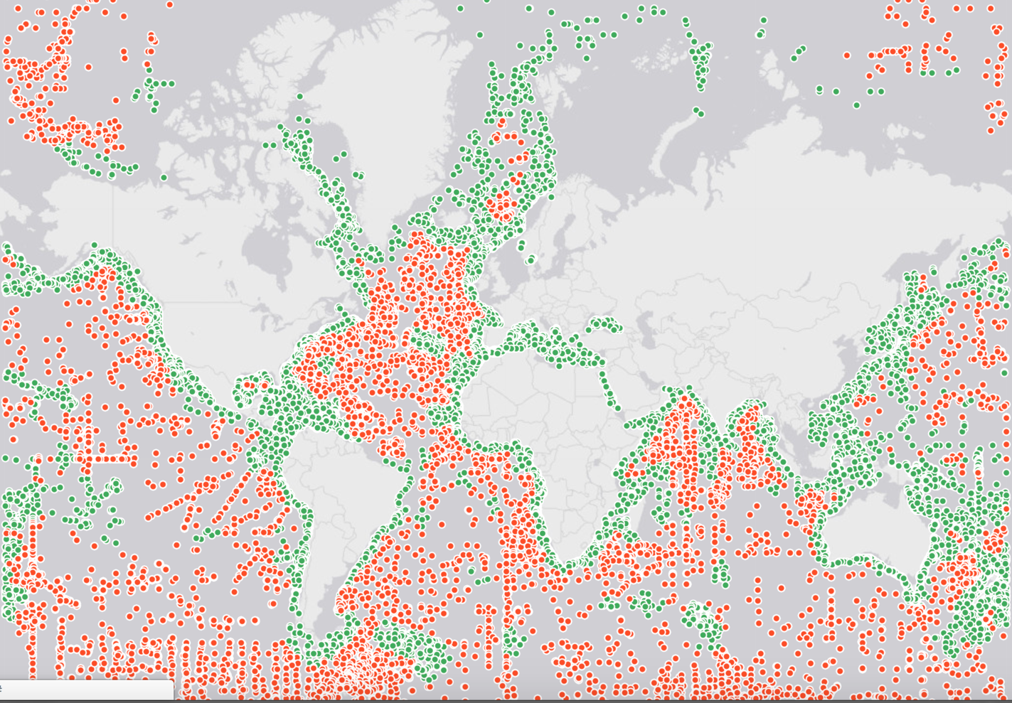
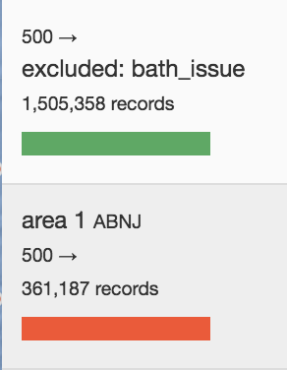
Data portal
Deep-sea records in OBIS (>500m)
Notes:
The new powerful mapper provides tools to visualize, filter and download the data in excel. For example, this is a map showing the 1.5 million deep-sea records in OBIS of which 360,000 are in ABNJ (red).
Here deep-sea means all records with a sampling depth below 500m.

Slide 17
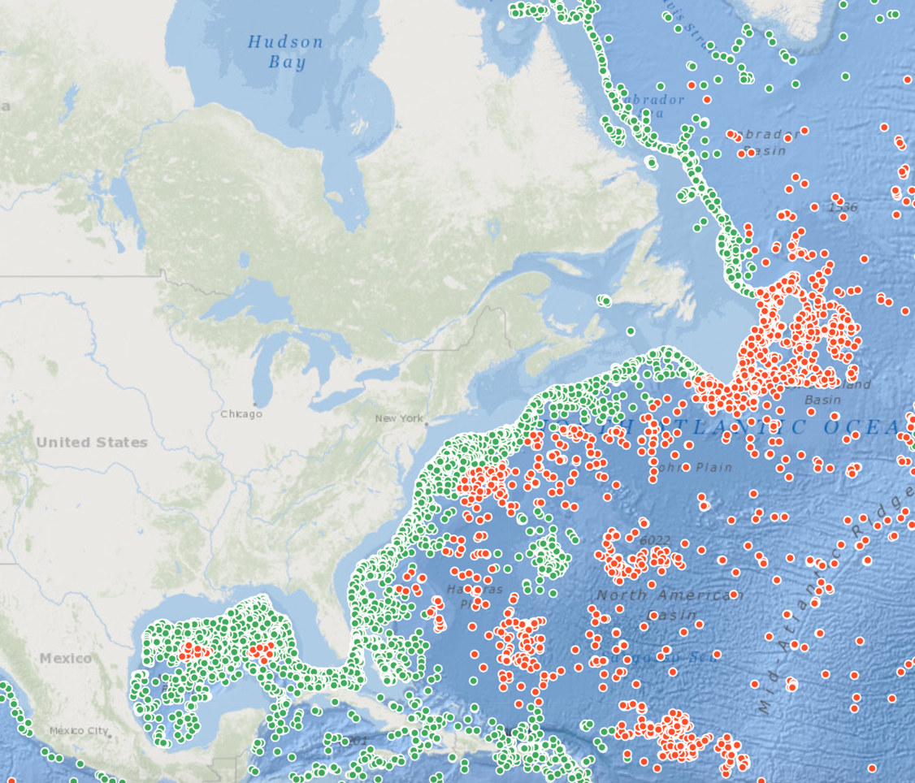
Data portal
Deep-sea records in OBIS (>500m)
Notes:
This is the same map, zoomed in on the N-W Atlantic and with a different base layer.

Slide 18
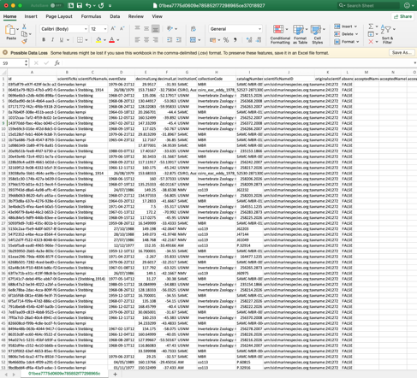
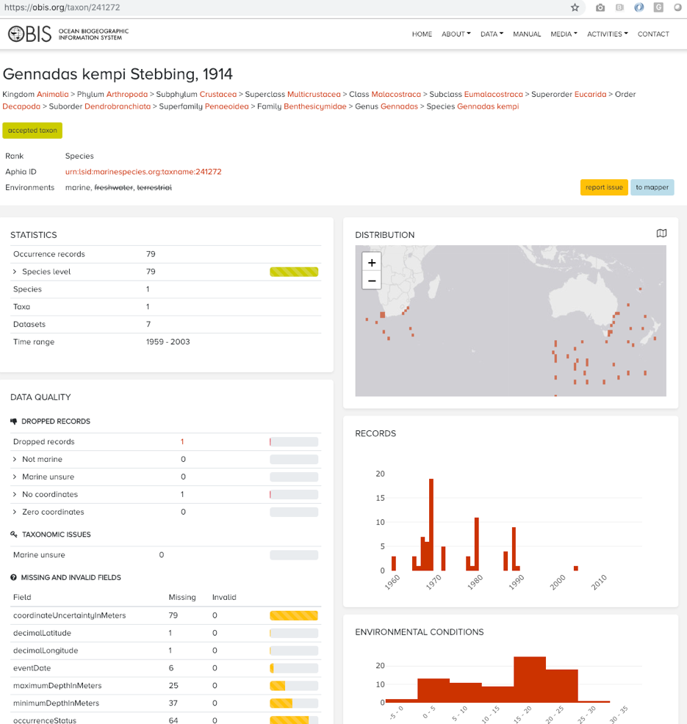
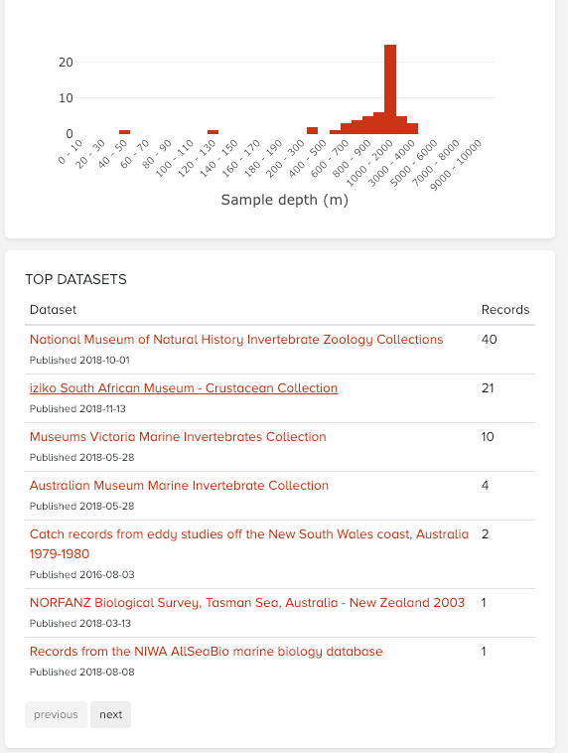
Data portal
Smithsonian Institution, National Museum of Natural History, Department of Invertebrate Zoology
Notes:
OBIS also provides information on species level, such as this deepsea shrimp for which OBIS provides 79 occurrences integrated from 7 different datasets.

Slide 19
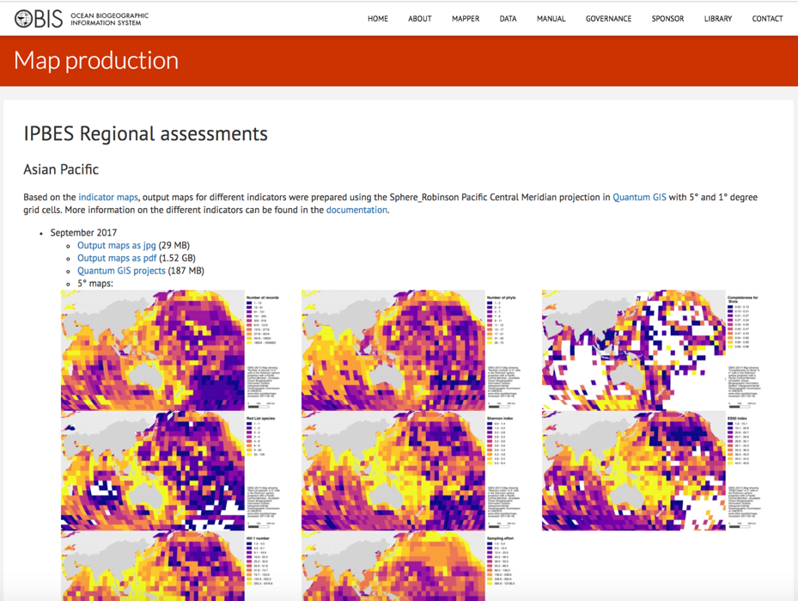
Supporting international processes
The 27th IOC Assembly (2015) encouraged increased participation of IOC in the work of IPBES through OBIS and other relevant IOC programmes (IOC-XXVIII/Dec.6.1).
Notes:
OBIS is called upon to support several international processus, such as the Intergovernmental Science-Policy Platform on Biodiversity and Ecosystem Services (IPBES). OBIS has provided statistics and maps for the regional and global assessments.

Slide 20
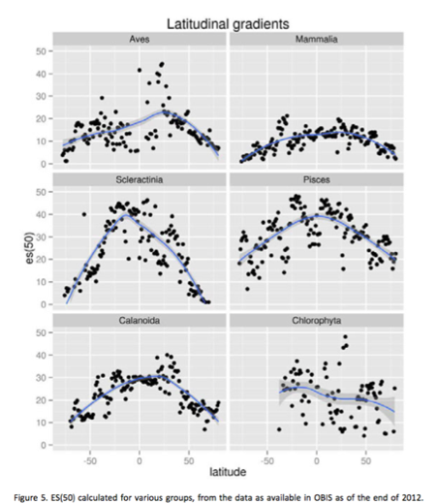
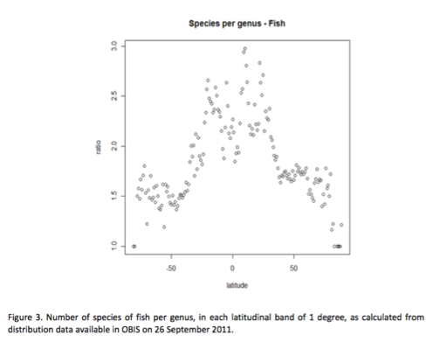
Supporting international processes
OBIS contributed to 3 chapters of the first World Ocean Assessment, and at the IOC Assembly, the coordinator explicitly asked IOC, through OBIS and other programmes,
to support the WOA-2
Notes:
OBIS data was used in 3 chapters of the first UN World Ocean Assessment and is currently supporting authors of the 2nd cycle.

Slide 21
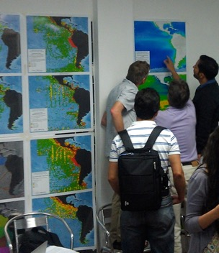
Supporting international processes
CBD decision X/29, para 35
Requests ... UNESCO-IOC, in particular the Ocean Biogeographic Information System (OBIS), .. and others... to facilitate availability and inter-operability of the best available marine and coastal biodiversity data sets and information across global, regional and national scales.
Data portal
Notes:
OBIS is one of the important information sources for the identification of EBSAs. And the OBIS portal provides summary statistics for all of the approved EBSAs.

Slide 22
Open-access to research data supports equitable access and benefit sharing and
enhances international collaboration
1300 papers
2700 authors
72 countries
Notes:
OBIS is recognized by the UN General Assembly for its contribution to MSR. This figure shows that open-access to research data supports equitable access and benefit sharing and enhances international collaboration. It shows the collaboration of 2700 scientists from 72 countries that published over 1300 publications citing OBIS.
It shows N-N, N-S and S-S collaboration, although the connections between developing countries and SIDS is very weak and needs to be strengthened.

Slide 23
Last 12 months, 191 people trained in 8 OBIS training courses
Capacity development through training
Notes:
Being part of IOC, Capacity Development is an important activity in OBIS. Scientists and data managers are trained in contributing data to OBIS as well as use data from OBIS for research.

Slide 24
OBIS 2.0
OBIS-ENV-DATA
List of events: Cruise planning
List of events: track and trace
Links to external repositories (genebanks)
Huge oversight

