Slide 1
From data to science, to scientific evidence as a basis for decision-making on sustainable use of the ocean
Side event
27 March BBNJ IGC-2
Anne Christine Brusendorff, ICES General Secretary
IOC

Slide 2
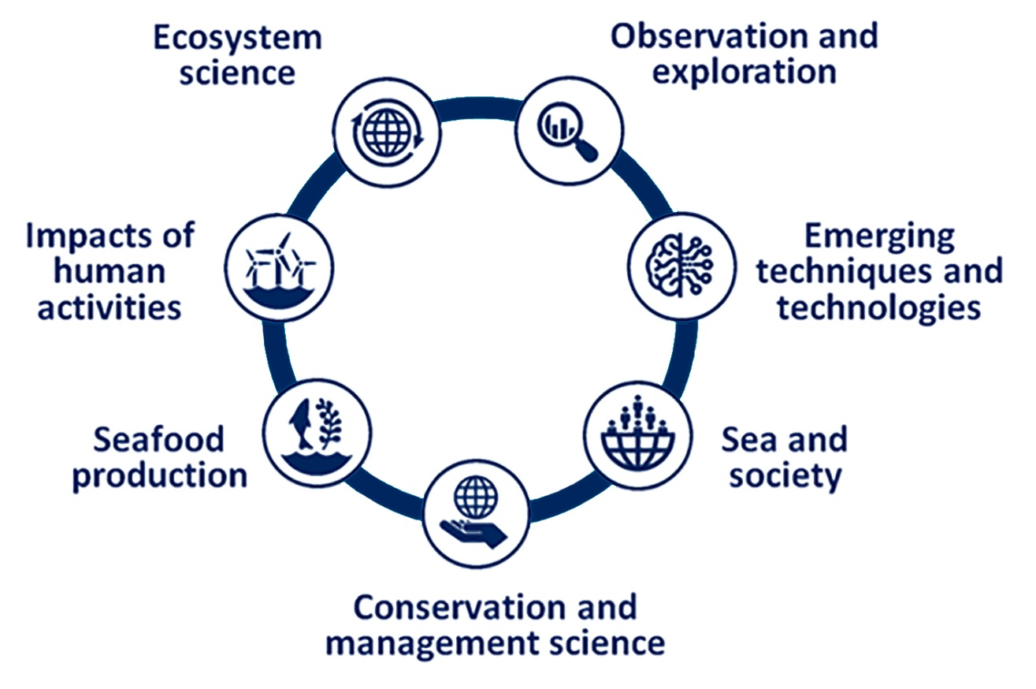
ICES creation, translation, and application of knowledge

Slide 3
ICES advice – providing knowledge to decision-makers
National waters
International waters
Environmental legislation, Management targets, Monitoring methods, Fishing and fish, Impacts of humans, Trade-off analysis, Environmental change, Conservation policy
Science for sustainable seas

Slide 4
How ICES works
International platform for scientists
Participation possible irrespective of country of origin

Slide 5
Biodiversity in ABNJ
ICES VME database - ABNJ
ICES annual advice on VME and fishing in NE Atlantic ABNJ
Basis for 13 closures to bottom fishing in Northeast Atlantic ABNJ

Slide 6
Arctic and ABNJ
Joint ICES PICES Arctic Council (PAME) State of the Central Arctic Ocean report
Planned for presentation by the spring 2019 Arctic Council ministerial meeting

Slide 7
Fisheries in ABNJ
ICES provides annual advice on 35 to 50 fish stocks in the Atlantic ABNJ

Slide 8
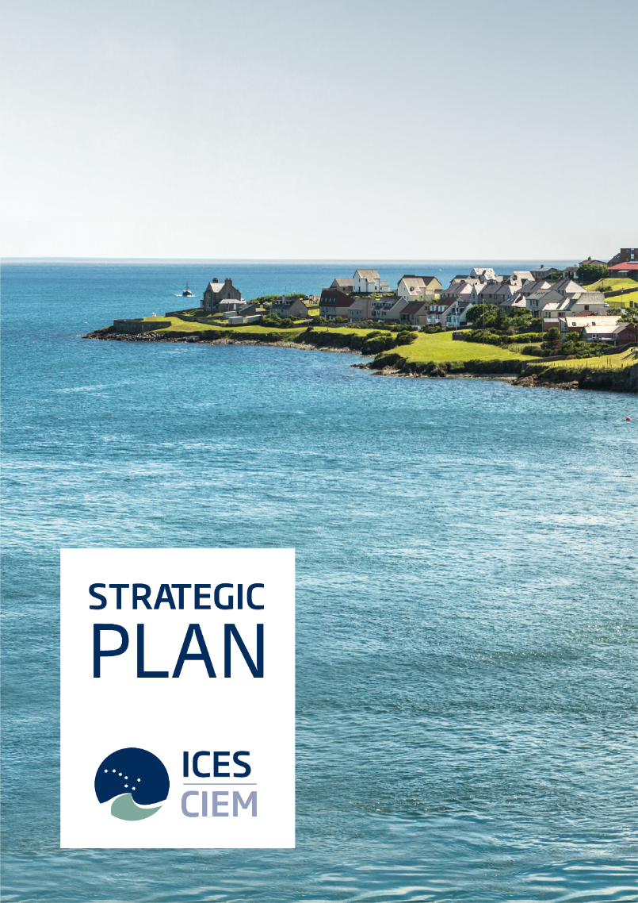
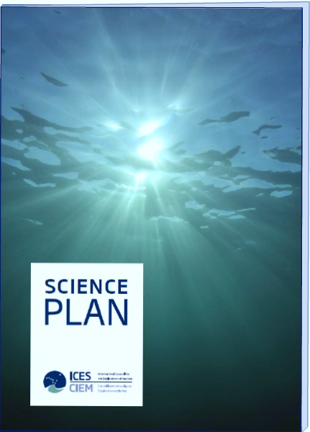
ICES Strategic and Science Plans
Vision
To be a world-leading marine science organization, effectively meeting societal needs for impartial evidence on the state and sustainable use of our seas and oceans.
Mission
To advance and share scientific understanding of marine ecosystems and the services they provide, and to use this knowledge to generate state-of-the-art advice on meeting conservation, management and sustainability goals.

Slide 9
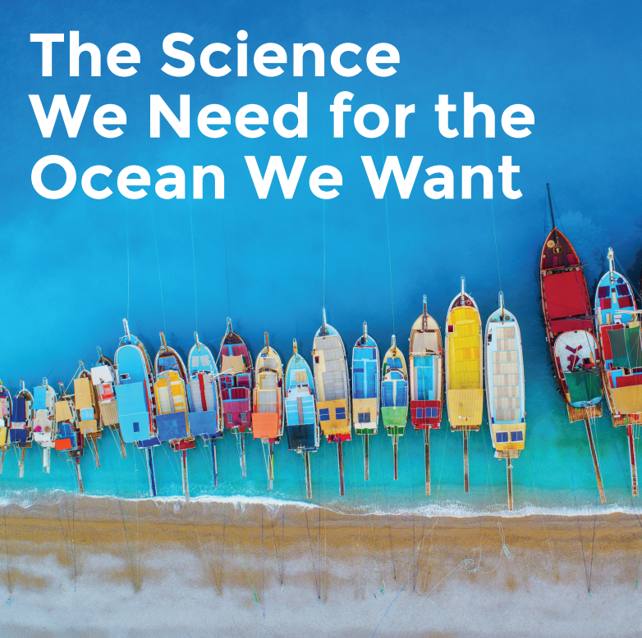
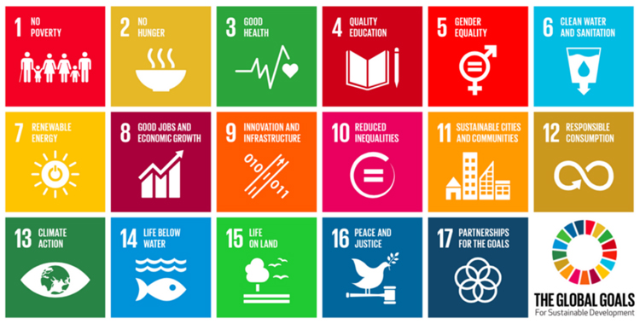
ICES UN GA Observer Status

Slide 10
Thank you

