Slide 1
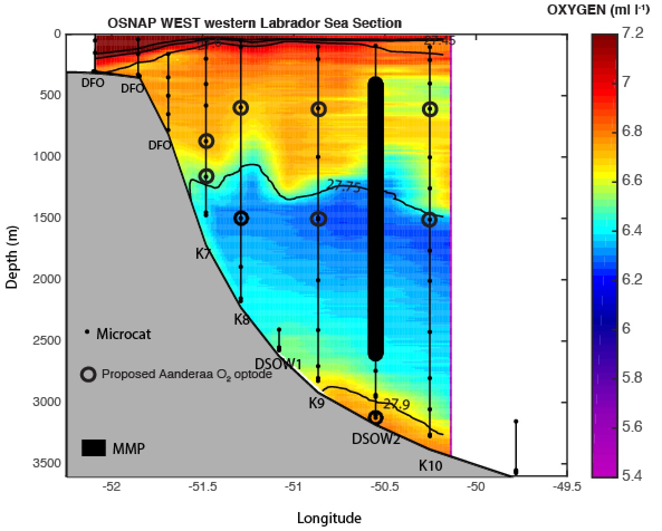

Deep moorings as reference sites for the ocean observing networks. Quality control and utility of oxygen time-series from the optodes
Dariia Atamanchuk (dariia.atamanchuk@dal.ca)
Doug Wallace (Dalhousie)
Jannes Koelling (Dalhousie, OFI)
Johannes Karstensen (GEOMAR)
Jaime Palter (URI) and PIs from GOHSNAP
A contribution to
OceanSITES Virtual Meeting
Session: Deep Ocean Observing, Sept 16, 2020

Slide 2
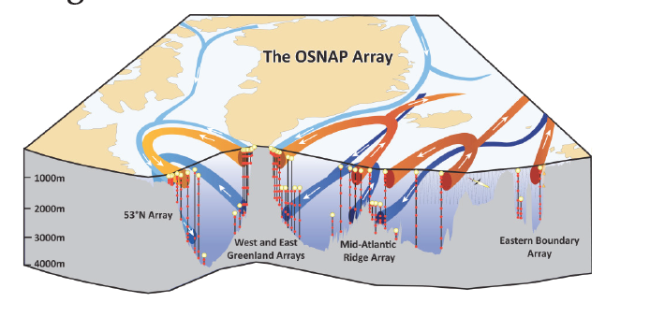
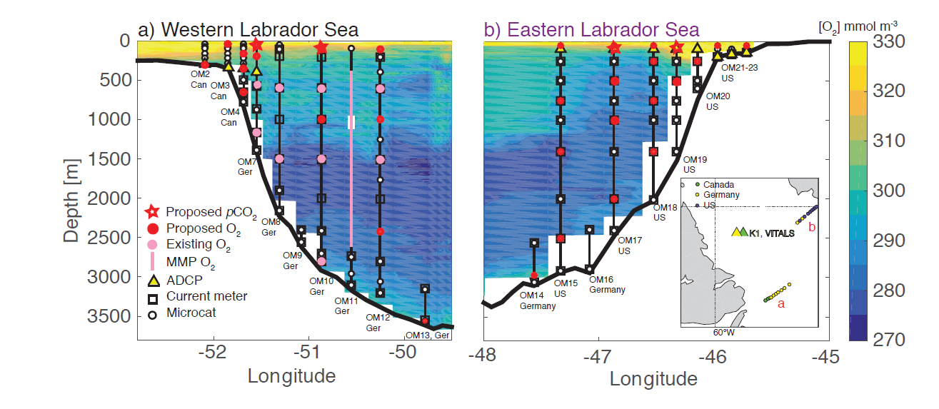
OSNAP
Overturning in the Subpolar North Atlantic (OSNAP) provides a continuous record fluxes of heat, mass and freshwater in the subpolar N Atlantic
Lozier et al., 2017
In 2016, oxygen optodes added to 53N Array (OSNAP WEST) to study transport of oxygen
GOHSNAP
In 2020, NSF-funded GOHSNAP (Gases in the Overturning and Horizontal circulation of the Subpolar North Atlantic
Program) equipped the entire LS array with oxygen optodes

Slide 3
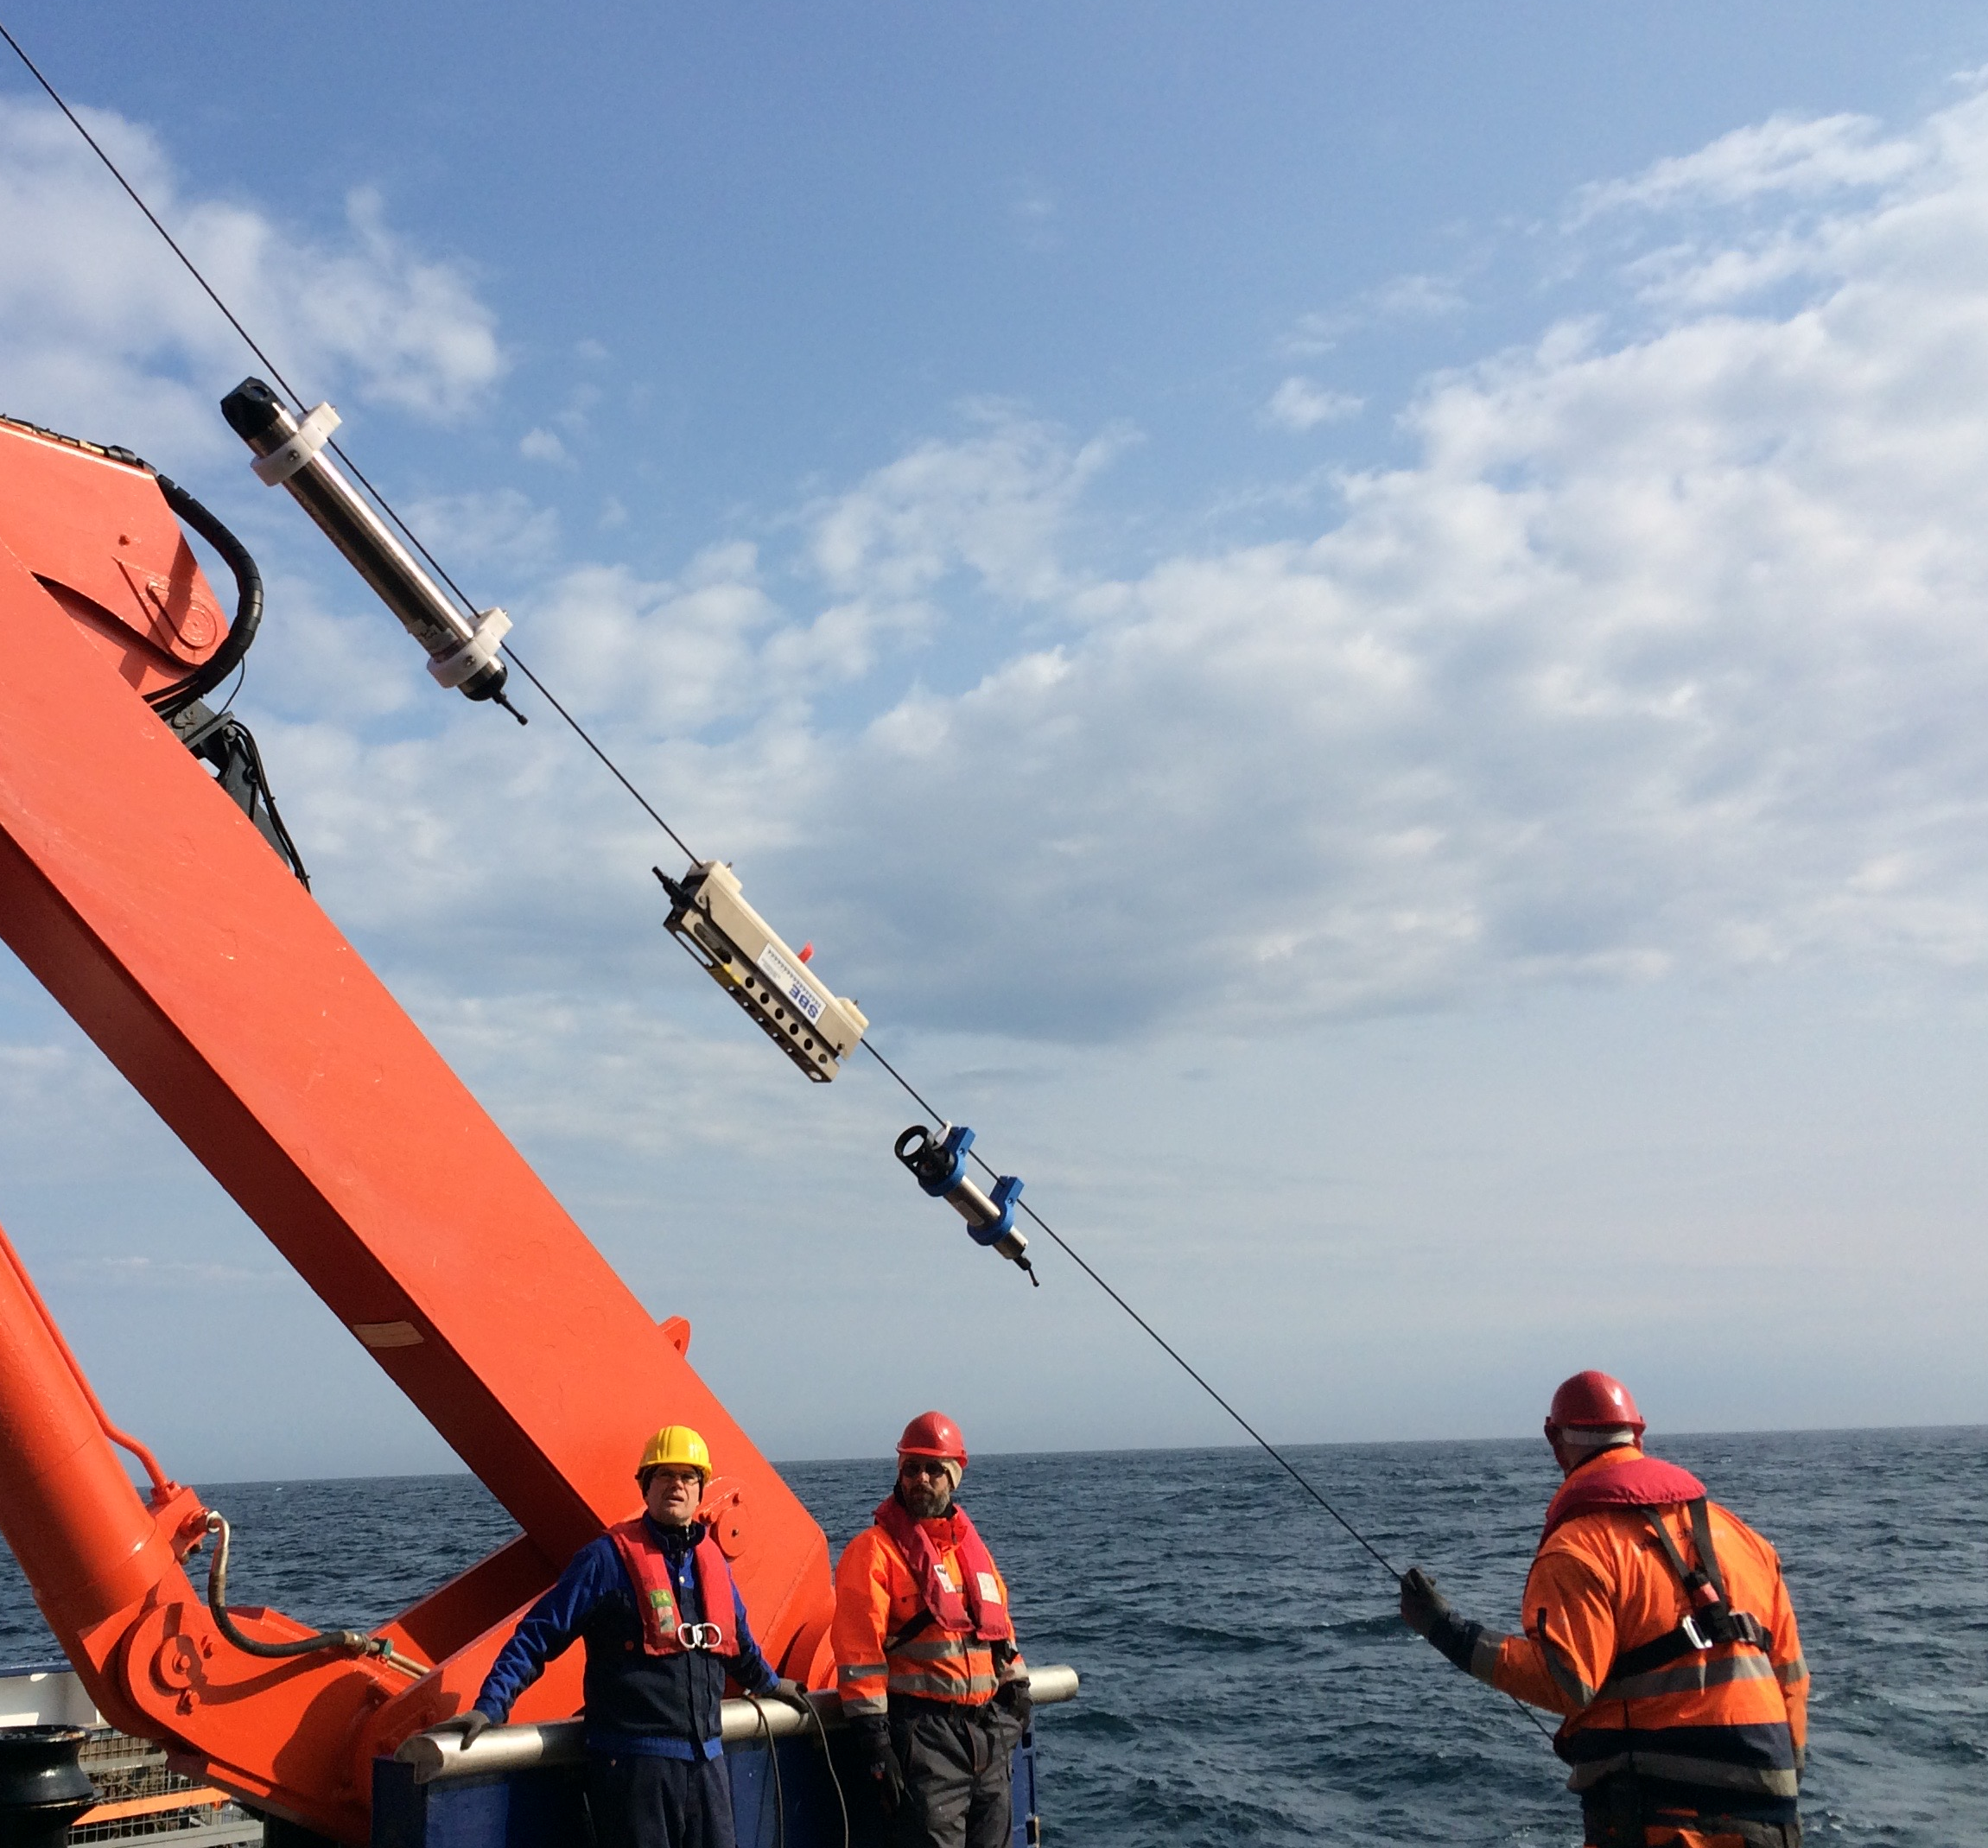
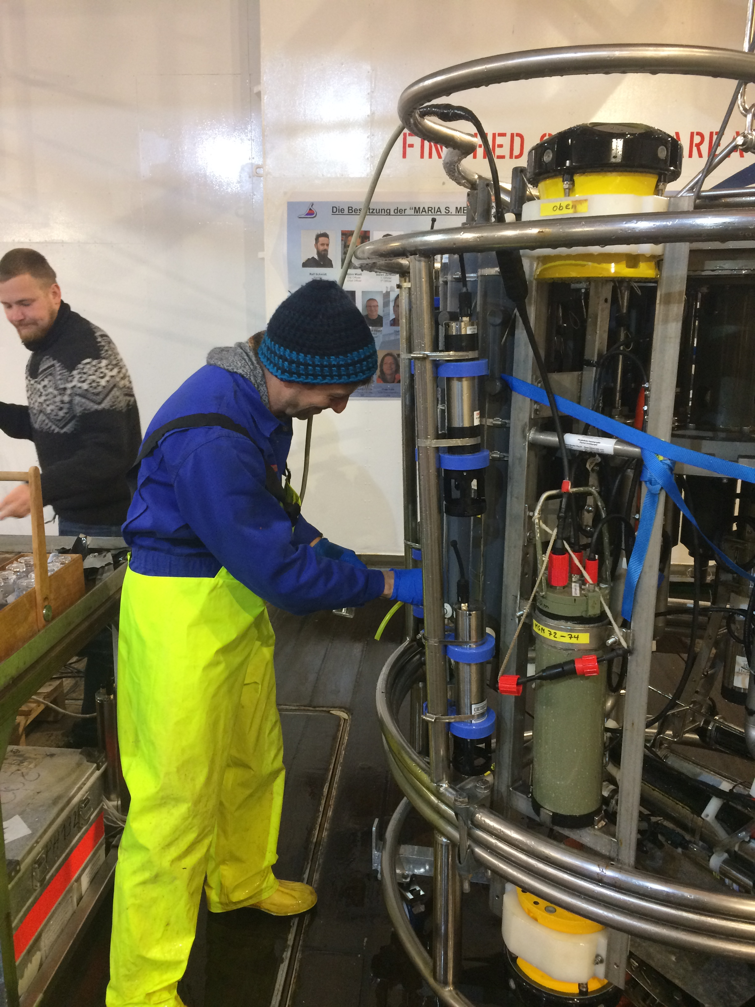
The oxygen sensors were paired with the existing MCs to provide CTD data for salinity correction
1st deployment – 2016-2018
2nd deployment -2018-2020
3rd deployment - 2020-onward (GOHSNAP)
MicroCat
optode
Quality Control of Oxygen Data
pre, post- deployment calibration cast (‘cal-dip’) with CTD and Winkler samples for oxygen (full depth with 3-5 stops);
CTD cast the mooring location after the deployment and before the recovery.
Cal-dips and CTD casts are needed to correct
for the drift of the sensors, including a so-
called ‘pressure-conditioning’.
optodes strapped to the CTD rosette for post-deployment calibration

Slide 4
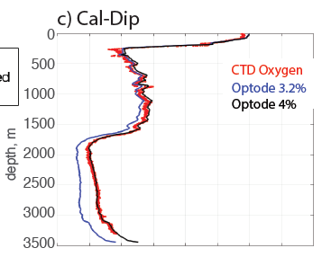
Pressure conditioning causes a non-linear drift in the first 2-3 weeks after the deployment.
Amplitude of this drift is a function of depth and is corrected for based on cal-dip data.

Slide 5
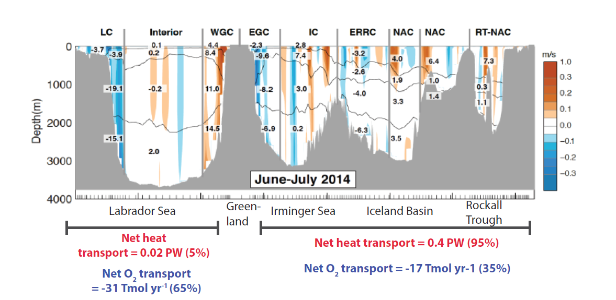
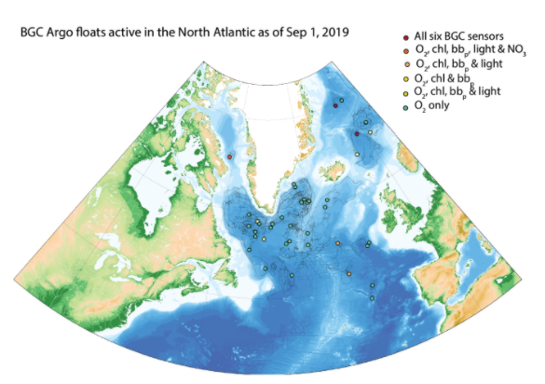
Utility of oxygen data from deep moorings:
Insight into the correlation between oxygen, heat, mass and freshwater fluxes;
Improvement and validation of biogeochemical models;
Oxygen utilization rates in the deep ocean (biological carbon pump).
Reference sites for ocean observing networks for data inter-calibration (BGC Argos, gliders, AUVs).

