Slide 1



Recent Developments in Deep Ocean Sensor Technology at Sea-Bird Scientific
2020 OceanSITES Virtual Meeting – Deep Ocean Observing Session
Deep Argo, Nathalie Zilberman, SIO
      Evaluation of new 7000 m pressure sensors for improved accuracy and stability
      Testing of new materials for encapsulation of conductivity cell
      Drift analysis of MicroCATs (SBE 37)
      Improved pH sensor technology for deep ocean observations
Jochen Klinke
Director of Science, SBS

Slide 2
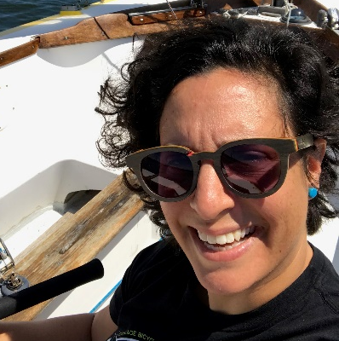
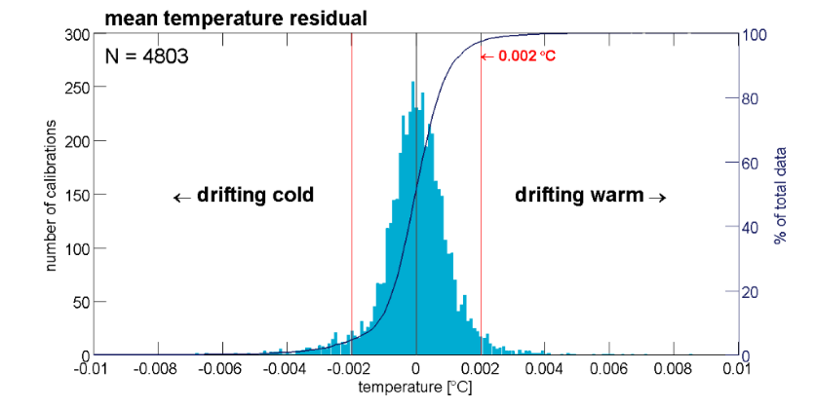
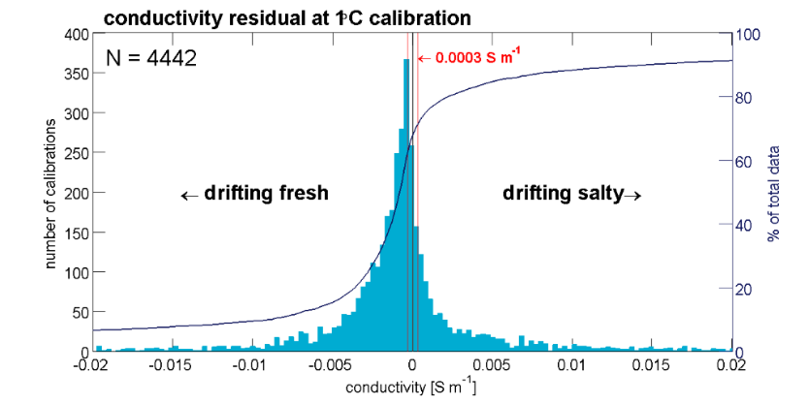
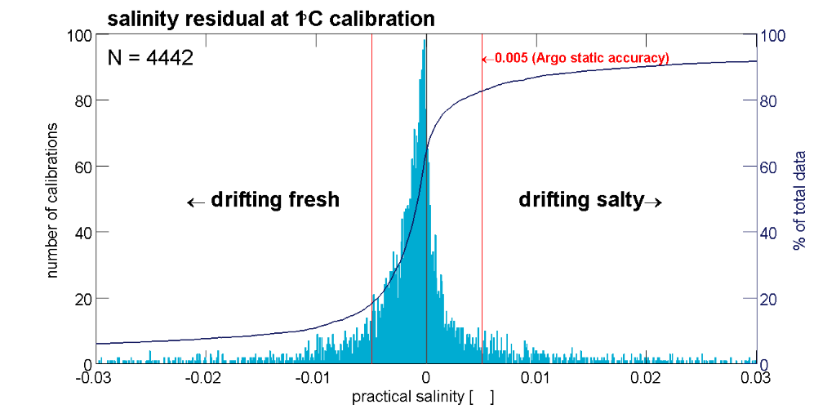
Drift Analysis of MicroCATs – Kim Martini
Goal: Determine long term stability of MicroCATs (SBE 37)
Drift determined from pre- and post deployment calibrations assuming linear rate of change over time span (typically 6 months – 2 years)
Calibration data covers 20 years (1998 – 2018) of manufacturing
Comparison includes over 4,000 sensors
Temperature
Conductivity
Salinity
More than 90% of temperature sensors maintain accuracy within initial specifications
Conductivity typically drifts fresh and is caused by environmental fouling within the conductivity cell

Slide 3

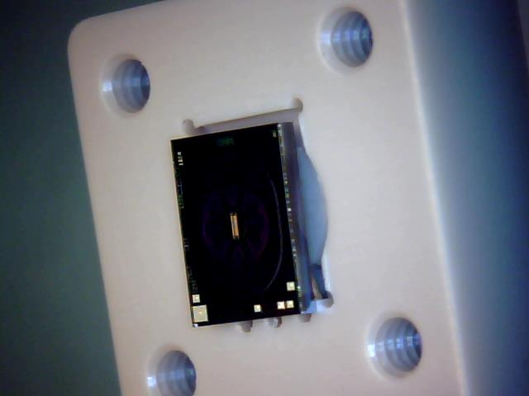
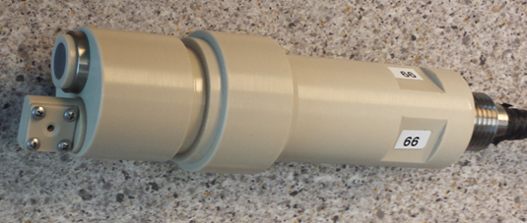
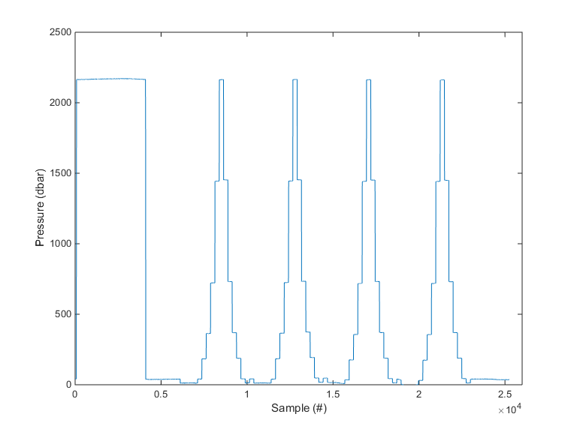
ISFET pH Sensor Technology – Charlie Branham
ISFET pH technology
  Integrated into Deep SeapHOx (Deep SeaFET™ + SBE 37 SMP ODO) and Float pH (Argo BGC) Deep SeaFET™
  Originally developed collaboratively by Ken Johnson (Monterey Bay Aquarium Research Institute), Todd Martz (Scripps Institution of Oceanography), and Honeywell.
  2000 m depth rating
  Requires nonlinear pressure & temperature characterization
  aka as k2 calibration
ISFET pH Specifications
Accuracy | ± 0.05 pH
Typical Stability | 0.0036 pH per year
reference
25C
35C
25C
15C
5C
25C
Large temperature and pressure offsets over the pressure range.
ISFET
Low pressure “hook” in the data can’t be modeled. Causes errors near the surface.

Slide 4
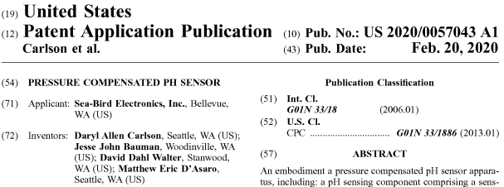
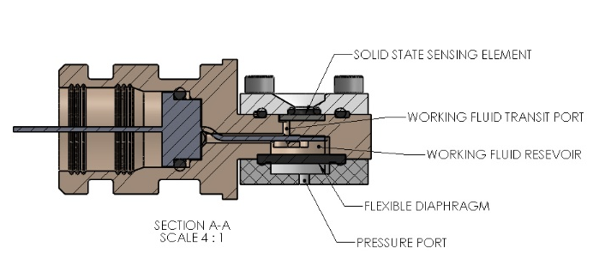
Improved ISFET pH Sensor
Improvements in the accuracy and endurance of the ISFET pH measurements
  Develop a pressure compensated sensor design to minimize effect of pressure on the ISFET signal and reduce calibration time
Standard pH Sensor
P-Comp pH Sensor
Pressure Response
Sensor 10375: Failed K2 redlines 3 times
Pressure Response
Sensor 10375(p-comp): Pass K2
Large temperature and pressure offsets over the pressure range.
Linear response wit 3x reduction in uncertainty over test range of T & P
Low pressure “hook” in the data can’t be modeled. Causes errors near the surface.
Extends depth rating to 4000 m, reduces calibration time, improves yield, linearizes calibration model while increasing accuracy by factor 3

Slide 5
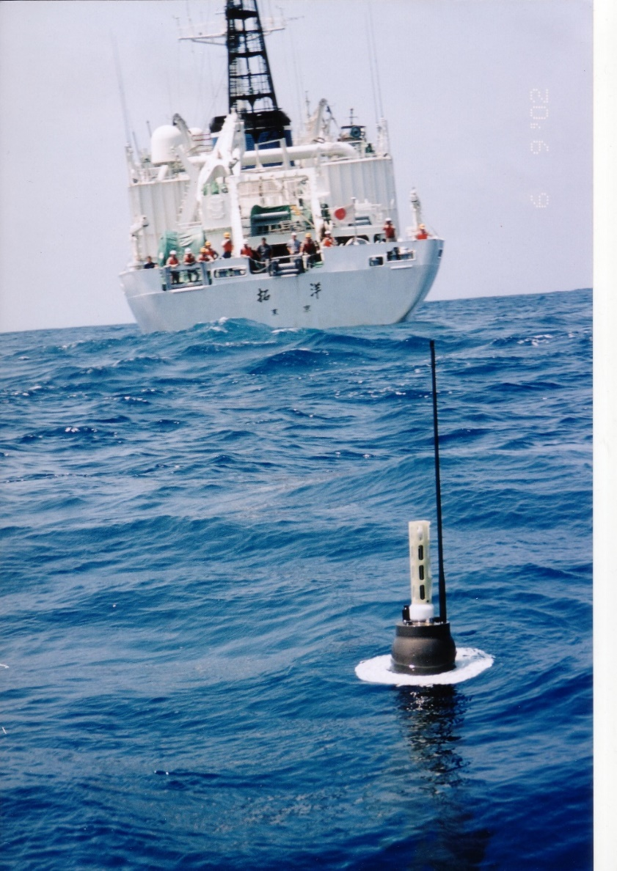










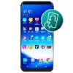

Outlook
  Connector and cable standardization
    Transition to MCBH connectors
  Next generation software:
    One software for all SBS instruments & models
    Device-agnostic software interface
    Standardized data formats
    Auto-detect sensor & connect
    Configuration cloning
    Realtime QA
    …
?
?
Sea-Bird Scientific Science Team
Dr. Jochen Klinke (Director of Science) – jklinke@seabird.com
Dr. Andrew Barnard (Chief Technology Officer) – abarnard@seabird.com
Dr. Charlie Branham (Senior Chemist) – cbranham@seabird.com
Dr. Kim Martini (Senior Oceanographer) – kmartini@seabird.com
Dr. Ian Walsh (Senior Oceanographer) – iwalsh@seabird.com
Dr. Eric Rehm (Senior Optical Scientist) – erehm@seabird.com
Laura Collins (Metrologist) – lcollins@seabird.com
?
?
?
?
?
?
?
?

