Slide 1
Making an observation using TurboWin (TW)
Adam Ryan
Met Office
Adam.ryan@metoffice.gov.uk

Slide 2
Step 1: Check Station Data Settings are Correct

Slide 3
Step 2: Check email settings are correct

Slide 4
Main TW Screen

Slide 5
Step 3: Process of making an observation

Slide 6
Position and Speed

Slide 7
Pressure + Tendency

Slide 8
Temperature

Slide 9
Wind and Waves

Slide 10
Visibility

Slide 11
Present + Past Weather

Slide 12
Low, Medium + High Cloud

Slide 13
Cloud Cover + Height

Slide 14
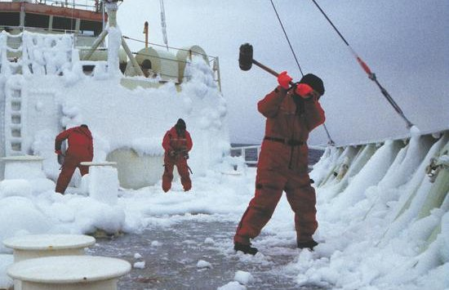
Icing + Ice

Slide 15
Observer + Captain Details
Add new observers and captains on the maintenance tab then click observers or captains. Double click line for new entry.

Slide 16
Final Result

Slide 17
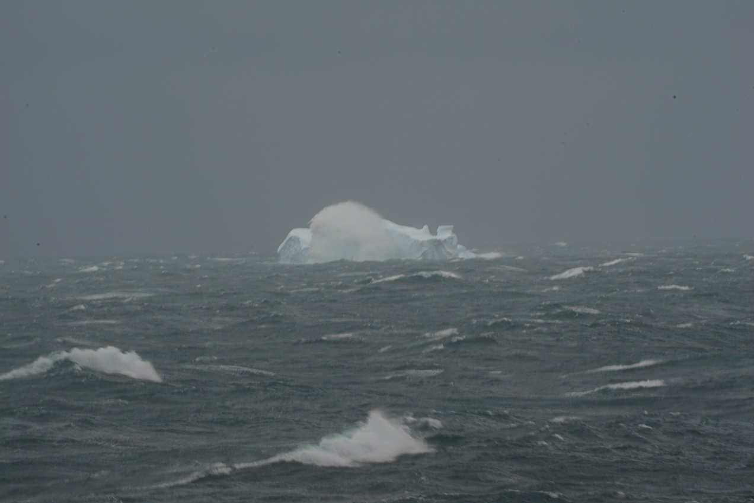
Sending the Observation + Log files.
To send the observation click on Output -> obs by email (this is the default).
check the details in the email are correct.
By Sat-C
1. Select OUTPUT from the top menu, then ‘Obs to file’ from drop-down menu.
2. The ‘Save’ window will appear and ask you to select a location to save the ob.
3. Save the observation on the appropriate media
4. Follow your sat-c instructions and transmit the observation using Special Access Code (SAC) 41 to the appropriate LES. Make sure the crew do not change the subject header.
Notes:
(floppy disc / SD card / USB / hard drive) and then transfer to your sat-c terminal. (Note: it’s recommended to always save the observation as met.txt file in the same location each time. Do not rename the file. This way, the old observation will be overwritten each time).
. The Met Office recommends using the following LES: • Santa Paula (KWBC 204) • Goonhilly (EGRR 002) • Burum (EHDB 112)

Slide 18
Other features
Get the observers to periodically send the log files. Click maintenance -> move log files by email.
You can easily change format to #101 by going to maintenance -> observation format setting.
You can change colour of interface and display graphs if needed.
You can assess the quality of the observations using Météo-France QC tool. We have more info about this on our Youtube page: voluntary observing ship (VOS) Scheme.
Each parameter box has a help button.
Any questions?

