Slide 1
The importance of accurate metadata and who uses it
David I. Berry¹ and Shawn R. Smith²
National Oceanography Centre, UK, dyb@noc.ac.uk
Center for Ocean-Atmospheric Prediction Studies, Florida State University, USA

Slide 2
Overview
What do we mean by metadata
Information about the ships and vessels making the observations
Information about the instruments used
Primary uses
Homogenization of observations (adjusting to common reference height)
Bias adjustment / removal (errors due to environmental factors)
Error characterization (estimating sensor / sampling noise)
Quality control / estimation (self consistency of metadata records)
Users
NMHS for NWP / weather forecasting
Developers of Reanalyses
Climate monitoring
Calibration, validation of satellite data
Notes:
What we mean by meta, how it’s used and who the resulting end users are

Slide 3
Overview
What do we mean by metadata
Information about the ships and vessels making the observations
Information about the instruments used
Primary uses
Homogenization of observations (adjusting to common reference height)
Bias adjustment / removal (errors due to environmental factors)
Error characterization (estimating sensor / sampling noise)
Quality control / estimation (self consistency of metadata records)
Users
NMHS for NWP / weather forecasting
Developers of Reanalyses
Climate monitoring
Calibration, validation of satellite data

Slide 4
Homogenisation – adjustment to common reference height
Over the historic climate record there has been a large increase in sensor height, ranging from ~ 4 – 5 m above sea surface to > 40 m
Temperature, humidity and pressure decrease with height, wind speed increases
Without accounting for these changes we introduce inhomogeneities and long-term spurious trends into the climate record
In the short term, NWP also needs accurate heights to reduce pressure to sea level, large difference in correction from small yacht or fishing vessel compared to container or cruise ship.

Slide 5
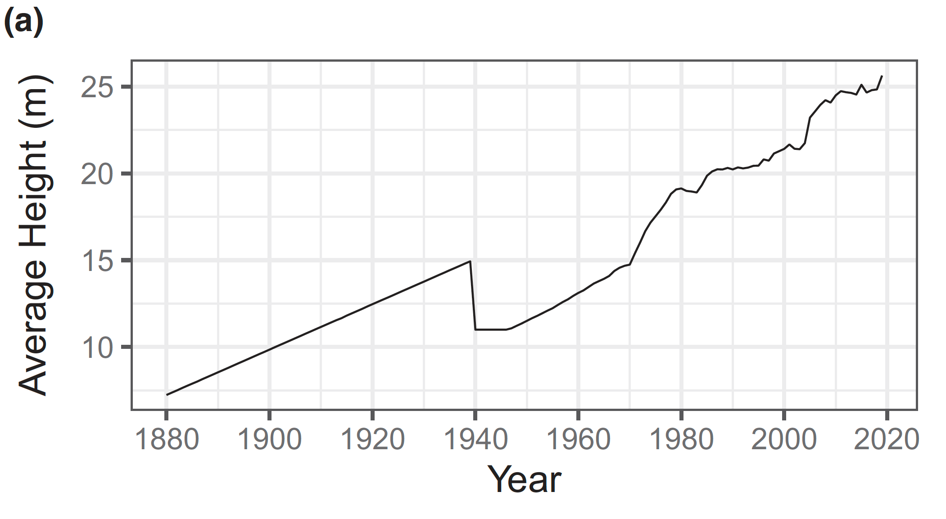
Changing air temperature measurement heights
Sensor heights inferred from sample of logbooks and historical records
Direct link between WMO Publication 47 and ship observations
Cornes et al., 2020
Notes:
Example how heights have changed

Slide 6
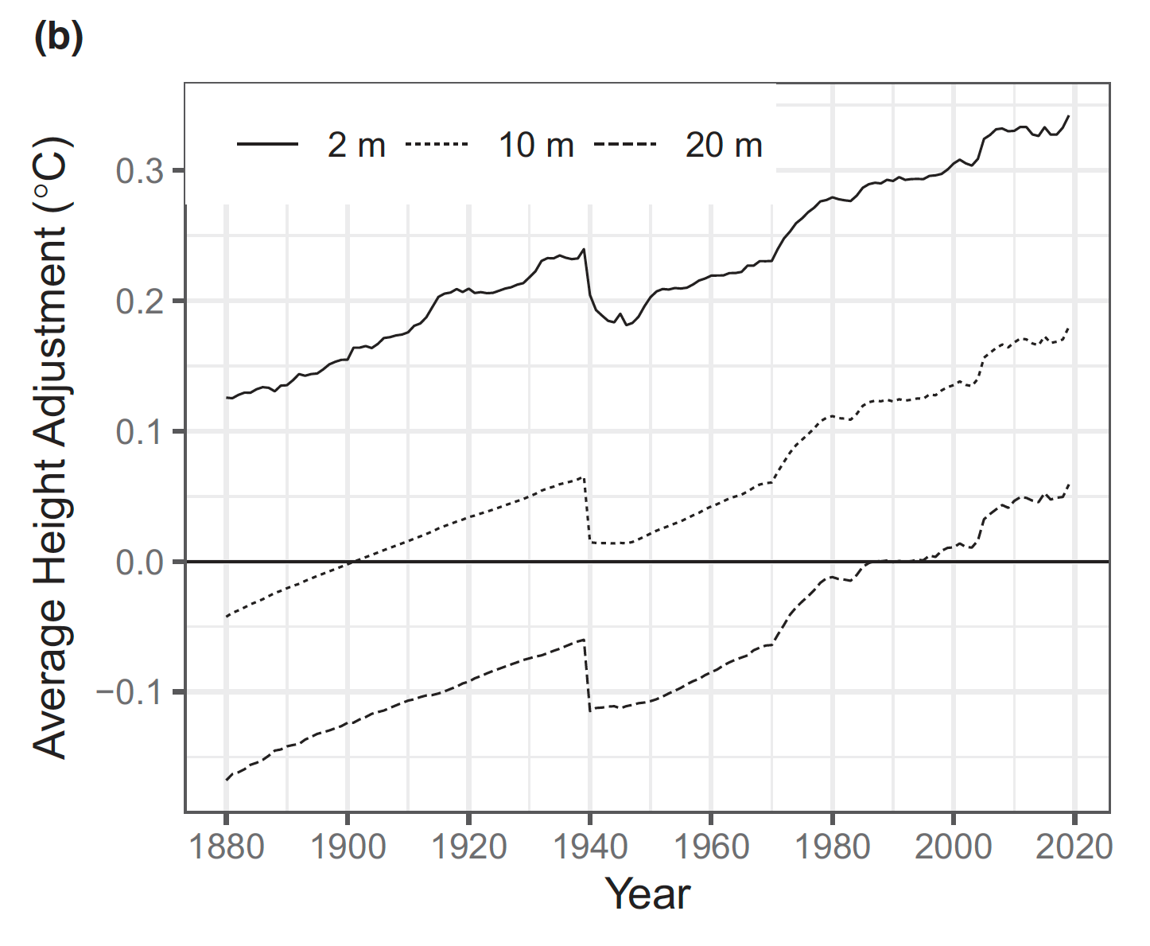
Magnitude of adjustments for standardizing to a uniform height
Cornes et al., 2020
Notes:
And the impact, adjustment added on to observations. Overall effect to increase trend (opposite to adjustments for SST which I’ll come on to).

Slide 7
Magnitude of adjustments for standardizing to a uniform height
Range (max – min) similar for all standard heights, different means
Cornes et al., 2020
Notes:
And the impact, adjustment added on to observations. Overall effect to increase trend (opposite to adjustments for SST which I’ll come on to).
Impact on trends similar for all heights

Slide 8
Bias adjustment / removal
Bias known to exist due to environmental factors
SST: Buckets biased cold due to evaporative cooling
SST: Early engine intake measurements biased warm, more complicated now
Wind speed: flow distortion, anemometers in region of acceleration / deceleration
Air temperature: Solar heating of ships super-structure, stack exhaust contamination
Humidity: Inadequate ventilation of wet bulb thermometers, wrong psychrometric coefficient, stack exhaust contamination
Given enough information we can model (statistically and numerically) these based on observing method, ship type and environmental conditions

Slide 9
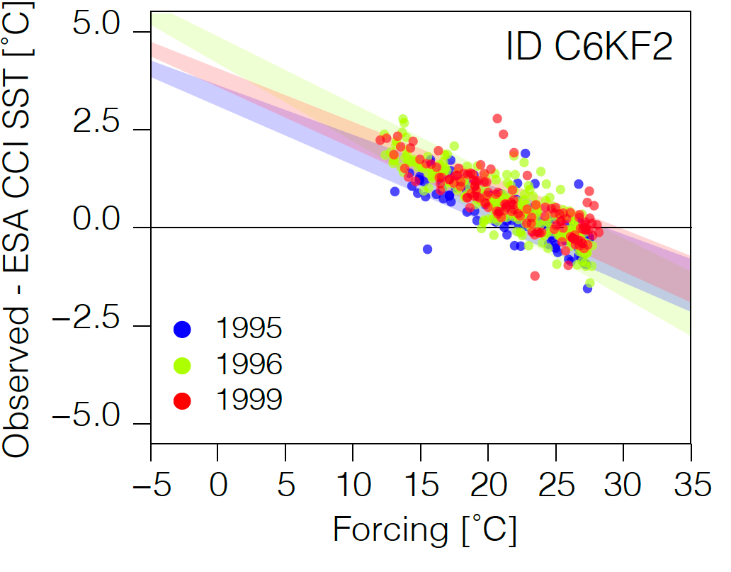
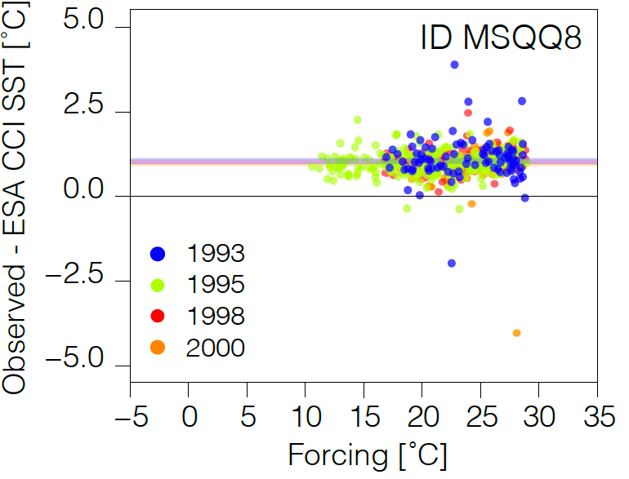
Understanding engine intake SSTs
Observed – satellite SST as a function of expected SST (climatological mean)
Carella, 2017
Notes:
Example of how our knowledge has improved and ERI biases more complex than previously thought.
Some ships have constant offset / bias, others appear to have a dependence on the temperature.
Even more complicated for research vessels with multiple SST sensors/intakes (and some IR skin sensors)

Slide 10
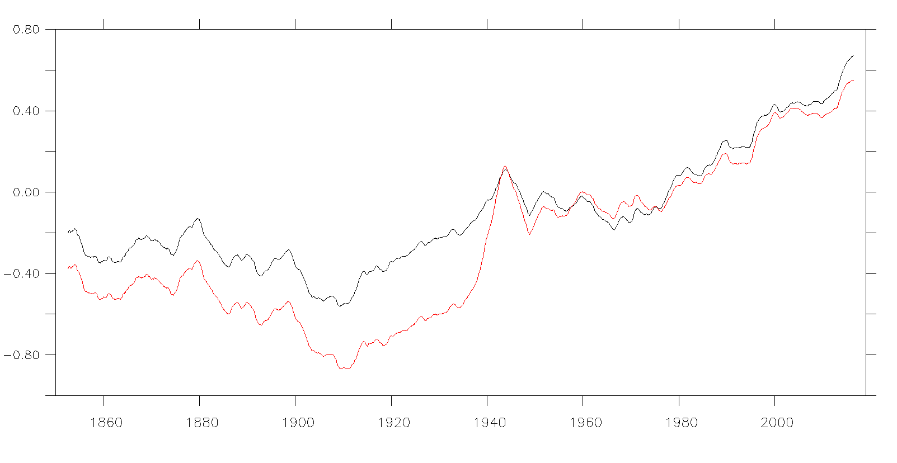
SST bias adjustment
Global SST anomalies (5 year running mean)
Unadjusted
Bias corrected (ensemble median)
Jump due to change from bucket measurements to engine room intake measurements
Data from HadSST4,Kennedy et al., 2019
Notes:
Over last 150 years we try and estimate the biases based on knowledge of observing methods.
For SST this has the impact of warming the early record and cooling later period, resulting in reduced trend (opposite to MAT).
Overall SST and MAT in better agreement after adjustment, giving confidence in the adjustments and estimated trends.

Slide 11
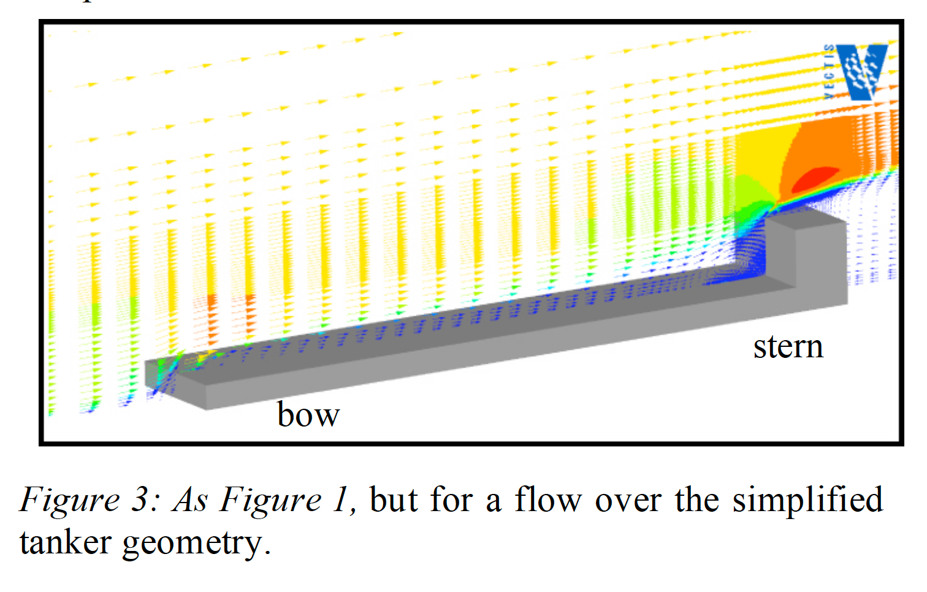
Modelling flow distortion
Moat et al., 2005
Notes:
Within the metadata we ask for bow to bridge distance and height of anemometer above deck. This slide illustrates why. With this information we can start to understand biases in anemometer wind speed measurements and how they depend on ship type and sensor location.

Slide 12
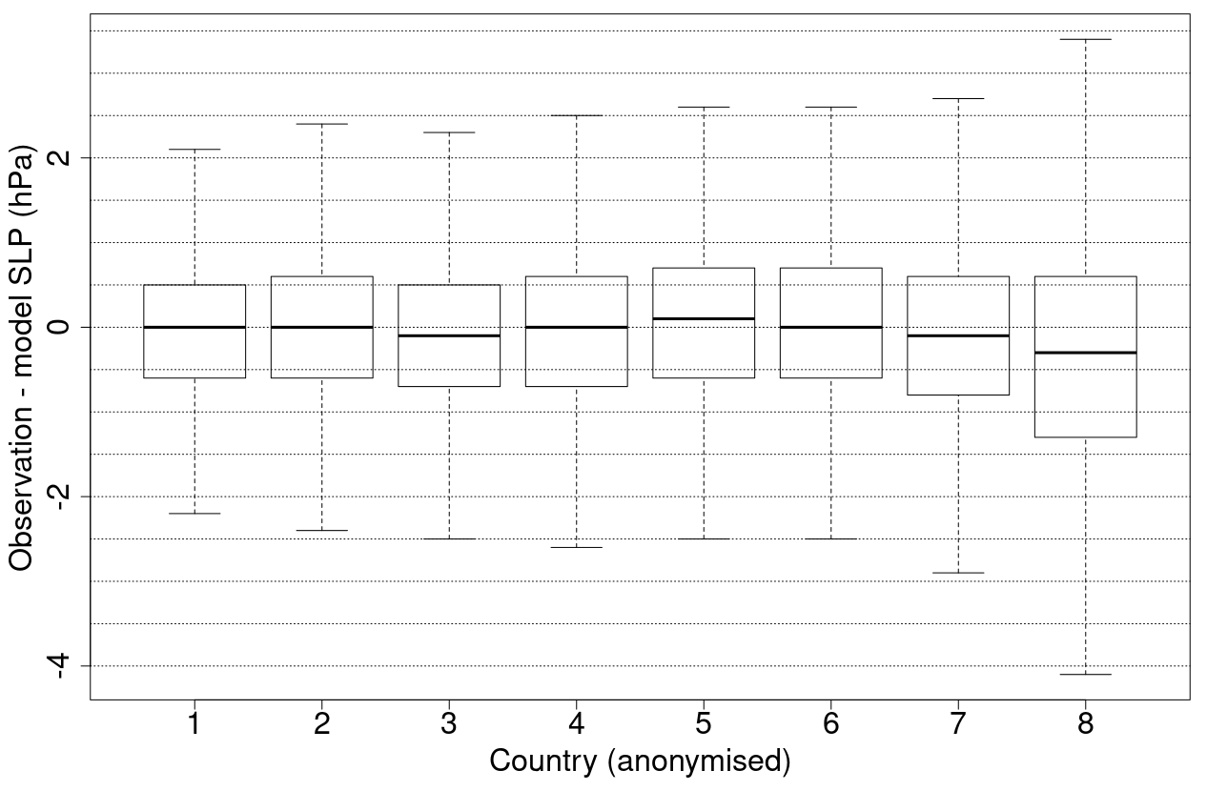
Characterising errors
Width of bars gives measure of uncertainty in observations
Data from VOSClim project
Notes:
As well as detecting, estimating and removing biases there will be errors we can not correct, this will lead to noise and uncertainty in the data.
This shows a example of the sorts of analysis we can do. Country 1 has errors 2/3 the size of country 8. We can do the same by instrument type and exposure.
The results can then be used to weight observations in analyses better, leading to better results and improved forecasts.

Slide 13
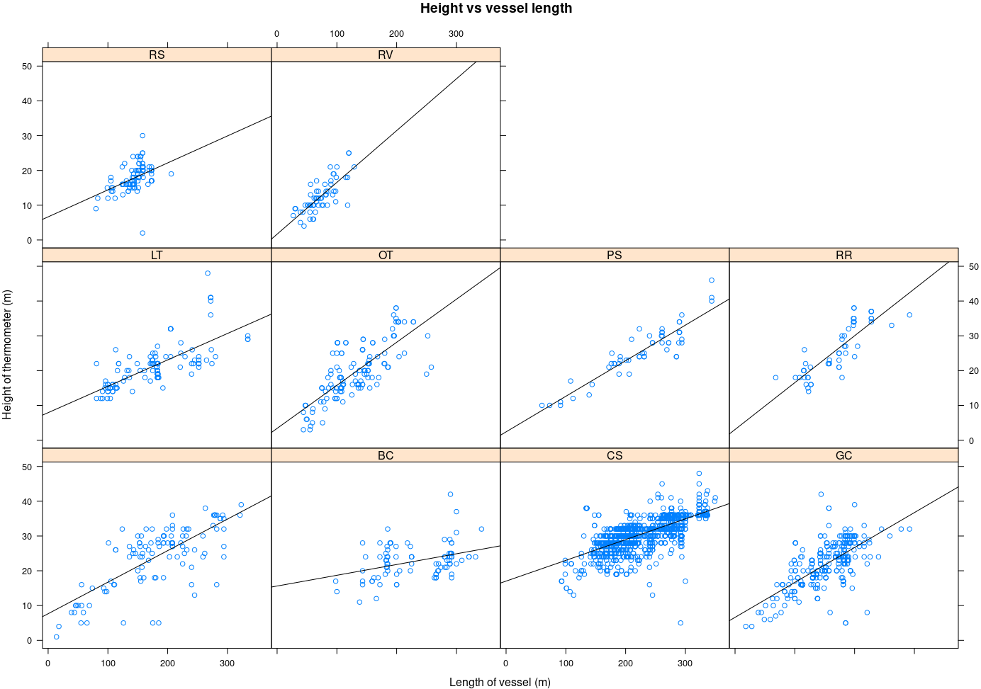
Quality control and estimation of missing elements
Based on vessel length we can estimate sensor height by ship type (e.g. by fitting linear model)
Likely wrong values
Notes:
Final example, we can use the different metadata fields to help quality check the meta data and to infer missing values.
Example shown here plots thermometer height against length of vessel split by ship type. We can see fairly linear relationships and use this information to identify suspect records etc.
We can also use the metadata to quality control the observations, for example knowing the type of anemometer (mechanical vs sonic) is important when looking for errors in the data.

Slide 14
Summary
Accurate metadata allows us to standardise measurements to a common reference height, Important for artificial / spurious trend removal (temperature, humidity, wind) and for accurate forecasts (e.g. NWP)
Accurate metadata also allows us to quantify and remove biases in the observations
We can also estimate the noise in the observations and weight them according to their quality in data assimilation and analysis
Accurate metadata can also be used to identify errors in the metadata and estimate missing values based on known / modelled relationships
References
Carella, G., 2017: New estimates of uncertainty in the marine surface temperature record, PhD thesis, University of Southampton, Southampton, UK
Cornes, R., et al., 2020: CLASSnmat: A global night marine air temperature data set,1880–2019. Geosciences Data Journal, 7(2), 170 – 184, doi: 10.1002/gdj3.100
Kennedy et al.,2019: An Ensemble Data Set of Sea Surface Temperature Change From 1850: The Met Office Hadley Centre HadSST.4.0.0.0 Data Set. Journal of Geophysical Research: Atmospheres, 124(14), 7719–7763. doi: 10.1029/2018j d029867
Moat, B.I., et al, 2005: The effect of ship shape and anemometer location on wind speed measurements obtained from ships. 4th International Conference on Marine Computational Fluid Dynamics. 30 - 31 Mar 2005. pp. 133-139.
Notes:
Thank you and questions?

