Slide 1
Sea Ice Observations with TurboWin+
Karolin Eichler
Deutscher Wetterdienst
Karolin.eichler@dwd.de

Slide 2
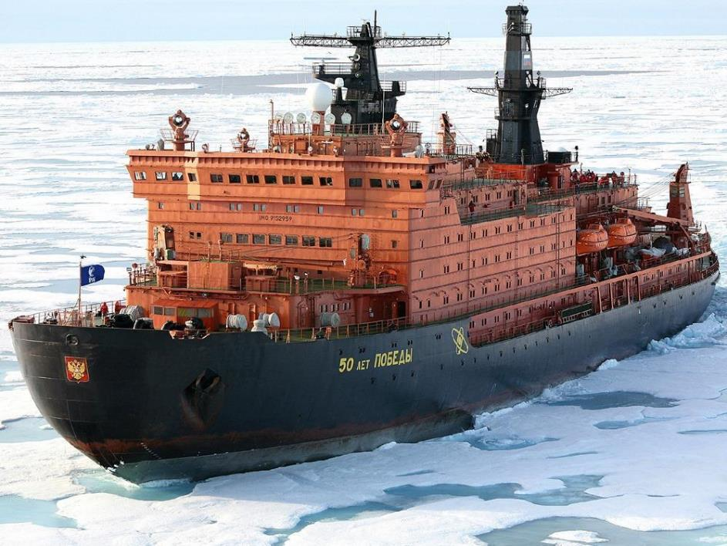
Setting the Scene

Slide 3
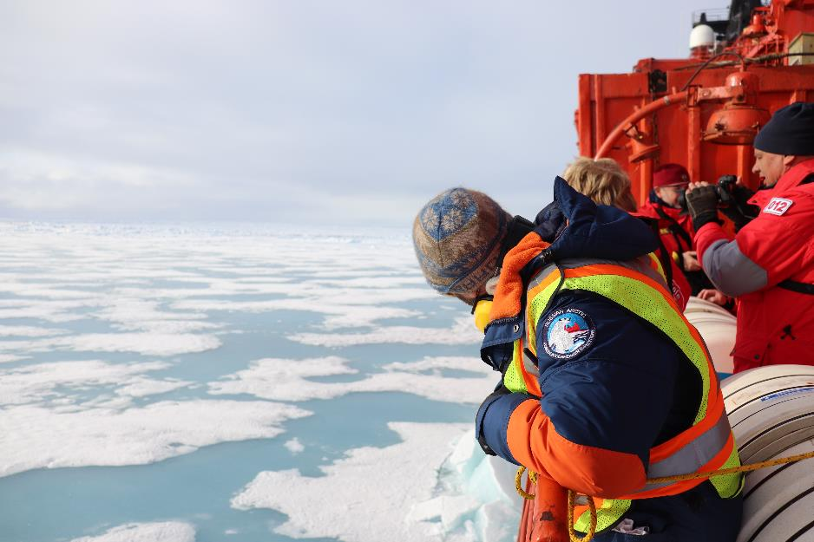
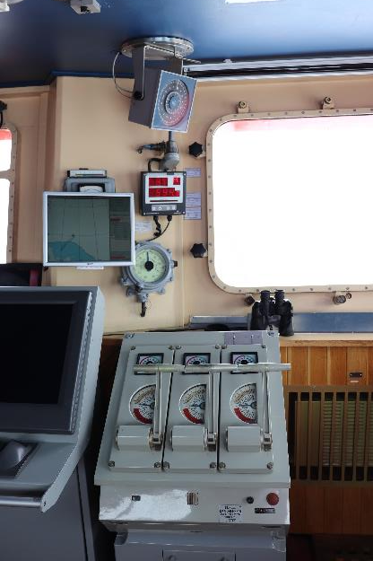
The bridge

Slide 4
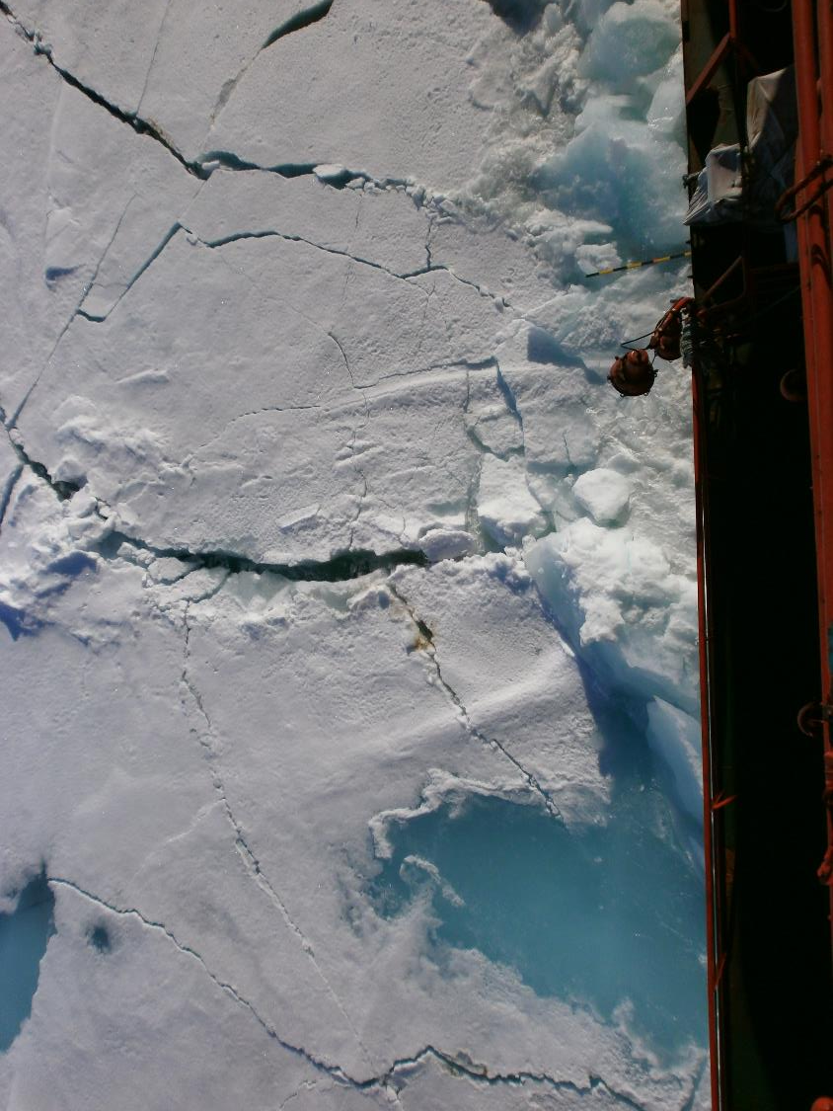
View from the bridge

Slide 5
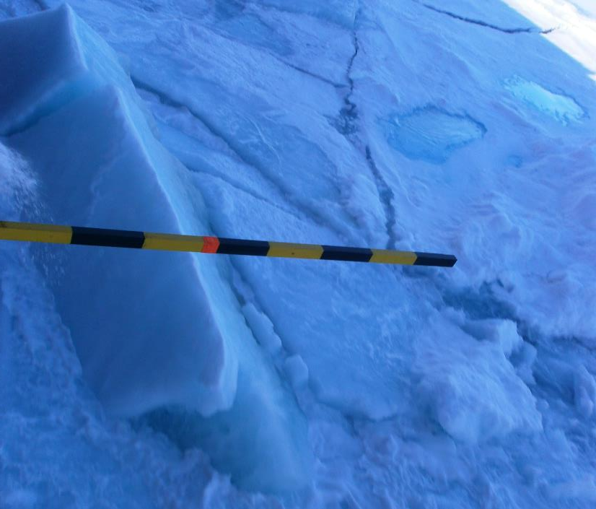
Our biggest help

Slide 6
Using TurboWin+

Slide 13
Example
BBXX CBAQ9GJ 1606/ 99803 10527 41/// 8//// 10031 21025 40236 5//// 7//// 88/1/ 22200 0//// 2//// ICE 3319/=
FM 13–XIV Ext. SHIP
C=ice concentration (3=4/10 to 6/10 (3/8 to less than 6/8), open pack ice)
S=stage of development (3 Predominantly new and/or young ice with some first-year ice)
B=Ice of land origin (1=1–5 icebergs, no growlers or bergy bits)
D=bearing (9=Not determined (ship in ice))
Z=ice condition (Not reported)

Slide 14
Cloud cover, Temperature, Ice concentration
Pressure (hPa)
Notes:
5=9-10/10 ice

