Slide 1
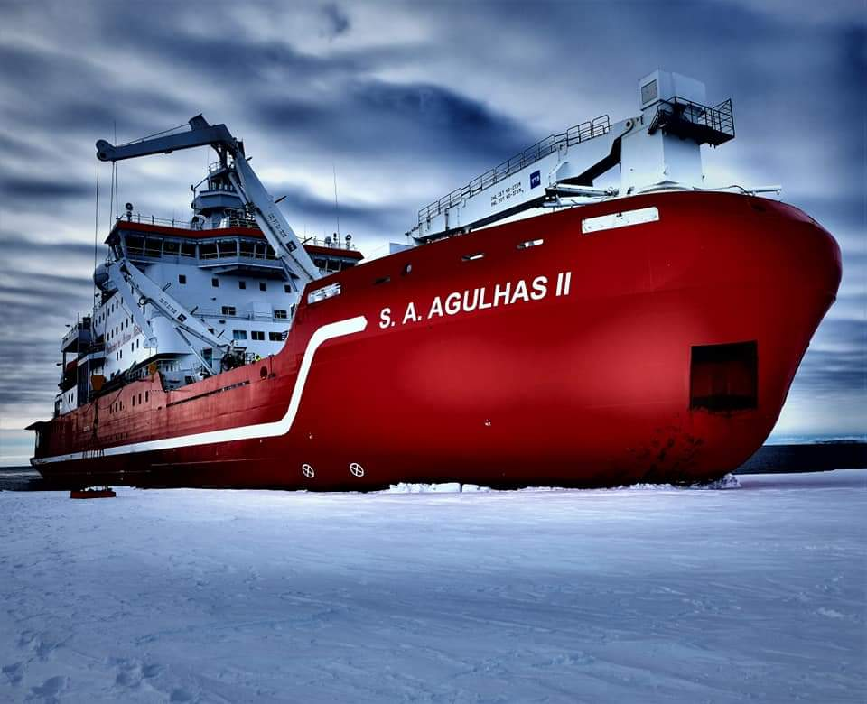
PMO Duties
Mardené de Villiers
South African Weather Service
Mardene.deVilliers@weathersa.co.za

Slide 2
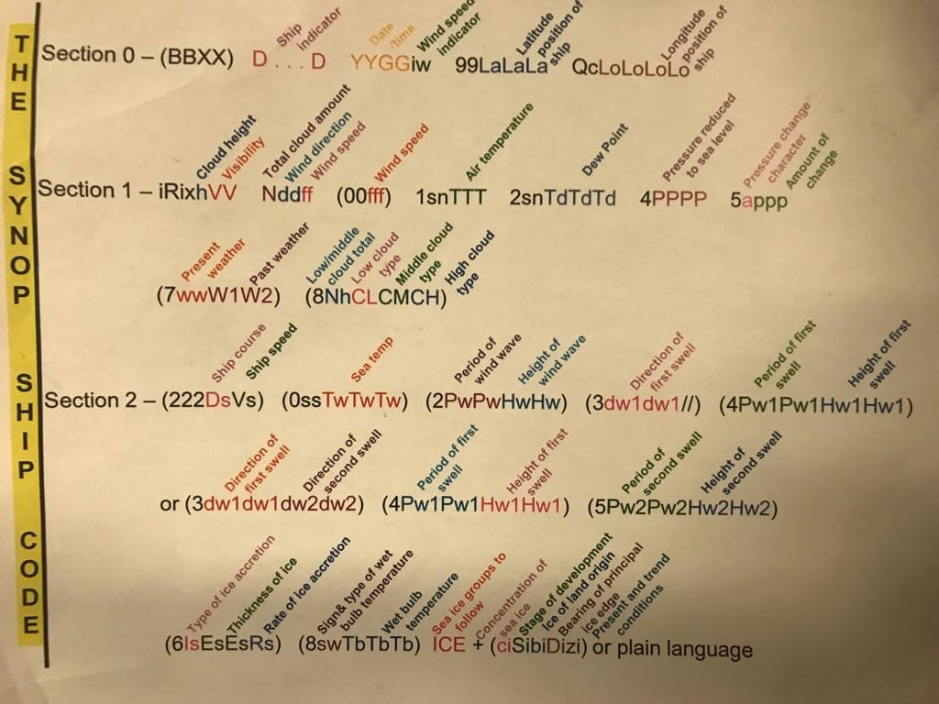
Role of a PMO
PMOs contribute directly to the effectiveness and efficiency of the VOS Scheme.
Additionally PMO’s represent not only National Meteorological Service (NMS), but are focal points for ship based observing operations.
Without the dedication and enthusiasm of the PMOs to maintain an active national VOS Fleet, the quality and quantity of reported meteorological and oceanographic data from ships would be adversely affected. This could have potentially serious implications for the;

Slide 3
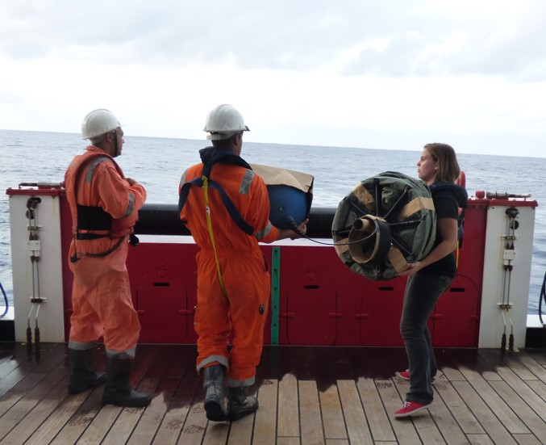
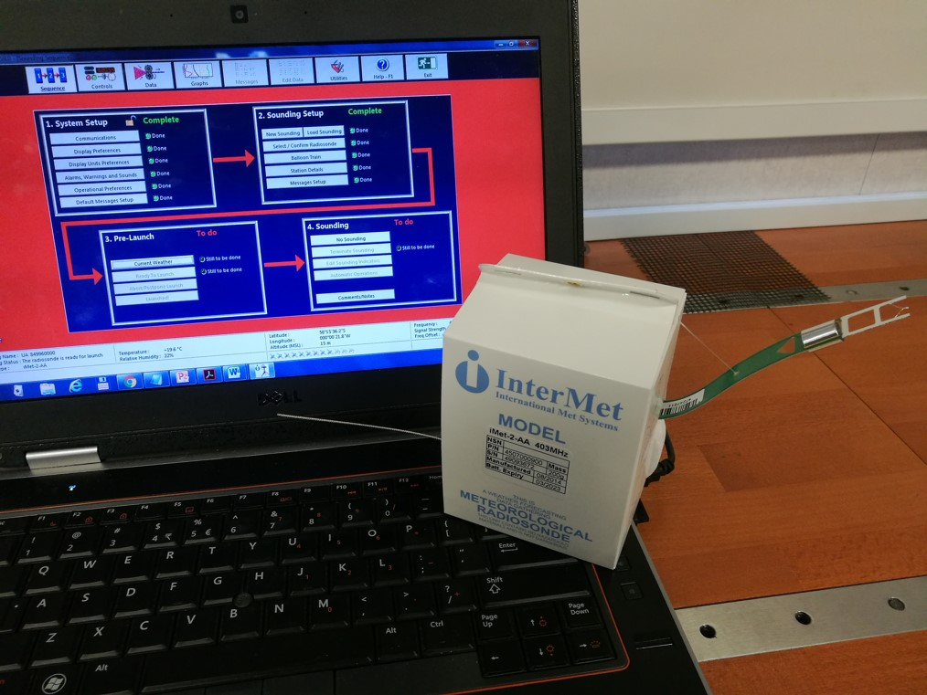
Specific Functions of the PMO
To maintain a national VOS fleet
To maintain accurate records of the ships recruited into the national VOS fleet
To regularly visit ships recruited into the national VOS fleet
At the request of another PMO or the Master of a ship, use reasonable endeavours to provide the following services, regardless of the ship's nationality and country of recruitment
Promote and maintain liaison
Enquire about problems that may be experienced
To support complementary national, regional and international marine meteorological and oceanographic programs

Slide 4
PMO "Best Practice Guide"
http://www.ocean-ops.org/sot/vos/quick_reference_pmo.html
The guide is available on the VOS website to help newly appointed personnel become familiar with the functions of a PMO and to re-acquaint experienced PMOs with these functions
It contains detailed guidance for the following activities...
Monitoring Ship Movements
Recruitment Preliminaries
Recruitment Visits
Post Recruitment Monitoring
Routine VOS fleet Monitoring
Routine Inspection Visits
Encouragement & Rewards
De-recruitment
Communication & Liaison
International Support
Related Programs

Slide 5
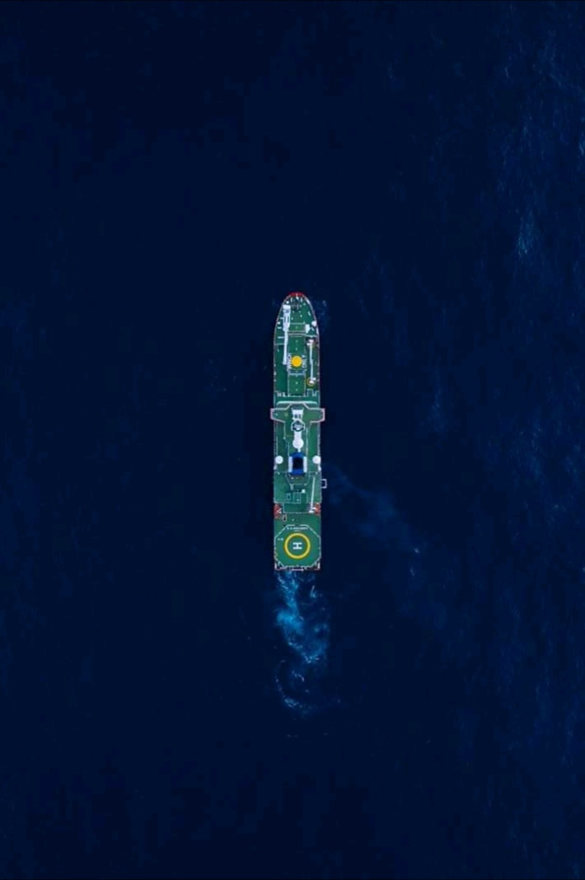
Recruitment Guidance FACTORS TO CONSIDER BEFORE RECRUITMENT
Identify potential ships for recruitment into the national VOS fleet. Depending on your location, some recruitment factors to consider might include:
The trading pattern or route of the ship to target particularly data-sparse areas;
The percentage of the time sailing in desired areas;
Length of charter on the route;
Ability to regularly inspect and service the ship;
The availability of certified NMS instruments for installation on the ship;
The suitability of the ship to carry and care for the loaned NMS instruments;
The availability of a suitable communication system on the ship to send the observations; and
The availability of a computer on the Bridge on which to install electronic logbook software.

Slide 6
Recruitment Guidance FACTORS TO CONSIDER BEFORE RECRUITMENT (AVOID DUPLICATE RECRUITMENTS)
Check the latest list of VOS vessels at OceanOPS to ensure that a ship under consideration for recruitment is not already a member of another national VOS fleet. If the ship is already recruited by another national VOS fleet:
Will a change to the recruiting country result in an overall improvement to the global network (i.e. provision of calibrated instruments, increased opportunities for PMO visits, etc...).
Requests for changes must be discussed and confirmed with the current country of recruitment before any further action takes place.
Confirm the participation of the ship in the national VOS fleet with the Master and the Shipping Company.
Register the ship immediately in the OceanOPS Metadata database using the 'Planned' status function, to avoid accidental duplicate recruitments during the recruitment period.
Please Note: Duplicate recruitments reflect poorly on the global network. By following these guidelines and engaging in proper communication with other NMSs, we ensure that the image of the VOS remains one of a professional and unified global observing program.

Slide 7
Recruitment Guidance INITIAL RECRUITMENT
Determine, in consultation with the Master, the most appropriate meteorological reporting class (NMS Operated, NMS Cooperative or Independent) of the vessel.
If appropriate, install calibrated NMS instruments ensuring the best possible exposure.
Install electronic logbook software (Turbowin) and configure.
Provide nationally prescribed marine observing stationery and reference material as appropriate, e.g. marine meteorological handbooks, sea-state and cloud charts/booklets, coding card/book.
Provide initial training in:
General observing requirements
Observing/estimating visual elements
Reading, use and care of meteorological instruments
Use of electronic logbook software, e.g. TurboWin
Advise on the preferred method of transmitting the observation (email) and, where appropriate, the use of Special Access Code 41 (SAC41) for Inmarsat transmissions through a LES that accepts BBXX.
Document required:
VOS Metadata Collection Form - Metadata for national and WMO purposes.
Recruitment forms should be sent to the VOS program manager in a timely manner, to allow population of the national VOS database and/or the JCOMMOPS Metadata database.

Slide 8
Recruitment Guidance POST RECRUITMENT
After the ship leaves, check the GTS for BBXX messages received during the first 7 days.
If BBXX were received, contact the ship to:
Provide feedback on the quantity, quality, frequency and timeliness of the observations;
Provide feedback on any coding problems or observational issues; and
Thank the Master and Observing Officers for their efforts.
If BBXX have not been received, contact the ship and ascertain if the observing program has started.
Yes the observing program has started:
Enquire about the method (e.g. SAC41) used to send the BBXX; and
If using SAC41, to which LES the BBXX were sent to.
No the observing program has not started:
Enquire when the program will start; and
Provide the Observing Officers with additional instructions, training and encouragement as necessary.

Slide 9
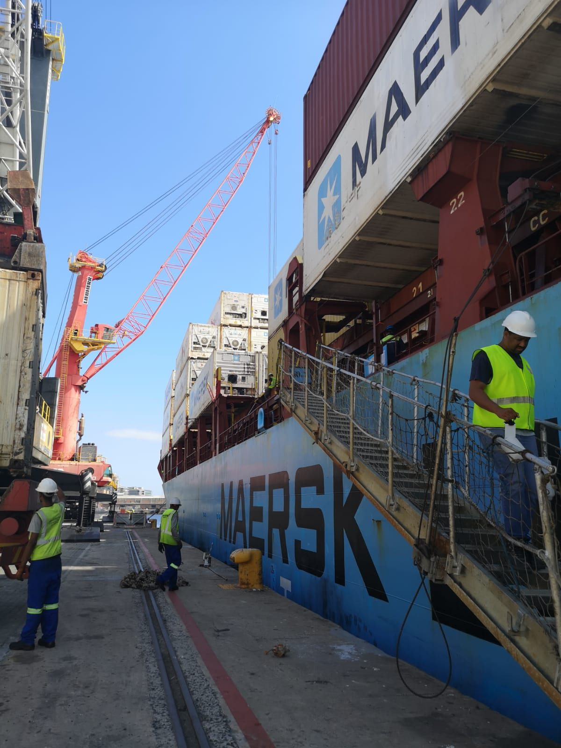
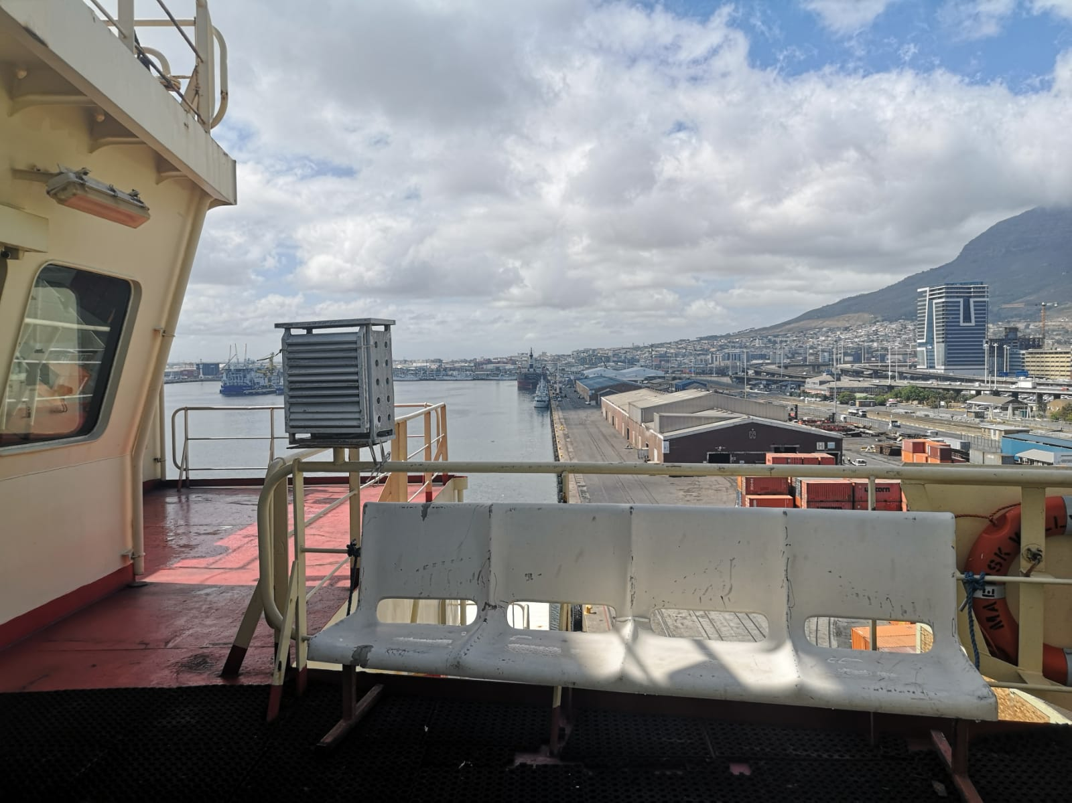
Ship Inspections
Schedule inspection visits at the intervals or frequency recommended by the NMS
Check the calibration, performance and accuracy of the meteorological instruments (including AWS sensors)
adjust, repair or replace as necessary.
Provide feedback on the quantity, quality, frequency and timeliness of observations sent on the GTS
Download log files and delayed-mode observation data from electronic logbooks (e.g. TurboWin)
Download delayed-mode observation data from an AWS in accordance with NMS instructions

Slide 10
Ship Inspections
Check and update as necessary, all previously collected metadata
Confirm that agent/owner/manager details have not changed.
Check if any there are expected changes in the trading pattern of the ship.
Document the ship visit
National VOS: use a nationally prescribed VOS Inspection Form (if applicable); or
Foreign VOS: use the Foreign VOS inspection form and email the completed form to the national VOS Focal Point of the ship's country of recruitment.
Collect feedback from ship's officers about the quality of marine forecasts and warnings, and reception quality of meteorological charts received via radio-facsimile or other means. Relay the feedback, both negative and positive, through the VOS Program Manager to the responsible person in the NMS
Return all faulty instruments to the NMS for repair and re-calibration

Slide 11
Barometers
Aneroid - Most common (Belfort, Fuess, Fischer)
Digital - Vaisala, Mintaka
Adjustments made to Aneroid Barometers must be within +/- .3 hPa. If the aneroid barometer is already within +/- .3 hPa an adjustment is not necessary. Barometers should be checked every six months.
Each barometer should be supplied with a certificate giving the corrections (if any) that must be applied to the readings of each individual instrument.
Common Problems Encountered:
Mounted in direct sunlight or near a heat source
Not at Eye level
Pressurized Bridge: A/C can cause errors up to +5 hPa
Incorrect barometer height
Some ship owned barometers no adjustment screw

Slide 12
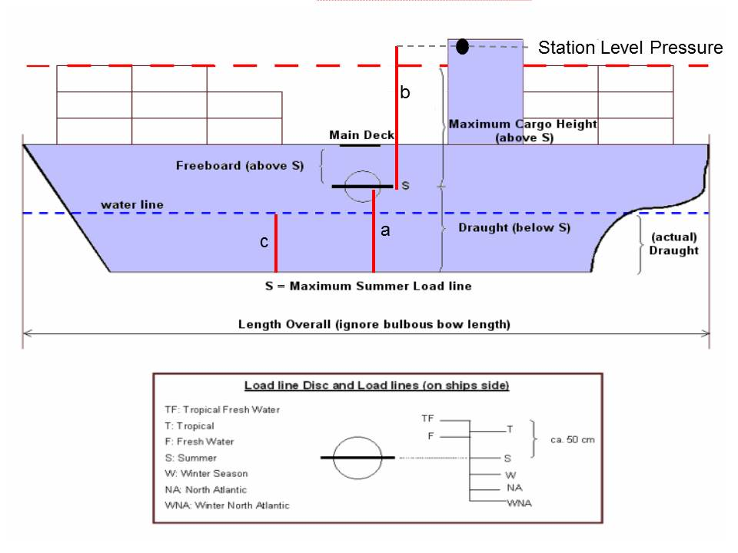
Barometers
MSLP Method
At dock read pressure from portable standard
Adjust reading for dock height
Adjust barometer to read MSLP
Barometer can not be adjusted; input instrument correction in TurboWin
Apply certification sticker
SLL Method
Must have accurate Barometer Metadata
Height of Barometer from SLL, Keel to SLL and Departure of Reference
Read station pressure from portable transfer standard at barometer height
Adjust barometer reading
Barometer can not be adjusted; input instrument correction in TurboWin
Apply certification sticker
a = Height of keel to SLL (m)
b = Height of Barometer above SLL (m)
c = Mean ship’s draft (m)
Height of Barometer = a + b – c
example: a = 12 m b = 20 m c = 8 m (12 + 20 – 8 = 24 m)
Height of Barometer = 24 m Height correction for 24 m = +2.9 hPa
“ ACCURATE MEASUREMENTS ARE CRUCIAL “

Slide 13
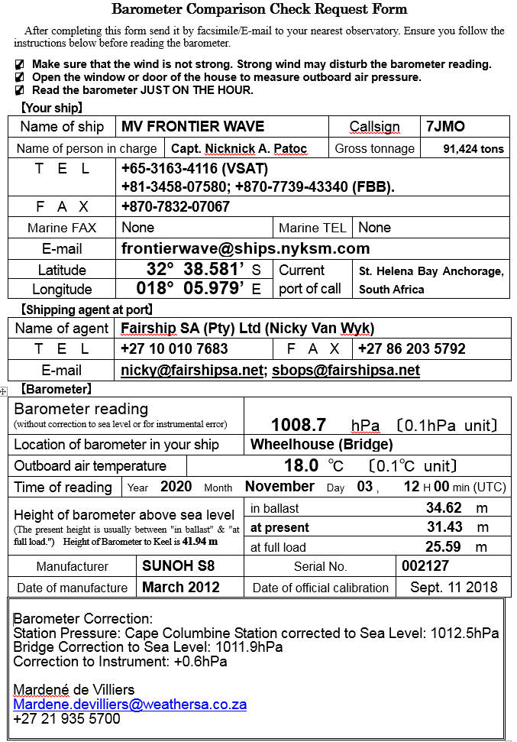
Barometer Remote Comparison
Ships request via email for barometer comparisons when not in areas where any PMO is available.
Comparisons are sent back with corrections using verified sources near their position.
Short-Term Solution

Slide 14
Communication, Encouragement and Awards
Encouragement and Awards
SOT Certificate of Appreciation
National award scheme
Distribute national newsletters or publications to ships in the national VOS fleet
Distribute international newsletters or publications to ships in the national VOS
In accordance with national customs or practices and on behalf of the NMS:
Send a welcome letter or email to each newly recruited ship
Send a thank you letter or email to each good reporting ship upon leaving the national VOS fleet; and
Distribute items of goodwill in recognition of the voluntary work undertaken by the crew to provide weather observations, e.g. Christmas cards, calendars, caps, etc.
Communication
Maintain regular contact with the VOS Program Manager or the national VOS Office.
Maintain regular contact with other national PMOs if applicable, e.g. to ensure that inspection visits will not be duplicated.
Maintain contact with international PMOs as necessary.
Maintain contact with, and provide training or assistance as necessary to:
Local maritime colleges;
Harbour authorities; and Yacht clubs, etc.

Slide 15
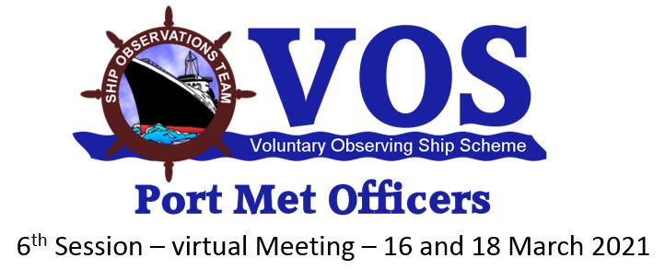
Thank you!

