Slide 1
Automated Pressure/Temperature Reports (APTR)
Joel Cabrié
Bureau of Meteorology, Australia
Joel.cabrie@bom.gov.au

Slide 2
Overview of the Australian VOS fleet
Fleet of 50 ships contributing over 40,000 observations per year
Mostly manual observing ships with only 2 vessels equipped with a full AWS
Recently commenced the rollout of APTR on 6 vessels
Working with several shipping companies to equip their fleets with APTR as standard
Coral Expeditions
CSL Australia
Toll Logistics

Slide 3
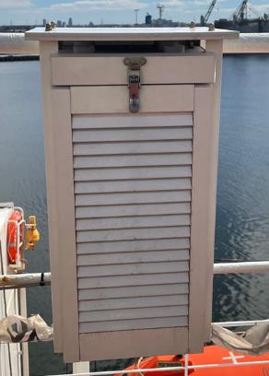
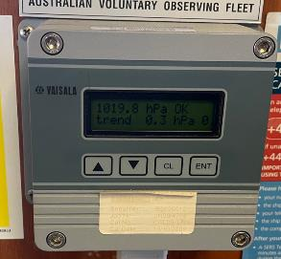
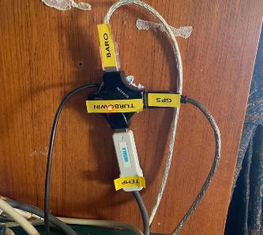
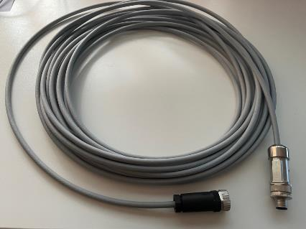
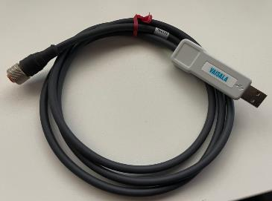
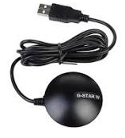
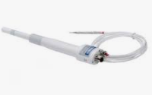
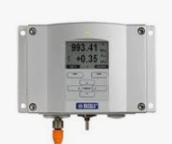
Equipment supplied
Vaisala PTB220 or PTB330 barometer
Vaisala HMP155 temperature/humidity sensor
MetSpec Met11 marine screen
G-Star IV GPS
4-port USB hub
Vaisala RS-485 USB adaptor cable
8 core cable w/ 8-pin round connector
Note: Most of the main items are already installed on board our manual observing ships.

Slide 4
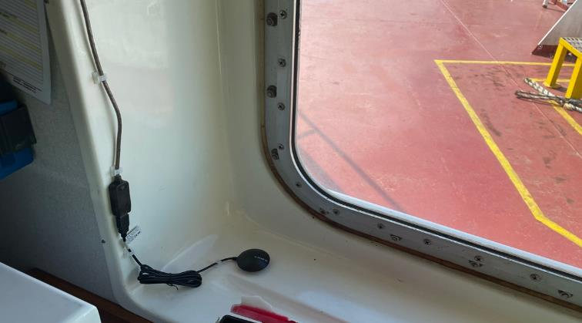
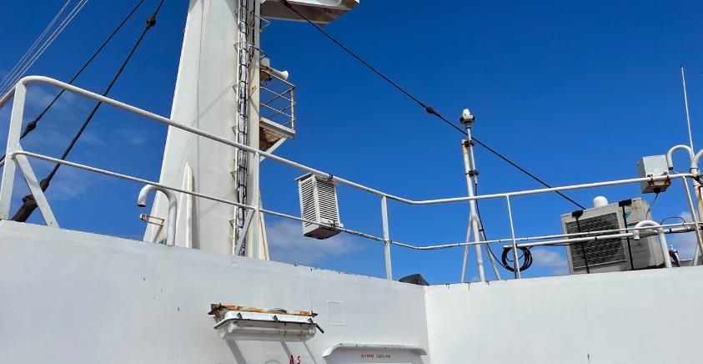
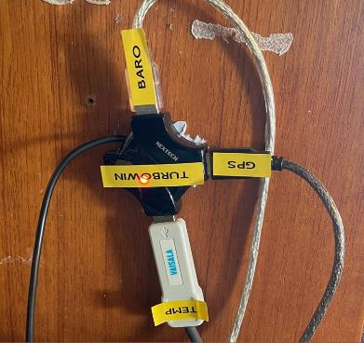
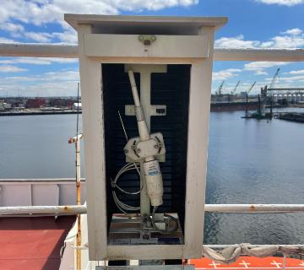
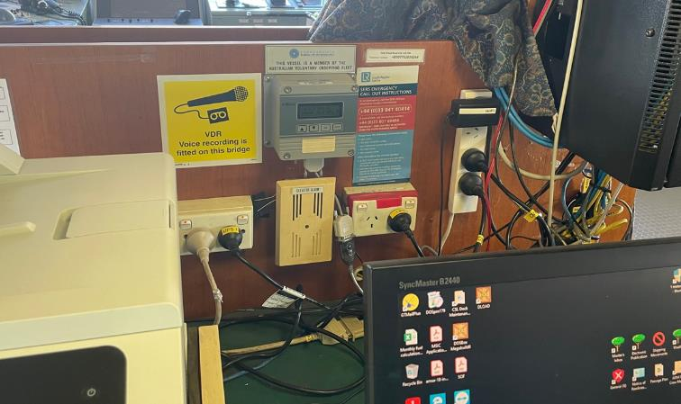
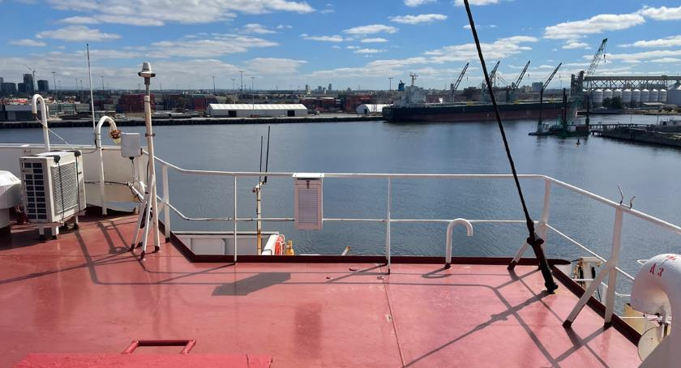
Instrument siting

Slide 5
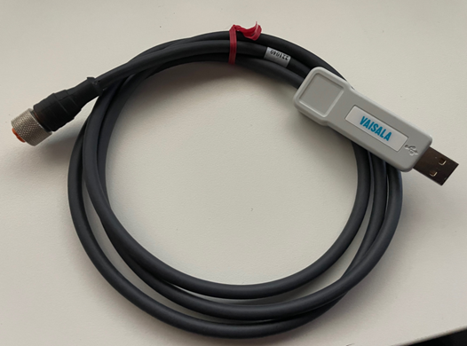
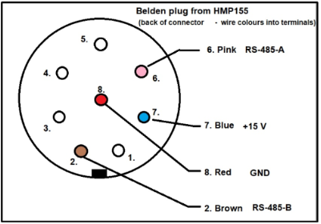
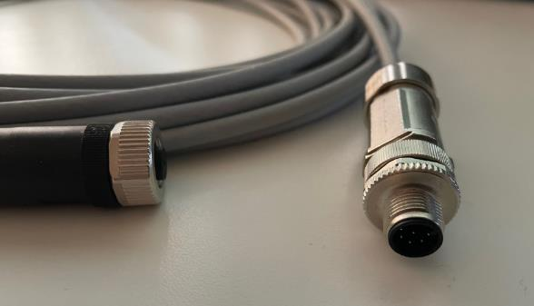
Cabling
The HMP155 is mounted in the Met11 marine screen on the monkey island and cabled to the PC on the bridge via existing cable glands or goose neck
30m 8-core cable terminated with 8-pin round plug
Connected to Vaisala RS-485 USB adaptor cable
4-port USB hub used to avoid occupying all available USB ports on the PC

Slide 6
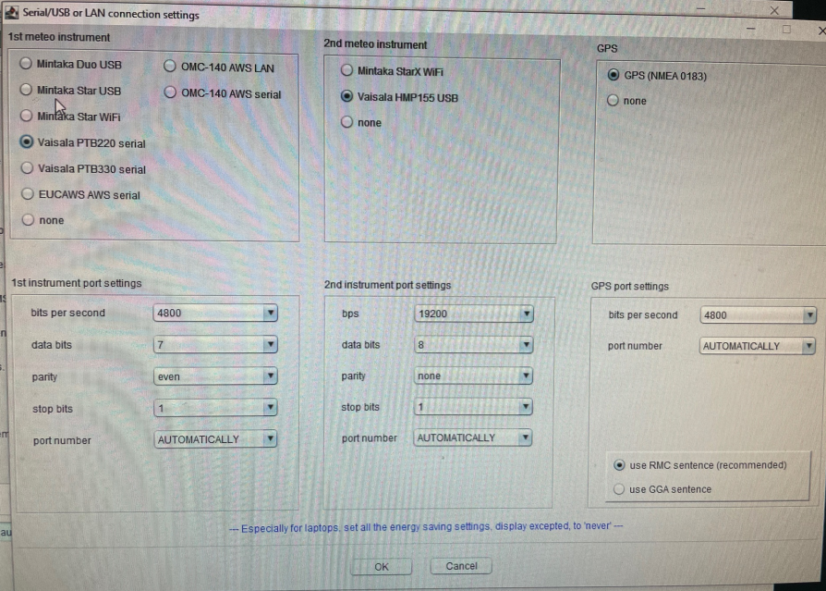
Turbowin+ configuration
The barometer, temp/humidity sensor and GPS are all connected to the PC via the USB hub
Turbowin+ must be configured with the appropriate comms settings to interface with these sensors (i.e. Baud rate, data bits, parity, stop bits)
These can be found under the Maintenance menu as Serial/USB or LAN Connection Settings

Slide 7
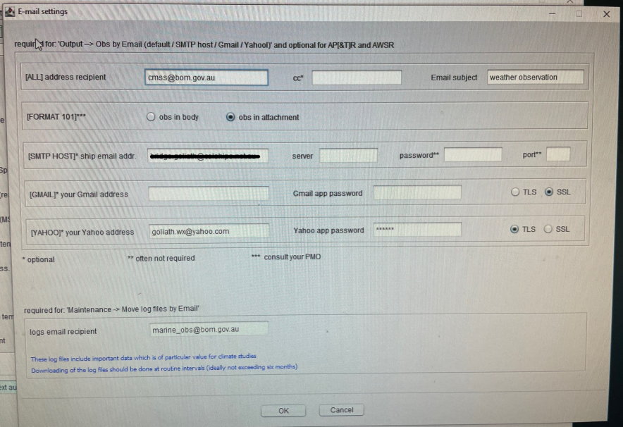
Data Transmission
We create a unique Gmail account for the ship and generate an App password to securely avoid using 2-factor authentication.
Turbowin+ then uses Gmail as the email client when sending the automated hourly weather reports.
Other email options include using the ship's own SMTP settings or Yahoo

Slide 8
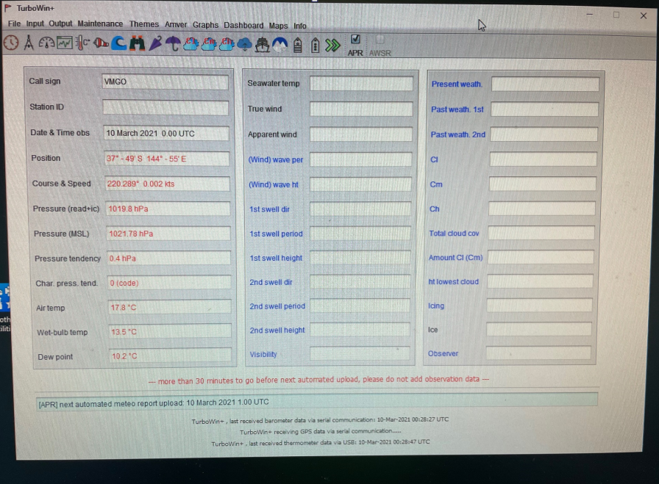
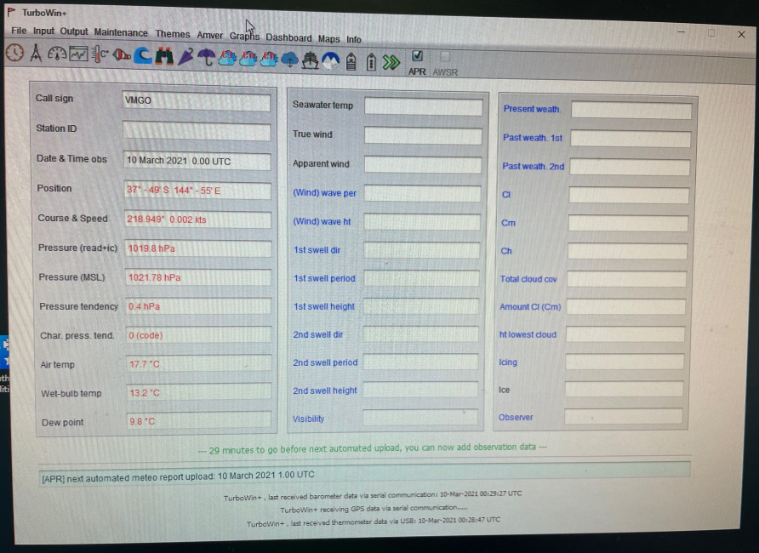
Data Display

Slide 9
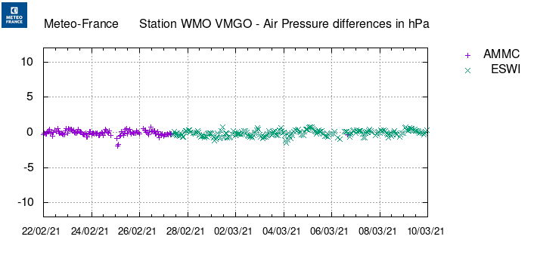
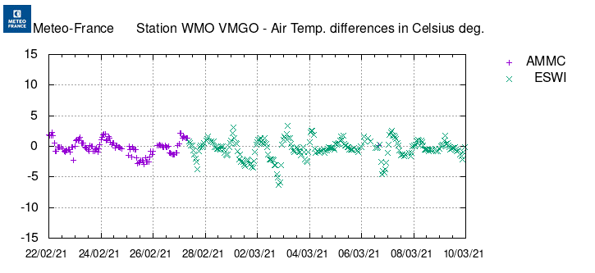
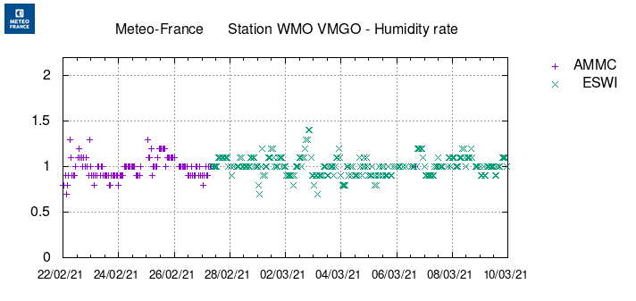
Data Availability & Quality

Slide 10
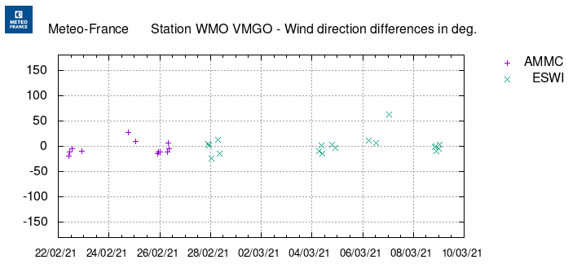
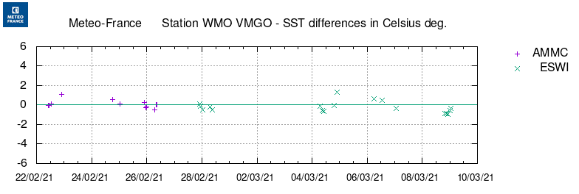
Visual Observations & Manual Data Entry
34 manually entered observations including visual parameters such as clouds, wind & visibility were received to complement the automated hourly pressure, temperature & humidity observations over this 2 week period

Slide 11
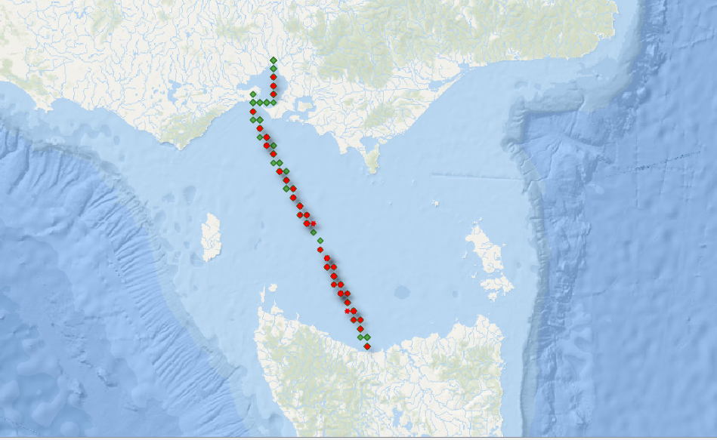
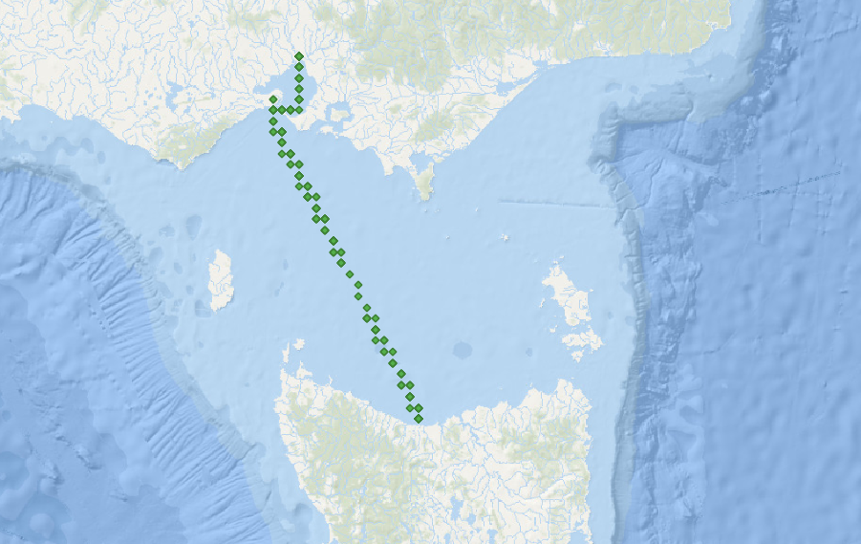
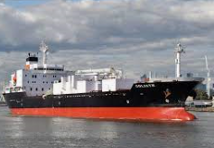
Melbourne, Victoria
Manual/Visual
APTR only
870 APTR observation since 1st January 2021
66 manual/visual observations
Devonport, Tasmania

Slide 12
Limitations
Poor internet / email access on the vessel
Vessel's cyber security prohibits access to internet
Pressurised bridge (A/C) effects the barometer when mounted inside
Vessel must cover cost of data transmission (minimal cost)
Note: We have found a willingness from shipping companies to work through some of these hurdles and help enable APTR to function on their vessels.

Slide 13
Questions?
This presentation is available on the event website for your reference
Please feel free to contact me directly with any technical questions at joel.cabrie@bom.gov.au

