Slide 1
PMO Resources
Joel Cabrié
Bureau of Meteorology, Australia
Joel.cabrie@bom.gov.au

Slide 2
VOS Website
URL: http://www.ocean-ops.org/sot/vos/index.html
Useful source of information for VOS program managers and PMOs
Program overview
Functions of the PMO
Contact information
Best practice guides
Instructions/handbooks
Software downloads
Links
Supporting documentation

Slide 3
VOS YouTube Channel
URL: https://www.youtube.com/channel/UCM8q9uvka_m20zWFsz9CGrQ
Includes short videos such as:
What is the VOS scheme?
A brief introduction to Turbowin+
How do I use the QC Tools?
What is a PMO?
How to create and send observations.

Slide 4
Turbowin+ User Guides
URL: http://www.ocean-ops.org/sot/vos/resources.html
Guides are broken down into 4 parts:
Part 1: Software download, installation & minimum configuration requirements
Part 2: Output options & email configuration
Part 3: Instrument integration & automated output options
Part 4: Collecting, entering and sending weather observations
Each guide provides a step-by-step process for setting up & using Turbowin+
Demonstrations of various configurations used by different NMS will be provided on Day 2

Slide 5
Ocean Best Practices System (OBPS)
URL: https://www.oceanbestpractices.org/
OPBS-R: Open access, permanent, digital repository for best practice documentation relevant to ocean research, operations & applications
Maintained by the International Oceanographic Data and Information Exchange (IODE) of the UNESCO-IOC
A trusted repository for the global ocean research and observing community to publish their best practice documents

Slide 6
QC Tools / QC Relay
URL: http://esurfmar.meteo.fr/qctools/
Marine Observation Monitoring (Buoys and VOS):
Monthly statistics
Blacklists
Data plots & comparisons to model outputs
Observation counters
QC reports
OceanOPS QC Relay
Daily monitoring of QC Blacklists by OceanOPS
Email notification to operator
Operator investigates and responds to notification via link

Slide 7
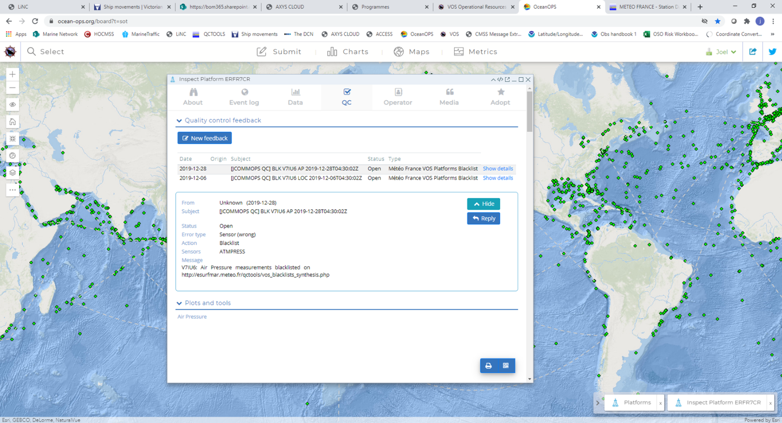
OceanOPS QC Relay

Slide 8
Questions?
This presentation is available on the event website
Presentation includes links to all of these useful resources

