Slide 1
VOS Overview
Henry Kleta
Deutscher Wetterdienst (DWD)
henry.kleta@dwd.de

Slide 2
Voluntary Observing Ship Scheme (VOS)
One of the networks within the Ship Observations Team (SOT) in the framework of the Global Ocean Observing System (GOOS, co-funded by WMO and IOC)
Providing marine meteorological observations since more than 150 years
Real Time Data (BUFR in GTS)
Delayed Mode Data (IMMT in GDAC)
Metadata (old: Pub47, future: WIGOS compatible SOT metadata format)
Endorsed by the International Maritime Organization (IMO)
MSC Circular 1293/Rev.1 25 May 2018 (can be found on VOS website)
"Participation in the WMO Voluntary Observing Ship Scheme"
Draft Rev. MSC Cicular 803, Participation of NON-SOLAS Ships in the GMDSS
(10) [...] ships operating in high seas are invited to participate in the WMO VOS scheme [...]

Slide 3
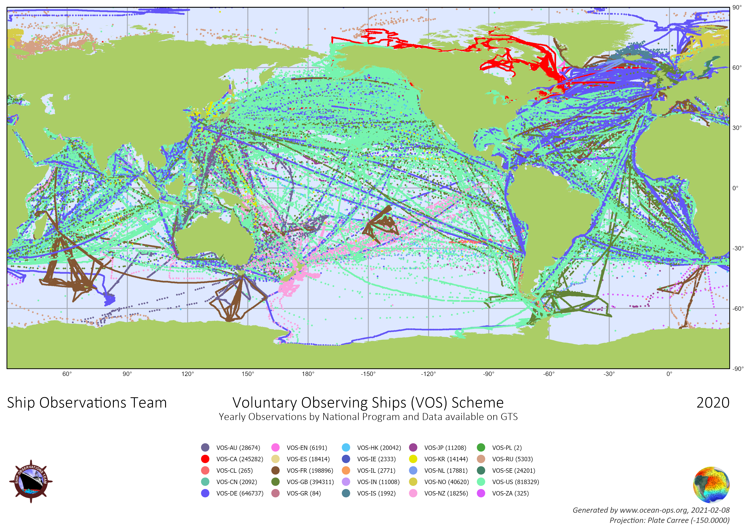

Slide 4
VOS Network Performance (real time data)
2018 24 VOS programmes 2.105.690 observations
~ 3500 VOS registered ~ 2500 VOS active
2019 23 VOS programmes 2.316.996 observations
~ 3700 VOS registered ~ 2650 VOS active
2020 25 VOS programmes 2.533.151 observations
~ 4000 VOS registered ~ 2750 VOS active
NMHS operated: 74,5 %
NMHS cooperative: 20,9 %
Independent: 4,6 %
~ 10% of the VOS fleet is automated

Slide 5
VOS Classes (approved by SOT, OCG, JCOMM)
NMHS Operated: Ships that are recruited by a national meteorological service which also supplies the necessary observing instruments, sensors and equipment.
(VOS-Clim + Selected + Supplementary)
NMHS Cooperative: Ships that are recruited by a national meteorological service but use own instruments, sensors and equipment.
(Auxiliary)
Independent: Third party support ships that are not recruited by a national meteorological service but contribute to the VOS Scheme.
(Third Party)

Slide 6
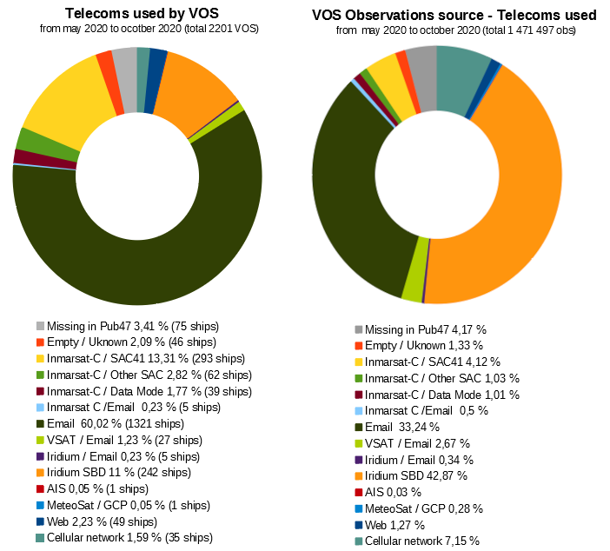

Slide 7
VOS Network Performance (delayed mode data)
2018 15 VOS programmes 793.141 observations
9 programmes missing ~ 1.300.000 observations missing
2019 16 VOS programmes 1.825.222 observations
7 programmes missing ~ 500.000 observations missing
2020 14 VOS programmes 1.562.377 observations
11 programmes missing ~ 1.100.000 observations missing
Delayed mode VOS data (IMMT) is vital input for the Marine Climate Data System (MCDS)
All VOS operators are invited to provide delayed mode data to the Global Data Assembly Centers (GDACs).

Slide 8
VOS Network – PMO Network
Approx. 63.25 FTE PMOs were reported (using SOT annual reports) in total in 2019.
Those PMOs reported approx. 50 ship visits per PMO in 2019 (in total ~3300 ship visits globally)
Geographical distribution of PMOs is not even. Less than 10% were reported from the southern hemisphere.
All VOS operators are invited to consider to assign more PMO capacities.
All VOS operators are invited to hand in the annual SOT reports.

