Slide 1
Reports from GOOS components Biology and Ecosystems Panel
The Global Ocean Observing System
www.goosocean.org
Nic Bax & Gabrielle Canonico
Sam Simmons, Frank Muller-Karger, Rick Stuart-Smith, Anthony Bernard, Lisandro Benedetti-Cecchi, Pier Luigi Buttigieg, Ward Appletons, Tammy Davies, Emmett Duffy, Karen Evans, David Obura, Lisa Marie Rebelo, Henry Ruhl, Raphe Kudela, Lavenia Ratnarajah
GOOS 10th Steering Committee meeting [online], April 2021

Slide 2
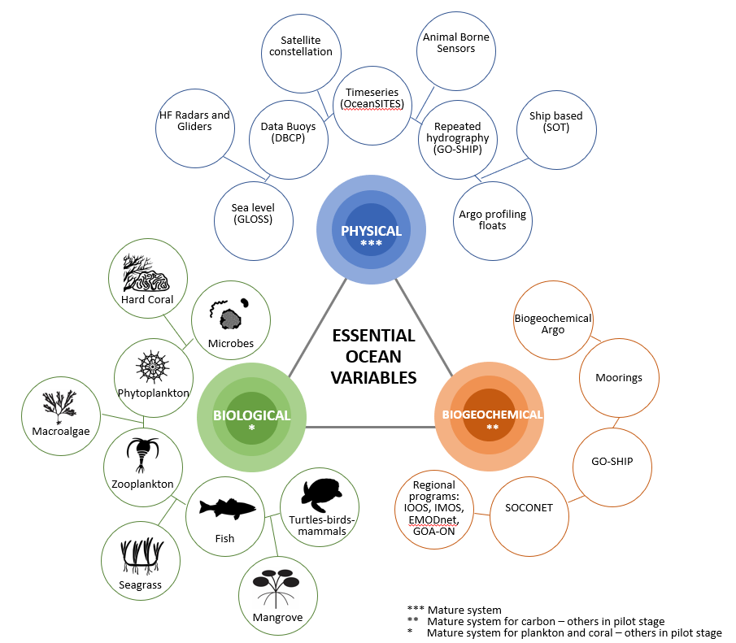
The Biology and Ecosystems Panel is one of three panels that help coordinate ocean observations by defining and supporting data collection for the Essential Ocean Variables (EOVs)

Slide 3
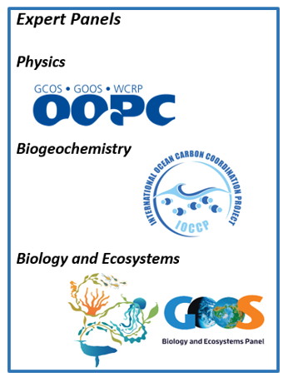
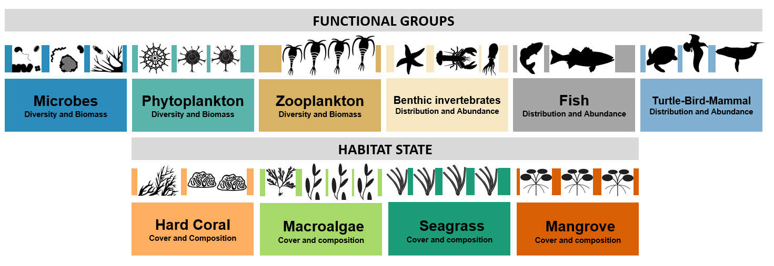
Panel Leadership
Nic Bax (co-chair) - CSIRO Australia (2015)
Gabrielle Canonico (co-chair) - NOAA USA (2019)
Lavenia Ratnarajah (IPO) - IMOS Australia (2020)
Development funding AIMS & CSIRO Australia plus UWA, MMS, IOC
No permanent funding
BIOLOGICAL
ESSENTIAL OCEAN VARIABLES
Notes:
20-30 min of presentation with 10 minutes of questions
The format will be a webinar, with 20-30 minutes of presentation by you, for the Steering Committee members only (goosocean.org/sc), with 10 minutes of moderated questions
The webinars will be recorded and made available for those not able to attend live
we’d also appreciate having your presentation sent to Forest Collins (f.collins@unesco.org) after the webinar for posting
The purpose is to give the whole SC a chance to hear about your achievements, future plans and opportunities, and issues
1/3 achievements, 1/3 future plans, 1/3 issues
Please plan to spend your time as follows:
A quick introduction of yourself and your component’s role in GOOS
1/3 of your time on the achievements and activities of your component since the last Steering Committee meeting in April 2020
1/3 of your time on future plans as identified contributions to the GOOS IP
1/3 of your time on opportunities, issues and threats of a cross-GOOS nature you’d like raised,

Slide 4
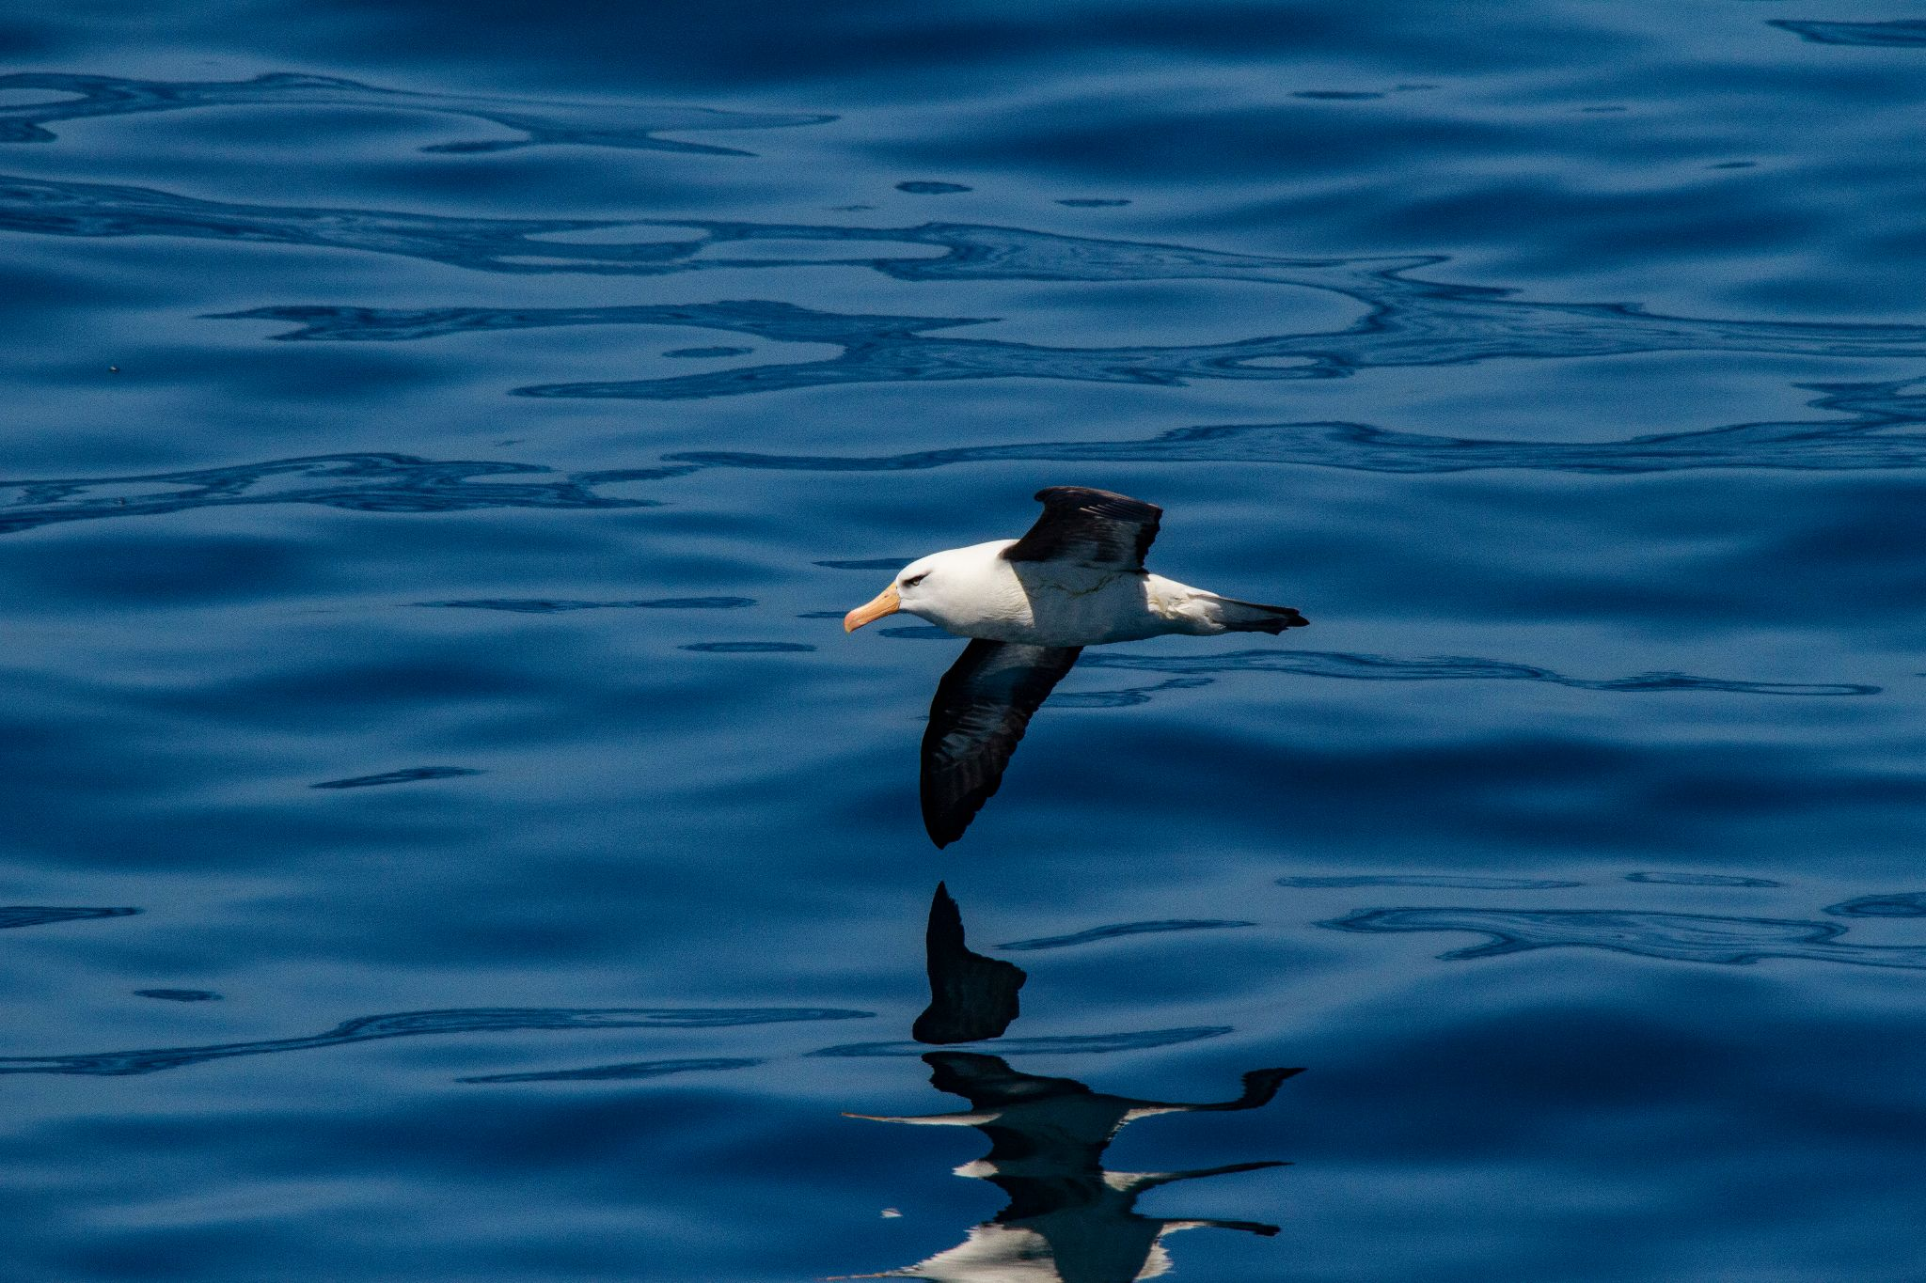
Headline Achievements (since April 2020)
Pegasus/Future Earth results – one slide
Regional implementation (EuroSea+) – one slide
Regional implementation (US) – one slide
OBIS metadata portal – one slide
EOV Snippets - one slide
Achievements against Implementation Plan
Future plans (as identified in GOOS IP)
Opportunities, issues and threats (of a cross-GOOS nature)

Slide 5
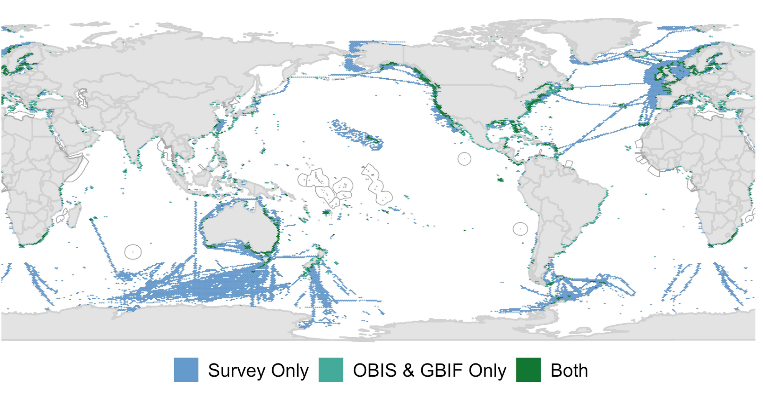
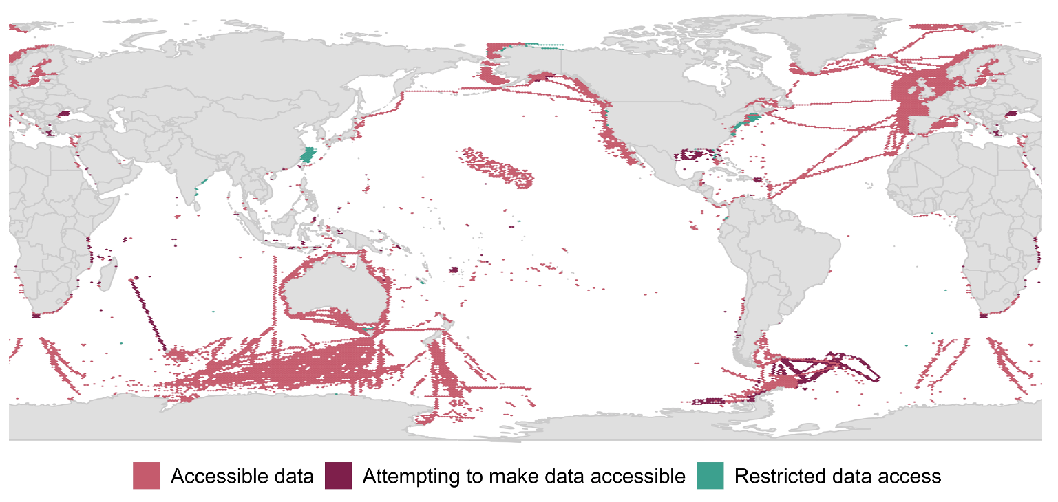
PEGASuS/Future Earth
Key findings
Identified 203 active, long-term (≥5 years old), programs that systematically sampled ≥1 of the Bioeco EOVs.
7% of the ocean surface had an active monitoring program
Programs sampling seagrass, mangroves, hard corals and macroalgae existed in 6% of the global coastal zone
53% contributed their data into a data repository, aggregator, or other data serving tool
66% had publicly accessible data whilst 34% had restricted data access
95% used SOPs
Yet only 10% of programs shared SOPs
67% conducted capacity development/tech transfer
Next steps
-Manuscript submitted to Global Change Biology
-BioEco portal
Figure 1: Spatial coverage of known active, long-term biological observations globally
Figure 2: Accessibility of data for the various programs identified

Slide 6
EuroSea
Key findings
Identified 369 active programs to-date that systematically sampled ≥1 of the Bioeco EOVs.
Next steps
-Survey (knowledge of GOOS EOVs, SOP/BPs, coordinating network, COVID impacts and data access)
-Workshop “Toward a Coordinated European Observing System for Seagrasses and Marine Macroalgae” in November 2021
To reach agreement on
Observation strategies
Data sharing practices
Best practices and standard operating procedures
Delivery and application of summary data and statistics
Identifying and connecting existing monitoring information

Slide 7
Biology: Integrating Core to Essential variables (BioICE) A Task Team of the US Interagency Ocean Observation Committee 2020-2022
Goal:
To advance integration of biological observations from US local, regional, and federal sources using best practices to inform national needs and feed seamlessly into GOOS.
Initial focus:
Marine Mammal and Coral EOVs
Activities:
Identify synergies and improve pathways for interoperable data flow from local, regional, and federal sources to IOOS, GOOS and appropriate databases;
Identify or develop and publish best practices for EOV implementation and data collection in the Ocean Best Practices System;
Evaluate how well the variables are being implemented (from observation to information delivery to meet requirements)
http://www.iooc.us/task-teams/bio-ice/

Slide 8
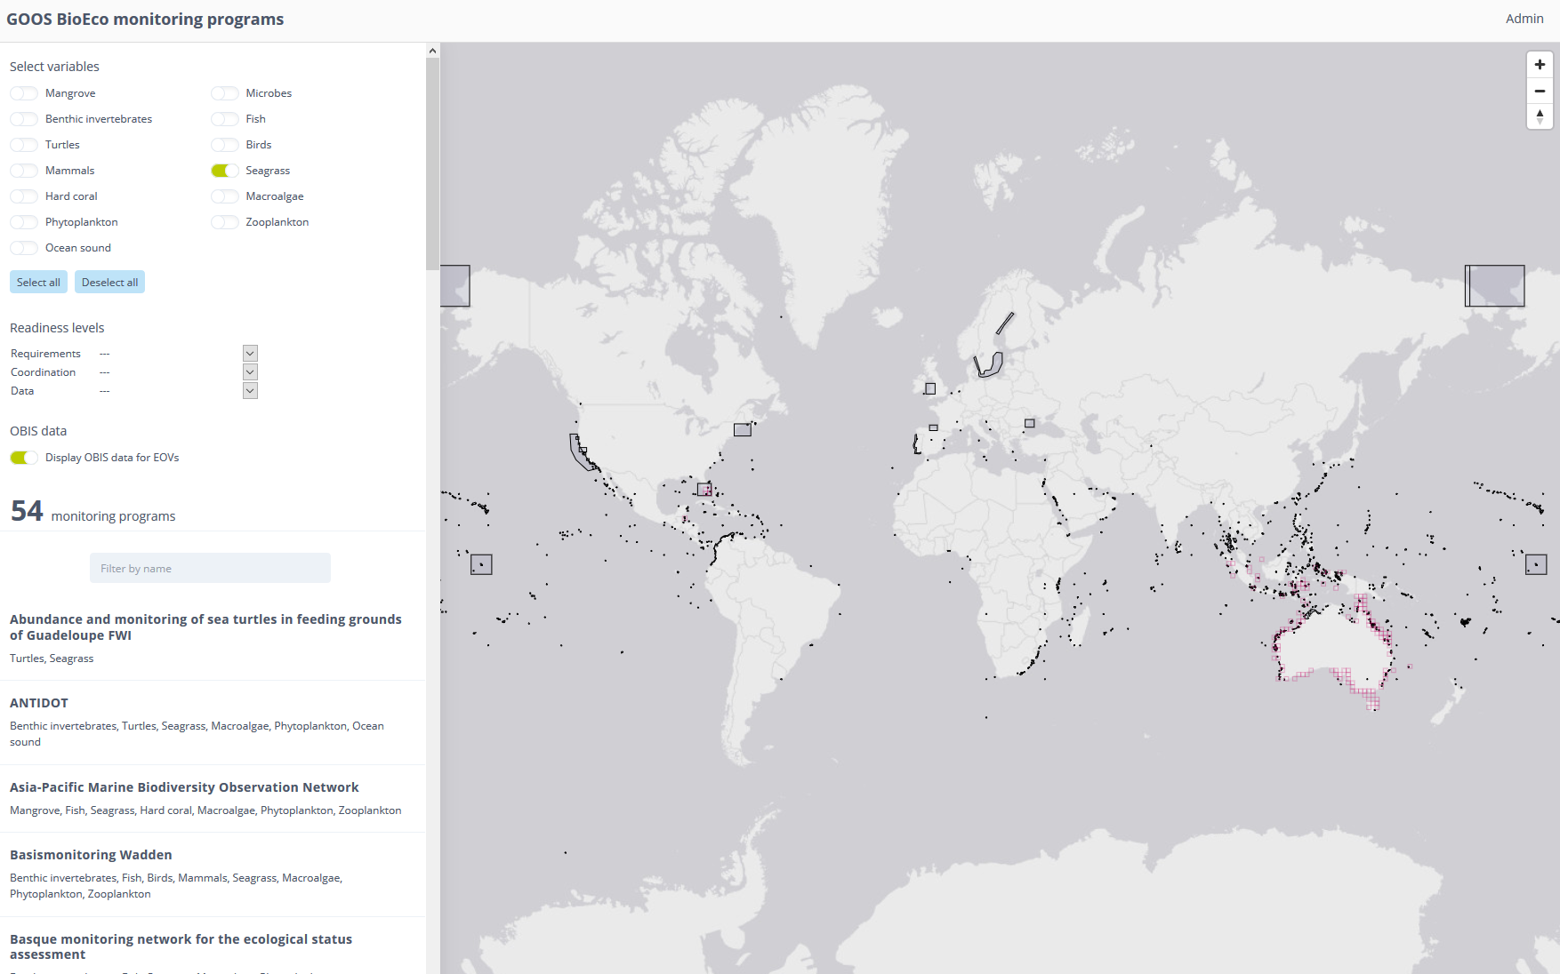
OBIS Metadata portal

Slide 9
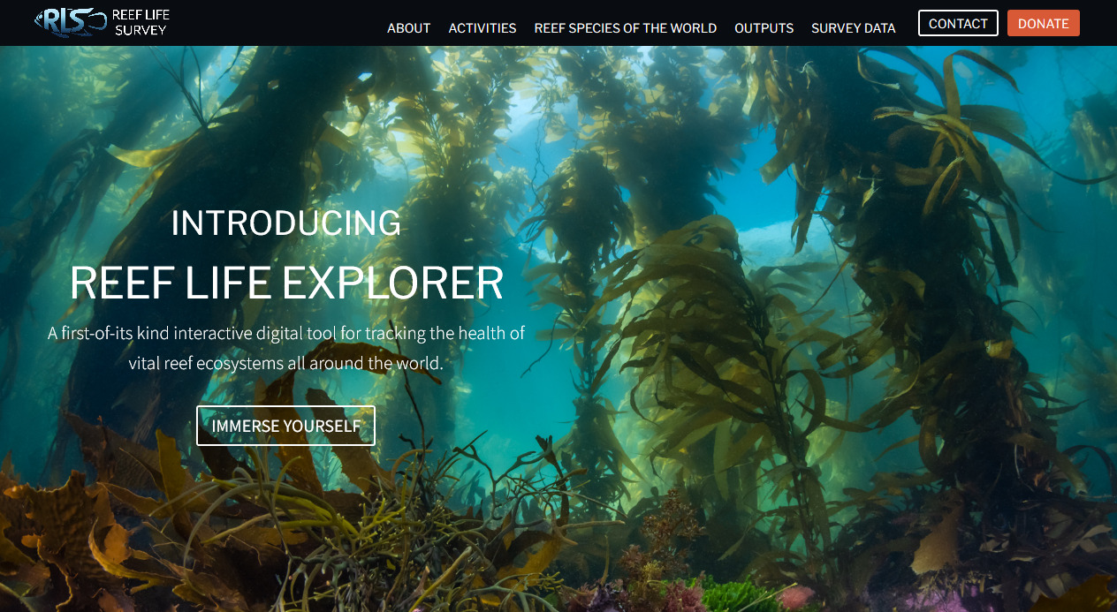
Biological EOV Snippets
Ocean Sound EOV specification sheet
RLS funded by Pew for second global survey
DOOS leading Invertebrate EOV
TBM EOV to split into Turtle, Bird and Mammal EOVs
Global coral reef report imminent
C-Grass at the Smithsonian
BRUVs first GOOS-endorsed OBP
Annual report:
https://www.goosocean.org/index.php?option=com_oe&task=viewDocumentRecord&docID=27598
https://reeflifesurvey.com/

Slide 10
Achievements against Implementation Plan
Implementation Plan (1-year deliverables)
1.1 Partnerships to improve delivery | DOOS, Marine Life 2030 (MBON, WCMC, OBIS)
3.1 Develop an interactive map of networks and metadata for biological monitoring | PEGASuS, EuroSea
5.1 Essential Ocean / Climate Variables Stewardship | Further specification of ECVs. Identified authors for combined land and water ECV/EOV paper
6.2 Advancing BGC/BioEco observations across global networks through projects | GO-SHIP and OceanSites
7.1 Building the community | Metadata portal (OBIS), C-GRASS, GOMON,
7.7 BioEco EOV data available through OBIS | Metadata portal nearing completion (OBIS)
9.1 Partner MBON, OBIS, and WCMC on capacity exchange | Marine Life 2030

Slide 11
Future plans (as identified in GOOS IP)
Implementation Plan (3&5 year deliverables)
6.3 GOOS Endorsed Best Practices (2023) | Endorsed BRUV BP in OBPS
8.2 Clear directive on use of eDNA to support biological EOVs (2023) | POGO workshop; Biomolecular Ocean Observing Network proposal
9.9 Capacity development for reporting on CBD post-2020 global biodiversity framework indicators UNSEEA and other relevant Multinational Environmental Assessments (MEAs) | CBD information document, UN System of Environmental Accounts, Ecosystem Assessment accepted by UN Statistical Commission. Input to Global Ocean Accounts Partnership leading ocean input to UN SEEA EA.
9.10 Capacity development for reporting on CBD post-2020 global biodiversity framework indicators for the business community | Blue Carbon, carbon offsetting and restoration (c.f. UN Decade on Ecosystem Restoration) opportunities to be followed up
10.2 Incorporate/link to the human pressure indices (2025) | Ocean Sound EOV

Slide 12
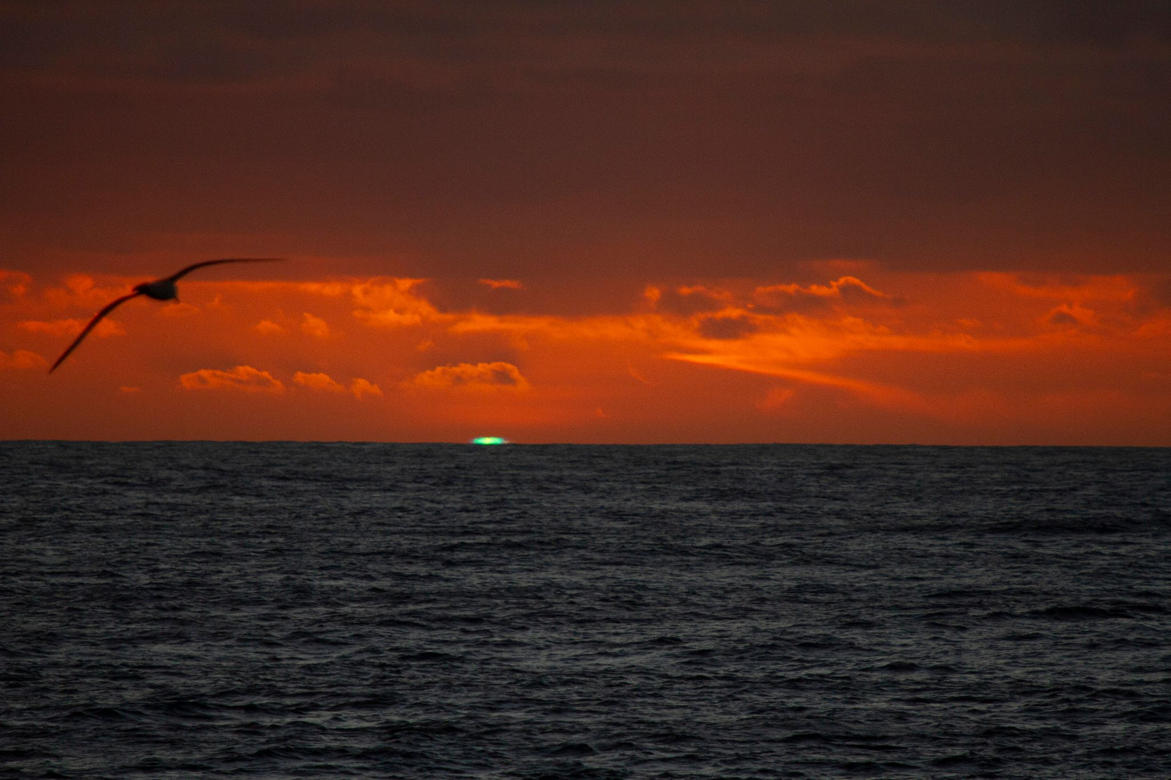
Opportunities, issues and threats (of a cross-GOOS nature)
Opportunities
Further regional focus
Ocean Decade (GOOS-led plus Marine Life 2030, BOON)
UN SEEA EA & GOAP
CBD post-2020 global biodiversity framework
Third World Ocean Assessment
SDGs?
Business community - how to engage and what is our product
Foundation community
Threats
Maintaining ongoing panel support
Maintaining ongoing OBIS support -- metadata portal and EOV data management (c.f. IP 7.1)
EOV Brand name
maintaining rigour of approach (c.f. IP 5.4)
maintaining data quality

