Slide 1
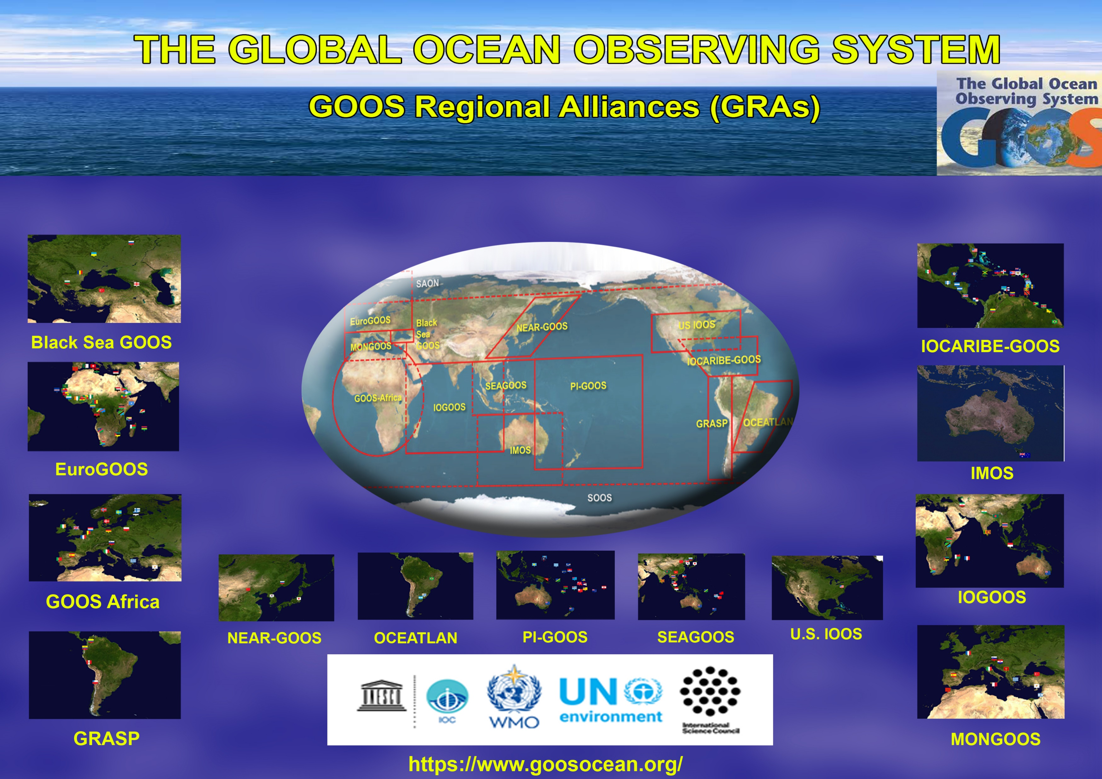

The Global Ocean Observing System
www.goosocean.org
GOOS Webinar
Reports from GOOS components
GRA - GOOS REGIONAL ALLIANCES COUNCIL
R Venkatesan
Chair GRA & Programme Director OOS ,NIOT,
Ministry of Earth Sciences Chennai India
Denis Chang Seng
Programme Specialist, Ocean Observation and Services Section / GOOS
GOOS 10th Steering Committee meeting [online], 19 April 2021

Slide 2
Report on GRAs - Activities , Challenges
Assessment of GRAs
Linkage to GOOS IP
To conclude GRAs- View of GOOS SC

Slide 3
US IOOS
U.S.lOOS Achievements: Biological Observations
US IOOS hosts US Marine Biodiversity Observation Network (MBON)
US IOOS staff member was appointed as co-chair of the GOOS Biology and Ecosystems Panel
Co-chair of the interagency “Biology - Integrating Core to Essential Variables (BIO-ICE) Task Team”: Global Ocean Monitoring and Observing (GOMO) Program
Animal Borne Sensors
AniBOS (Animal Borne Ocean Sensors) Multi-National Network - Emerging Network by OCG
ATN Binary Universal Format for Reporting (BUFR) template formally approved by the WMO
U.S. IOOS Activities: Advancing Ocean Technology
Six new 3-year project awards beginning in late FY20.
Notes:
Animal Borne Sensors:
Our Proposed AniBOS (Animal Borne Ocean Sensors) Multi-National Network is Approved as an Emerging Network by the GOOS-Observations Coordination Group (OCG): The U.S. ATN is a proud member of the international team led by Dr. Clive McMahon – Australia and Dr. Fabien Roquet – Sweden, who joined together in preparing a formal proposal for AniBOS to the GOOS-OCG. In response to our proposal, Emma Heslop, Programme Specialist for GOOS and the OCG, wrote: “Congratulations, the ANIBOS proposal to become a GOOS network is an excellent response to the GOOS OCG attributes characterizing mature GOOS observing networks. The proposal is of such high standards that it is a model for the community to emulate. We are very excited about the prospects for ANIBOS and are happy to welcome you as an OCG emerging network. The proposal addresses all critical elements of a well-coordinated international effort to further develop an animal-borne sensor observing network (existing efforts within this community are already addressing key observational gaps). It identifies where the ANIBOS community is already doing well, and shortcomings that it plans to address in the coming years. It points out opportunities to engage with other GOOS networks, and enhance integration across the system for the benefit of ANIBOS and others.”
ATN Global Telecommunications System (GTS) Project Takes a Big Leap Forward: Our BUFR (Binary Universal Format for Reporting) template for coding quality-controlled oceanographic profile data collected by animal borne sensor tags and disseminating them globally via the World Meteorological Organization (WMO) GTS has been validated technically and has been formally approved by the WMO BUFR Team. The WMO will define it as operational in November of this year. A great deal of thanks to Dr. David Berry - UK-National Oceanography Center, and Axiom Data Science – Luke Campbell and Kyle Wilcox, for this big success.

Slide 4
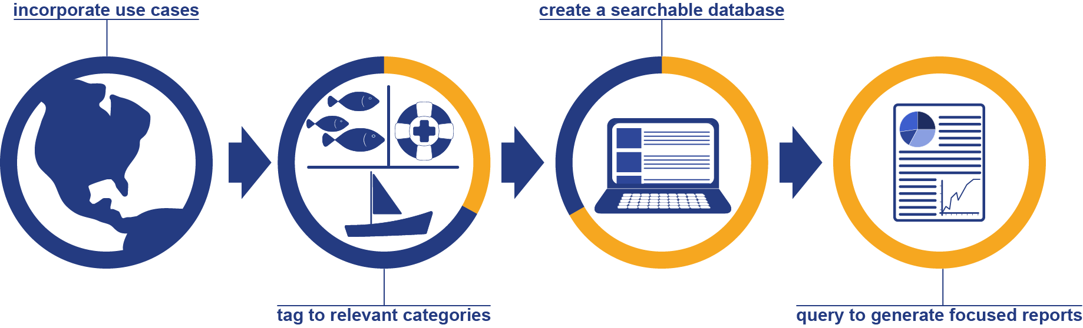
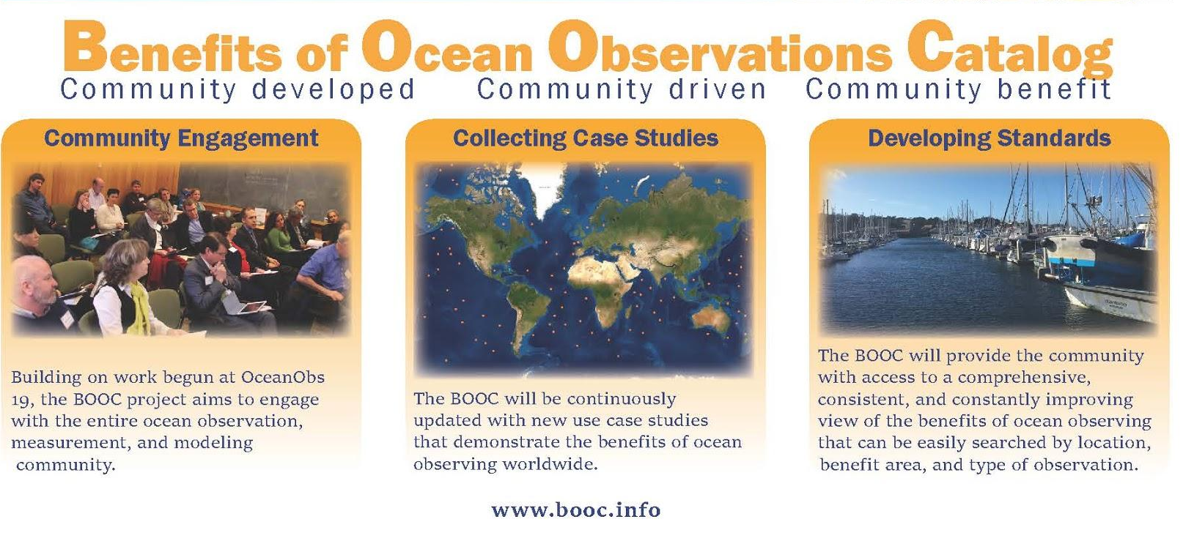
U.S. IOOS Future Plans
The Benefits of Ocean Observations Catalog
www.booc.info
Notes:
The Benefits of Ocean Observations Catalog is a project that had its inception at the OceanObs 19 conference.
BOOC aims to deliver an interactive catolog of use cases demostrating the qualitative and quantitative use of ocean observations and measurements in the delivery of economic and societal benefits.
Seeking to demonstrate a prototype catalog fall 2021.
Engaging with the international ocean observing community to populate and continuously update.
Next GRA council meeting we will review development plans and how GRAs can begin to consider developing use cases.
The Benefits of Ocean Observations Catalog, or BOOC, aims to create a continuously updated searchable repository of use-cases, demonstrating the qualitative and quantitative benefits of operational ocean observation and measurement and the activities of national and international organizations in translating and making accessible core ocean information supporting multiple applications.
www.booc.info has information on planned development

Slide 5

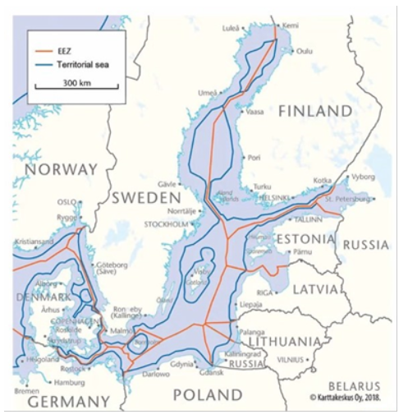
EuroGOOS
Establishment of the EOOS Operations Committee
Re-establishment of EuroGOOS Fixed Platform Task Team
1st EuroSea Tide Gauge Network Workshop
EuroGOOS Ocean Literacy Network 1st Ocean Literacy Course ogranized within the UN Decade.
Main challenges
Connected with the COVID pandemic and related restrictions:
Postponement/cancellation of workshops, RV cruises, deployments, servicing operation (e.g. ferrybox).
Gaps and duplications on tide gauge data portals – Different international data portals deal with different temporal sampling, latencies, QC Having unique identifiers for tide gauges
Glider missions in EEZ of neighbouring countries are still not regulated,

Slide 6
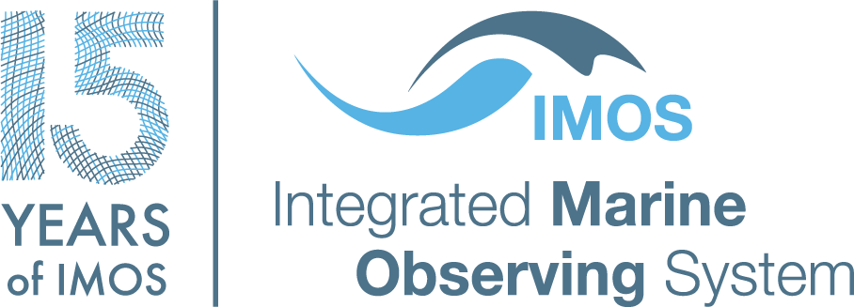
IMOS Michelle Heupel
Director, IMOS michelle.heupel@utas.edu.au
IMOS
2021 marks 15 years of IMOS special logo for the year
Program changes
  Examined the entire IMOS program.
Planning for Impact
  Impact metrics based on OECD guidelines are being applied IMOS program.
  Outputs – to define relevance of observing data to key areas of societal benefit and aligns with GOOS 2030 Strategy.
Opportunities for growth : coastal observing, marine plastic, eDNA, event-based sampling, data visualization and others
Continued excellence 14th Annual Planning Meeting
International connectivity

Slide 7
IOGOOS
Indian Ocean Global Ocean Observing System
Governance
  Officers representing from (i) Eastern IO (ii) Western IO, (iii) Central IO, (iv) IORP Nomination, (v) SIBER Nomination and Head, IOC PRPO
  16th Annual meeting virtually in July 2020
  Observing System
  Indian Ocean Regional Panel (IORP)
  Sustained Indian Ocean Biogeochemistry and Ecosystem Research (SIBER)
  IndOOS Resource Forum (IRF) - A High-level committee to oversee the observations
  International Indian Ocean Expedition (IIOE)-02
  Chair (Interim): Dr. T. Srinivasa Kumar (CIO); Officers: Dr. Brett Molony (EIO); Dr. Faiza Yamani (WIO); Dr. Jenny Huggett (SIBER); Dr. Elaine McDonagh (IORP)

Slide 8

IOCARIBE-GOOS
Dr. Cesar TORO
IOCARIBE-GOOS Technical Secretary c.toro@unesco.org
Multi-hazard information and forecasting system for the wider caribbean
IOCARIBE sea level monitoring network
The coastal inundation forecasting demonstration project (cifdp-c)
Pilot project on improvement of hurricane observing forecasting capacity
Strengthening IOCARIBE-GOOS Alliances in the region and establishing new partnership with
The global ocean acidification observing network (GOA-ON) Latin American Ocean Acidification Network (LAOCA).
Coral reef monitoring

Slide 9


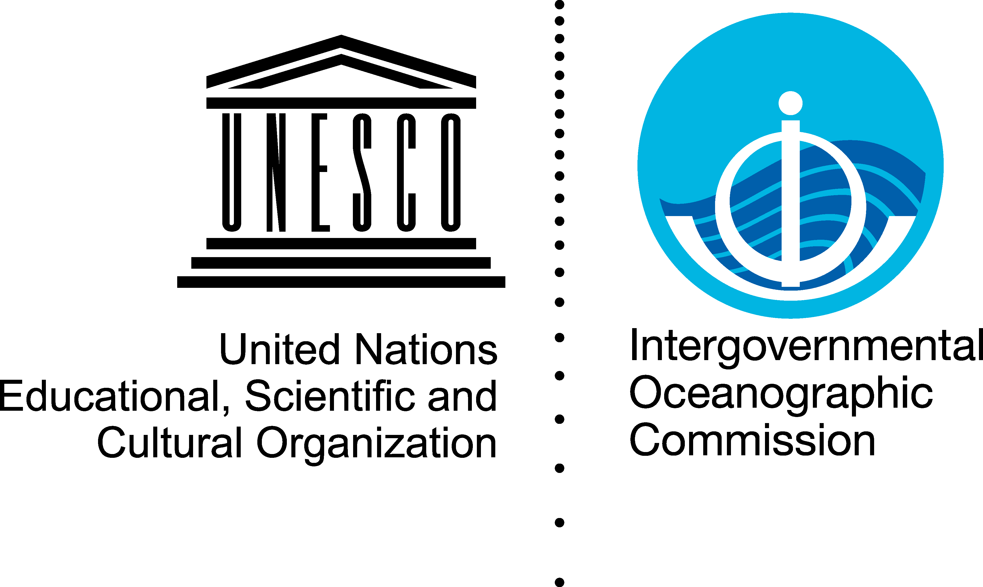

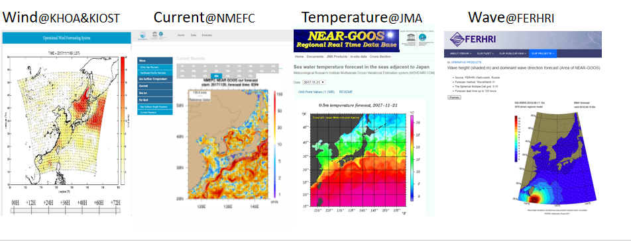
NEAR-GOOS
Major activities
Achievements
  Oceanographic data from buoys, observation stations and volunteer ships
  forecasting service products daily ( Currents, wave, wind, sea surface temperature, sea surface height )
  Improvement of data-sharing and forecasting services through establishing more user-friendly website
  developing more precise forecasting models and better data quality control method
  To organize a symposium with the IOC WESTPAC Office in Aug 2021 GOOS 2030 Strategy and the United Nations Decade
  To develop a NEAR-GOOS gateway website
  To develop collaboration with other regional organization in form of joint projects or joint scientific session with NOWPAP, PICES, PACON and other international organizations
Challenges
Financial support for working groups
NEAR-GOOS forecasting service products sharing portal

Slide 10
WESTPAC-SEAGOOS
Under 3 projects namely
(1) Monsoon onset monitoring and its impacts on ecosystem (MOMSEI),
(2) Ocean forecasting system (OFS), and
(3) Ocean acidification and its impacts on coral biodiversity,
Ocean forecasting system
Monitoring of ocean acidification and its impact on coral biodiversity
Under COVID-19 situation

Slide 11
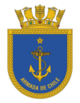

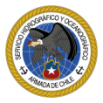
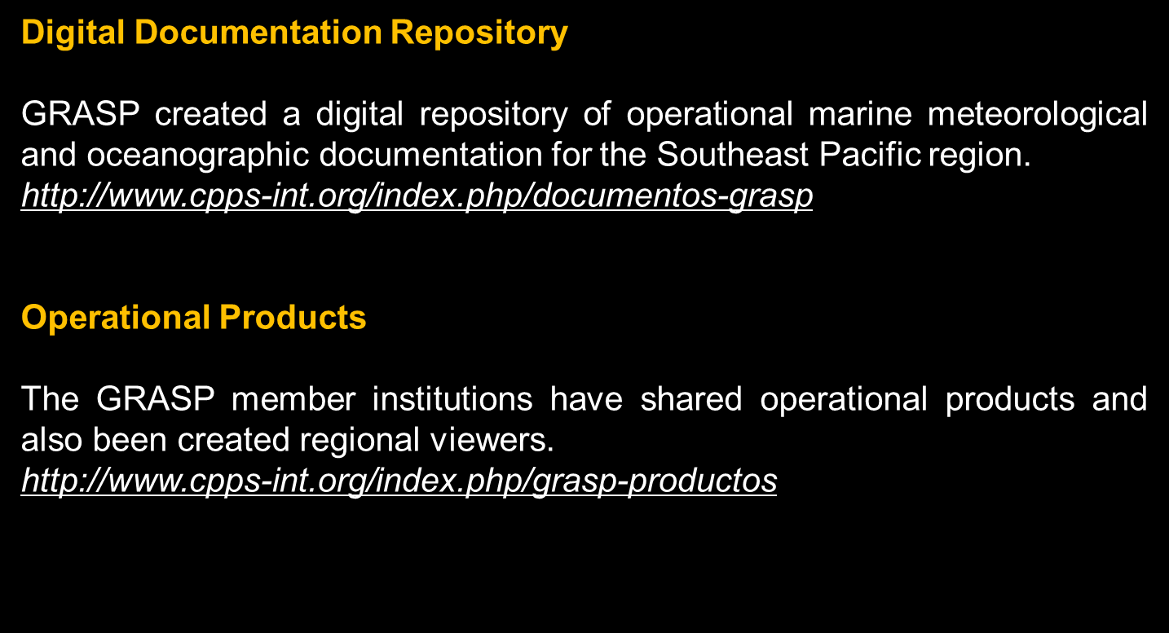
GOOS Regional Alliance for the Southeast Pacific (GRASP)
GRASP PRODUCTS
Web portal for visualization of numerical models.
Visualization of global models of oceanographic and meteorological data in the Southeast Pacific region.
http://coos.inocar.mil.ec/visores/ dash.html
Regional Observational Network.
integrate the Tidal Stations in the region. In the future, it integrate environmental variables, such as SST and meteorological variables. This task is in continuously develop.
http://coos.inocar.mil.ec/visores/red_mareografica/
Contact Focal Points of IOCaribe-GOOS and OCEATLAN, in order to exchange experience of each Regional Alliance, through videoconferences. Deadline: second, third and fourth quarter 2021.
P A T R I O T I S M O
HONOR
LEALTAD
VALENTÍA
INTEGRIDAD
DEBER

Slide 12

NAME: ALVARO SCARDILLI COUNTRY: ARGENTINA
GOOS SC: REGIONAL EXPERT GROUP III (Latin America and the Caribbean)
New Specialized Center for Ocean Sciences OTGA (Ocean Teacher Global Academy
Proposed campaign on board ARA “AUSTRAL” SAMOC and iAtlantic projects.
Improving integration of ocean observations and marine meteorology products/services.
Assist in developing/strengthening links between Member States of Group III and experts.
Contribute regional perspective to the GOOS SC.

Slide 13
BLACK SEA GOOS
Operational services running in the Black Sea are:
Black Sea ARGO - providing in-situ data CTD and DO profiles - 12 floats.
Copernicus marine environmental service (CMEMS) - physics, bio and waves daily forecasts and 20 years re-analysys.
Plans
Increasing the number of ARGO floats
Enhancing the forecasts and extending the re-analysis

Slide 14
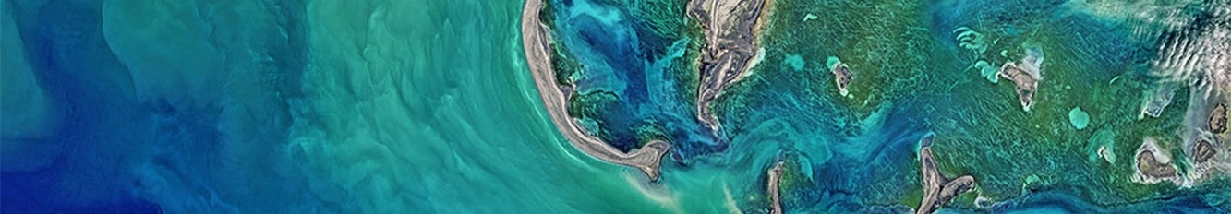
GOOS-AFRICA MANDATE
GOOS Africa formation: PACSICOM, Maputo and Cape Town Declarations
Abidjan and Nairobi Conventions
GOOS Africa Framework for Action
GMES & AFRICA
African Union/NEPAD Environmental Action Plan
2050 Africa’s Integrated Maritime Strategy
African Union Vision’2063
African Decade of Oceans and Seas
African Blue Economy Strategy
UN Decade of Ocean Science for Sustainable Development

Slide 15
ACTION PLAN ALINE WITH GOOS IMPLEMENTATION PLAN
Find a way to represent Decade Programmes, GOOS Projects | Identify and tackle barriers to GOOS ability to more forward | Support dialogue with partners about roles, where fit in achieving the 2030 Strategy | Track progress towards achieving the Strategy, milestones and output | Provide visibility of how GOOS is responding to societal needs, tracking impacts
Contribution to the establishment of national coordiantion of the UN decade for ocean sciences for sustainable developement | Development of GOOS-AFRICA Women Network Establish a Pan African Youth Leadership Network in Ocean, Climate and Atmospheric Sciences | Establish linkages/synergies between existing African Research Facilities towards a Shared Research Resources Platform, Research Vessels, UNESCO Chairs, Remote Sensing networks, | Synchronized Cruises Around AFRICA for the African and UN Decades (East Africa, West Africa, Noth Africa) | Webinar on how science response to coastal erosion
Issues and threats of a cross-GOOS nature
Funding issue
Visibility of GOOS in each country
Full cooperation with private sector

Slide 16
CIOOS
Data integration - i,400 datasets across 3 regional associations national web portal metadata.
Collaboration
International data standards development - with US IOOS.
Multidisciplinary Data to Understand our Oceans
A Connected Cyberinfrastructure
CIOOS’ first Communication Plan -. A brand guide was also developed to provide guidelines
CIOOS participated in numerous events:
UN Decade of Ocean Science
GOOS Components
GOOS expert panels for physics, biogeochemistry, and biology
GOOS Projects – CIOOS has expertise that could advance innovation and contribute to the expansion into new areas for GOOS
Notes:
Essential Ocean Variables, or EOVs, are those that are mature in their methodology, standardized in the community, and widely collected. CIOOS is currently hosting data that were identified as widely useful to test the system. These include a selection of physical and biogeochemical variables and variables that may be derived from them. This list of EOVs is regularly expanding according to community interest and we are currently building capacity for many biological variables, including genomics, and making CIOOS compatible with existing repositories like the Ocean Biodiversity Information System, or OBIS, and the National Center for Biotechnology Information, or NCBI.
Data integration - integration of more than XXXXX datasets across 3 regional web portals and one national web portal harvesting their metadata
Collaboration - Connecting more than XXXXX partnering organizations across Canada
International data standards development - Multiple meetings and two code-sprints in collaboration with IOOS
Multidisciplinary Data to Understand our Ocean - CIOOS puts in place the best practices to manage, integrate and share physical, biogeochemical and biodiversity data, based on the 31 variables identified as essential to monitor our oceans by the Global Ocean Observing System (GOOS).
A Connected Cyberinfrastructure - CIOOS launched three regional Data Catalogues and as well as a National Catalogue to allow easy and fast discoverability of data across Canada.
CIOOS’ first Communication Plan - Includes communication objectives, guidelines and key messages; general and sector specific value statements. A brand guide was also developed to provide guidelines when using the CIOOS brand.
CIOOS participated in numerous events:
MEOPAR Annual Scientific Meeting 28 octobre 2020
CIOOS Atl Ocean Data Connector 30 novembre 2020
IOOS DMAC 13-15 octobre 2020

Slide 17
Basic Analysis - numbers
72 actions across 8 GOOS elements and 11 Strategic Objectives
Notes:
Note that this is a first view of where actions are being proposed and this is only a basic guide. Some actions are larger than others, and there is no implied amount of work in the quantity of actions. There is no need for all elements to have actions in all areas or years.
As the next steps in the implementation planning process are undertaken, actions may move between SO or become consolidated with others - this remains a first view.

Slide 18
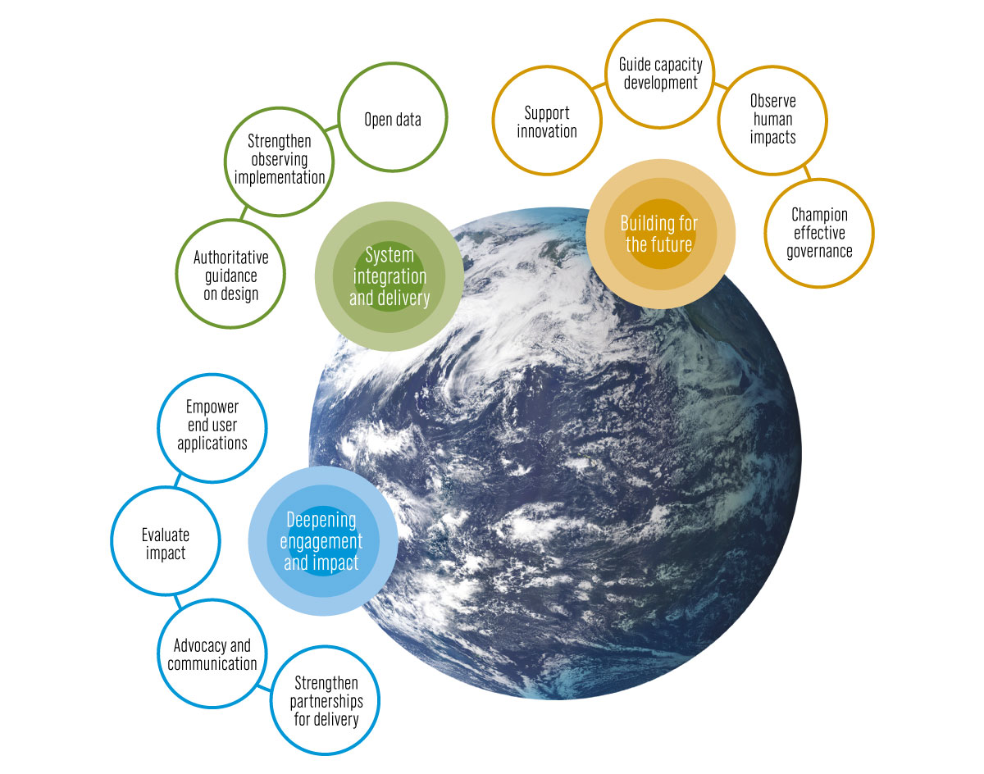
SO4 Empower end user applications
Data Integration Products Across GRAs
Initial action is to develop case studies, IMOS has initiated such a project and this would constitute an initial case study, users to learn and expand across GRAs
SO1 Partnerships for delivery
GRA forecasts, services and assessment
GRAs - forecasts, services and assessment (FS&A) and showcase success stories. evolve a methodology to develop interconnection among GRAs and Initiate dialogue during the next GRA Forum
SO9 Capacity Development
Implementing ocean monitoring and forecasting system with the engagement of GRAs
Engage with Member States at regional level, in particular SIDS and African countries on implementing ocean observing and forecasting systems
Ocean Observation Network Training Workshops
For interested African Member States aspiring to undertake National Ocean
Observation Network.
Notes:
By SO
Most actions are focused in SO5 Authoritative guidance on design (12 actions) and SO6 Strengthen observing implementation (15 actions), which are the core of GOOS work today. However, there are a great number of actions already distributed into the newer strategic objectives. There are a number of actions indicated for evaluating the observing system (SO3), although some consolidation of actions likely possible here, for SO9 Guide capacity development, effort has also been directed towards SO2 Advocacy and communication and SO7 Open data. Most of which were identified as priority actions in the development of the 2030 Strategy. SO1 Strengthen partnerships for delivery was also identified as a priority action and perhaps some more work here is needed. SO4 Empower end user applications, SO8 Support innovation, and SO10 Observe human impacts have few actions as yet, and also perhaps require more focus as we develop the implementation planning, either within GOOS or with external partners.
By timeframe
Most 1 year actions are initiated and much work will be delivered by SC-10. There is an emphasis on delivery in the 3 year timeframe (41 actions in total), and particularly for SO5 Authoritative guidance on design and SO6 Strengthen observing implementation. Some consolidation of actions is possible (see 4.2), however this first pass analysis suggests that consideration of, whether all this can be achieved in 3 years, if some actions should be shifted into a 5 year timeframe, if the concentration of activity on these two areas and timeframe mean that other Strategic Objectives will advance sufficiently, would be useful. It also suggests that GOOS look at resource implications for ongoing support any of these 3 year actions. Developing some additional longer term 5 year actions should be considered, excepting perhaps in SO9 Guide capacity development where the view is already for the long term.

Slide 19
SO1 Partnerships for delivery
GRA forecasts, services and assessment
An initial phase would involve a preliminary study on GRAs - forecasts, services and assessment (FS&A) and showcase success stories.
To evolve a methodology to develop interconnection among GRAs and Initiate dialogue during the next GRA Forum 2021.
To develop pathway delivery for FS&A - with support of successful GRA (EUROGOOS) and establish a procedure to sustain.
Overall bring visibility/highlight services rendered by GRAs to member states through respective GOOS Focal Points; Capture the strength of GRAs and their association with other agencies.
SO4 Empower end user applications
Data Integration Products Across GRAs
Initial action is to develop case studies, IMOS US IOOS as initiated such a project and this would constitute an initial case study, users to learn and expand across GRAs
SO9 Capacity Development
Implementing ocean monitoring and forecasting system with the engagement of GRAs
Engage with Member States at regional level, in particular SIDS and African countries on implementing ocean observing and forecasting systems
Ocean Observation Network Training Workshops
For interested African Member States aspiring to undertake National Ocean Observation Network.
Notes:
Awareness and alignment
Through working on the implementation plan
Interact and reinforce one another activities
Support the integration of many decisions and actions across GOOS (advantage)
Decide what not to do (trade offs)
Clear about GOOS role

Slide 20
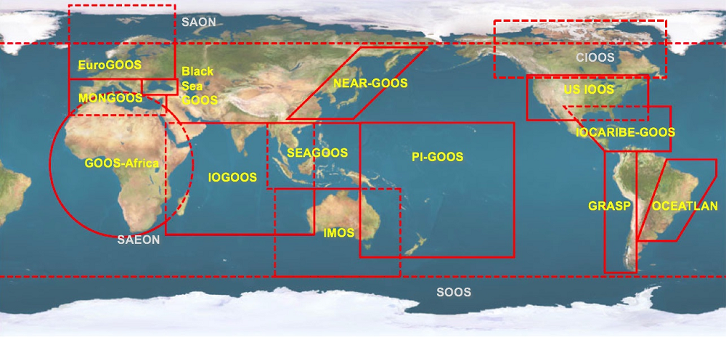

GOOS SO

Slide 21
SO1 Partnerships for delivery
GRA forecasts, services and assessment
OBSERVATION-DATA-PRODUCT-FORECAST

Slide 22
SO1 Partnerships for delivery
Overall bring visibility/highlight services rendered by GRAs to member states through respective GOOS Focal Points; Capture the strength of GRAs and their association with other agencies.
CONNECTION GOOS TO FOCAL POINTS

Slide 23
SO4 Empower end user applications
Data Integration Products Across GRAs
OBSERVATION-DATA-PRODUCT-FORECAST

Slide 24
^{st} Ocean Literacy Course
UN DECADE

Slide 25
CONNECTION TO WMO

Slide 26
Physics, bio waves daily forecasts re-analysys. Physics & Climate(OOPC) BGCIOCCP) BioEco ETOOFS
MBON BioChem
Physics & Climate
(OOPC) BGC (IOCCP) BioEco
Ocean state forecast, Monsoon
ETOOFS
Capacity Building
Marine meteorology products
ETOOFS
CoastPredict,
Partnerships in Indo-Pacific and Southern Ocean
Cross GOOS

Slide 27
Identified contributions to the GOOS IP
Launch of the EuroGOOS 2030 Strategy at the EuroGOOS 9th Conference
EuroGOOS strategy 2030 is underpinning the implementation of GOOS scope in EuroGOOS
Regular exchange GOOS BioEco Panel, EuroGOOS and GEO BON MBON SO3, SO5, SO7
Work towards the “European OceanOPS” collaboration OceanOPS SO3
Build stronger synergies between operational and ocean monitoring communities, for operational services to quality-controlled archived data repositories (EOOS OC, EuroGOOS ROOS, TT, WG).SO1, SO6, SO8
Engage GOOS National Focal Points in Europe to support ocean observing coordination in each member state to increase observing capacity, efficiency and visibility of the impact of ocean observations in vital services (EOOS Operations Committee). SO2

Slide 28
IMOS strategy
The IMOS Strategy GOOS 2030 Strategy and IP
  Need (our national and international context),
  Impact (harnessing our influence),
  Amplify (enhancing national ability through leadership) and
  Capability (the power of our people and infrastructure)
Align with GOOS 2030 Strategy elements
  Increase our relevance and visibility with stakeholders
  Ensure our program meets stakeholder and end-user needs (fit for purpose)
  Apply impact metrics to measure our progress and inform planning
  Sustain and expand our capability and influence
  Through our capabilities, ensure FAIR data delivery and technology innovation
  Engage new partners and stakeholders to meet national priorities
  Work to train the next generation of marine scientists
  Play a role as a key partner, resource and leader in the Indo-Pacific
  Turn observations into easily applied information for use by stakeholders

Slide 29
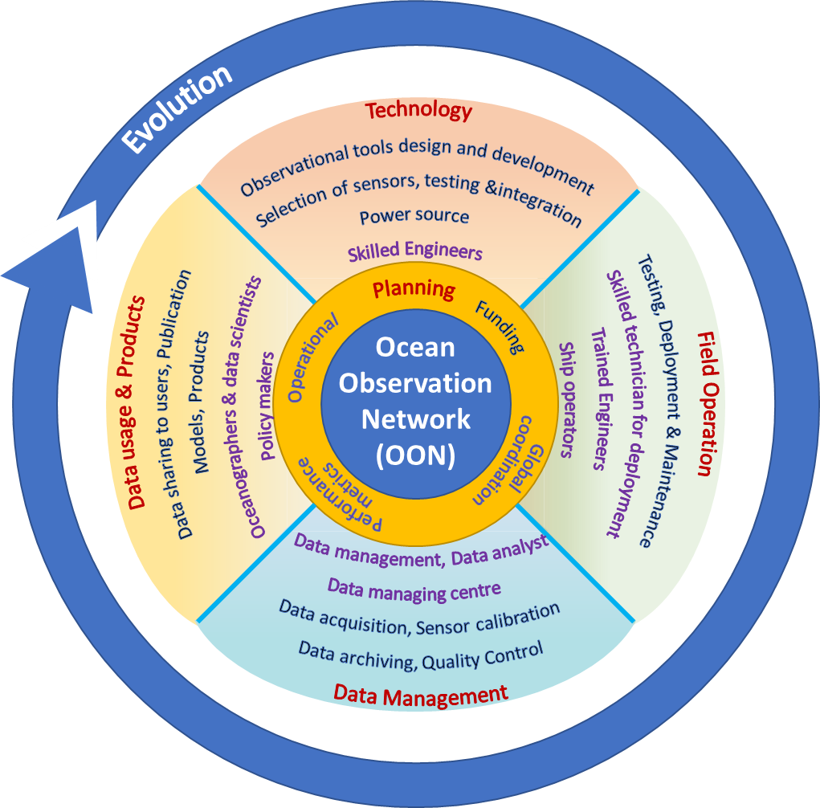
Source :"1 Introduction." National Academies of Sciences, Engineering, and Medicine. 2017. Sustaining Ocean Observations to Understand Future Changes in Earth's Climate. Washington, DC: The National Academies Press. doi: 10.17226/24919

Slide 30
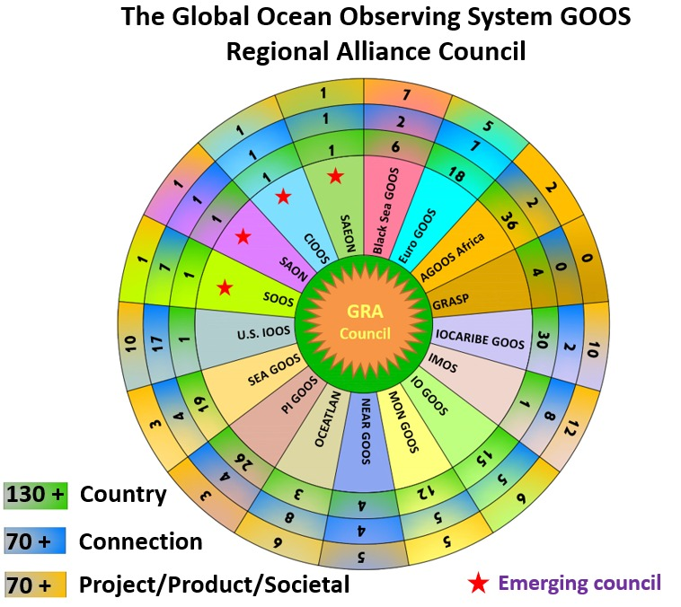
6 IOC sub-commissions or related intergovernmental structures.
4 memorandum of understanding.
1 international nonprofit association,
2 funded national government programs
IOCARIBE GOOS
NEARGOOS
SEA-GOOS
GRASP
PI GOOS
GOOSAfrica
MANGOOS
Black Sea GOOS
IOGOOS
OCEATLAN
EuroGOOS
IMOS
USIOOS

Slide 31
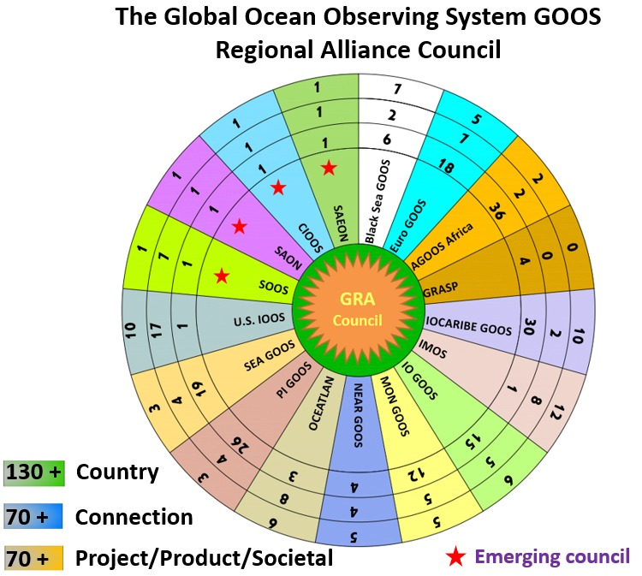
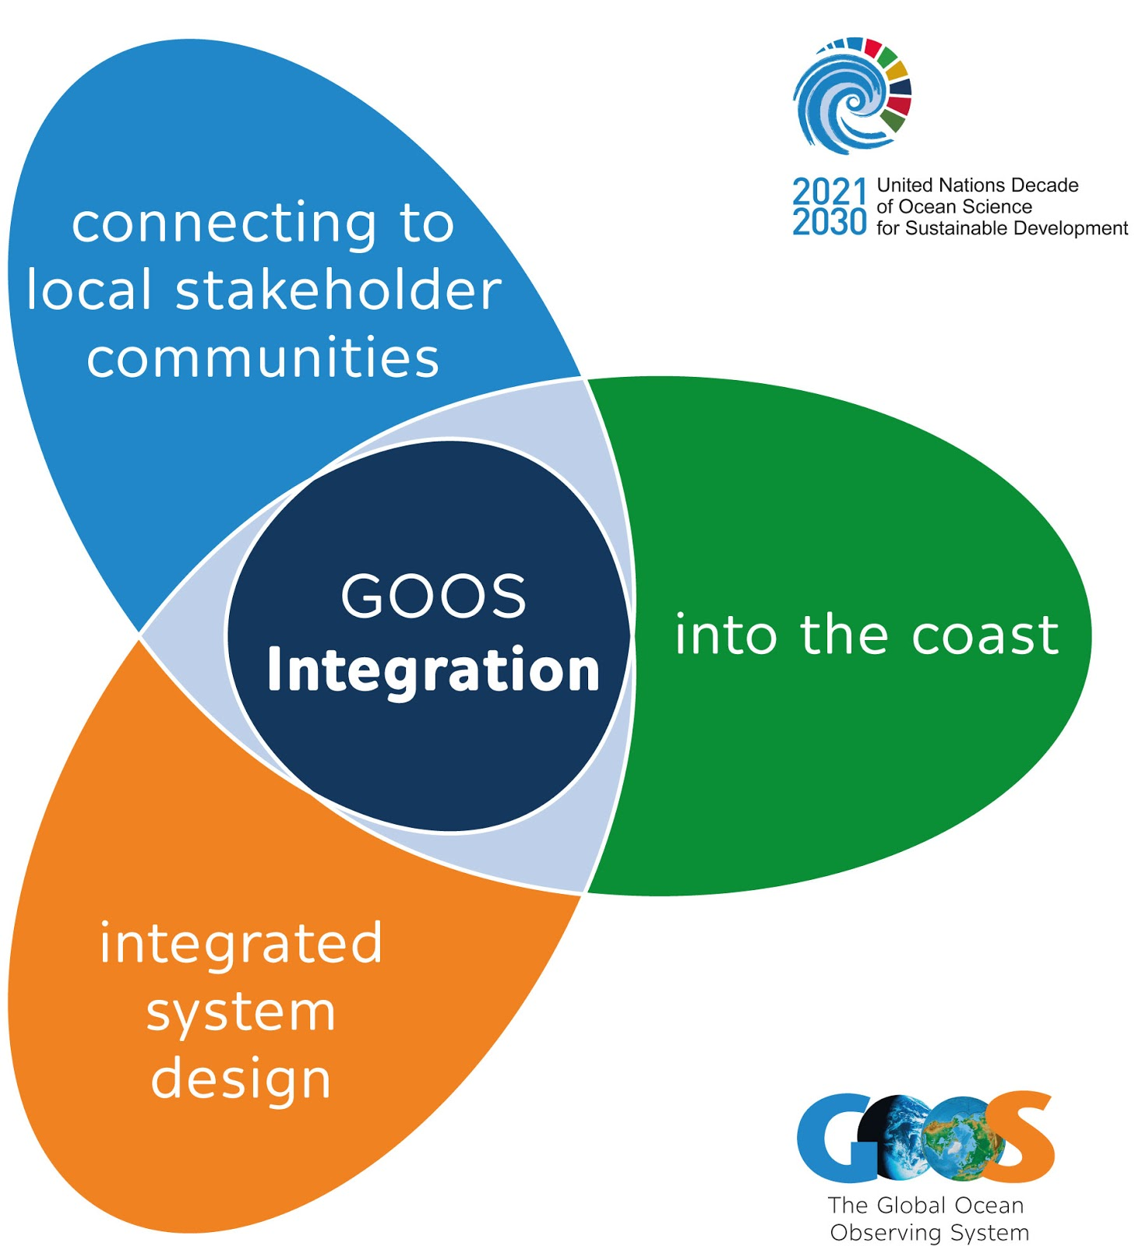
GOOS in the Decade Proposal
Three transformative Decade Programmes
United under the theme of INTEGRATION
Integrated system design
Connecting to local stakeholder communities
Integrating observations into the coast
Project
Project
Project
Project
Project
Project

Slide 32
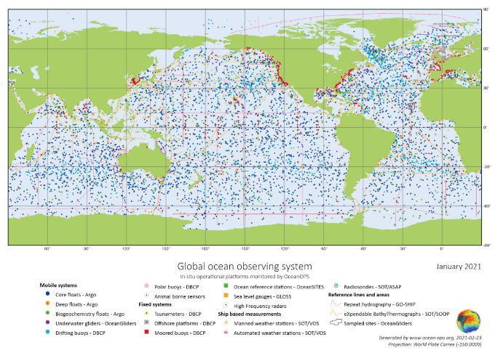




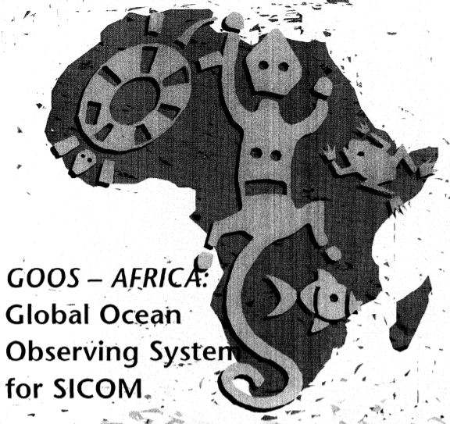
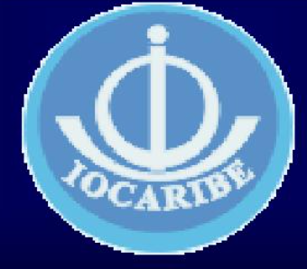
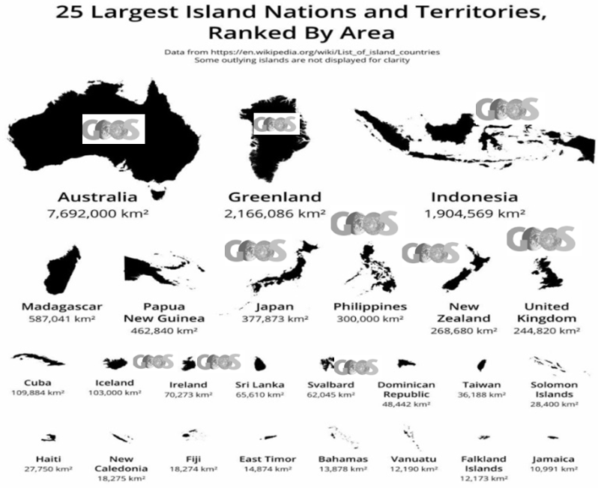
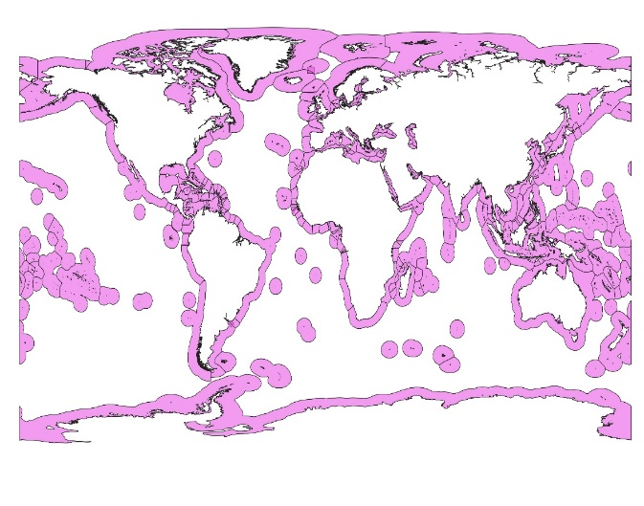
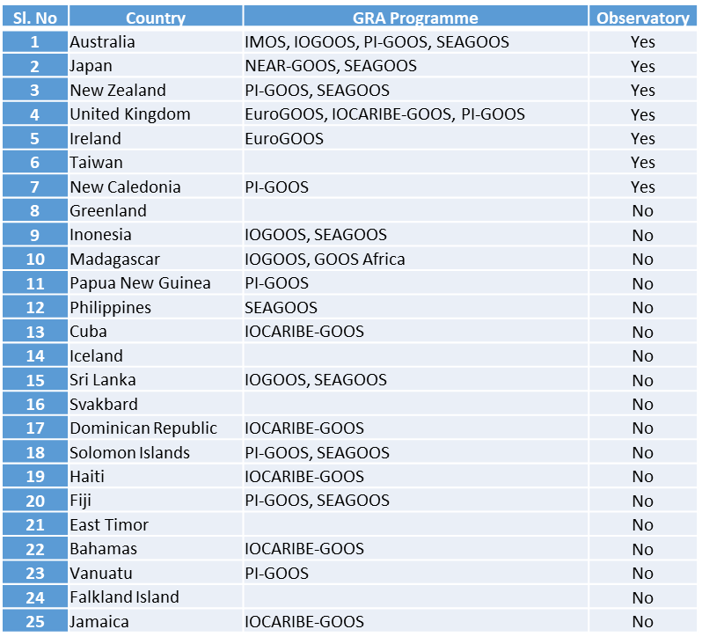
Exclusive Economic Zone (EEZ)

Slide 33
GOOS SC to consider
GRA Forum X Virtual
To start Webinar Series Focus to build expertise in the value chain Request support of GOOS SC
Support to expand Global Ocean Obs ?
Initiate action from emerging GRAs to full fledged GRA ?
Historically, the GRAs were introduced as a way to integrate national needs into a regional system and to deliver the benefits of GOOS strategy, structure, and programs at a regional and national level.
Connecting to National Focal Points
GRAs role Global Regional nAtional
SEEK ADVISE OF GOOS SC
First GRA was formed in 1994 - Where do we want GRAs by 2024 - 3 Decades
Connect – Guide - Resolve - Strengthen GRAs activities

Slide 34
THANK YOU VERY MUCH FOR YOUR KIND ATTENTION

