Slide 1
Reports from GOOS SC Steering Committee Actions report
The Global Ocean Observing System
www.goosocean.org
A. Fischer
Director, GOOS Office
GOOS 10th Steering Committee meeting [online], April 2021

Slide 2
Actions SC-9 part 1 & 2 [priority order, 1/3]
Action | timing | 2020 Q4 | 2021 Q1 | 2021 Q2
GOOS role in the Ocean Decade | Programme Proposals submited Jan 2021 | SC (most-all) | structure next steps
GOOS Implementation Plan | Plan + process April 2021 | Exec | SC (most-all) review Draft | SC-10
GOOS Data Project |  | Secure funding | OCG BGC Panel | OCG BGC Panel
Partnership development team | Report out to SC-10 | Specific SC members Exec Core coord | Specific SC members Exec Core coord | Specific SC members Exec Core coord
Task team on EOVs: | Paper before GOOS SC-10 | Panels supported by consultant | Panels supported by consultant

Slide 3
Actions SC-9 part 1 & 2 [2/3]
Action | timing | 2020 Q4 | 2021 Q1 | 2021 Q2
GOOS Communications - Incremental Plan | Communications Plan April 2021 | Core coord | Agency | SC-10
GOOS National Focal Points | ongoing | Specific SC members Core coord | Core coord | SC-10
GOOS-WMO focal point and Ocean Experts team | ongoing | Specific SC members Core coord broader GOOS | Specific SC members Core coord broader GOOS | Specific SC members Core coord broader GOOS
GOOS structure team | Interim report SC-10 |  | Initiate? | SC-10

Slide 4
Actions SC-9 part 1 & 2 [3/3]
Action | timing | 2020 Q4 | 2021 Q1 | 2021 Q2
Scope OCG-OceanOPS report card expansion | Scope by Q4 2020
Task Team on Evaluation and Review Framework | Not specified
GOOS resourcing development | ToRs by 9.2020
Mid Nov Decade cross programme call
Mid Nov Projects call
2021 Feb SC Call topical call
2021 April SC-10 part 1

Slide 5
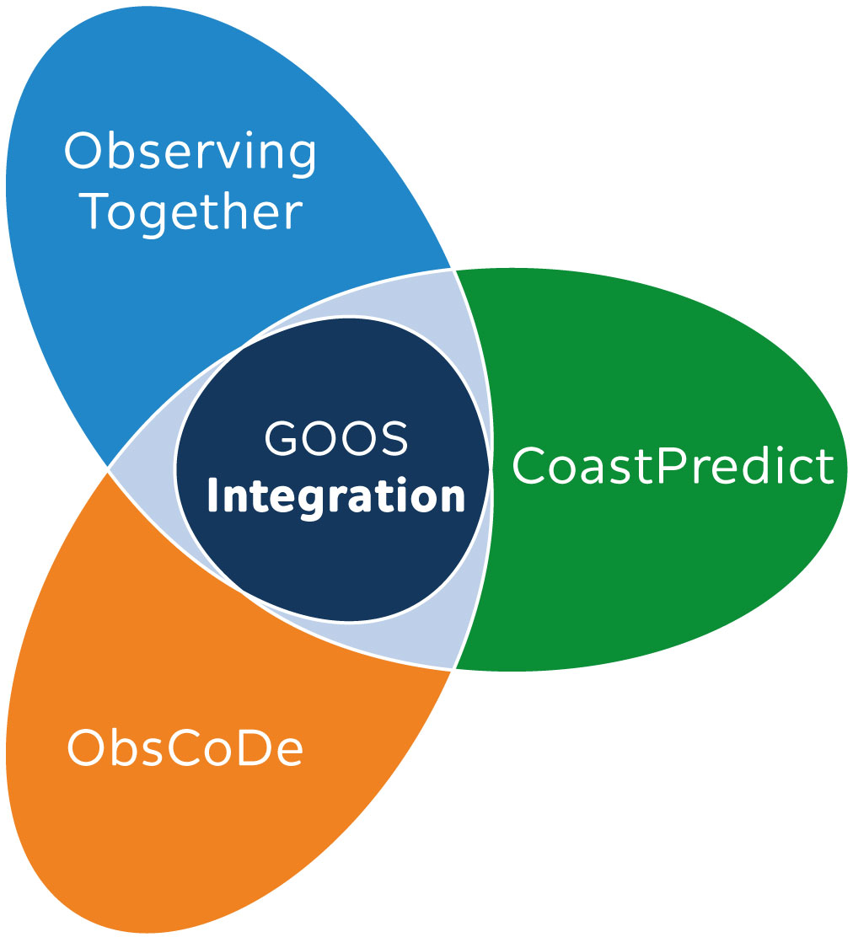
Action | timing | status
GOOS role in the Ocean Decade | Programme Proposals submitted Jan 2021 | Complete
Observing Together
SC development leads: Kim Currie, Molly Powers
observing_together@goosocean.org
CoastPredict
leads: Nadia Pinardi, Villy Kourafalou, Joaquín Tintoré
coastpredict.org
Ocean Observing Co-design
SC development leads: Sabrina Speich, David Legler
oceanobs_co-design@goosocean.org
Proposed next steps
Support to start steering bodies Communications Coordinating with community of ocean observing programmes/ projects Creating investable projects, seeking funding
Notes:
Insert clover picture
remember to thank Joaquin, Kim, Molly, David, Sabrina, Emma
speak to the Ocean Decade process: more than 200 proposals; community of proposals from obs the most complex and numerous. Probably 6-7 programmes in this challenge initially, self-organized community of practice encouraged.
Final endorsements of first round of submissions by end May / early June.

Slide 6
Action | timing | status
GOOS Implementation Plan | Plan + process April 2021 | Substantive planning process initiated with great participation Plan drafted
Proposed next steps
Seek input on SC on priorities Put plan in software to enable planning and tracking Ongoing planning, refinement and management process Creating investable projects, seeking funding
Notes:
Thank Emma for leading a team that has produced a substantive and useful view across GOOS, arming SC with levers for priorities

Slide 7
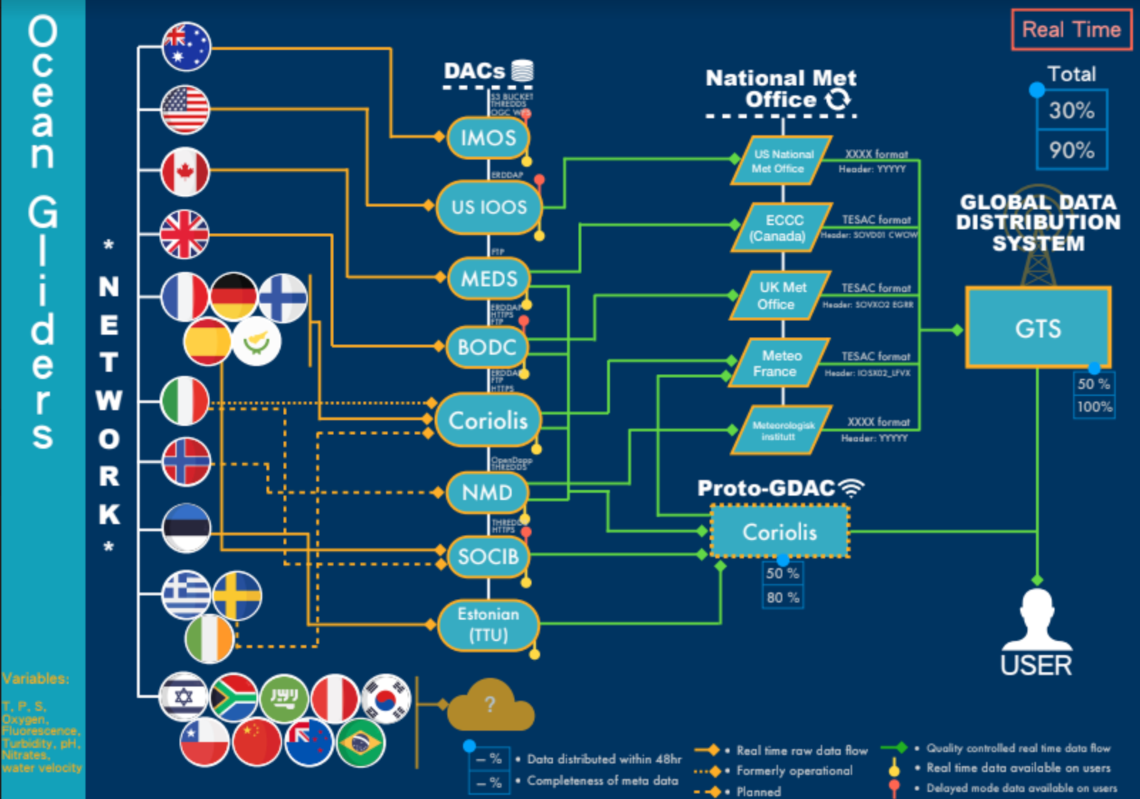
Action | timing | status
GOOS Data Project |  | Substantive progress
Proposed next steps
Continued refinement of mapping gaps and areas for improved efficiency identified Further engagement of IODE, WIS Definition of OceanOPS metadata role See IP

Slide 8
Action | timing | status
Partnership development team | Report out to SC-10 | Underway
GOOS-WMO focal point and Ocean Experts team | ongoing | Underway, through OCG/OceanOPS management, SG-OOIS, RRR redefinition, JCB
Many partner contacts initiated through Ocean Decade programme development
Ongoing engagement with WMO as a partner
Two TT calls (November, April)
Proposed next steps
See IP: series of actions under SO1 Categorize, visualize partners Discuss priorities, communications Focus on UNEP as partner, starting with marine litter

Slide 9
Action | timing | status
Task team on EOVs | Paper before GOOS SC-10 | Underway
Analysis of EOVs and the OceanObs’19 CWPs, supported by consultant
Work on definitions and processes
Work across 3 panels to harmonize EOV approach
Proposed next steps
Engage consultant to further work including on EOV paper

Slide 10
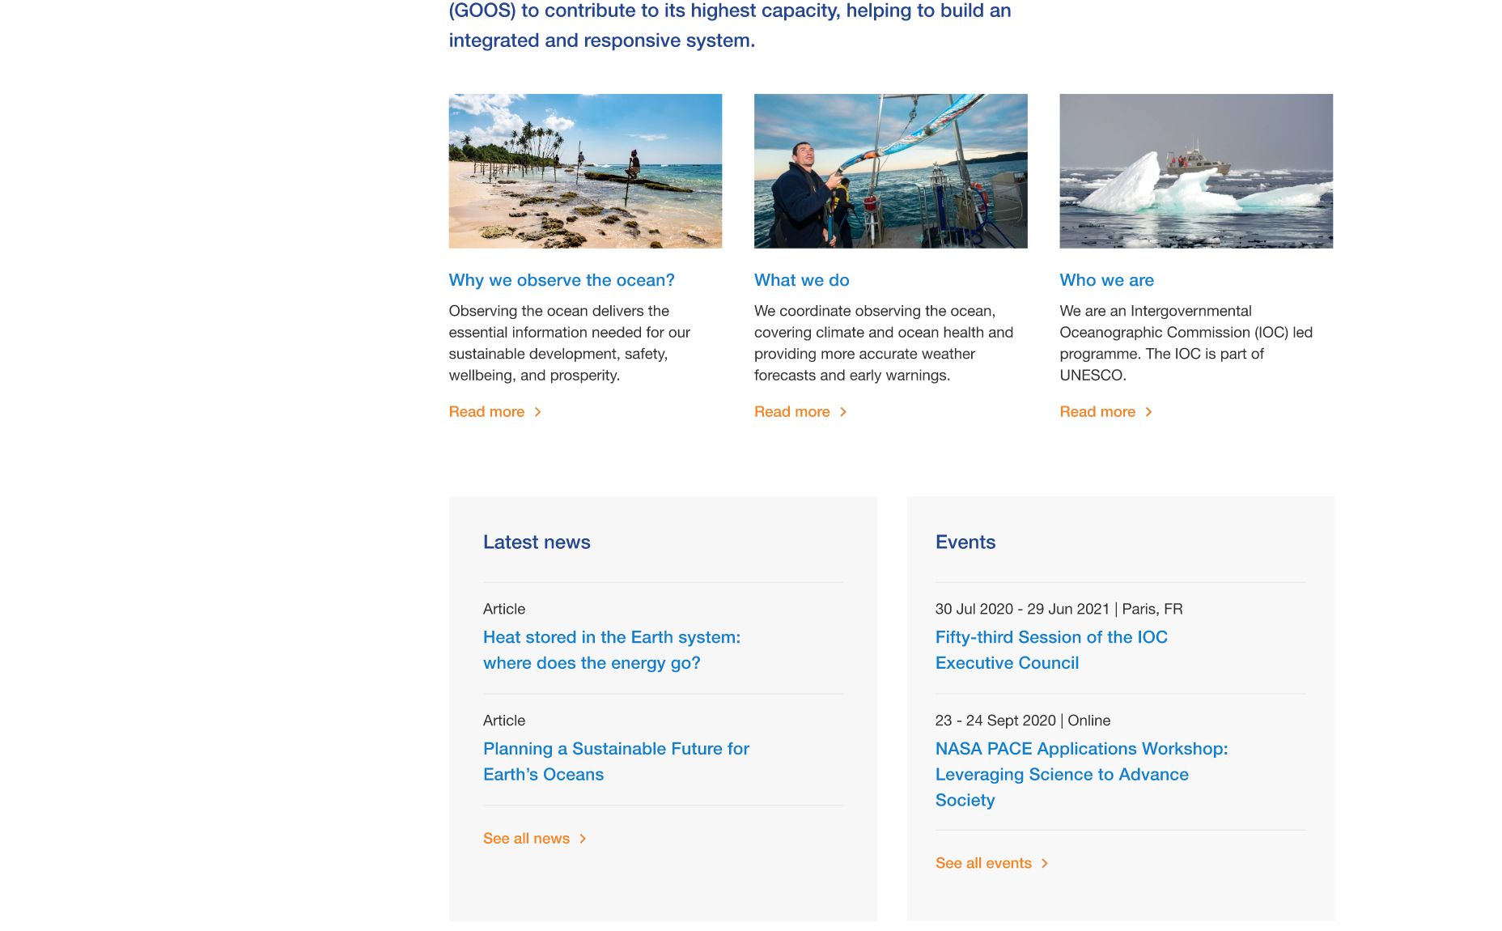
Action | timing | status
GOOS Communications - Incremental Plan | Communications Plan April 2021 | Underway: - website refresh 90% - Covid-19 followup - Decade messaging: for SC - engaging consultancy to develop plan 10% - reminder that national comms are key
Proposed next steps
Engage consultancy to develop plan through action, and based on learning so far

Slide 11
Action | timing | status
GOOS National Focal Points | ongoing | Underway: advanced with European NFP, model to renew GOOS NFP Terms of Reference; recommendation to reinforce communications
GOOS structure team | Interim report SC-10, initiate at SC-10? | Proposed focus of GOOS engagement in governance team
Scope OCG-OceanOPS report card expansion | Scope by Q4 2020 | 2021 report card underway; aim to scope by end 2021
Task Team on Evaluation and Review Framework | Not specified | Substance picked up by ObsCoDe programme
GOOS resourcing development | ToRs by 9.2020 | IP and Decade have both identified the need: team or consultant?

Slide 12
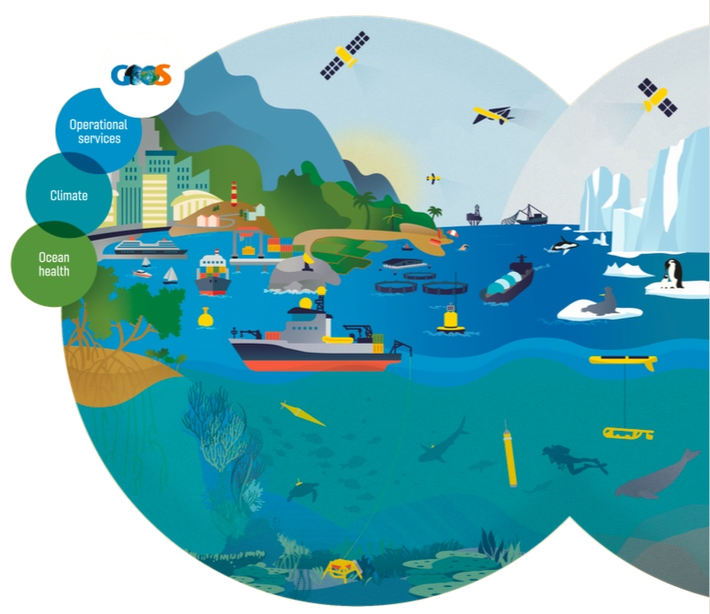
Thank you
goosocean.org

Slide 13
On break
Returning at 7:00 UTC for
the OOPC webinar

