Slide 1
Reports from GOOS projects TPOS2020 (2014-2021)
The Global Ocean Observing System
www.goosocean.org
S. Cravatte¹, W. S. Kessler², W. Yu³
and all other members of the TPOS2020 project
1- IRD, LEGOS, Toulouse, FRANCE 2-NOAA/PMEL, Seattle, USA 3- China
GOOS 10th Steering Committee meeting [online], April 2021

Slide 2
Outline
TPOS2020 project is an International effort to rethink the T.P.O.S.
It started in 2014: opportunity to build a more integrated,
modern and robust observing system,
taking advantage of new science and technology
- TPOS2020 goals and organization
- Main outcomes from the project
- Successes, challenges, lessons learnt
- Future organization – where to next?
- What can GOOS do to support the future direction?

Slide 3
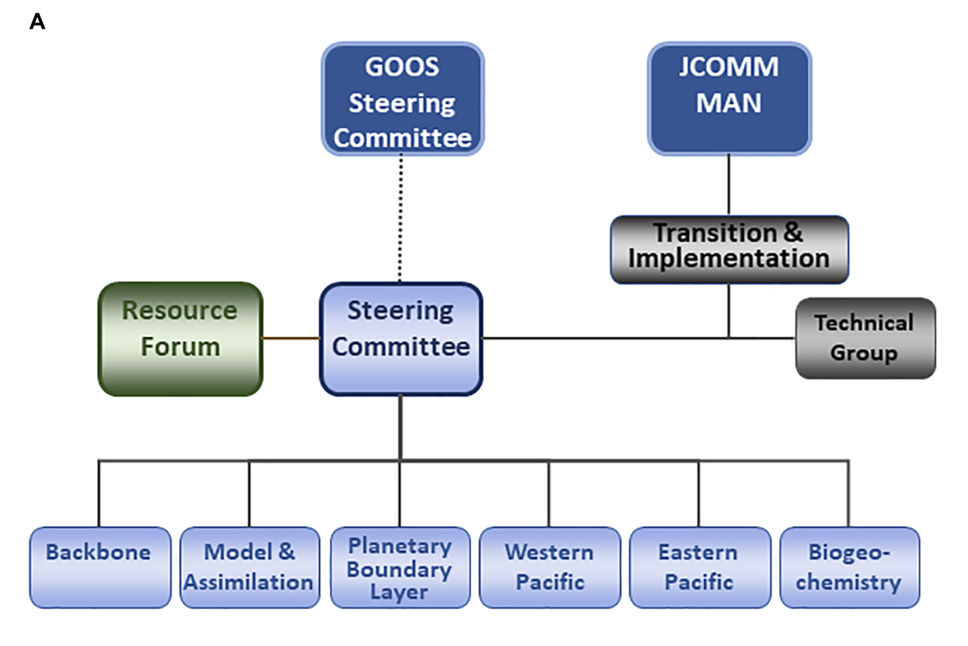
TPOS2020 goals and organisation
To redesign and refine the T.P.O.S. to observe ENSO and advance understanding of its causes,
To determine the most efficient and effective observational solutions to support prediction systems for ocean, weather and climate services,
To advance understanding of tropical Pacific physical and biogeochemical variability and predictability.
Steering Committee:
15 members from 7 nations
6 Task Teams:
With around 60 members
Resource Forum
Stakeholders
Notes:
RF: group representing the key stakeholders
The dotted line: the link with GOOS was light, and TPOS2020 mainly worked independantly, as an offine project, to be flexible, responsive, to move forward more rapidly.
TPOS2020 was reporting about annually to GOOS
Transition and Implementation TT: established, but was in sleep mode, since implementation didn’t really start yet.

Slide 4
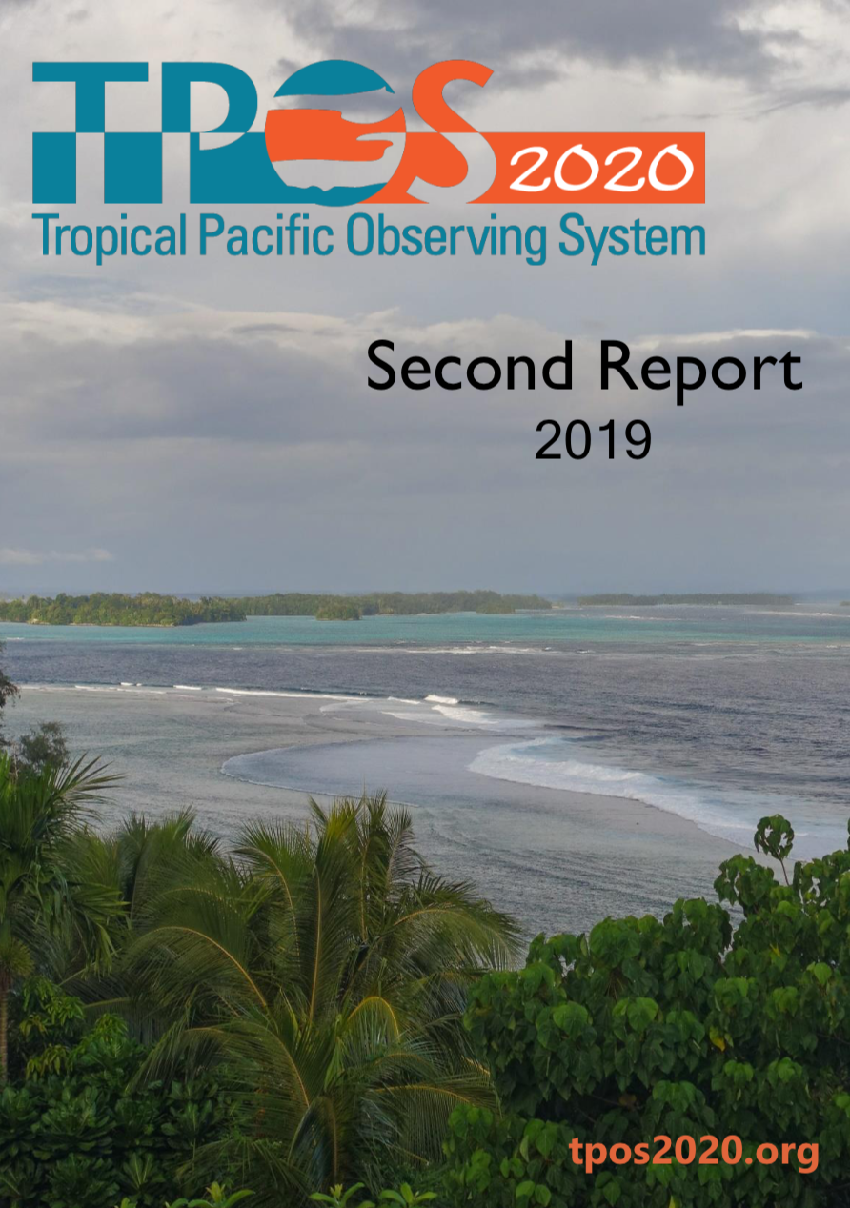
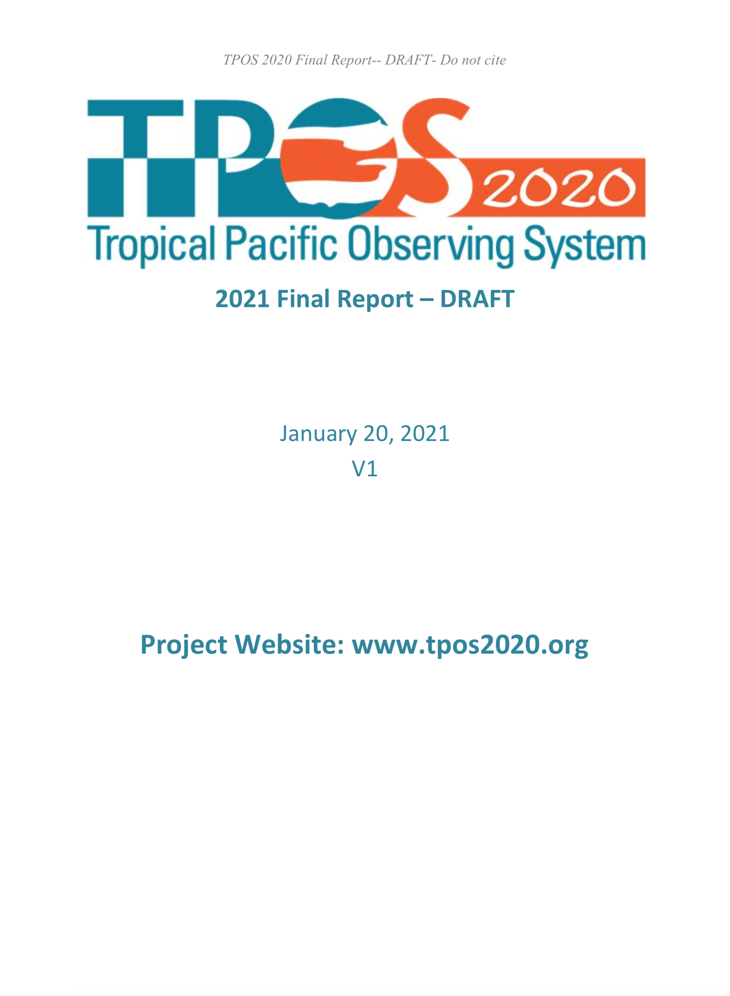
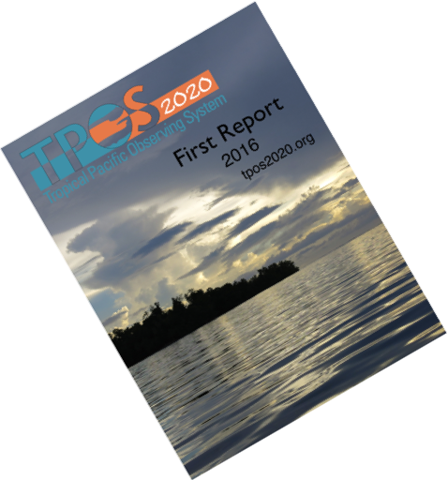
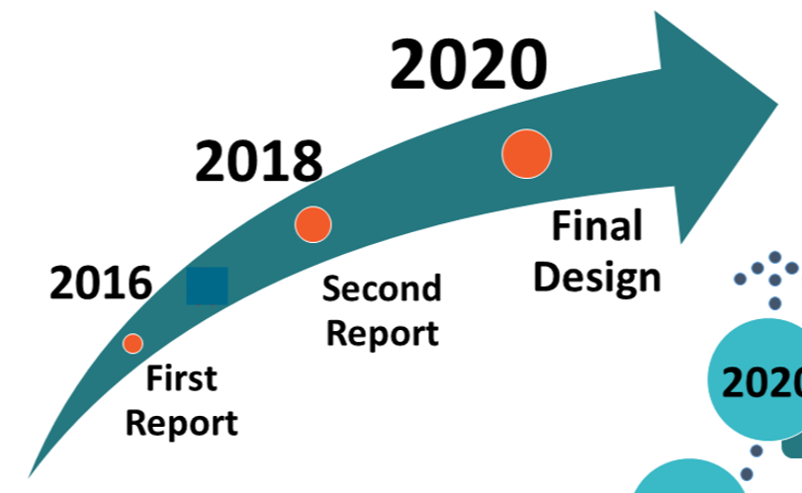
What did we achieve?
Revise the recommendations
Focus on models and prediction systems
Biogeochemistry
Eastern Pacific
Evaluation of the pilots
Under Review
22 recommendations
15 actions
Specify missing elements
Provide guidance for the future
2019
- Requirements, gaps, and solutions for the sustained T.P.O.S, following the GOOS Framework
- Suggestions for pilot and process studies
Each Report cycle involves extensive consultation, analysis work
Reports were externally reviewed
Notes:
We published three Reports during the course of the project
Pilots and process studies: prerequisite, essential to guide the future design, and learn how to monitor key processes from sparse observations, and improve model developement and parametrization

Slide 5
22 recommendations, 15 Actions
Main outcomes from the First Report
Schematic of the process deployed
(an adaptation of the Framework for Ocean Observing, Lindstrom et al., 2012).
Operational centers
Climate services
Research…
Integrated design,
satellite/in situ
responding
to multiple needs!

Slide 6
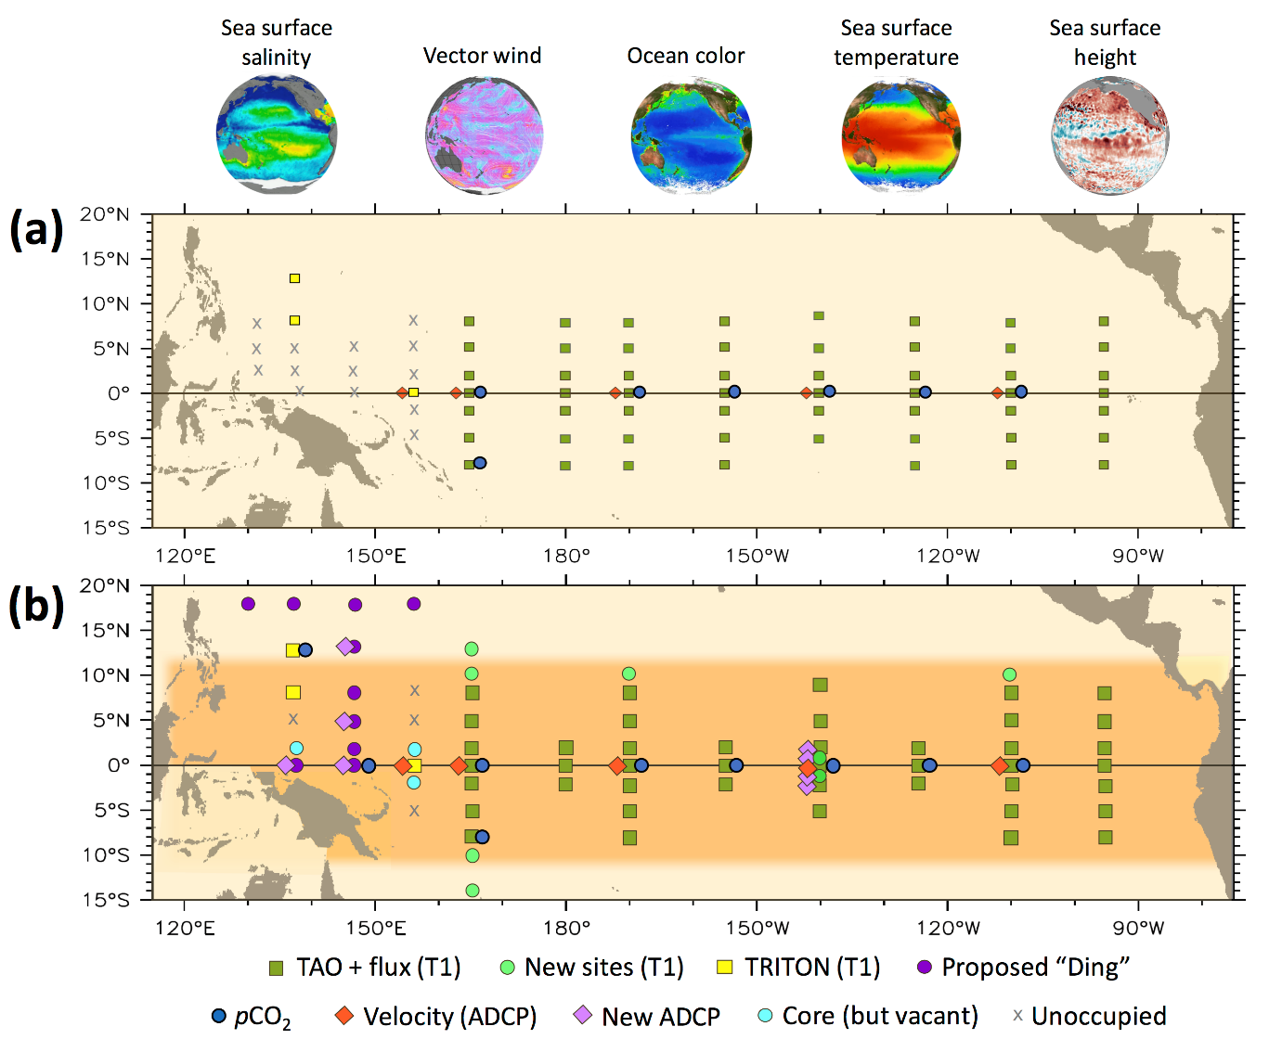
Main outcomes from the Second Report
FOR THE BACKBONE: revised, detailed design, integrating Biogeochemistry
Other key in situ elements of GOOS remain essential elements of TPOS
Ships are essential:
CTDs with a BGC suite along moorings servicing lines
Underway pCO₂
Present
Future
Argo:
-double core mission
-add BGC mission (124)
Notes:
Based on community feedbacks and extensive consultation, we presented a revised, detailed design.

Slide 7
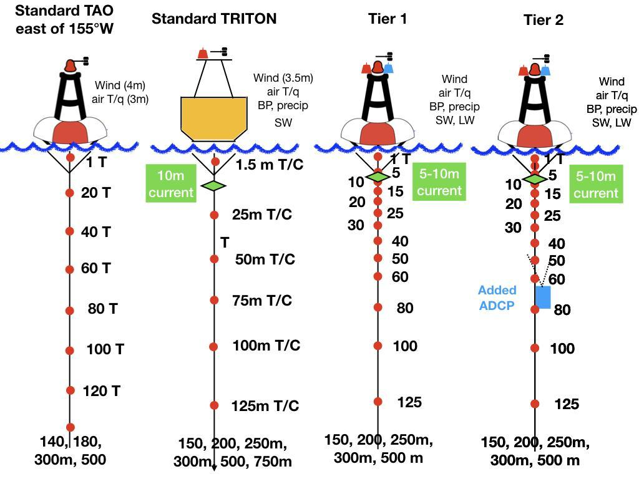
Main outcomes from the Second Report
Present
Future
Present
Future
Argo:
-double core mission
-add BGC mission (124)
Notes:
TPOS2020 tried to be specific for the mooring configurations, to help new partners engaged to have a seamless array.

Slide 8
Gains for surface and subsurface variables
Present
Future

Slide 9
Modelling engagement crucial to get the full value of the O.S
Systematic approach for S2I prediction systems,
Planned cycle of experiments, assessment of model biases and prediction skill
Standard set
of metrics
Essential for model and data assimilation improvements
Notes:
Coupled models and DA systems that underpin predictions have biases and systematic errors that compromise their ability to get the full value of the O.S
There is an urgent need to improve the skill, effectiveness and efficacy of the modeling systems that are critical to realizing the impact of an improved TPOS.
From Neville GOOS talk in 2019: A schematic showing the three parallel cycles of activity needed for model and data assimilation improvement. The outer circle is a planned and systematic cycle of experimentation; the first 1-2 years are devoted to planning and commitment, while years 3 and 4 are devoted to execution. The middle circle is a more NWP-like cycle of process and/or case studies. The inner circle is the regular system evaluation, which is continuous through the cycle. An independent assessment would occur across all elements every five years.
5-years cycle similar to CMIP
Another recommandation: Increase support for observing system sensitivity and simulation experiments

Slide 10
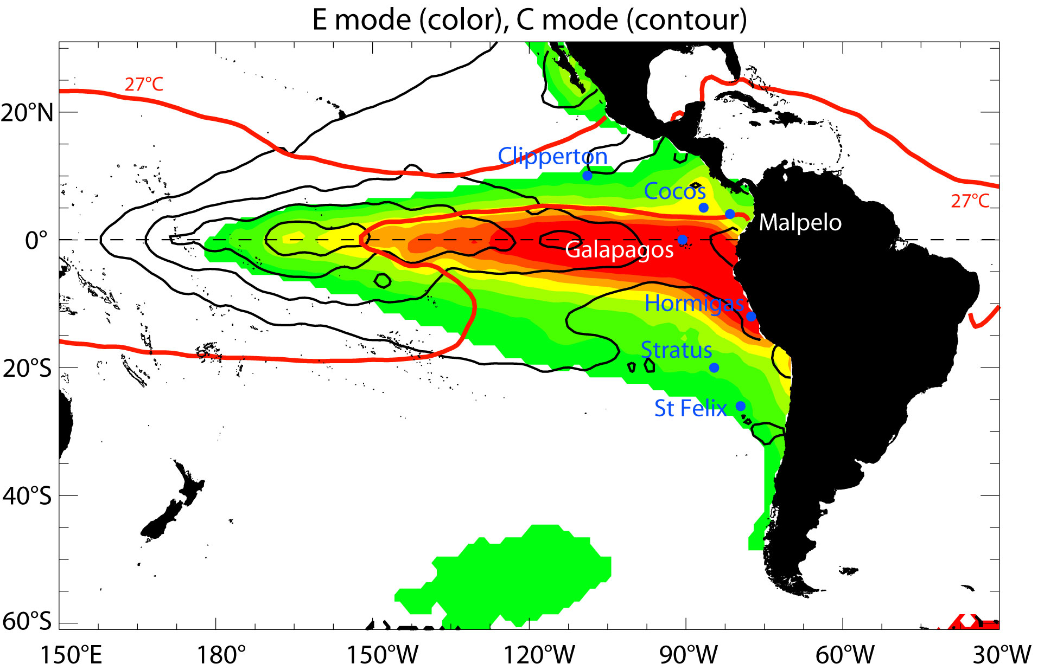
Recommendations for the eastern Pacific O.S
Opportunities to enhance/improve regional coordination (Peru, Chile, Ecuador, Costa Rica, Mexico) for developing the regional observing system (real-time data sharing, Argo doubling, pilot studies)
Develop "atmosphere/ocean sites" in strategic islands, observations of atmospheric vertical structure
Observations for the Oxygen Minimum Zone
Notes:
Eastern Pacific: important for many reasons:
The region has high societal impact, home to the eastern boundary coastal upwelling region with high productivity, fisheries
It is where extreme El Nino events developp
It is among the most problematic region for climate modeling, where non linearities are stronger.

Slide 11
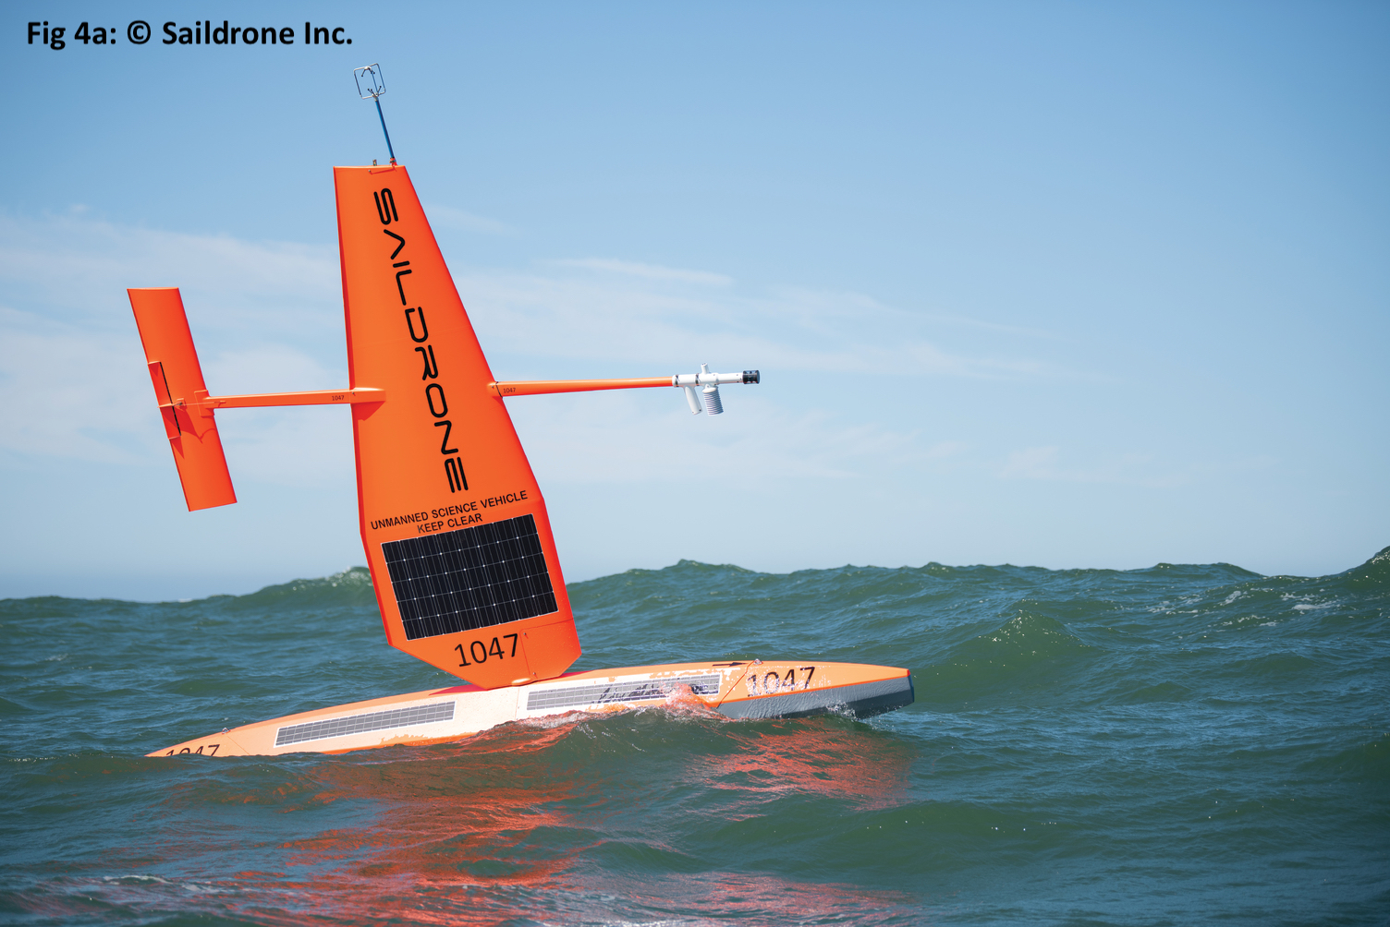
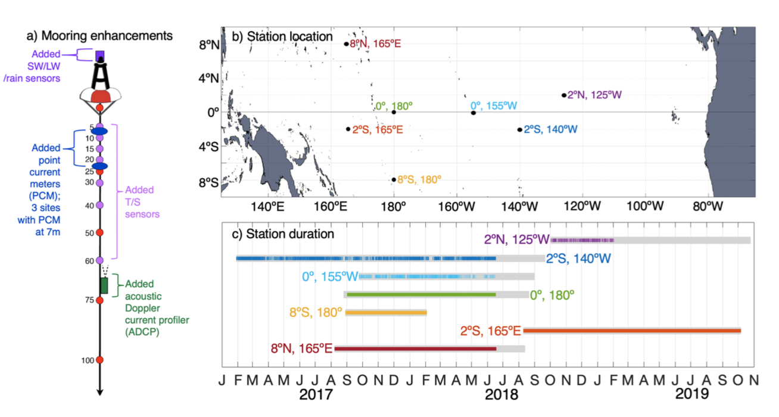
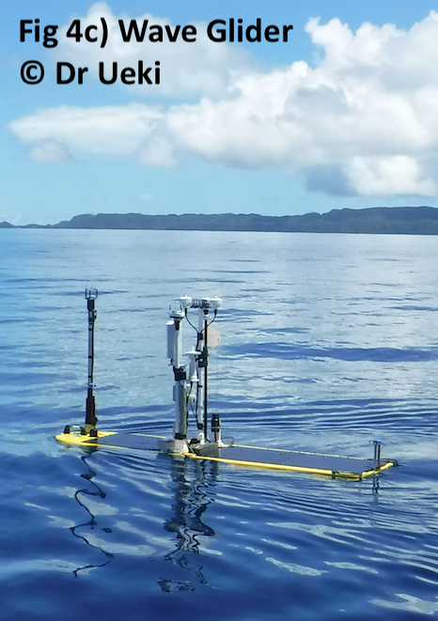
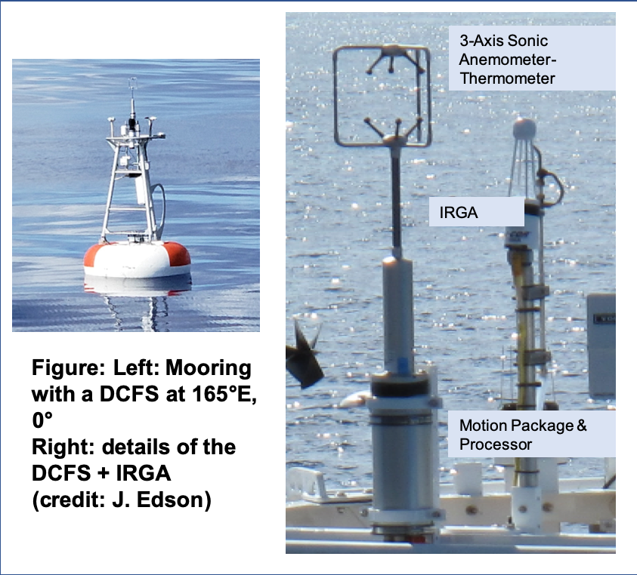
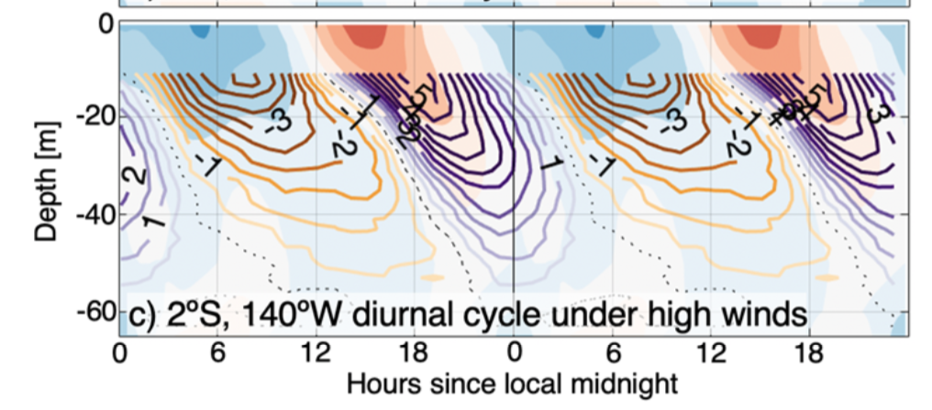
New Technology pilots
Test new technology, assessing their potential for TPOS
Moored instrumentation
Autonomous platforms
Credit: J. Masich

Slide 12
Success, challenges and issues
The aim was to design a refreshed, integrated TPOS, to meet multiple needs
The three reports fully responded to this (satellite/in situ, mature/new technology, integrated biogeochemical sampling, and models)
TPOS2020 reinvigorated agency interest, funding of many pilots and process studies. Many people contributed.
Design still « On the paper »: we need the implementation phase to evaluate its effectiveness
Limited to BGC sampling: biological and ecosystem aspects are left for the future
The aim was to build greater cooperation and coordination among the international sponsors and contributors to the TPOS, for reduced risk and greater robustness.
The TPOS is not more robust
dialogue improved, challenging to get commitments, and portfolio of resources
During implementation, enhanced dialogue and coordination will be crucial

Slide 13
Success, challenges and issues
The aim was to design a refreshed, integrated TPOS, to meet multiple needs
The three reports fully responded to this (satellite/in situ, mature/new technology, integrated biogeochemical sampling, and models)
TPOS2020 reinvigorated agency interest, funding of many pilots and process studies. Many people contributed.
Design still « On the paper »: we need the implementation phase to evaluate its effectiveness
Limited to BGC sampling: biological and ecosystem aspects are left for the future
The aim was to build greater cooperation and coordination among the international sponsors to the TPOS, for reduced risk and greater robustness.
T.P.O.S. is not more robust
dialogue improved; challenging to get commitments, and portfolio of resources
During implementation, greater engagement and coordination will be crucial

Slide 14
Lessons learned
Effectiveness of a basin-focused regional approach
TPOS2020 project was « taken offine » of the intergovernmental system …. more flexible, responsive, fast moving
TPSO2020 kept links with the intergovernmental system, GOOS SC, WMO/WIGOS, and it was key to engage Met Services
Importance to have a close link with stakeholders, funders, implementers
Critical need for dialogue with relevant research groups, such as the WCRP/CLIVAR project
Notes:
Basin-focused: very effective to gather experts working on the same basin, even if some of our conclusions have much broader relevance
2017: TPOS2020 recognised as a pre operational WIGOS pilot: important to engage Met Services

Slide 15
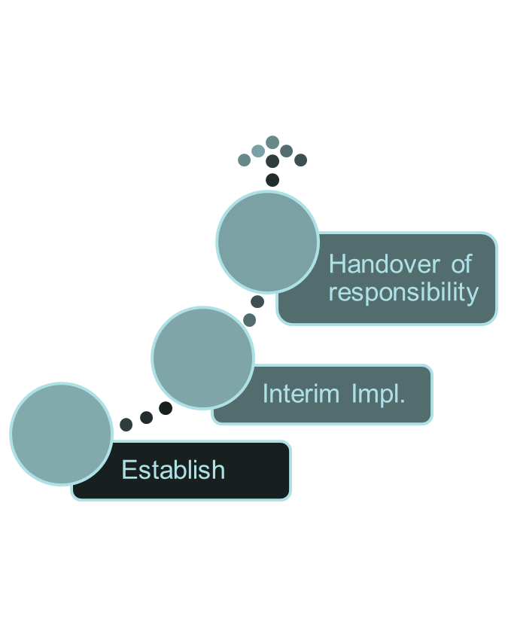
The future: toward implementation
2021
2019
Final Design
2016
Mid-term Report
Interim Report
TPOS 2020 Transition Team → Permanent Coordination Mechanism

Slide 16
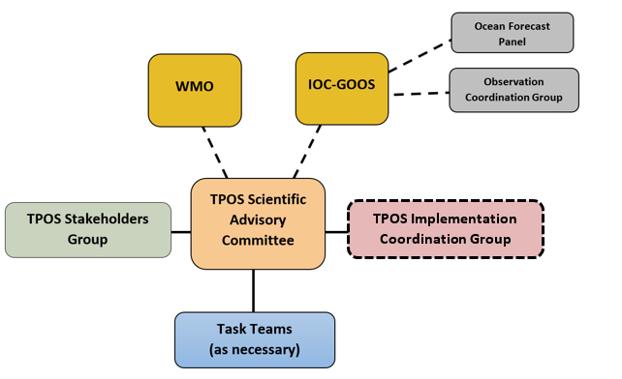
Future governance
SAC: legacy of the SC
expert assessment, enable evolution (inclusion of new technology, when readiness is assessed).
Reporting on the state of TPOS
Stakeholders group:
work toward greater international participation; engage and contribute to coordination; active and mutually supportive partnerships are vital
Implementation CG: (short-term)
Technical advice on staged Implementation,
Coordination, intercomparison studies
Data management principles
(Experts for data flow, quality)
Notes:
SAC: legacy of the SC: advising TPOS Forum, and assessing the new technology, and evolving the requirements.
A Stakeholders Forum for TPOS stakeholders to engage and contribute to coordination and commitment to the operation of the observing system.
An Implementation Coordination Group to work on the implementation of the observing system, including through the transition period.

Slide 17
The future: how could GOOS help?
How will TPOS connect to GOOS in a meaningful way going forward with the project's transition?
Take advantage of GOOS’s intergovernmental mechanism to advance TPOS2020 implementation, which is critical for TPOS2020 success
- Work closely with Observation Coordination Group (OCG) to promote platform implementation?
Opportunity: UN Ocean Decade may inspire major change and improved capacity
- Use it as a vehicle to engage more stakeholders with more commitments
=> entrain new partners from South America and Small Island developing States?
=> help for coordination among users (ocean best pratices, data sharing …)
Work with WMO/GOOS Expert Panels to further develop TPOS2020 multidisciplinarity,
address the inter basins consistency, and to strengthen the connections between modelling and observing community in a systematic way

Slide 18
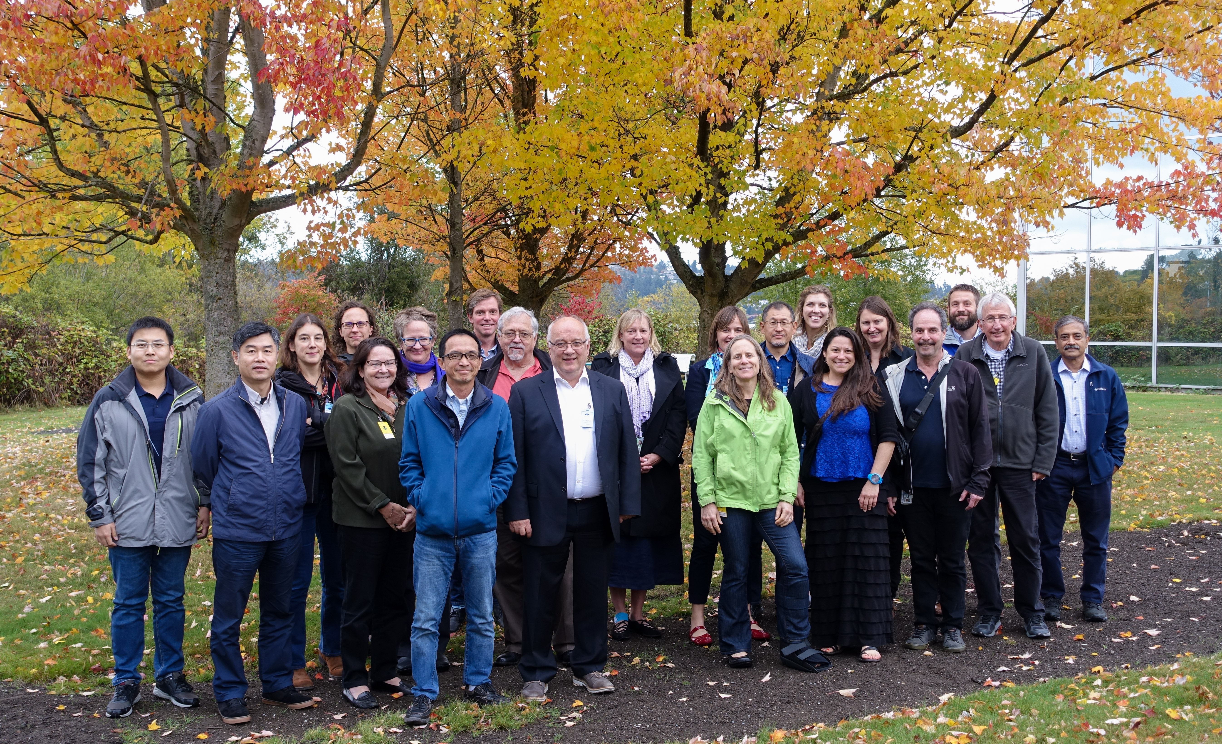
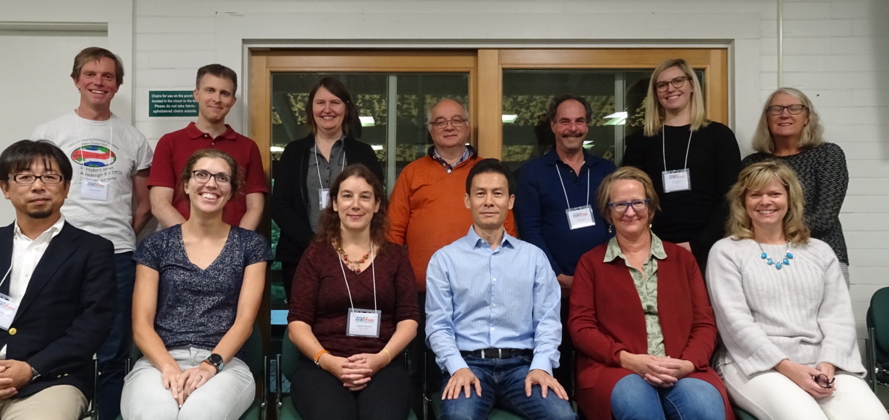
Thanks to the many contributors to the TPOS2020 effort!
Backbone Task Team meeting, WHOI, 2018
Steering Committee meeting, Seattle, 2017
Thanks to Katy Hill for comments on this presentation!

Slide 19
Additional slides

Slide 20
The request
20 min of presentation with 10 minutes of questions
The format will be a webinar, with 20 minutes of presentation by you, for the Steering Committee members only (goosocean.org/sc), with 10-15 minutes of moderated questions
The webinars will be recorded and made available for those not able to attend live
we’d also appreciate having your presentation sent to Forest Collins (f.collins@unesco.org) after the webinar for posting
The purpose is to give the whole SC a chance to hear about the achievements of the project to date, future plans and opportunities, and issues

Slide 21
Content
1/3 achievements, 1/3 future plans, 1/3 issues
Please plan to spend your time as follows:
A quick introduction of yourself and the project’s objectives and relationship to GOOS
1/3 of your time on the achievements and activities of the project
1/3 of your time on future plans
1/3 of your time on opportunities and issues you’d like to raise, particularly about the engagement with GOOS and support you expect, relationship to GOOS core team components, implementation planning, and long-term evolution

Slide 22
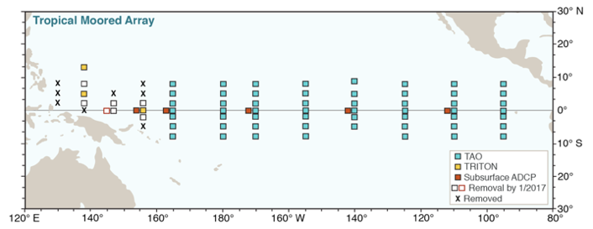
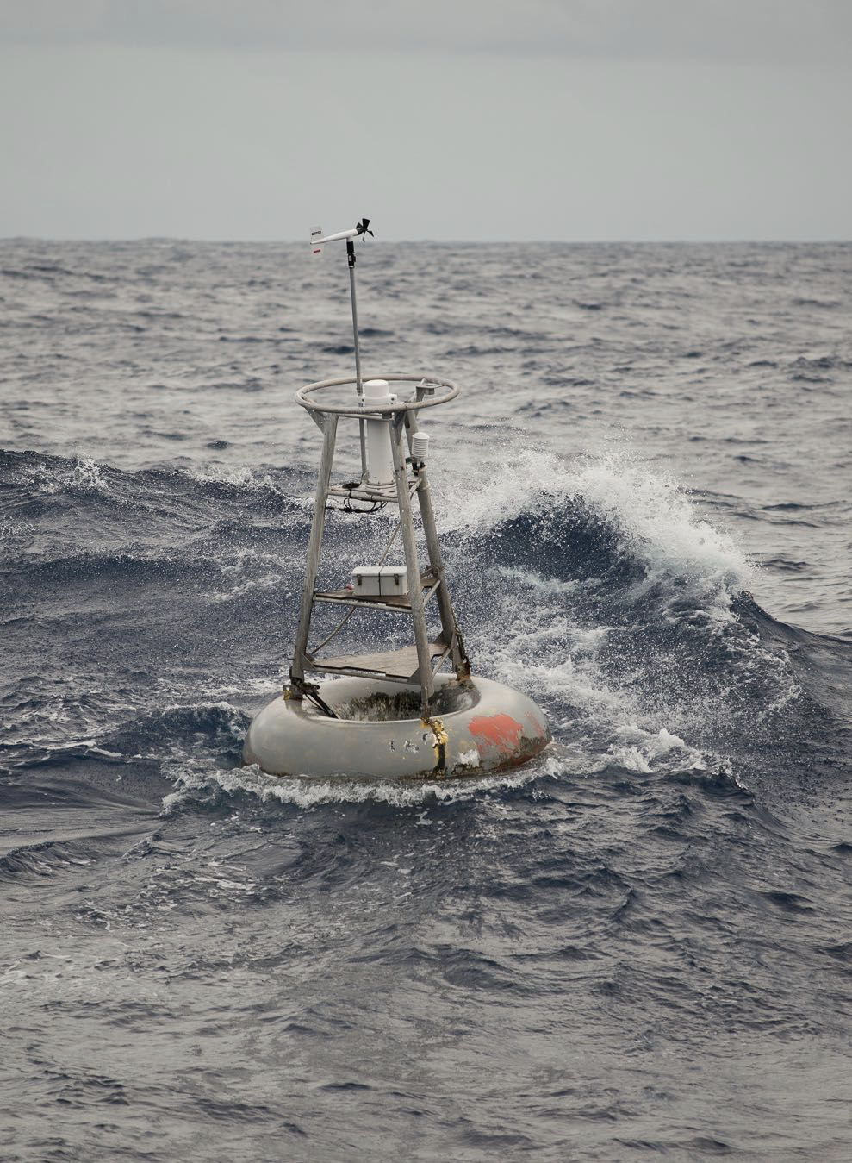
TPOS2020 started in 2014 with TAO/TRITON crisis…
% of TAO moorings reporting data
TRITON Crisis
Serious risk for ENSO prediction, and more generally for seasonal forecasting and tropical research
Need for international cooperation over the long term
Time to reexamine the whole system, to construct a more effective, modern and robust T.P.O.S

Slide 23
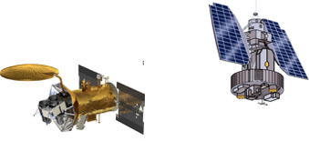
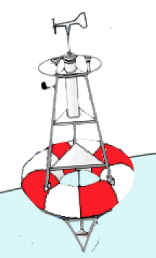
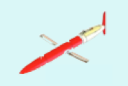
Evolution was timely and essential
The ENSO observing system was designed in the 1980s-90s:
Based on the scientific challenges of that era,
Largely on the technology from that era,
It is an independent collection of pieces.
We were in a position to improve the system by taking full advantage of:
Present technology:
New models and DA methods
Operational centers have (and will have) different observational needs
Providing data to advance these systems is crucial for better forecasts, better gridded products
New scientific understanding and issues:
ENSO diversity
near-surface physics on sub-daily timescales, air-sea exchanges
Biogeochemistry, air-sea carbon fluxes, OMZ
=> integrated design
The project aimed to build a truly integrated system
Notes:
Key message: Integrated in terms of platform design, observations/model, Physics/biogeochemistry

Slide 24
Main outcomes from the First Report
FOR THE BACKBONE: Integrated in situ and satellite approach.
Maintain space-based broad-scale measurements of the essential ocean surface variables
Strengthen satellite vector wind sampling
Advocate for follow on SSS missions, and maintain SST, SLA, colour
Enhance in situ obs of state variables in key climate regimes
Reconfigure the moored array to sample more regimes and focus on near surface/short timescales
Enhance Argo (10ºN-10ºS) to increase subsurface T/S vertical/spatial resolution

Slide 25
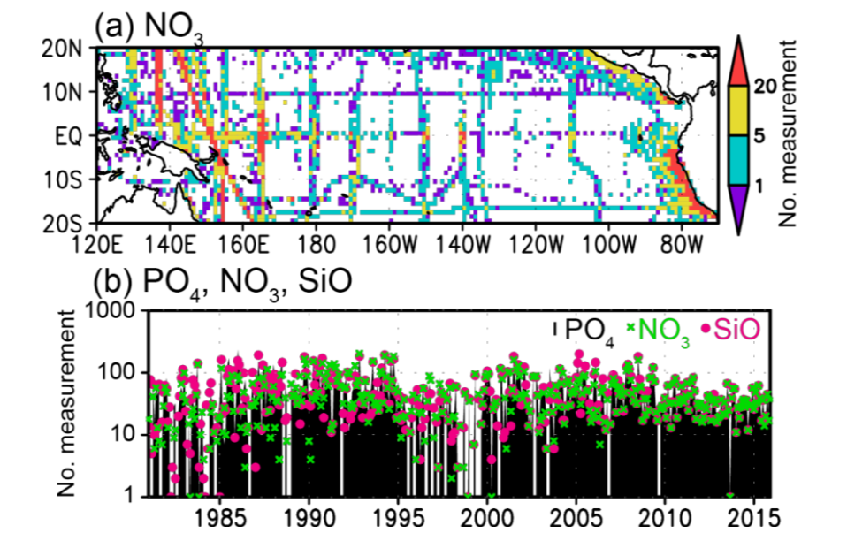
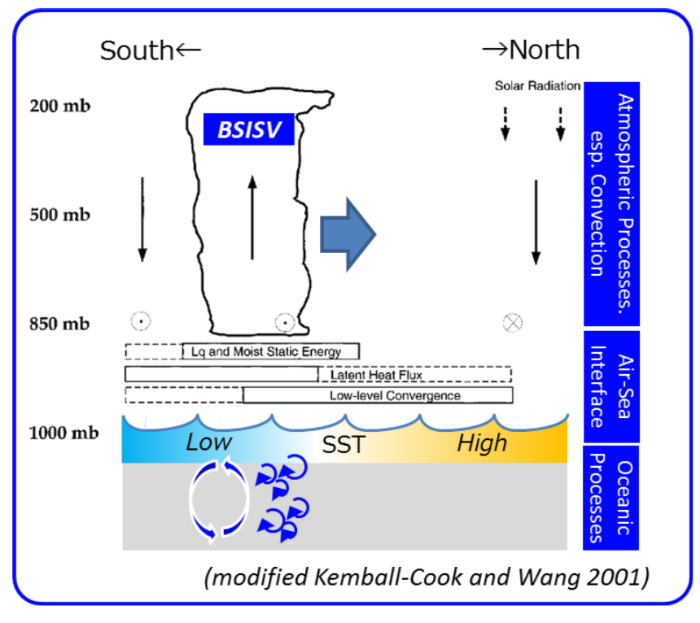
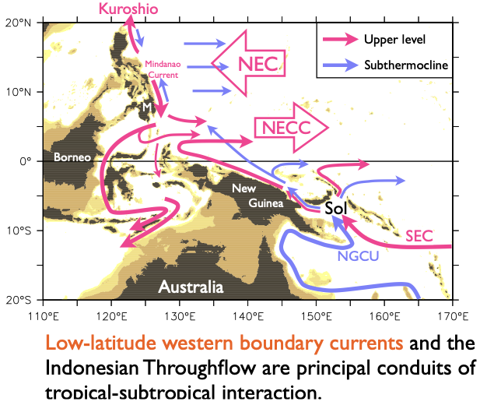
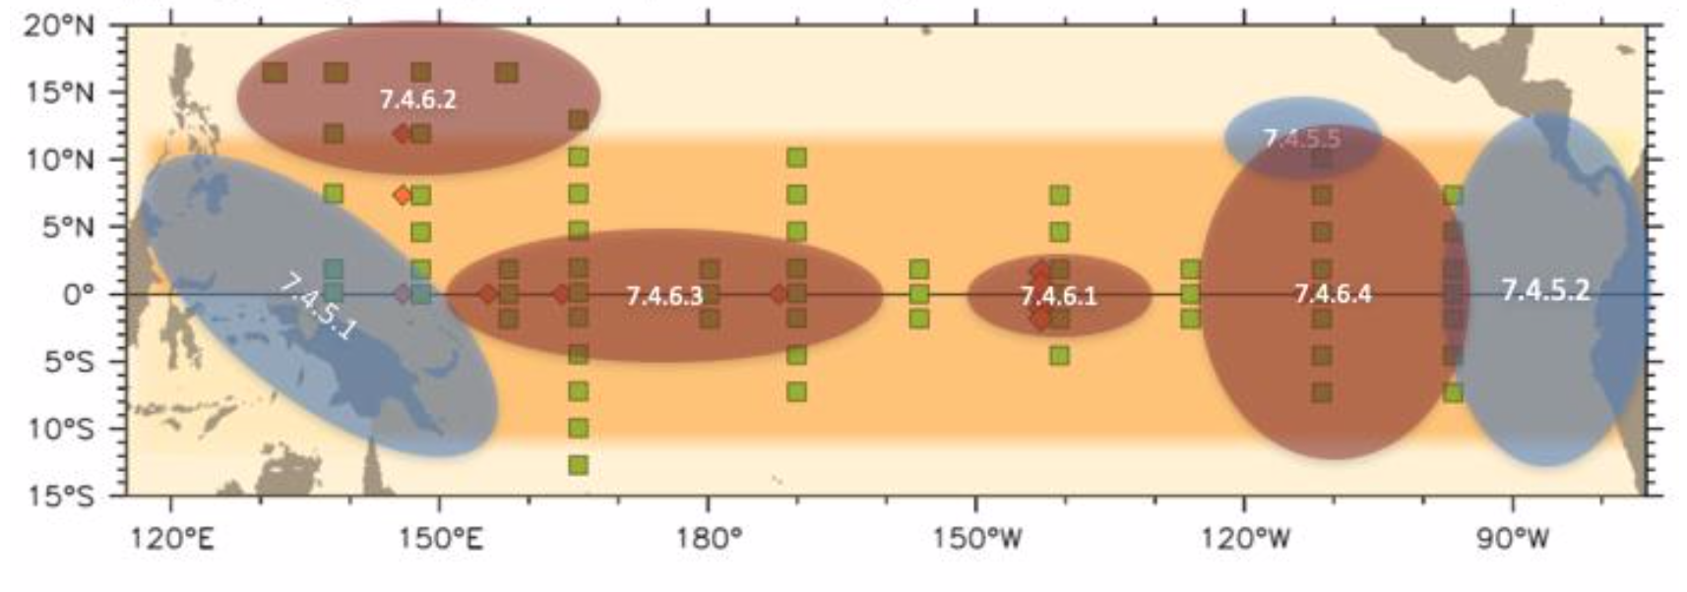
Main outcomes from the First Report
Process: Air-sea interaction
at the edges of the Warm pool
Pilot: determining the space/time scales for BGC
Pilot studies
to test sampling strategy
Process studies
to understand critical phenomena
Modeling studies
on impact and uptake
Pilot: Low-latitude WBCs
Process: Equatorial upwelling
Notes:
We recognize that research is still needed to guide sampling strategy, and learn how to sample key process/phenomena with limited observations.

Slide 26
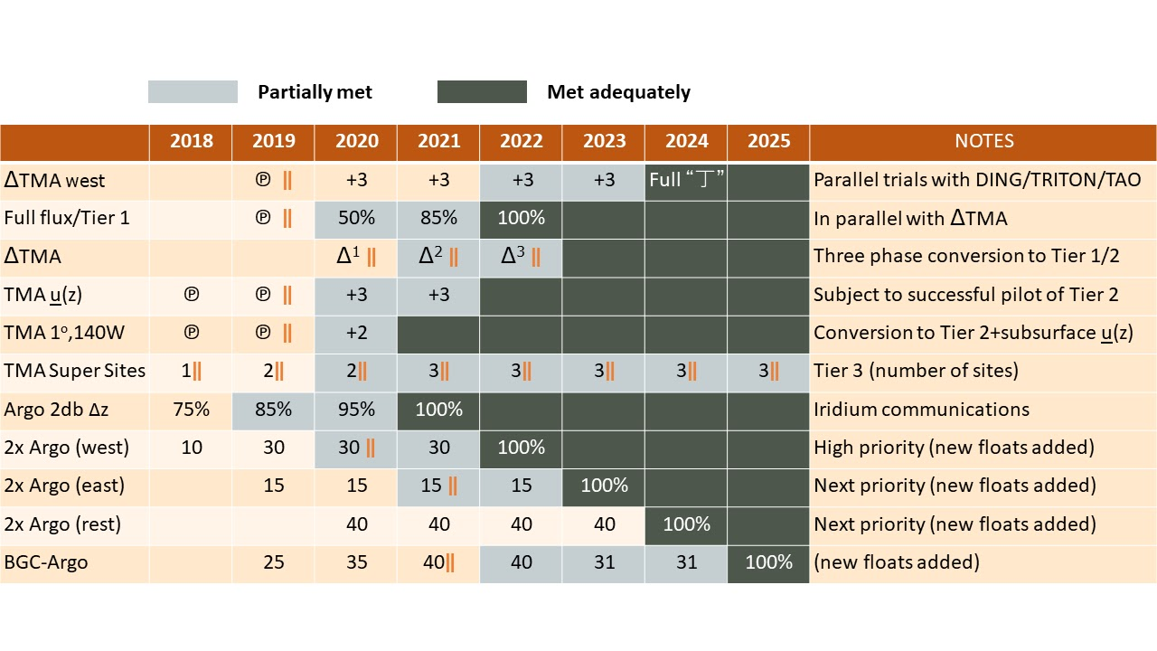
Steps for Implementation? (Second Report)
STEPS FOR IMPLEMENTATION
a staged implementation plan is being formulated
assessments of the changes are built into the plan (||)
the transitions will likely take > 5 years

Slide 27
Transition and Implementation
ICG WIGOS DECISION Jan 2017:
TPOS 2020 recognised as a pre operational pilot.
Action: develop pilot, through pre-operational phase by the T&I task team
JCOMM MAN DECISION Jan 2017:
approves formation of the T&I Cross Cutting Task Team;
agreed in principle the Terms of Reference
supports the proposed governance and membership with a Chair and Vice-Chair
* JCOMM October will consider regional mechanisms

