Slide 1
Reports from GOOS projects Deep Ocean Observing Strategy (DOOS)
The Global Ocean Observing System
www.goosocean.org
Lisa Levin¹, Patrich Heimbach², Felix Janssen³, Henry Ruhl⁴, Karen Stocks¹
1. Scripps Institution of Oceanography, UC San Diego
2. University of Texas at Austin
3. Alfred-Wegener-Institut Helmholtz-Zentrum fuer Polar- und Meeresforschung (AWI)
4. Monterey Bay Aquarium Research Institute, Moss Landing
GOOS 10th Steering Committee meeting [online], April 2021
*Support from Leslie Smith and Andrea McCurdy

Slide 2
Deep Ocean Observing Strategy Presentation for GOOS SC
Talk Outline
DOOS Goals and Structure
DOOS Accomplishments and Activities
DOOS Pending Projects/Proposals
DOOS and the Decade
DOOS and GOOS
DOOS is a GOOS project envisioning a globally integrated network of systems that observes the deep ocean (> 200 m, with emphasis > 2000 m) in support of strong science, policy and planning for sustainable oceans.
deepoceanobserving.org

Slide 3
Steering Committee
Name | Country | Affiliation
Simone Baumann-Pickering | USA | Scripps Institution of Oceanography
Kristina Gjerde | Poland | International Union for Conservation of Nature
Bruce Howe | USA | University of Hawaii at Manoa
Katsuro Katsumata | Japan | Japan Agency for Marine-Earth Science and Technology
Deb Kelley | USA | University of Washington
Nadine LeBris | France | Universite Pierre et Marie Curie
Craig Smith | USA | University of Hawaii at Manoa
Paul Snelgrove | Canada | Memorial University
Sun Song | China | Institute of Oceanology, Chinese Academy of Sciences
Adam Soule | USA | University of Rhode Island
R. Venkatesan | India | National Institute of Ocean Technology Ministry of Earth Science
Bob Weller | USA | Woods Hole Oceanographic Institution
PROJECT LEADS
Lisa Levin
Patrick Heimbach
Felix Janssen
Henry Ruhl
Karen Stocks
STEERING COMMITEE
17 Members
8 Countries
13 Institutions
TASK TEAMS
Physics EOVs
Biogeochemistry EOVs
Biology & Ecosystem EOVs
Data & Cyberinfrastructure

Slide 4
DOOS Science Goals
Understand global deep- and bottom-water formation rates, variability, & the time scales of property changes while assessing heat sequestration, & circulation dynamics
Document deep-ocean transport and ventilation processes & assess their impact on ocean biogeochemical processes on the seafloor and in the water column
Understand marine deep-sea biodiversity & ecosystem services in light of human-induced & natural changes
Advance understanding these processes to contribute to sustainability efforts and climate policy decisions

Slide 5
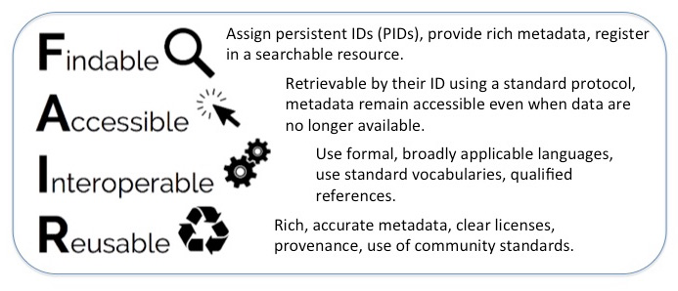
DOOS Mission
Identify Essential Ocean Variables (EOVs) and evolve their specifications to fully consider deep-ocean perspectives across physical, BGC, biological, and ecological variables
Incorporate modeling needs, expand deep-observing community to embrace exploration and industry, promote multi-disciplinary observing
Design and evaluate observing systems and oversee demonstration projects to provide a blueprint for global deep-ocean observation technology readiness.Currently proposed demonstration projects: Clarion Clipperton Fracture Zone, Northeast Pacific, & Azores Archipelago.
Promote FAIR data across deep-ocean observing
Serve as a communication hub for a broad spectrum of stakeholders in the deep-ocean science, data, and information user communities
Provide an avenue through which the deep ocean research community and the data they produce can reach policy makers and inform policy decisions

Slide 6
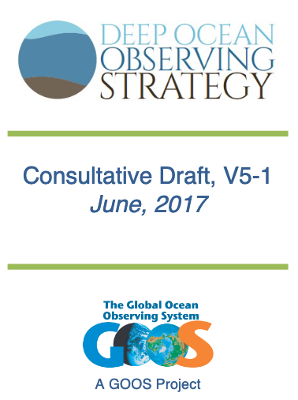
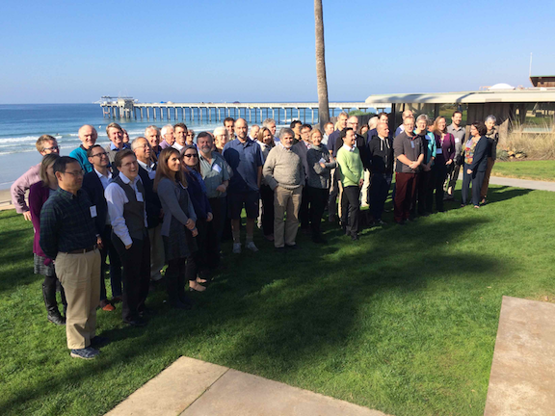
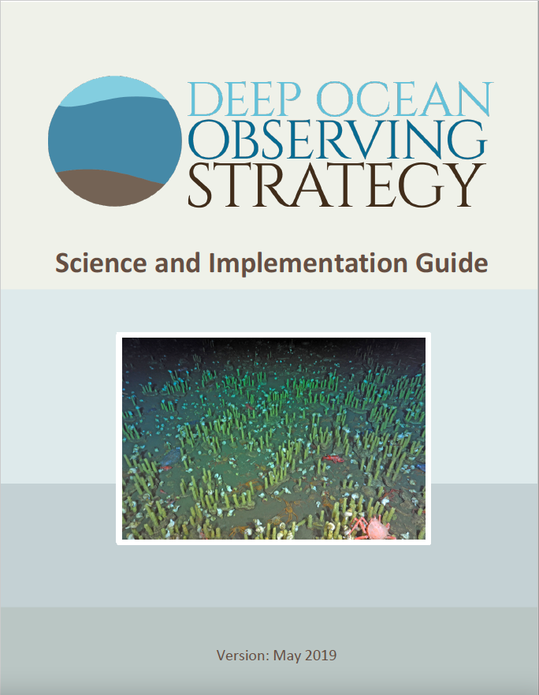
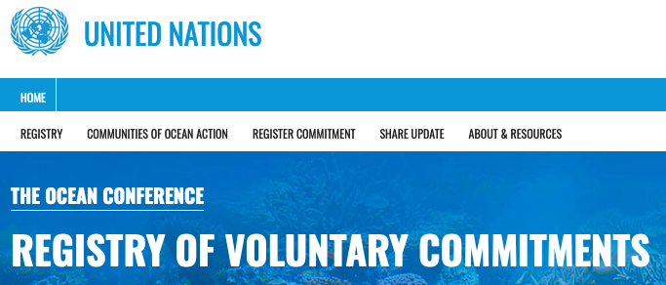
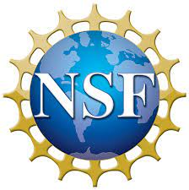
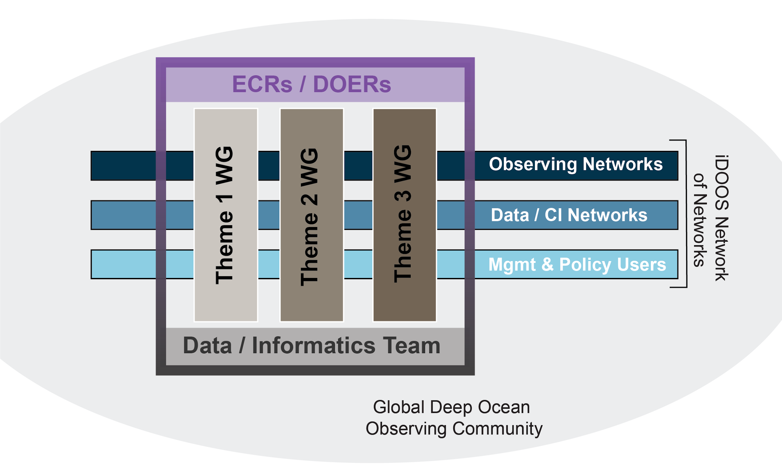
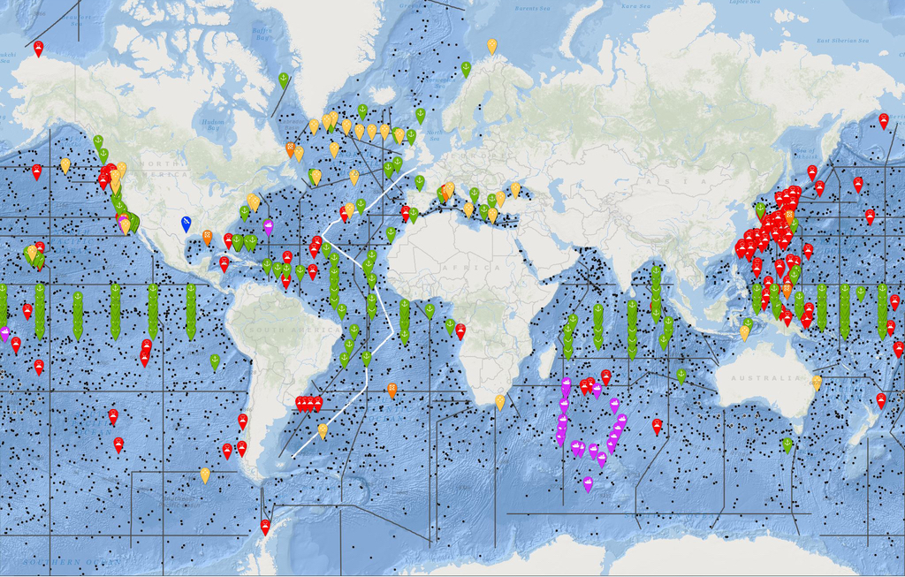
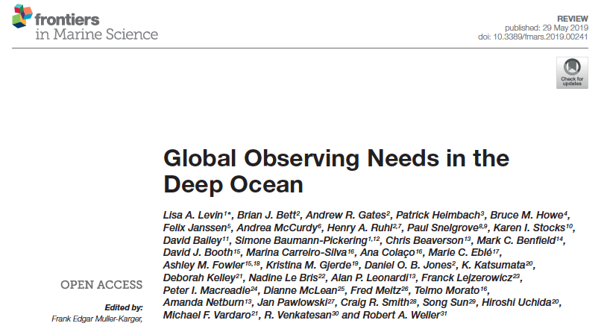
Timeline
2016: DOOS Scoping Workshop (51 attendees , 9 countries)
2011: ”From Space to Deep Seafloor” Workshop
2013-2016: DOOS Consultative Draft Posted for Review
2017: Project Plan and Engagement Plan Completed
2019: DOOS SIG Released
iDOOS
(proposed)
2014: Adopted as a GOOS Project (SC-3)
2016: Deep-Ocean Observing Inventory Launched (Ongoing)
2017: First DOOS Steering Committee Meeting
2018: Community Events (Townhall, OceanObs‘19 CWP)
2020 Onward: Implementation of Deep Ocean Initiatives based on OceanObs‘19 outcomes

Slide 7
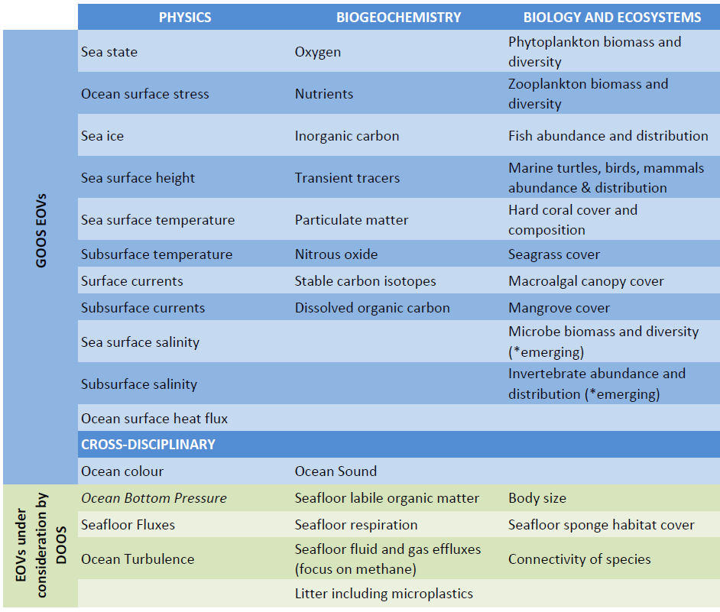
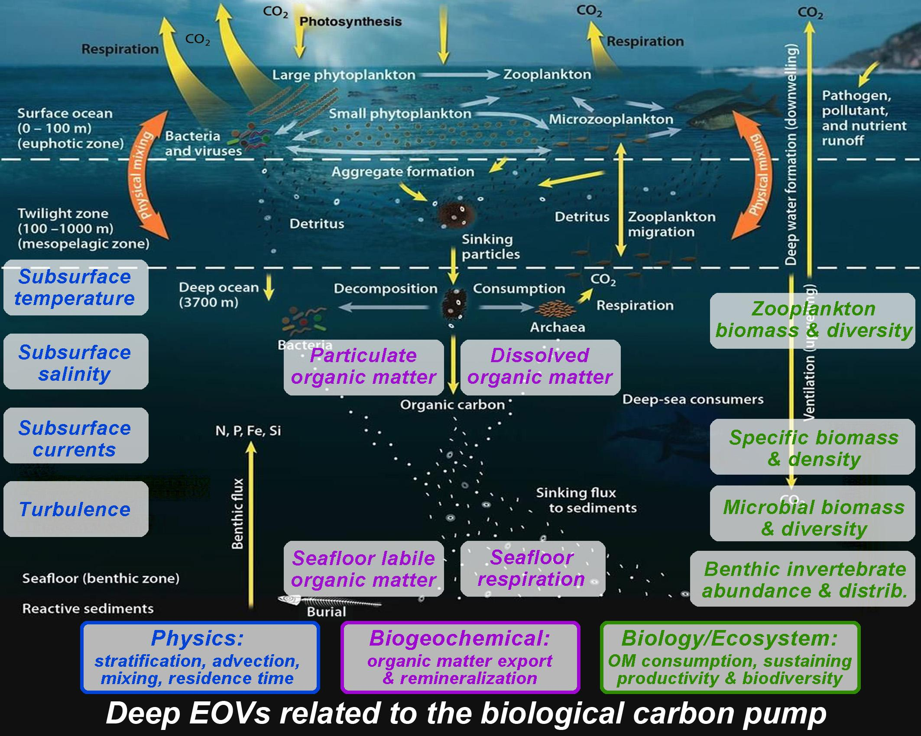
Adopting the GOOS EOV Framework
Inclusion of deep ocean observing requirements

Slide 8
DOOS Interactions on the U.S. & International Scene: 2020
Community Townhall at OSM - Feb. 2020
Lenfest Biodiversity Project – June 2020
AtlantOS - July 2020
AIR Centre/MBON – July 29, 2020
IOOC - July 27, 2020
GOOS Bio-Eco Panel - Sept. 2020
OceanSITES - Sept. 2020
IMCC 6 - August 2020
NOPP Biodiversity Interagency Working Group – Oct. 2020
CNR Italy (Offshore Oil & Gas to Seabed Mining) - Nov. 2020
ISA Deep Data Workshop - Sep. 2020

Slide 9
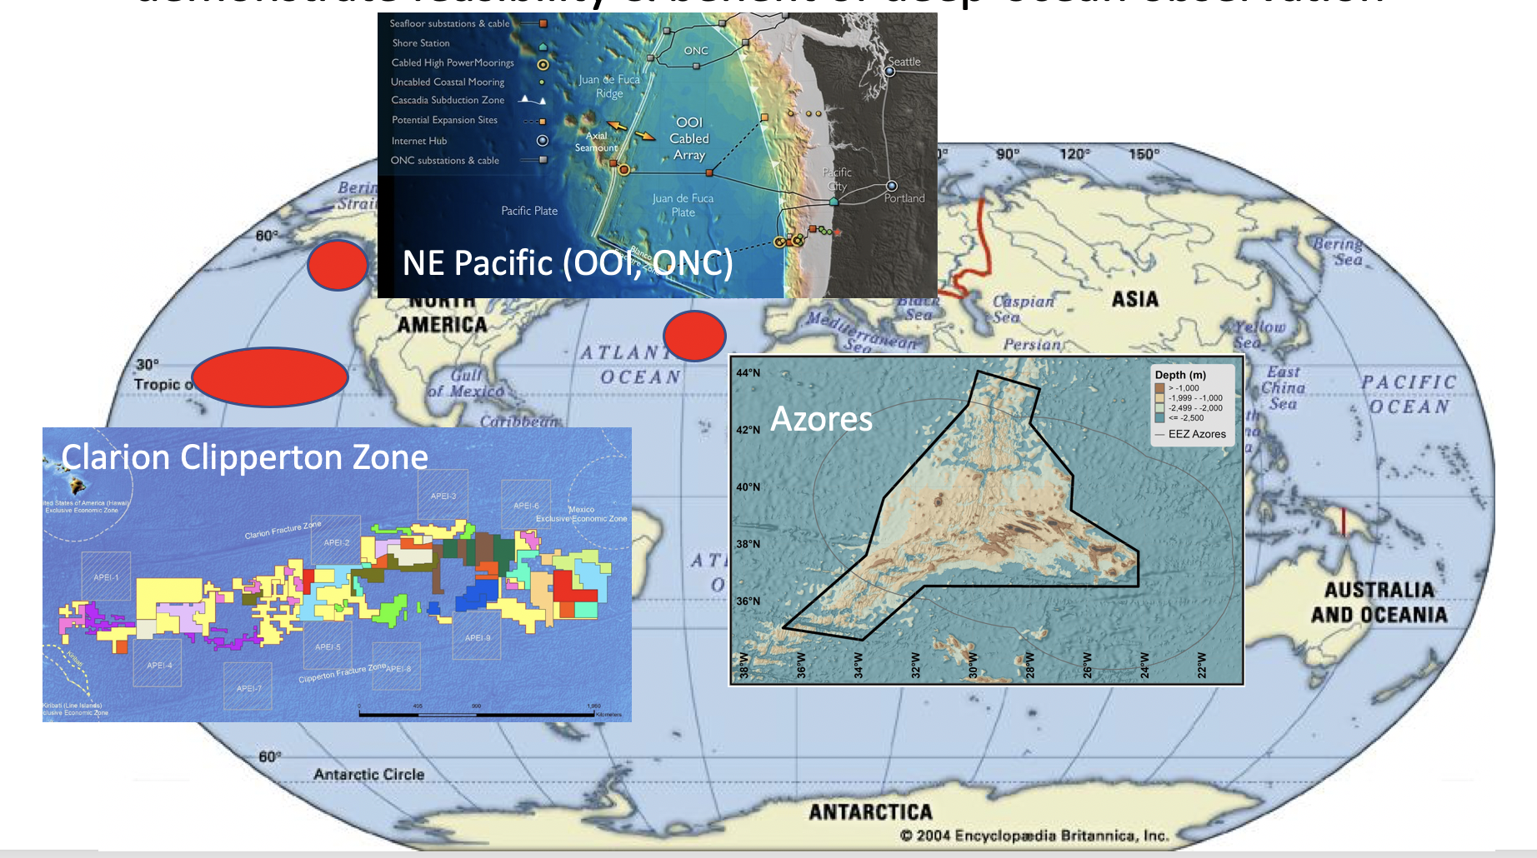
Demonstration Project Progress
Azores
AtlantOS - Use Case Discussion
NOAA Office of Ocean Exploration and Research (ASPIRE)
Univ. dos Açores Scientists (Ana Colaco, Marina Cariero Silva, Telmo Morato)
MBON - Azores Secretariat/ AIR Centre
Scripps Geological Data Center
Azores Use case Workshop with AtlantOS - June 24, 2021
CCZ
Deep Green Contractor Workshop (Feb. 2020)
ISA- DeepData Workshop (Sept. 2020)
NE Pacific
Deep Ocean Observing Workshop with OOI (Aug. 2018)

Slide 10
AccelNet Proposal Pending with NSF
Implementing a Deep Ocean Observing Strategy (iDOOS)
*Requirement Setting
*FAIR Data
*Implementation
*Translation of Knowledge to Users
*Early career training (DOERs)
within the Global Ocean Observing System (GOOS)
Observing & Exploration Networks
Argo (Core, BGC, Deep)
Challenger 150 (DOSI/SCOR)
EMSO
GEO BON
GO-SHIP
iAtlantic
MBON
NDSF/UNOLS
NOAA Ocean Exploration
OceanSITES
OECI
ONC
OOI
REV Ocean
Schmidt Ocean Institute
JTF SMART Cables
SOOS/SOCCOM
TPOS 2020
US-IOOS
Data & Modelling
CI Networks
CCHDO
CLIVAR GSOP
CLIVAR/OMDP & CMIP
ECCO
EMODnet
ESIP/MDC
Esri
FathomNet
IODE/ODIS
IRIS
ISA DeepData
Mercator Ocean
OBIS
OBPS
OceanPredict
Seabed 2030
Management
& Policy Users
AtlantOS
DOSI
GEO-BluePlanet
GOOS
Internat. CLIVAR
InterRidge
ISA
IUCN
POGO
UN Decade
UN Global Compact
U.S. CLIVAR
U.S. OCB
U.S. Sanctuaries
& Monuments
US Gov’t: BOEM, NOAA, NASA, NSF,

Slide 11
Deep Ocean Early-career Researchers (DOERs)
Collaborative early career mentoring program designed to:
bring together ECRs from across and beyond iDOOS, and
include members from underserved communities, including developing countries, indigenous communities, women, underrepresented minorities.
GOAL: foster a new generation of (early career) leadership that is
capable of guiding future deep-ocean observing and research
engaged with the deep-ocean programs & people outside their own discipline
able to use data across variables, platforms and sensors.

Slide 12
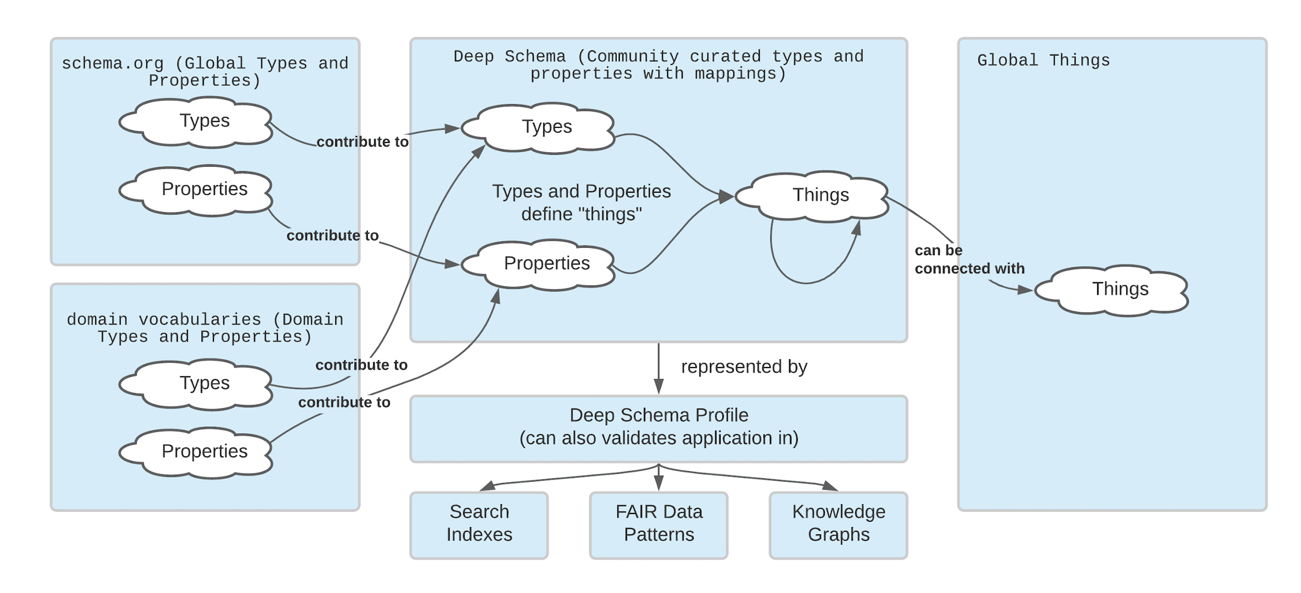
EarthCube: Deep Schema Proposal (pending @ NSF)
PURPOSE: improving deep sea data discovery across national and international data facilities by developing and implementing a deep sea profile in schema.org
COMPONENTS:
1) Develop a schema.org profile that captures critical concepts needed for discovering deep-ocean data
2) Support ocean data facilities to implement the profile for their data
3) Develop a scientifically useful, cross-facility data discovery portal
4) Support “do-athons” where scientists use the portal to address their scientific research goals and provide feedback.
FOCUS: Clarion Clipperton Zone (CCZ) and the Azores, but promoted widely throughout the deep-ocean science community. Awareness of larger schema.org efforts will foster compatibility and will provide lessons learned for other disciplines looking to create schema.org profiles.

Slide 13
DOOS for the UN Decade
Ocean Decade US: Ocean Shots (submitted Dec. 2020)
IOC Decade for Ocean Science (submitted Jan. 2020)
IOC Deep Sea Cluster (April 2020)
Challenger 150
Deep Ocean Observing Strategy (DOOS)
Geosystems and Mineral Resources (GEOMIR)
One Ocean Network for Deep Observation (OneDeepOcean)

Slide 14
DOOS Interaction with GOOS
Resources/Funding: DOOS management & participant support (e.g., Leslie Smith)
Extend reach within the science community (e.g., present at GOOS webinar, distribute DOOS information through GOOS network / mailing list)
Secretariat support, e.g., with workshops (Azores and others)
More prominently mention (and link) DOOS on GOOS website (mention as endorsed project)
Connect more closely to GOOS EOV panels
Coordinate data standards, approaches and technologies through GOOS
Early Career Program Development (DOERS). Help us get DOERS off the ground (again, some management support, help to reach out). Connect to GOOS early career project (if that exists).
Innovate and Collaborate on capacity building and tech transfer.
Assist with, enhance Decade for Ocean Science engagement.

Slide 15
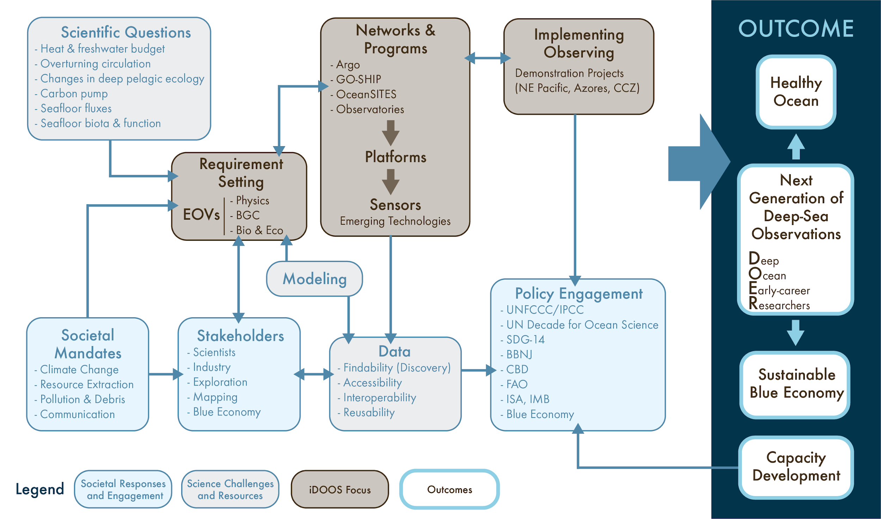
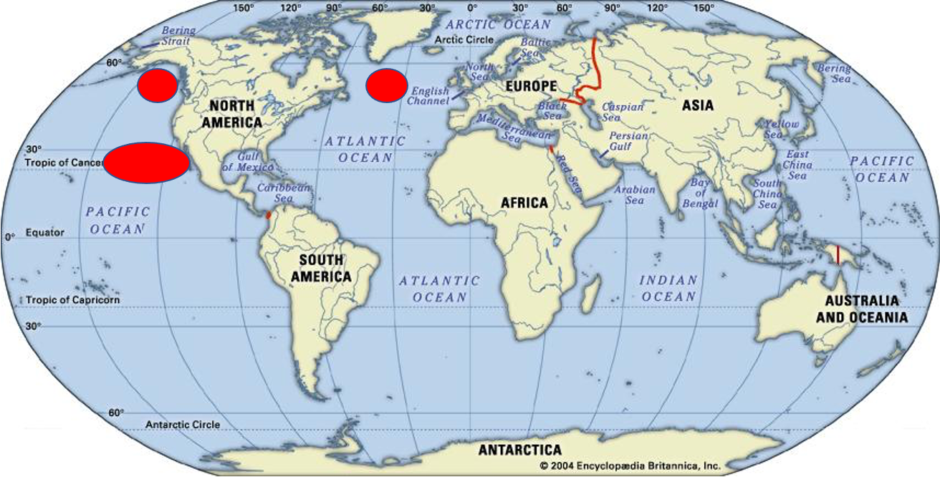
Implementing a Deep Ocean Observing Strategy

