Slide 1


Reports from GOOS core team components
OOPC
The Global Ocean Observing System
www.goosocean.org
The Ocean Observations Physics and Climate panel
A panel of the Global Climate Observing System (GCOS), the Global Ocean Observing System (GOOS), and the World Climate Research Programme (WCRP)
Chairs: Sabrina Speich (LMD/IPSL, France) &
Weidong Yu (SYSU, China)
GOOS 10th Steering Committee meeting [online], April 2021

Slide 2


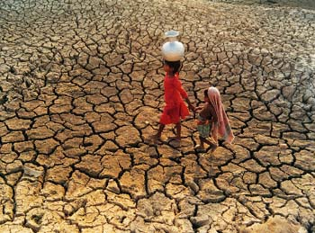
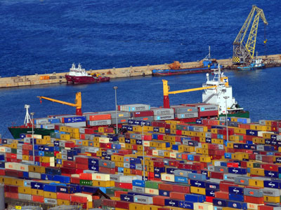
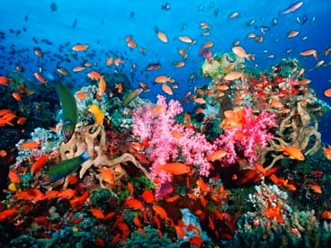


ROLE
Global Ocean Observing System
Climate
Services
Ocean Health
OOPC oversees
the Ocean component of GCOS and
the physical variables for GOOS,
while defining sustained ocean observing requirements for WCRP
(GOOS’s cross-panel climate interface with GCOS)
Support the value chain “observation/data – science/knowledge –service/policy”
https://www.goosocean.org
https://gcos.wmo.int

Slide 3
ROLE
Assessment of Ocean Observing System to meet user requirements
  Global integration of parts (i.e. Basin systems, and topical systems, platforms)
  Assess, review and prioritize requirements for EOVs and ECVs
  Identify gaps
  Promote consistency of EOVs/ECVs across the observing system
Coordination/integration with other organisation and community panels
Review/Evaluation of the observing system
Advocacy for the Ocean Observing System
Work with OCG and regional bodies to coordinate observing networks

Slide 4
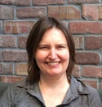
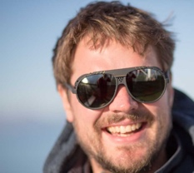
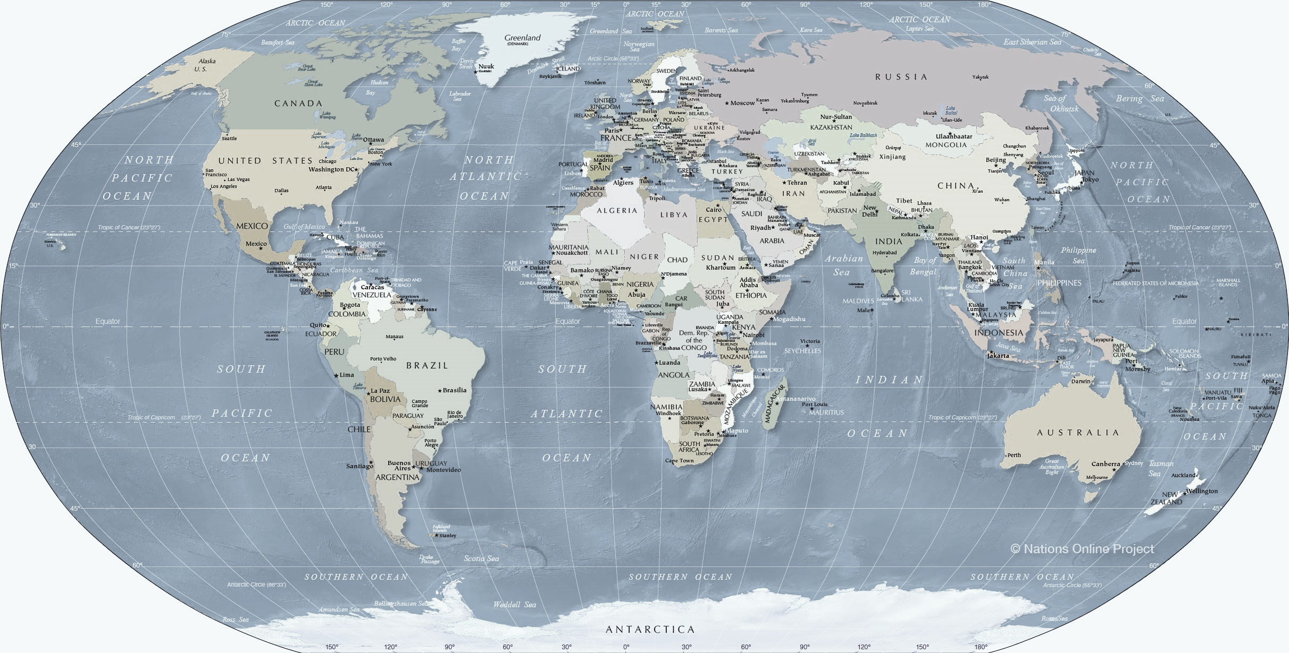
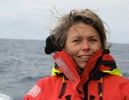
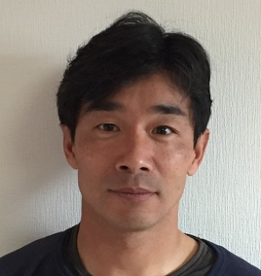

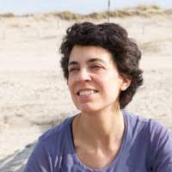
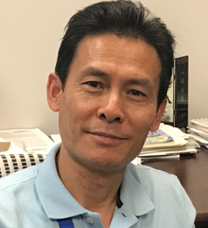
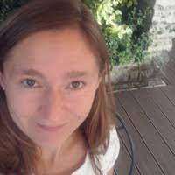
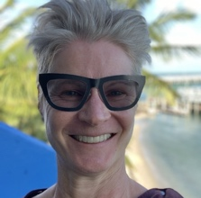
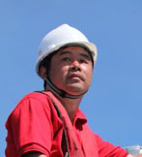
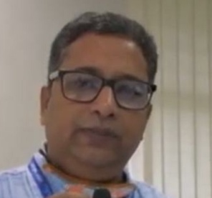
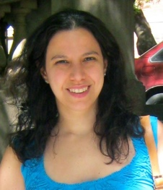
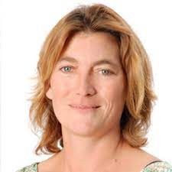
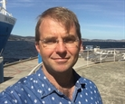
Benjamin Rabe
Sabrina Speich
Meghan Cronin
Eitarou Oka
Matt Palmer
Belén
Martín Míguez (Secretariat Support)
Tony Lee
Karina von Schukmann
Lisa Beal
Weidong Yu
Satya Prakash
M. Paz
Chidichiamo
Marjolaine Krug
Peter Oke

Slide 5
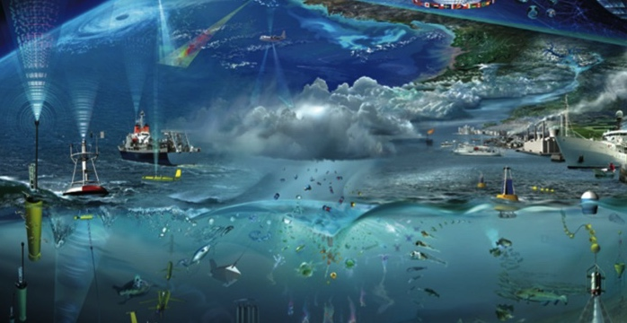

ACHIEVEMENTS

Slide 6
ACHIEVEMENTS
OOPC has continued his activity but it has been slowed-down heavily by the COVID 19 pandemic and by the absence of a secretariat for 6 months
OOPC has contributed significantly (and it is an ongoing work), to GCOS and WMO related activities:
  Writing of the GCOS Status Report (now under revision)
  Working on the new GCOS IP
  Working on the Joint Study Group on the evolution of GCOS
  Preparing the GCOS Joint Panel Meeting (taking place this week)
  Contributing o a very short notice to the WMO 2021 Bulletin on the Ocean
  Preparing the GCOS Science Conference taking place in September 2021

Slide 7
ACHIEVEMENTS
GOOS RELATED ACTIVITIES
OOPC Revised Terms of Reference (Draft)
Essential Ocean / Climate Variables Stewardship
Observing System Evaluation and Reviews
Strategy for Ocean Heat and Freshwater Cycles
Observing System Evaluation and Strategy for the Ocean-Atmosphere Interface
Observing System Evaluation and Strategy for Boundary Systems
Global Ocean Indicators Framework
TPOS
INDOOS
TAOS
Deep Ocean Observing Strategy (DOOS)
Regional network coordination/OO19 synthesis

Slide 8
ACHIEVEMENTS
Ocean Heat and Freshwater Storage and Transports in Observations and Climate Models
Major objectives:
Explore the use of observation-based estimates of large-scale ocean heat and freshwater transport and storage in model evaluation, assessment and development.
Assess the current capability of the ocean observing system to measure ocean heat and freshwater transport and storage changes, including budget constraints at global and regional scales to identify priority areas for new observations.
Assess CMIP6 models fitness-for-purpose in diagnosing forced heat and freshwater changes, including: global and regional conservation of ocean heat and freshwater; systematic model biases; model representation of regional heat/freshwater budgets.
Workshop had been organzied in 2020 – but finally cancelled…. (postponed until 2021/2022)
Organizing Committee
Matt Palmer (OOPC/Met Office Hadley Centre)
Karina von Schuckmann (Mercator Ocean International)
Till Kuhlbrodt (NCAS, University of Reading)
Lijing Cheng (IAP, Chinese Academy of Sciences)
Paul Durack (PCMDI / Lawrence Livermore)
Gokhan Danabasoglu (NCAR)
Maria Hood (OOPC/WMO)
Tristan L’Ecuyer (U. Wisconsin-Madison)
Adele Morrison (Australian National University)
Bernadette Sloyan (CSIRO)
Neil Swart (Environment Canada / CliC)
Amy Solomon (CU/NOAA/NORP)
WHAT NEXT ?
Due to membership change, activity will reorganized, including new member for support (to be confirmed)
Establish new terms of reference
Establish new roadmap, including a workshop in 2022

Slide 9

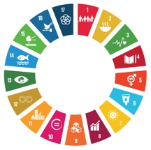
OCEAN MAJOR CHARACTERISTICS:
Storage & redistribution of Heat, Water & Carbon
EVOLUTION ?
The overall goal is to bring together climate research communities all concerned with the storage and redistribution of heat, water and carbon in the ocean, and the ocean’s role in the major Earth system cycles aiming to:
Analyse the consistency between different ocean and climate observing system components, and reanalyses (e.g. assessments, global and regional budget constraints) to report on ocean storage and redistribution and their related uncertainties, and to identify priority areas for observing system maintenance and extensions.
Further demonstrate the critical role of the ocean in the major Earth’s system cycles as derived from the global ocean and climate observing system, including the role of storage and redistribution establishing the cross-linkage between the cycles.
Liase with the climate model community (CMIP) in support of the diagnosis of model biases and ocean major characteristic model representations, and establish recommendation for the observing system and data dissemination for climate model evaluation and validation.
Establish a link to climate and ocean services, and to the transdisciplinary community to enhance the delivery of science-based ocean knowledge for ocean major characteristics in support of sustainable development.
WHAT NEXT ?
Due to membership change, activity will reorganized, including new member for support (to be confirmed)
Establish new roadmap, including a workshop in 2022

Slide 10

Ten year goal: To provide observational-based knowledge to fundamentally improve weather, climate and ocean prediction, promote healthy oceans, the blue economy, and sustainable food and energy.
Update on Achievements and Status for the April 2021 GCOS Joint Panel Meeting
ACHIEVEMENTS
Observing Air-Sea Interactions Strategy
(OASIS)
SCOR Working Group #162 was launched in November 2020. Administrative support provided by Consortium for Ocean Leadership as a post-OceanObs19 contribution for the NSF Regional Coordination Network.
  See our webpage: airseaobs.org! Contact Meghan.F.Cronin@noaa.gov to Join our slackpage or our next quarterly telecon, open to community (Apr 29, 2021).
Strategy builds off of more than 40 OceanObs19 community strategy papers. First synthesis report of recommendations expected in June 2021.
Encouraging & Developing Best Practices: Surface Radiation OBPS Workshop in 2020 & 2021, Direct Covariance Flux SOLAS Workshop
UN Decade Program proposal: “Observing Air-Sea Interactions Strategy (OASIS)”
US National Academy of Science Ocean-Shot proposals:
  “A global network of surface platforms for Observing Air-Sea Interactions Strategy (OASIS)”
  “Super Sites for advancing understanding of the oceanic and atmospheric boundary layers”

Slide 11
Boundary Systems
ACHIEVEMENTS
BOUNDARY SYSTEM TASK TEAM
The OOPC Boundary System Task Team (BSTT) provides guidance to GOOS observing networks and GOOS Regional Alliances on observing asset deployments in coastal and boundary current regions.
6 well observed boundary systems will be discussed.
Boundary System | Webinar Date (2021) | Presenters
Iberian Upwelling System | 4 May | Enrique Álvarez-Fanjul
California Current | 8 Jun | In discussion
Kuroshio | 6 Jul | Eitaro Ota, Yasumasa Miyazawa
East Australian Current | 3 Aug | Moninya Roughan, Colette Kerry
Gulf Stream | 7 Sep / 5 Oct | Magdalena Andres, Jonathan Gula
Mediterranean | 7 Sep / 5 Oct | In discussion
The BSTT is launching a GOOS webinar series entitled “Dialogues towards integrated boundary current observing and forecasting systems” which aims to:
(1) derive knowledge from historically well-observed sub-tropical boundary current systems and mature observing systems
(2) engage the coastal-shelf, climate analysis and modelling communities to identify knowledge gaps and to inform observing system design and the synthesis of multi-platform observations
(3) discuss innovative approaches, including the potential of new technology, to observe ocean boundaries.
All pre-recorded presentations provided by experts in ocean observing and ocean modelling as well as the discussion of these systems, will be publically released.

Slide 12
OCEAN INDICATOR FRAMEWORK
ACHIEVEMENTS
An ocean indicator can be defined as:
A simple easy to understand tool to describe, measure and monitor a complex Ocean phenomenon. The Ocean indicator may change globally to locally, at different time scales, and can be utilized for Ocean literacy, and to build a sustainable Ocean observing system for holistic scientific assessment and stewardship.’ (von Schuckmann et al. (2020), Journal of Marine Policy)
WHY ?
providing science-based ocean information for ocean stewardship, decision making management and ocean literacy
fostering international collaborations across multiple disciplines and key research areas
supporting observing system recommendations, assessments and quality control
HOW ?
proposal on the development of an international global ocean indicator framework submitted (September 2020) to GOOS as part of OOPC (Karina von Schuckmann, Marjolaine Krug, Sabrina Speich, Weidong Yu, Maria Hood)
Establish an international team dedicated to an international ocean indicator framework

Slide 13
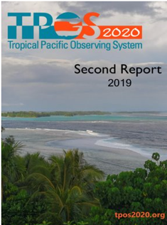
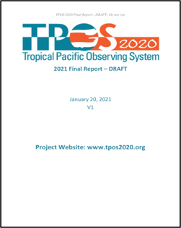
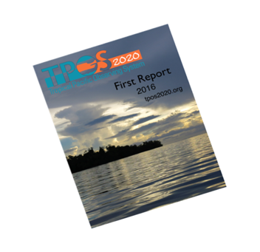
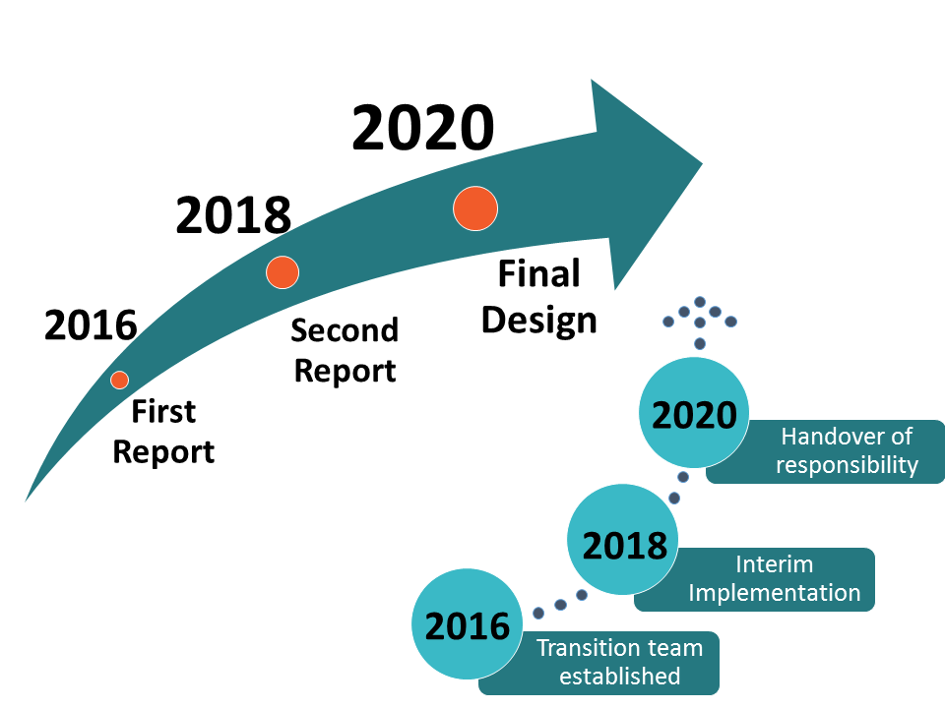
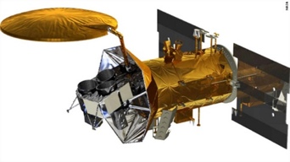
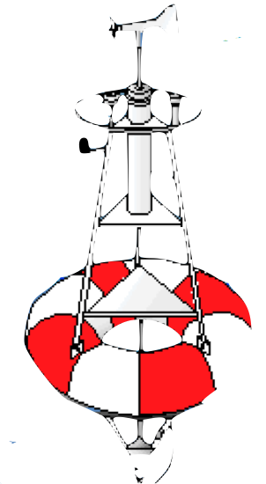
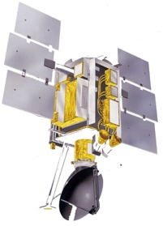
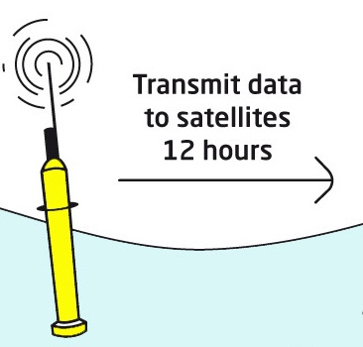

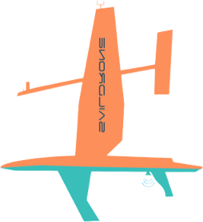



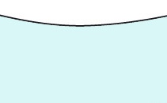

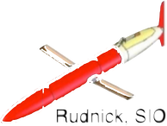

ACHIEVEMENTS
TPOS2020
TPOS2020 Key outcomes: Demo of the integrated approach
Complementary “backbone” technologies:
  Satellites give global coverage, horizontal detail
  Moorings sample across timescales, allow
  co-located ocean-atmosphere observations,
  velocity sampling
  Argo resolves fine vertical structure, adds salinity,
  maps subsurface T and S, connects to subtropics
Assimilating models integrate diverse observations
TPOS data reaches our stakeholders primarily as the output of an assimilation
Notes:
We are in a fundamentally different environment than when TAO was designed (no satellites except SST, no Argo, weak models)
Now we can take advantage of complementary technologies … but these require integration in an assimilating model.

Slide 14
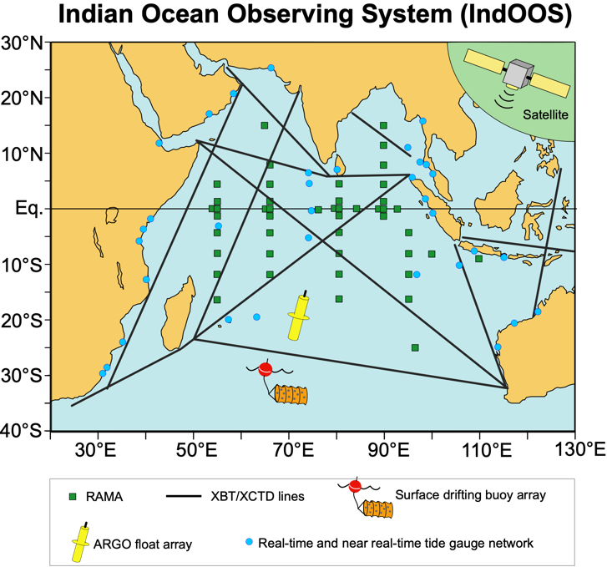
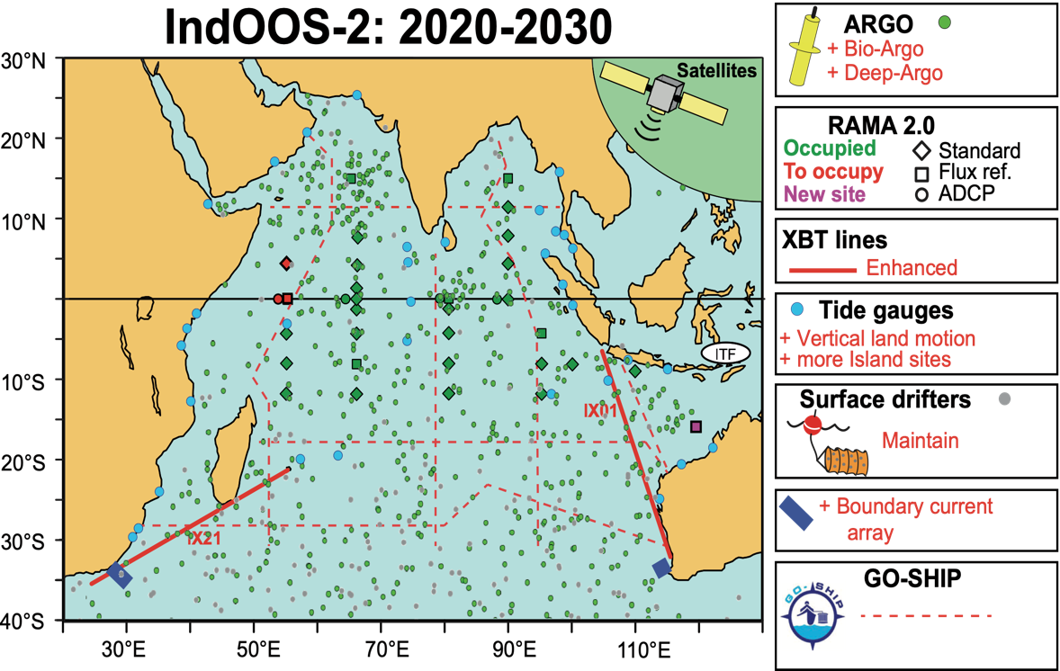

ACHIEVEMENTS
IndOOS Review
IndOOS has provided unprecedented knowledge of weather, ocean, and climate phenomena.
Remaining gaps:
Low prediction skill of sub-seasonal to seasonal forecasts
Large discrepancies in climatologies of heat exchange at the air-sea interface
Lack of observations in western equatorial Indian Ocean (piracy and vandalism) and of boundary currents
No sustained ecosystem measures
The way forward:
+ surface pressure
IndOOS-2 roadmap: doi.org/10.36071/clivar.rp.4.2019
+ leadership for line I1

Slide 15
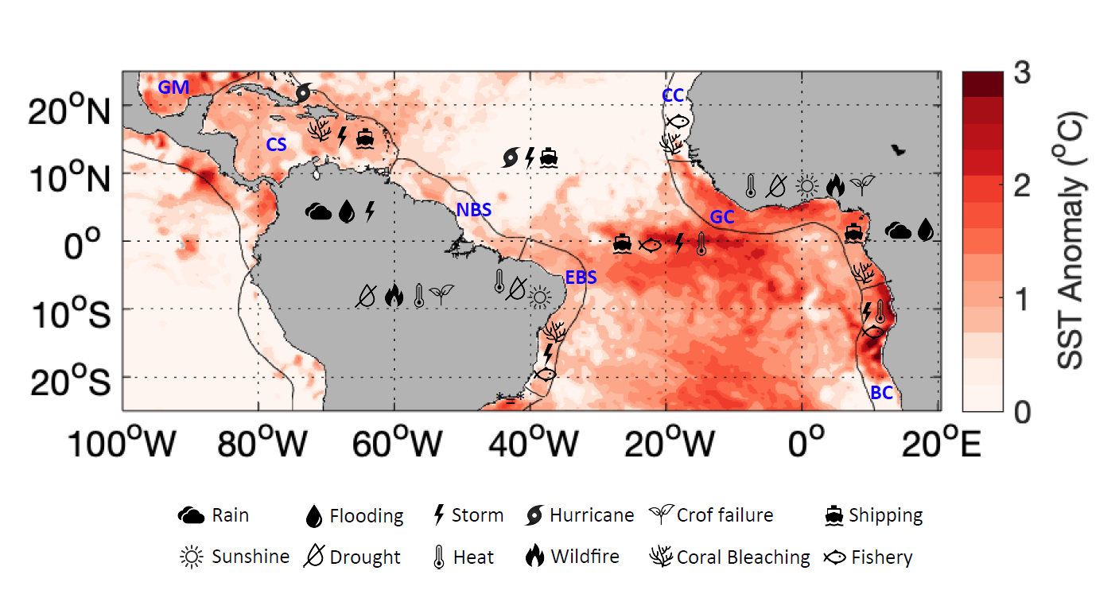
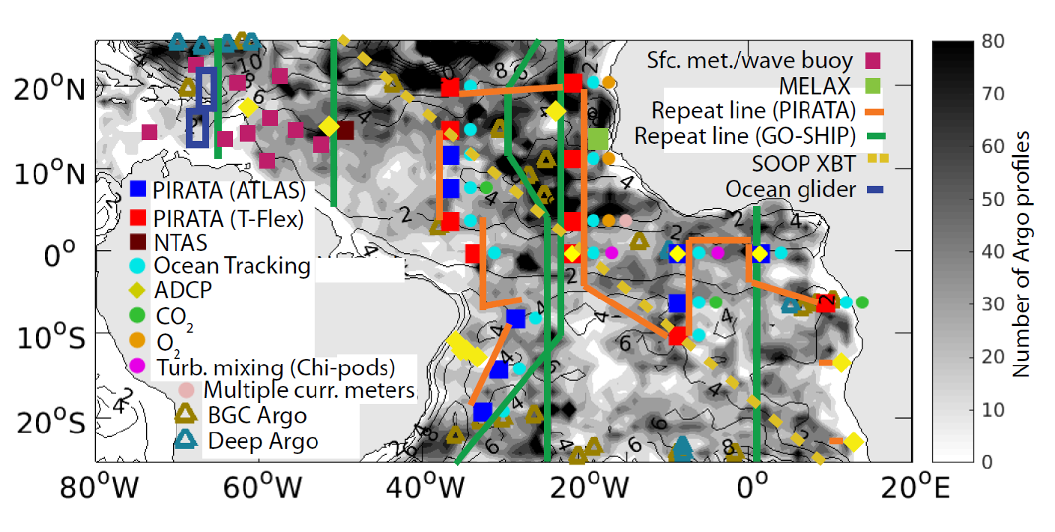


TAOS Review
(to be published shortly)
ACHIEVEMENTS
Ongoing and past observing projects have provided unprecedented knowledge of weather, ocean, and climate phenomena in a very complex system.
However, there is a need of an integrated Tropical Atlantic Observing System in order to
Build a sustained observing system
Identify gaps, coordinate solution and adapt swiftly to new requirements
The actual observing system is the minimal to ensure fit-for-purponess for at least some requirements
Evolution reccomended that includes an expantion toward the coast and Caribbean
Insure a strong coordination and co-design with stakeholders and end users against the evolving requirements
Governance via a TAOS “Forum”

Slide 16
FUTURE PLANS

Slide 17
LINK WITH NEW WCRP
OOPC mostly connects WCRP through its core project CLIVAR, particular its regional panels, including Indian Ocean Panel (Lisa and Weidong served as the former co-chairs), Atlantic Ocean Panel (Sabrina served as co-chair), the Pacific Ocean Panel, Southern/Northern Ocean Panels where Ben sitted.
OOPC needs strong links with the two new core projects (i.e. model/data home and the Regional Climate Information for Society).
CLIVAR-GOOS Observing System Workshop will be convened in May 2022.

Slide 18
OOPC leading
Future plans – Contributions to GOOS IP
3.4 Global Ocean Indicators Framework
5.1 Essential Ocean / Climate Variables Stewardship
5.3 Observing System Evaluation and Reviews
5.3.1 Strategy for Ocean Heat and Freshwater Cycles
5.3.2 Observing System Evaluation and Strategy for the Ocean-Atmosphere Interface
5.3.3 Observing System Evaluation and Strategy for Boundary Systems
5.4 GOOS Evaluation and Review Framework
5.5 Regional network coordination/OO19 synthesis/OO19 Action Plan
Notes:
1) I suppose you can mention that OOPC has lacked Secretarial support for a long time and that has had an impact on the "performance" of the group. The panel has not met for several months.
2) COVID has also had a clear impact, as many of the activities relied heavily on face-to-face meetings. Some of them were very advanced and had to be cancelled.
With respect to GOOS IP and OOPC:
With the support of Emma Heslop, OOPC has made an effort to adjust the definition of its tasks, already described in the OOPC Workplan approved in 2019, so that they are better aligned with GOOS IP. In particular:
It has clarified the timeline and milestones for the activities
It has identified and added information about connections with other GOOS elements as well as with non-GOOS partners.
It has included an estimation of the estimated costs, when resources beyond GOOS regular ones were required
It has attempted to improve the definition of output/impact (even though I am not sure we succeeded)
One of OOPC activities was considered not suitable to be included in GOOS IP, so it was removed.

Slide 19
ISSUES

Slide 20
Issues - Optimize cross-work with GCOS/WCRP
OOPC has lacked Secretarial support for a long time and that has had an impact on the "performance" of the group. The panel has not met for several months.
COVID has also had a clear impact, as many of the activities relied heavily on face-to-face meetings. Some of them were very advanced and had to be cancelled (OOPC-OO19 Action Plan Meeting March 2020; Ocean Heat & fresh Water Meeting October 2020; GOOS/CLIVAR Workshop May 2021).
Important amount of work in connection with GCOS, probably more cross-actions with WCRP is needed, there will be very likely interseption/cross-actions with WMO
COVID has exagerately expanded the time we spend in (e)meetings

Slide 21
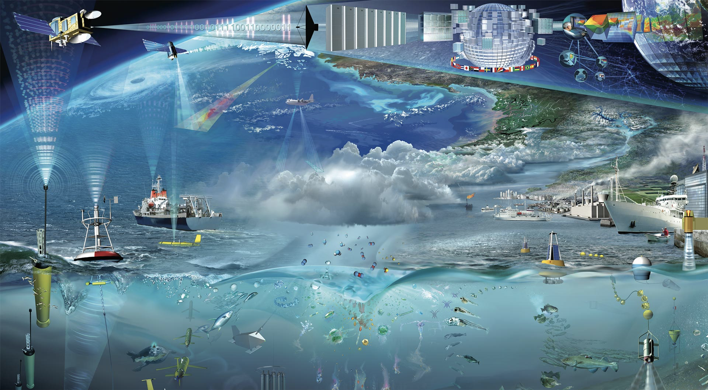


Thank you!

Slide 22
WCRP’s New Structure
2
Lighthouse
Activities
3
1
Additional activities and fora
Community Home:
Hosting core projects with two new ones
CLIC
CLIVAR
GWEX
SPARC

Slide 23

GCOS REPORTING TIMELINE
ACHIEVEMENTS
March Panel Meetings
Revise Requirements based on public review
March Panel Meetings
Agree revised SR
March Panel Meetings
Agree revised IP
Panels revise requirements
Public review
panels draft IP4
IP4 finalise & review
`
Jan 2020
Jan 2021
Jan 2022
panels draft SR4
SR4 finalise & review
Jan 2023
+ JSG GCOS evolution
SEPTEMBER: 4th Status Report published
SEPTEMBER: GCOS Climate Observation Conference (TBC)
OCTOBER: SC Meeting: 4th Implementation Plan published
Notes:
In Blue, the EOVs which are also ECVs.

Slide 24
TERMS OF REFERENCE (DRAFT) ?
Recognize the need for ocean observations beyond those for climate, and the increased need to connect to societal issues in the coastal zone
OOPC sits at the nexus between the GCOS, GOOS, WCRP, provides science advice to WMO, and needs to connect to modelling and coastal observing community. Lots of connections to make!
TOR Highlights:
Assess, review and prioritize requirements for sustained observations of physical Essential Ocean Variables (EOVs) and ocean Essential Climate Variables (ECVs)
Coordinate observing networks with the WMO, GOOS Regional Alliances and other relevant bodies – best practices, data sharing, synergies, metrics
Data and Information Management status and requirements
Develop process for ongoing evaluation of the observing system in liaison with
users of the data
Report to the GCOS SC, the GOOS SC, and the WCRP Data Advisory Council on progress implementing ocean observations for key physical and climate variables.

Slide 25
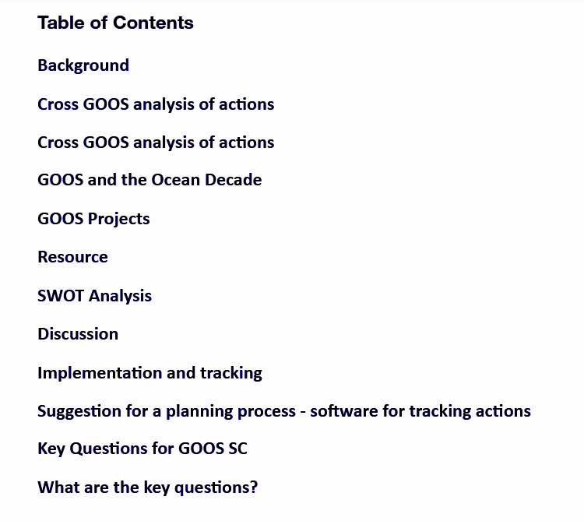
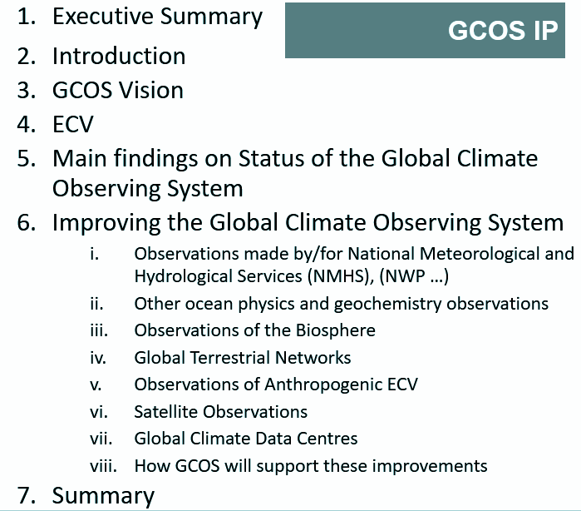
GOOS IP
FUTURE PLANS
GCOS IP

