Slide 1
Chair - Brad deYoung - Memorial University (Canada)
Steering Committee: M. Visbeck (Germany) l S. Speich, P.Y. Le Traon (France) l J. Snowden (U.S.) l N. P. Holliday (United Kingdom) l T. Lamont (South Africa) l L. Cotrim (Brazil) l I.S. Pinto (Portugal) l M.P. Chidichimo (Argentina)
Coordination Team: S. Ketelhake (Germany) | A. Zinkann (U.S.)
#AtlantOS

Slide 2
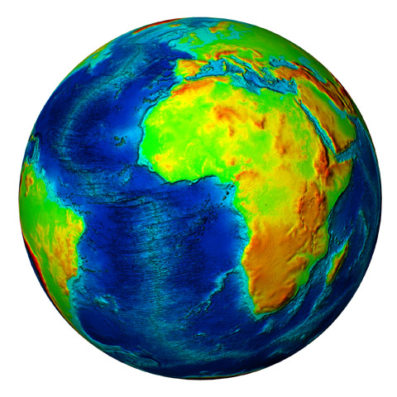
Vision
A comprehensive Atlantic Ocean Observing System that benefits all of us living, working and relying on the ocean.

Slide 3
Mission and Ambition
Implement an All-Atlantic Perspective
Including the North Atlantic, Tropical Atlantic and South Atlantic and their connectivity to the Marginal Seas and sub-basins. Bringing together upper, deep and coastal observing partners and connecting observing networks and systems.
Support Regional Implementation
Support policy agreements such as the EU – USA – Canada Galway and EU – South Africa – Brazil Belém Statements (plus additional countries) and contribute to GEO Blue Planet Initiative and Global Ocean Observing System (GOOS).
Work towards a fit-for-purpose system connected to users
Through free and open access to ocean data information (Digital Twin Ocean) supporting system review and national and regional commitments towards the implementation of the system and how it optimally serves ocean information, knowledge and societal value.

Slide 4
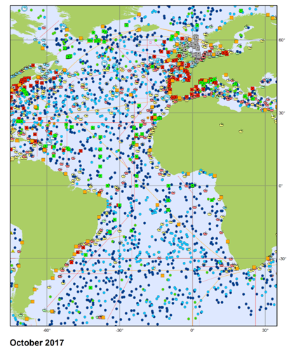
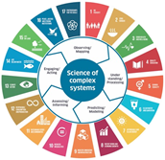
What is the value of Basin-Scale Observing?
Improved coordination at the scale of implementation
Articulate an optimised basin scale ocean observing system (design and impact)
More targeted response to societal needs in the region
Facilitate sharing of resources and build implementation partnerships
Connect program actions within the basin (e.g. EArOOS, Atlantic dimension of IOOS, CIOOS) and GOOS networks

Slide 5
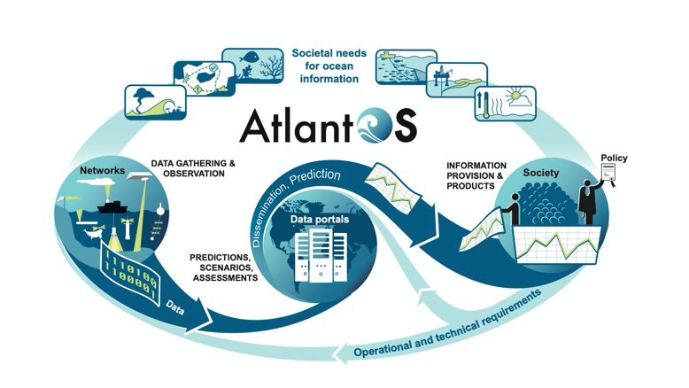
Promoting the Value Chain approach

Slide 6
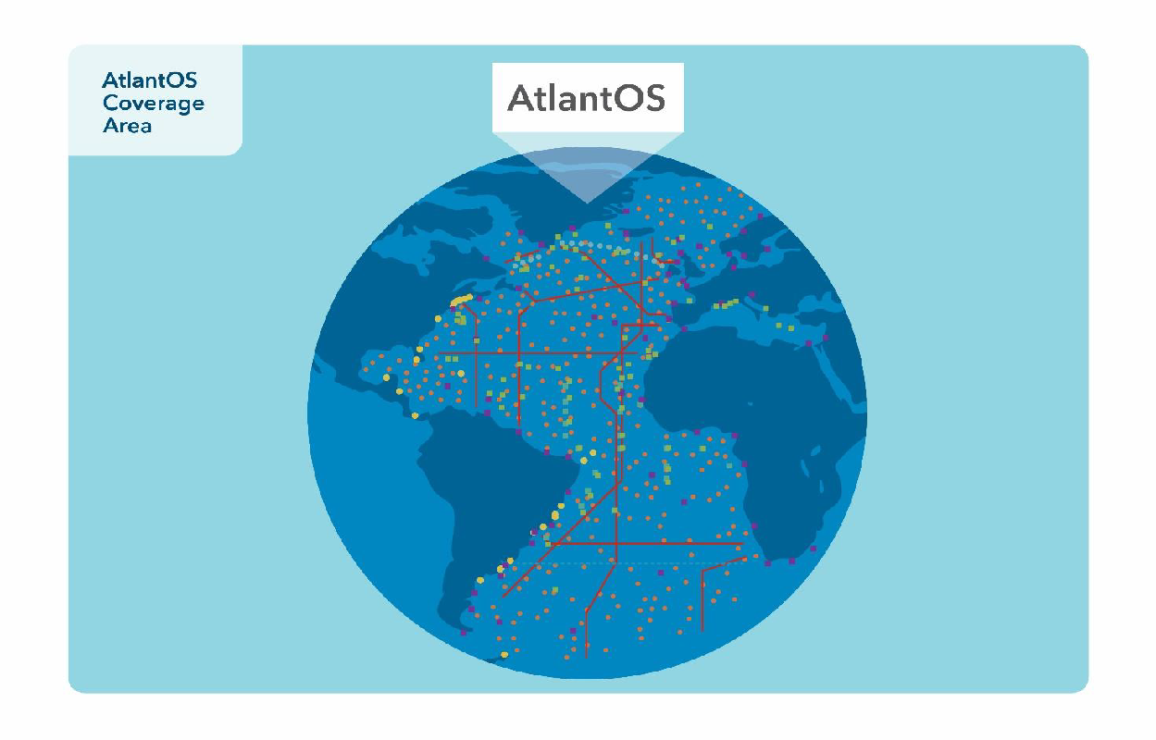
Atlantic Basin Scale Implementation Actions
VISIBILITY
BRIDGE
CONNECTIVITY
INTERNATIONAL COOPERATION
ENGAGEMENT & INNOVATION
INTEROPERABILITY OF DATA

Slide 7
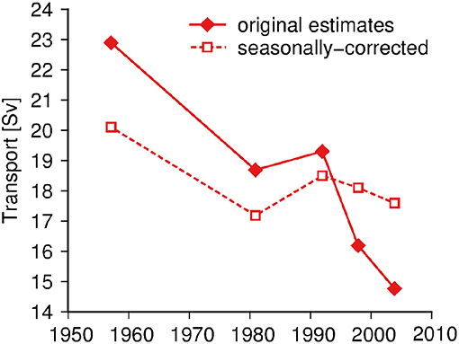
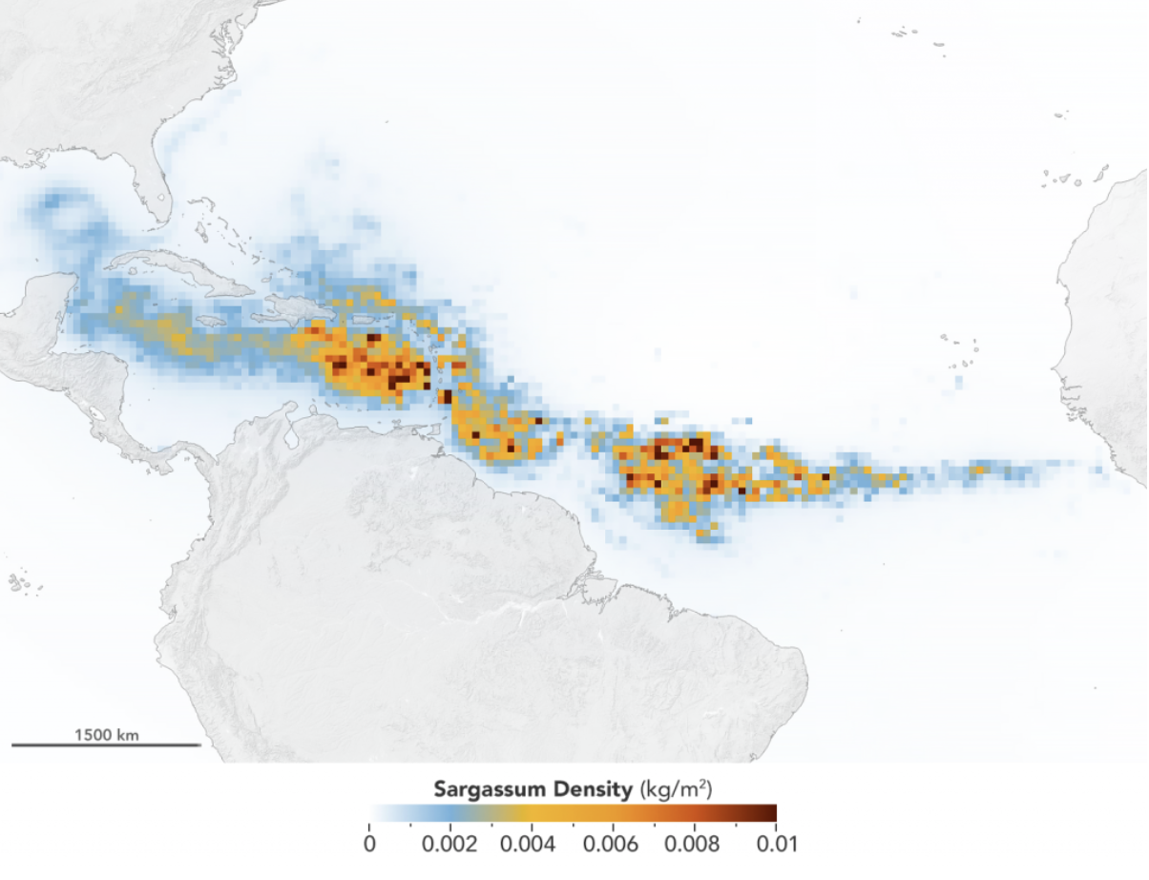
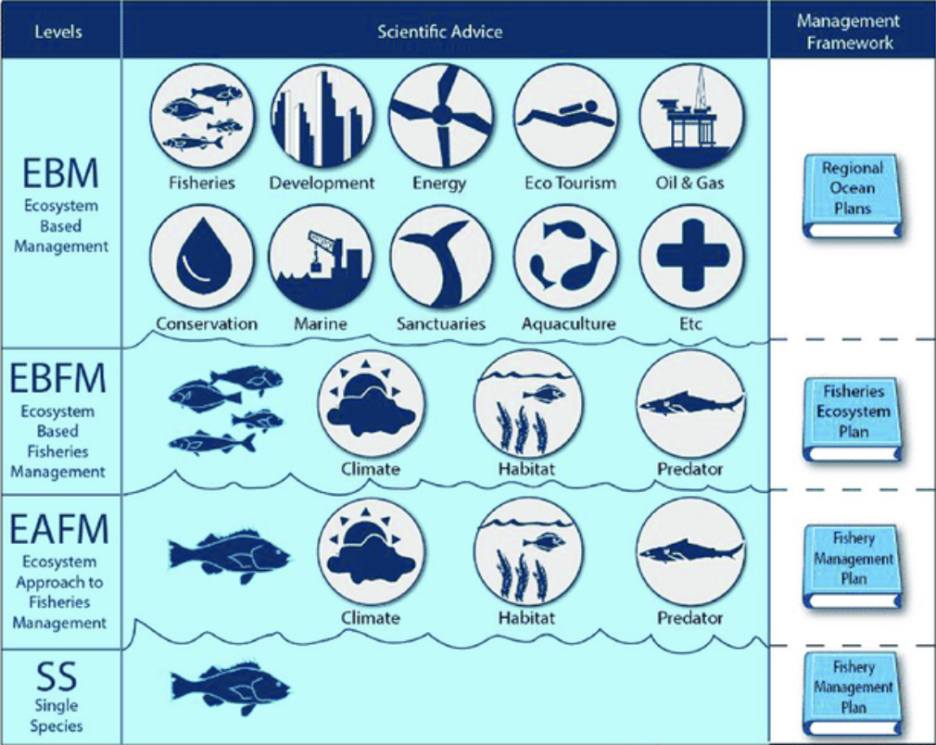
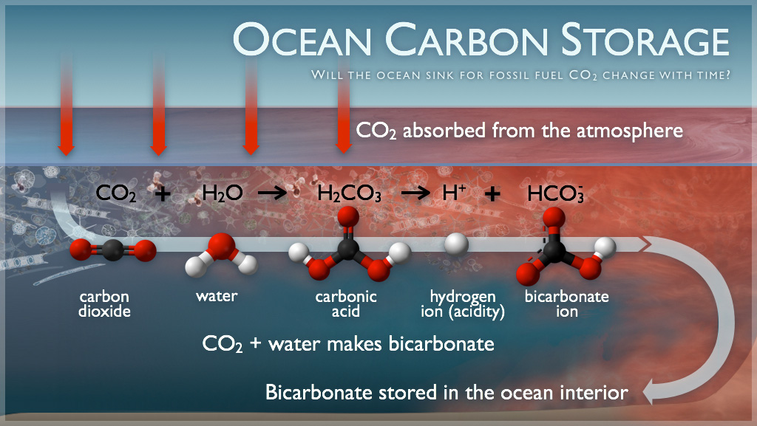
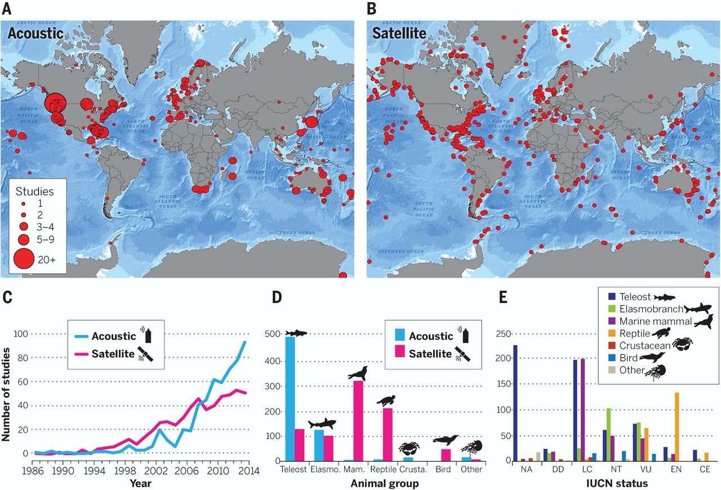
Current Use Cases
Providing Basin-Scale Climate Services – Atlantic Meridional Ocean Circulation
Credit: Fraijka-Williams et al. (2019)
Mitigating Impacts of Sargassum on Coastal Communities in the Tropical Atlantic
Credit: NASA/Earth Observatory
Supporting Ecosystems Based Management for Fisheries in Atlantic Upwelling Regions
Credit: Schmidt et al. (2019)
Carbon Uptake – Identifying sources and sinks of carbon
Credit: PMEL Carbon Group, NOAA
Networks to predict and explain marine animal movements in a changing environment
Credit: Hussey et al. (2015)

Slide 8
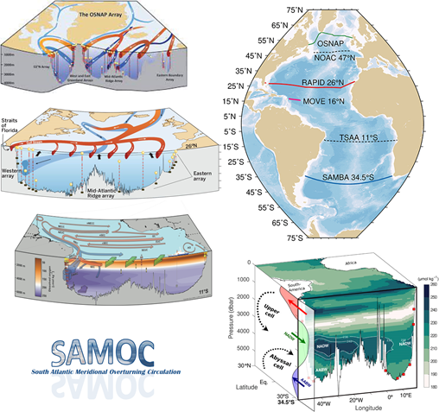
Atlantic Meridional Overturning Circulation
Issue: Long-term sustainability and collaboration between programs making various property and biogeochemical measurements
Need: Promote the sharing of infrastructure and ease linkages to models
Approach: Developing program engagement (OSNAP, RAPID, SAMOC et al.) – Complementary Partnership with CLIVAR AMOC Task Team
Leaders: Brad deYoung (MUN), Maria Paz Chidichimo (CONICET | SHN) and others

Slide 9
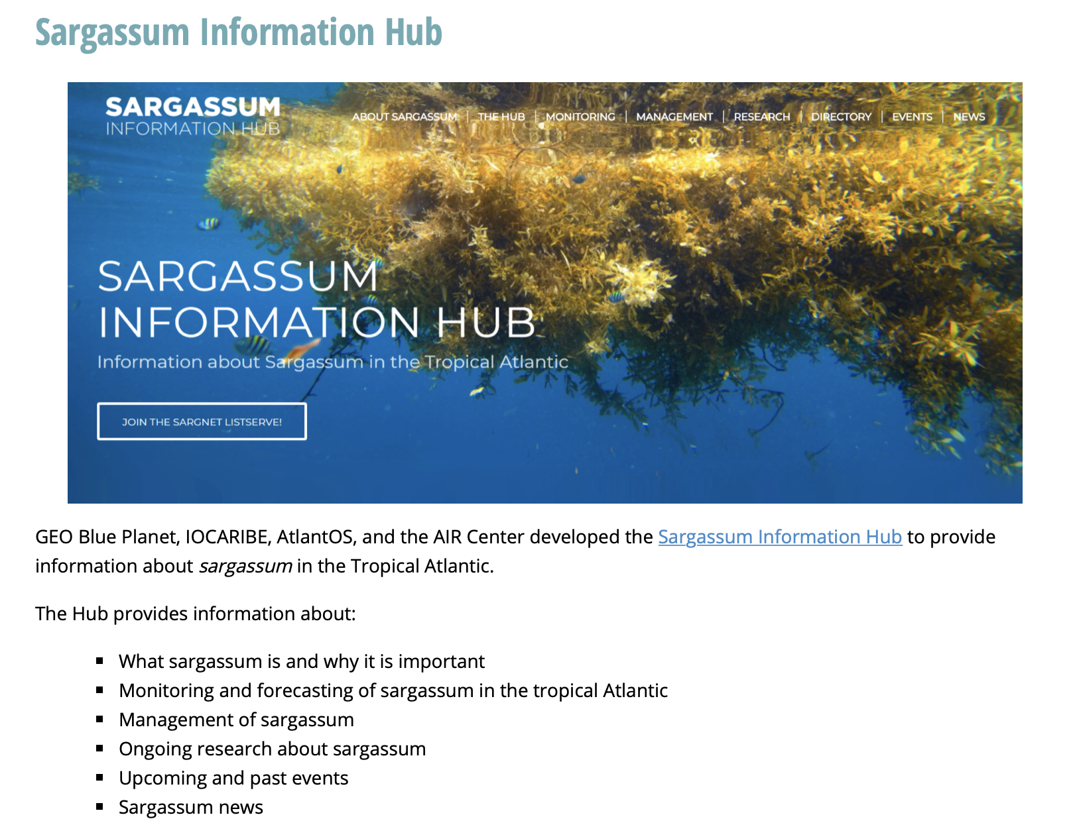
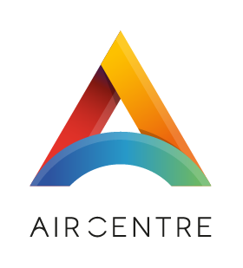
Sargassum in the Tropical Atlantic
Connects the whole Tropical Atlantic
Focuses on a problem with immediate impact and high-profile
Provide linkages to wider capabilities – e.g. between observing, modeling/prediction, and scientific expertise
Next steps:
Access to free, open and easily understandable monitoring and forecasting products for society
Knowledge about the impacts of the increased Sargassum: biological, ecological, socio - economic
Information on how Sargassum biomass can be used (e.g. products, carbon uptake)

Slide 10
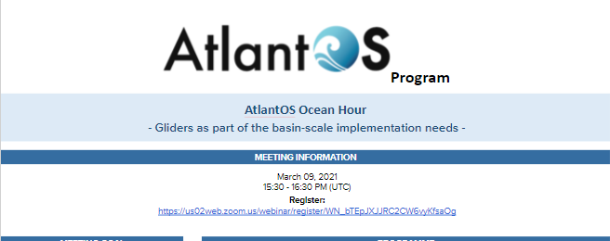
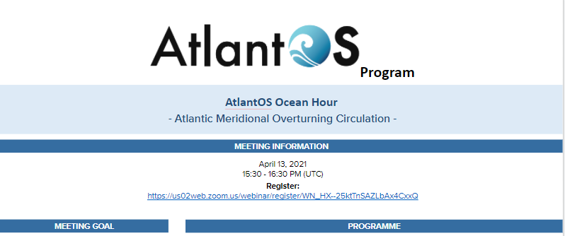
AtlantOS Ocean Hour
Aim
Inform the Atlantic Ocean Community of advances in the AtlantOS program, progress of use cases, ongoing and new project developments
Support community engagement and feedback
Help build a collective vision for ocean observing in the Atlantic
Engage those interested in All-Atlantic Ocean Observing
Past Ocean Hours
Glider Network l Atlantic Meridional Overturning Circulation (AMOC)
Upcoming Ocean Hours
May: VOS Program l June: Carbon Uptake
Fall: BGC Argo l Deep Ocean Observing System l
OceanSITES l Fisheries in Atlantic Upwelling Regions

Slide 11
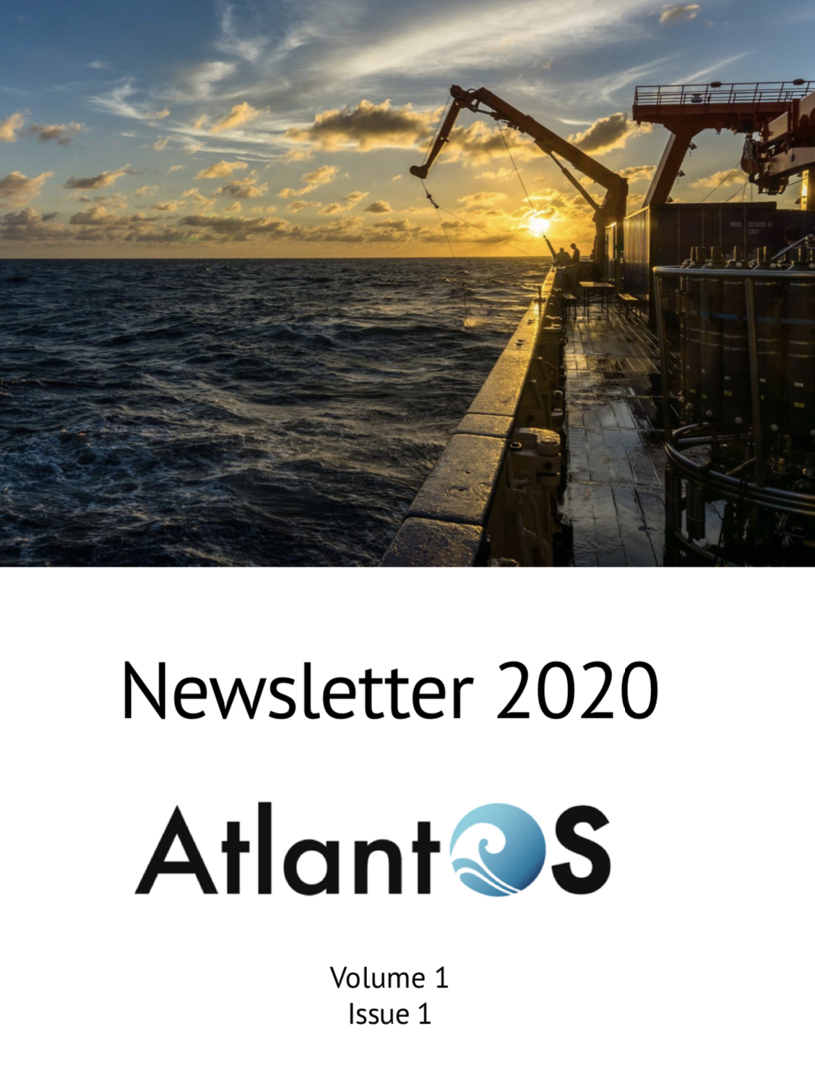
Quarterly Newsletter
Quarterly newsletter
Sharing progress around AtlantOS activities
Help to build sense of community
Enables us to reach out beyond the research community
Offer space for partners to contribute to AtlantOS discussions
Provide a record of activities and actions

Slide 12
Value-added and Goals of AtlantOS
Using lessons learned from the AtlantOS Project and its collaborations to plan research, observing and monitoring strategies
Ensuring and expanding link between ocean, atmospheric, and environmental observation communities and existing efforts to this basin-wide phenomenon
Using existing international data platforms (like GEOSS) promoting FAIR principles
Demonstrate value of information derived from ocean observations through contribution to international activities like UN Ocean Decade
Establish a basin-scale ocean observing system framework and promote community of practice on basin-scale
Co-evolve with GOOS and others to ensure co-design and sustained observing

Slide 13
The 5 Year Development Plan
Engage with national regional supporters e.g. CIOOS, USIOOS, EuroGOOS and EOOS, IOC Caribe, PIRATA, TAOS, SAMOC and other South Atlantic activities
Connect and support Atlantic implementation of GOOS networks – Argo, Ocean Gliders, OceanSITES, VOS and others
Establish process to design fit for purpose observing system
Governance and implementation by December 2021
Turnover plan for Steering Committee, Open call for new membership, Regular reporting requirements
Roadmap development – by February 2022

Slide 14
Connections with GOOS
AtlantOS will support the implementation of the GOOS 2030 Strategy in the Atlantic
Optimizing the design of the observing system
Facilitate the sharing of platforms
Enhance co-benefits of the GOOS networks in the Atlantic
Support the GOOS ambitions for the UN Ocean Decade
Realizing the Value Chain
Connecting with stakeholders
Contribute use cases and best practices in the Atlantic to the global scale

Slide 15
Why should AtlantOS be a project of GOOS?
Plans to directly contribute to GOOS and needs for basin scale implementation
GOOS and AtlantOS have shared goals and aspirations
Official accreditation with GOOS will raise the visibility of AtlantOS and enable access to other actors and entities
Creates transparency for the roles and actions of both AtlantOS and GOOS in the Atlantic

Slide 16
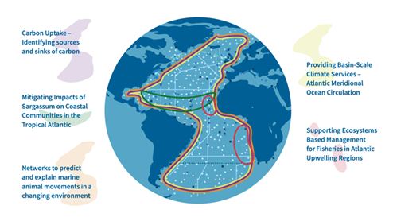
Thank you for listening … questions?
Improving international collaboration in the design, implementation and benefit sharing of ocean observing,
Promoting engagement and innovation in all aspects of ocean observing,
Facilitating free and open access to ocean data and information => Digital-Twin Ocean
Enabling and disseminating methods of achieving quality and authority of ocean information,
Strengthening the Global Ocean Observing System (GOOS) and contribute to GEO Blue Planet Initiative,
Contributing to the Galway and Belém Statements on Atlantic Ocean Cooperation

Slide 17
Additional Slides
AtlantOS

Slide 18
What will AtlantOS build?
Enable a basin-scale ocean observing system
Establishment of basin-scale framework to support GOOS and GEO Blue Planet
Development community of practice around basin-scale observing
Coevolve with GOOS elements and others to ensure the co-design and sustained basin-scale ocean observing
Bridge across communities

Slide 19
Basin Implementation Use Cases
AtlantOS Program Structure
Community Building
Services for Society
Communication
AtlantOS Symposium
Supporting Ocean Information Product Generation
AtlantOS Ocean Hour
Thematic
Workshops
Fit-for-purpose System Evaluation
Briefings and Fact Sheets
Education and Training
Support National and Regional Review and Commitments
Newsletter

Slide 20
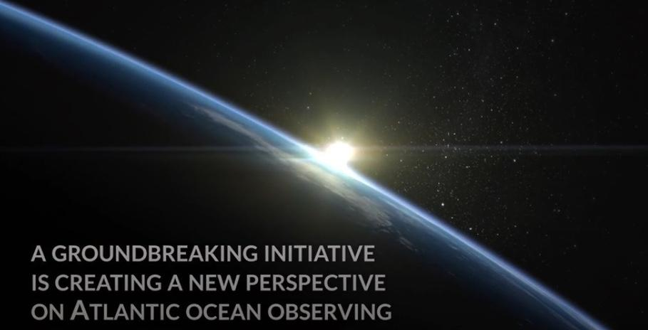
AtlantOS - Video

