Slide 1



council.science
The co-sponsorship of GOOS
April 2021

Slide 2
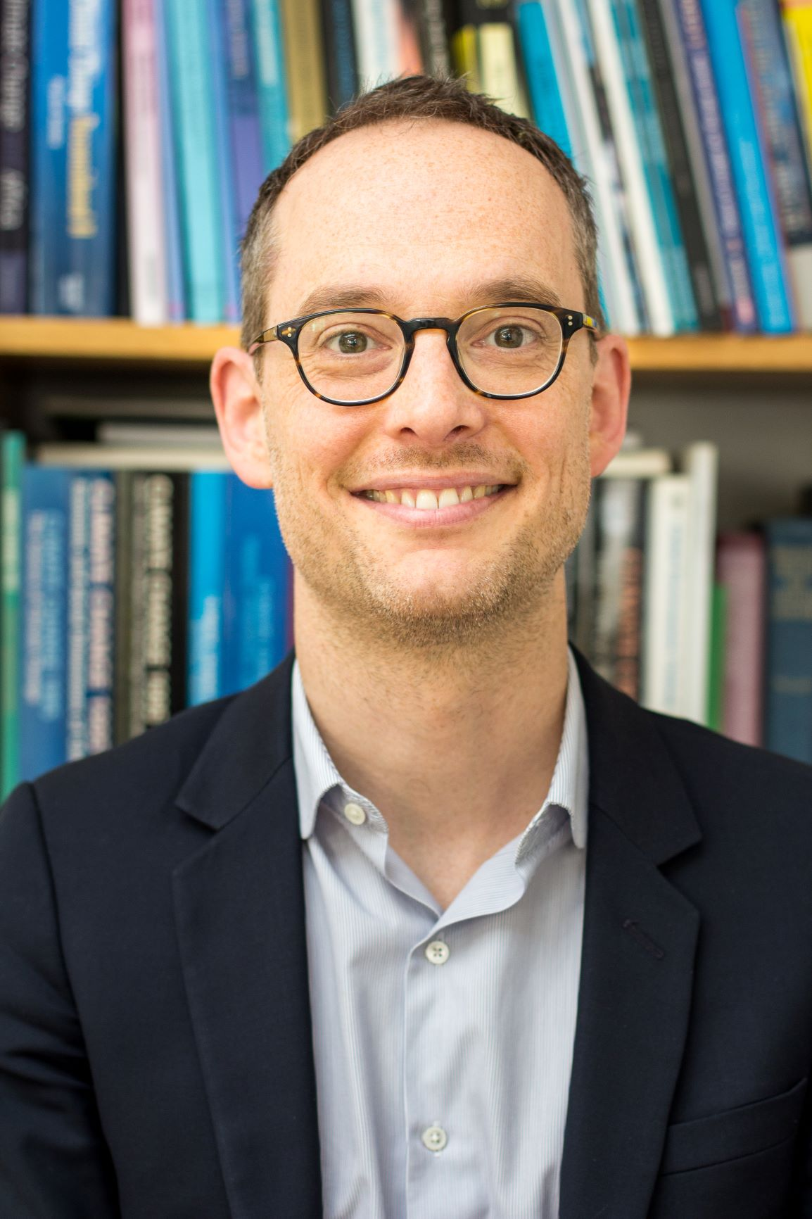
Mathieu Denis
Science Director,
International Science Council

Slide 3



The ISC convenes expertise and influence across scientific fields,
disciplines, regions and stakeholder communities in order to
Promote international, integrated research on key global challenges
Increase evidence-informed understanding and decision making at all levels of public policy, discourse and action
Protect scientific freedom and advocate principles for the responsible practice of science
Support the continued and equal development of science systems in all parts of the world

Slide 4
The vision of the Council is to advance science as a global public good
The mission of the Council is to be the global voice for science
Our members include:
140+ National and Regional Scientific Organizations, including Academies and Research Councils
40+ International Scientific Unions and Associations, across the natural and social sciences
30 International Affiliates, including organizations like The World Academy of Sciences, the International Institute for Applied Systems Analysis, the Global Young Academy
We maintain active partnerships with:
Other international scientific bodies, including the InterAcademy Partnership, the World Federation of Engineering Organizations and the Global Research Council

Slide 5



ISC sponsored and affiliated international scientific bodies
International Research Programmes
International Scientific Committees
International Scientific Committees
Antarctic Research (SCAR)
Frequencies for Radio Astronomy and Space Science (IUCAF)
Oceanic Research (SCOR)
Space Research (COSPAR)
Solar Terrestrial Physics (SCOSTEP)
Future Earth
Climate Research Programme (WCRP)
Integrated Research on Disaster Risk Programme (IRDR)
Urban Health and Wellbeing Programme (UHWB)
Comparative Research on Inequality (GRIP)
International Data Bodies
Global Observing Systems
Committee on Data for Science and Technology (CODATA)
World Data System (WDS)
Global Climate Observing System (GCOS)
Global Ocean Observing System (GOOS)
The International Network for Government Science Advice (INGSA)

Slide 6


The ISC leads on interfacing at the UN
The ISC is a Lead Coordinator of the UN Major Group for Science and Technology.
In this role the Council works with the World Federation of Engineering Organizations (WFEO)
to secure a mandate for science at the UN.
UNDESA
UNESCO
The ISC represents the international scientific community in the annual High Level Political Forum on the Sustainable Development Goals
The ISC a key partner for UNESCO on Open Science, and The Ocean Decade through the Intergovernmental Oceanographic Commission
UNDP
UNEP
Phase One of Rethinking Human Development has just been completed, a major achievement in including the natural environment in future human development reports
We collaborate with UNEP in the context of co-sponsoring the international sustainability research programme, Future Earth
UNDRR
WMO
The Council, working with its members has produced a comprehensive Hazard Definition & Classification Review: Technical Review
WMO is one of our partners in the World Climate Research Programme, and the Global Observing Oceans and Climate Systems (GOOS and GCOS)

Slide 7
Priorities for ISC and GOOS
Strengthening ongoing collaborations (e.g. Ocean Decade) and developing new ones (e.g., GEO, UN work)
Connecting GOOS with scientific networks to help achieve the 2030 Strategy (e.g., FAIR data, human and social dimensions, etc.)
Supporting GOOS’ outreach and dissemination efforts

