Slide 1

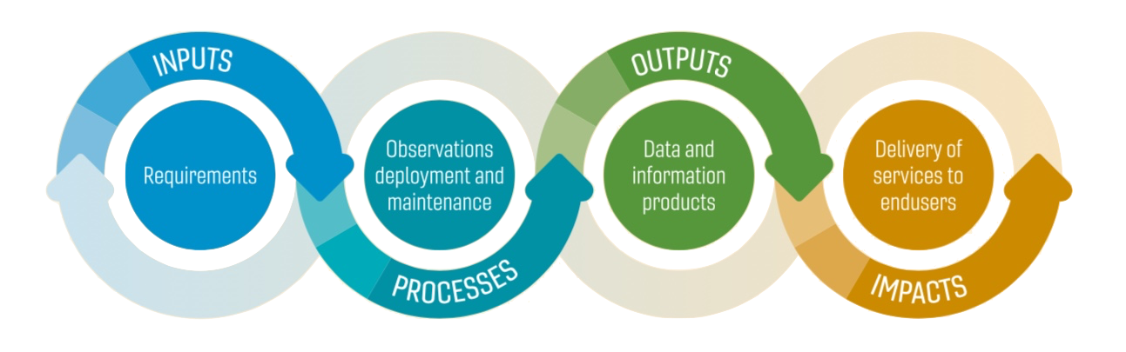

The Global Ocean Observing System
Governance consultations
The Global Ocean Observing System
www.goosocean.org
Notes:
IOC – some characteristics of a central hierarchical governance structure, with central governing body, very formal membership, a secretariat or support staff arranged in pyramid.
Some characteristics of a collective impact backbone organization, with member states deciding a common agenda by concensus, holding each other accountable, building mutually reinforcing activities, communicating. And engaging a broad scientific community and with the Ocean Decade, a growing set of stakeholders.
Intergovernmental organization in the UN system, focused on govt’s.
Ocean observing – presupposes that governments are the central players in implementing ocean observing.
They are the major funders and in some cases implementers, but academic institutions have always been a key partner in implementation. local govt, industry, end users are becoming more and more relevant.
Another sponsor is WMO – much more central / hierarchical.
Operational weather services, weather system – central rules are key to keeping things running 24/7 across the globe.
Oceans are different, many more players, many more users.

Slide 2
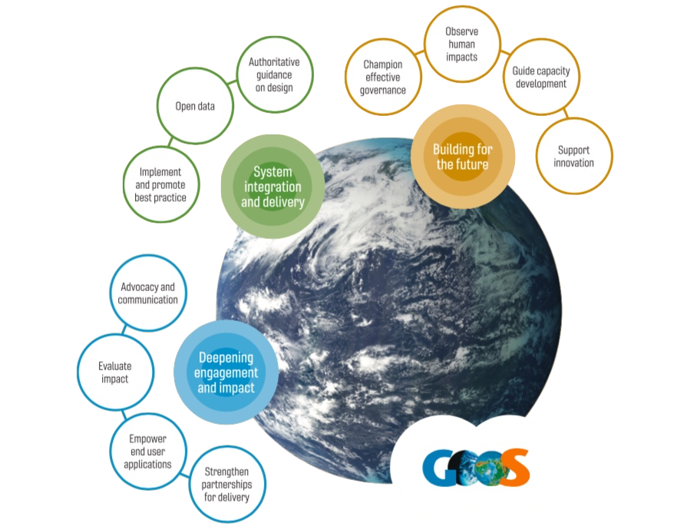
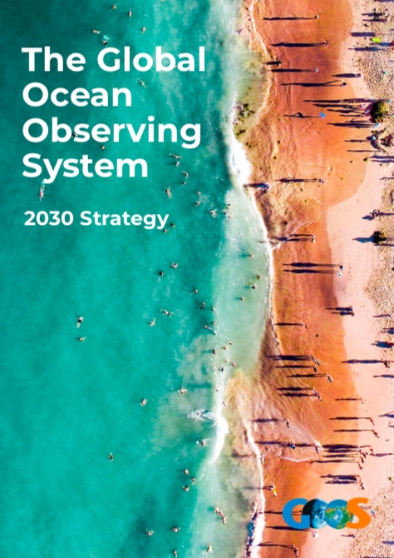
Vision
A truly global ocean observing system that delivers
the essential information needed for our sustainable development, safety, wellbeing and prosperity
Mission
To lead the ocean observing community and create the partnerships to grow an integrated, responsive and sustained observing system

Slide 3
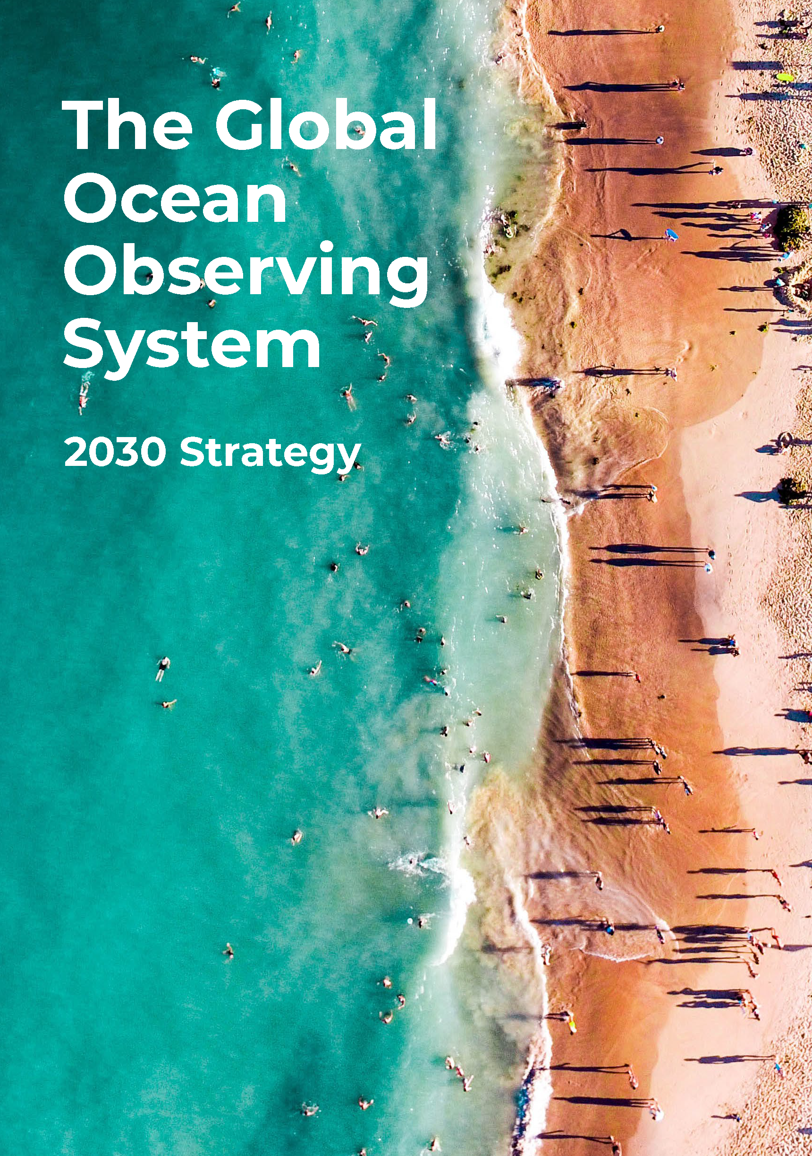
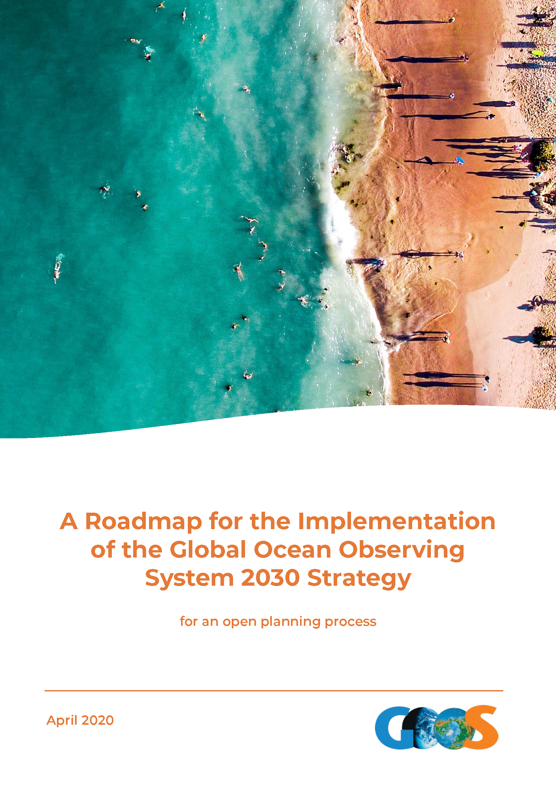
GOOS is advancing well
There is a need for GOOS
The ocean observing community is recognizing GOOS
But:
GOOS wants to advance to deliver more and better to society
We are not living up to the ambition articulated in the strategy
GOOS is keen to evolve
We need to address structural weaknesses and ability to attract funding with appropriate governance
GOOS needs to deliver to the Ocean Decade!

Slide 4
Why this report, why now?
This report was commissioned by GOOS to adress the "sub-optimal financial and management support levels for many of the [GOOS] efforts“
GOOS needs to do the heavy lift that society and our strategy demands - we cannot do it with existing resources.
Demand is increasing - the Decade will depend on observations
An underfunded GOOS risks becoming irrelevant and a failing organization.
Significant pressures arising from an unreasonably heavy workload, short-term outlooks, and unreasonable expectations in terms of delivery
The current support structure effective in some areas, but in general not meeting expectation for the vision and mission of GOOS
The efficiency of the support structure is compromised by the fragmented approach and insecure lines of support,
……
Notes:
Point out that this conceptual model against the Framework for Ocean Observing diagram is not perfect. BioEco is working hard to get EOV-based observing networks off the ground, GRAs work in the space of requirements, evaluation, and data; and the link with national observing systems and programmes needs to be developed.

Slide 5
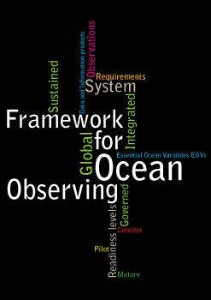
GOOS mandate today: IOC XXVI-8
Decides to:
recommit to GOOS, building on existing achievements, by:
(i) focusing on GOOS as a holistic system encompassing global, regional and
coastal observations and products;
(ii) integrating all available observational data;
(iii) aligning GOOS with a Framework for Ocean Observing oriented to an essential
ocean variable approach;
(iv) promoting GOOS’ essential role in providing observations and products to inform
actions taken under global conventions such as UNFCCC, including its emphasis
on adaptation, (including data for) consideration of natural hazards; CBD, and
SOLAS, and regional conventions such as the UNEP Regional Seas
Conventions and Action Plans; as well as the UN Regular Process;
(v) reinforcing global participation through increased extrabudgetary support for
capacity development, especially in Africa, Small Island Developing States and
Least Developed Countries;
Notes:
Point out that this conceptual model against the Framework for Ocean Observing diagram is not perfect. BioEco is working hard to get EOV-based observing networks off the ground, GRAs work in the space of requirements, evaluation, and data; and the link with national observing systems and programmes needs to be developed.

Slide 6
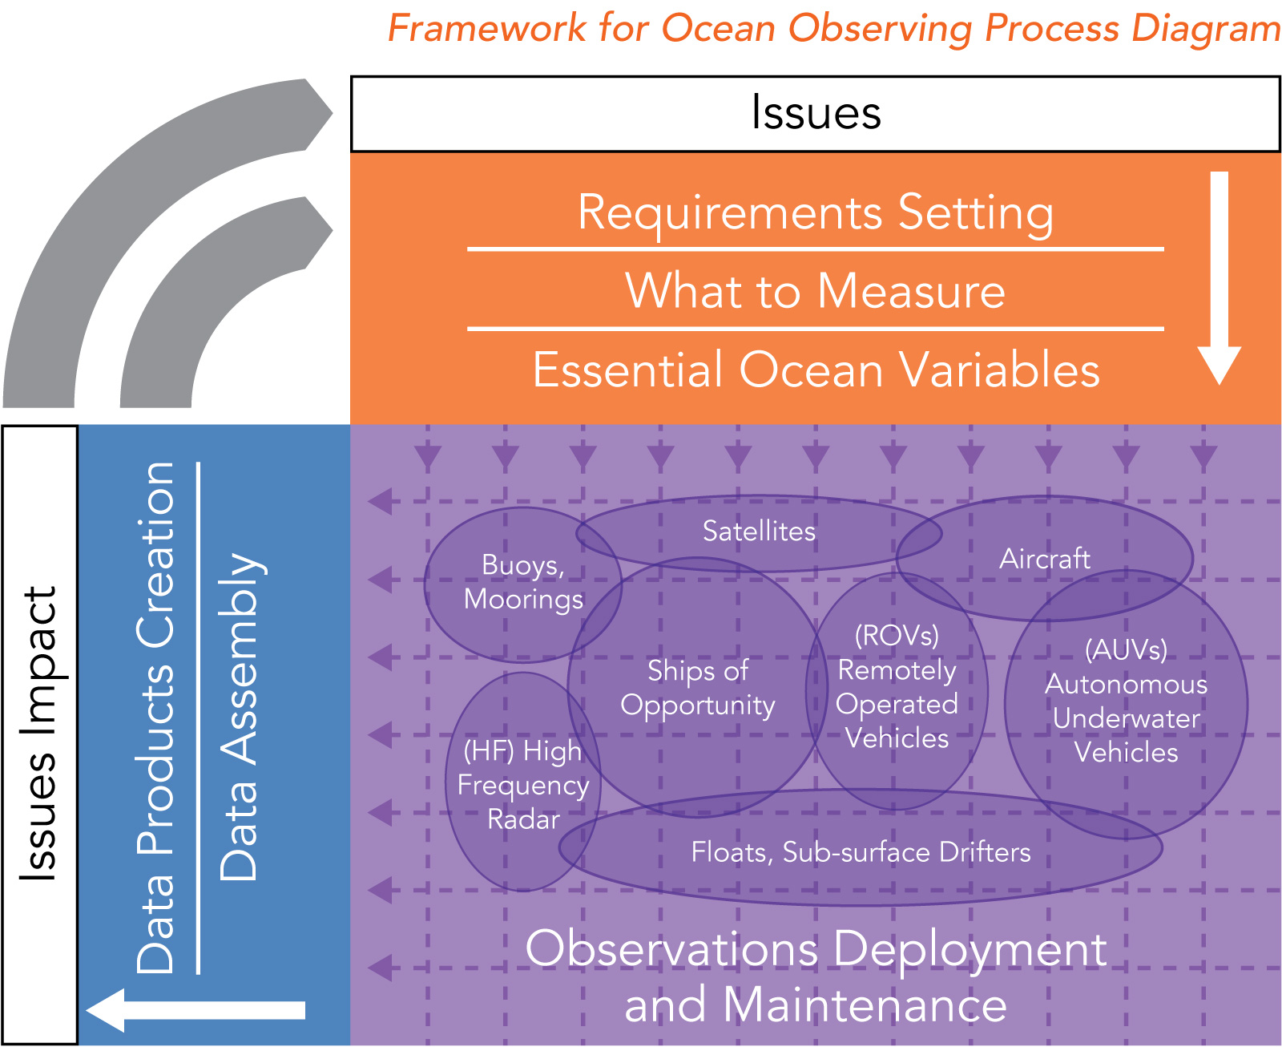
GOOS structures today
Sponsors: IOC/UNESCO, WMO, UN Envi, ICS
GOOS Steering Committee
Requirements & Evaluation
Physics & Climate (OOPC)
Biogeo-chemical Panel
(IOCCP)
Biology & Eco-systems (Bio/Eco)
Delivery of services to end users
Data & Information
Observations
Projects
Observations Coordination Group
GOOS Regional Alliances
TPOS 2020
ETOOFS
DOOS
AtlantOS
OceanOPS
links to IODE, WMO Information System
Observing networks
National systems
Notes:
Point out that this conceptual model against the Framework for Ocean Observing diagram is not perfect. BioEco is working hard to get EOV-based observing networks off the ground, GRAs work in the space of requirements, evaluation, and data; and the link with national observing systems and programmes needs to be developed.

Slide 7
Report on “Support Provided to Global and Regional Ocean Observing Systems”
Based on many interviews and additional research:
9 Recommendations
25 Findings
Suggest a roadmap for change
Recommendation 1 The GOOS community should reconsider its structure within the governance discussions, aligning GOOS uniquely with ocean observation activities, and recognizing a Global Ocean Information System and a Global Ocean Processing, Modelling and Forecasting System as the two other elements of a world ocean system.

Slide 8
GOOS structures tomorrow?
Recommendation 1 envisions a larger structure for the global ocean observing system that is logically built around the value chain of ocean observing, and mimics the structure of the provision of meteorological services by WMO.
At this point, the proposed structure see GOOS focusing on Observation-only system, and construction of additional Data and Modelling/Forecasting components
The architecture should include clearly delineated observation, information and data management, and production and forecasting elements and a virtual 'cloud of support' that ensured it operated effectively as a system, with effective connectivity internally and externally.
Notes:
BioEco is working hard to get EOV-based observing networks off the ground, GRAs work in the space of requirements, evaluation, and data; and the link with national observing systems and programmes needs to be developed.
this is put forward as needed to support the flow of funds - but that needs to be tested and discussed in an open forum;
although GOOS exists for obs, no 'global' organisation exists for modelling, services or data - this is quite fragmented and I am not sure I see how this will help bring the downstream elements together
the voice of more emerging OO nations is not well considered in the report. However, the important thing is to enable the discussion to happen about how to fund and govern a GOOS and what its boundaries in expertise might be and governance look like.

Slide 9
Hub-and-spoke model suggested
The study likened the present form to a hub-and-spoke model, with one hub arranged around GOOS, and secondary hubs and other centers of action located on the spokes.
The weakness of the spokes (poor connectivity) and the lack of clarity around the relative responsibilities of hubs blunted the effectiveness of the model.
The existence of multiple hubs without a full understanding of the interrelationships has led to a level of confusion.
One finding is: The present form of support arrangements for global and regional ocean observing systems lacked (?) authority, clarity and transparency, and its effectiveness and efficiency were determined to be unsatisfactory for many stakeholders.
Notes:
Point out that this conceptual model against the Framework for Ocean Observing diagram is not perfect. BioEco is working hard to get EOV-based observing networks off the ground, GRAs work in the space of requirements, evaluation, and data; and the link with national observing systems and programmes needs to be developed.

Slide 10

GOOS structures tomorrow?
Sponsors: IOC/UNESCO, WMO, UN Envi, ICS …
GOOS Steering Committee + Engagement board
Requirements & Evaluation
Themes - Climate, Marine Ecosystem Health, Operational Services
Physics & Climate (OOPC)
BGC
(IOCCP)
Bio/Eco
EOVs (physics, BGC, bio-eco)
Delivery of services to end users
Observations
Projects / Associated
Data & Information
Observing networks required to measure all EOVs per requirements
TPOS 2020
GTS/
Open GTS
DOOS
IPCC etc
ETOOFS
GDACs
OceanOPS
OCG
AtlantOS
WOA etc
OBIS
core
emerging
out of scope
GOA-ON
NWP etc
IODE
GRAs
National systems
GO2NE
on track
potential
in need
WIS
SOOS
Notes:
Point out that this conceptual model against the Framework for Ocean Observing diagram is not perfect. BioEco is working hard to get EOV-based observing networks off the ground, GRAs work in the space of requirements, evaluation, and data; and the link with national observing systems and programmes needs to be developed.

Slide 11
Possible Path forward:
Targeted discussions with the sponsors
Discussion with the SC, deciding on path forward
Report outlined three options:
Business as usual but reinforced.
An unknown structure arising from other governance discussions
A renovated and rejuvenated hub-and-spoke model
We note that the report suggest a road-map for option 3, and that this includes forming a group to manage the transformation.
Notes:
Point out that this conceptual model against the Framework for Ocean Observing diagram is not perfect. BioEco is working hard to get EOV-based observing networks off the ground, GRAs work in the space of requirements, evaluation, and data; and the link with national observing systems and programmes needs to be developed.

Slide 12
‘Zero draft’ Decision - starting point for the Steering Committee The SC thanks Neville Smith for his extensive and insightful report. GOOS core team elements at present cover observations, the interface to and from data systems, and operational ocean forecasting systems. The GOOS SC reaffirms the importance of integration of this value chain infrastructure, and also recognizes that each of those areas requires focused hubs of activity for coordination and partnership. Welcoming discussion around what to name each of these elements, [the SC suggests that the Global Ocean Observing System could be the umbrella world ocean system suggested in the report]. The SC decided to advance on three tracks: Lead the formation of a small team among stakeholders to guide the initial steps in a process of change (as suggested in Recommendation 9’s roadmap) Connected to this team above, form a task team of Steering Committee members and ‘superpartners’ identified in the Implementation Plan (WMO, IODE, OceanPredict, IOC) to examine the fitness-for-purpose of GOOS core team elements, identify alternate scenarios, and make recommendations on changes by April 2022, for GOOS Request the co-sponsors IOC, WMO, UNEP, and ISC to design individual or joint ways of examining and evolving their GOOS governance that would lead to improved advice and operational support to the co-sponsors, in consultation with the SC. [For IOC and WMO, the SC suggests the Joint WMO-IOC Collaborative Board could develop a joint approach to setting up a formally-mandated study group in 2022.] The SC asks that Actions 11.1-3 in the GOOS Implementation Plan be revised. The SC decided to incorporate as much as possible the other recommendations of the report into its Implementation Plan.

Slide 14

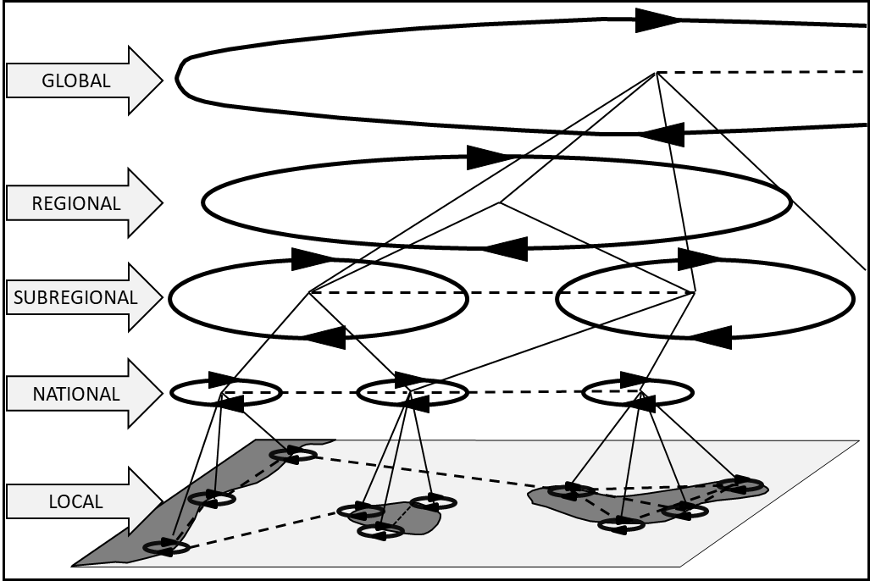
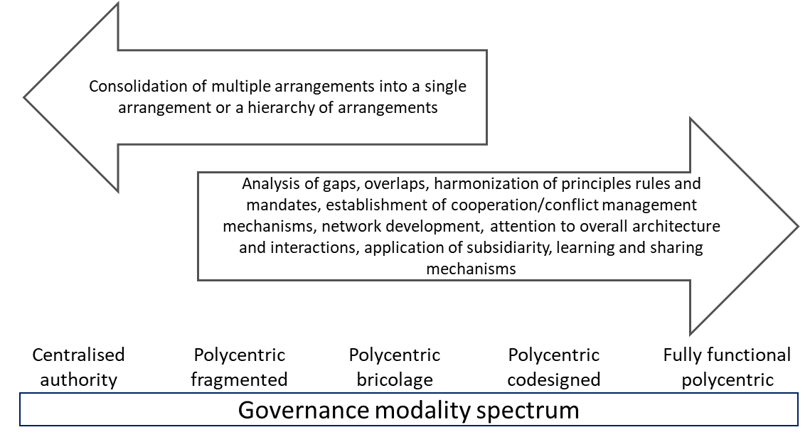
Multilevel Polycentric Governance
‘An important lesson is that simply recommending a single governance unit to solve global collective-action problems—because of global impacts—needs to be seriously rethought’ (Ostrom, 2010)
Notes:
This is possibly a better representation of „big“ GOOS with inceasing partnership
One way of looking at governance of a complex organization operating over different geographical scales and with many partners
Read out some of the bullet points

Slide 15
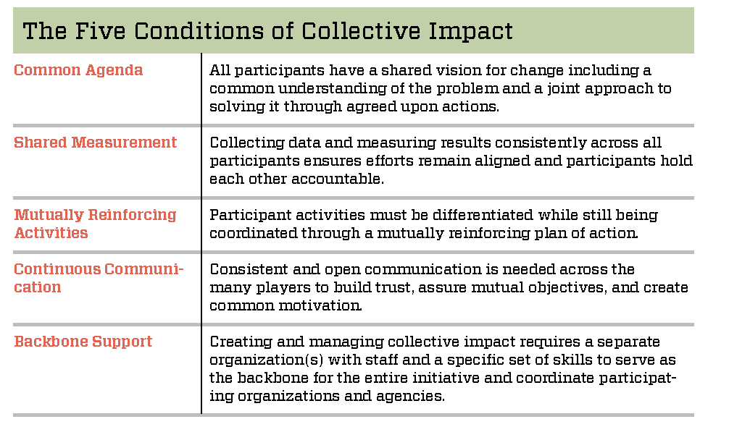
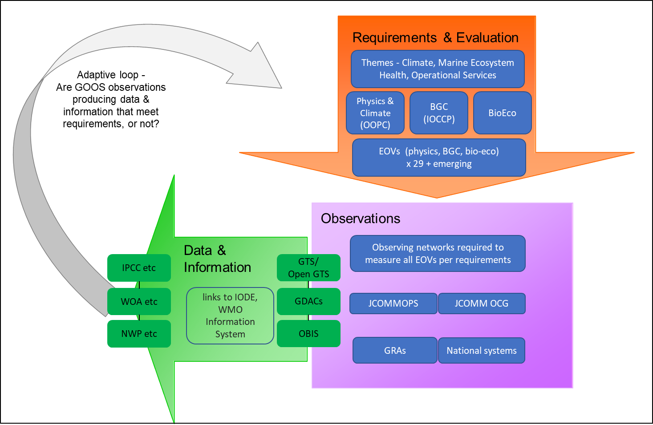
Collective Impact Organization
Hanleybrown et al., 2012, Weller et al., 2019
Any individual organizations could not do the work of collective impact without support from a “Backbone Support Organization”
Notes:
Collective impact organization – similar to “polycentric”
Can GOOS be the important Backbone Organization?

