Slide 1
Global Ocean Observation – core support on the environmental dimensions of SDGs Implications for GEMS, GPML, and the Science Policy Interface at large in UNEP’s MTS
UNEP’s Role in Sustained Ocean Observations and liaison with GOOS
Hartwig Kremer (hartwig.kremer@un.org)

Slide 2
Introduction
UNEP’s role as a co-sponsor and part of the GOOS Steering Committee:
Representation of interests and agenda setting (e.g. relevance of EOVs in UNEP’s Ocean mandate, and expanding to coastal dimension and climate adaptation/mitigation, Regional Seas)
Contributing to the SC composition and leveraging global expertise
Engaging GOO in UNEP’s Programme of Work and MTS (UNEA Mandates; Science Policy Interface)
Collaboration with GOOS e.g. in the co-design of GEMS/Oceans and ML Observation
Building on existing ocean monitoring/observation prioritize niche for GEMS/Oceans, avoid duplication!
Capitalize Essential Ocean Variables (under climate action, nature and pollution)
Bring in meaningful data to inform Natural Capital and Blue Economy aspects
Mobilize and visualize data/information to support the science-policy interface (GOOS/WESR)
Improve integrated management of the ocean and coastal zones – bridging freshwater dimension
GPA &GPML)
Regional
Seas
Green Deal
Oceans Decade
SDGs & Oceans Conference
Observation Community/GOOS
UNEA Mandate / MTS
Framing
WCMC GRID, TEEB
GEMS/OCEANS/Marine Litter – co-creation and Alliance approach
(UNEP value added and niche)
2
Notes:
UNEP is in preliminary discussions for a partnership at the science policy interface between Ocean Observations and implementation at scale of blue economy and other solutions. A co-design of Global Environmental Monitoring System which aims to convene an ocean monitoring and sustainability dialogue with partners in an outside the UN System to raise awareness and foster solutions (this follows roughly the model of the World Water Quality Alliance). UNEP is already engaged in the monitoring of freshwater (GEMS/Water) and air quality (GEMS/Air), an additional monitoring of oceans (GEMS/Oceans) will establish the links between the SDG 6, 14 and 3. Mutual agenda between GOOS and UNEP are among others in co-designing an innovative ocean monitoring that addresses key knowledge gaps and provides for actionable information, complementing a quite far developed but diverse space of ocean observation data.
UNEP is considering an innovative Global Environment Monitoring System for oceans and coasts as a critical complement to its portfolio of observatories. By drawing on available information from the variety of existing monitoring initiatives on national, regional and global scale and working closely across the UN and with the Earth Observation and global observing system communities the GEMS/Ocean shall in future also inform and enable action at scale. By focusing on climate action, nature and pollution action as stipulated in the UNEP MTS 2022-2025 substantial expertise can be accessed through existing programmes and activities within UNEP, including to build partnership to embrace the notion of maintaining and building natural coastal and ocean capital.

Slide 3
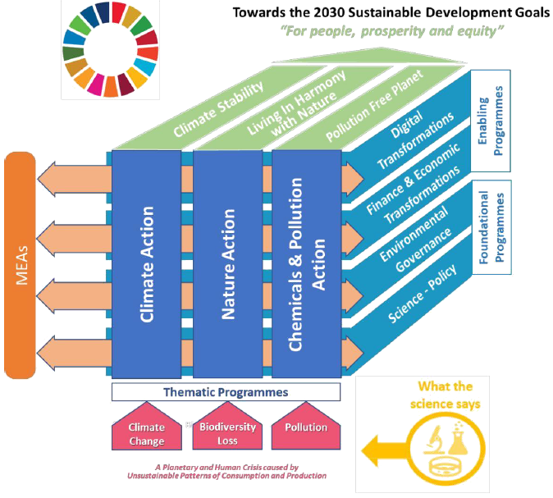
UNEP Medium Term Strategy (MTS) 2022-2025
3
Notes:
UNEP is considering an innovative Global Environment Monitoring System for oceans and coasts as a critical complement to its portfolio of observatories. By drawing on available information from the variety of existing monitoring initiatives on national, regional and global scale and working closely across the UN and with the Earth Observation and global observing system communities the GEMS/Ocean shall in future also inform and enable action at scale. By focusing on climate action, nature and pollution action as stipulated in the UNEP MTS 2022-2025 substantial expertise can be accessed through existing programmes and activities within UNEP, including to build partnership to embrace the notion of maintaining and building natural coastal and ocean capital.

Slide 4
Implications for Global Environmental Monitoring Systems (GEMS)
Which data from which source? Physics / BioGeo / Social / Cultural / EVs / Links:
Drivers
Responses
How will GEMS Support the UNEP MTS 2022-25:
Climate Action
Pollution Action
Nature Action
Which scale? (Info/Transform/Engage):
Global
Regional
Country
System (LME, catchment/Coast, shelf etc.
Which Audience?
All of society (Science/Policy/Civil Society (provate Sector Public Sector Culture Arts – Quintuple Helix)
To assess what kind of processes?
Environmental State and Change over time and space – towards transformational policy
(Governance across Nexus-dynamics, i.e. health – humans/ecosystems/food/natural capital stocks and flows, etc.)
Real-time visualization on WESR
4
Notes:
UNEP is considering an innovative Global Environment Monitoring System for oceans and coasts as a critical complement to its portfolio of observatories. By drawing on available information from the variety of existing monitoring initiatives on national, regional and global scale and working closely across the UN and with the Earth Observation and global observing system communities the GEMS/Ocean shall in future also inform and enable action at scale. By focusing on climate action, nature and pollution action as stipulated in the UNEP MTS 2022-2025 substantial expertise can be accessed through existing programmes and activities within UNEP, including to build partnership to embrace the notion of maintaining and building natural coastal and ocean capital.

Slide 5
Global Environmental Monitoring System & thematic observation
Services in –house / external
Climate Action
informing Transformation GEMS service
Nature Action
Nature-based solutions(NBS)
Ecosystem based Adaptation (EbA) Ecosystem based Management (EbM)
NBSAPs
Natural Capital Accounting (e.g. SEEA system)
Valuing Coastal and Ocean systems (e.g. WWDR2021)
Energy
Transport
Urbanisation
National Oceanography Centre (NOC) National Adaptation Plan (NAP) Nationally Determined Contributions (NDC)
Pollution Action
Circular economy/ Energy Transformation/ Food/ Waste Systems/Chemicals/Digitalization
Climate as Driver
Demo-graphy
Production/ Consumption/
Transport
Integrated Marine Debris Observation System (IMDOS / GPML)
5

Slide 6
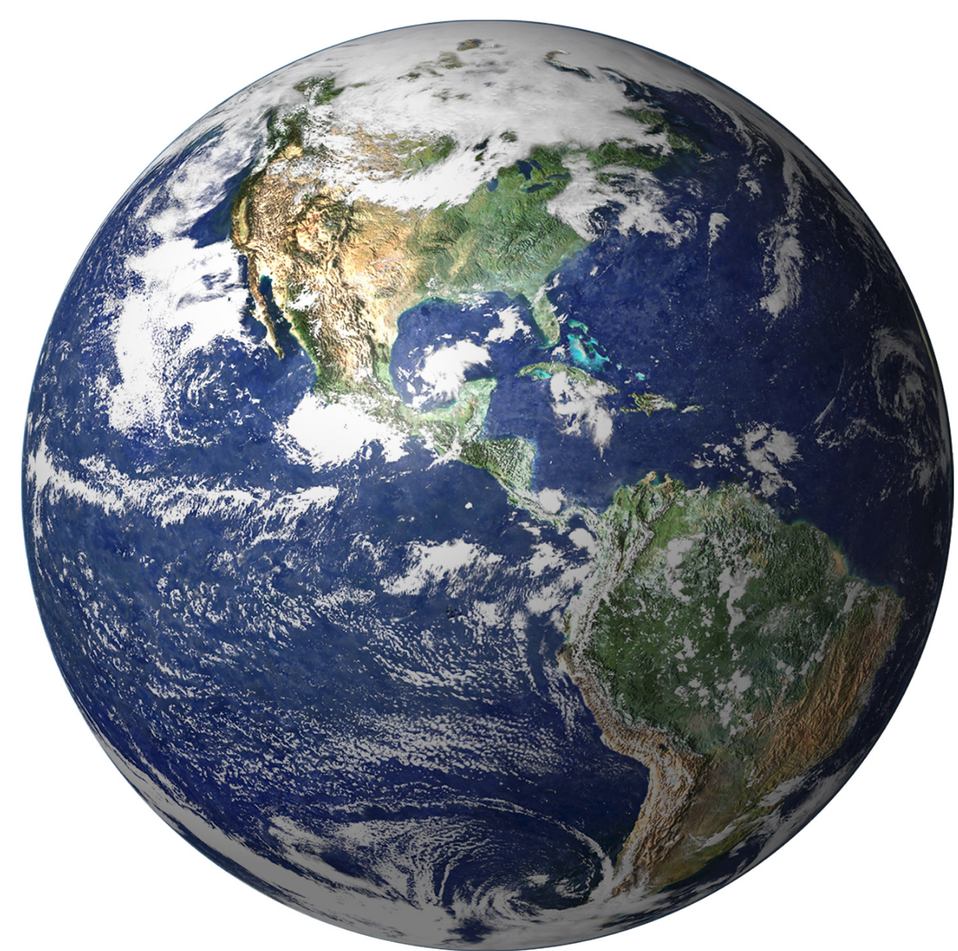
DECADE OF OCEAN SCIENCE FOR SUSTAINABLE DEVELOPMENT
In collaboration with IOC-UNESCO, UNEP supports the UN Decade on Ocean Science for Sustainable Development (2021-2030), e.g. through the World Environment Situation Room, WESR:
WESR strengthens the science-policy interface by providing governments and the public with visualized information on environmental state and pressures and by making this analysis accessible to policies for the environment and sustainable development.
WESR is currently piloting a dedicated space on oceans to showcase the work of UNEP and partners on ocean data, indicators and science. This space will focus on the following 3 issues:
Marine Plastics- GPML multi-stakeholder platform (link to IMDOS)
Nutrients
Ocean Acidification
WESR will be instrumental in visualizing the outcomes of the UN Decade on Ocean Science for Sustainable Development
Other in-house collaboration includes links between the Decade on Ecosystem Restoration and the Decade on Ocean Science
(WESR Link: https://wesr.unep.org/)
6

Slide 7
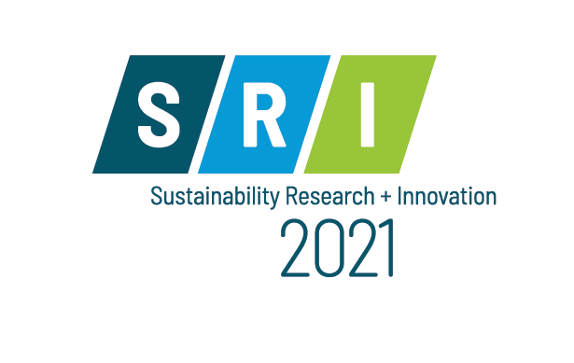
Thank you & join us in the co-design/partnership process of GEMS Oceans at SRI 2021(12-15 June) Brisbane/Cyberspace (https://sri2021.org/)
Hartwig Kremer / Science Division / Global Environment Monitoring System (GEMS) / hartwig.kremer@un.org
www.unep.org

