Slide 1
Reports from GOOS components GOOS Implementation Plan & Next Steps GOOS SC-10 Session
The Global Ocean Observing System
www.goosocean.org
Emma Heslop
GOOS Programme Specialist
GOOS Implementation Plan Task Team, Chanmi Kim
GOOS 10th Steering Committee meeting [online], April 2021

Slide 2
Why are we doing this?
Specific objectives:
Provide visibility across GOOS of action towards implementing 2030 Strategy
Enable priority setting, Steering Committee to ‘steer’ / adjust direction
Enable gap filling, including through partnerships
Create cohesive cross-GOOS actions
Understand interdependencies, and use GOOS resource more effectively
Identify resource needs and target fundraising activity against action/impact
Identify and tackle any barriers to GOOS ability to execute
Support dialogue with partners about roles, where fit in achieving the Strategy
Track progress towards achieving the Strategy, milestones and output
Provide visibility of how GOOS is responding to societal needs – action impact
Integrate/represent Decade Programmes, GOOS Projects
– re-iterate - it’s a process

Slide 3
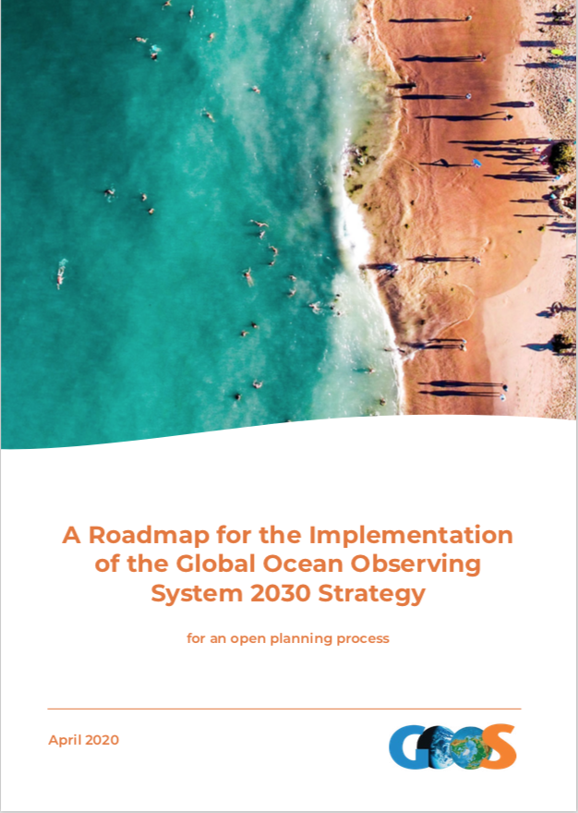
Next steps from GOOS SC-9 part 2
Oct-Dec 2020 focused calls to refine/work on actions, integrate Decade and projects, assess gaps
Dec 2020 analysis outputs/impacts, discuss assessment towards SOs/impact, understand how Decade integrated
Consider hire of additional support for cross-GOOS actions (Covid-19 savings)
Jan 2021 Review Draft plan and work on gaps, priorities, resource, structure, SWOT
March 2021 Implementation Plan available for SC review with suggestion for process
GOOS Implementation Plan
April 2021
5 year Outlook
Implementation Plan Task Team: increased through the process!
Anya Waite, Toste Tanhua, Prof Karnawati, Pierre Bahurel, Kim Currie, Gabrielle Canonico, Nic Bax, Venkat, David Legler, Veronique Garcon, Sabrina, Speich, Weidong Yu, Belen Martin Miguez, Maciej Talzweski, Mathieu Belbeoch, Denis Chang-Seng
Notes:
5 Team meetings - November to April 2021, extra specific element meetings
Looking across actions, merging, integrating, clarifying, analysis
Considering integrating Decade Programmes
Quantifying resource needs
Software for action management
>> Webinar reported out on this analysis
>> today have time for discussion

Slide 4
5 Team meetings - November to April 2021, extra specific element meetings
Looking across actions, merging, integrating, clarifying, analysis
Considering integrating Decade Programmes, GOOS Projects
Quantifying resource needs
Software for action management
>> Webinar and report more on this analysis
>> today highlights and time for discussion

Slide 5
Analysis across actions - SOs
Strategic Objectives | No. Actions | Actions by Year |  |  | Review | Level
 |  | Year 1 | Year 3 | Year 5 | hi importance 2019 | major | multi | single | Decade
SO1: Partnerships to improve delivery | 2 | 1 | 1 | 0 | * | 1 |  | 1
SO2: Build advocacy and visibility with stakeholders through communications | 4 | 1 | 2 | 1 | * | 3 |  | 1
SO3: Regularly evaluate system impact to assess fit for purpose | 7 | 1 | 2 | 4 |  | 2 | 2 | 2 | 1
SO4: Strengthen knowledge and exchange around services, boost local uptake | 2 | 1 | 1 | 0 |  |  |  | 2
SO5: Provide authoritative guidance on integrated observing system design | 6 | 1 | 4 | 1 |  | 1 | 5
SO6: Sustain, strengthen and expand observing system implementation | 11 | 0 | 6 | 5 | * | 1 | 5 | 4 | 1
SO7: Ensure GOOS ocean observing data and information are FAIR | 9 | 1 | 5 | 3 | * |  | 2 | 7
SO8: Support innovation in observing technologies and networks | 2 | 1 | 1 | 0 |  |  |  | 1
SO9: Develop capacity to ensure a broader range of stakeholder participation. | 10 | 1 | 3 | 6 | * |  |  | 9 | 1
SO10: Extend systematic observations to understand human impacts | 2 | 0 | 1 | 1 |  |  | 1 | 1
SO11: Champion effective governance with partners and stakeholders | 3 | 0 | 2 | 1 |  | 3
Totals | 58 | 8 | 28 | 22 |  | 11 | 15 | 28
58 actions
Next priorities for work – SO1 Delivery partnerships and SO2 Advocacy and Comms
Work in some SOs – SO7 Data, SO9 Capacity Development
Increase in major x-GOOS and multi element actions

Slide 6
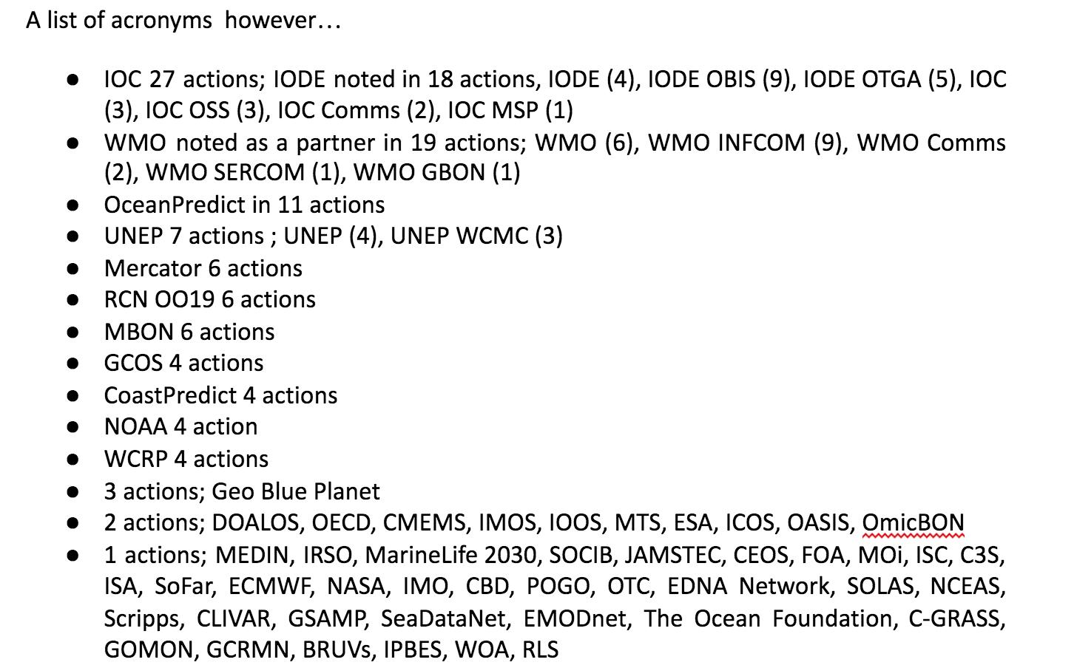
Partners
58 different partners identified, 22 more active partners >1 action
Superpartners - featured in many actions, WMO, IODE/IOC, OceanPredict - need a strategic link
Satellite community are referenced, no strategic overview

Slide 7
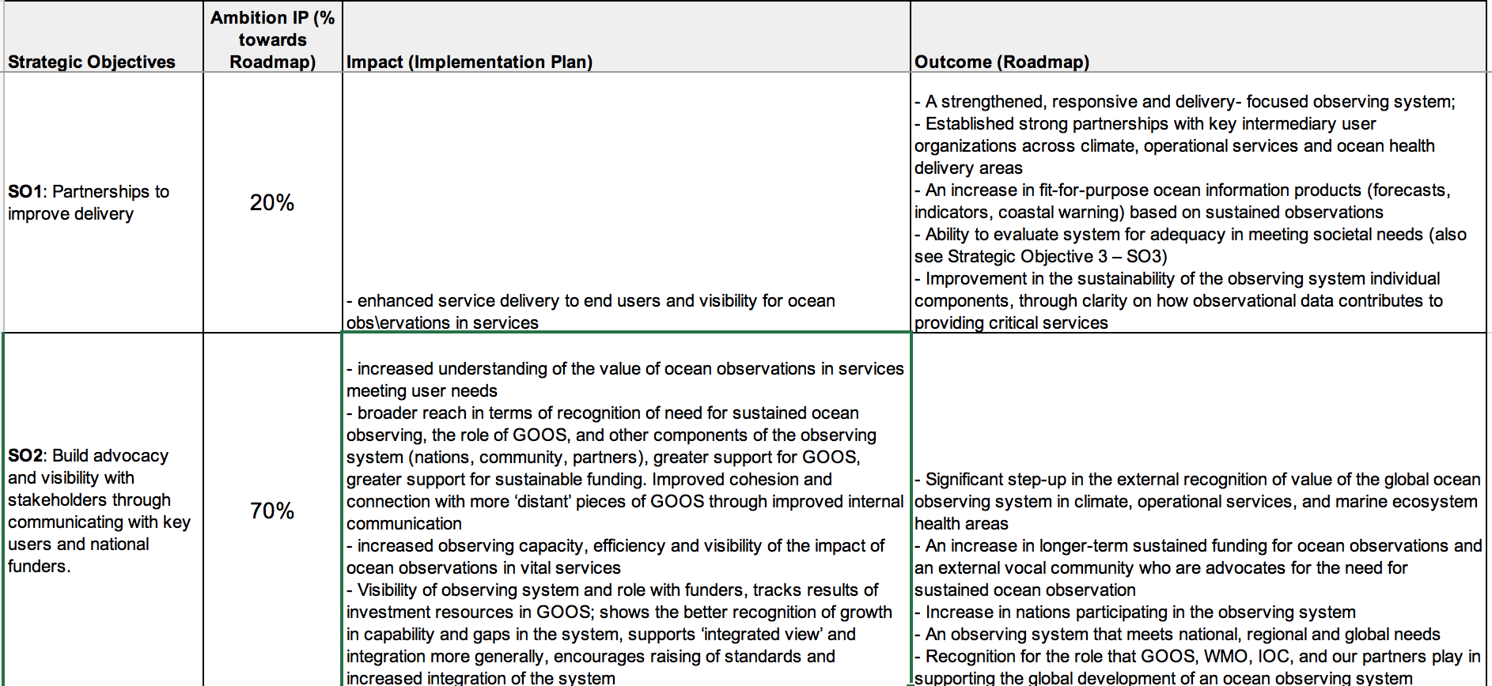
Analysis impact
So far ‘bottom up’, with impacts look ‘top down’, where are we in terms of our ambition? Does the impact match the anticipated outcomes as put forward in the Roadmap?
SO1, SO4, SO9, SO10 and SO11 appear to be lacking in ambition
SO6 looks a little underpowered
SO2, SO3 and SO7 appear to hit a number key outcomes
But mpact statements need work
Notes:
Caveat – early work – qualitative

Slide 8
Core GOOS support today
GOOS Element | FTEs | Funding source | Location
Core Coordination | 2.65 | IOC | Paris, France
OOPC | 1.00 | NOAA | Geneva (WMO hosted), Switzerland
BGC Panel | 2.00 | NSF, SCOR, EuroSea, IOC | Sopot, Poland
BioEco Panel | 1.00 | CSIRO, AIMS, EuroSea, IOC | Hobart, Australia
IODE/OBIS | 0.10 | IOC | Oostende, Belgium
OCG | 0.65 | IOC, WMO, NOAA | Paris, Geneva (WMO), Washington DC, USA
Networks | 0.35 | IOC, WMO, NOAA | Paris, Geneva (WMO)
OceanOPS | 6.00 | National contributions and projects | Brest, France
ETOOFS | 0.25 | IOC | Paris, France
GRAs | 0.25 | IOC | Paris, France
Total | 14.25
Most GOOS elements appear profoundly under resourced
OceanOPS is one of the largest components in terms of FTEs, it is an operational centre
GOOS has support in funding and in-kind from a number of sources - this should be formally recognised
Notes:
OceanOPS - WMO will fund a new leadership position, NOAA a metadata - OceanOPS total to 7 FTEs and GOOS FTE total to 15.25 by September 2021.

Slide 9
Implementation Plan – support needs by SO
Resource by SO | 2021 | 2022 | 2023 | 2024 | 2025
SO1 | 0.5 | 1.2 | 3.1 | 3.1 | 3.1
SO2 | 0.3 | 2.5 | 2.5 | 1.5 | 1.5
SO3 | 2.0 | 2.4 | 1.9 | 1.9 | 1.9
SO4 | 0.0 | 0.0 | 0.3 | 0.0 | 0.0
SO5 | 1.0 | 1.0 | 2.0 | 1.0 | 1.0
SO6 | 1.0 | 3.5 | 5.0 | 2.5 | 2.5
SO7 | 0.5 | 2.4 | 2.4 | 1.7 | 1.7
SO8 | 0.3 | 0.3 | 0.0 | 0.0 | 0.0
SO9 | 1.0 | 1.8 | 2.3 | 2.3 | 2.3
SO10 | 1.0 | 2.0 | 2.0 | 0.5 | 0.5
SO11 | 0.0 | 1.0 | 1.0 | 2.0 | 2.0
Total | 7.5 | 18.0 | 22.5 | 16.5 | 16.5
7.5 additional FTE needed by the end 2021, doubling by end of 2022, 22.5 FTE in 2023
The human resources dedicated to GOOS core work will need to increase by 260% in 2 years
New locations IODE OBIS and Mercator, many staff could potentially work remotely
SO8 and SO4 will need some additional focus
SO6 has many actions, and peaks at 2023 and then declines

Slide 10
Additional resources $
Additional resource needs in $
Travel/Other
2021 | 2022 | 2023 | 2024 | 2025
It is clear that GOOS will need to undertake some serious fundraising in order to fulfill its intentions.
The Task Team discussed the resource and was in favor of putting forward a clear and well justified ‘big ask’
The GOOS Ocean Decade Programmes could cast a shadow over the needs of GOOS in the Implementation Plan
GOOS will need to ‘ask’ for both GOOS Implementation and Ocean Decade, integrating the support and initial projects within the IP may be one way
435,000$ | 275,000$ | 165,000$ | 200,000$ | 115,000$
Decade resource needs in $
The GOOS Ocean Decade programmes need 582,120,000$ across 10 years. CoastPredict only provided costs for the coordination office - so this is likely much higher, perhaps of order $8 million.
IOC funding
Years | $ biennial | % travel
Previous | $464,994.00 | 80%
2020-2021 | $435,000.00 | 0%
2022-2023 | $291,450.00 | ???

Slide 11
SWOT – Big ‘ask’ for resources
Strengths Visible Get the conversation out there - what it will take to make a difference (similar to Decade idea) GOOS has some control over the message Coherent with the governance discussions - coherence | Weakness No one entity to ‘ask’ (positioning only?) Cannot be just for advice - needs to be for infrastructure* What is the structure for this ‘ask’, what am I investing in? Planning is one thing - asking is another - there will be adjustment through dialogue - need to be prepared for and to support this process i.e. need resource to engage in the process of the ‘ask 'negotiation/dialogues Ocean Decade ‘asks’ can cast a shadow over broader GOOS infrastructure needs
Opportunities Message that funding needs to be more cross government, environment, transport, etc. than just science research funded - different ‘ocean’ commitment Message that the ask is big because it is seriously important Ask but be prepared to be opportunistic in securing - funding for packages/ in nation investments Offeri recognition of support Hire expertise to help craft this Change to more operational (seen by some as an opportunity) | Threats GOOS ‘ask’ could cast a shadow over our implementation base - GOOS big ‘ask’ in competition (see opportunities.. shift dialogue). Need to position our ‘ask’ with awareness Change to more operational (seen by some as a threat)

Slide 12
Conclusions & Recommendations for SC-10
Priorities for GOOS implementation:
Increase focus and resource for SO1 Partnerships for delivery:
Increase focus and resource for SO2 Communications:
GOOS Projects represented, plus description of aim/role in GOOS
SO7 Data work to connect the many single actions, a more strategic approach
SO9 Capacity Development review the number of long term plans, single elements, and address the gap between impact and Roadmap outcomes, perhaps partnership
SO4 Services and local uptake, and SO8 New Technology review long term plans
SC10 Human impacts - GOOS cannot undertake this alone, need plan for partnership actions
Assess the gap between impact and outcome where this is large
Integrate the Decade Programs with the Implementation Plan, the support is not yet visible
Assess boundaries of GOOS value vs. successful partnership. Can actions be better undertaken in/or by partners? Should GOOS stretch to fill all gaps or work with partners, GOOS role as a catalyst?
Revise Roadmap in 2022, more inclusive of forecasting, partner roles, tracking impact

Slide 13
Conclusions & Recommendations for SC-10
Resources:
Communicate on the big ‘ask’ to potential funders, sponsors
Employ support for fundraising
GOOS will need to work to be ‘investable’, this may involve; a clear structure, defined timelines and outcomes, trust in the teams ability to execute, accountability and governance
Nations may find it easier to invest nationally and so GOOS may need to consider what this could look like, e.g.‘centres of excellence’ for aspects of the plan, project management
Staff that can work ‘anywhere’ could be provided in-kind, additionally brings leadership training, capacity development, and connecting countries to GOOS activities

Slide 14
Conclusions & Recommendations for SC-10
Review GOOS structure:
BioEco network, data and metadata development resource needs, how does this scale? Is the infrastructure sufficient? Do we need to signal with BioEco OCG, Super OCG, BioEco OceanOPS, OceanOBIS?
Focus point/structure is needed to lead SO7 Data and data interface
Focus point/structure is needed to manage modelling interface (ETOOFS?)
Recognise the support GOOS receives for its core work
Assess roles, responsibilities and interplay between regional bodies (GRAs/Projects), and national bodies (NFP, National Systems, IOC) – GOOS SC special topic meeting?
Focus point/structure is needed for oversight of superpartners with multiple connections
SC members consider designated interest areas or SOs, in seeking funding

Slide 15
Conclusions & Recommendations for SC-10
Management process:
Implementation Plan Task Team persists, start work on priorities
Regular (bi-monthly?) meetings of the Implementation Plan Task Team
discuss cross-GOOS actions
review for specific SOs
bring larger decisions to the GOOS SC
GOOS invests in project management online software tool so actions in this document are placed where GOOS elements can access and update, tracking and analysis can be undertaken
Report out regularly (6 months) to GOOS SC
Evolve the Plan and Roadmap

Slide 16
Questions, comments, ideas…

