Slide 1
Chair - Brad deYoung - Memorial University (Canada)
Steering Committee: M. Visbeck (Germany) l S. Speich, P.Y. Le Traon (France) l J. Snowden (U.S.) l N. P. Holliday (United Kingdom) l T. Lamont (South Africa) l L. Cotrim (Brazil) l I.S. Pinto (Portugal) l M.P. Chidichimo (Argentina)
Coordination Team: S. Ketelhake (Germany) | A. Zinkann (U.S.)
#AtlantOS
Notes:
The AtlantOS program offers a service for the community to act as a forum for exchange and aligning interest in thematic scopes
We work at the basin scale to enhance existing activities – so we are building upon past success
One key goal is to achieve true sustainability – by collaborating with countries, and other global initiatives and institutions like GOOS
Want to fully realize the value chain of the FOO (adapted to AtlantOS)
Seek to fully meet users needs (active not static process)

Slide 2
Value-added and Goals of AtlantOS
Using lessons learned from the AtlantOS Project and its collaborations to plan research, observing and monitoring strategies
Ensuring and expanding link between ocean, atmospheric, and environmental observation communities and existing efforts to this basin-wide phenomenon
Using existing international data platforms (like GEOSS) promoting FAIR principles
Demonstrate value of information derived from ocean observations through contribution to international activities like UN Ocean Decade
Establish a basin-scale ocean observing system framework and promote community of practice on basin-scale
Co-evolve with GOOS and others to ensure co-design and sustained observing
For further information please take a look at a more detailed presentation here (Webinar April 21, 2021)

Slide 3
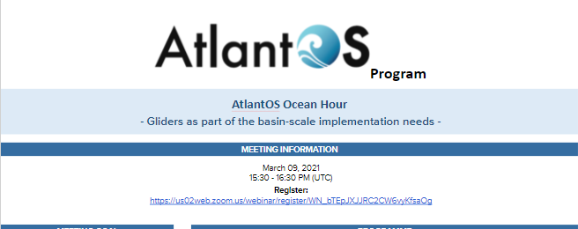
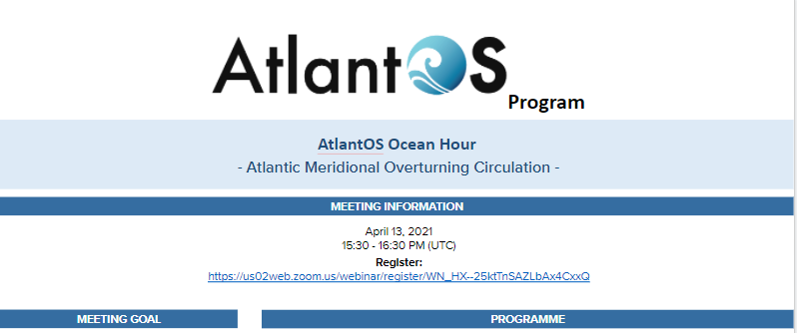
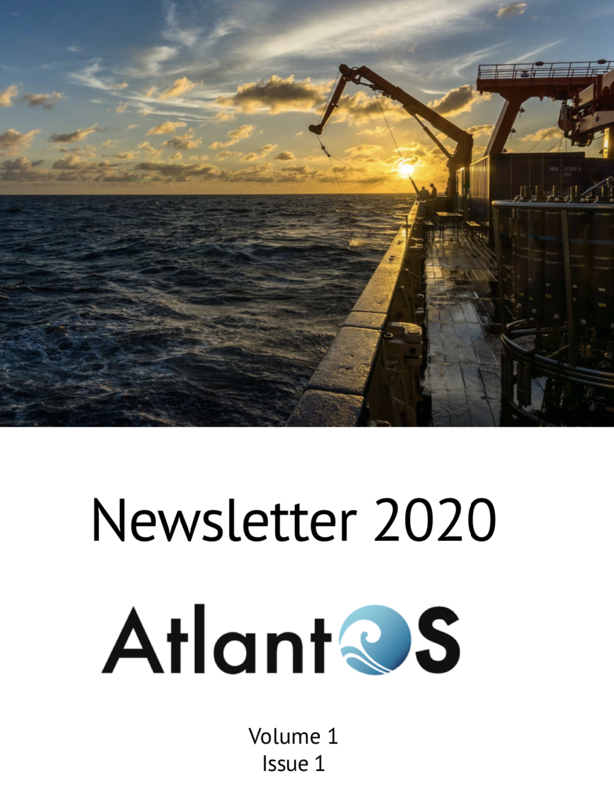
5 year ambition and current activities
Increased engagement and connection with national & regional initiatives e.g. GOOS networks, CIOOS, IOCARIBE of IOC-UNESCO, PIRATA, TAOS
Governance and implementation by December 2021
Turnover plan for Steering Committee, Open call for new membership, Regular reporting requirements
Roadmap development – by February 2022
Communications: AtlantOS Ocean Hour, Quarterly Newsletter
Event: All-Atlantic 2021 Side Event, DOOS Scoping Workshop, Townhall OSM 2022
Notes:
Engage with national regional supporters e.g. CIOOS, USIOOS, EuroGOOS and EOOS, IOC Caribe, PIRATA, TAOS, SAMOC and other South Atlantic activities -
Connect and support Atlantic implementation of GOOS networks – Argo, Ocean Gliders, OceanSITES, VOS and others
Governance and implementation by December 2021
Turnover plan for Steering Committee, Open call for new membership, Regular reporting requirements
Roadmap development – by February 2022
Establish process to design fit for purpose observing system

Slide 4
Connections with GOOS
AtlantOS will support the implementation of the GOOS 2030 Strategy in the Atlantic
Optimizing the design of the observing system
Facilitate the sharing of platforms
Enhance co-benefits of the GOOS networks in the Atlantic
Support the GOOS ambitions for the UN Ocean Decade
Realizing the Value Chain
Connecting with stakeholders
Contribute use cases and best practices in the Atlantic to the global scale
Notes:
Why should AtlantOS be a project of GOOS?
Plans to directly contribute to GOOS and needs for basin scale implementation
GOOS and AtlantOS have shared goals and aspirations
Official accreditation with GOOS will raise the visibility of AtlantOS and enable access to other actors and entities
Creates transparency for the roles and actions of both AtlantOS and GOOS in the Atlantic

Slide 5
Additional Slide
AtlantOS

Slide 6
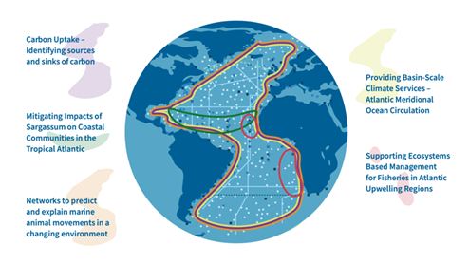
Thank you for listening … questions?
Improving international collaboration in the design, implementation and benefit sharing of ocean observing,
Promoting engagement and innovation in all aspects of ocean observing,
Facilitating free and open access to ocean data and information => Digital-Twin Ocean
Enabling and disseminating methods of achieving quality and authority of ocean information,
Strengthening the Global Ocean Observing System (GOOS) and contribute to GEO Blue Planet Initiative,
Contributing to the Galway and Belém Statements on Atlantic Ocean Cooperation

