Slide 1
April 2021
GOOS SC-10
Emma Heslop
Chanmi Kim
Kevin O’Brien
Mathieu Belbéoch
Long Jiang
Victor Turpn
OCG Data Mapping

Slide 2
OCG Data Mapping
From GOOS SC 9 (2020):
Question: How can we collectively map data flows from GOOS to IODE and other data systems?
Action: OCG to begin mapping data flow from OCG networks
OCG Data Mapping (OCG Exec, OceanOPS, Ms. Chanmi Kim)
Developing basic mapping from the OCG network perspective
Have identified the data contacts from each network
Including structures such as GDACs/DACs
Identify where QC (near-real time, delayed mode) is implemented
Identify route into the global data distribution systems (GTS, data products, etc.)
Notes:
The Data mapping effort is part of the data strategy and metadata harmonization efforts

Slide 3
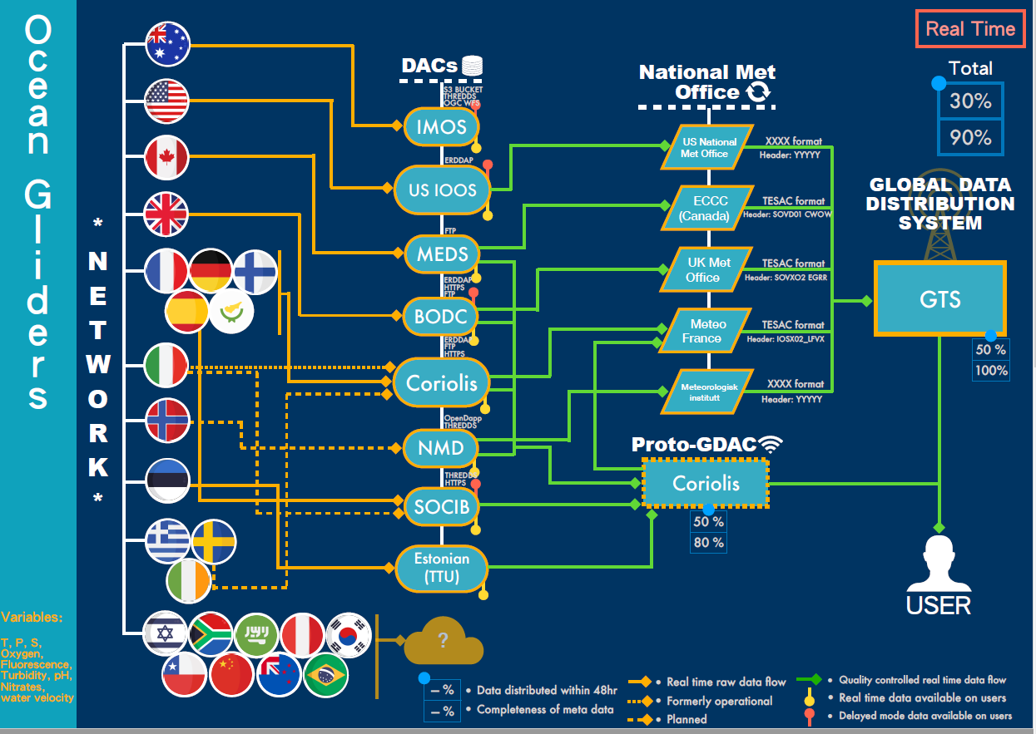
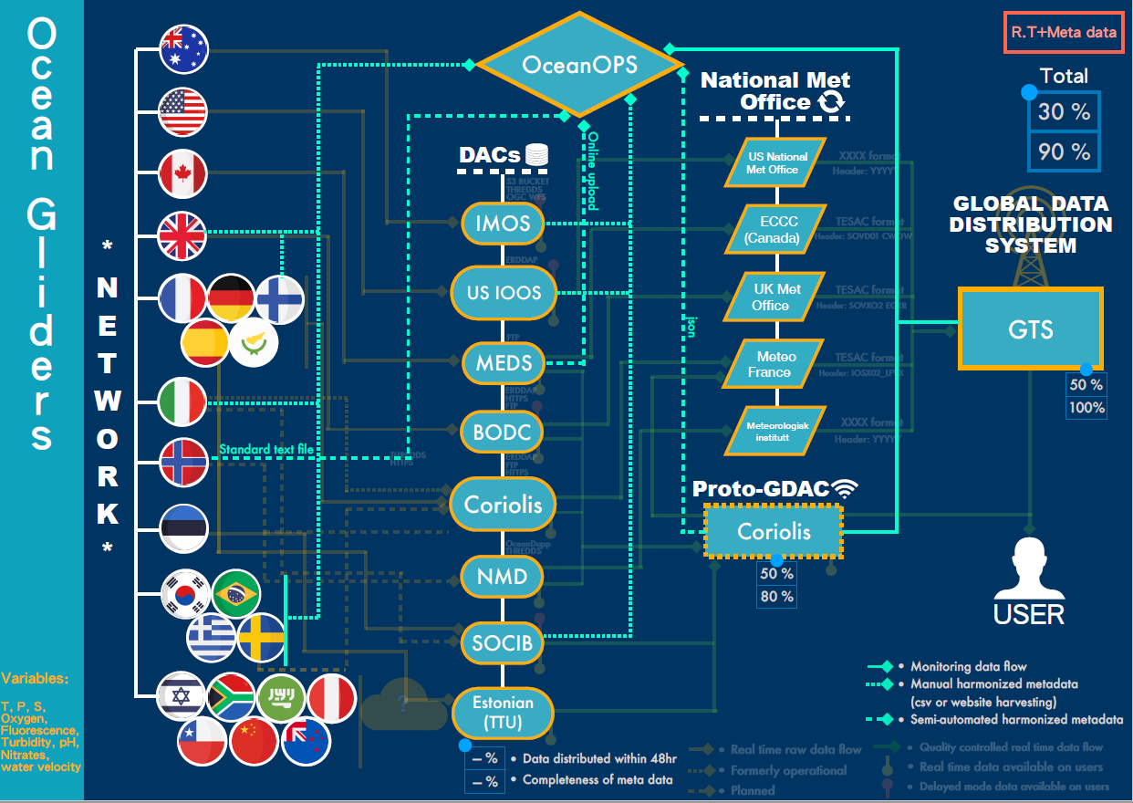
OCG Data Mapping - Example Ocean Gliders

Slide 4
OCG Data Mapping: Status and Next Steps
Have completed first draft of mappings for:
Argo, DBCP, OceanGliders
SOT, GO-SHIP, OceanSITES soon to follow
Will work with AniBOS, HF Radar, GLOSS
OCG provide completed drafts to networks for comment and then discuss at the OCG Data and Metadata workshop (May 10)
OCG will also work with IODE and WMO to extend mapping beyond just OCG scope
Benefits of the data mapping:
Identify gaps in data/metadata flow and recommended best practices
Identify potential efficiencies to improve metadata and data access, discovery and use (to be documented in OCG data strategy)
Identify areas of coordination opportunities with WMO and IOC/IODE
Develop more useful data KPIs for delayed and near-real time data
Notes:
The Data mapping effort is part of the data strategy and metadata harmonization efforts

