Slide 1
Agenda Item 9 Communications
The Global Ocean Observing System
www.goosocean.org
F. Collins
GOOS 10th Steering Committee meeting [online], April 2021

Slide 2
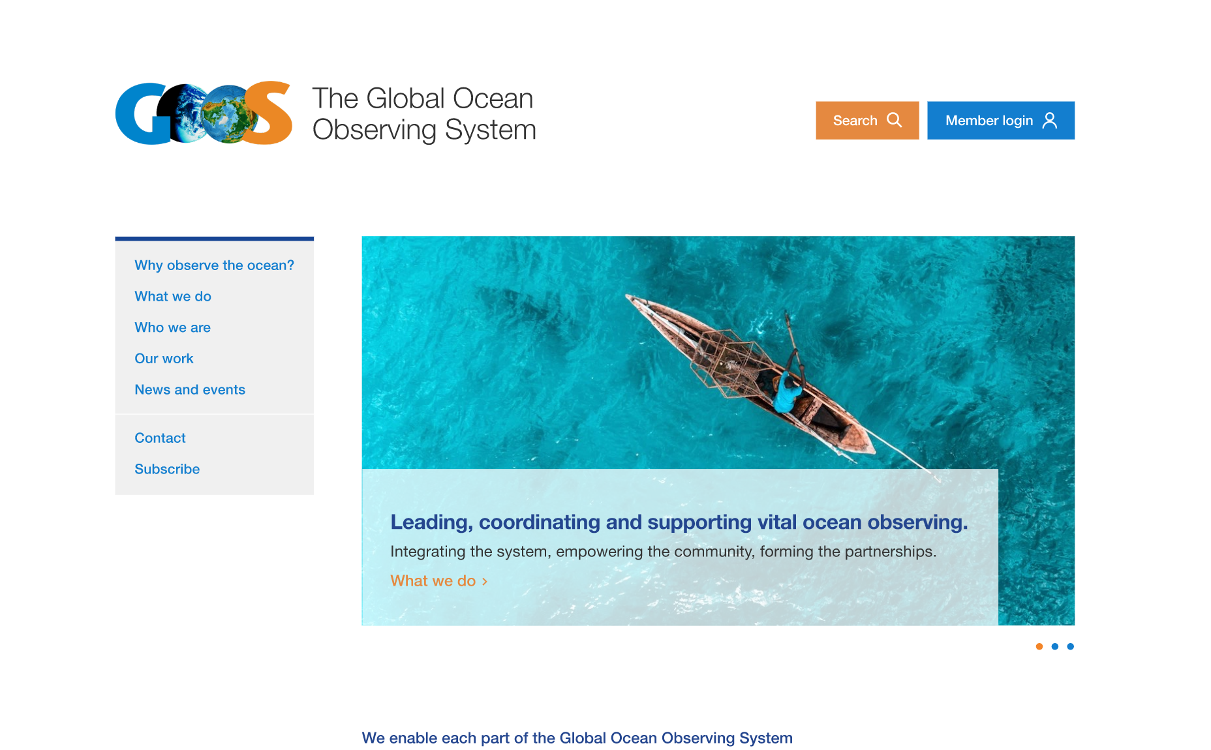
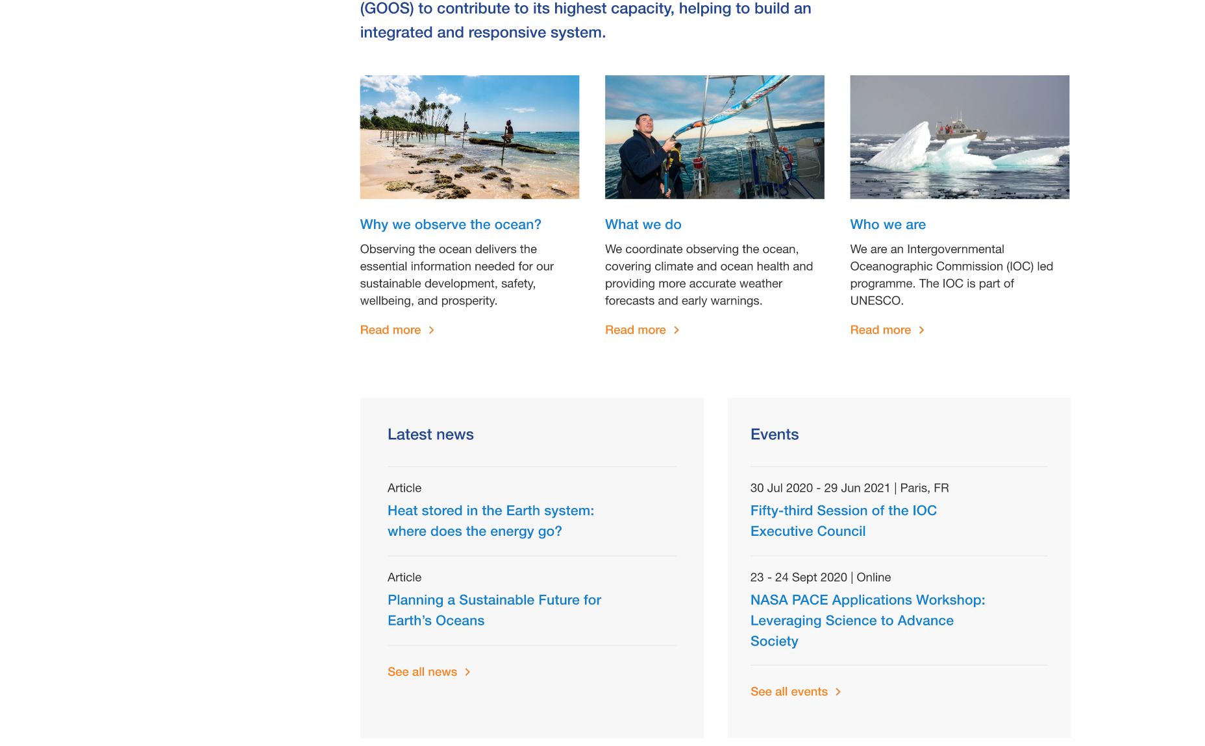
Achievements since GOOS SC-9 (1/2)
Successful completion of tasks underway and launching of new initiatives agreed to at SC-9
Website Revamp
- Refreshed visual identity, copy and navigational layout - To launch when imagery finalized and server-side IT issues resolved - Confident it will make GOOS – both the global system and the Core Team - more easily understandable to a wider range of audiences

Slide 3
Achievements since GOOS SC-9 (2/2)
Successful completion of tasks underway and launching of new initiatives
User Stories
- Close to finishing the planned 6 (Examples: Decadal Hurricane Forecasting with UK Met Service, Improving Fish Finding in India with INCOIS) - Use on website and elsewhere (e.g., working with the IOC comms to highlight in the monthly newsletter) - Potential media traction (e.g. agency to pitch to The Economist World Ocean Initiative)
Short term incremental goals proposed at SC-9
- Decade programme branding - Communications around the OceanOPS Report Card - Vendée Communications

Slide 4
Ongoing Communications Work
Creation of quality, relevant content and capitalizing on our channels to share and amplify
Webinars
49 recordings on our dedicated GOOS YouTube channel
OCG series around capacity
BSTT are underway
Briefs & Press Releases
COVID & Ocean Observations: Large ripple effect
Vendée Globe 2020: Most popular tweet, wide audience
Maersk committing ships for observations: Picked up in industry press, WMO
OceanOPS report: WMO multiplier of this work
Online Presence/Amplifiers
- Twitter (4909 followers) - Facebook (579 followers) - Mailing list (1,532 subscribers) - IOC online channels

Slide 5
What’s Next?
Moving forward with plans and projects in a timely manner
Communications Plan
- Engaging external consultant to work on communications projects, learn, and define an ongoing plan - Support the strategy with appropriate communications & engage clearly defined major stakeholders - Development of metrics
National Focal Points
- Task Team established - ToR under review for update - Should be part of developing communications and plan
OECD Valuation project
- Quantifying the use of the data we collect, quantifying the value and impact of what we do - Engaging external consultant to develop suitable valuation methods - Communications opportunity provided by the report and future work

