Slide 1
GOOS National Focal Points Update
The Global Ocean Observing System
www.goosocean.org
Emma Heslop Programme Specialist IOC/UNESCO GOOS
Based on discussions and work with Albert Fischer, Director GOOS Programme, Glenn Nolan, Section Manager Oceanographic and Climate Services, Marine Institute, and the GOOS Steering Committee
Notes:
observations, but also the outlook and mitigation

Slide 2
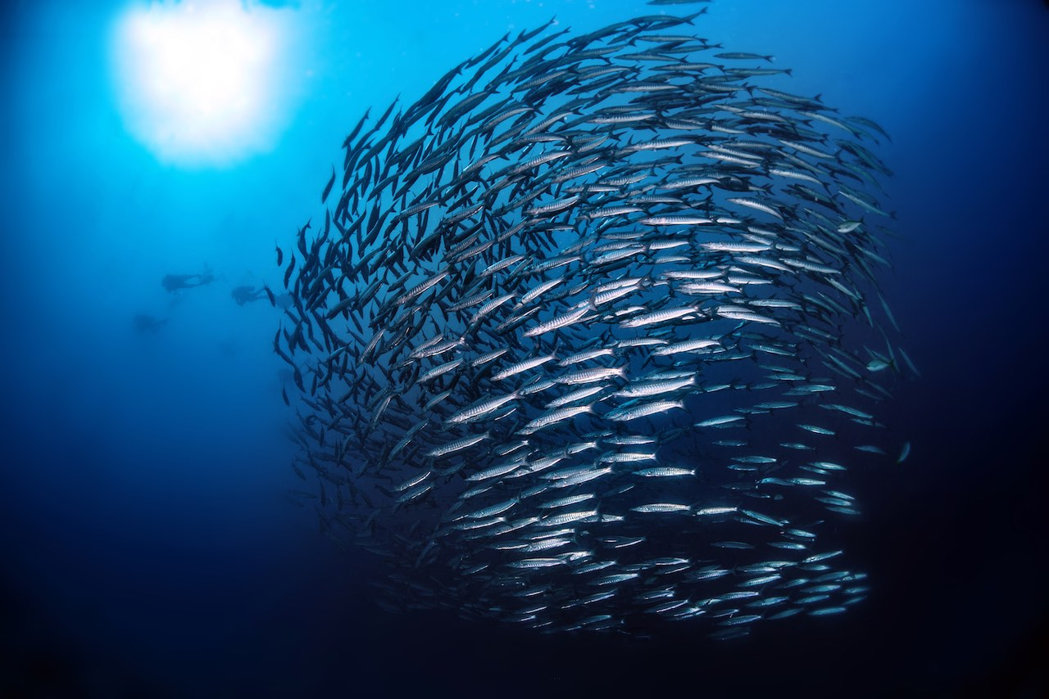
GOOS National Focal Points – background
Letter requesting nominations June 2017 to IOC national coordinating bodies
GOOS National Focal Point ‘will be a focal point for communication between the GOOS Programme and the national organisations and individuals involved in your Member State's sustained ocean observing system infrastructure for research and/or operational needs’
To date role not well implemented

Slide 3
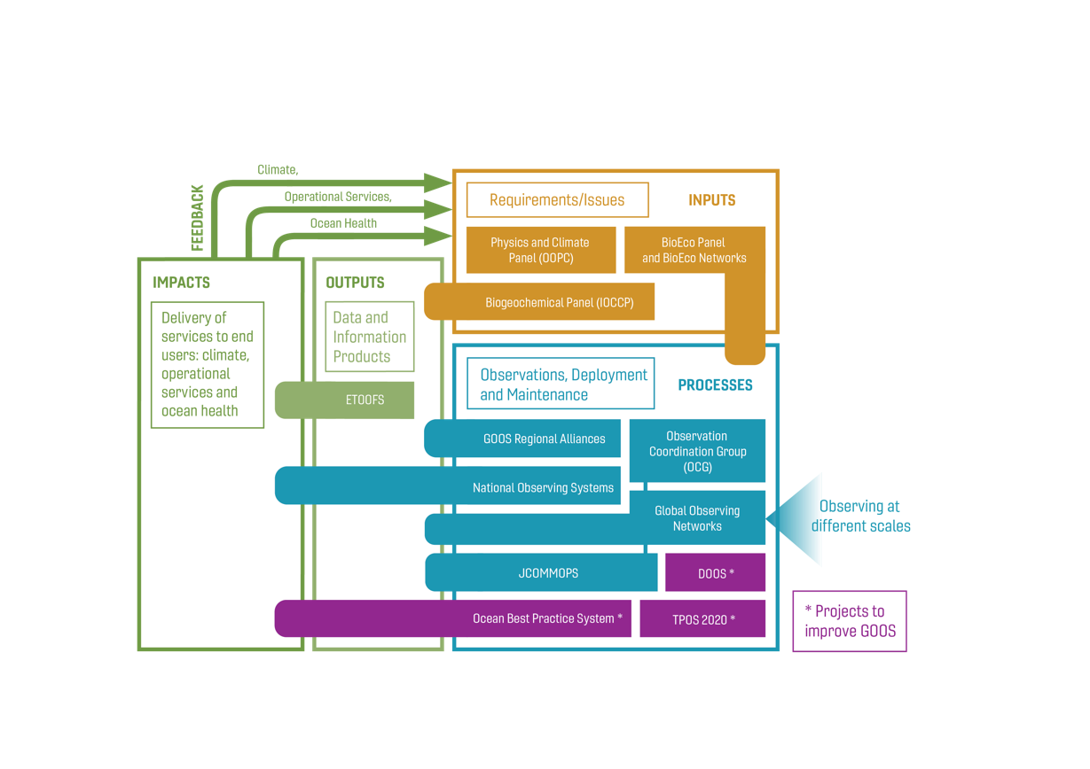
Feedback GOOS Steering Committee
GOOS SC-8, Kiel, 2019
Members (many also GOOS National Focal points) made clear that vital for GOOS to connect more closely
Suggested aspects to the role:
increase in-country coordination
encourage forming GOOS committees
request national reports
advocacy for long term funding
2-way communication national needs
Notes:
networks, ministries, institutes, modeling

Slide 4
EuroSea, EOOS and GOOS National Focal Points
EOOS Operations Committee a key component of governance building connection to sustained ocean observing, national level and sustained infrastructure
EuroSea support development of connections and dialogue with GOOS National Focal Points in European context and globally
2 Committee Meetings – TORs discussed for the committee, positive to response role of national focal points and national committees formed/forming, NFP survey shown interesting results, actions developed
Action 1.6 GOOS to clarify role of National Focal Points (coherence between global / EOOS roles)
GOOS, EOOS, EuroSea – working together to strengthen observing system implementation

Slide 5
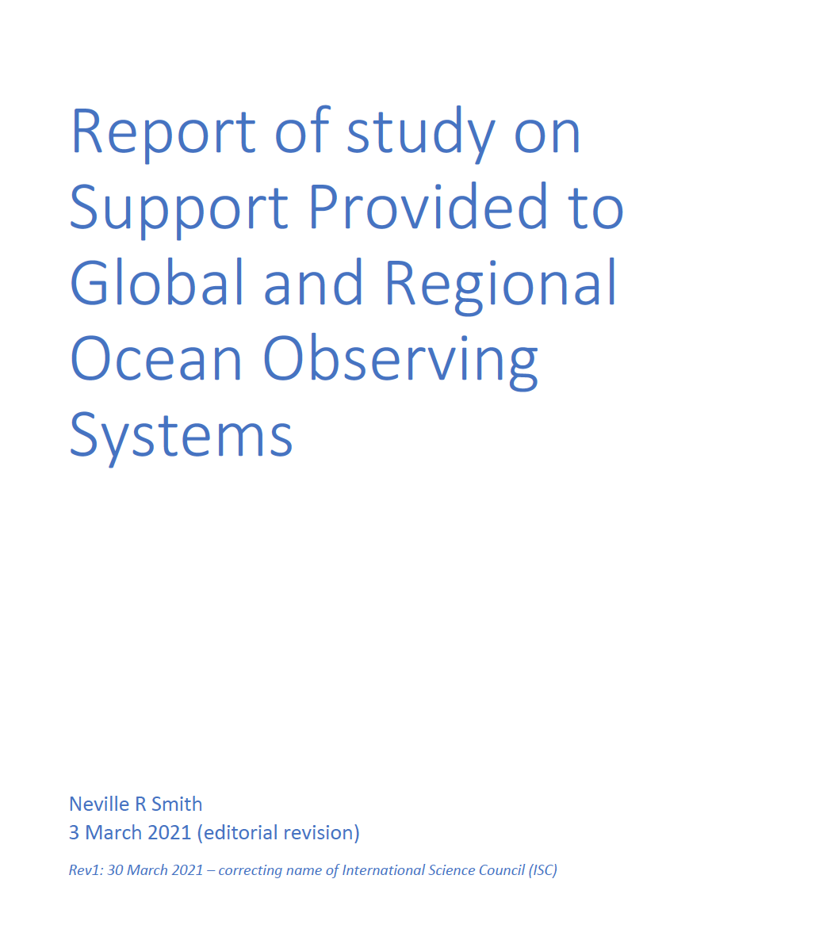
GOOS Support Structure Report
March 2021, findings to be discussed at GOOS SC this month
Recommendation 2: A plan for rejuvenating national engagement should be developed, including for communicating progress with all parts of the support structure. Communiques should be issued immediately upon the conclusion of any major activity (e.g., Committee or Panel meetings) to inform stakeholders of areas of discussion and decisions to create a sense of timely action. Such activity was at best only partly resourced as part of the present support structure.

Slide 6
Benefits - nations and global ocean observing
support demonstrating the value of observations to services, economic and socioeconomic
advocate for long term thinking around funding mechanisms
two-way communication on national needs – fit for purpose system for national, regional and global information needs
learning and sharing - strengthen system, increase efficiency, build capability, e.g. cross border cooperation
regional connections/national committees - integrated view
strengthen voice of advocates within national context
Issues: Ocean observing mainly funded through national investment, often fragmented across sources and based on short term research based funding mechanisms

Slide 7
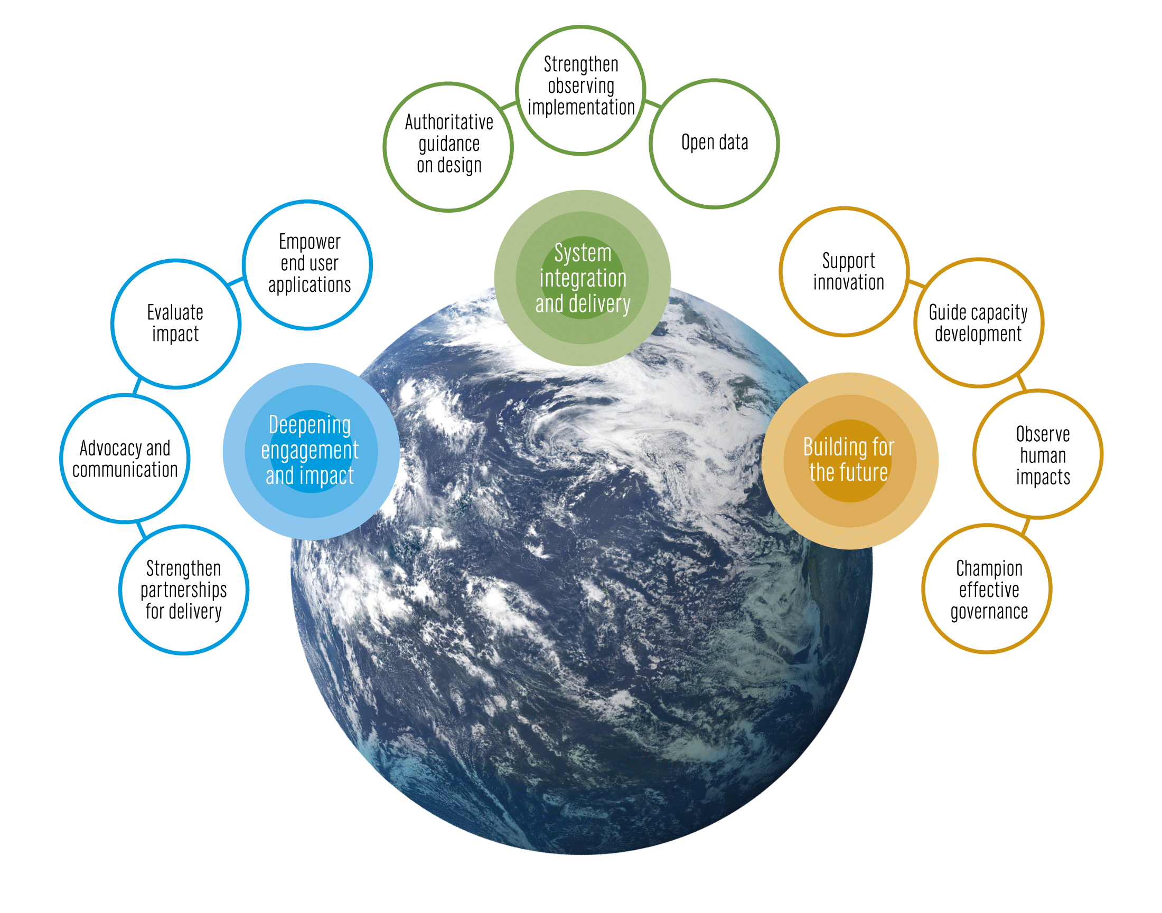
Opportunity to develop role and interaction
support 3-way flow of information - GOOS, national focal points, and between nations
GOOS to advocate on importance of national role/voice
promote coordinated implementation of ocean observing / GOOS committees or networks
national locus for communication
support GOOS advocacy for investment in sustained ocean observing
report on national ocean observing system implementation/activity
bringing national needs and gaps to the attention of GOOS
participating in governance

Slide 8
Develop GOOS NFP – set up a small group initiate
Review and develop ToRs
Develop thoughts, feedback about role, how can GOOS support?
How to realise potential – next steps?
ToRs for broad review – with communication
Develop regional forums / one big forum
Role in GOOS SC?

