Slide 1
Strengthening connections: Biology and Ecosystems Panel
The Global Ocean Observing System
www.goosocean.org
Gabrielle Canonico & Nic Bax
Sam Simmons, Frank Muller-Karger, Rick Stuart-Smith, Anthony Bernard, Lisandro Benedetti-Cecchi, Pier Luigi Buttigieg,
Ward Appletans, Tammy Davies, Emmett Duffy, Karen Evans, David Obura, Lisa Marie Rebelo, Henry Ruhl, Raphe Kudela,
Lavenia Ratnarajah
Observations Coordination Group Meeting (OCG-12)
May 2021

Slide 2
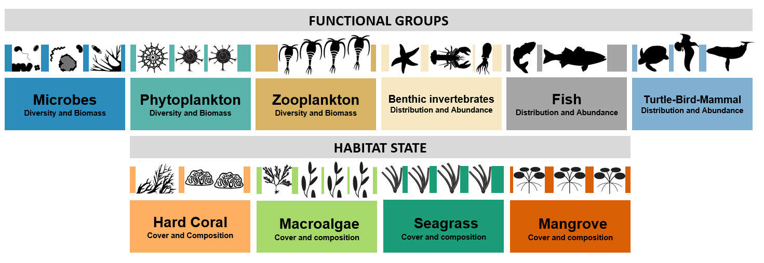
Biology and Ecosystem EOVs
Focus: defining and supporting data collection for the biology and ecosystem Essential Ocean Variables (EOVs)
+ Ocean Sound
Notes:
20-30 min of presentation with 10 minutes of questions
The format will be a webinar, with 20-30 minutes of presentation by you, for the Steering Committee members only (goosocean.org/sc), with 10 minutes of moderated questions
The webinars will be recorded and made available for those not able to attend live
we’d also appreciate having your presentation sent to Forest Collins (f.collins@unesco.org) after the webinar for posting
The purpose is to give the whole SC a chance to hear about your achievements, future plans and opportunities, and issues
1/3 achievements, 1/3 future plans, 1/3 issues
Please plan to spend your time as follows:
A quick introduction of yourself and your component’s role in GOOS
1/3 of your time on the achievements and activities of your component since the last Steering Committee meeting in April 2020
1/3 of your time on future plans as identified contributions to the GOOS IP
1/3 of your time on opportunities, issues and threats of a cross-GOOS nature you’d like raised,

Slide 3
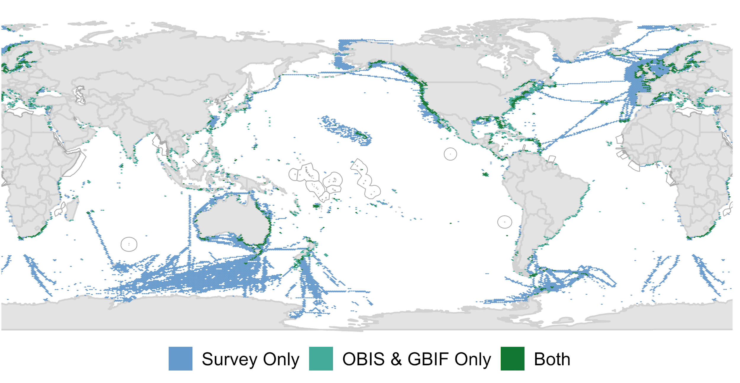
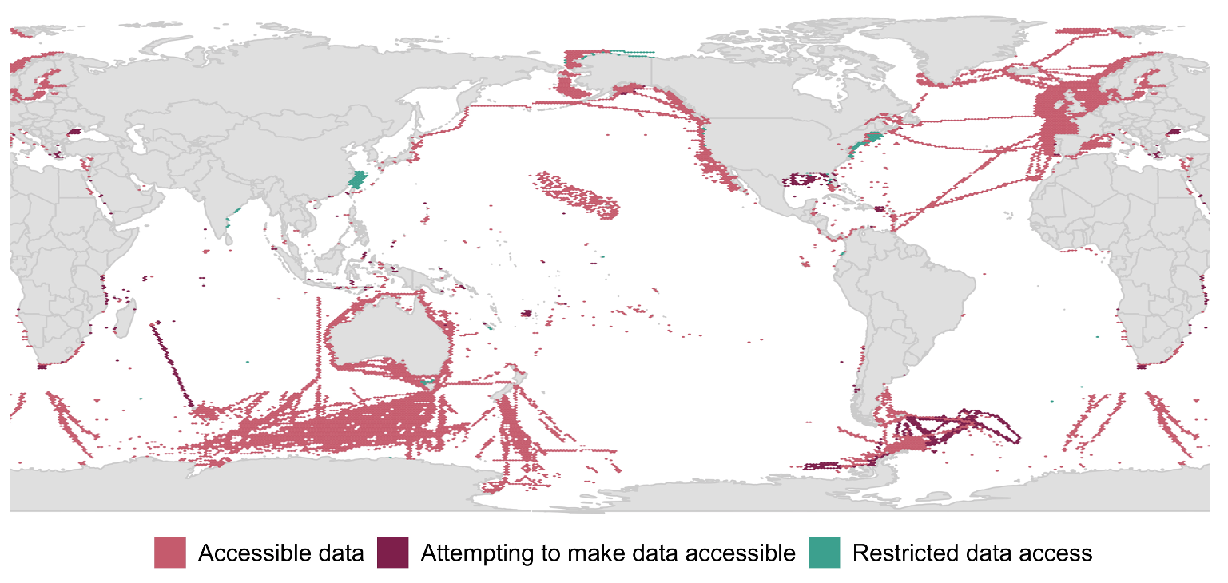
PEGASuS/Future Earth
Key findings
Identified 203 active, long-term (≥5 years old), programs that systematically sampled ≥1 of the BioEco EOVs.
7% of the ocean surface had an active monitoring program
Programs sampling seagrass, mangroves, hard corals and macroalgae existed in 6% of the global coastal zone
53% contributed data into a repository, aggregator, or other data serving tool
66% had publicly accessible data; 34% restricted data access
95% used SOPs, yet only 10% shared SOPs
67% conducted capacity development/tech transfer
Next steps
-Manuscript in process of submission
-BioEco portal – OBIS partnership
Figure 1: Spatial coverage of known active, long-term biological observations globally
Figure 2: Accessibility of data for the various programs identified

Slide 4
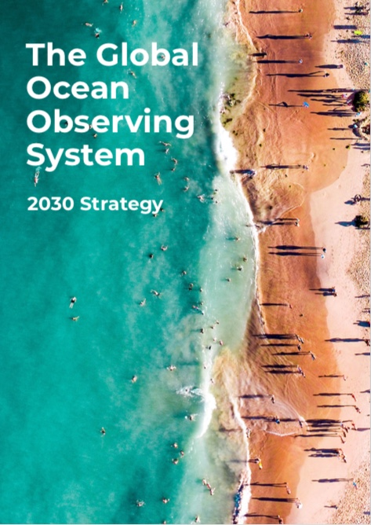
Biology and GOOS
Integrate biology and ecosystem observations across GOOS components in support of the 2030 strategy
Define the BioEco/OCG relationship and what each group brings to the table

Slide 5
“Integrating Biology into OCG”
Being intentional about biology as part of our global observing system
Integrate biological observations and data into OCG activities and/or to link new networks to OCG if they satisfy the OCG attributes
Integrate biology observations into existing OCG networks (eg Bio-GO-SHIP cruises and OceanSites)
US Bio-GO-SHIP Pilot announced May 2020 - https://biogoship.org/

Slide 6
Possible Next Steps
Define our respective roles in helping advance integration of biology into GOOS across the observing-to-product pipeline (technical issues, data collection and management, modeling, product delivery, and stakeholder engagement)
Identify and plan work in areas where we might leverage and complement
Data management and visualization
Identifying biological observations needed for climate and ecosystem models
Informing the global ocean observing report card
Focus on data/metadata mapping - identify concrete example to exercise linkages between OceanOps, BioEco, OBIS, and other global data efforts
How will OCG handle biological observations and data that are beginning to come through its networks?

