Slide 1
OCG – 12 Virtual meeting May 2021
Elaine McDonagh, NORCE, Norway
GO SHIP
Global Ocean Ship-based Hydrographic Investigations Program

Slide 2
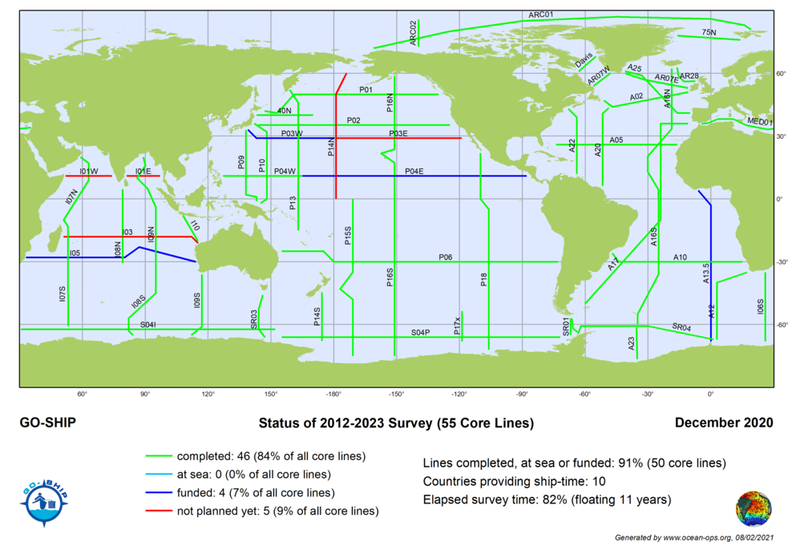
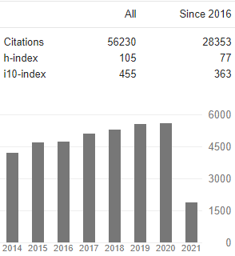
Network Overview
Status
91% of all core reference lines in present decadal survey already completed or funded
10 countries providing ship-time, 15 countries represented in GO-SHIP Committee
Ongoing website improvements and updates
577 publications in GO-SHIP bibliography
28K citations for GO-SHIP
based papers since 2016

Slide 3
Developments and Achievements
****** New Co-Chair Leticia Barbero, NOAA, AOML*******
10 GO-SHIP cruises completed in 2020
2 GO-SHIP decadal full cruises
6 GO-SHIP high frequency cruises
2 GO-SHIP associated cruises
Addressing US GO-SHIP review recommendations: setting the stage for the next 6-years
A 6-year US GO-SHIP continuation approved jointly supported by NSF and NOAA
Engagement with the biological community through SCOR WG P-OBS with a BIO GO-SHIP plan
Funding by the US National Ocean Partner ship Program (NOPP) for a pilot program initiating BIO GO-SHIP on US GO-Ship cruises in 2022
Major Contributor to BGC/Deep Argo deployment & Cal/Val

Slide 4
Challenges and Concerns
Ongoing Covid impacts
Some reference sections have no national commitment
Diplomatic clearance issues to perform Marine Scientific Research in EEZs
Recognition of the network
Management and tracking of add-on projects and new variables including validation samples for BGC Argo

Slide 5
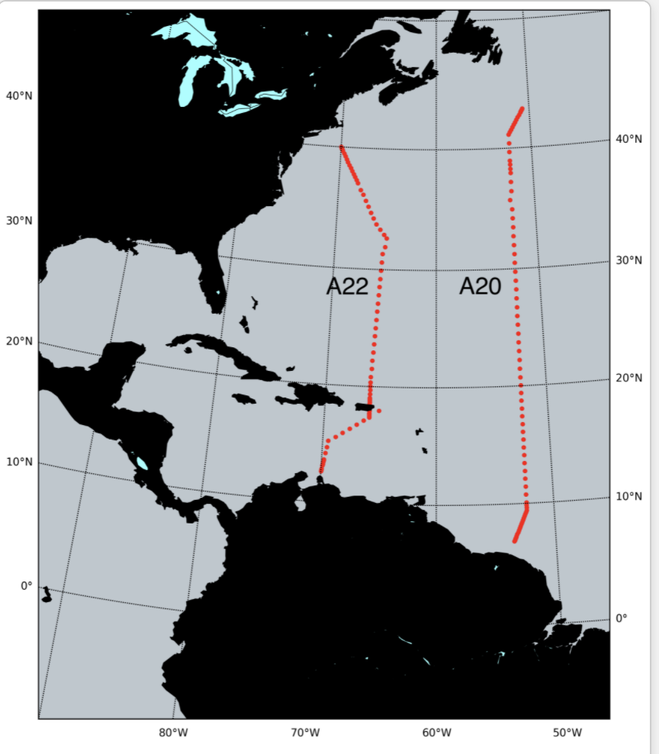
Future Plans and Opportunities
Foci for 2021
9 cruises on core ref. lines planned (A20/22 completed May 17, 2021)
Continue working groups on Best Practices
Engagement with GOOS and its strategy for a fit-for-purpose
Global Observing System
Addressing outcomes of Ocean Obs’19
Continue next decadal survey planning
Preparation of EU GO-SHIP Infrastructure plan
Submission of GO-SHIP Ocean Decade project

Slide 6
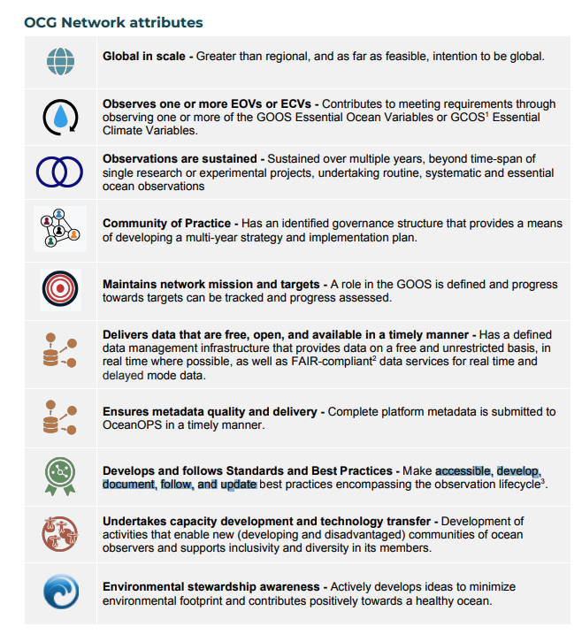
Attribute Report out
Attributes fulfilled: Global, EOVs, sustained, community of practice, network mission and targets, FAIR data, metadata, standards and best practices
Attributes being worked on: FAIR data, metadata, Capacity development - new nations.
Attributes to be worked on: environmental stewardship awareness.

Slide 7
Asks from OCG
Improved coordination with float providers through OceanOPS
Guidance on EEZ issues and facilitation to do MSR in EEZs
Continued support for platform coordinator
Continued interactions between OceanOPS (metadata) and data depositories (e.g CCHDO)
Guidance on data repositotries for ADCP and underway measurements
Support/encouragement for creation of data products (e.g. GoSHIP EasyOcean)
Encourage linkages with other OCG elements notably SOT and Argo

