Slide 1
OCG – 12 Virtual meeting May 2021
GLOSS
Gary Mitchum
Chair, GLOSS Group of Experts

Slide 2
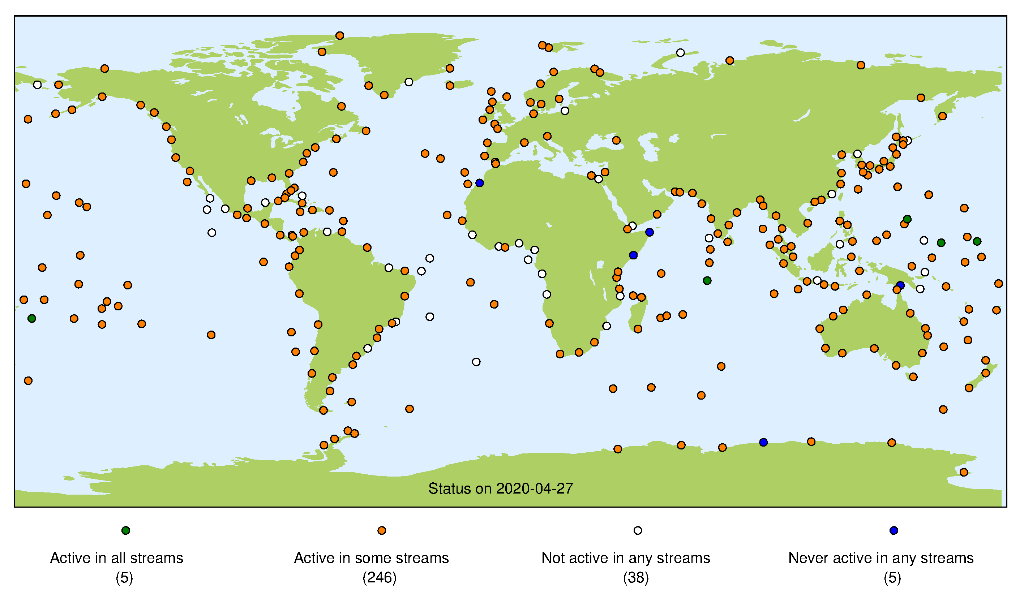
Network Overview and Status (2020)

Slide 3
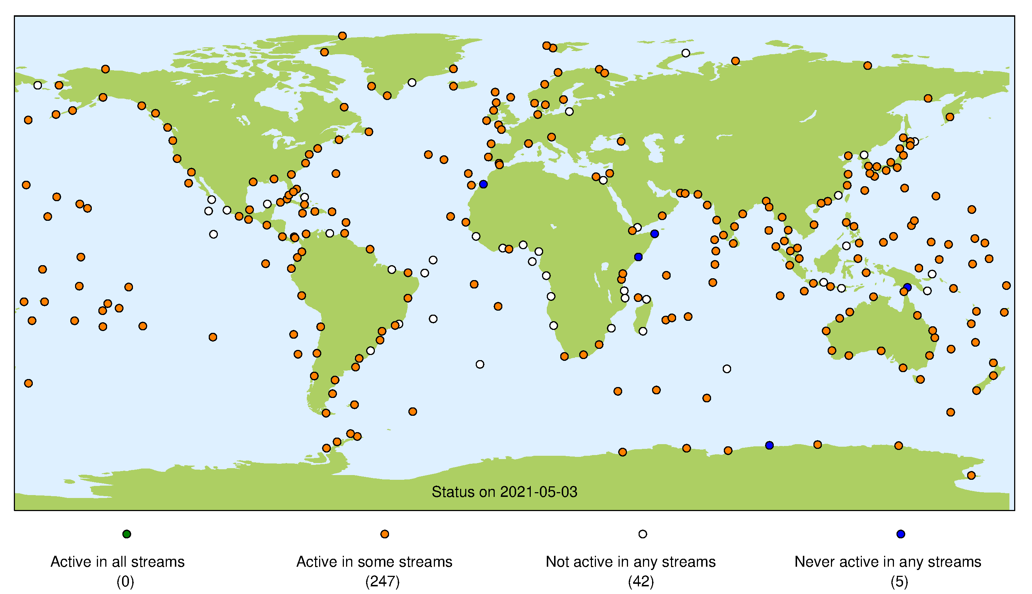
Network Overview and Status (2021)

Slide 4
Future Plans from 2020 OCG meeting with Updates
Work remaining from meeting last year (our work cycle is two years)
Complete the update of the Implementation Plan (Mitchum)
Next GLOSS meeting is in Fall 2021, and this will be approved then.
Proposal to IAPSO CMSLT about intercomparison of GNSS rates at tide gauges
Not done yet.
Work with Juliet on Best Practices
Some progress, but needs work. This will be a priority in the coming year.
Implement data portal on the GLOSS web site
Progressing well.
Contribution to the UN Decade of Ocean Science, especially in the area of improving geographic coverage via capacity development and instrument development
Still an open area

Slide 5
Issues and Concerns From 2020 OCG Meeting and 2021 Updates
Major concern is continuity of leadership, especially the Technical Secretary position
Bernardo Aliaga has done a great job supporting GLOSS.
It would be good, however, to get this issue settled.

Slide 6
Asks from OCG
Patience

Slide 7
Questions?

