Slide 1
https://irso.info/
The International Research Ship Operators (IRSO) is a group of research ship operators representing 49 organisations from 30 countries who manage over 100 of the world’s leading marine scientific research vessels. IRSO membership is open to all research ship operating institutes or national research programmes that are engaged in the collection of data from ships at sea, and follow established protocols for the open publication of their results.
IRSO members gather annually to share information and solve problems of mutual interest to better support the marine scientific community’s research efforts at sea. IRSO also acts as a voice to promote the research ship community and provide expert advice to other bodies as required. Previously known as the International Ship Operators Meeting (ISOM), IRSO was founded in 1986 and is attended voluntarily with meetings hosted by participating countries.
IRSO has close links with and is attended by research vessel groups such as the European Research Vessels Operators (ERVO), the Ocean Facilities Exchange Group (OFEG) and the University-National Oceanographic Laboratory System (UNOLS). We welcome links with other like bodies.
Main topics and objectives of the annual agenda are:
Best practice design and operation of research ships and associated scientific equipment
The exchange of ship time and equipment between countries
Benchmarking and co-operation in support of marine research
Developments in national research fleets

Slide 2
Update on RV Operations
Europe – RV’s have returned to operations successfully albeit with the various restrictions related to isolation prior to cruises, testing before cruises, and various degrees of safety measures onboard depending on the pre-voyage measures and length of the cruises. Some still operate with limited numbers of scientists onboard and foreign port calls are being avoided as much as possible.
USA – UNOLS fleet are adapting guidelines for the fleet as vaccinations come into play especially if they can get to fully vaccinated crews and science parties. They are adapting their pre-cruise quarantine and testing protocols "downward" for those who are fully vaccinated and remain symptom free. The U.S. Centers for Disease Control and the U.S. Coast Guard have not relaxed the federal law regarding mask wearing onboard ships yet.
Asia Pacific – Australia and NZ are largely back to normal operations. Australia still have ongoing challenges bringing in crew from different states in Australia due to the variation in C-19 controls from state to state.

Slide 3
Exchange of information between OCG/JCOMMOPS and IRSO - collaboration progress so far;
Through cooperation with IRSO and discussions with the developers of the MFP (Marine Facilities Planning) software tool, there has been some progress to will allow automated synchronization of cruise plans by end of May 2021
The pilot project will focus on core cruise metadata for UK cruises
The findings of the pilot phase will be presented at the 2021 IRSO meeting
The goal is to roll the project out at global scale, and include additional metadata (e.g. contact information and science operations)
For non-MPF users a traffic light system was suggested (and a sample produced) for categorising vulnerable assets – IRSO members are yet to discuss whether this is practical. A map based system may be an improvement so that sensitive areas can easily be identified.

Slide 4
RV Kaharoa – built 1981
Length – 28m
Beam – 8.2m
Draft – 3.4m
Range – 6000nm
Berths – 10
At 40 years old Kaharoa is approaching the end of her useful life

Slide 5
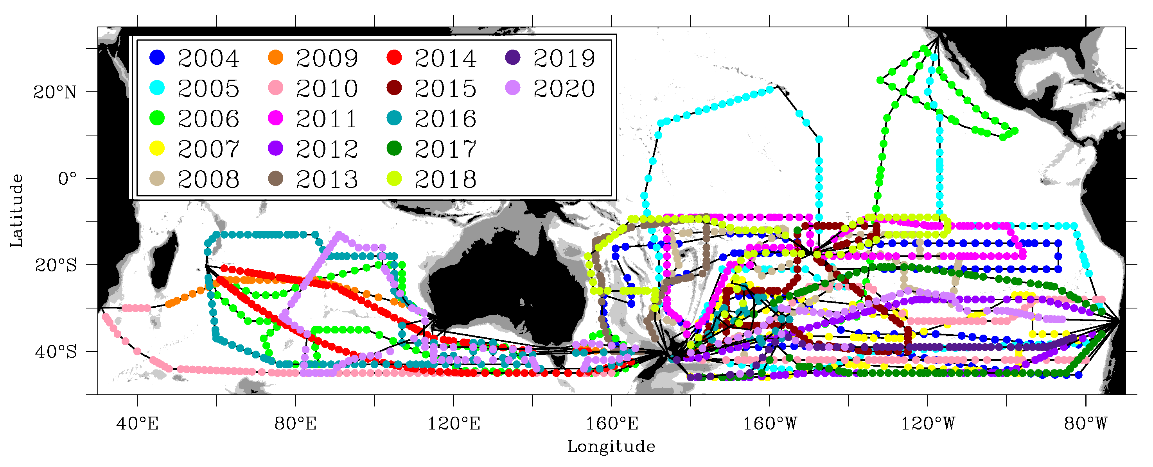
RV Kaharoa – ARGO voyages undertaken since 2004

Slide 6
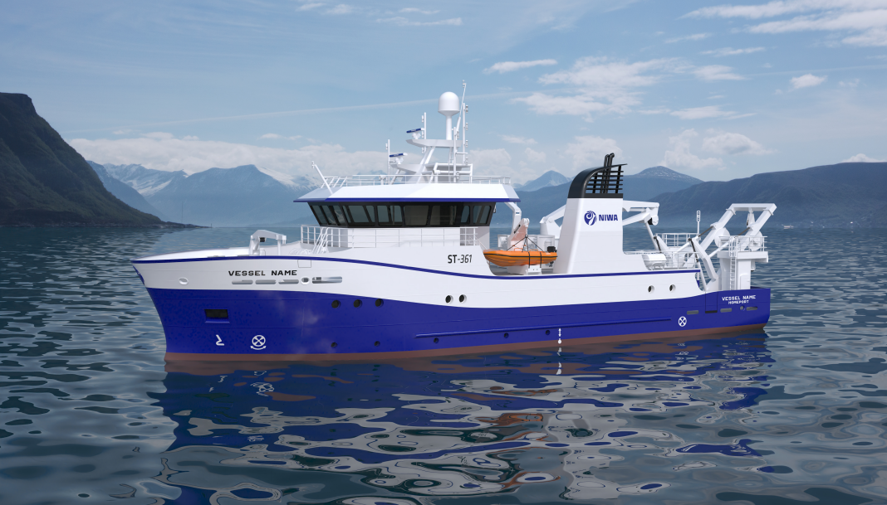
Kaharoa Replacement– estimated to be in service mid-2024
Length – 36m
Beam – 9.5m
Draft – 3.5m
Range – approx. 6500nm
Berths - 15

Slide 7
THANK YOU FOR YOUR ATTENTION- ANY ENQUIRIES PLEASE CONTACT;
IRSO Chair: Dr. Erica Koning National Marine Facilities (NMF) NIOZ Royal Netherlands Institute for Sea Research PO Box 59, 1790 AB Den Burg, The Netherlands T: +31-222-369441 M:+31-6 11710875 Email: erica.koning@nioz.nl
IRSO Vice-Chair: Greg Foothead General Manager – Vessel Operations NIWA Vessel Management Ltd 301 Evans Bay Parade Greta Point, Wellington, New Zealand T: +64-4-386-0553 M: +64-27-273-3894 Email: Greg.Foothead@niwa.co.nz

