Slide 1
Toward enhanced communication between observational and modeling communities
OCG-12, May 20th, 2021, Online
Yosuke Fujii (JMA/MRI, Co-chair of OceanPredict OS-Eval TT)
Elisabeth Rémy (MOI, Co-chair of OceanPredict OS-Eval TT)
Recent Activities of OceanPredict Observing System Evaluation Task Team (OP OS-Eval TT)
Challenges in observing system evaluation with ocean and earth system models
Concluding Remarks
Notes:
I am Yosuke Fujii from JMA/MRI.
thank you for giving me the opportunity to talk about the communication between observational and modeling communities.

Slide 2
1. Recent Activities of OceanPredict Observing System Evaluation Task Team (OP OS-Eval TT)
Notes:
First, I will introduce recent activities of OceanPredict Observing System Evaluation Task Team.

Slide 3
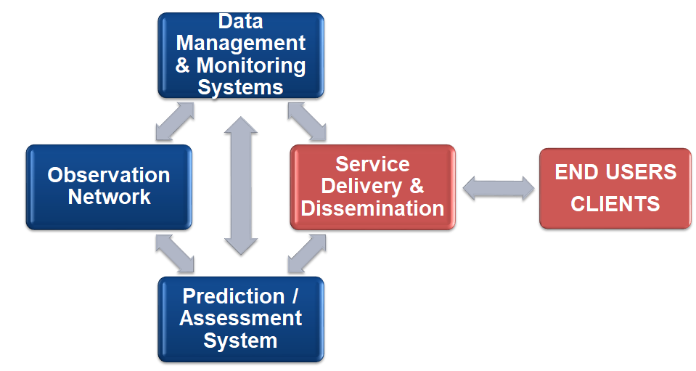
Ocean Information Value Chain
Follow-on program of GODAE OceanView started from 2019
Aim to increase the capacity of operational oceanography and to enhance the ocean information value chain
Participated by scientists who are engaging development and/or operation of ocean prediction systems.
Constituted of Advisory & Sponsors Board, science team, national representative group, and 6 Task Teams.
TTs in OceanPredict
Notes:
You know, OceanPredict is the follow-on program of GODAE OceanView started from 2019.
It aims to increase the capacity of operational oceanography and enhance the ocean information value chain.
OceanPredict is participated by scientists who are engaging development and/or operation of ocean prediction systems.
It’s constituted of the , Advisory & Sponsors Board, science team, national representative group, and six task teams, including coastal task team, coupled prediction task team, data assimilation task team, intercomparison and validation task team, marine eco-system task team, and OS-Eval task team.

Slide 4
OceanPredict Observing System Evaluation Task Team (OS-Eval TT)
OceanPredict has the OS-Eval TT to provide consistent and scientifically justified requirements and feedbacks to observational agencies.
Co-chairs: Yosuke Fujii (JMA/MRI), and Elisabeth Rémy (MOI)
Aim to construct a positive feedback cycle between observational agencies and operational forecasting centers.
Data
Observational Agency
Targets
Multi-System Evaluation for more reliable results
Built up a system for Real-Time OS-Eval
Regular reporting on observation impacts
Operational Centers
Evaluation
Notes:
Thus, OceanPredict has the OS-Eval TT to provide consistent and scientifically justified requirements and feedbacks to observational agencies.
Currently, Elisabeth and I lead the task team.
The task team aims to construct a positive feedback cycle between observational agencies and operational forecasting centers.

Slide 5
OS-Eval TT Regular Online Meeting
Once a two months, and one hour each. Usually 10-20 participants.
Share the information on the observation networks and the latest results of observing system evaluation
Discuss about the collaborative activities in OS-Eval TT
https://oceanpredict.org/science/task-team-activities/observing-system-evaluation/#section-online-meetings
Notes:
One of the major activities is the regular online meeting, which started due to the COVID-19 pandemic.
The meeting is held once a two months, and each meeting lasts one hour.
In the meeting, we share the information on the observation network and latest results of observing system evaluation.
We also discuss about the collaborative activities in the task team.
The information of the online meeting can be seen from this web page.

Slide 6
Table on Use of Observation Data in OP Systems
Aim to show what data are used in OP systems clearly in public!
will be open at the OceanPredict web page.
Center/Institute | System Name | Ocean Temperature | Salinity | Velocity (Mechanical) | Velocity (ADCP) | Surface Air Temperature | Surface Air Humidity | Surface Wind
BoM (CSIRO) | OceanMAPS | Level 5 | Level 5 |  | Level 1
CHM-REMO | RODAS | Level 1 | Level 1
ECCC | GIOPS (global 1/4°) | Level 5 | Level 5 |  |  | Level 5 | Level 5 | Level 1
 | RIOPS (Pac-Arctic-NAtl 1/12°) | Level 5 | Level 5
ECMWF | OCEAN5 Global 1/4 | Level 5 | Level 5 | Level 1 | Level 1 |  |  | Level 4
 | ECWAM
INCOIS | RAIN (1/12 degree) | Level 5 | Level 5 |  | Level 1
 | INCOIS-GODAS (1/2X1/4 global) | Level 5 | Level 5 |  | Level 1
 | HYCOM (1/12 degree)
 | SWAN
 | WAVEWATCH III (1 degree)
JMA | MOVE (Global) | Level 5 | Level 5 | Level 1 | Level 1 | Level 1 | Level 1 | Level 1
 | MOVE (Regional) | Level 5 | Level 5 | Level 1 | Level 1 | Level 1 | Level 1 | Level 1
 | Wave DA Systems
Notes:
And in the last year, we generated the table on the use of observation data in ocean prediction systems.
This is an example.
The extent of use of data from specific sensor is evaluated from Level 0 to 5.
Through this table, we aim to show what data are used in OP systems clearly in public.
This table will be open at the OceanPredict web page.

Slide 7
Multi System OSEs for the Fast Salinity Drift of the Argo floats (planned)
More than 15% of Argo floats suffer from the Fast Salinity Drift (FSD). The drift is caused by a manufacturing problem.
We confirmed that FSD affects some of ocean prediction systems.
In order to clarify the influence of FSD in ocean prediction systems, we plan to conduct multi-system OSEs.
For example, the participating centers will perform
1. OSE assimilating real-time Argo data
2. OSE assimilating real-time Argo data but using the gray list
3. OSE assimilating delayed mode Argo data
A close communication with the ocean observation community is required in order to make this activity effective.
Notes:
And the last online meeting, we decided to prepare for the multi-system OSEs for the fast salinity drift of the Argo floats.
As you now, currently more than 15% of Argo floats suffer from the fast salinity drift or FSD.
We confirmed that FSD affects some of ocean prediction systems.
Then, in order to clarify the influence of FSD in ocean prediction systems, we plan to conduct multi-system OSEs.
A close communication with the ocean observation community is required in order to make this activity effective.

Slide 8
Sharing the QC Information
Some centers share their QC information through communication in OS-Eval TT.
It may be possible to share this kind of information with observational communities.
QC Monitor in JMA. Circles indicate discarded data. One of discarded salinity profiles is plotted with corresponding first-guess, and analysis profiles. (This web page is not open due to JMA’s data policy.)
Notes:
And, you know, some centers share their QC information through communication in OS-Eval TT.
This is an example of QC monitor in JMA.
Circles indicate discarded data.
One of discarded salinity profiles is plotted with corresponding first-guess and analysis profiles.
I am sorry but this web page is not open due to JMA’s data policy.
But it may be possible to share this kind of information with observational communities.

Slide 9
Plan of Ocean Observation Impact Annual Report (OIAR)
OSEval TT proposed to publish annual reports (OIAR) on the use of observation data and their impacts in ocean/weather/climate prediction systems.
Publishing annual reports can be an effective way to provide a feedback to observational communities. It helps decision making and helps to secure funding for developing and sustaining ocean observing system.
OIAR can include:
What observations are used in different prediction systems?
What is the spread in multi-system ensemble?
Information about data misfits and analysis increments
Impacts of recent changes in ocean observing system
Results of international OS-Eval campaign
A summary of recent OS-Eval studies
Regular
Observational Agencies/Groups
Report
Making decisions related to the design of observing system
Secure funding for observing systems
This plan will be modified for the new environment with the UN Decade for Ocean Sciences!!
Notes:
And, the OS-Eval task team proposed to publish annual reports or OIAR on the use of observation data and their impacts in ocean/weather and climate prediction systems.
OIAR can include what observations are used in different prediction systems,
What is the spread in multi-system ensemble,
impacts of recent changes in ocean observing system, etc.
Publishing annual reports can be an effective way to provide a feedback to observational communities.

Slide 10
OceanPredct contributions to the UN Decade of Ocean Science
OS-Eval TT
Plan to submit
Decade Programme
OceanPredict
Science Team
have submitted
ForeSea
Enhance the value chain b/w OP and users
Decade Project
SynObs
Develop schemes for better assim. of observaton data
Obs. sys. eval. for ocean prediction systems.
have submitted
CoastPredict
Development of coast predictions and their use
COSS-TT
have contributed
GOOS
ObsCoDe
Observing system design for various purposes.
contribute
have submitted
Issuing authorized reviews like WMO’s RRR.
Notes:
Then, this figure summarizes the OceanPredict contributions to the UN Decade of Ocean Science.
OceanPredict Science Team has submitted the Decade Programme, ForeSea, which aims to enhance the value chain between ocean prediction systems and users.
And the OceanPredict Coastal Sea task team has submitted another Decade Programme, CoastPredict, coorpolating with GOOS.
And, GOOS has also submitted ObsCoDe.
In addition, OS-Eval TT plans to submit a Decade Proejct, SynObs.
We plan to manage it as a common comprehensive project among ForeSea, CoastPredict, and ObsCode.

Slide 11
Decade Project to be submitted by OceanPredict OS-Eval TT
Title: Synergistic Observing Networks for Impactful and Relevant Ocean Predictions (SynObs)
The project will seek the way to extract the maximum benefit from the combination among various observation platforms, typically between satellite and in situ observation data, or between coastal and open ocean platforms, in ocean (and earth system) predictions.
We aim to identify the optimal combination of different ocean observation platforms, and develop assimilation methods with which we can draw synergistic effects from the combination.
It includes coastal and open ocean studies, weather and climate coupled predictions, and physical and biogeochemical studies.
It plans to be managed as a common comprehensive project among ForeSea, CoastPredict, and ObsCoDe.
It plans to publish the Observation Impact (Annual?) Report as a part of the authorized report planed in ObsCoDe.
Notes:
The tentative full name of SynObs is Synergistic Ocean Observations for Ocean and Coupled Predictions.
The project will seek the way to extract the maximum benefit from the combination among various observation platforms, typically between satellite and in situ observation data, or between coastal and open ocean platforms, in ocean and earth-system predictions.
Mainly, we aim to identify the optimal combination of different ocean observation platforms, and develop assimilation methods with which we can draw synergistic effects from the combination.
SynObs includes coastal and open ocean studies, weather and climate coupled predictions, and physical and biogeochemical studies.
Then SynObs plans to publish the Observation Impact Report as a part of the authorized report planed in ObsCoDe.

Slide 12
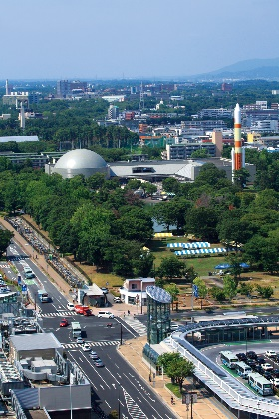
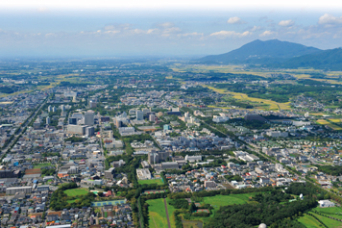
Symposium toward Synergistic Observation Networks for Ocean and Earth System Predictions
10-13 Nov, 2020, Tsukuba Japan
30 Nov – 3 Dec, 2021
Held as the regular face-to-face meeting of OS-Eval Task Team, but jointed with the coupled prediction task team.
Open for all researchers who are interested in evaluation and effective use of ocean observations in ocean and earth system predictions.
Also, having a role as the kick-off meeting of SynObs.
Having a presentation about the evaluation/design of ocean observation networks, DA development for effective use of observations, and earth system predictions.
It can be postponed again if the pandemic is not enough suppressed.
Notes:
Then, we plan to have a symposium toward Synergistic Observation Networks for Ocean and Earth System Predictions in December in Japan. It will be the kick-off meeting of SynObs.
It will be open for all researchers who are interested in SynObs activities.
So I wish many researcher who are interested in SynObs attend this meeting.
But it can be postponed again if the COVID-19 pandemic is not enough suppressed, and I am afraid that this possibility is increasing now due to the recent Japanese situation.

Slide 13
2. Challenges in observing system evaluation with ocean and earth system models
Notes:
Next, I will briefly talk about the difficulties and challenges of ocean observing system evaluation with ocean prediction systems.

Slide 14
Systematic Errors and System Dependency
Results of OSEs based on NCEP and GFDL systems (Impacts TAO, Argo, In-situ on RMSE skill for various SST indices)
In the 2014 TPOS workshop, we found strong system dependency and some inconsistency in the results of OSE studies, and shared the sentiment that model biases and model dependencies are too severe to evaluate the observing system through DA systems.
GFDL-CM2.1
Filled bar: 0-5 month lead
Unfilled bar: 5-9 month lead
TAO and Argo reduces RMSE by 10-20 % for ENSO
TAO, Argo, XBT together did not reduce RMSE in some cases. The impact is often smaller than TAO or Argo alone.
There is a large difference between the two systems (System dependency.)
Implying model systematic biases and model initialization shocks are obstacles in quantifying benefits of ocean observing systems
NCEP-CFSv2
Further improvement of ocean and earth system prediction systems to reduce the systematic errors is indispensable for performing reliable observing system evaluation.
Multi-System Evaluation is also essential.
From Fujii et al., 2015 QJRMS
Notes:
The first difficulty is the systematic errors and system dependency.
In the 2014 TPOS workshop, we found strong system dependency and some inconsistency in the results of OSE studies, and shared the sentiment that model biases and model dependencies are too severe to evaluate the observing system through DA systems.
So, I think further improvement of ocean and earth system prediction systems to reduce the systematic errors is indispensable for performing reliable observing system evaluation.
Multi-System Evaluation is also essential.

Slide 15
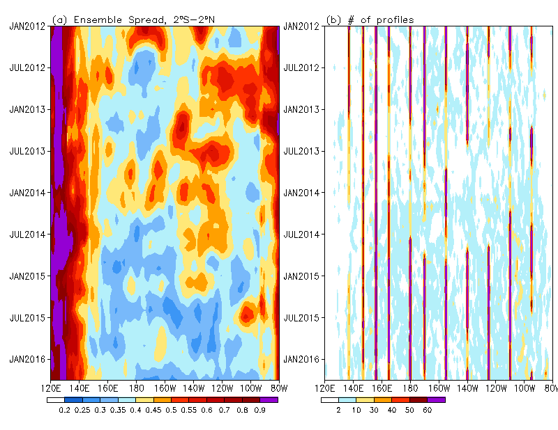
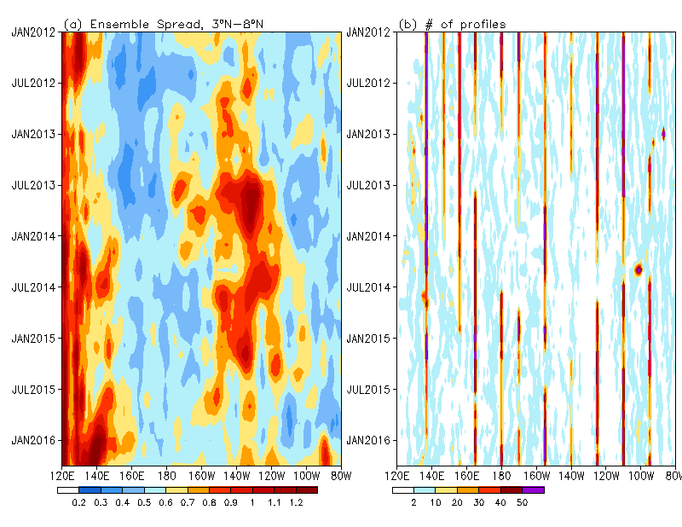
Need of Near-Real-Time Evaluation
When the TAO Crisis happened in 2012-2014, we had few effective means to evaluate the impacts of on-going event, and to appeal the importance of recovering the status.
In order to resolve this problem, we started Multi-System Ocean Reanalysis Intercomparison (RT-ORA-IP). Multi-system ensemble spread can be a indicator of how well the ocean field is constrained. But we need further efforts to perform near-real-time evaluation.
Longitude-time section of the ensemble spread of temperature averaged in 0-300m and the number of profiles
2ºS-2ºN
3ºN-8ºN
Ensemble Spread
number of profiles
Ensemble Spread
number of profiles
Temperature (NCEP):
https://www.cpc.ncep.noaa.gov/products/GODAS/multiora_body.html (1980-2019, 6 ORAs)
https://www.cpc.ncep.noaa.gov/products/GODAS/multiora93_body.html (1993-2019, 9 ORAs)
Salinity (ABOM): http://poama.bom.gov.au/project/salinity
(1993-2019, 5 ORAs)
From Xue et al., 2017 Clim. Dyn.
Notes:
Another challenge is the near-real-time evaluation.
When the TAO Crisis happened in 2012-2014, we had few effective means to evaluate the impacts of on-going event, and to appeal the importance of recovering the status.
In order to resolve this problem, we started Multi-System Ocean Reanalysis Intercomparison (RT-ORA-IP).
Multi-system ensemble spread can be a indicator of how well the ocean field is constrained.
But, I think we need further efforts to perform near-real-time evaluation.

Slide 16
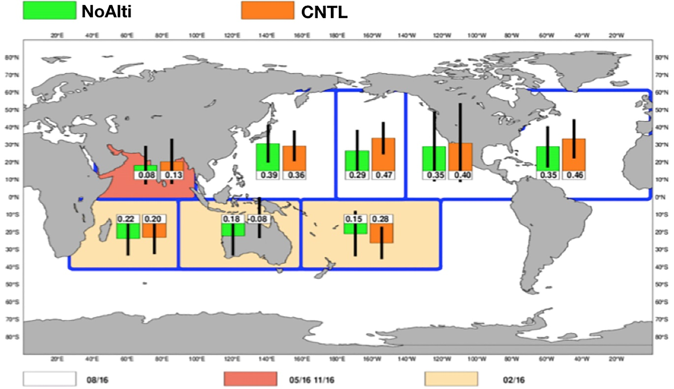
Evaluation for subseasonal forecasts and coupled DA
Considering recent use of coupled systems in operational weather and subseasonal predictions and development of coupled DA, evaluating ocean data impacts in those systems is essential.
Although it is still difficult to identify the ocean data impacts, some operational centers have started the evaluation studies.
Possibly impacts on tropical cyclones, MJO, equatorial wind bursts, etc.
ACC score of accumulated cyclone energy prediction at days 16–45 for the regular predictions and OSE predictions without assimilating sea level anomaly (SLA) in the ECMWF coupled prediction system
Assimilating SLA improves the score in the Indian Ocean, North central, North eastern, and South Pacific and North Atlantic.
From Subramanian et al., 2019, frontiers in Marine Science
Notes:
Considering recent use of coupled systems in operational weather and subseasonal predictions and development of coupled DA, evaluating ocean data impacts in those systems is essential.
Although it is still difficult to identify the ocean data impacts, some operational centers have started the evaluation studies.

Slide 17
Observation Values not counted in OSE/OSSE
It should be emphasized that ocean data have “many lives” beyond the value revealed by OSE/OSSE studies.
We use ocean observation data for the atmospheric forcing, estimating statistical data, validation, model development, etc.
We need to consider various contribution of observation data when we evaluate or design observing systems.
Difference of the T and S fields in the equatorial Pacific vertical session in an old version of JMA’s ocean reanalysis due to the difference of atmospheric forcing
NCEP-R1
ERA-40
Notes:
Also, It should be emphasized that ocean data have “many lives” beyond the value revealed by OSE/OSSE studies.
For example, we use ocean observation data for the atmospheric forcing, estimating statistical data, validation, model development, etc.
We need to consider various contribution of observation data when we evaluate or design observing systems.

Slide 18
3. Final Remarks
Notes:
Then, I would like to make some remarks.

Slide 19
Final Remarks
I hope resent improvement of ocean prediction systems makes it possible to perform fair and reliable evaluation and design of the ocean observing network.
However, multi-system approach is indispensable in order to mitigate the influence of system dependency. It requires good coordination and huge computer and human resources.
Further development of the system in order to reduce the systematic errors will contribute to increasing the capacity of the observing system evaluation.
To develop the methods to assimilate new-type observation or for more effective use of currently assimilated data will increase the values of observation data in ocean prediction systems. Collaboration should be done also in this direction.
It is essential to evaluate the impacts of various observation platforms as a whole network and to extract synergy from the whole system.
Operational output of ocean prediction systems and its by-products (e.g., QC information, data misfits, analysis increments, etc.) can be used by observational community. (Possibility of providing those information depends on the data policy and human resources of operational centers.)
Notes:
You know, I hope resent improvement of ocean prediction systems makes it possible to perform fair and reliable evaluation and design of the ocean observing network.
However, multi-system approach is indispensable in order to mitigate the influence of system dependency. It requires good coordination and huge computer and human resources.
In addition, further development of the system in order to reduce the systematic errors will contribute to increasing the capacity of the observing system evaluation.
To develop the methods to assimilate new-type observation or for more effective use of currently assimilated data will increase the values of observation data in ocean prediction systems. Collaboration should be done also in this direction.
Then, it should be noted that it is essential to evaluate the impacts of various observation platforms as a whole network and to extract synergy from the whole system.
Meanwhile, operational output of ocean prediction systems and its by-products (for example, QC information, data misfits, analysis increments, etc.) can be used by observational community. It is also possible to start the communication in this direction.

Slide 20
Thank you
Notes:
That’s it.
Thank you for your attention.

