Slide 1
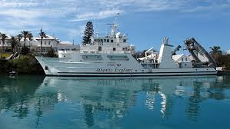
Shipboard Ocean Time Series as part of OCG
Angel White, Univ. of Hawaii
Heather Benway, Ocean Carbon & Biogeochemistry Program

Slide 2
Why Ocean Time Series as part of OCG?
Ship-based Ocean TS constitute likely the most comprehensive in-situ biological/biogeochemical ocean observing platforms at a global level.
Ocean TS attributes
Local in footprint, but global in scale: time series have a limited footprint - they survey the area in which they are located (most often the coastal zone), but pooled together they have global extension and coverage.
Sustained observation: This is the key for time series, and they provide the only means to routinely measure the suite comprehensive BGC and Bio parameters.
Most time series follow standard protocols and best practices. The community has been purposely working together for over a decade to further standardize methods
Observe many EOVs, in particular Bio and Eco, and BGC
METs RCN recently funded focusing on data practices. However, they could benefit from more scientific coordination and belonging to a broader ocean observing community.
Several efforts regarding data discoverability and accessibility have been undertaken over the past 3 years. Many of the parameters TS measure require time to be processed and QA/QC.

Slide 3
Most common Biogeochemical and Biological Parameters sampled at Time Series
Pigments - Chlorophyll a and others
CTD parameters and discrete calibrations – T, S, fluorescence, oxygen, beam attenuation
Inorganic macro- and micronutrients – NO₃, NO₂⁻, NH₄, PO₄, SiO₄
Biomass and community composition – Bacteria, viruses, phytoplankton, zooplankton
Inorganic carbon parameters – DIC, TA, pH, discrete pCO₂, computations
Biological rates – Primary and bacterial production
Trap fluxes – Collection methods, sample processing, data reporting, etc.
Organic matter – C, N, P (dissolved and particulate fractions)

Slide 4

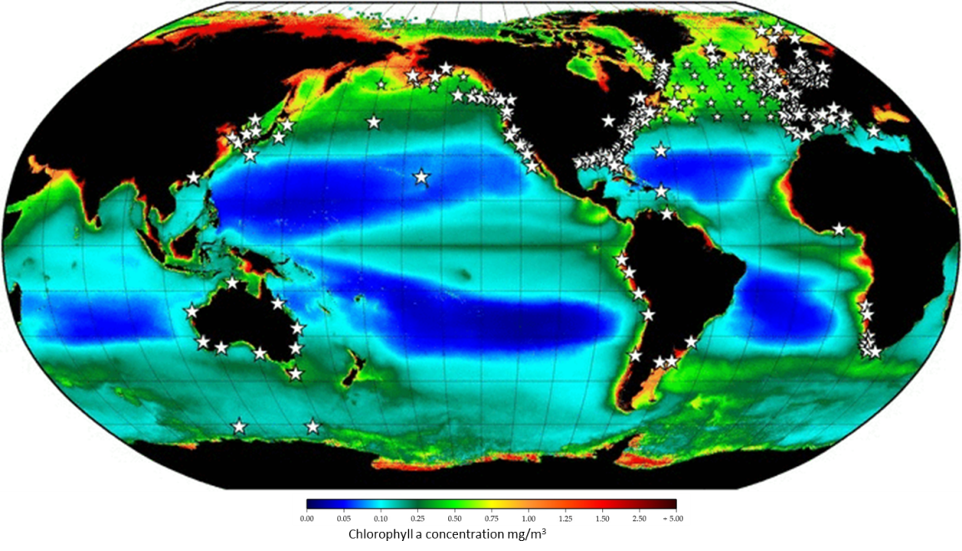
Map showing Time Series sites involved in the 2017 IGMETS assessment.
Notes:
IGMETS had the following vision; this map shows the TS globally, overlaid on top of a satellite chla concentration composite.
IGMETS Vision:
Encourage the use of already-established common metadata standards and formats to further facilitate cost-efficiency of new and existing sampling programs.
Analyze time series data at the global and regional level to create a platform for modelling studies based on maximized input quality and quantity;
Increase the visibility of less internationally connected groups;
Allow the possibility for web-based quick-look analysis of time series variables;
Provide a strong base for future predictions which in turn can strengthen policy advise/suggestions.
Most of you are likely familiar with this figure from Dickey et al. When you do a single time series analysis, you get to the orange square, when you join the ts, you get Understanding of regional/global process – insights on linkages between climate variability and ocean biogeochemistry and ecology, which is the green box.

Slide 5

An International Time-Series Methods Workshop
November 28-30, 2012 (Bermuda Institute of Ocean Sciences)
Objective: To review current shipboard biogeochemical time-series sampling and analytical protocols
Participants: Technical and scientific staff from 33 shipboard ocean time-series sites (17 countries represented)

Slide 6
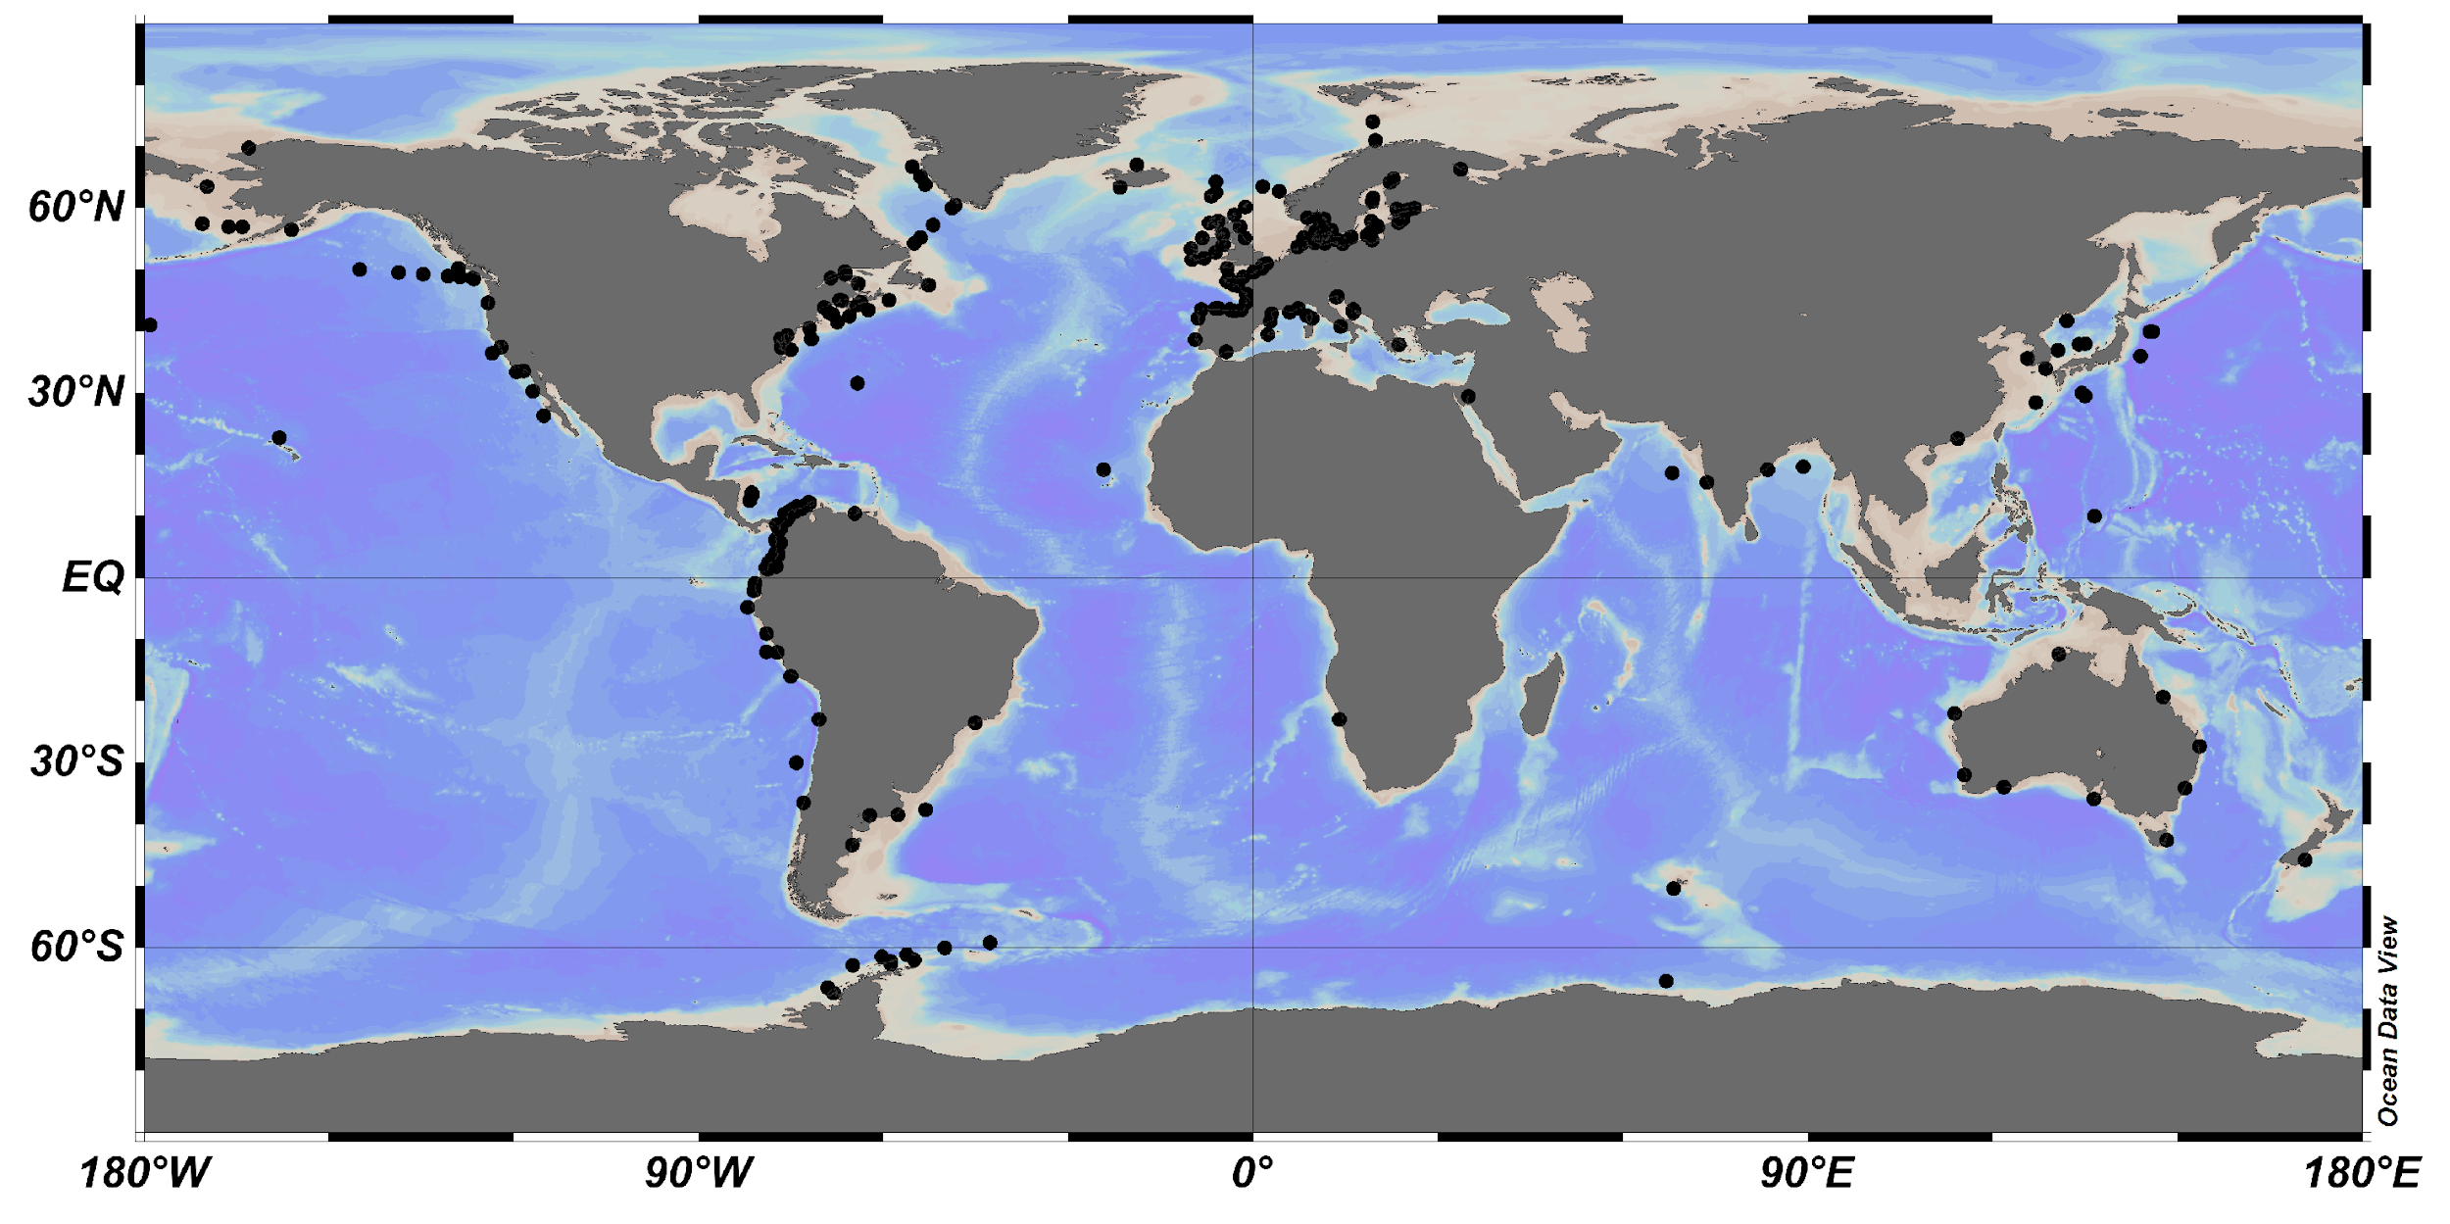
Workshop Outcomes: Global compilation of measurements and methods
Time-series name, location, and lead contact
Duration and frequency of measurements
Variables being measured
Methods being used
Data access and methods information

Slide 7


Marine Ecological Time Series (METS)
NSF EarthCube Research Coordination Network
Co-PIs: H. Benway, WHOI/OCB, D. Kinkade, BCO-DMO and A. White, Univ. Hawai’i
Objectives
Build consensus on key components of a METS data model
Engage broader prospective community of METS data users
Build capacity for METS data analysis, statistics, and data-model integration

Slide 8
Marine Ecological Time Series (METS)
NSF EarthCube Research Coordination Network
Phase 1. Spin-up and data model development
Steering committee, web presence, network building
Consensus building workshop
METS data working group
Phase 2. Broaden METS data users
Regional user networks
METS user workshop
Phase 3. Build METS data analysis capacity
Hackathon!

Slide 9
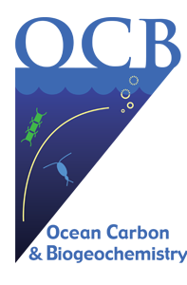
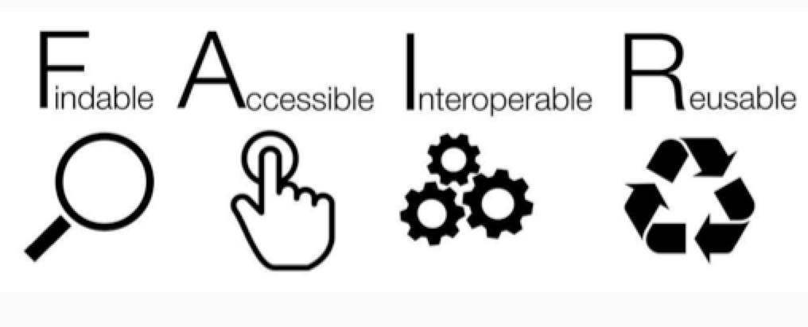
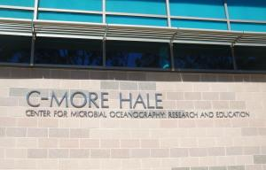
Ocean Time-Series Data Coordination Workshop
Sept. 2019 (Honolulu, Hawai’i USA)
Goal: To address shipboard ocean time series data cyber-infrastructure challenges and discuss strategies toward a FAIR data model
Data citation
Data access and discoverability
Interoperability
  Variable user interfaces
  Tighten and refine community-adopted standards and best practices for data and metadata
Data submission

Slide 10
Ocean Time-Series Data Coordination Workshop
Sept. 2019 (Honolulu, Hawai’i USA)
Actionable Recommendations
Prolonged effort and investment in FAIR data model development for ship-based ocean time series
Pilot data product that includes a limited set of time series sites and core variables
High-level international leadership group to provide scientific oversight and coordination
Broaden users of ship-based ocean time series data sets, including modelers, educators, decision makers, etc.
DOI 10.1575/1912/25480

Slide 11
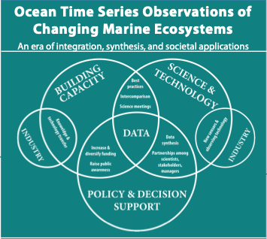
OceanObs19 Community White Paper
Decadal Vision for Ocean Time Series
Expand marine ecological observing capacity
Integrate time series data and models to improve process understanding and prediction
Broaden applications and end users of time series data
Foster global collaboration and networking
DOI 10.3389/fmars.2019.00393

