Slide 1
OCG – 12 Virtual meeting May 2021
Chair: Boris Kelly-Gerreyn
Technical Coordinator: Long Jiang
Data Buoy Cooperation Panel (DBCP)

Slide 2
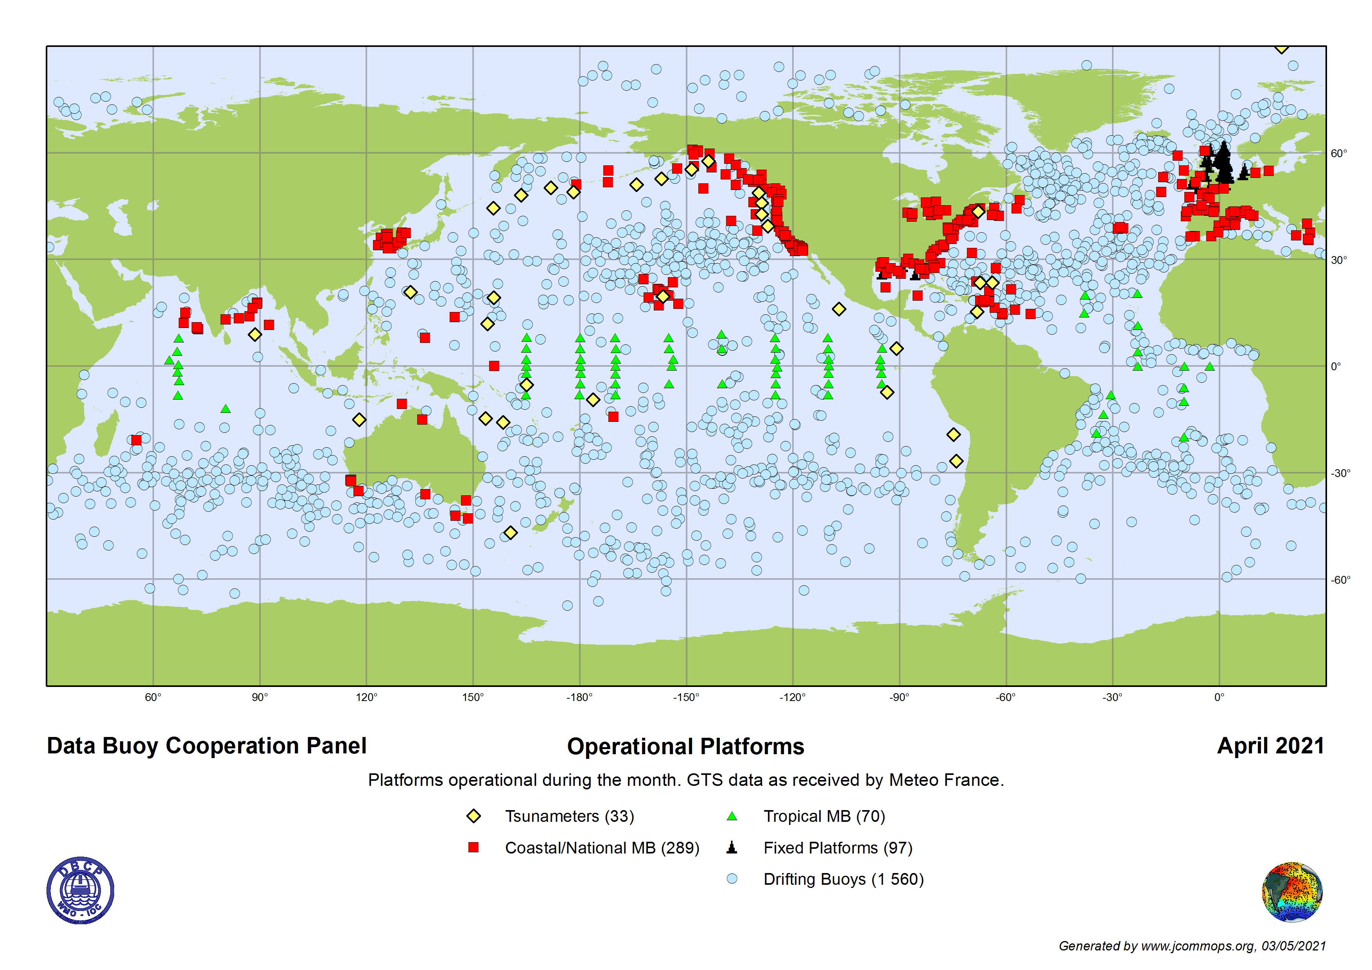
Network Overview
Moored Buoy Networks | # Operational Units | Wave Measurements | BUFR | Sensor Metadata | Operating Countries
Coastal/National Buoys | 289 (↑) | 88% | 71% | 98% (↑) | 13(↓)
Tsunameters | 34 | NA | 0 | 100% | 5
Tropical Moored Buoys | 70 (NDBC) | NA | 100% | 100% | 1
Global Drifter Array | # Operational Units | Timeliness (<1hour to GTS) | Air Pressure | BUFR Migration | Sensor Metadata | Operating Countries
Arctic | 61 | 96% | 55% | 100% | 100% | 3 (--)
Antarctic | 55 | 98% | 65% | 100% | 100% | 5 (↑)
Overall | 1560 | 97% | 54% | 100% | 100% | 8 (↓)

Slide 3
Developments and Achievements
DBCP-36 – Record Participation (~150 people from ~40 Members)
New Strategy - Broad Consultation (OCG, GOOS, WMO, IOC, ECMWF, OceanPredict, Satellite community, Users+)

Slide 4
DBCP Strategy 2021-2026
Economic
prosperity
Sustainable
development
Impact and value
Operational
& Scientific
excellence
Diversity and
inclusivity
Well-being
Our users
Science and
knowledge
Environmental
protection
Technology
innovation
Ocean Health
International cooperation
and (commercial) partnerships
(+capacity development)
Weather and climate
prediction
Notes:
And so all of these strategic pillars which are geared towards our users help to bring about economic prosperity, sustainable development, well-being, a healthy ocean and planet, excellent science and enhanced weather and climate predictions.
So this is our strategy in a nutshell.
Other things that are in the draft strategy are specific strategic actions, an implementation timeline and how we are going to measure our success over the next five years.

Slide 5
Developments and Achievements
DBCP-36 – Record Participation (~150 people from ~40 Members)
New Strategy - Broad Consultation (OCG, GOOS, WMO, IOC, ECMWF, OceanPredict,
Satellite community, Users+)
Ran OCG workshop on environmental stewardship
Starting 2 new Task Teams:
Environmental Stewardship (workshop 12th May)
User Engagement
Mostly Healthy and resilient network in Covid-19 pandemic (less deployments than in 2019, but prolonged life-time of drifters)
Dramatic increase of moored buoys in BUFR 315008, with overall migration rate doubled to 65% in 2020
~100% operational drifter metadata now synchronized with OSCAR/WIGOS
Data flow mapping conducted

Slide 6
Challenges and Concerns
Commercial sector both a threat and an opportunity
Is the network design fit for purpose (overdone/underdone)?
Greater uptake of barometer upgrade and wave sensors
Low/no BUFR migration - coastal buoys & tsunameters
RAMA moorings approximately 50% active

Slide 7
Future Plans and Opportunities
Prepare virtual DBCP-37 (8-11 November 2021)
Launch new DBCP strategy and start implementing
Refresh Executive Board & Review DBCP structure (incl. functional connections with WMO/IOC/GOOS)
Tsunami detection innovation workshop
PI-5 virtual training workshop (May & June)
Funding buoy deployments in area of need
Embed in UN Decade
Workshop on Operational Wave Measurements (postponed to 2022)

Slide 8
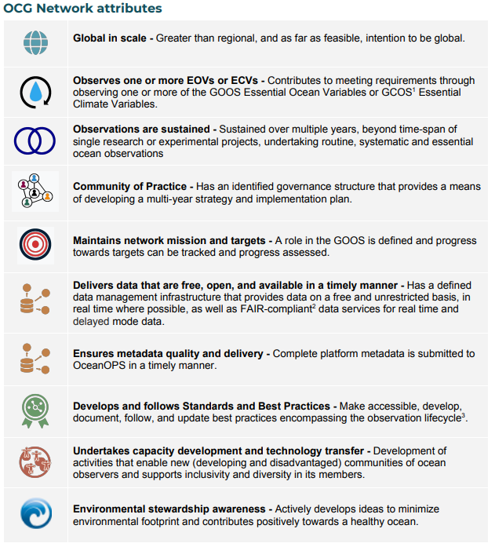
Attribute Report out
✓
✓
11 out of 31
✓
4 decades
✓
TTs: Data Management, Moored Buoys, Wave Measurements, Capacity Building, DBPTD (below)+ new (Environmental Stewardship, User Engagement)
✓
GTS BUFR: Drifter 100%, MB 65%
DAC: AOML; GDACs drifter: Coriolis/France, MEDS/Canada
CMOC
✓
✓
✓
Task Team on Drifter Best Practices and Technology Development
✓
✓

Slide 9
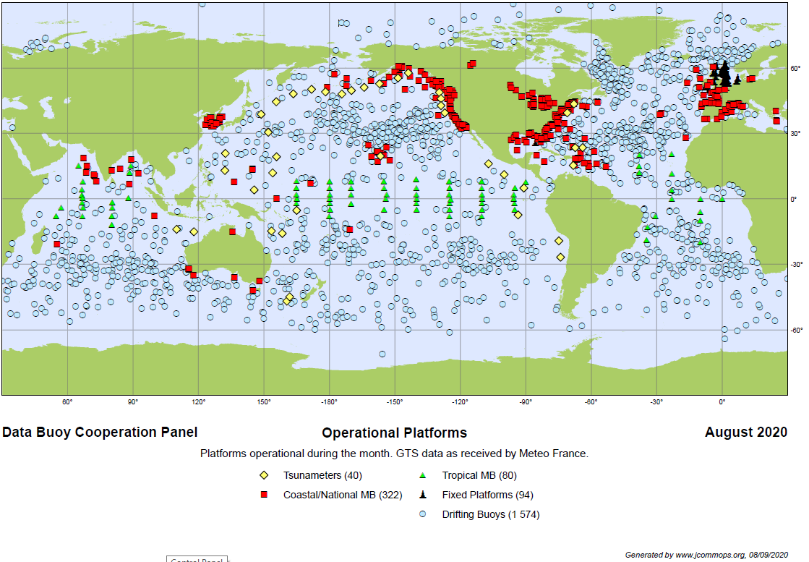
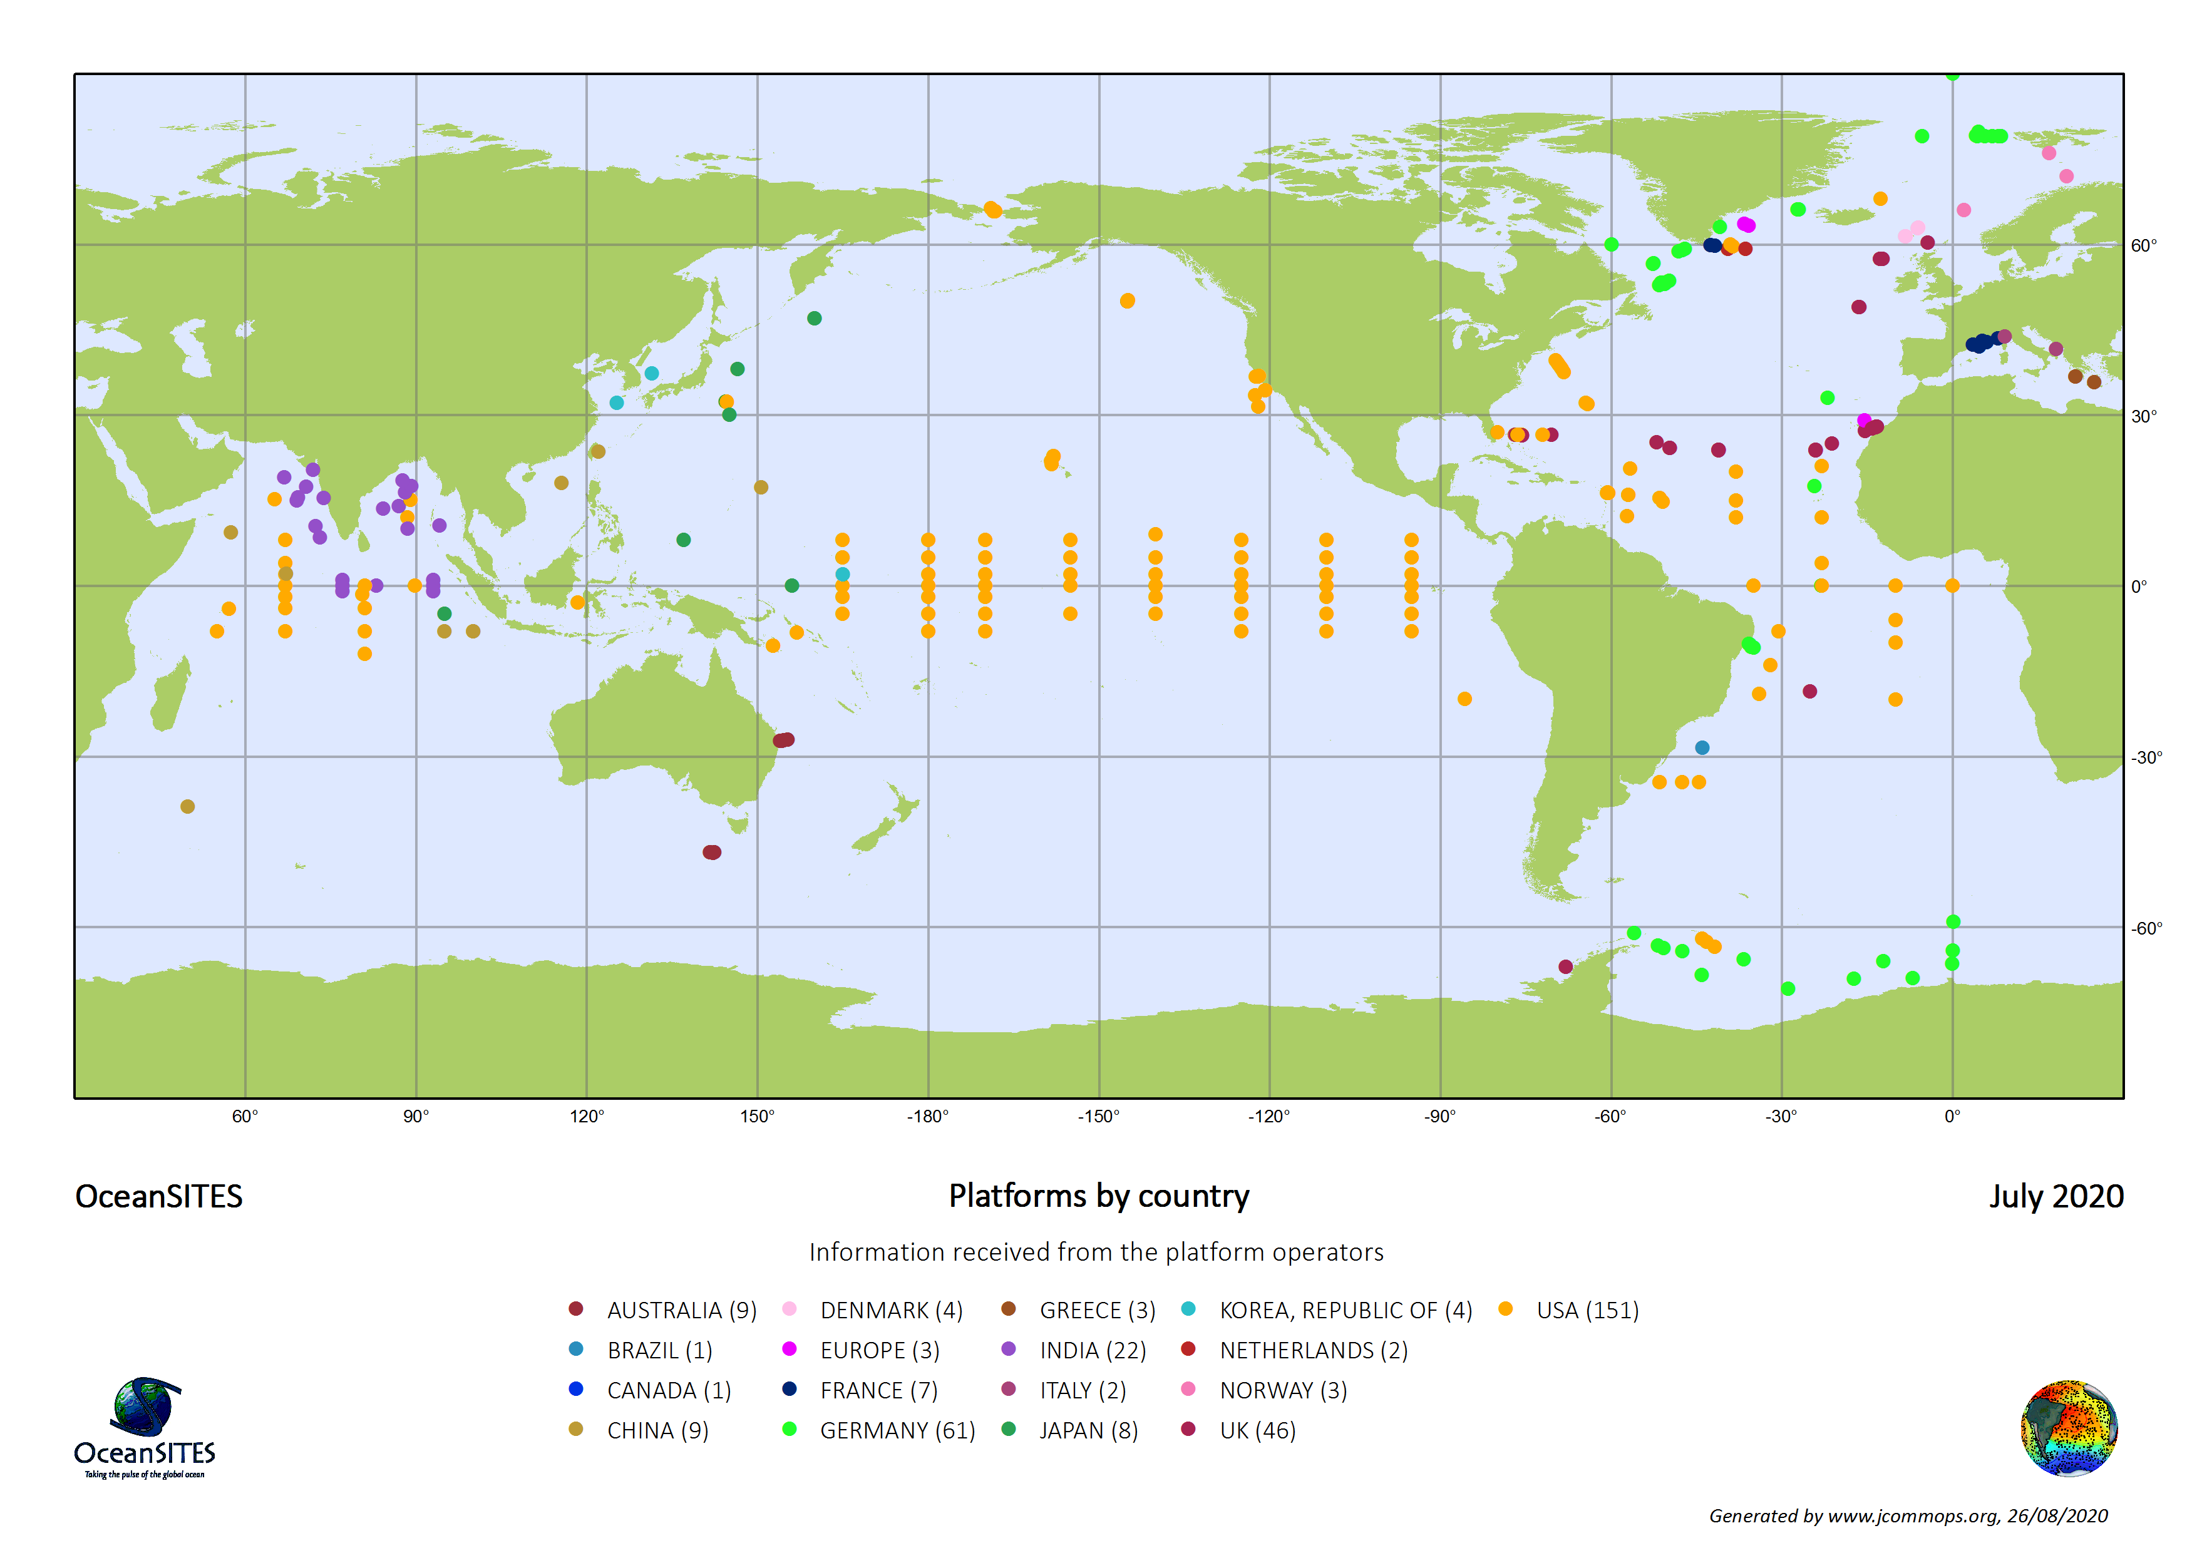
DBCP OceanSITES
Surface ocean + air-sea
Open ocean and coastal
Physics observations
Focused on real-time data
GTS delivery
Operational services + research
Sea surface to seafloor
Open ocean
Multidisciplinary observations
Highest quality data
Research focused
Key overlap = tropical mooring array +
technical coordinator

Slide 10
Asks from OCG
Advice and guidance on partnering with growing commercial sector – how best to coordinate across the networks?
Provide a mechanism to ensure OCG network annual meetings do not coincide (e.g. 2019)
How to leverage workshop outcomes on environmental stewardship?
How to increase diversity and inclusion across the OCG networks?
What is the status of the metrics on users/user impact and value?
Advice on how to best embed in the UN decade… Holistically as OCG and/or separately as individual networks?
Request OCG establish a repository of user impact stories from ocean observations

