Slide 1
12th Observation Coordination Group (OCG-12)
Virtual Meeting
Data and Metadata
Kevin O’Brien
OCG Vice-chair for Data and Information
OCG Executive Committee

Slide 2
OCG-12 Virtual Meeting
Session 7. Data and Metadata
Report from the Metadata and Data workshop
Update on OCG data strategy implementation
Data Mapping project updates
Update on Open-GTS activities
OCG Data connections to other activities

Slide 3
Data and Metadata Workshop report out
Nearly 80 Participants
Representatives from all of the networks, plus OceanOPS and OCG Exec
Split into three sessions:
Network Round table discussion about challenges, opportunities
Metadata discussion
Present OceanOPS metadata requirements document, and discuss efforts to harmonize across networks
Data discussion and OCG data strategy
Notes:
Thank Forest, Ann, Emma, Champika

Slide 4
Network Rountable
Challenges:
Pulling together a complete metadata record from distributed sources
New data types, such as BGC parameters and passive acoustic data
Strict format conventions can be both a blessing and a burden
Improving flow of data from developing nations onto the GTS
Multiple data processing codesets across a single network/data stream
Finding data once it’s available
Understanding metadata requirements from stakeholders outside of OCG
Opportunities:
Developing common data formats and metadata content across networks
NetCDF is common among many OCG networks
Metadata harmonization work with OCG/OceanOPS
OCG data strategy focuses on FAIR principles which will improve discoverability and usability of data
HF Radar synergies between US and European nodes
Improved data systems will help to better exploit virtual research environments, etc.
BGC parameters are a challenge and coordination between networks and development of best practices would be helpful to avoid duplicative effort

Slide 5
Actions and Way Forward
Continue with regular roundtables on specific data/metadata topics
Consider creating an OCG Data Committee or Task Team
Publish OceanOPS metadata requirements (collect and incorporate feedback)
Encourage and assist networks in:
Implementing uniform data formats and metadata content
Improving transmission of metadata to OceanOPS
Engage in discussions with sensor manufacturers to improve metadata processes
Improve discovery and accessibility of data through OCG data strategy (ERDDAP integration)
Pilot implementation of OCG Data strategy with ANIBOS - focusing on complete metadata and data services
Encourage cross-network attendance and network-specific data meetings
Survey new metadata requirements from a larger stakeholder base
Notes:
MTS/GOOS Industry Dialogue (September) - can this be a way to bring metadata concerns to industry partners??
ERDDAP - many parts of the networks have adopted an ERDDAP service. Next steps are to increase a more organized adoption of ERDDAP and federate the services through an OCG top-level ERDDAP server
AniBOS implementation of pilot is focused on complete and harvestable metadata and ERDDAP data services. These two components from the basis of the OCG data strategy, and successful implementation will bring OCG networks into FAIR data compliance.

Slide 6
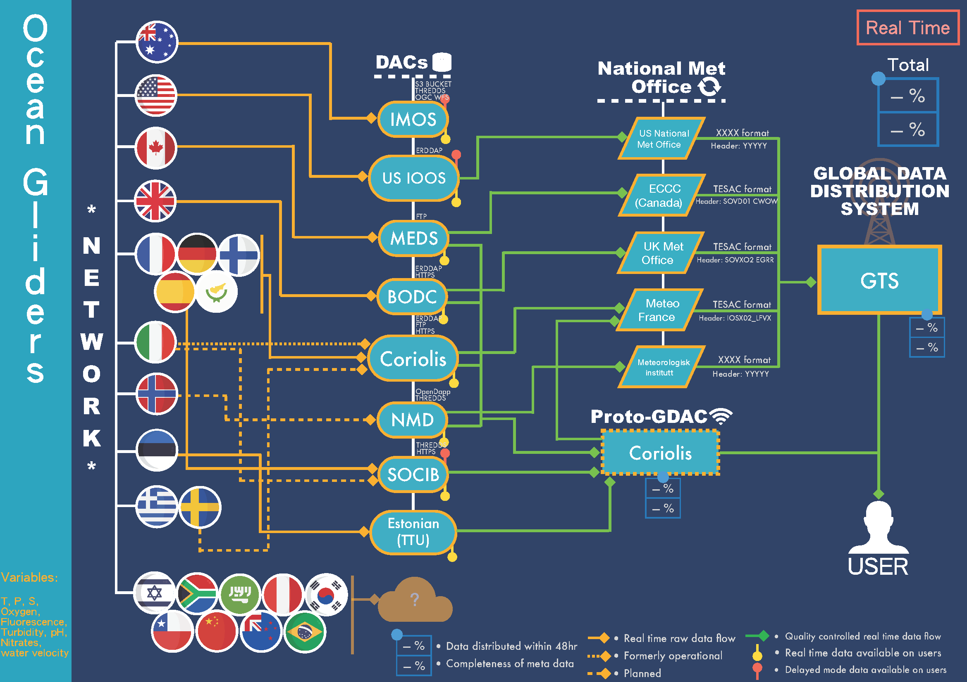
OCG Data Mapping
Thanks to Chanmi Kim (UNESCO) for developing the diagrams
Goal is to clearly map out data flow from networks
Real time data, and Delayed mode data
Developing basic mapping from OCG network perspective
Work with T.C.’s and identified data contacts from each network
Work with IODE and WMO to extend mapping beyond just OCG scope
Why are we doing this?
Identify gaps and potential efficiencies
Will help development of OCG data strategy
Will share with networks for feedback as the first drafts are finalized (Argo, DBCP, OceanGliders, VOS nearly ready)
Notes:
The Data mapping effort is part of the data strategy and metadata harmonization efforts.
This mapping will be critical to understanding data flow overlaps between the physical, BGC and bio/eco networks. For example, it will be extremely useful to map the BIO data flows in GO-SHIP, as we heard about yesterday. Currently, I’m not sure how or where that data or metadata flows.

Slide 7
Open-GTS activity update
ASV BUFR template released; Glider and Animal Profile templates by end of year
Open-GTS selected as a WMO Information System (WIS) 2 demonstrator project
In parallel with effort to enable near-real time data distribution with CF NetCDF
Two NetCDF data profiles (trajectories, radials) have been accepted for provisional inclusion in the WMO data manual
Soon to begin pilot to use Open-GTS services along with NetCDF to test distribution of some ocean data
Currently involved in pilot project distributing met data from AIS systems on the GTS
Open-GTS is a likely UN Decade project with potential to attach to several Programs
Notes:
AIS provides surface pressure and some others (increase in total obs, if not necessarily increased coverage (operational shipping lanes))

Slide 8
OCG External connections
IODE
Join intersessional working group to help revise IODE data strategy
Working with IODE on development of Ocean Data Information System (ODIS) architecture
Will be part of an ODIS implementation testing group
Goal is to ensure OCG data strategy implementation work is compatible with the ODIS and Ocean Info Hub services
OCG networks should be represented in these services without adding additional burden to networks
BIOEco
Convened an OCG/BioEco meeting (March 2021) as first attempt to better define BioEco relationship with OCG
Identify overlaps through data mapping efforts (GO-SHIP, AniBOS, OceanSITES)
IOCCP
Would like collaboration with OCG as the process for developing a BGC GDAC moves forward
Notes:
Bio/Eco (as Gabrielle mentioned yesterday)
- Use AniBOS and GO-SHIP data mapping to also bridge to BioEco
- share OCG examples of data flow pathways
- focus on metadata as a low hanging fruit
IOCCP BGC GDAC could be an avenue by which OCG can engage more with BGC obs (not sure this is true or how to say this)

Slide 9
12th Observation Coordination Group (OCG-12)
Virtual Meeting Data and Metadata
Kevin O’Brien
OCG Vice-chair for Data and Information
OCG Executive Committee

