Slide 1


OOPC
The Ocean Observations Physics and Climate panel
The Global Ocean Observing System
www.goosocean.org
https://www.wcrp-climate.org
https://gcos.wmo.int
A panel of the Global Climate Observing System (GCOS), the Global Ocean Observing System (GOOS), and the World Climate Research Programme (WCRP)
Chairs: Sabrina Speich & Weidong Yu
Lisa Beal, Maria Paz Chidichimo, Meghan Cronin, Marjolaine Krug, Tony Lee, Eitaru Oka, Peter Oke, Mat Palmer, Satya Prakash, Benjamin Rabe, Karina von Schukmann
Belén Martin Martiguez

Slide 2


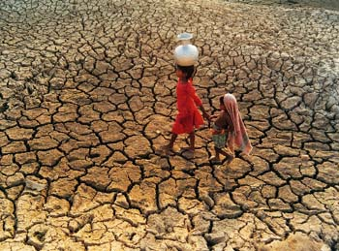
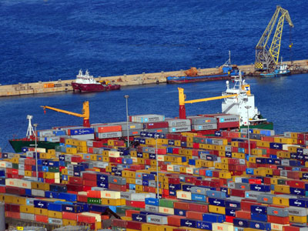
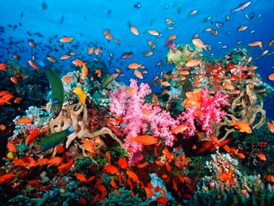


ROLE
Global Ocean Observing System
Climate
Services
Ocean Health
OOPC oversees
the Ocean component of GCOS and
the physical variables for GOOS,
while defining sustained ocean observing requirements for WCRP
(GOOS’s cross-panel climate interface with GCOS)
Support the value chain “observation/data – science/knowledge –service/policy”
https://www.goosocean.org
https://gcos.wmo.int

Slide 3
ROLE
Assessment of Ocean Observing System to meet user requirements
  Global integration of parts (i.e. Basin systems, and topical systems, platforms)
  Assess, review and prioritize requirements for EOVs and ECVs
  Identify gaps
  Promote consistency of EOVs/ECVs across the observing system
Coordination/integration with other organisation and community panels
Review/Evaluation of the observing system
Advocacy for the Ocean Observing System
Work with OCG and regional bodies to coordinate observing networks

Slide 4
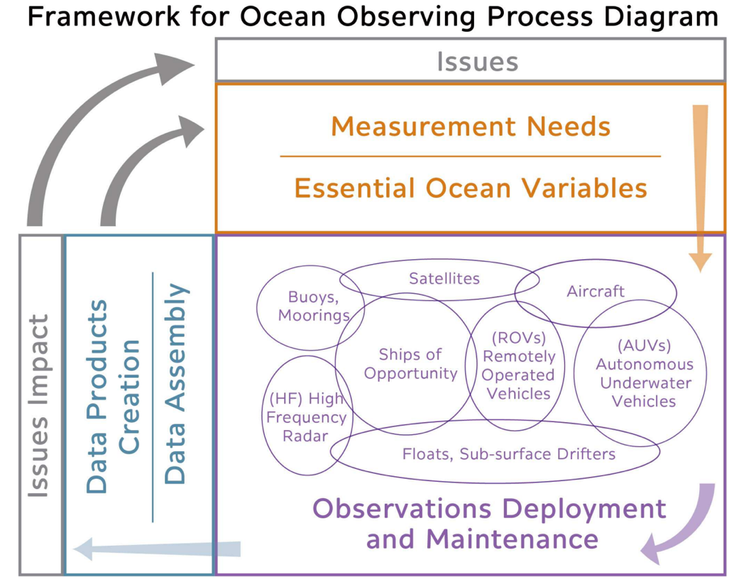
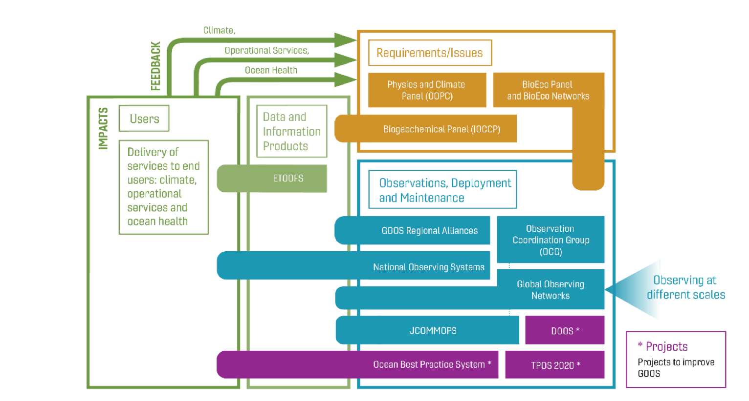

A GOOS Expert Panel
From GOOS Perspective, OOPC has a large and important role to play, responsible for leading on
  Physics Essential Ocean Variables
  Leads on Climate applications (Ocean Essential Climate Variables)
  Leads on Operational applications
  Supporting Ocean Health applications.
GCOS
WCRP
OOPC
GOOS Structure (based on the FOO*)
Integrating the Ocean Observing
Notes:
Main point: OOPC is for GCOS the panel that brings all ocean climate observations together; while for GOOS the OOPC is the Physics panel, a repository of expert advice and assessment on the physical aspects of ocean observations. This matrix design isn’t easy to deal with, and GCOS and GOOS are in dialogue on how to improve that coordination.

Slide 5
WCRP’s New Structure
2
Lighthouse
Activities
3
1
Additional activities and fora
Community Home:
Hosting core projects with two new ones
CLIC
CLIVAR
GWEX
SPARC

Slide 6

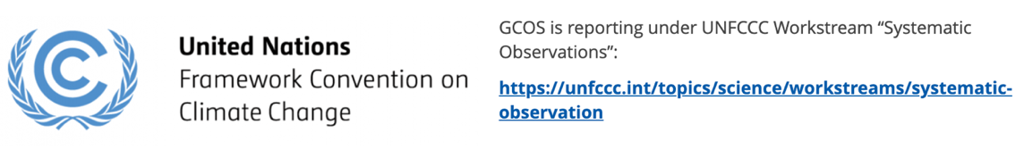
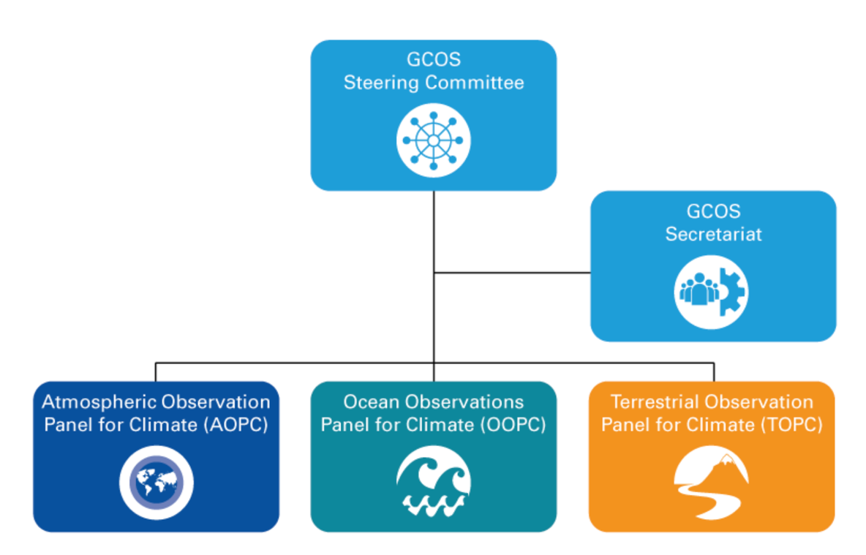
GCOS Implementation Plan & Status Report

Slide 7
A GOOS/GCOS Expert Panel
OOPC Revised Terms of Reference (Draft)
Essential Ocean / Climate Variables Stewardship (across GOOS & GCOS activity)
Developing scientific based ocean indicators (across GOOS activity; link with WCRP & GCOS)
Observing System Evaluation and Reviews
Regional/Basin observing system evaluation (together with CLIVAR)
TPOS
IndOOS
TAOS
OOPC actions for improving the observing system (link with GCOS/WCRP)
Strategy for Ocean Heat and Freshwater Cycles (will discuss also Carbon)
Observing System Evaluation and Strategy for the Ocean-Atmosphere Interface
Observing System Evaluation and Strategy for Boundary Systems

Slide 8
LINK WITH OCG
Working together to build a global tropical observing system: Building on TPOS, IndOOS, TAOS, with OCG together with CLIVAR/WCRP (Clivar Foci, new WCRP home and Light House Activities) and in connection with GCOS (and WMO)
Co-construct the UN Ocean Decade Programme Ocean Observing Co-Design
The Boundary System task team: An opportunity to co-develop integrated observing system(s).

Slide 9
LINK WITH OCG
The boundary current task team
Lead: M Krug, M. P. Chidichimo, L. Beal, J. Wilkin, R. Todd
Establish an ongoing project to guide, support the development of boundary current observing systems
Leveraging OO’19 Whitepapers (Boundary Currents ‘super’ paper; Coastal BGC/Eco papers; Network based papers; New technologies).
Work with OCG to coordinate multi-platform approaches and model synthesis
Collaboration with OceanPredict through OSSEs etc.
Engage GOOS Regional Alliances on capacity development, open data, collaboration/access to coasts; articulate societal impacts
A possible OOPC(GOOS)–OCG joint project under the UN Decade ObsCoDe in link with CoastPredict and Observing Together ?

Slide 10
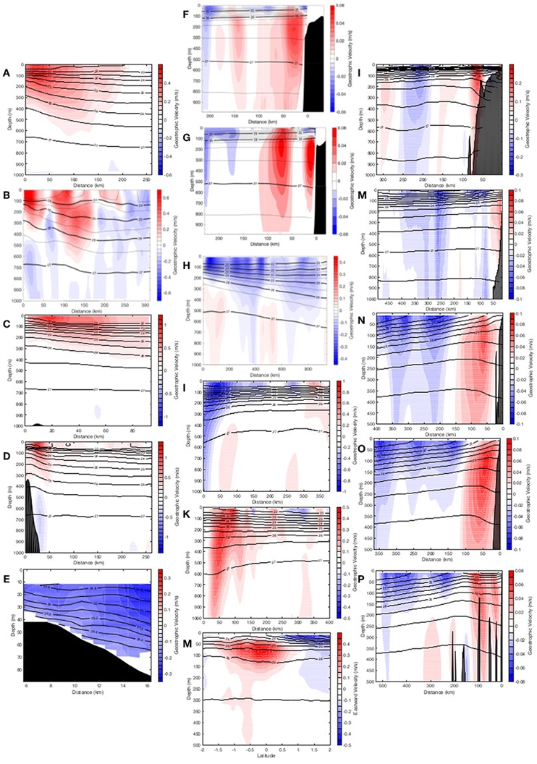
– OCG A Boundary Observing UN Project?
A starting activity in OOPC
Co-developing requirements in terms of EOVs/ECVs
Great potential for building a process to guide network integrations and provide fit-for-purpose integrated observing system
A step between the open ocean (TAOS, IndOOS, TPOS) and the coast.
Major interest from CLIVAR/WCRP/IPCC/UNFCCC
Glider sections of Boundary Currents
Testor et al. 2019

Slide 11
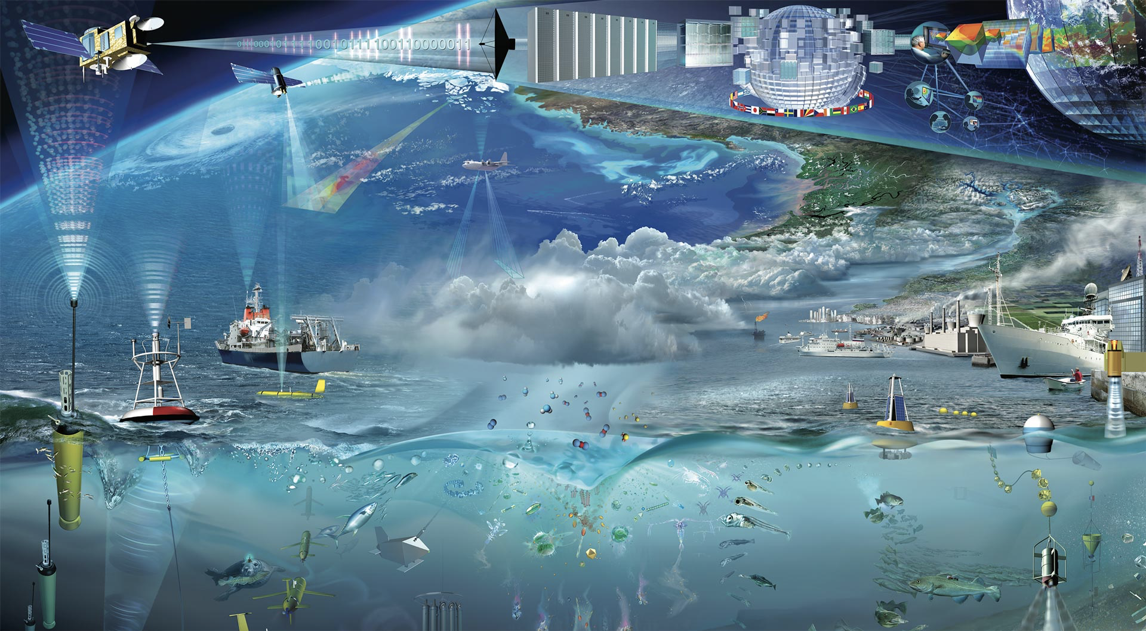


Thank you!

