Slide 1
OCG – 12 Virtual meeting May 2021
OCG
Environmental Stewardship Workshop
Ann-Christine Zinkann, Karen Grissom, Boris Kelly-Gerreyn

Slide 2
What is Environmental Stewardship?
Definition: 2 similar definitions
“The responsible use and protection of the natural environment through conservation and sustainable practices to enhance ecosystem resilience and human well-being.”
“Promotion of practices that reduce the impact of our operations on the environment”.
Five Stewardship actions:
Restore and Protect, Science stewardship, Community awareness, Civic actions, Lifestyle choices
What assessments are conducted?
Informal: self-assessment of environmental footprint to establish baseline of our environmental impact
Formal: Environmental Impact Assessment (EIS), National Environmental Policy Act (NEPA)
ES Folder:
https://drive.google.com/drive/folders/1GErQREXsI3HKs8J4AY3FqGT0VNdqeYFL
Notes:
What is ES, responsible , resilient, enhancing wellbeing.
ES is action oriented and foster sustainability.
Action-oriented framework intended to foster sustainability. Three strategies of stewardship
Reduce the magnitude, exposure and sensitivity to known stresses;
Promote proactive policies of change;
Evade and escape unsustainable social-ecological traps

Slide 3
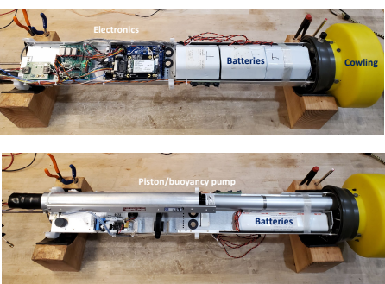
Example of Existing efforts
Argo (Stephen Riser)
Assessment of the composition of an Argo float and possibilities to reduce e.g., plastic
Environmental impacts during a lifetime of a float (e.g., scenario assessments including hall breach, TBTO, float dies)
Assessments of costs and environmental impact if all floats were recovered
900 floats = $9 billion / year ship time
75000 kg/day CO2 [roughly equivalent to the annual emissions of 50,000 cars]
Conclusion:
Argo floats have a contamination footprint but MANY orders of magnitude smaller than what environmentally is put into the environment / natural and anthropogenic fluxes and recovery of Argo floats is not cost-effective and potentially environmentally damaging
Notes:
What is ES, responsible , resilient, enhancing wellbeing.
ES is action oriented and foster sustainability.
Action-oriented framework intended to foster sustainability. Three strategies of stewardship
Reduce the magnitude, exposure and sensitivity to known stresses;
Promote proactive policies of change;
Evade and escape unsustainable social-ecological traps

Slide 4
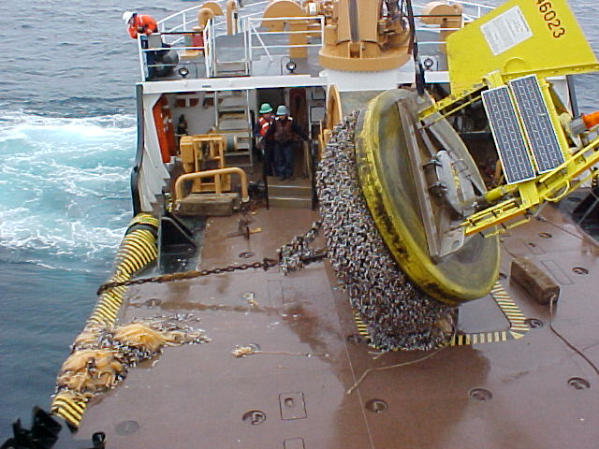
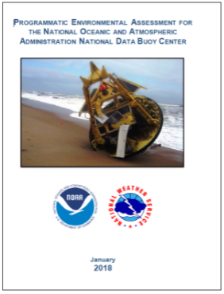
Example of Existing efforts
DBCP (Shannon McArthur)
NEPA Assessments: National Environmental Policy Act (enacted 1970 in the US)
2017/2018 NDBC prepared and publicly adjudicated:
Motivation/Driver: Compliance, NOAA’s Stewardship Mission, Mitigate threat/risk to program operations.
Programmatic Environmental Assessment (PEA) & Finding of No Significant Impacts (FONSI)
Described physical (e.g., equipment, material, facilities), biological (e.g., population, biotic components) , and cultural resource (e.g., past human activity) characteristics
Impact considerations
Economic Loss, habitat damage, entanglements, vessel damage, invasive species transport
Conclusions;
NEPA PEA Results: “Findings of No Significant Impact” (“FONSI”)
Proposed Improvements: Recover moorings, improve adrift buoy recovery, prevent hull fouling & transport of invasive species
Notes:
What is ES, responsible , resilient, enhancing wellbeing.
ES is action oriented and foster sustainability.
Action-oriented framework intended to foster sustainability. Three strategies of stewardship
Reduce the magnitude, exposure and sensitivity to known stresses;
Promote proactive policies of change;
Evade and escape unsustainable social-ecological traps

Slide 5
Poll Responses
What do we mean by environmental stewardship?
Promotion of practices that reduce the impact of our operations on the environment. 82% / The responsible use and protection of a resource through conservation and sustainable practices to enhance resilience and well-being. 91%
What should the OCG role be in environmental stewardship? Select up to 5 options
Education, information, 80% / Monitoring, 70% / Best Practices, 100%
What are your concerns and challenges in conducting Environmental Assessments?
Lack of resources (time, people, money), / Lack of knowledge, information,
Are you or someone in your program involved in current activities or have future plans to tackle environmental stewardship?
Yes, 78% / No, 11% / Unknown, 11%
Select the answer(s) that best describes your program environmental stewardship activities?
Working on best practices (reviewing, adopting, advocating, creating). 67% / Plan to undertake future environmental assessment of impact of program. 44% / Researching and gathering information on laws, actions and resources needed to engage in environmental stewardship activities. 33%
Notes:
What is ES, responsible , resilient, enhancing wellbeing.
ES is action oriented and foster sustainability.
Action-oriented framework intended to foster sustainability. Three strategies of stewardship
Reduce the magnitude, exposure and sensitivity to known stresses;
Promote proactive policies of change;
Evade and escape unsustainable social-ecological traps

Slide 6
Conclusion / Ask
DBCP Task Team
ToRs established and under review
Team membership is in built up phase and could act as a focal point
OCG / Networks:
Possibility for OCG establish/assist: Information / Tracking progress / Share Best Practices
Increased availability of information on how ES assessments are conducted
Quantify the risk from not conducting ES assessments (e.g., risk to continued operations through denied permits, delayed EEZ plans, denial of deployment through ships of opportunity)
Ask: Please share any assessments or best practices with the DBCP task team
(sent to: ann-christine.zinkann@noaa.gov)
Notes:
What is ES, responsible , resilient, enhancing wellbeing.
ES is action oriented and foster sustainability.
Action-oriented framework intended to foster sustainability. Three strategies of stewardship
Reduce the magnitude, exposure and sensitivity to known stresses;
Promote proactive policies of change;
Evade and escape unsustainable social-ecological traps

