Slide 1
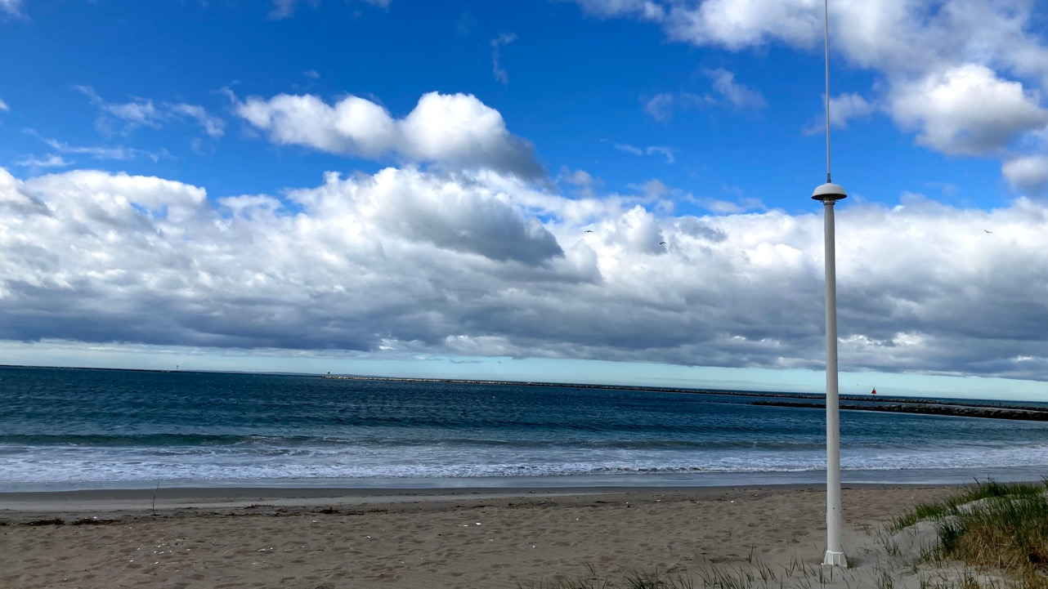





High Frequency Radar in Pacific Island Countries
Dr. Hugh Roarty
5th Pacific Islands Workshop on Ocean Observations and Data Applications
June 10, 2021

Slide 2
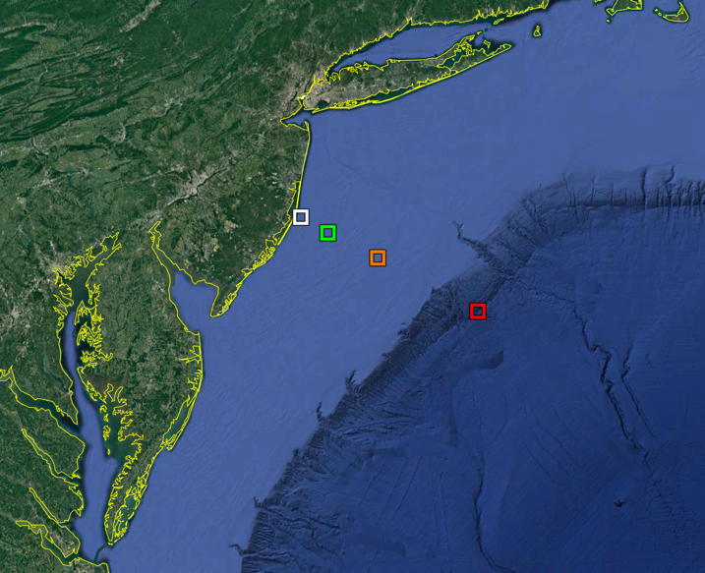
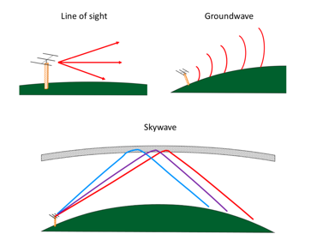
Benefit of High Frequency Radar
Horizon (5km)
25 MHz(30km)
13 MHz (80km)
5 MHz (180km)
Notes:
Sends a radar signal out across the water
About as much energy as a 100w light bulb
3 types of networks with 3 resolutions
The mid range also measure wave height just offshore.

Slide 3
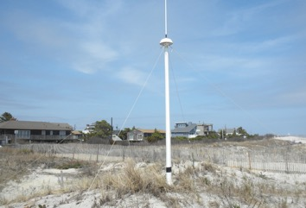
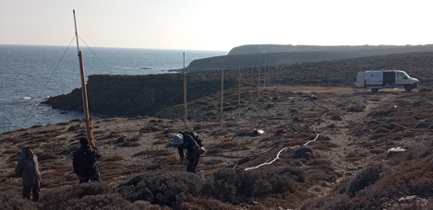
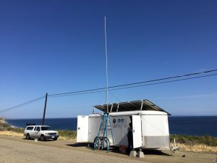
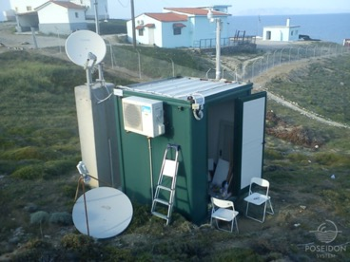
High Frequency Radar
CODAR Tx/Rx NJ, USA
WERA Rx Plaka, Greece
Temporary HFR Station CA, USA
HFR Station Plaka, Greece

Slide 4
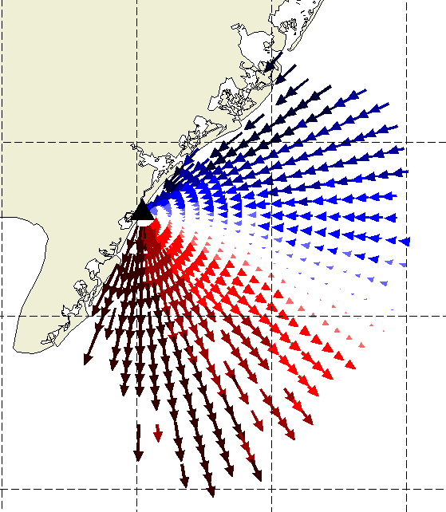
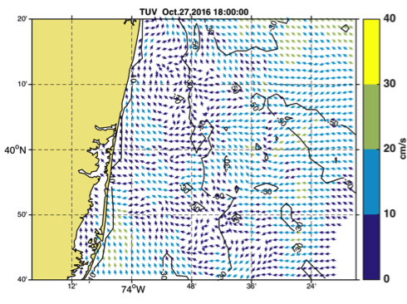
Hourly radial surface current measurements
Hourly total current measurements

Slide 5
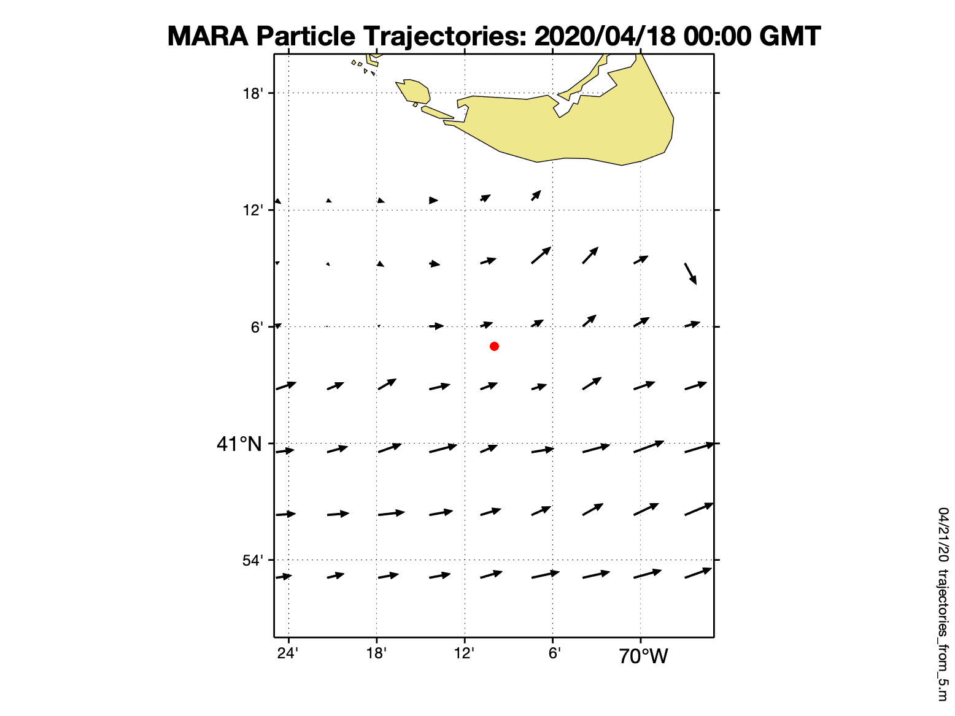
Surface Currents from HF Radar
5 miles
Notes:
NOAA_Cape_Cod_virtual_HFR_virtual_2020_04_18

Slide 6
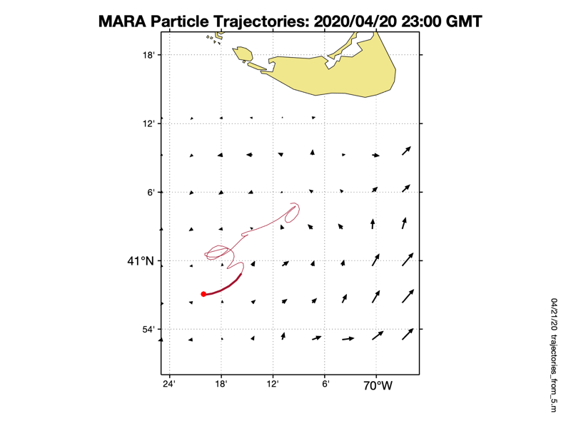
Surface Currents from HF Radar
24 km
70 km total path in 3 days
5 miles
Notes:
NOAA_Cape_Cod_virtual_HFR_virtual_2020_04_18

Slide 7
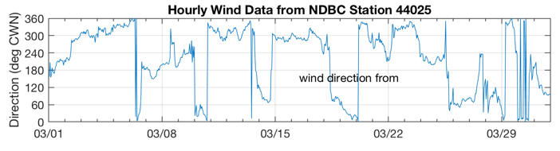
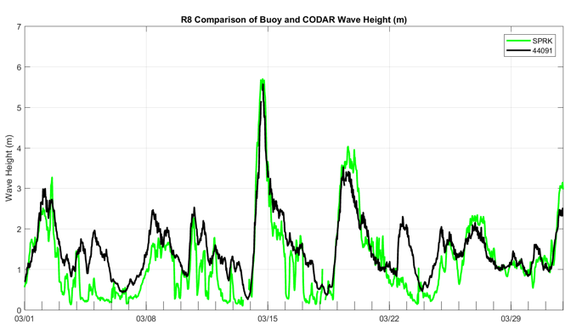
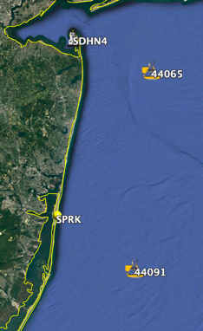
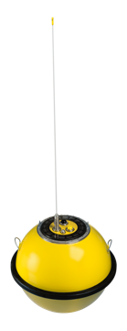
Wave Measurements from HF Radar Stations
Frequency (MHz) | Radio λ (m) | Ocean λ (m) | Period (s)
5 | 60 | 30 | 4.4
13 | 23 | 11.5 | 2.7
25 | 12 | 6 | 2.0
13 MHz
10º
190º
March 2017

Slide 8
HF Radar in
Pacific Island Countries

Slide 9
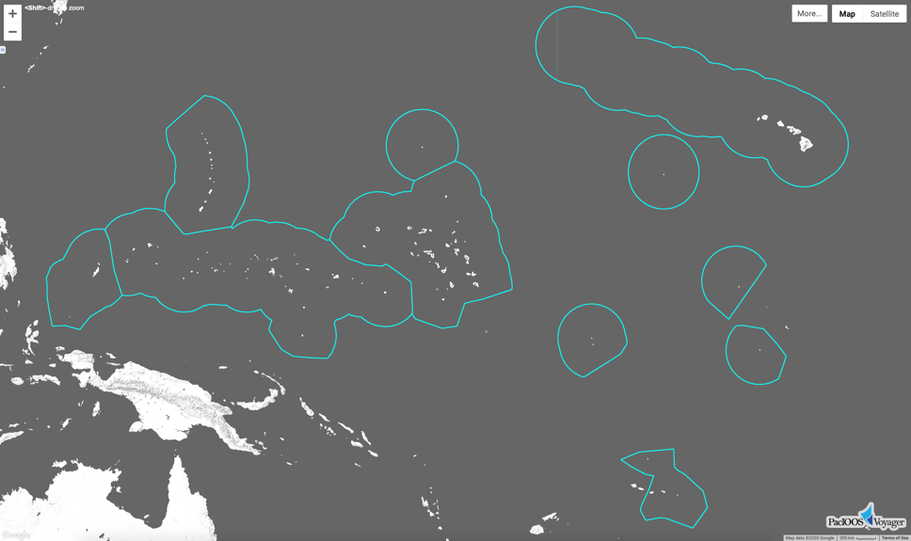
DBCP 2021
Sea Surface Currents Observations - Pacific Islands Ocean Observing System (PacIOOS)
Existing HFR coverage, Hawai‘i
Planned HFR coverage, Guam and Tinian
2 new Datawell Mk4 buoy locations, RMI and Palau (2021 install)
3-5 new Datawell Mk4 buoy locations, within the region (2022+ install)
Notes:
-Existing High Frequency Radar (HFR) sites are within the state of Hawaii. Currently PacIOOS is expanding HFR coverage in Guam and CNMI.
-Datawell Mk4 wave rider buoys have sea surface current measurement capability. 1 new location will be installed in RMI and Palau in 2021. And, beginning in 2022, 3-5 new locations will be chosen and installed across Micronesia. 6 Datawell Mk4 buoys have been purchased by PacIOOS and the order is currently being filled by Datawell (in preparation for the 2022+ buoy deployments).

Slide 10
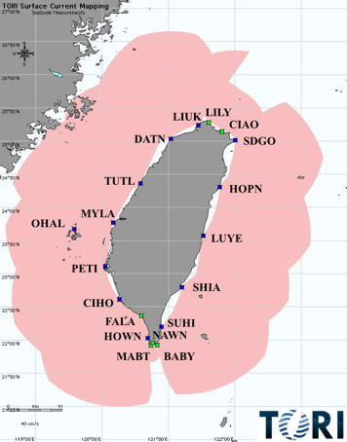
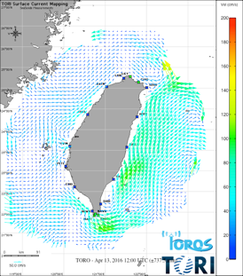
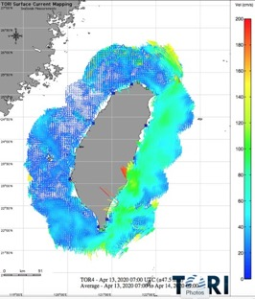
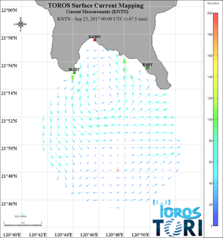
China’s Taiwan Ocean Radar Observing System (TOROS)
10 km
4 km
1 km
17 stations progressively installed from 2009 to 2015

Slide 11

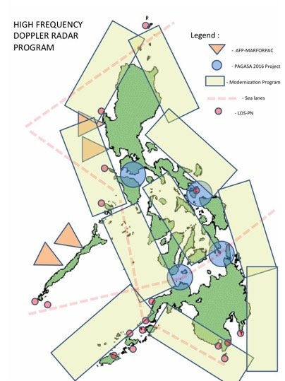
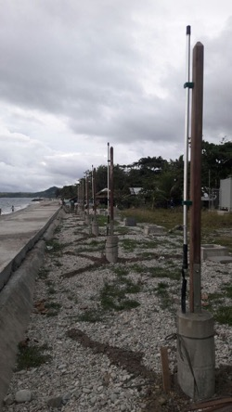
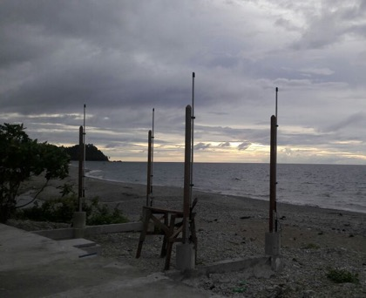
HF Radar Network for the Philippines
Existing Stations
Proposed Locations
Sea Routes
Philippine Navy Stations

Slide 12

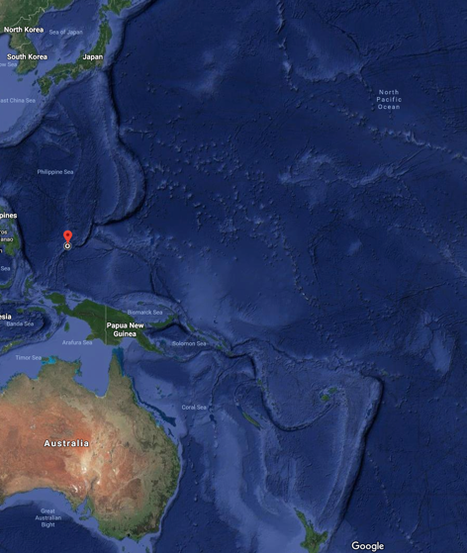
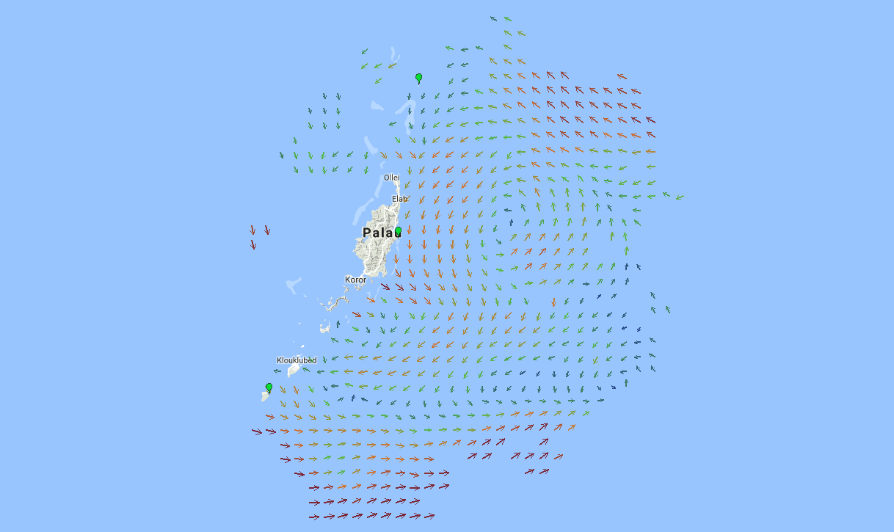
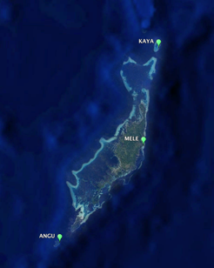

Palau HFR Network - Overview
Notes:
3 station HF Radar observatory was installed along the east coast of Palau to study sea surface current variability. Radar sites are located at Melekeok, Kayangel, and
Angaur (Figure 1), where the later two sites are located on remote islands and require off-grid solar power and satellite internet connection.

Slide 13
High Frequency Radar in Pacific Island Countries
THANK YOU
5th Pacific Islands Workshop on Ocean Observations and Data Applications
June 10, 2021

