Slide 1
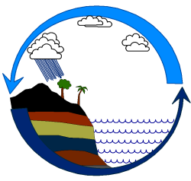
Country Report in Myanmar
Workshop on Ocean Observations and Data Applications (DBCP-PI-5)

Slide 2
Meteorological Division Organization Chart
Agrometeorological
Meteorological Division
Aviation
Meteorological Division
Weather & Long Range
Meteorological
Division
Aviation
Meteorological Division
Marine
and Rada r Meteorological Division
1Assistance Director
1 Staff Officer
2 Senior Observers
1 Junior Observer
KYAUKPYU
RADAR STATION
YANGON
RADAR STATION
MANDALAY
RADAR STATION
1 Staff Officer
1 Assistance forecaster
1 Senior Observer, 2 Junior Observer, 1Field man
1 Staff Officer
1 Assistance forecaster
1 Senior Observer, 2 Junior Observer
2 Staff Officer,
3 Senior Observer, 4 Junior Observer, 1Field man

Slide 3
Marine and Radar Meteorological Division
Marine and Radar Meteorological Division established in March, 2013
8 staffs ( Currently, 4 staffs)
3 radar have been installed in Kyaukpyu, Yangon and Mandalay.
3 sea level tide gauge (Sittwe, H ainggyigyun and Mawlamyine stationa)

Slide 4
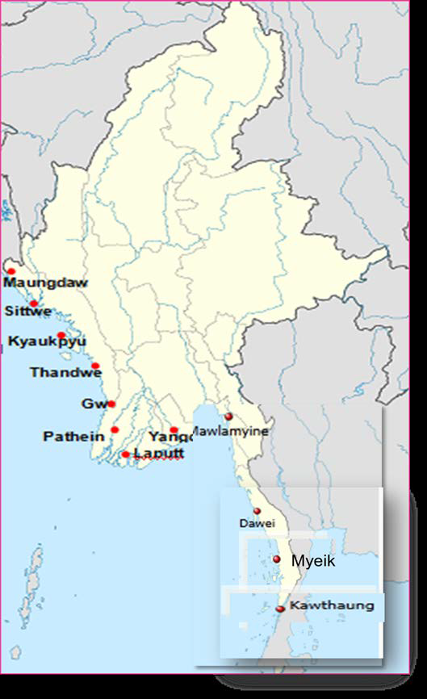
Coastal Observations in Myanmar
About 2400 km in Myanmar coast
12 coastal stations
No marine stations

Slide 5
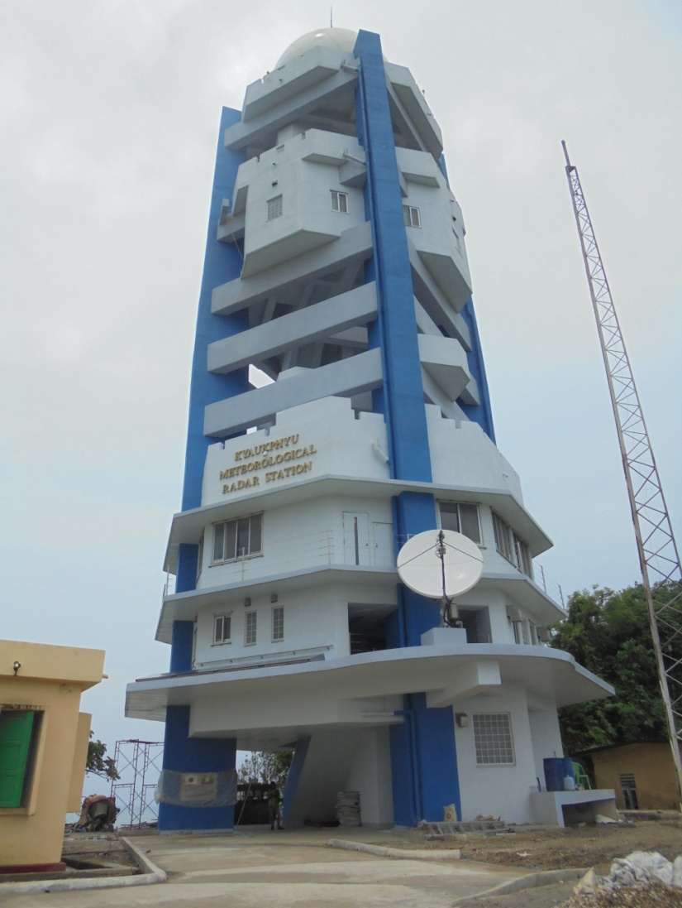
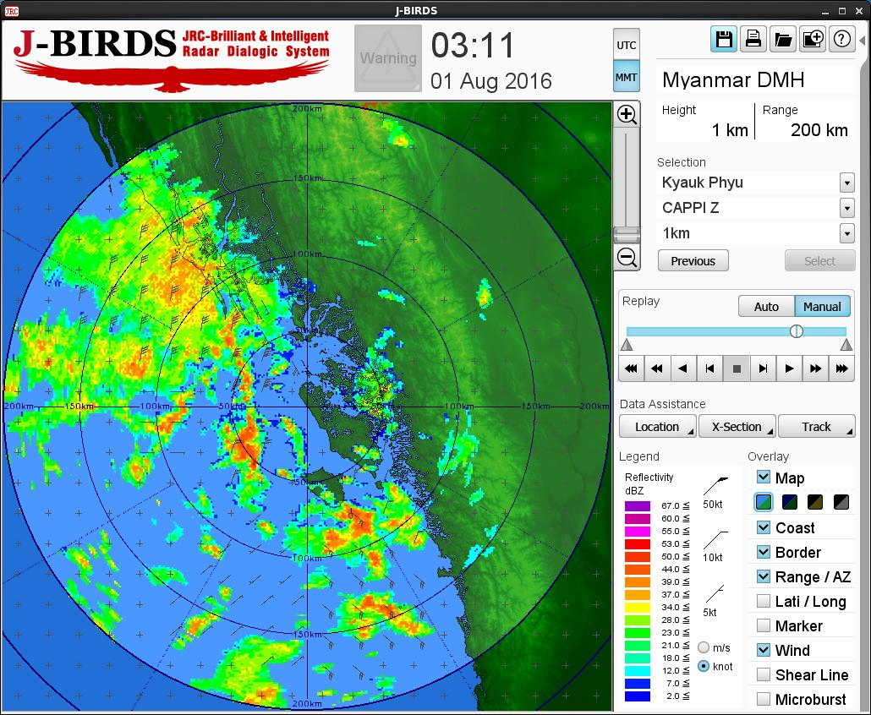
ကျောက်ဖြူရေဒါ
၂၀၁၅ ခုနှစ်၊ အောက်တိုဘာ လ (၉) ရက်နေ့တွင် လွှဲပြောင်းပေးအပ်ခဲ့ပါသည်။

Slide 6
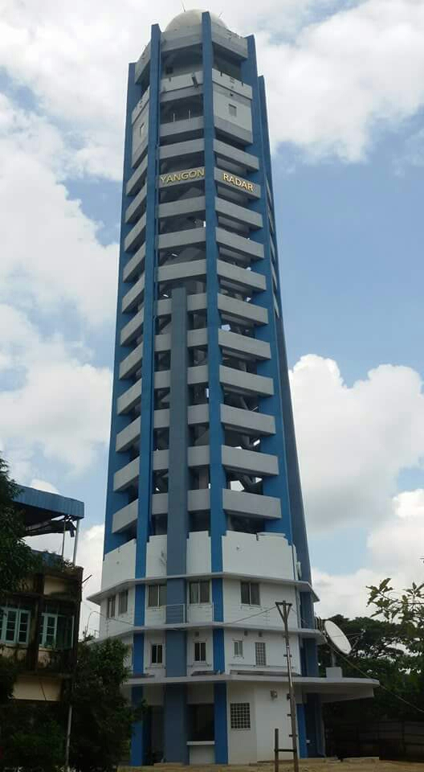
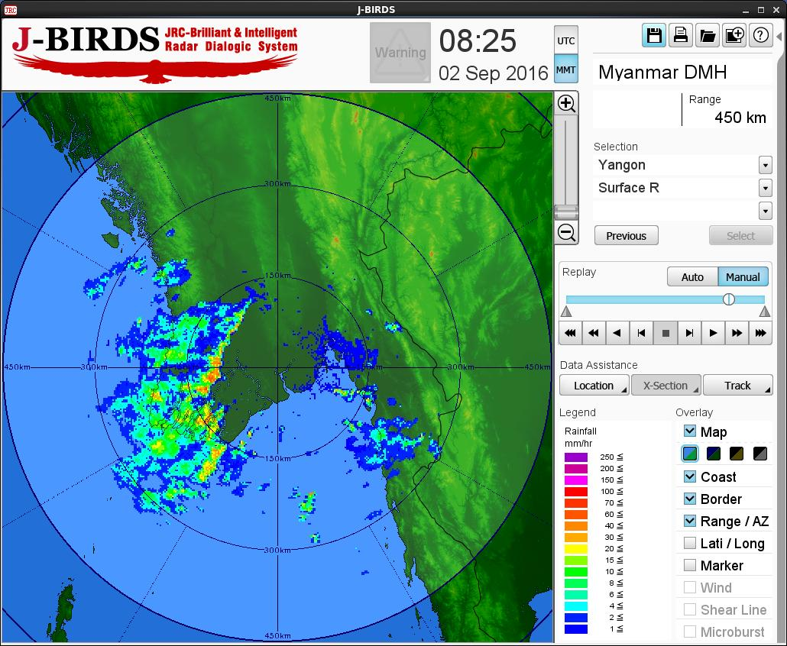
ရန်ကုန်ရေဒါ
ဆောက်လုပ်သည့်ကာလ ၂၀၁၄ စက်တင်ဘာလမှ
၂၀၁၆ အောက်တိုဘာလ
၂၀၁၆ ခုနှစ် အောင်တိုဘာလ(၂၄)ရက်နေ့တွင် ရန်ကုန်ရေဒါကို လွဲပြောင်းပေးခဲ့ပါသည်။

Slide 7
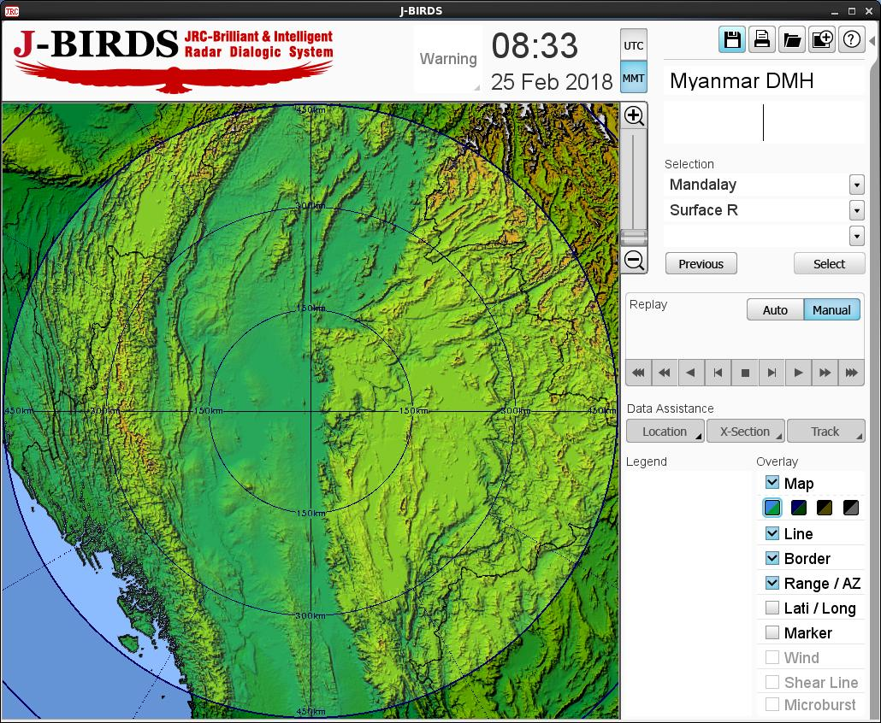
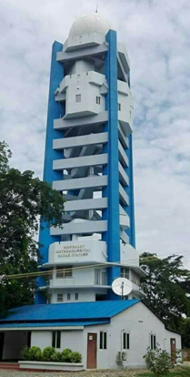
မန္တလေးရေဒါ
(၈.၆.၂၀၁၈) ရက်နေ့တွင် လွှဲပြောင်းပေးအပ်ခဲ့ပါသည်။

Slide 8
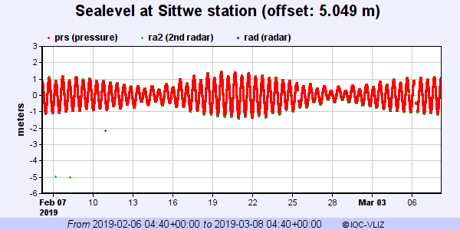
Sittwe in Rakhine State

Slide 9
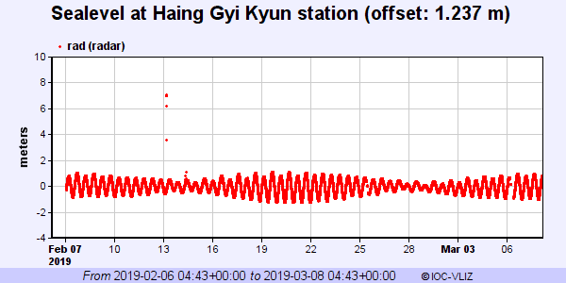
Hainggyigyun in Ayeyarwady Region

Slide 10
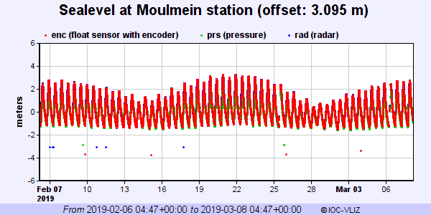
Moulmein in Mon State

Slide 11
Marine Monitoring Activities
Currently, DMH issued sea conditions over the Andaman sea and Bay of Bengal.
Squalls with moderate to rough sear are likely attimes off and along Myanmar coasts. Surface wind speed in squall may reach (35) mph. Wave height will be (8-10) feet off and along Myanmar coasts.
DMH issued the marine weather forecast
for Bay Bulletins

Slide 12
Marine Observations and Data Management
DMH have not marine observations in the coastal areas.
DMH have three sea level stations. (Sittwe, Haing Gyi Kyun and Mawlamyine)
Currently, DMH using the NWP output the neighboring website
(TMD, IMD, SWFDP, .. Etc)

Slide 13
Future plans:
To promote of Numerical weather Prediction System
To Substitute conventional instruments to advanced instruments.
To install modernize weather radars to cover the coastal regions.
To upgrade DMH’s Data collection and processing system with automation.
To enhance Climate Services, Application and Modeling
Dense Meteorological observational networks
To extend Automatic Weather Station (AWS)
Upper air observation facilities (Pilot balloon, wind, moisture, etc)
More instruments to observed radiation, evaporation, sun shine, ozone, upper air, wind and temperature
High gust anemometer for coastal station

Slide 14
Gaps and Requirements
To apply to forecast of Satellite Data and Satellite image
Need to know Satellite data in Now-casting and very Short Range Forecasting
DMH has been installed three radar. After that Need basic Rader information/Analysis of radar . Three radar is not cover in the whole country. We need to more install radar.
Radar training
Need Radar QPE(Quantitative Precipitation Estimation) Techniques
Case study on Radar Data Analysis
NWP product and Verification
We need to install marine observation station in the coastal areas, Myanmar.

