Slide 1





Fifth Pacific Islands Training Workshop on
Ocean Observations and Data Applications (PI-5)
27-28 May and 10-11 June 2021 (Fiji Time, UTC+12)
OceanOPS report
Long Jiang, Technical Coordinator
Email: ljiang@ocean-ops.org
https://www.ocean-ops.org/dbcp/

Slide 2
Outline
OceanOPS
  Strategy and Work plan
  Web-based metadata interface
OceanOPS networks and Pacific Islands
  Argo
  DBCP
  Tidal Gauges
  OceanSITES
  Gliders
  HF Radars
  Saildrones and More
Further Thoughts

Slide 3
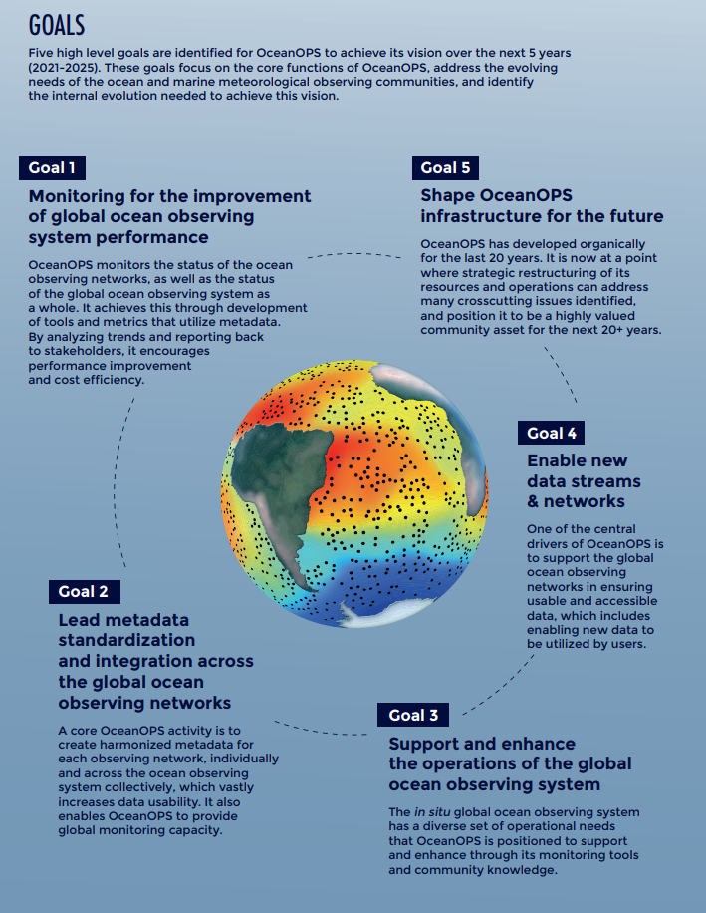
OceanOPS Strategy (2021-2025)

Slide 4
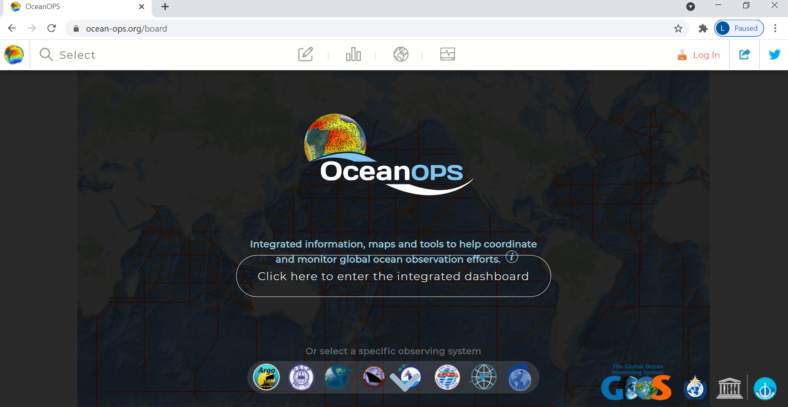
Metadata management https://www.ocean-ops.org/

Slide 5
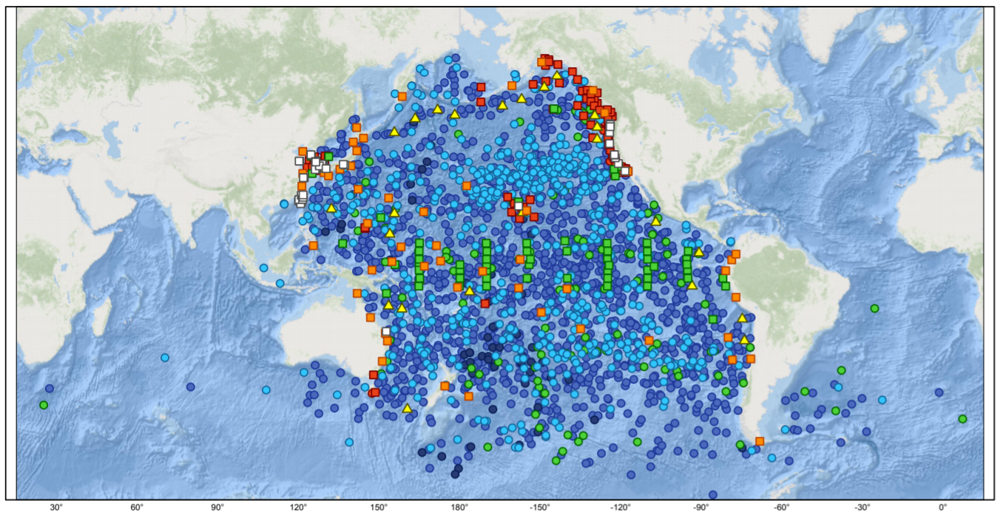
Integrated Map

Slide 6
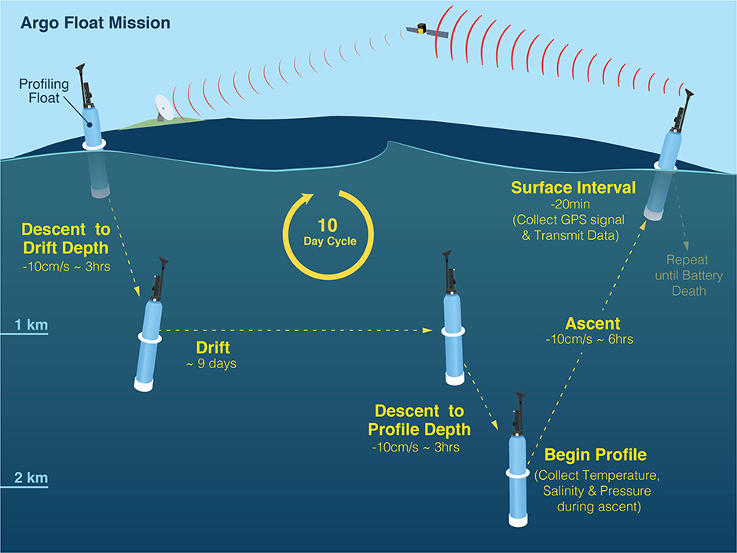
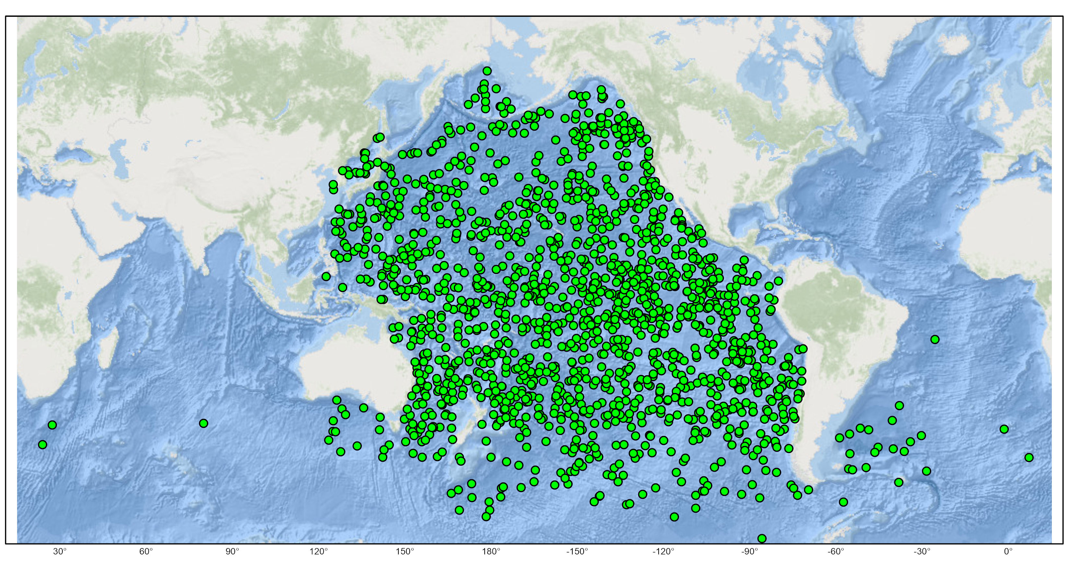
Argo
Circulation
Sea level
Heat storage
Mixed layer
Stratification
BGC
......
10~15 days
5 days
~80%
WBC, Deep, BGC, …
Notes:
1604 operational (78% USA,but all the rest <5%)
, Japan/Australia follows,
image@UCSD

Slide 7
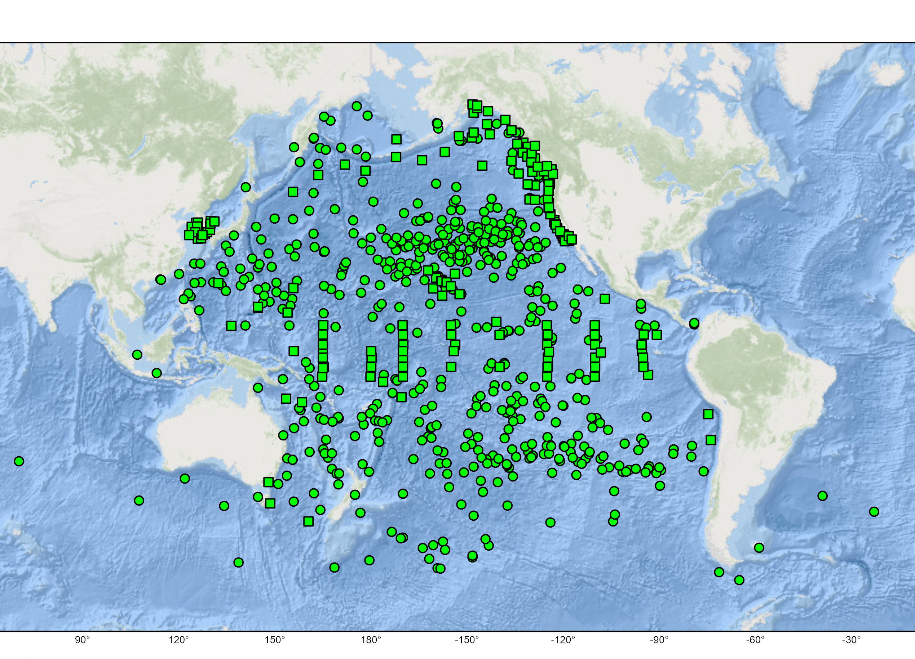
DBCP
Drifters: 555 (98% USA)
TAO: 47 (all USA)
Tsunameters: 25
Coastal/National: 98
Current, SST, SSS, SLP, wave, wind, …
NWP, Operational Wave Forecast, Hurricane Forecast,
Tsunami detection, Climate monitoring…

Slide 8
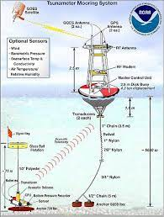
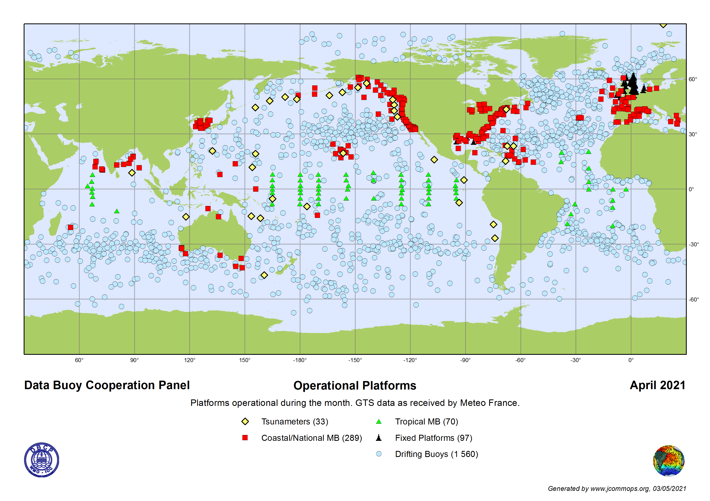
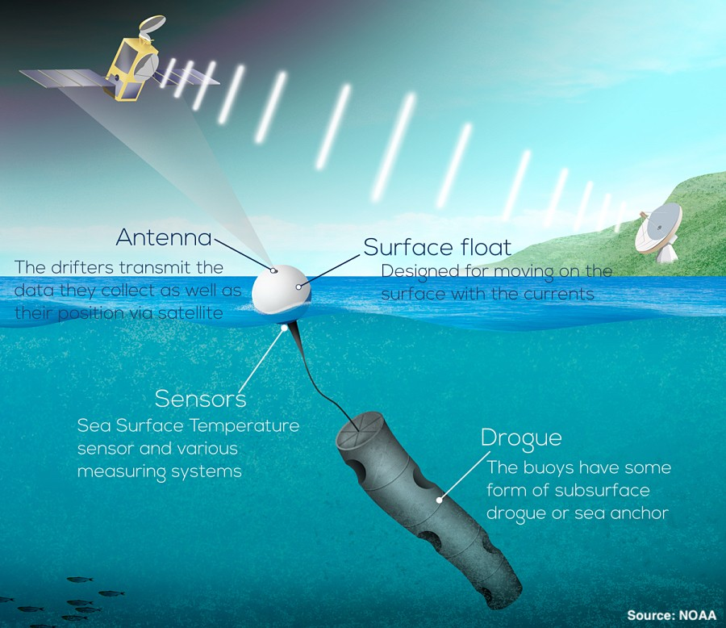
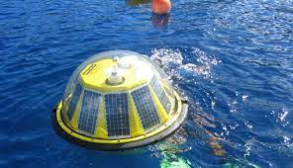
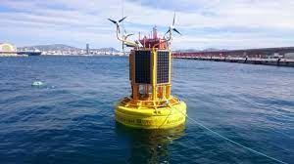
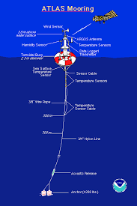
DBCP Overview
Barometer Upgrade? ➔ here
Wave Drifter? ➔ here

Slide 9
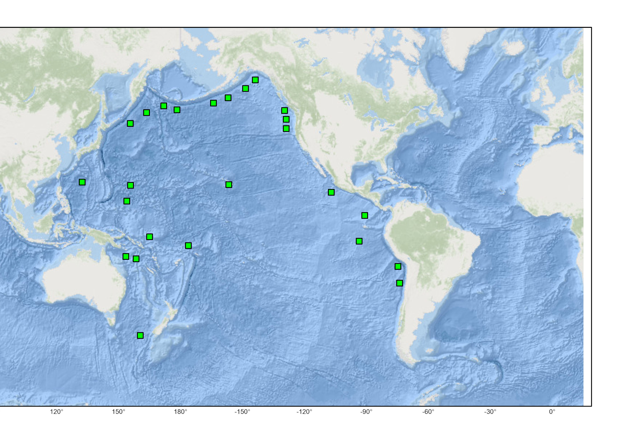
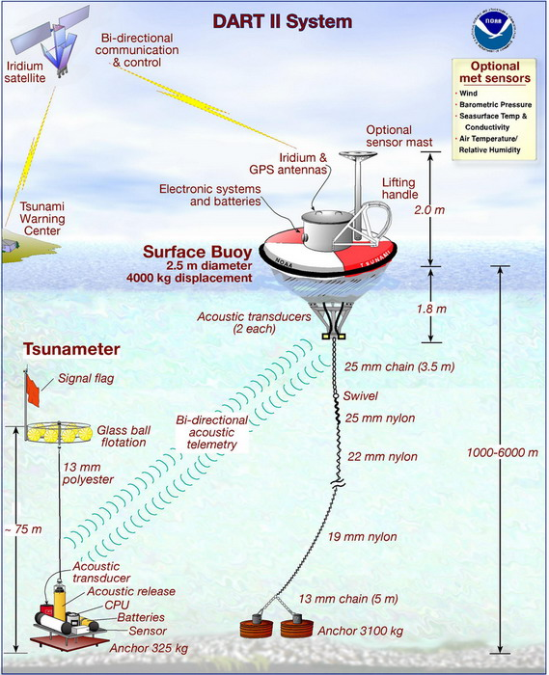
Tsunameters
Notes:
Sea level pressure

Slide 10
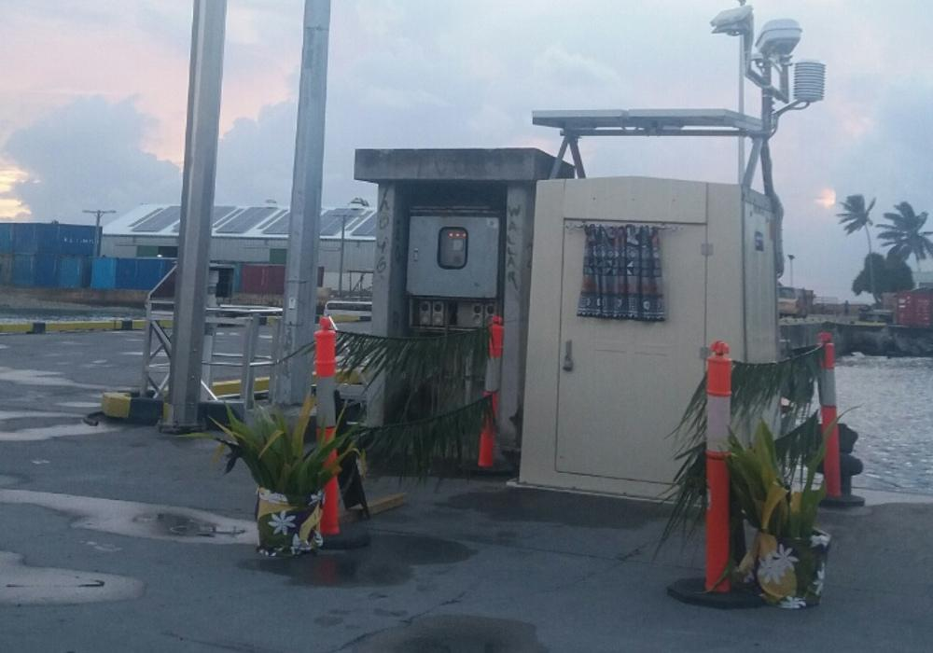
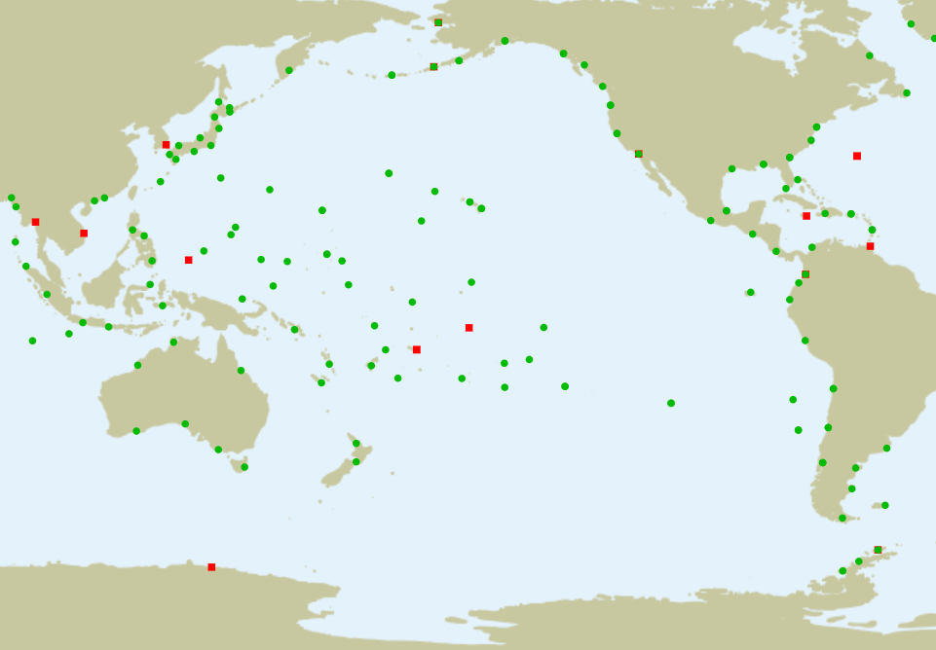
Core GLOSS Stations
Sea Level, Heat Storage, Extreme Events
Storm Surge, Tsunami, Climate Services…
Notes:
image@SPC
Funafuti
Tuvalu
Latitude:
Longitude:
8.525°S
179.195°E
UHSLC ID: 025
Data:
Fast Delivery
Research Quality
GLOSS ID: 121

Slide 11
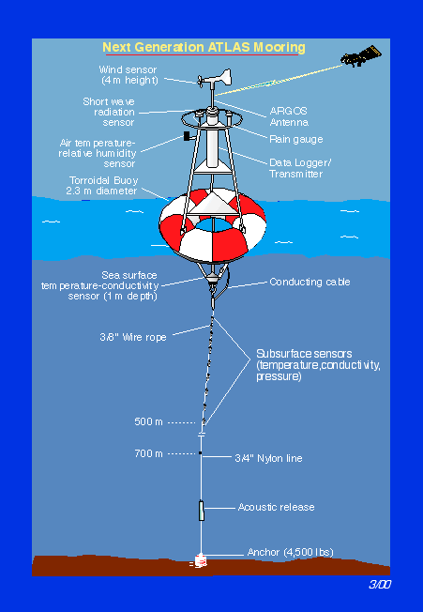
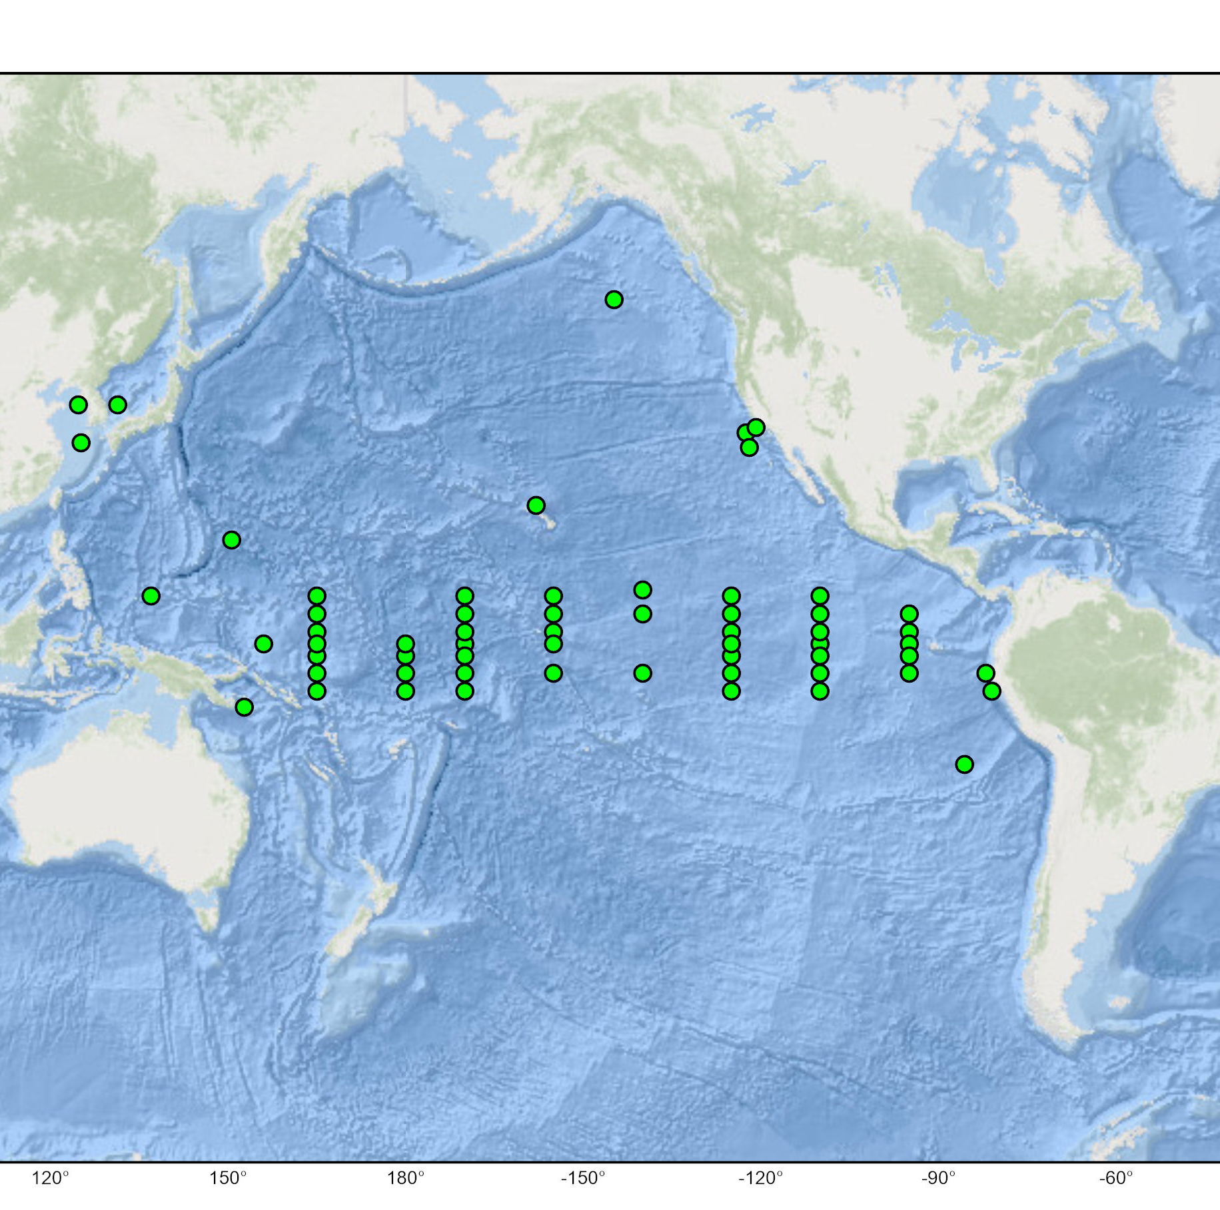
OceanSITES
47 TAO + 14 others
Air sea fluxes, mixed layer, BGC, OC, deep T/S,…
➔➔ Climate, ocean Health, BC, …
Notes:
14
47 TAO, image@NDBC

Slide 12
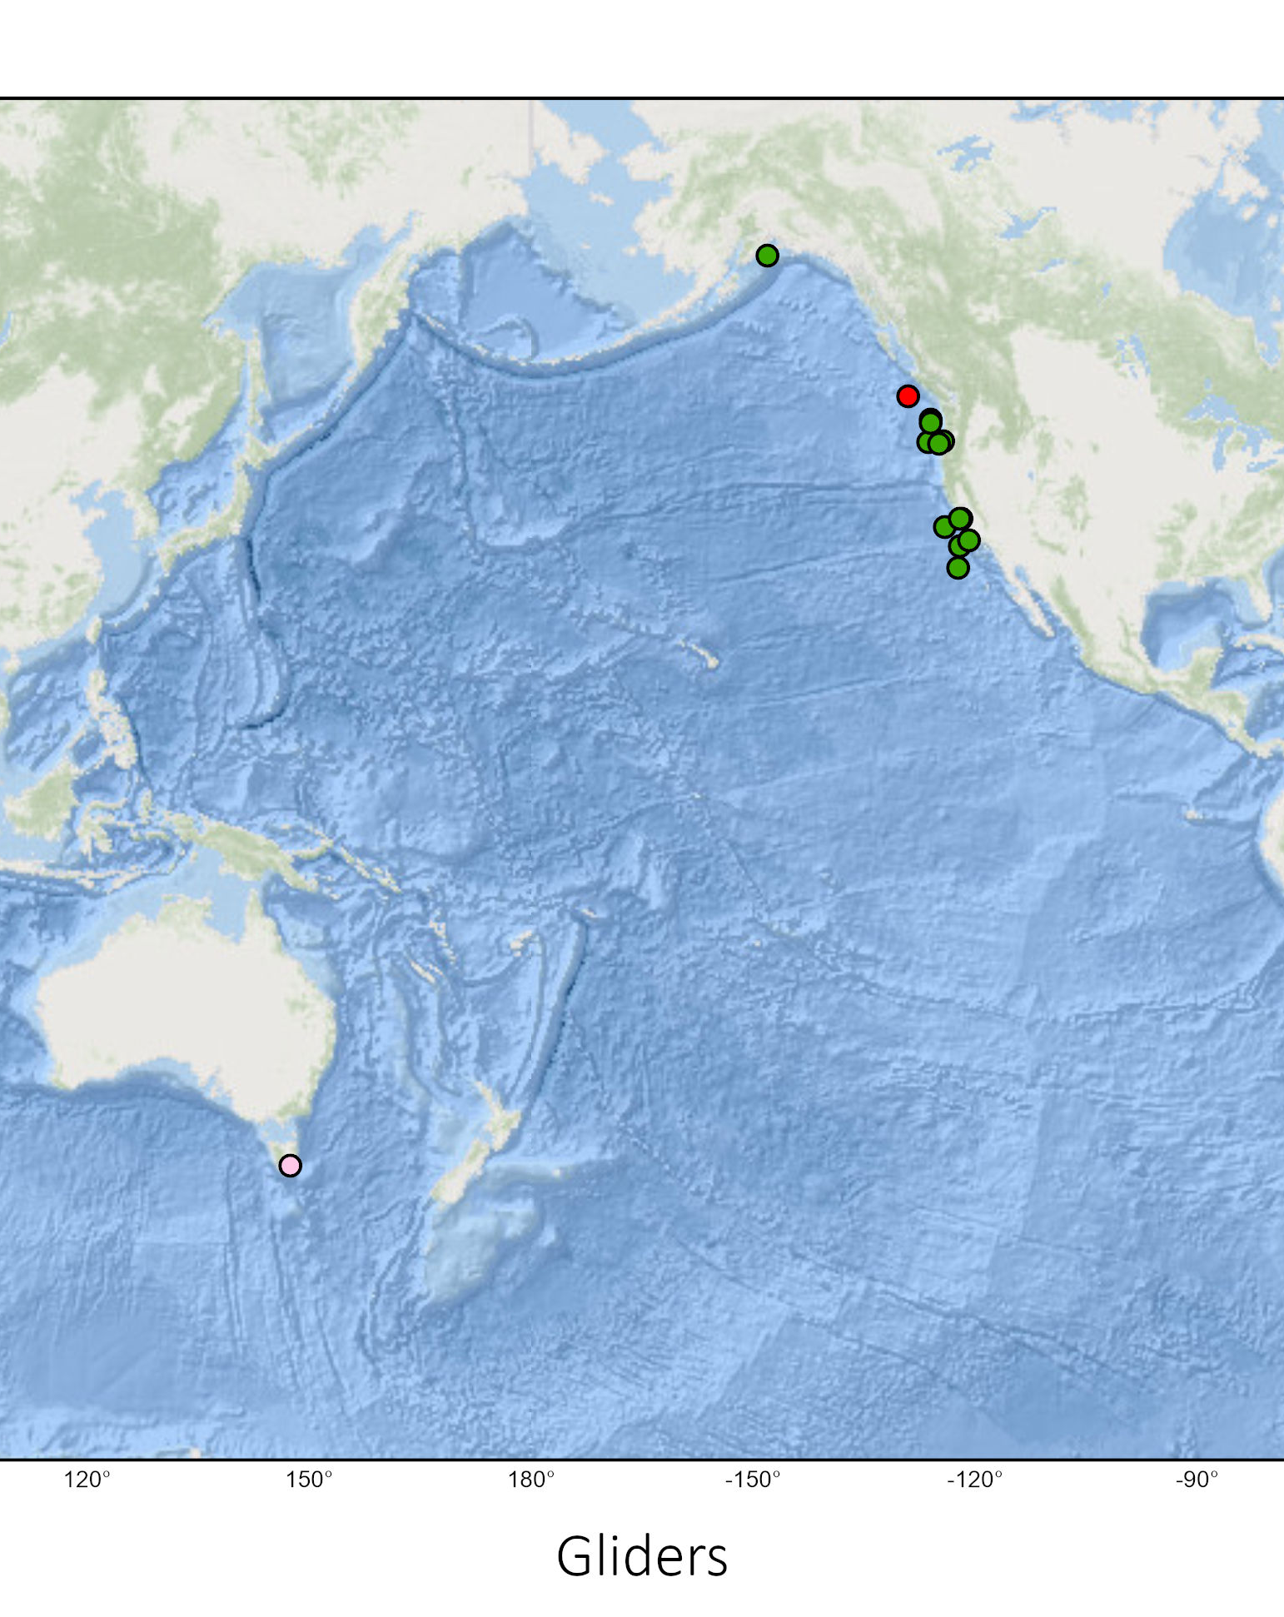
Gliders
SST, SSS, pressure, BGC, BioEco, …
➔
BC, Climate, ocean health, …
Notes:
1 Canada
1 Australia
13 USA

Slide 13
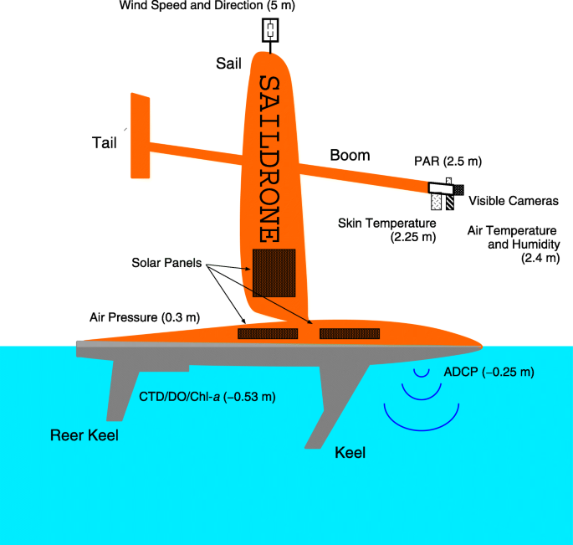
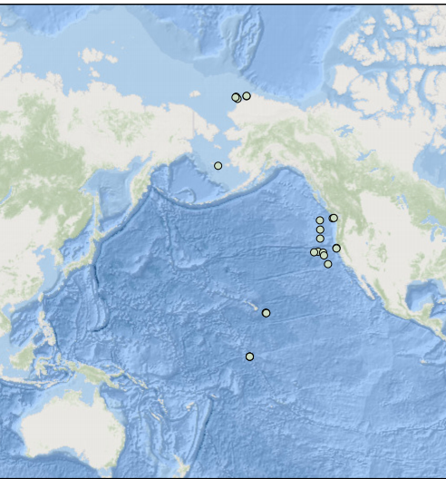
Saildrone
Notes:
25 pilots monitored but all closed
Redefining ocean data collection
Image@NOAA

Slide 14
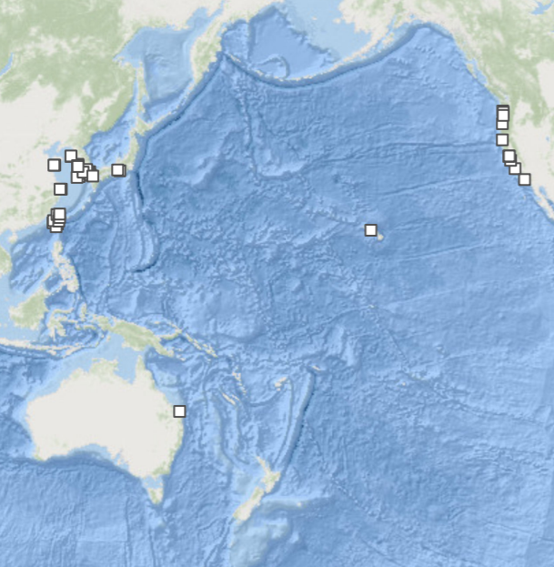
HF Radars
Circulation
Fronts and eddies
Surface waves and winds
Near-inertial oscillations
Coastal processes
Upwelling
Tsunamis
…

Slide 15
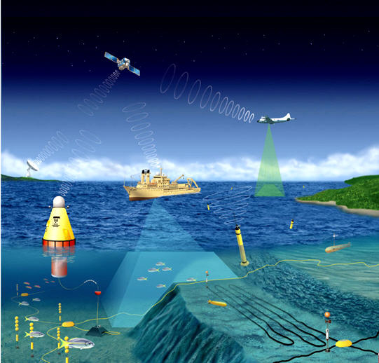
Further Thoughts
Prioritize requirements and cost effectiveness
Optimal design and deployments
Barometer upgrade? ➔ here
Wave drifter? ➔ here
Buoy Protection (Carton)
Notes:
image@NOAA

Slide 16
Thank you!
Questions?
LJiang@ocean-ops.org

